Slide 1



free presentation template
INTERNSHIP

Slide 2


Welcome to the world of fantasy! Join us on a journey to explore the mystical creatures, enchanted lands, and magical wonders that exist beyond our reality. Discover the wonders and secrets of this exciting realm and unlock the power of imagination.
welcome

Slide 3


01
introduction
The Extraordinary Realm
company overview
projects and assignments
02
04
Unicorn Sightings
Spellcasting
03
internship role
skills development
Wishes Granted
05
Happily Ever After
06
conclusion
table of contents
Embrace the Fantasy

Slide 4

introduction
The Fantasy Realm: Uncovering the Secrets of the Imagination and the Magic that Lies Within

Slide 5

company overview
Welcome to the Fantasy World, a realm of wonder and enchantment where anything is possible. Here, dragons breathe fire, unicorns prance through meadows, and rainbows shine brightly. This world is a place where wishes come true, where potions can be cursed and spells are cast. It's a place of treasure and adventure, where the impossible becomes possible. But the greatest treasure of all is the one that lies within.
The world of fantasy is a reflection of our deepest desires, our fondest dreams, and our wildest imaginations. It's a place where we can let go of the constraints of reality and explore the boundless possibilities of the human mind. In this introduction, we will delve into the mysteries of this realm, uncovering the magic and wonder that lies within. So come with us and let's embark on a journey through the Fantasy World.

Slide 6





mission
unicorn sightings
A record of the number of unicorns spotted in the fantasy realm and the beauty and mystery that surrounds these enchanting creatures.
dragon taming
A closer look at the art of taming dragons and the brave adventurers who dare to take on these fearsome creatures.

Slide 7





unicorn sightings
dragon taming
A record of the number of unicorns spotted in the fantasy realm and the beauty and mystery.
A closer look at the art of taming dragons and the brave adventurers who take on these creatures.
vision

Slide 8


fantasy is the gateway to the impossible, the land where the ordinary becomes extraordinary, and the impossible becomes possible. it is the realm of the imagination, where anything can happen and everything is possible.
the dream weaver

Slide 9


dragon taming technique
A guide to taming and caring for dragons in the realm of magic.
the art of unicorn sighting
Tips and tricks for spotting the elusive unicorns in their natural habitat.
internship role

Slide 10







"The Life of an Elf": Learn about the customs and daily life of the elves, from their familial structure to their religious beliefs.
"The Art of Archery": Discover the intricacies of the Art of Archery as practiced by the graceful and precise elves.
the tasks
"The Music of the Elves": Immerse yourself in the enchanting music of the elves, whose songs have the power to heal.

Slide 11

1
discover the secrets
2
find your own path
Explore the lush, vibrant forest and uncover the mysteries that lie within.
Choose your own path through the forest, and see where it takes you.
3
meet the creatures
4
uncover the magic
Encounter the mythical creatures that call the forest home, from talking animals to fairies.
Learn about the powerful magic that pervades the forest and how it affects all who enter.
the responsibilities

Slide 12


75%
enchanted creatures
possess the ability to cast spells.
magic-wielding individuals
60%
practice the art of illusions.
90%
spells cast
are dark magic, foretelling danger.
achievements

Slide 13

234,567
unicorn sightings
A tally of the number of unicorns spotted in the fantasy realm.
accomplishments

Slide 14



233 coins
Treasure Found
85%
Wished Granted
535 km
Journey Distance

Slide 15

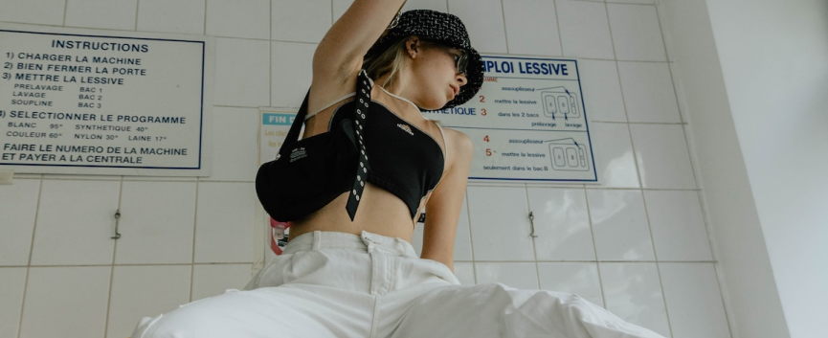
projects and assignments
"The Evolution of the Unicorn" is a study exploring the historical, cultural, and mythical development of the iconic fantasy creature. From its ancient roots in Mediterranean mythology to its modern-day representation in popular culture, this research delves into the various interpretations and beliefs surrounding the mystical horse with a single horn. The goal is to understand the evolution of this captivating creature and its enduring place in human imagination.

Slide 16




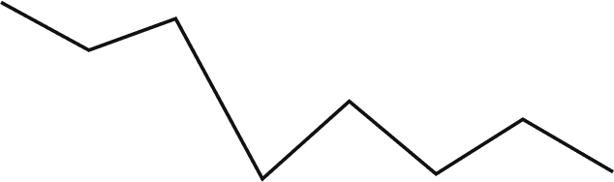

graph
100
90
80
70
60
50
34.574
40
Total
30
20
10
0
1
2
3
4
5
6
7
8
spellcasting progress
treasure found
A record of the number of spells cast per year
A record of the amount of treasure found per month

Slide 17



portal to adventure
a web application
A web application designed for discovering the world of fantasy

Slide 18


the future of fantasy
an mobile app
An app designed for exploring and experiencing the enchanting realm of fantasy
  Explore a magical world
  Experience fantasy firsthand
  Immerse in a realm of magic
  Discover untold wonders
  Live your fantasy dreams

Slide 19



a web application
A web application designed for discovering the world of fantasy
a gateway to a world of fantasy and wonder

Slide 20


the enchanted forest
A magical forest filled with talking animals and enchanted creatures.
the crystal caves
A network of underground caves filled with precious gems and crystals.
the dragon's lair
A dangerous and mysterious place where dragons reside.
fantasy realm at a glance

Slide 21

09:00
A group of adventurers sets out to recover an ancient artifact.
11:00
A volcanic eruption devastates a nearby city, forcing its inhabitants to flee to the safety.
13:00
A powerful sorcerer and a cunning thief cross paths, leading to an unlikely partnership.
15:00
An elf helps humans obtain the Crystal of the Unicorn from the Elven Forest.
17:00
The civilization of the Shimmering City is founded by a group of powerful wizards.

Slide 22





Adventure: 75%
Mystery: 85%
Magic: 90%
skills development
Danger: 50%
Wonder: 20%

Slide 23




skills and knowledge
spellcasting competition
treasure
hunt
great
adventure
A significant event in the history of the fantasy realm, in which the greatest spellcasters of the realm.
A significant event in the history of the fantasy realm, in which a massive and awesome treasure hunt was organized.
A notable year in the history of the fantasy realm, in which a large number of adventurers set out to explore.

Slide 24

conclusion
The journey of self-discovery and the exploration of the human imagination are just as important as the creatures and wonders that populate this realm. Here, you can reflect on your deepest

Slide 25

thank you for choosing eatemp
We offer free and high-quality slides templates for your presentations. We appreciate you choosing us and hope our templates have been helpful.
As a new website, we rely on your support to grow, so please help us by sharing our site with your friends and colleagues.
Credit | Image: Unsplash

