Slide 1
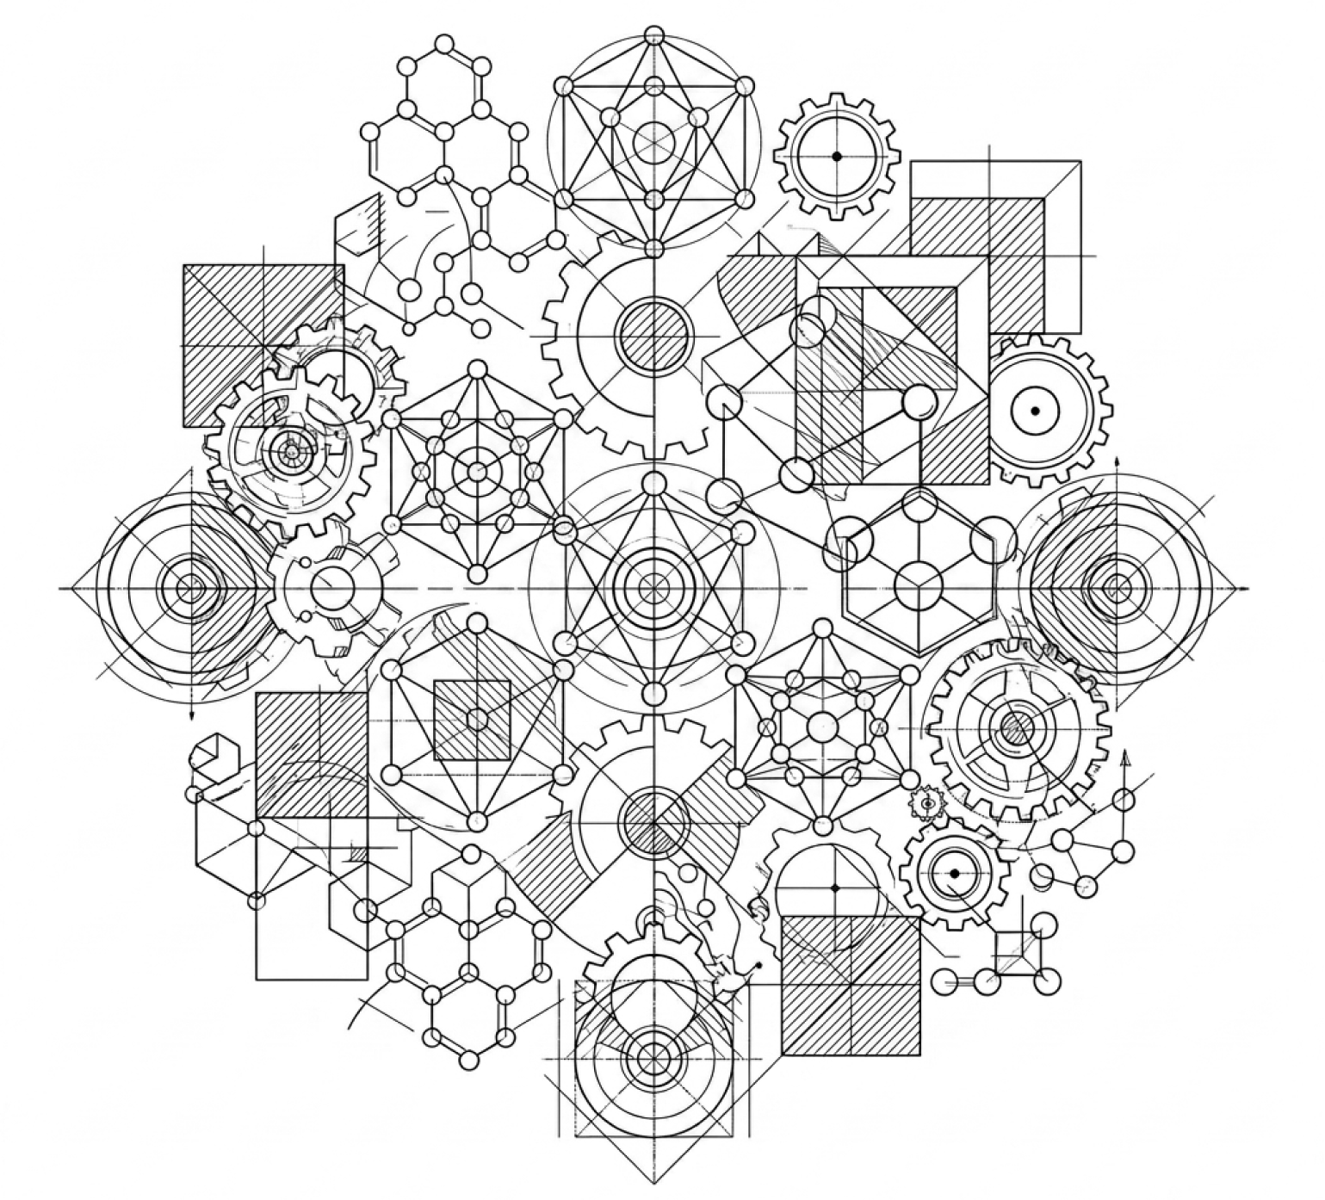
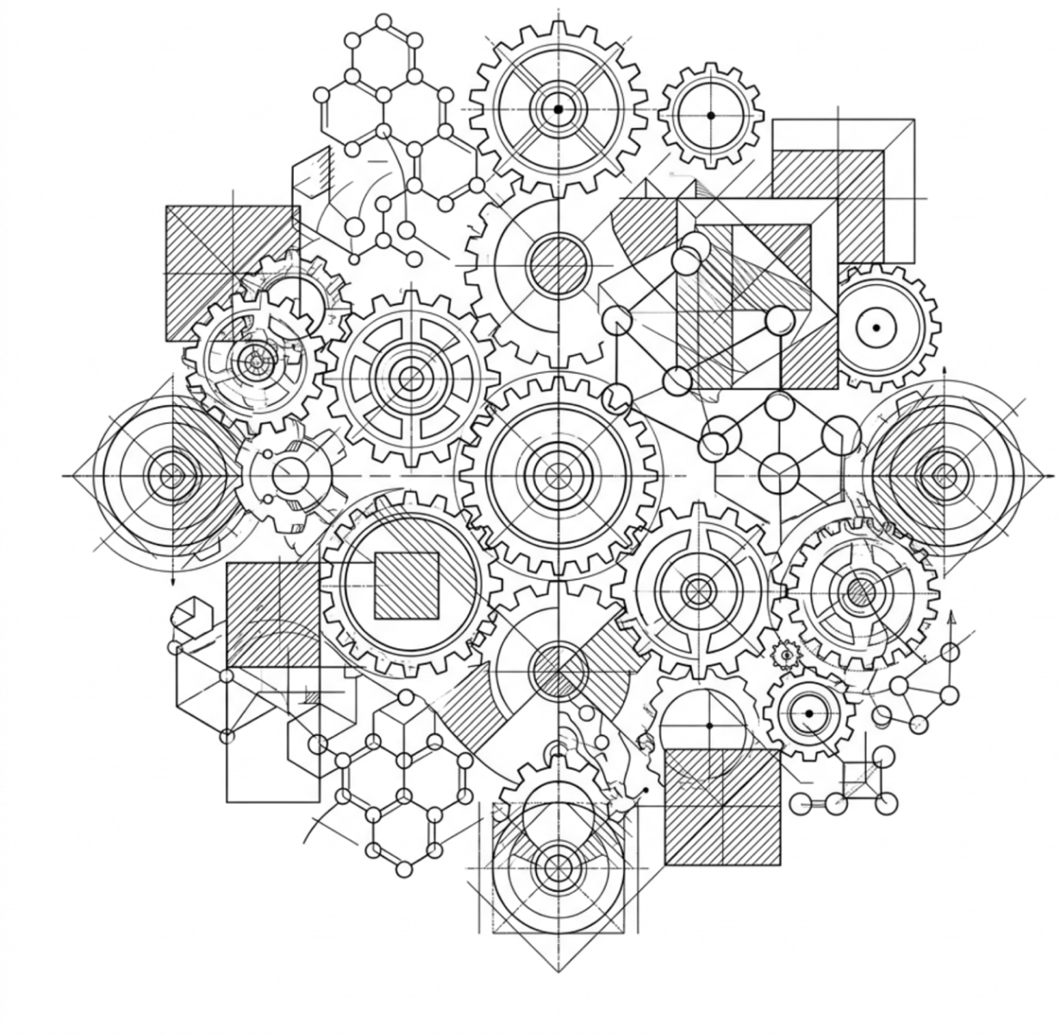

Material
Engineering
Free PPT Template
EaTemp

Slide 2
Introduction
Material properties
01
02
Study of materials for various applications.
Physical and chemical characteristics of materials.
Table of Contents
Material processing
Advanced materials
03
04
Techniques to manipulate materials into shapes.
Emerging materials with unique properties.
Applications
Future
05
06
Various industries relying on material engineering.
Innovations shaping the future.
EaTemp

Slide 3


multidisciplinary field
Material engineering is a multidisciplinary field that combines principles of physics, chemistry, and engineering to create new materials and improve existing ones.
Introduction
Material engineering is a field that involves developing and selecting materials for various applications across different industries.
Importance
Material engineering is vital in aerospace, medical devices, and renewable energy technologies. It enables the development of lighter and more fuel-efficient aircraft.

Slide 4

Material engineering is essential in advancing technology and improving the quality of life for people around the world, as seen in aerospace, medical devices, and renewable energy technologies.
EaTemp

Slide 5

Material Properties
Material properties determine behavior and performance.
Mechanical properties include strength, stiffness, and toughness.
Thermal properties include thermal conductivity and expansion.
Other properties include electrical conductivity, optical properties, and corrosion resistance.
Material engineers study and utilize these properties.
Material properties are crucial in material engineering.
EaTemp

Slide 6

Material properties determine behavior and performance, including mechanical, thermal, electrical, optical, and corrosion resistance, making them crucial in material engineering.
EaTemp

Slide 7


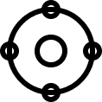

Enchanted Wood
Our enchanted wood is sourced from the mystical forests of the realm
Faerie Oak
Faerie Oak is a rare and coveted type of enchanted wood that is exclusive
Arcane Ash
Arcane Ash is a type of enchanted wood that is imbued
EaTemp

Slide 8



Materials science is the foundation of all engineering.
Dr. G. Brent Dalrymple
EaTemp

Slide 9

Material Processing
Material processing techniques include casting, forging, machining, and 3D printing, each with unique advantages and limitations.
EaTemp

Slide 10


Common Techniques
Casting is a material processing technique used to shape metals by pouring molten metal into a mold. This process can create complex shapes that would be difficult to achieve using other methods.
Casting
Forging, is a material processing technique that uses heat and pressure to shape metals while maintaining their strength. The forging process typically involves heating the metal to a specific temperature.
Forging
EaTemp

Slide 11




the process
design
synthesis
processing
characterization
Identify required properties and select materials.
Create the material using chemical or physical methods.
Modify material structure and properties
Analyze material properties using advanced techniques
EaTemp

Slide 12


Advanced materials are materials engineered to possess superior properties, such as strength, durability, and conductivity, compared to traditional materials.
Advanced materials
EaTemp

Slide 13

Advanced materials are used in a variety of applications due to their superior properties.
They have revolutionized industries like aerospace, medicine...
EaTemp

Slide 14
234,567
Unicorn Sightings
A tally of the number of unicorns spotted in the fantasy realm.
EaTemp

Slide 15


materials comparison
High Quality
Celestial Plains
EaTemp
Crystal Caves
Mirrored Lake
Low Price
High Price
Lost City
Enchanted Forest
Treasures
EaTemp
Low Quality

Slide 16




materials details
Faerie Oak
Arcane Ash
Faerie Oak is a rare and coveted type of enchanted wood that is exclusive
Arcane Ash is a type of enchanted wood that is imbued in the forests of the realm
Enchanted Wood
Treant Timber
Our enchanted wood is sourced from the mystical forests of the realm
Treant Timber is sourced from the ancient treants that roam the forests of the realm
EaTemp

Slide 17

Material engineering has a wide range of applications, from aerospace and automotive to medicine and renewable energy.
Applications
EaTemp

Slide 18




industries
Material engineering plays a critical role in industries like aerospace, where advanced materials like carbon fiber composites.
Similarly, medical devices rely on biocompatible materials like titanium alloys, and renewable energy technologies.
EaTemp

Slide 19

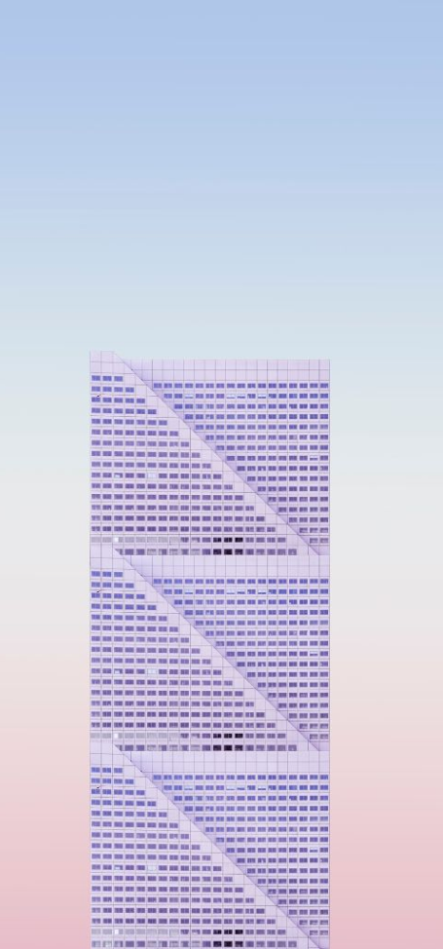
Some Data
Enchanted Creatures
56%
possess the ability to cast spells.
67%
Magic-Wielding Individuals
practice the art of illusions.
Spells Cast
97%
are dark magic, foretelling danger.
EaTemp

Slide 20




EaTemp

Slide 21




Thank you for choosing EaTemp
We offer free and high-quality slides templates for your presentations. We appreciate you choosing us and hope our templates have been helpful.
As a new website, we rely on your support to grow, so please help us by sharing our site with your friends and colleagues.
eatemp._
@eatemp
eatempofficial
@eatemp.official
EaTemp

