Slide 1
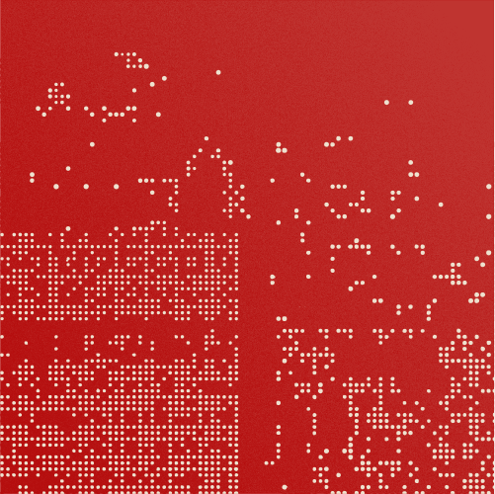
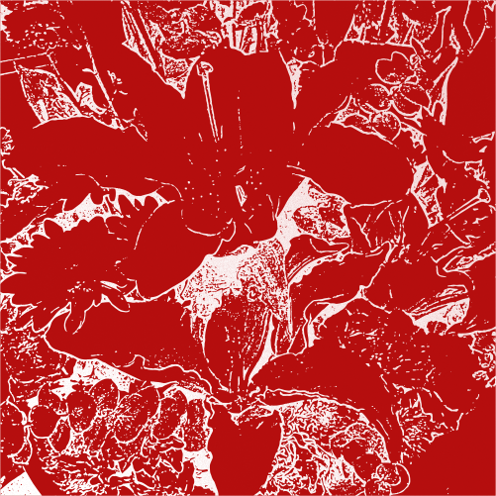
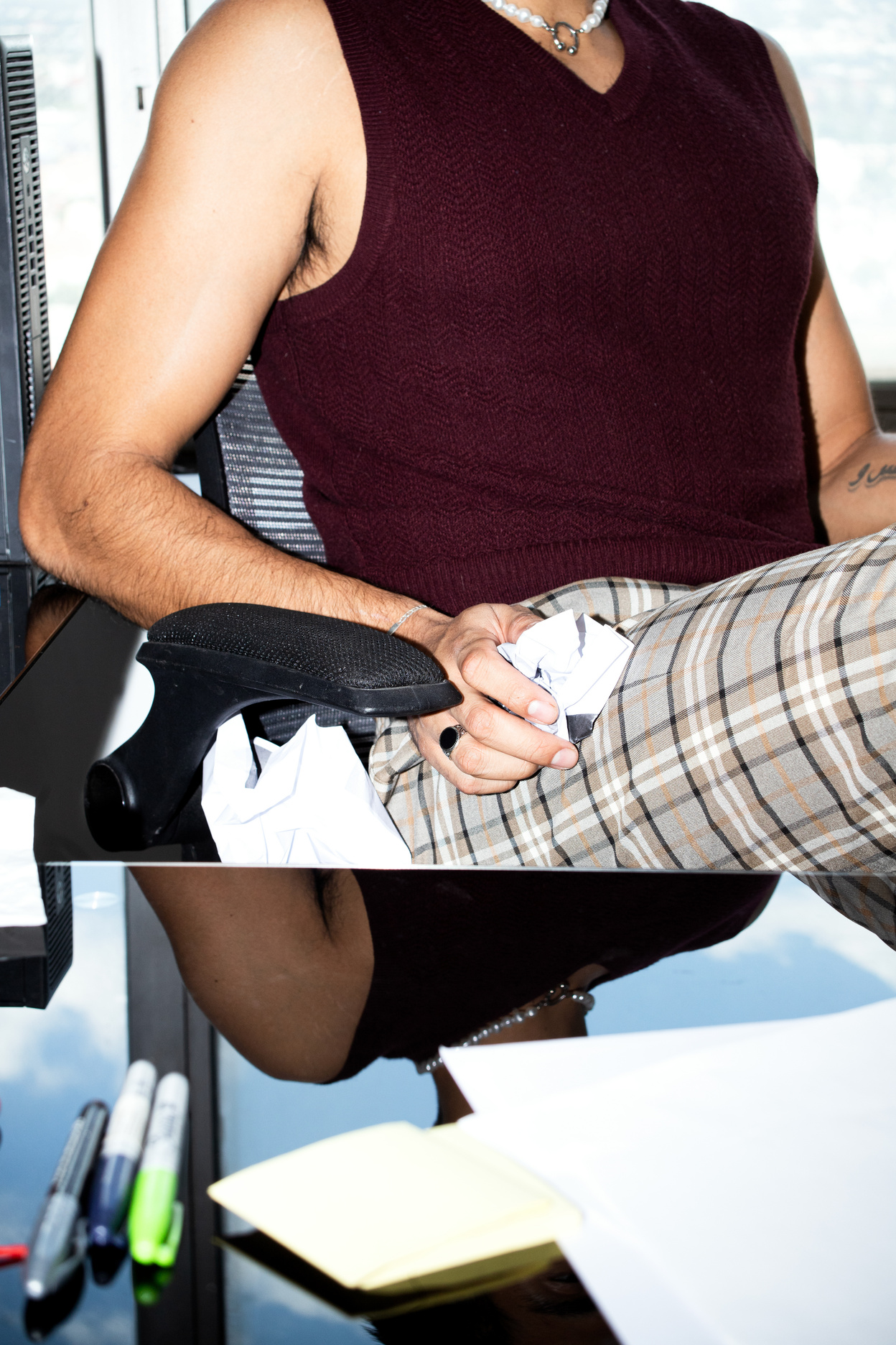

Jonathan Patterson
[2025]
CREATIVE
Portfolio

Slide 2
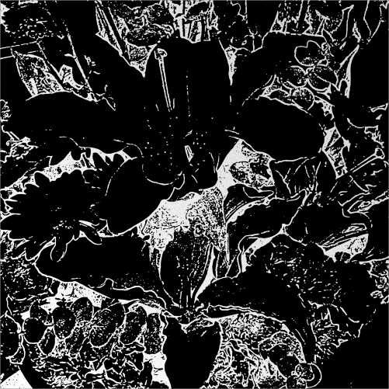

TABLE OF
01
About Me
CONTENT
02
Statement of Style
03
Experience and Project
07
Client Testimonials
08
Contact & Booking Info
Jonathan Patterson
Page 01

Slide 3

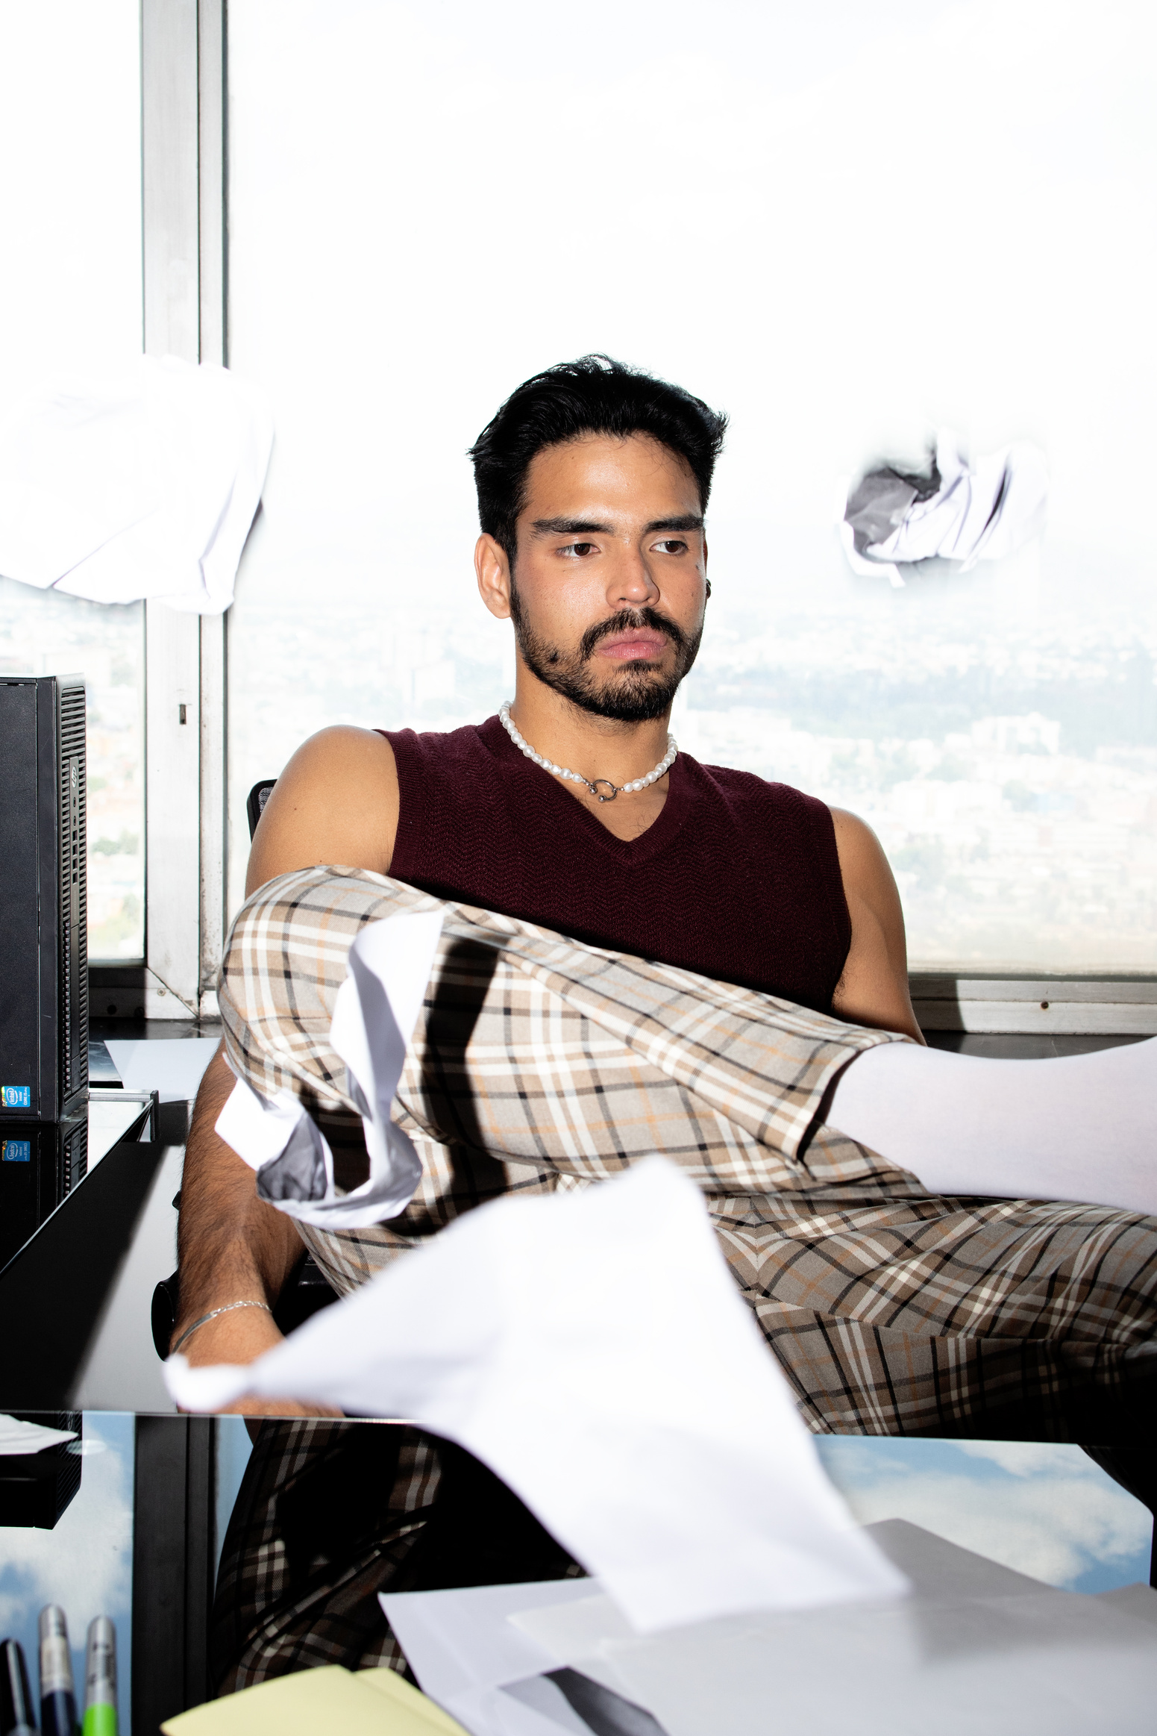
About Me
I’m Jonathan Patterson, a photographer with a passion for capturing meaningful moments through the lens. Photography, for me, is more than just taking pictures—it's about telling stories, preserving emotions, and freezing fleeting moments in time.
I’ve been working professionally for over five years, shooting everything from solo portraits to large-scale outdoor scenes. My approach is always grounded in authenticity, aiming to make every subject feel seen, comfortable, and valued.
Page 02

Slide 4
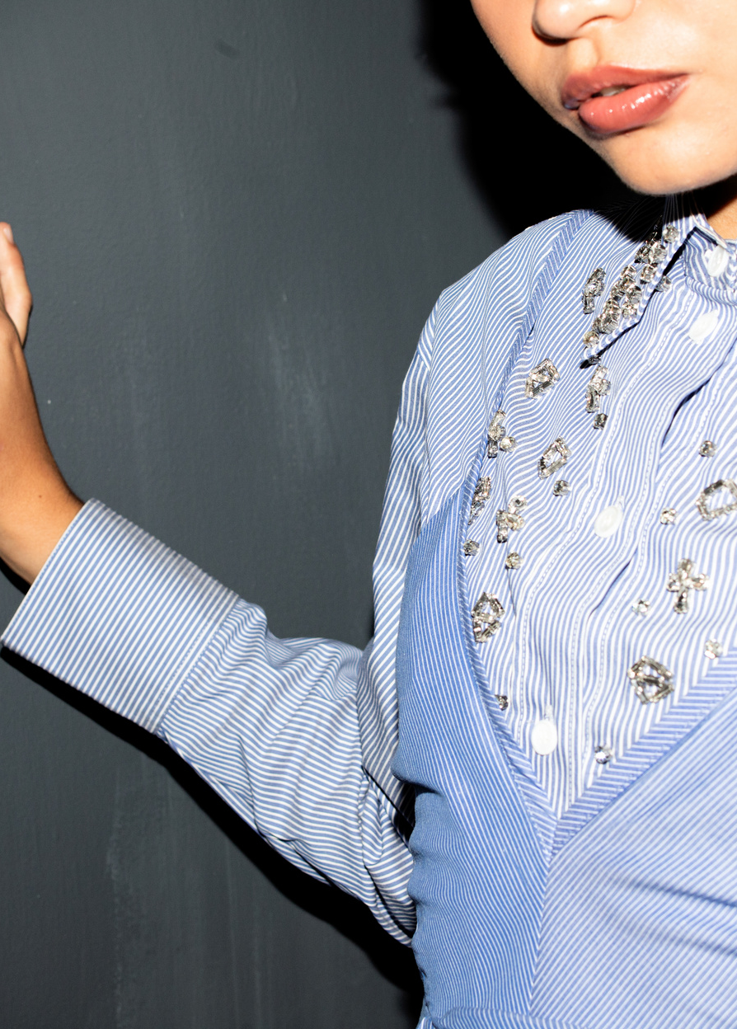
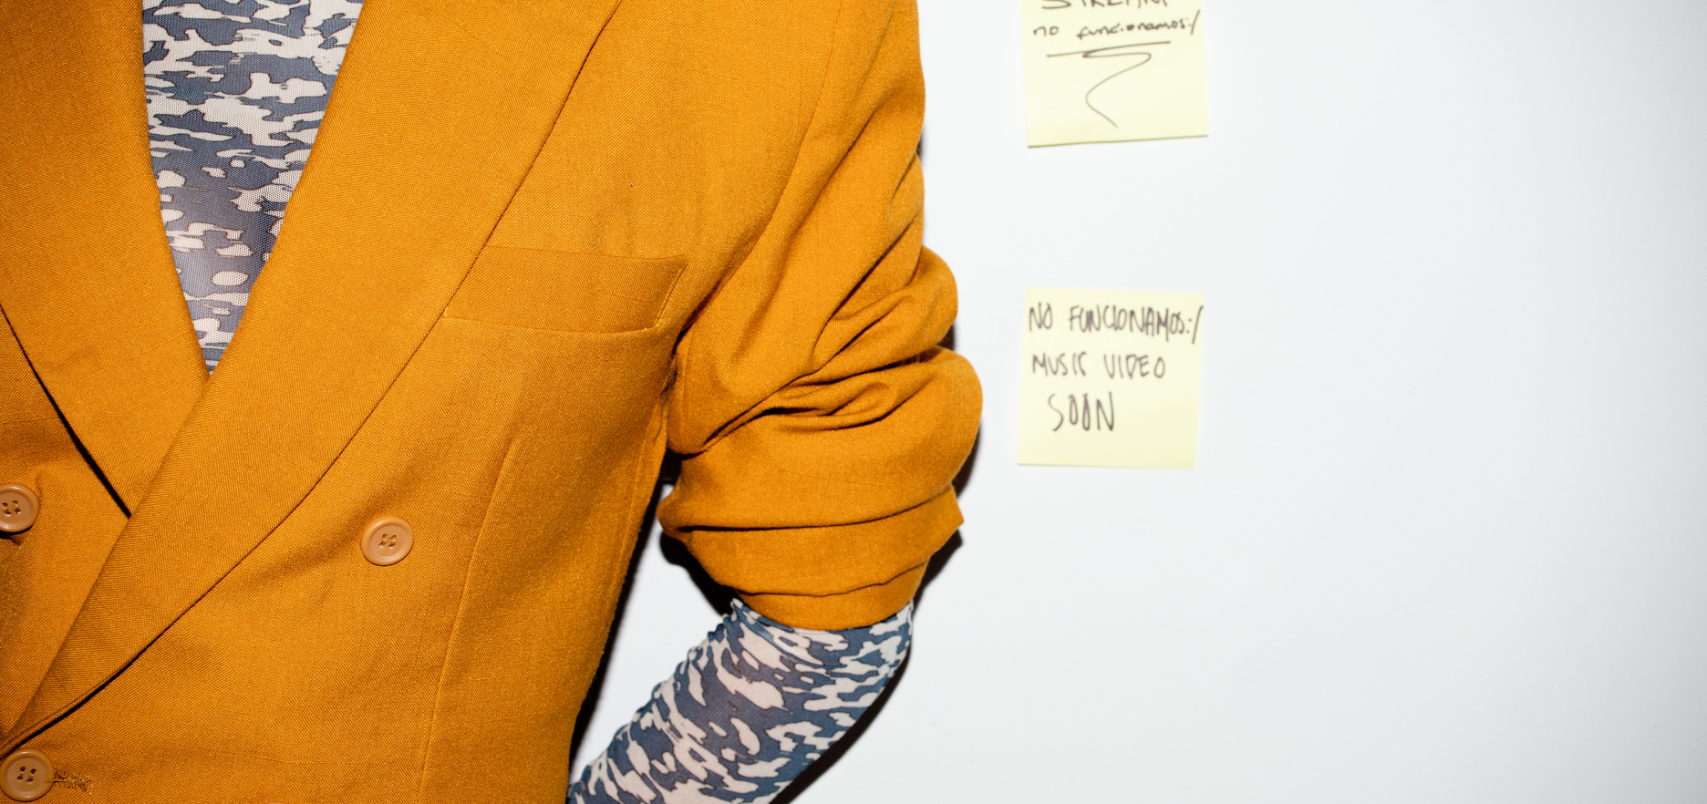
STATEMENT
OF STYLE
My style is simple, clean, and emotionally driven. I lean heavily on natural light and soft tones to create images that feel real and timeless. I avoid over-editing and instead focus on capturing true moments—those unposed, in-between flashes that show real character.
Whether I’m shooting in an open field or a city alley, I’m always chasing subtle beauty in everyday settings. I want my photos to make people pause and feel something.
Page 03

Slide 5
Jonathan Patterson
Experience
Over the years, I’ve had the opportunity to work with individuals, brands, and creatives from a variety of industries. I’ve photographed musicians, entrepreneurs, couples, travelers, and small businesses—each with their own unique vision and story.
From lifestyle shoots to corporate branding and travel editorials, I bring the same level of care and creativity to every project. I pride myself on being easy to work with, and always focused on creating something meaningful.
EXPERIENCE
and Project
Page 04

Slide 6
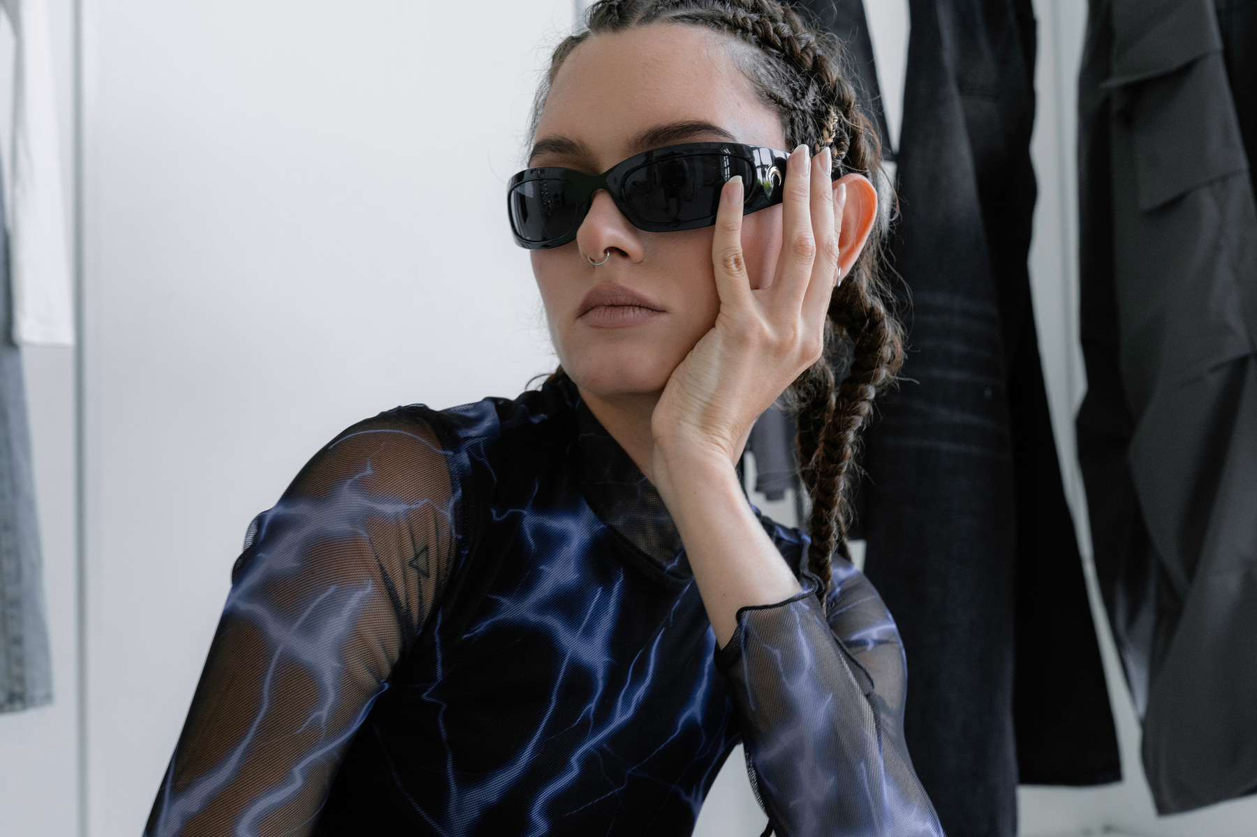
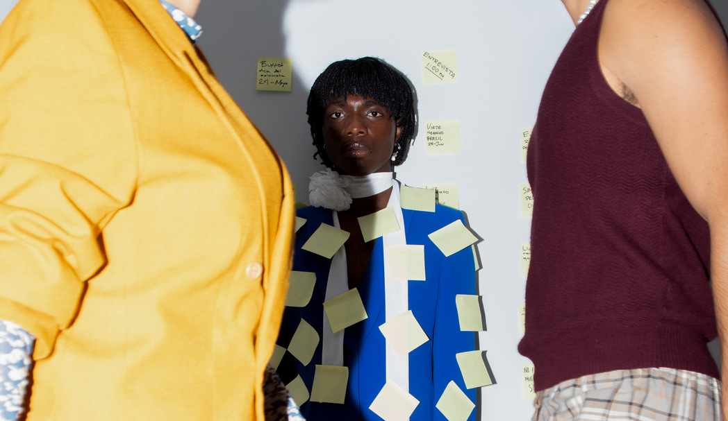
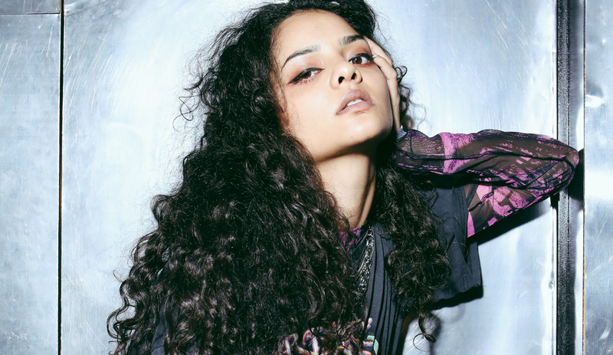
Experience
2022 - Modeling Photographer
2023 - Profile Company
2024 - Modeling Photographer
Studio Shodwe - Fashion
Larana Inc. - Company
Rimberio Co. - Fashion
Page 05

Slide 7
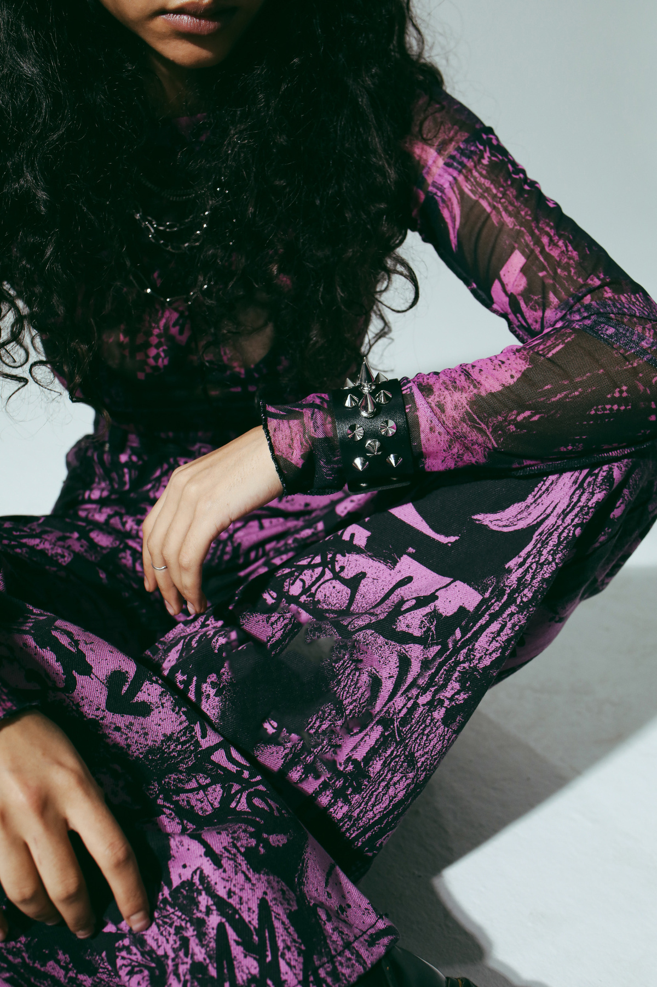
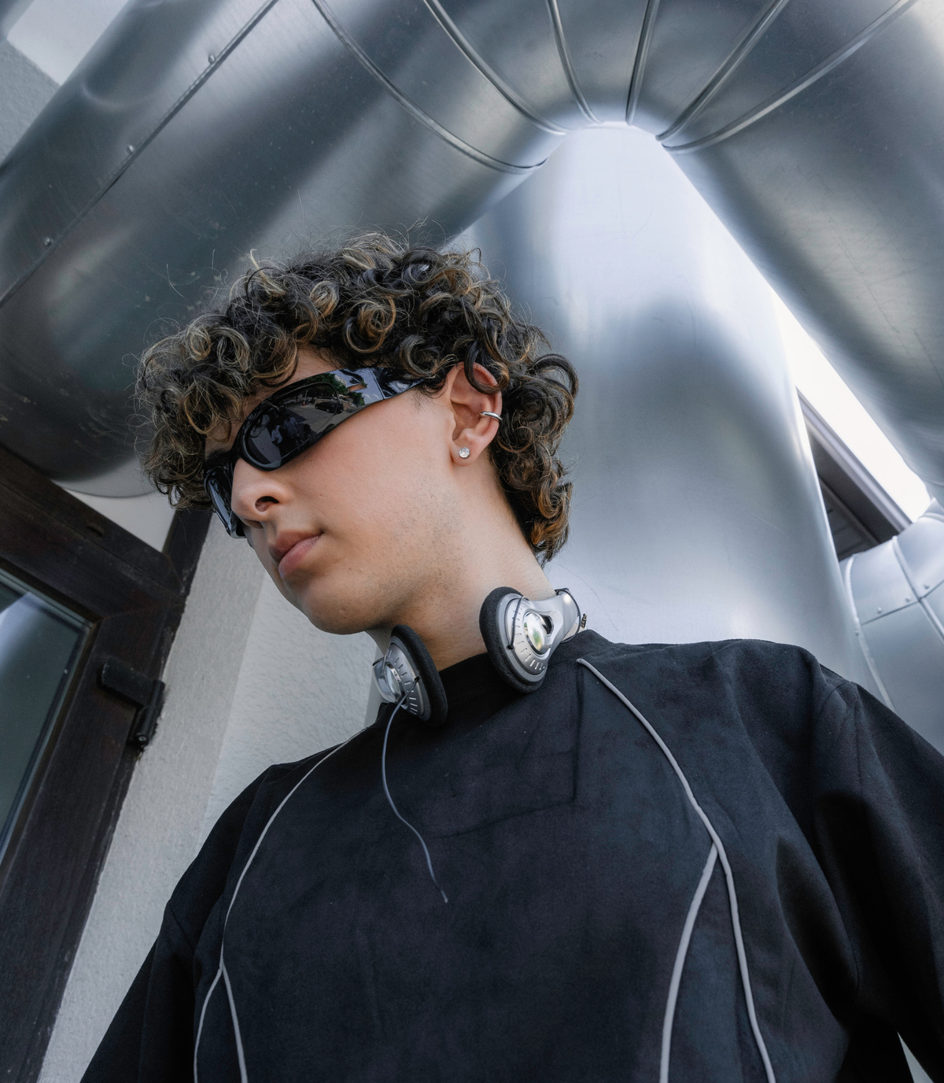
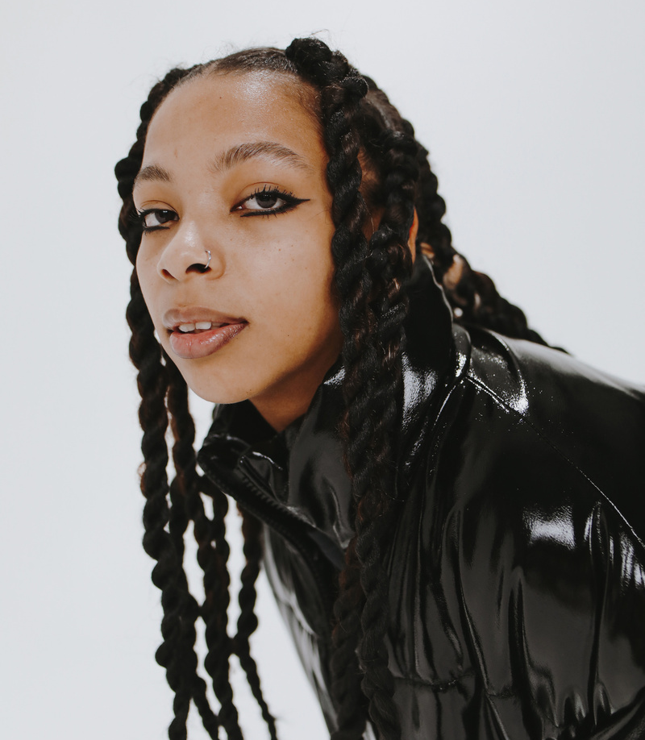
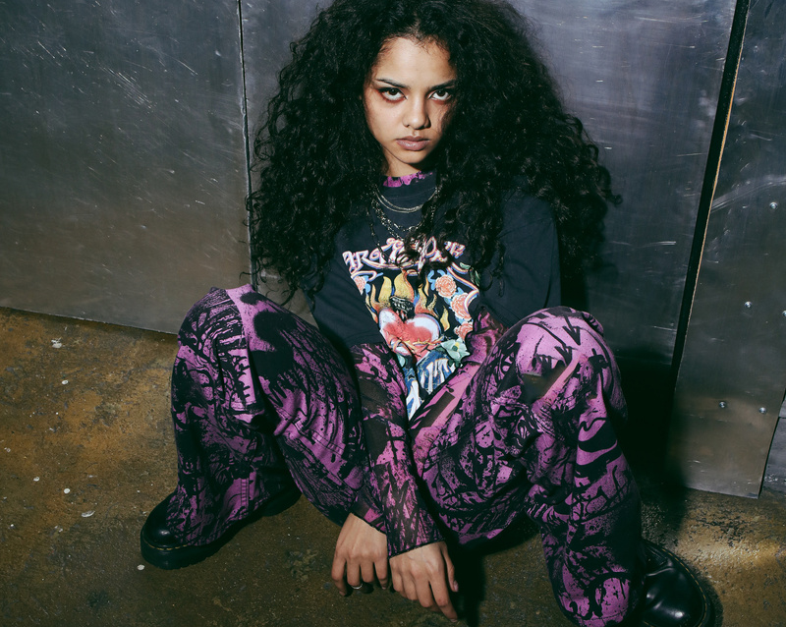
Project.
Portraits are one of my favorite things to shoot because they allow for deep connection.
Page 06

Slide 8
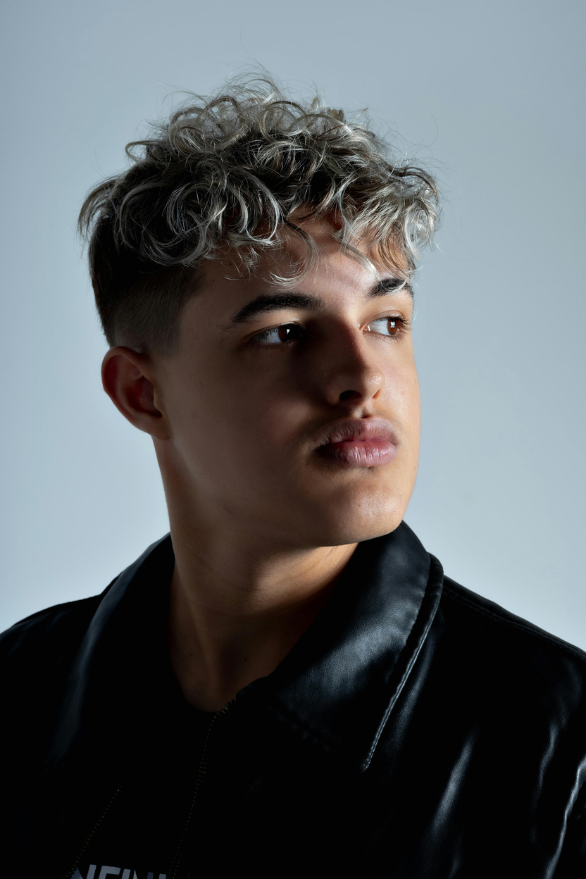
CLIENT
TESTIMONIAL
Aaron Loeb
“I was so impressed by Jonathan’s ability to make me feel completely comfortable during our session. I’m usually awkward in front of a camera, but he guided me in a way that felt natural. The final photos were beautiful—simple, honest, and exactly what I had hoped for.”
Page 07

Slide 9
CONTACT &
Booking Info
Social Media
@reallygreatsite
Website
www.reallygreatsite.com
E-mail
hello@reallygreatsite.com
Page 08

Slide 10
Jonathan Patterson
[2025]
THANK YOU
Everyone

