Slide 1

Flower Power
How do flowers bloom in the spring?
How To Make A Flower
1. Cut out a square along thick dashed lines.
2. Fold in half along thick black line so pattern is facing out.
3. Pull up corner with the sun until the edge meets the dark grey
area. Fold.
4. Pull top left corner down until it meets bottom edge. Fold.
5. Cut along two dashed lines. Unfold.
6. Pull tip of each petal until it meets center circle. Fold. Repeat for all petals.
.

Slide 2


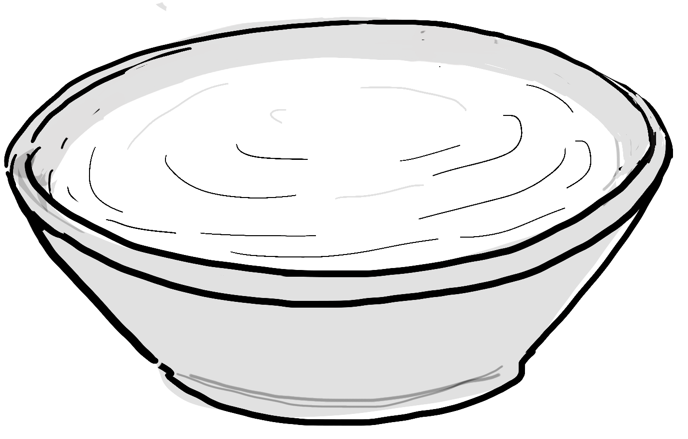





How do flowers bloom in the spring?
1. Gently remove the flower from the card.
2. Remove tape from the back.
3. Place your flower, with the petals facing.
up, in a shallow bowl of water.
4. Watch closely and enjoy!
A surprise for someone special
How To Make Your Flower Bloom
Dear
,
I made a flower that will bloom just for you.
flower
Love,

