Slide 1


ART DESIGN
PRESENTATION TEMPLATE

Slide 2
1
FLOWER
2
PLANT
CONTENTS
3
TREE
4
SEED

Slide 3
1
FLOWER
A complex idea can be conveyed with just a single still image,
namely making it possible to absorb large amounts of data quickly.

Slide 4

TITLE HERE
STEP 1
A complex idea can be conveyed with just a single still image, namely making it possible to absorb large amounts of data quickly.
STEP 2
A complex idea can be conveyed with just a single still image, namely making it possible to absorb large amounts of data quickly.
STEP 3
A complex idea can be conveyed with just a single still image, namely making it possible to absorb large amounts of data quickly.
STEP 4
A complex idea can be conveyed with just a single still image, namely making it possible to absorb large amounts of data quickly.
A complex idea can be conveyed with just a single still image, namely making it possible to absorb large amounts of data quickly. A complex idea can be conveyed with just a single still image, namely making it possible to absorb large amounts of data quickly.
Go ahead and replace it with your own text. Go ahead and replace it with your own text.

Slide 5

TITLE HERE
TITLE 1
TITLE 4
A complex idea can be conveyed with just a single still image, namely making it possible to absorb large amounts of data quickly.
Go ahead and replace it with your own text.
TITLE 2
TITLE 5
A complex idea can be conveyed with just a single still image, namely making it possible to absorb large amounts of data quickly.
Go ahead and replace it with your own text.
Go ahead and replace it with your own text.
TITLE 3
TITLE 6
A complex idea can be conveyed with just a single still image, namely making it possible to absorb large amounts of data quickly.
A complex idea can be conveyed with just a single still image, namely making it possible to absorb large amounts of data quickly.
Go ahead and replace it with your own text.

Slide 6
TITLE HERE
01
Content 01
TITLE HERE
A complex idea can be conveyed with just a single still image, namely making it possible to absorb large amounts of data quickly.
A complex idea can be conveyed with just a single still image, namely making it possible to absorb large amounts of data quickly.
A complex idea can be conveyed with just a single still image, namely making it possible to absorb large amounts of data quickly.
02
Content 02
A complex idea can be conveyed with just a single still image, namely making it possible to absorb large amounts of data quickly.
03
Content 03
A complex idea can be conveyed with just a single still image, namely making it possible to absorb large amounts of data quickly.

Slide 7
TITLE HERE
03
TITLE HERE
A complex idea can be conveyed with just a single still image, namely making it possible to absorb large amounts of data quickly.
A complex idea can be conveyed with just a single still image, namely making it possible to absorb large amounts of data quickly.
Content 01
Go ahead and replace it with your own text. Go ahead and replace it with your own text.
01
Content 02
Go ahead and replace it with your own text. Go ahead and replace it with your own text.
Content 03
Go ahead and replace it with your own text. Go ahead and replace it with your own text.
02

Slide 8
TITLE HERE
TITLE HERE
TITLE HERE
Go ahead and replace it with your own text.
Go ahead and replace it with your own text.
TITLE HERE
TITLE HERE
Go ahead and replace it with your own text.
Go ahead and replace it with your own text.
TITLE HERE
TITLE HERE
Go ahead and replace it with your own text.
Go ahead and replace it with your own text.

Slide 9
2
PLANT
A complex idea can be conveyed with just a single still image, namely making it possible to absorb large amounts of data quickly.

Slide 10

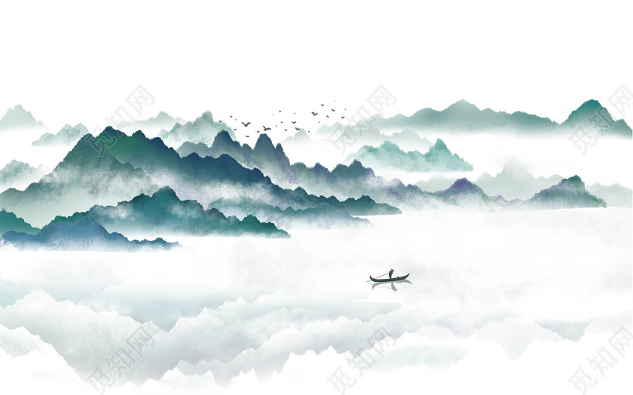
TITLE HERE
STAGE 1
A complex idea can be conveyed with just a single still image, namely making it possible to absorb large amounts of data quickly.
STAGE 2
A complex idea can be conveyed with just a single still image, namely making it possible to absorb large amounts of data quickly.
STAGE 3
A complex idea can be conveyed with just a single still image, namely making it possible to absorb large amounts of data quickly.
TITLE HERE
Assertively unleash flexible technology whereas equity invested internal
TITLE HERE
Assertively unleash flexible technology whereas equity invested internal
TITLE HERE
Assertively unleash flexible technology whereas equity invested internal
TITLE HERE
Assertively unleash flexible technology whereas equity invested internal

Slide 11
TITLE HERE
STEP 2
STEP 4
A complex idea can be conveyed with just a single still image, namely making it possible to absorb large amounts of data quickly.
A complex idea can be conveyed with just a single still image, namely making it possible to absorb large amounts of data quickly.
STEP 1
STEP 3
A complex idea can be conveyed with just a single still image, namely making it possible to absorb large amounts of data quickly.
A complex idea can be conveyed with just a single still image, namely making it possible to absorb large amounts of data quickly.

Slide 12
TITLE HERE
A complex idea can be conveyed with just a single still image, namely making it possible to absorb large amounts of data quickly.
A complex idea can be conveyed with just a single still image, namely making it possible to absorb large amounts of data quickly.
A complex idea can be conveyed with just a single still image, namely making it possible to absorb large amounts of data quickly.
A complex idea can be conveyed with just a single still image, namely making it possible to absorb large amounts of data quickly.
TITLE HERE
A complex idea can be conveyed with just a single still image, namely making it possible to absorb large amounts of data quickly.
01

Slide 13
TITLE HERE
TEXT HERE
TEXT HERE
A complex idea can be conveyed with just a single still image, namely making it possible to absorb large amounts of data quickly.
TEXT HERE
A complex idea can be conveyed with just a single still image, namely making it possible to absorb large amounts of data quickly.
TEXT HERE
A complex idea can be conveyed with just a single still image, namely making it possible to absorb large amounts of data quickly.
A complex idea can be conveyed with just a single still image, namely making it possible to absorb large amounts of data quickly.

Slide 14
TITLE HERE
A complex idea can be conveyed with just a single still image, namely making it possible to absorb large amounts of data quickly.
NOTE 1
A complex idea can be conveyed with just a single still image, namely making it possible to absorb large amounts of data quickly.
NOTE 2
A complex idea can be conveyed with just a single still image, namely making it possible to absorb large amounts of data quickly.
NOTE 3
NOTE 4
A complex idea can be conveyed with just a single still image, namely making it possible to absorb large amounts of data quickly.
NOTE 5
A complex idea can be conveyed with just a single still image, namely making it possible to absorb large amounts of data quickly.

Slide 15
3
TREE
A complex idea can be conveyed with just a single still image, namely making it possible to absorb large amounts of data quickly.

Slide 16


TITLE HERE
TITLE HERE
A complex idea can be conveyed with just a single still image, namely making it possible to absorb large amounts of data quickly.
Go ahead and replace it with your own text. Go ahead and replace it with your own text.
NOTE HERE
Go ahead and replace it with your own text. Go ahead and replace it with your own text.
TITLE HERE
A complex idea can be conveyed with just a single still image, namely making it possible to absorb large amounts of data quickly.
Go ahead and replace it with your own text. Go ahead and replace it with your own text.

Slide 17
TITLE HERE
STEP 1
STEP 2
STEP 3
STEP 4
STEP 01
STEP 02
STEP 03
STEP 04
A complex idea can be conveyed with just a single still image, namely making it possible to absorb large amounts of data quickly.
A complex idea can be conveyed with just a single still image, namely making it possible to absorb large amounts of data quickly.
A complex idea can be conveyed with just a single still image, namely making it possible to absorb large amounts of data quickly.
A complex idea can be conveyed with just a single still image, namely making it possible to absorb large amounts of data quickly.

Slide 18



TITLE HERE
Text
Text
Text
TITLE 1
TITLE 2
TITLE 3
A complex idea can be conveyed with just a single still image, namely making it possible to absorb large amounts of data quickly.
A complex idea can be conveyed with just a single still image, namely making it possible to absorb large amounts of data quickly.
A complex idea can be conveyed with just a single still image, namely making it possible to absorb large amounts of data quickly.

Slide 19
TITLE HERE
90%
80%
70%
95%
A complex idea can be conveyed with just a single still image, namely making it possible to absorb large amounts of data quickly.
A complex idea can be conveyed with just a single still image, namely making it possible to absorb large amounts of data quickly.
A complex idea can be conveyed with just a single still image, namely making it possible to absorb large amounts of data quickly.
A complex idea can be conveyed with just a single still image, namely making it possible to absorb large amounts of data quickly.

Slide 20
TITLE HERE
STAGE 1
STAGE 2
Go ahead and replace it with your own text.
Go ahead and replace it with your own text.
01
02
04
03
STAGE 4
STAGE 3
Go ahead and replace it with your own text.
Go ahead and replace it with your own text.

Slide 21
4
SEED
A complex idea can be conveyed with just a single still image, namely making it possible to absorb large amounts of data quickly.

Slide 22

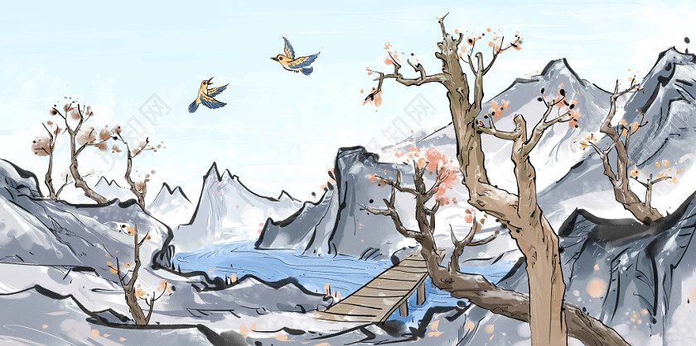
TITLE HERE
A complex idea can be conveyed with just a single still image, namely making it possible to absorb large amounts of data quickly. A complex idea can be conveyed with just a single still image, namely making it possible to absorb large amounts of data quickly.
TITLE 1
Go ahead and replace it with your own text.
TITLE 2
Go ahead and replace it with your own text.
DESCRIPTION
A complex idea can be conveyed with just a single still image, namely making it possible to absorb large amounts of data quickly. A complex idea can be conveyed with just a single still image, namely making it possible to absorb large amounts of data quickly.
TITLE 3
Go ahead and replace it with your own text.

Slide 23
TITLE HERE
TEXT HERE
TEXT HERE
TEXT HERE
TEXT HERE
Go ahead and replace it with your own text. Go ahead and replace it with your own text.
Go ahead and replace it with your own text. Go ahead and replace it with your own text.
Go ahead and replace it with your own text. Go ahead and replace it with your own text.
Go ahead and replace it with your own text. Go ahead and replace it with your own text.

Slide 24
TITLE HERE
Go ahead and replace it with your own text.
TITLE HERE
TITLE HERE
A complex idea can be conveyed with just a single still image, namely making it possible to absorb large amounts of data quickly.
A complex idea can be conveyed with just a single still image, namely making it possible to absorb large amounts of data quickly.
Go ahead and replace it with your own text.

Slide 25
TITLE HERE
STAGE 1
STAGE 3
A complex idea can be conveyed with just a single still image, namely making it possible to absorb large amounts of data quickly.
A complex idea can be conveyed with just a single still image, namely making it possible to absorb large amounts of data quickly.
45%
12%
STAGE 2
36%
10%
STAGE 4
A complex idea can be conveyed with just a single still image, namely making it possible to absorb large amounts of data quickly.
A complex idea can be conveyed with just a single still image, namely making it possible to absorb large amounts of data quickly.

Slide 26
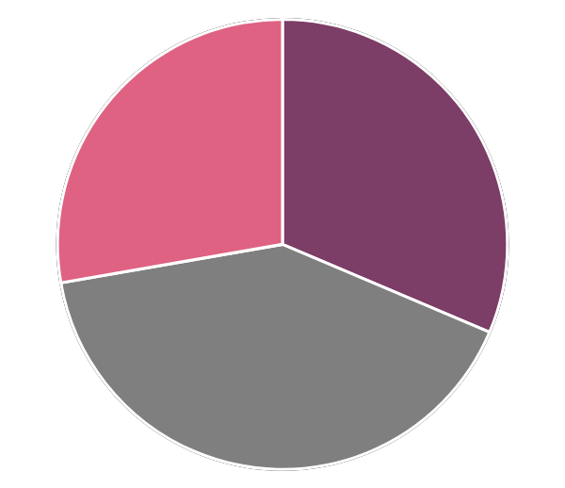
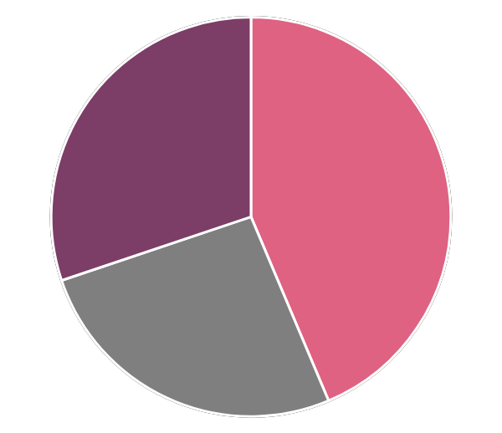
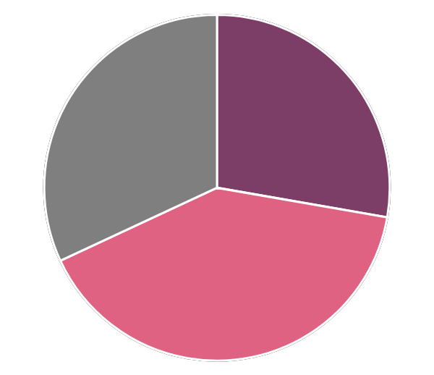
TITLE HERE
STEP 1
STEP 2
STEP 1
STEP 2
STEP 1
STEP 2
STEP 3
STEP 3
STEP 3
A complex idea can be conveyed with just a single still image, namely making it possible to absorb large amounts of data quickly. A complex idea can be conveyed with just a single still image, namely making it possible to absorb large amounts of data quickly.

Slide 27

THANKS!
Presentation template and Google Slides
Thanks to Freepptbackgrounds.net

Slide 28
FreePPTBackgrounds.net
Powerpoint Templates
Free Powerpoint Presentation Template (.PPTX)
You can upload Google Slides..
Google Slides
Select slide and edit your presentation
You can download and share your presentation!
Free Powerpoint Templates: https://www.freepptbackgrounds.net/browse
Abstract Powerpoint Templates: https://www.freepptbackgrounds.net/abstract
Animal and Wildlife Presentation: https://www.freepptbackgrounds.net/animals-wildlife
Love Powerpoint Templates: https://www.freepptbackgrounds.net/love
Business & Finance Google Slides: https://www.freepptbackgrounds.net/business-finance
Music Powerpoint Slides: https://www.freepptbackgrounds.net/music
Christmas Google Slides: https://www.freepptbackgrounds.net/christmas
Education Google Slides: https://www.freepptbackgrounds.net/education
Flowers Powerpoint Templates: https://www.freepptbackgrounds.net/flowers
Food and Drinks Slides: https://www.freepptbackgrounds.net/food-drink
Flags Powerpoint Templates: https://www.freepptbackgrounds.net/flags
Medical Google Slides: https://www.freepptbackgrounds.net/healthcare-medical
Nature Powerpoint Templates: https://www.freepptbackgrounds.net/nature
Religious Google Slides: https://www.freepptbackgrounds.net/religious
Sports Powerpoint Slides: https://www.freepptbackgrounds.net/sports
Technology Google Slides: https://www.freepptbackgrounds.net/technologies
Transportation Powerpoint Templates: https://www.freepptbackgrounds.net/car-transportation

