Slide 1
Delivery
&
Presentation Aids

Slide 2
Principles of dynamic
speech delivery
Delivery styles/methods
Practice techniques
Types of presentation aids and associated content
Guidelines for selecting, creating, and using presentational aids
Working with technological media
Learning
Objectives

Slide 3
“The interplay between the verbal and nonverbal components of your speech can either bring the message vividly to life or confuse or bore the audience.
Therefore, it is best that you neither over-dramatize your speech delivery behaviors nor downplay them.
This is a balance achieved through rehearsal,
trial and error, and experience.” ¹
Stand up, Speak out: The Practice and Ethics of Public Speaking. Ch. 14

Slide 4
Modes of Delivery
IMPROMPTU
Made up on the spot; no time for preparation
MANUSCRIPT
Delivering from pre-written speech; use when details or language are critical
MEMORIZED
Speech committed to memory; used when speaker must move or notes are impractical
EXTEMPORANEOUS
Delivered off the cuff with ample preparation and notes/outline; ideal for most speaking situations

Slide 5
Contexts that Affect Delivery
THE SPACE
Using a lectern
Size / layout of the physical space
Speaking outside
Using a mic
Using presentation aids and/or other technology
THE AUDIENCE
# of listeners
Familiarity
Power & authority
THE SPEECH
Purpose: inform, entertain, persuade?
Goals
What’s at stake?

Slide 6
Keys to Successful Delivery
Be prepared; have notes & presentation aids ready
Aim for conversational style / conversational quality
Maintain appropriate eye contact throughout
Make use of vocalics (rate, pitch, pauses, dynamics)
Be purposeful with movement & gestures
Variety: access a wide range of verbal, vocal, and nonverbal communication strategies
MOST IMPORTANTLY: Practice, Practice, Practice!
Deliver your speech several times alone and with an audience; seek feedback; use audio/video recordings to observe yourself.

Slide 7
Preparing & Using
Notes Effectively
Using notes demonstrates credibility & preparation
Reading the entire speech can be BORING and the audience may zone out
Memorizing the speech can be dangerous!
What if you forget?
Note cards vs. paper
CONSIDER THE “5-Card Method”
1
2
3
4
5
INTRO POINT 1 POINT 2 POINT 3 CONCLUSION

Slide 8
Presentation Aids
Materials (visual or otherwise) that engage the audience, support the speaker’s ideas, aid in persuasion, clarify information, or communicate complex ideas.
EXAMPLES:
• Pictures • Diagrams • Charts/graphs
• Maps • Videos • Music
• Other audio • Sound effects • Food samples
• Scents • Props • Demonstrations
• Animals/people/artifacts • Presentation slides

Slide 9
Why Use Presentation Aids?
Enhance audience understanding
  Clarify difficult topics
  Support audience retention & recall
  Emphasize important points
Entertain & engage
Demonstrate speaker credibility
  Show “proof” in pictures
  Illustrate knowledge of topic
  Show you’ve prepared

Slide 10
Designing Effective Materials
Make sure your visuals are appropriate & supportive of your speech
Aim for back row comprehension
Pick the proper number - don’t overwhelm
Use color / type / images carefully
When in doubt, remember:
K.I.S.S. (“Keep it simple, silly!” )
AS ALWAYS: PREPARE and PRACTICE with your presentation aids before speech day!

Slide 11
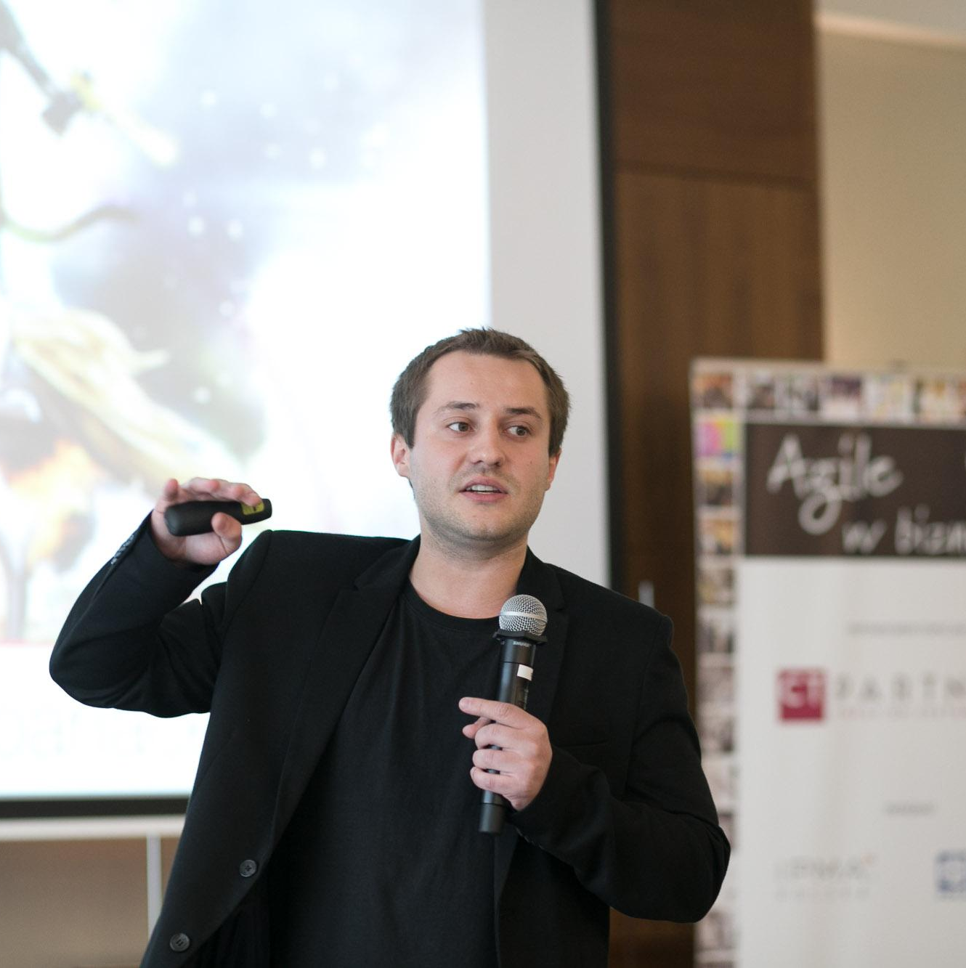
Using PAs Effectively
• Timing
• Handouts?
• Be aware of physical barriers
• Don’t rush
• Don’t distract
• Don’t talk AT the presentation aid
• Use progressive revelation
(one bit at a time)
• Know your audience
Image: astro_matt [CC BY-SA 2.0 (https://creativecommons.org/licenses/by-sa/2.0)]

Slide 12
Remember Murphy’s Law...
While ample preparation can prevent problems with PAs, sometimes you need to adapt when things go wrong:
Computer/tech failures
Network connections
Forgotten passwords
File formats / corruption
Adapters / dongles / drives
Microphone issues
Physical barriers
Ripped, torn, soiled, wrinkled, or missing materials
“Anything that can go wrong will go wrong”

Slide 13
Credits
Special thanks to all the people who made and released these awesome resources for free:
Presentation template by SlidesCarnival
Photographs from Wikimedia Commons

