Slide 1
STEREOCHEMISTRY
Conformation and Configuration

Slide 2

Stereochemistry is the study of the three-dimensional structure of molecules.
….. Zeroth dimension
….. First dimension
….. Second dimension

Slide 3
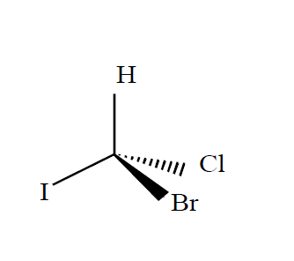
To represent molecules as three dimensional objects, we need at least one sp3- hybridized carbon.
A carbon–carbon single bond (a $σ$ bond) is formed when an sp3 orbital of one carbon overlaps an sp3 orbital of another carbon.

Slide 4
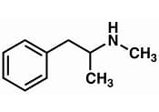
ISOMERS – THE ARRANGEMENT OF ATOMS IN SPACE
Isomers refer to compounds which have different structures but the same molecular formula
Interchanging two groups bonded to a carbon can have a profound effect on the physiological properties of a compound. For example, interchanging a hydrogen and a methyl group converts the active ingredient in Vicks vapor inhaler to methamphetamine, the street drug known as meth. The same change converts the active ingredient in Aleve, a common drug for pain, to a compound that is highly toxic to the liver.
Methamphetamine

Slide 5
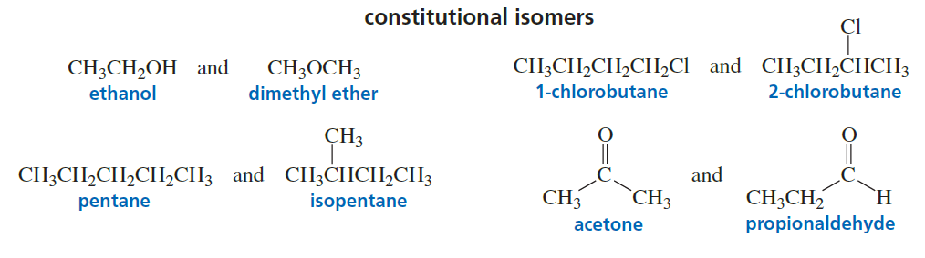
Isomers fall into two main classes: constitutional isomers and stereoisomers.
■ Constitutional isomers differ in the way their atoms are connected. For example, ethanol and dimethyl ether are constitutional isomers because they both have molecular formula C₂H₆O, but their atoms are connected differently (the oxygen in ethanol is bonded to a carbon and to a hydrogen, whereas the oxygen in dimethyl ether is bonded to two carbons).

Slide 6
The atoms in stereoisomers are connected in the same way. Stereoisomers differ in the way their atoms are arranged in space.
There are two kinds of stereoisomers: conformational isomers and configurational isomers.
■ Conformational isomers (also called conformers) are stereoisomers that rapidly interconvert at room temperature. Because they interconvert, they cannot be separated.
■ Configurational isomers are stereoisomers that cannot interconvert unless covalent bonds are broken. Because they cannot interconvert, configurational isomers can be separated.
■ There are two kinds of conformational isomers—those due to rotation about carbon–carbon single bonds and those due to amine inversion.

Slide 7
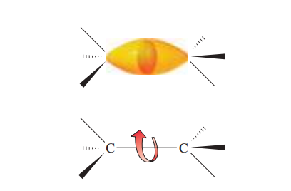
As shown below, rotation about a carbon–carbon single bond can occur without any change in the amount of orbital overlap.
conformational isomers due to rotation about carbon–carbon single bonds (staggered, eclipsed, chair, boat, and so on).
amine inversion
■ There are two kinds of configurational isomers—cis–trans isomers and isomers that contain asymmetric centers.

Slide 8
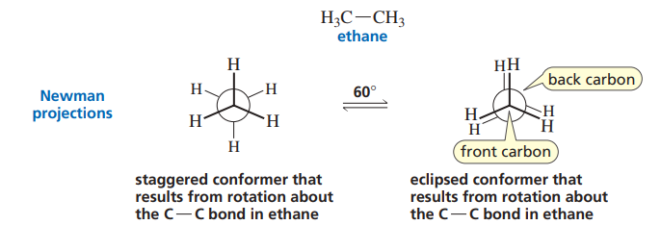
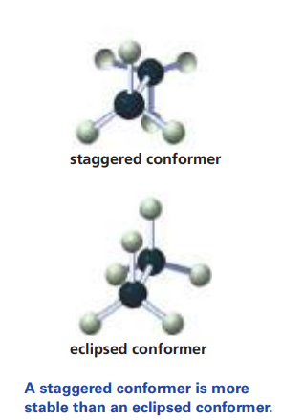
A Newman projection assumes that the viewer is looking along the longitudinal axis of a particular C¬C bond. The carbon in front is represented by a point (where three lines are seen to intersect), and the carbon at the back is represented by a circle.
The three lines emanating from each of the carbons represent its other three bonds.

Slide 9
Staggered and Eclipsed Conformers
Rotation about a C–C bond can produce an infinite number (a continuum) of conformers. Hence, the staggered conformer and the eclipsed conformer represent two extremes.
A staggered conformer is more stable, and, therefore, lower in energy, than an eclipsed conformer. Thus, rotation about a C–C bond is not completely free because an energy barrier must be overcome when rotation occurs. However, the energy barrier is small enough (2.9 kcal/mol) to allow continuous rotation at room temperature.
A molecule’s conformation changes from staggered to eclipsed millions of times per second at room temperature. As a result, the conformers cannot be separated from each other. At any one time, approximately 99% of ethane molecules will be in a staggered conformation because of the staggered conformer’s greater stability, leaving only 1% in less stable conformations.

Slide 10
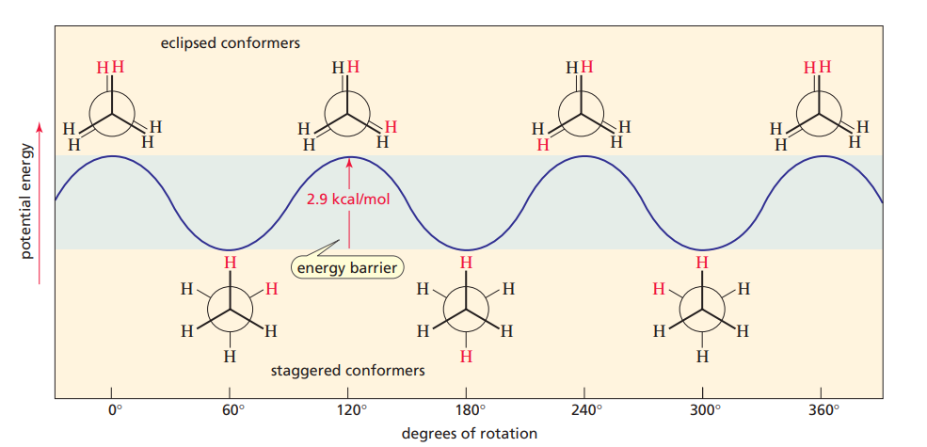

Slide 11
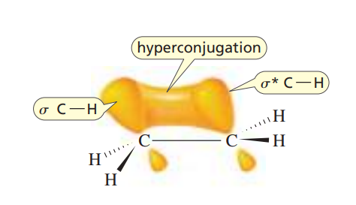
Why is a staggered conformer more stable than an eclipsed conformer?
Hyperconjugation

Slide 12
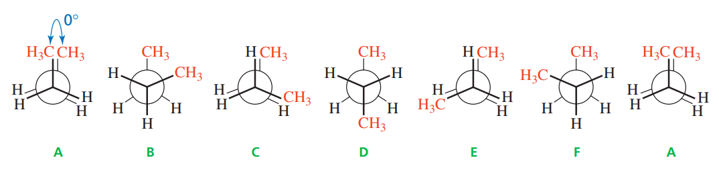
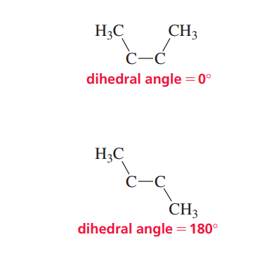
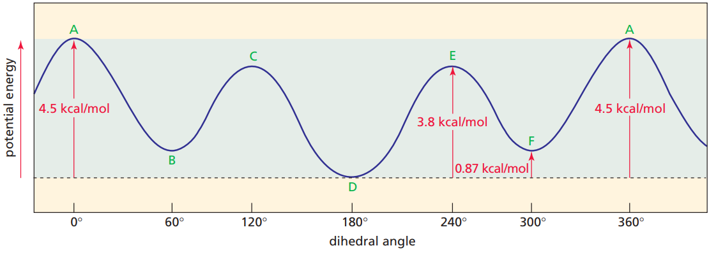
Anti and Gauche Conformers
Of the three staggered conformers of butane (C₄H₁₀), D has the two methyl groups as far apart as possible, so D is more stable (has lower energy) than the other two staggered conformers (B and F); D is called the anti conformer, and B and F are called gauche (“goesh”) conformers.

Slide 13
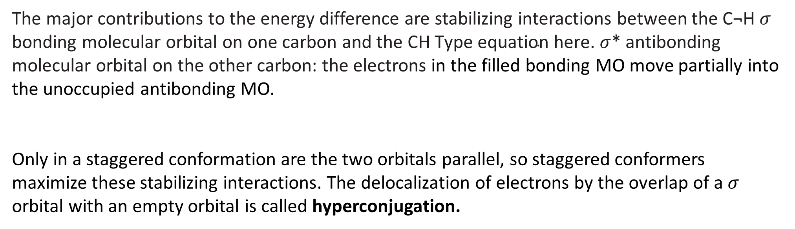
The major contributions to the energy difference are stabilizing interactions between the C¬H $σ$ bonding molecular orbital on one carbon and the CH $σ$* antibonding molecular orbital on the other carbon: the electrons in the filled bonding MO move partially into the unoccupied antibonding MO.
Only in a staggered conformation are the two orbitals parallel, so staggered conformers maximize these stabilizing interactions. The delocalization of electrons by the overlap of a $σ$ orbital with an empty orbital is called hyperconjugation.

Slide 14
The anti and gauche conformers have different energies because of steric strain (when atoms or groups are close enough for their electron clouds to repel each other.
There is a greater steric strain in a gauche conformer because the two substituents (in this case, the two methyl groups) are closer to each other. This type of steric strain is called a gauche interaction.
In general, steric strain in molecules increases as the size of the interacting atoms or groups increase.

Slide 15
Organic molecules are not static—they have many interconvertible conformers, because there is continuous rotation about all the C¬C single bonds in a molecule.
The relative number of molecules in a particular conformation at any one time depends on its stability—the more stable it is, the greater the number of molecules that will be in that conformation.
Most molecules, therefore, are in staggered conformations at any given instant, and there are more anti conformers than gauche conformers.

Slide 16
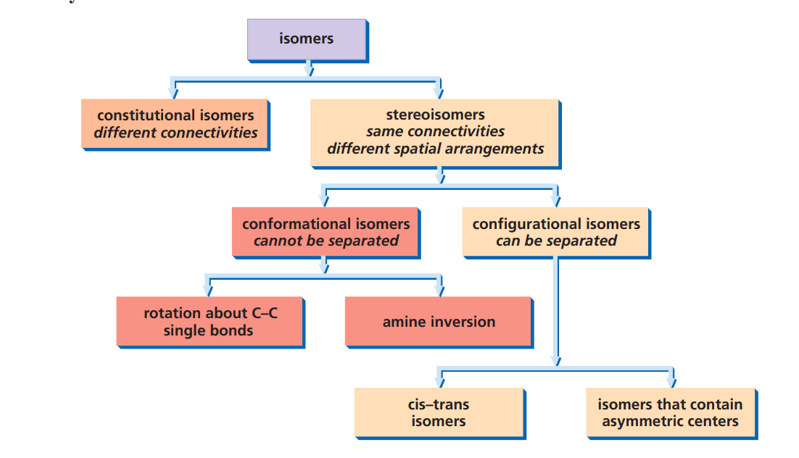

Slide 17
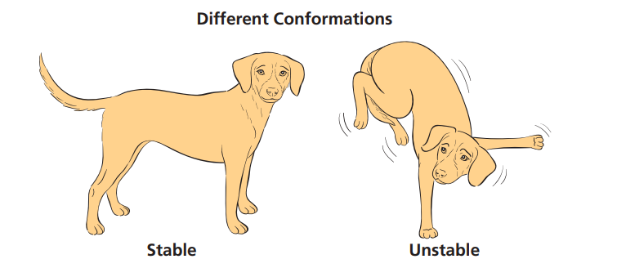
Conformational isomers (or conformers) are different spatial arrangements of the same compound (for example, anti and gauche conformers. They cannot be separated. Some conformers are more stable than others.

Slide 18
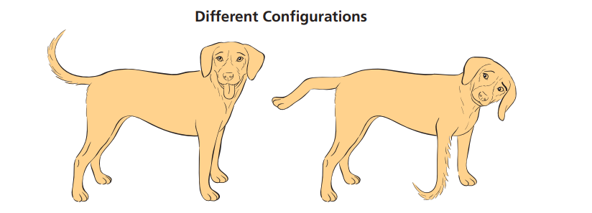
Configurational isomers are different compounds (for example, cis and trans isomers). They can be separated from each other. Bonds have to be broken to interconvert compounds with different configurations.
Conventionally, chemists use the term stereoisomers to refer only to configurational isomers.

Slide 19
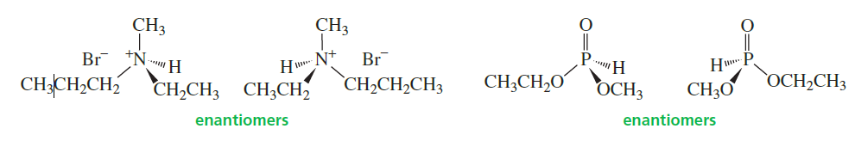
Conformational isomers due to amine inversion
Atoms other than carbon can be asymmetric centers. Any atom that has four different groups or atoms attached to it is an asymmetric center. For example, the following pairs of compounds, with nitrogen and phosphorus asymmetric centers, are enantiomers.
If one of the four “groups” attached to nitrogen is a lone pair, the enantiomers cannot be separated because they interconvert rapidly at room temperature. This rapid interconversion is called amine inversion. The lone pair is necessary for inversion: quaternary ammonium ions—ions with four bonds to nitrogen and hence no lone pair—do not invert. One way to picture amine inversion is to think of an umbrella that turns inside out in a windstorm.

Slide 20
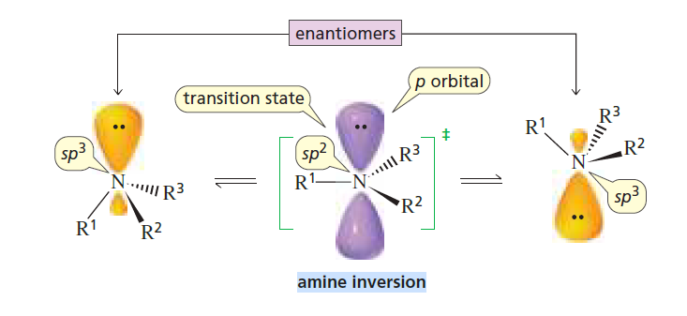
The energy required for amine inversion is approximately 6 kcal/mol, about twice the energy required for rotation about a carbon–carbon single bond, but still small enough to allow the enantiomers to interconvert rapidly at room temperature. As a result, the enantiomers cannot be separated.

Slide 21
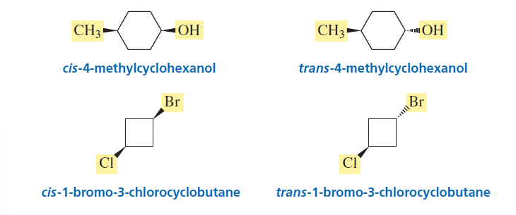
CIS–TRANS ISOMERS DUE TO RESTRICTED ROTATION
Cis–trans isomers are also called geometric isomers. These isomers result from restricted rotation, caused by either a cyclic structure or a double bond.
Cyclic Compounds
The cis isomer has its substituents on the same side of the ring; the trans isomer has its substituents on opposite sides of the ring.

Slide 22
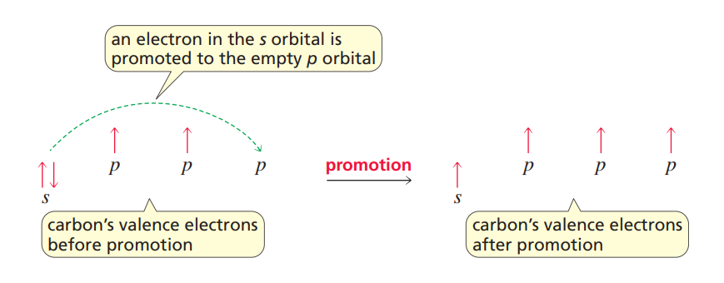
Hybrid Orbitals
If the one s and three p orbitals of the second shell (of carbon) are all combined and then apportioned into four equal orbitals, each of the four resulting orbitals will be one part s and three parts p. This type of mixed orbital is called an sp³. Each sp³ orbital has 25% s character and 75% p character.

Slide 23
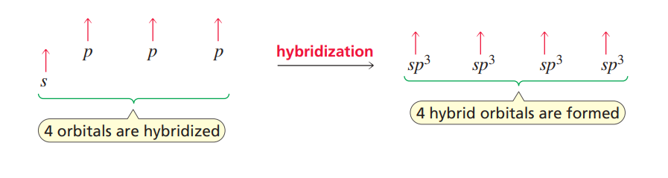
The four sp3 orbitals are degenerate—that is, they all have the same energy.

Slide 24
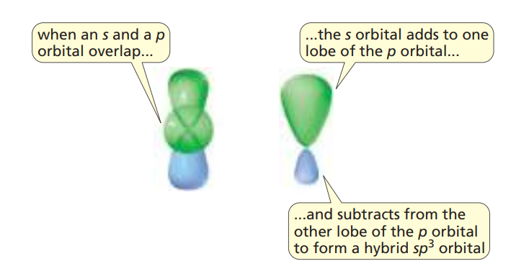
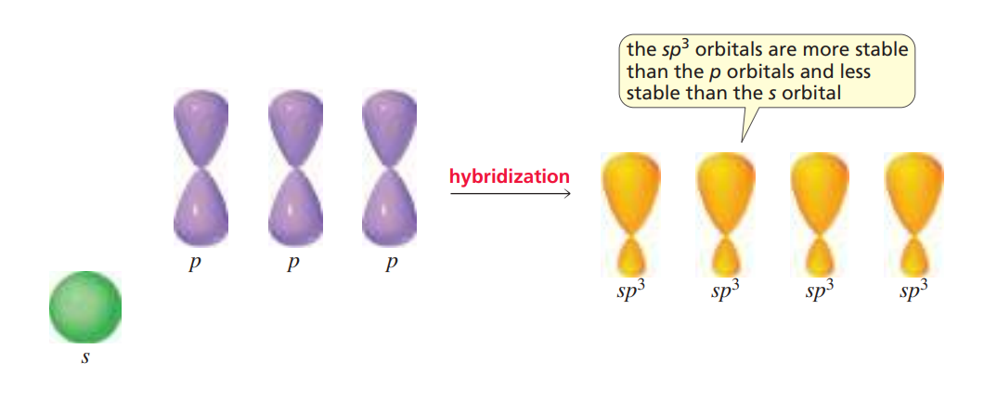

Slide 25
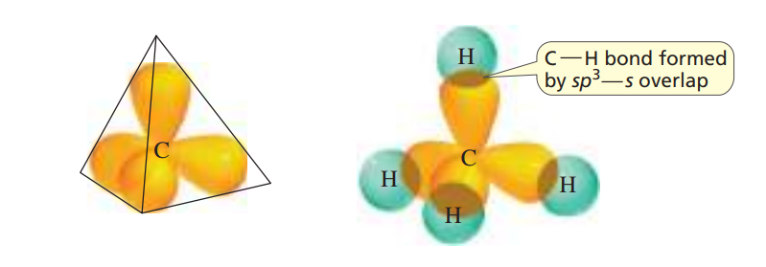
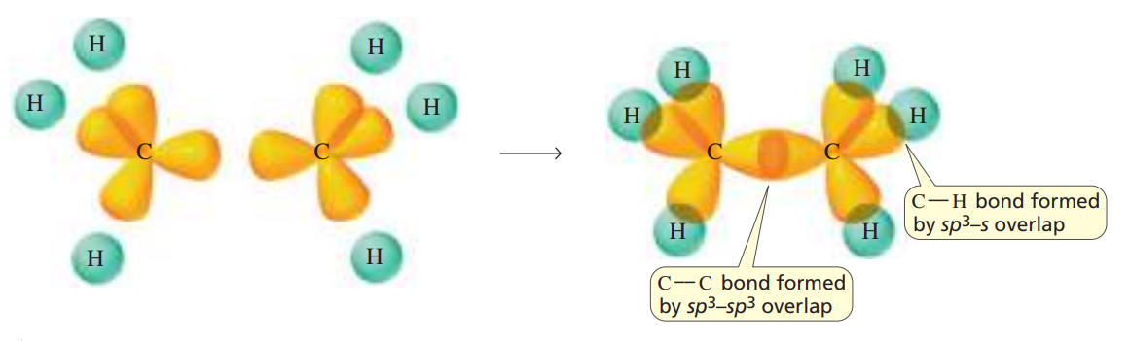

Slide 26
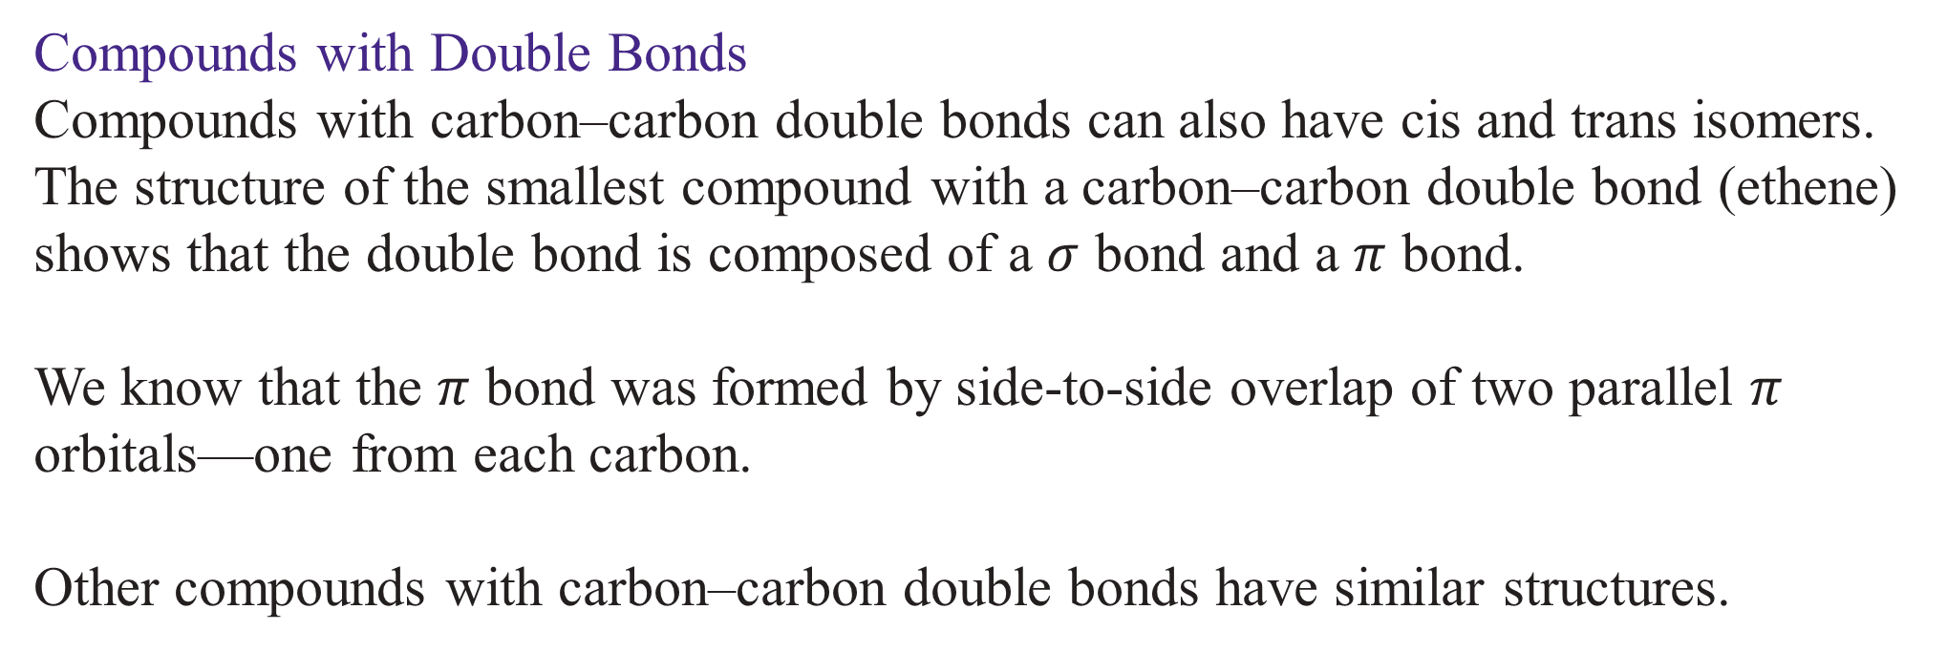
Compounds with Double Bonds
Compounds with carbon–carbon double bonds can also have cis and trans isomers. The structure of the smallest compound with a carbon–carbon double bond (ethene) shows that the double bond is composed of a $σ$ bond and a $π$ bond.
We know that the $π$ bond was formed by side-to-side overlap of two parallel $π$ orbitals—one from each carbon.
Other compounds with carbon–carbon double bonds have similar structures.
The carbons in ethene (also called ethylene) form two bonds with each other.
Each of the carbons forms four bonds, but each carbon is bonded to only three atoms.

Slide 27
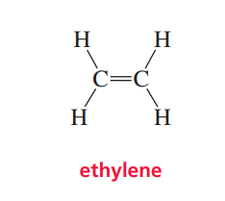
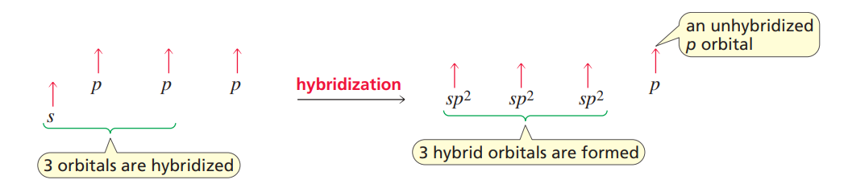
To bond to three atoms, each carbon hybridizes three atomic orbitals: an s orbital and two of the p orbitals. Because three orbitals are hybridized, three hybrid orbitals are formed. These are called sp2 orbitals. After hybridization, each carbon atom has three degenerate sp2 orbitals and one unhybridized p orbital

Slide 28
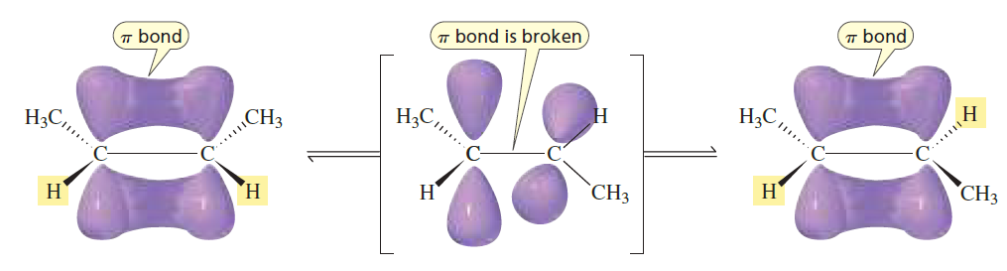
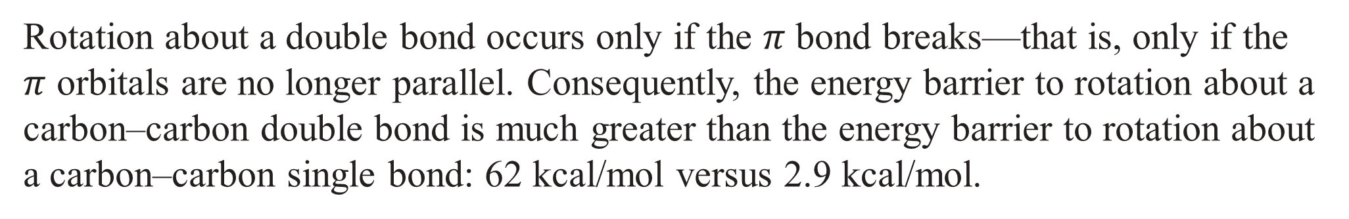
Rotation about a double bond occurs only if the $π$ bond breaks—that is, only if the $π$ orbitals are no longer parallel. Consequently, the energy barrier to rotation about a carbon–carbon double bond is much greater than the energy barrier to rotation about a carbon–carbon single bond: 62 kcal/mol versus 2.9 kcal/mol.

Slide 29
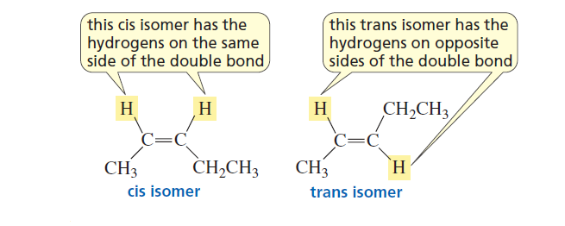
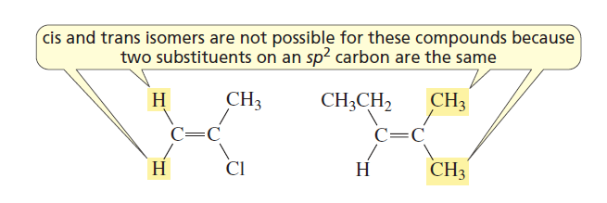
The high energy barrier to rotation about a carbon–carbon double bond means that a compound with a carbon–carbon double bond can have two distinct structures—the hydrogens bonded to the sp2 carbons can be on the same side (cis) of the double bond or on opposite sides (trans) of the double bond.

Slide 30
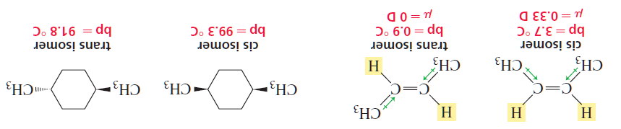
Cis and trans isomers can be separated from each other because they are different compounds with different physical properties—for example, they have different boiling points and different dipole moments.

Slide 31
Cis–Trans Interconversion in Vision
Our ability to see depends in part on an interconversion of cis and trans isomers that takes place in our eyes. A protein called opsin binds to cis-retinal (formed from vitamin A) in photoreceptor cells (called rod cells) in the retina to form rhodopsin. When rhodopsin absorbs light, a double bond interconverts between the cis and trans configurations, triggering a nerve impulse that plays an important role in vision.
trans-Retinal is then released from opsin. trans-Retinal isomerizes back to cis-retinal, and another cycle begins. To trigger the nerve impulse, a group of about 500 rod cells must register five to seven rhodopsin isomerizations per cell within a few tenths of a second.

Slide 32
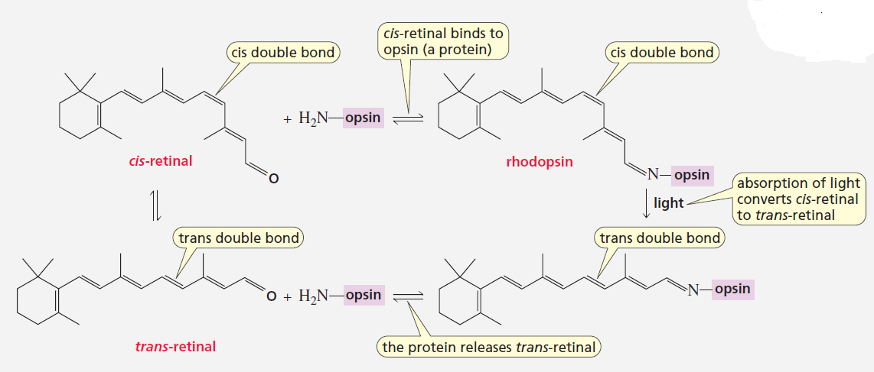

Slide 33
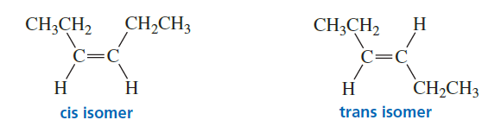
USING THE E,Z SYSTEM TO DISTINGUISH ISOMERS
As long as each of the sp² carbons of an alkene is bonded to one hydrogen, the terms cis and trans can be used to designate its geometric isomers: if the hydrogens are on the same side of the double bond, it is the cis isomer; if the hydrogens are on opposite sides of the double bond, it is the trans isomer.

Slide 34
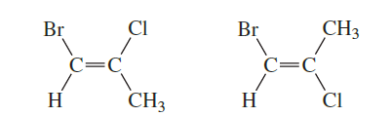
But the cis-trans designation may be unsuitable for the following structure
The E,Z system of nomenclature was devised for alkenes that do not have a hydrogen attached to each of the sp² carbons.
To name an isomer by the E,Z system, we first determine the relative priorities of the two groups bonded to one of the sp² carbons and then the relative priorities of the two groups bonded to the other sp² carbon.

Slide 35
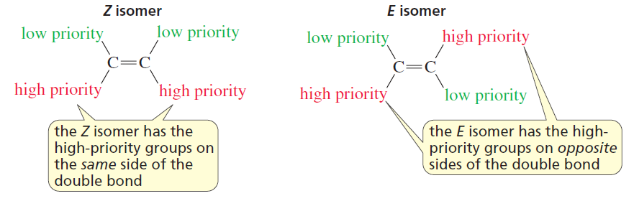
When the two high-priority groups (one from each carbon) are on the same side of the double bond, the isomer is the Z isomer (Z is for zusammen, German for “together”). If the high-priority groups are on opposite sides of the double bond, the isomer is the E isomer (E is for entgegen, German for “opposite”).

Slide 36
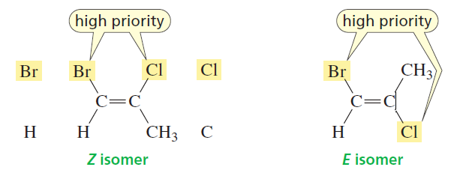
Determining Relative Priorities
The relative priorities depend on the atomic numbers of the atoms bonded directly to the sp² carbon. The greater the atomic number, the higher the priority. The isomer below on the left is the Z isomer: The sp² carbon on the left is bonded to a Br and to an H; Br has a greater atomic number than H, so Br has the higher priority.
The sp² carbon on the right is bonded to a Cl and to a C; Cl has the greater atomic number, so Cl has the higher priority. Thus, the isomer on the left has the high-priority groups (Br and Cl) on the same side of the double bond, so it is the Z isomer. The isomer on the right has the high-priority groups on opposite sides of the double bond, so it is the E isomer.

Slide 37
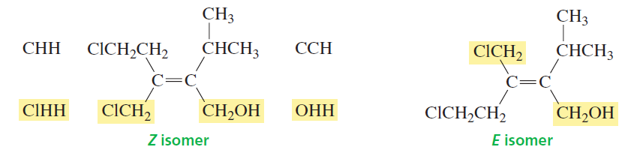
If the two atoms attached to an sp² carbon are the same (there is a tie), then consider the atomic numbers of the atoms that are attached to the “tied” atoms. Now we will see why the isomer below on the left is the Z isomer: Both atoms bonded to the sp² carbon on the left are carbons (in a CH₂Cl group and in a CH₂CH₂Cl group), so there is a tie.
The C of the CH₂Cl group is bonded to Cl, H, H, and the C of the CH₂CH₂Cl group is bonded to C, H, H. Cl has a greater atomic number than C, so the CH₂Cl group has the higher priority.
Both atoms attached to the sp² carbon on the right are Cs (in a CH₂OH group and in a CH(CH₃)₂ group), so there is a tie on this side as well. The C of the CH₂OH group is bonded to O, H, H, and the C of the CH(CH₃)₂ group is bonded to C, C, H. Of these six atoms, O has the greatest atomic number, so CH₂OH has the higher priority.

Slide 38
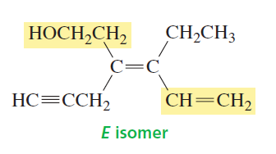
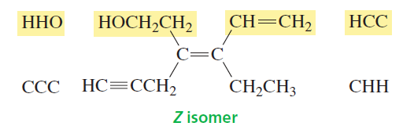
If an atom is doubly bonded to another atom, the priority system treats it as if it were singly bonded to two of those atoms. If an atom is triply bonded to another atom, it is treated as if it were singly bonded to three of those atoms.
E.g., in the isomer shown below, the sp² carbon on the left is bonded to a CH₂CH₂OH group and to a CH₂C‚CH group
Because the atoms bonded to the sp² carbon are both carbons, there is a tie. Each of the carbons is bonded to C, H, H, so there is another tie. We turn our attention to the groups attached to the CH₂ groups to break the tie. One of these groups is CH₂OH, and the other is C‚CH; the C of the CH₂OH group is bonded to H, H, O; the triple-bonded C is considered to be bonded to C, C, C. Of the six atoms, O has the greatest atomic number, so CH₂OH has the higher priority.

Slide 39
Both atoms bonded to the sp² carbon below are Cs, so they are tied. The first carbon of the CH₂CH₃ group is bonded to C, H, H; the first carbon of the CH=CH₂ group is bonded to an H and doubly bonded to a C, so it is considered to be bonded to H, C, C. One C cancels in each of the two groups, leaving H and H in the CH₂CH₃ group and H and C in the CH=CH₂ group. C has a greater atomic number than H, so CH=CH₂ has the higher priority.

Slide 40
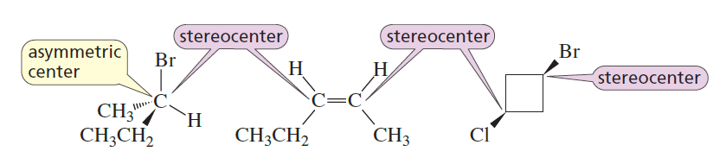
ASYMMETRIC CENTERS AND STEREOCENTERS
An asymmetric center is also called a stereocenter (or a stereogenic center), but they do not mean quite the same thing. A stereocenter is an atom at which the interchange of two groups produces a stereoisomer. Thus, stereocenters include both
asymmetric centers, where the interchange of two groups produces an enantiomer, and
the sp² carbons of an alkene or the sp³ carbons of a cyclic compound, where the interchange of two groups converts a cis isomer to a trans isomer or vice versa.
This means that although all asymmetric centers are stereocenters, not all stereocenters are asymmetric centres.

Slide 41
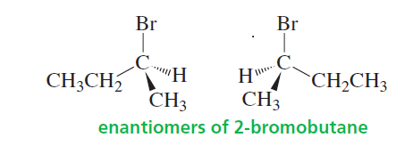
THE R,S SYSTEM
How do we name the enantiomers of a compound such as 2-bromobutane so that we know which one we are talking about?
We need a system of nomenclature that indicates the arrangement of the atoms or groups around the asymmetric center. Chemists use the letters R and S for this purpose. For any pair of enantiomers, one member will have the R configuration and the other will have the S configuration. This system of nomenclature is called the Cahn-Ingold-Prelog system after the three scientists who devised it.
Naming a Compound Drawn as a Perspective Formula
We can use this system to determine the configuration of a compound drawn as a perspective formula.
Lets use the enantiomers of 2-bromobutane as an example.

Slide 42
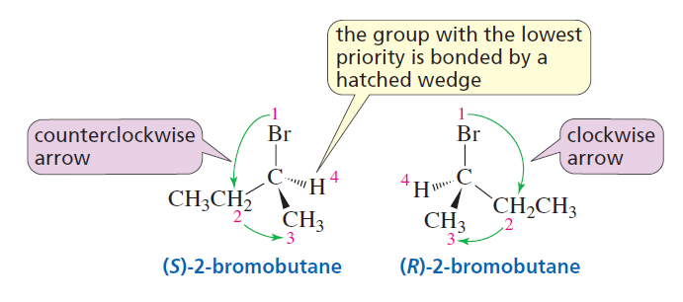
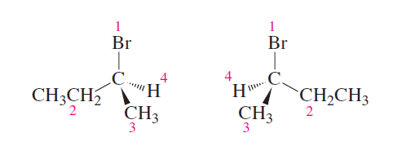
1. Rank the groups (or atoms) bonded to the asymmetric center in order of priority. The atomic numbers of the atoms directly attached to the asymmetric center determine the relative priorities. The higher the atomic number of the atom, the higher the priority. If there is a tie, you need to consider the atoms to which the tied atoms are attached.
The Cs of the methyl and ethyl group tie. Because the methyl group C is attached to H, H, and H and the ethyl group C is attached to C, H, and H, the ethyl group has the higher priority. The priorities are:
(1) bromine (2) ethyl (3) methyl (4) hydrogen.

Slide 43
2. If the group (or atom) with the lowest priority (4) is bonded by a hatched wedge:
Draw an arrow in the direction of decreasing priority—(1) to (2) to (3).
If the arrow points clockwise, then the compound has the R configuration (R is for rectus, which is Latin for “right”).
If the arrow points counterclockwise, then the compound has the S configuration (S is for sinister, which is Latin for “left”).
The letter R or S (in parentheses) precedes the systematic name of the compound.

Slide 44
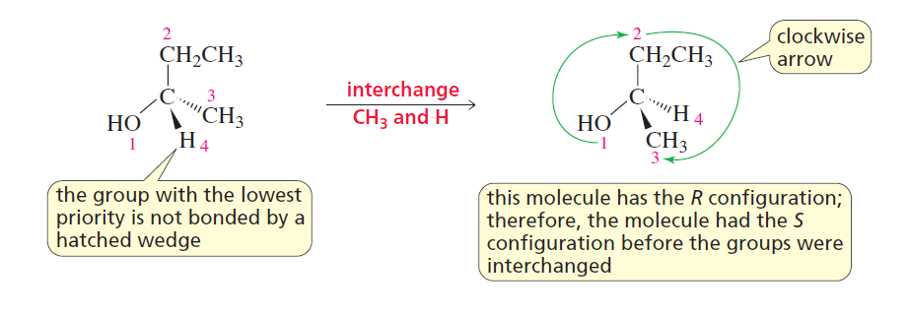
3. If the group (or atom) with the lowest priority (4) is not bonded by a hatched wedge:
Interchange group 4 with the group that is bonded by a hatched wedge.
Proceed as in step 2—namely, draw an arrow from (1) to (2) to (3).
Because the arrow points clockwise, the compound with the interchanged groups has the
R configuration. Therefore, the original compound, before the groups were interchanged, has the S
configuration.

Slide 45
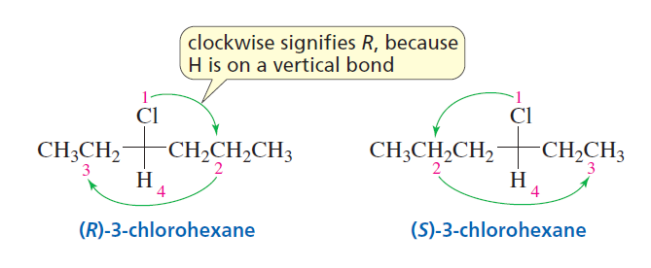
Naming a Compound Drawn as a Fischer Projection
1. Rank the groups (or atoms) that are bonded to the asymmetric center in order of priority.
2. Draw an arrow from (1) to (2) to (3). If the arrow points clockwise, then the compound has the R configuration; if it points counterclockwise, then the compound has the S configuration, provided that the group with the lowest priority (4) is on a vertical bond.
If the group (or atom) with the lowest priority is on a horizontal bond, the answer you get from the direction of the arrow will be the opposite of the correct answer. For example, if the arrow points clockwise, suggesting the R configuration, then the compound actually has the S configuration.

Slide 46
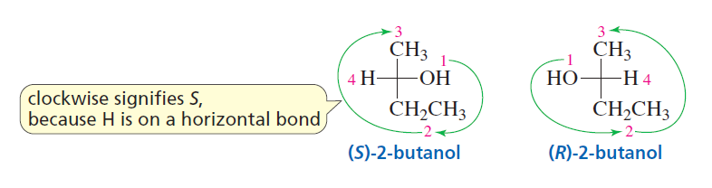

Slide 47
CHIRAL COMPOUNDS ARE OPTICALLY ACTIVE

Slide 48
HOW SPECIFIC ROTATION IS MEASURED

Slide 49
ENANTIOMERIC EXCESS

Slide 50
COMPOUNDS WITH MORE THAN ONE ASYMMETRIC CENTER

Slide 51
STEREOISOMERS OF CYCLIC COMPOUNDS

Slide 52
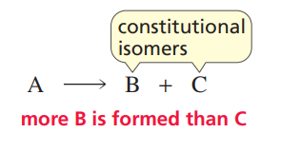
REGIOSELECTIVE, STEREOSELECTIVE, AND STEREOSPECIFIC REACTIONS
When we study the stereochemistry of a reaction, we are concerned with the following questions:
If the product of a reaction can exist as two or more stereoisomers, does the reaction produce a single stereoisomer, a set of particular stereoisomers, or all possible stereoisomers?
If the reactant can exist as two or more stereoisomers, do all stereoisomers of the reactant form the same stereoisomers of the product or does each stereoisomer of the reactant form a different stereoisomer or set of stereoisomers of the product?
A regioselective reaction is one in which two constitutional isomers can be obtained as products but more of one is obtained than the other. In other words, a regioselective reaction selects for a particular constitutional isomer. A reaction can be moderately regioselective, highly regioselective, or completely regioselective depending on the relative amounts of the constitutional isomers formed in the reaction.

Slide 53
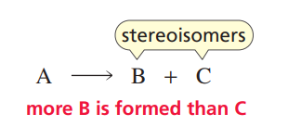

A stereoselective reaction results in the preferential formation of a stereoisomer rather than a constitutional isomer. A stereoselective reaction forms one stereoisomer preferentially over another. In other words, it selects for a particular stereoisomer. Depending on the degree of preference for a particular stereoisomer, a reaction can be described as being moderately stereoselective, highly stereoselective, or completely stereoselective.
A reaction is stereospecific if the reactant can exist as stereoisomers and each stereoisomer of the reactant forms a different stereoisomer or a different set of stereoisomers of the product.

Slide 54
In the preceding reaction, stereoisomer A forms stereoisomer B but does not form D, so the reaction is stereospecific. Because a stereospecific reaction does not form all possible stereoisomers of the product, all stereospecific reactions are also stereoselective. However, not all stereoselective reactions are stereospecific, because there are stereoselective reactions with reactants that do not have stereoisomers.

Slide 56
Stereoselective reactions give one predominant product because the reaction pathway has a choice. Either the pathway of lower activation energy is preferred (kinetic control) or the more stable product (thermodynamic control)
Stereospecific reactions lead to the production of a single isomer as a direct result of the mechanism of the reaction and the stereochemistry of the starting material. There is no choice. The reaction gives a different diastereoisomer of the product from each stereoisomer of the starting material

Slide 57
The stereospecificity of the reactions you have just met is very good evidence that E2 reactions proceed
through an anti-periplanar transition state. We know with which diastereoisomer we started,
and we know which alkene we get, so there is no question over the course of the reaction.
More evidence comes from the reactions of substituted cyclohexanes. You saw in Chapter 18 that
substituents on cyclohexanes can be parallel with one another only if they are both axial. An equatorial
C–X bond is anti-periplanar only to C–C bonds and cannot take part in an elimination. For
unsubstituted cyclohexyl halides treated with base, this is not a problem because, although the axial
conformer is less stable, there is still a significant amount present (see the table on p. 000), and elimination
can take place from this conformer.

