Slide 1

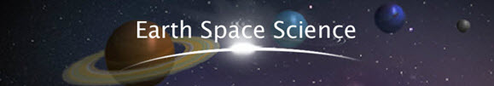
Segment 2
Final Exam Review
*We offer tutoring videos for the majority of the lessons in segment 2, if you need additional support. Please ask your teacher for details or go to the student help site.

Slide 2
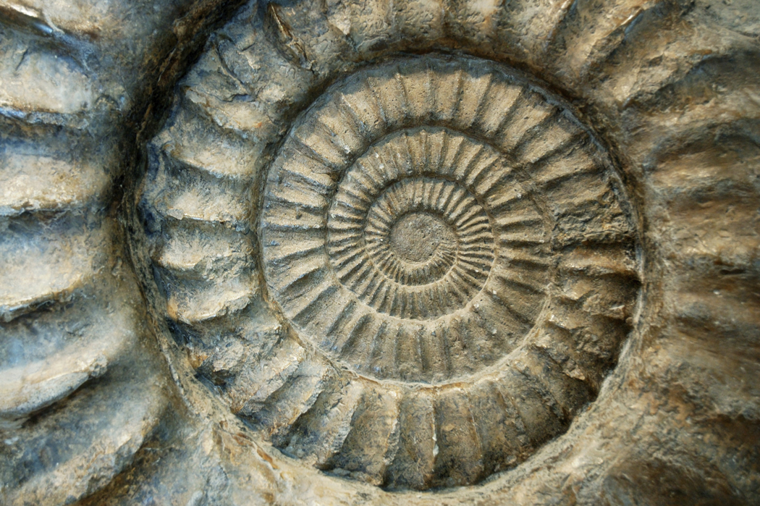
Geologic Time

Slide 3
Geologic time scale:
A visual display of the history (the age) of the Earth in the form of a scale
Huge sections of time are broken down into smaller groups of time:
Eons, Eras, Periods, and Epochs
Each box represent a period of time, draw a line matching the box to the group above:

Slide 4
Geologic time scale:
A visual display of the history (the age) of the Earth in the form of a scale
Huge sections of time are broken down into smaller groups of time:
Eons, Eras, Periods, and Epochs
Each box represent a period of time, draw a line matching the box to the group above:
Era
Period
Eon
Epoch

Slide 5
Fossils
“Fossils are rocks that formed from the remnants (what’s left) of once-living things. All living organisms, under the right conditions, can be fossilized.”
Name the types of fossils…

Slide 6
Which is NOT a type of fossil?
A.) Cast
B.) Crystallization
C.) Leaf
D.) Mold

Slide 7
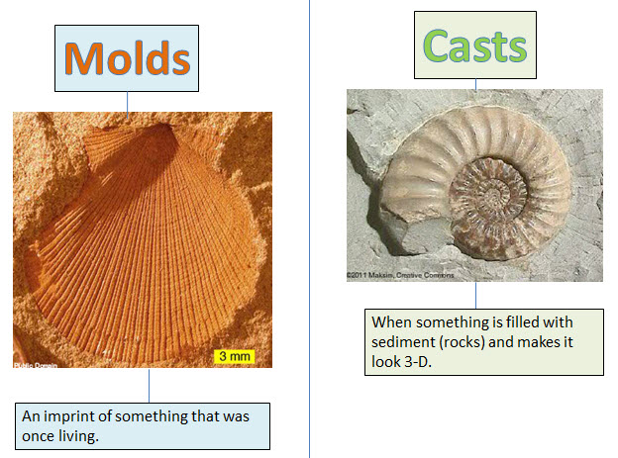
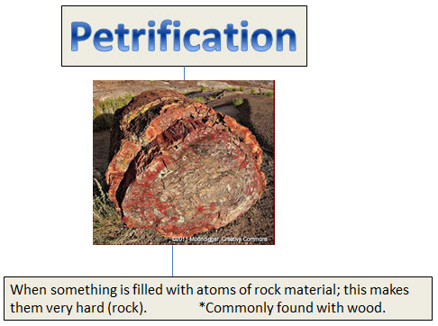
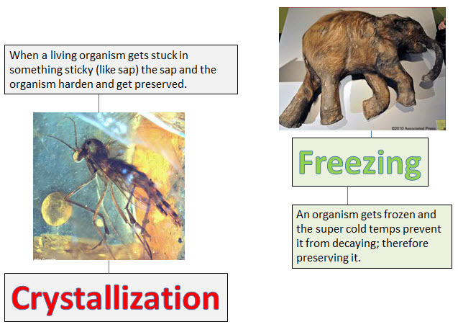

Slide 8
Trace Fossils:
The remains of an organism's activities but not of the organism itself.
EXAMPLES:
-broken eggshells from a dinosaur's nest are trace fossils. -footprints from an organism
-chewed section of a plant
-”coprolites” fossilized dung or feces (meaning: poop)

Slide 9
There are two types of dating which geologists can use to make the timelines:
relative dating and absolute dating.
Relative dating does not give an exact age (in years) to rocks or geologic events…

Slide 10
Instead, relative dating puts the events in sequential order; the oldest comes first, and all the rest of the events follow after, on the “relative dating timeline”.
Example of relative dating (putting events in sequential order):

Slide 11
More advanced dating techniques have allowed geologists to
get more exact dates.
SO…
Absolute dating is the:
The measurement of time in definite periods of time and is measured with something that gives us a definite (exact) time.
It assigns specific dates to rocks and geologic events.

Slide 12
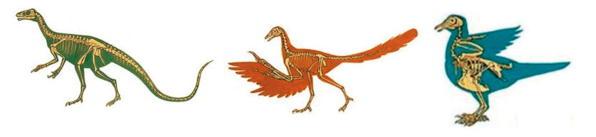
Theory of evolution
“Life on Earth did not always look the same as it does today. Life has evolved” (changed / altered).
“Evolution explains how new species of organisms arise or how existing organisms adapt to new conditions over time.”
Dinosaur
Modern day bird

Slide 13

“An adaptation refers to a characteristic of an organism that allows it to survive in a particular environment. “
When an adaptation (a change) makes an organism more likely to survive and reproduce, the organism may pass the new adaptation on to its offspring (babies); organisms with the new adaptation will produce more babies than organisms that don’t have the new adaptation. This process called: natural selection is why some organisms with certain adaptations survive and others do not, depending on Earth's changing conditions.

Slide 14
Chemical evolution:
The idea that the appearance of living systems (stuff) on Earth came from non-living molecules.

Slide 15

Oceans:

Slide 16
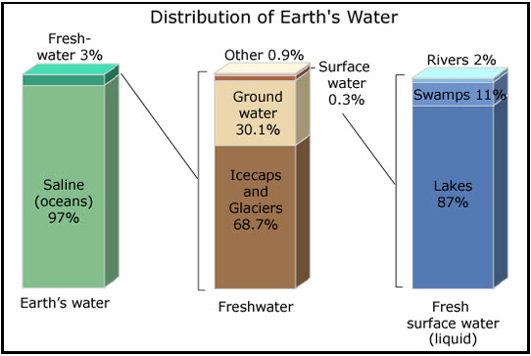
The distribution (how it is divided or broken up) of Earth's water is shown in the image below.

Slide 17

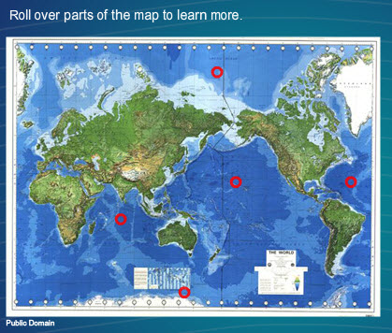
Ocean basins:
***The image above is an interactive from: Lesson 1, Discover page 1, “water world” tab

Slide 18
Ocean basins:
The areas between land masses.
5 major ocean basins:
1. Artic Ocean
2. Indian Ocean
3. Pacific Ocean
4. Antarctica Ocean
5. Atlantic Ocean
***The image above is an interactive from: Lesson 1, Discover page 1, “water world” tab

Slide 19
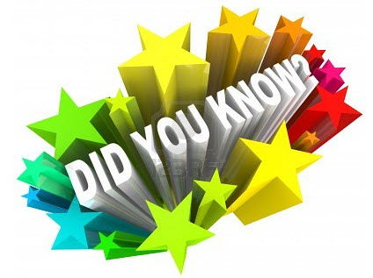
The ocean plays a major role in the water cycle.
All life on Earth depends on the ocean in some way. All water eventually flows into the ocean, where it evaporates and is recycled by rain back onto land.

Slide 20
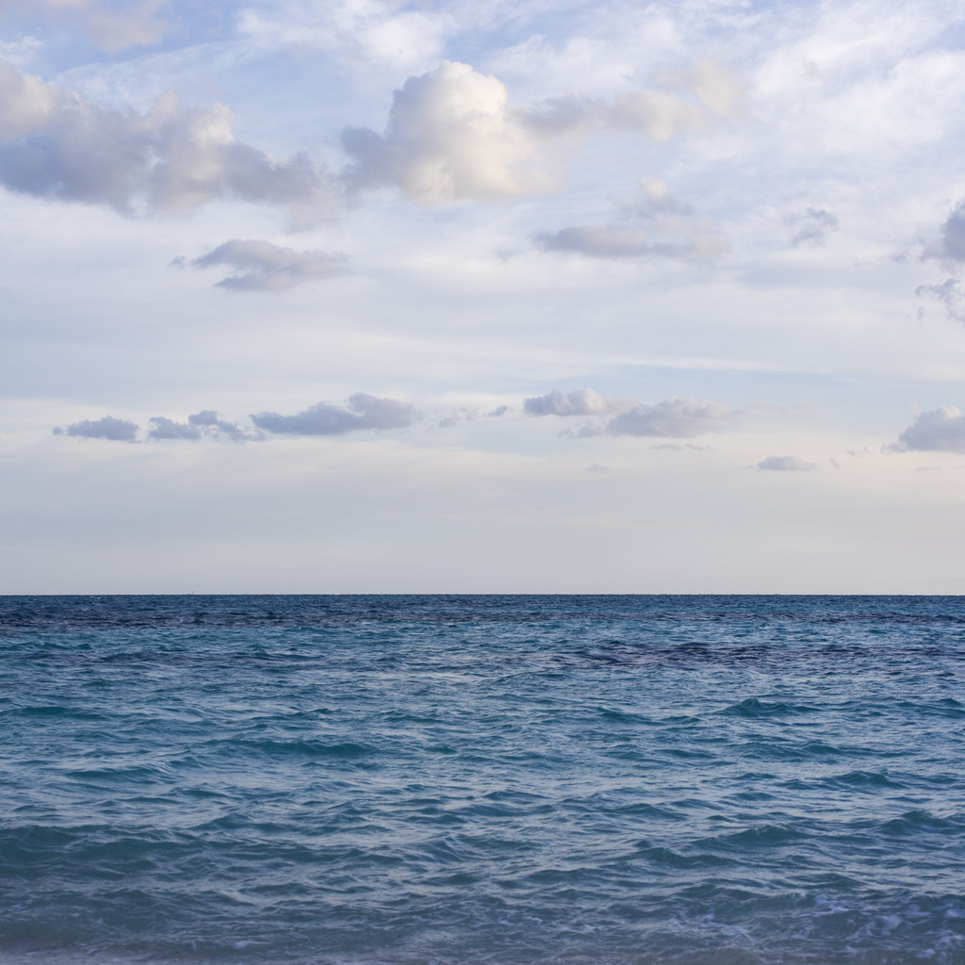
Salty Water
Ocean water is salt water containing a variety of salts. Salts in soils and rocks that are continually eroded from land cause the ocean's saltiness. Rivers and streams carry small amounts of salt to the ocean day after day. As the water in the ocean is evaporated by the sun in the water cycle, the salts get left behind. Therefore, in areas where there is a lot of evaporation, the ocean water is actually saltier.
The amount of salt in water is a measure of its salinity. Ocean salinity varies by climate. On average, salinity is about 3.5 percent. This means that 3.5 percent of all ocean water is made of salt. In areas with a high evaporation rate, the salinity is higher. When freshwater mixes with ocean water, such as where a river meets the ocean, the salinity is lower than normal.
Water with dissolved salts has a higher density than freshwater without dissolved salts.

Slide 21
Warm water rises
Cold water sinks
As it rises and sinks in the ocean, water circulates from bottom to top and back down again.

Slide 22

What things impact (or cause) water movement?

Slide 23
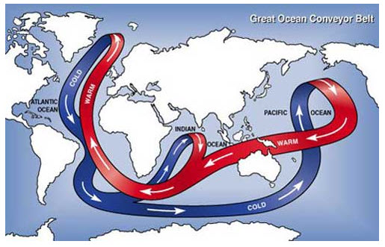
Movement:

Slide 24
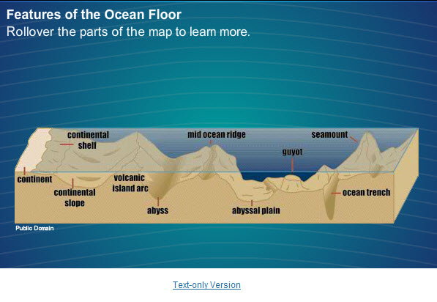
** Please do this interactive activity in lesson 1, under “Discover” page 2, “The Ocean floor” tab:

Slide 25

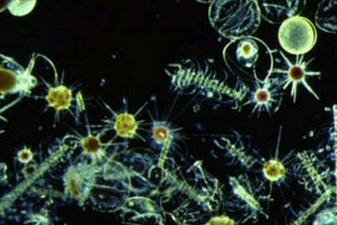
Currents cause movement of ocean water by a process called ocean circulation. The constant cycling of ocean water distributes nutrients and energy from the poles to the equator, and back again.
Phytoplankton are microscopic plants at the bottom of the ocean food chain; all the other creatures in the sea depend on phytoplankton.
Phytoplankton are distributed by ocean currents and waves.

Slide 26

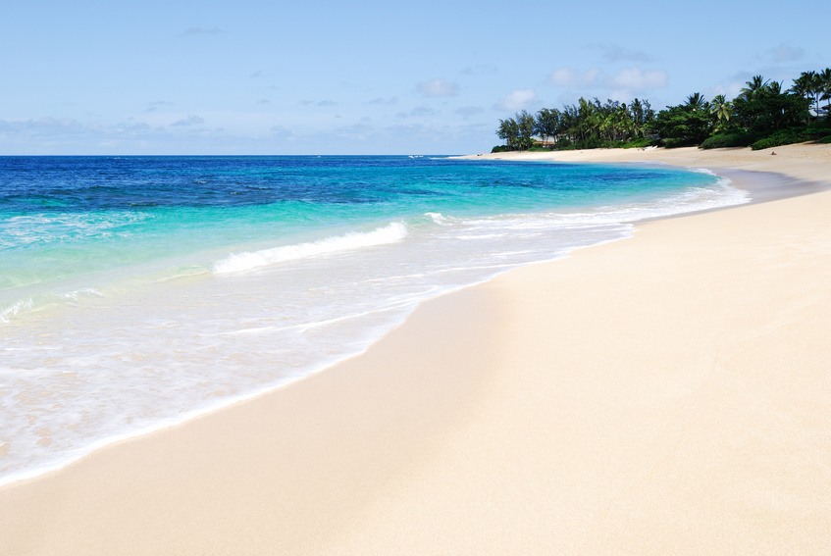
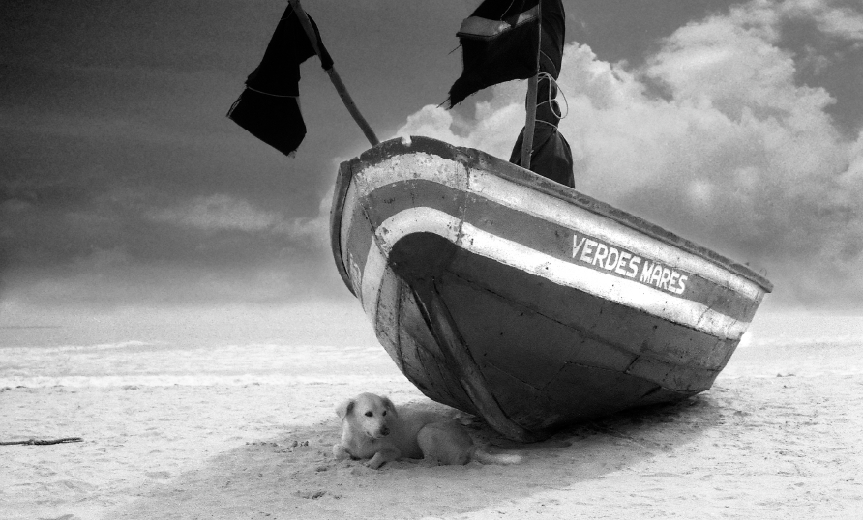
Upwelling's bring the cold deep water up, cooling the air (environment) around it.
The exchange of heat between the ocean and the atmosphere causes changes in weather patterns.

Slide 27

Effects on the
climate:
Upwelling water can change weather patterns in an area.
When upwelling currents are happening often they bring the cold water up therefore cooling the air. The closer you are to the water the more moderate your climate (it doesn’t drastically change as much as it does inland).
Remember that the ocean absorbs solar (heat) energy slowly and releases it slowly. So once the ocean water warms, it is slow to cool off; and vice-versa.
The ocean always releases (in the form of evaporation) water molecules which impact the air, therefore impacting our weather.

Slide 28
Density Currents:
To most of us, when we think of density we usually think of how heavy something is. The more mass that an abject has the more dense it is, so the heavier it is.
Density currents have more mass and are therefore pulled toward the ocean bottom by gravity.
REMEMBER: Water density is largely affected by temperature and salinity (the amount of salt), so water which is very cold or higher in salt content sinks deep beneath the surface.

Slide 29
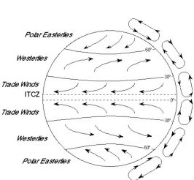
Wind changes directions, when moving, do to the movement of the Earth.
Coriolis Effect

Slide 30
Coriolis Effect broken down… the basics!
Air always moves for a high pressure area to a low pressure area.
The Earth is curved and the sun hits areas on the Earth different; so it warms them different.
Warm air rises and cold air sinks (cold air is more dense). So the warm air from the equator rises, and the cold air from the poles sinks.
The Earth is rotating (so we get night and day), but was it does it deflects the air.
Air actually moves in specific areas (globally) but to you and I (locally) it moves all over.

Slide 31

We’ve learned so far that the movement of ocean water occurs due to:
1. The amount of salt in the water
2. The temperature of the water
3. The Coriolis Effect (the effects of the Earth’s movement)

Slide 32
Wind
The winds closest to the surface of the Earth affect the ocean water.
Currents that are formed as a result of the wind above them are called: wind-driven currents.
A wind’s strength and the length of time that it blows determine the strength and direction of a surface current. Because winds are deflected by the Coriolis effect, surface currents follow the same pattern.

Slide 33

Things move from:
high low
AND
cold warm

Slide 34
We’ve learned so far that the movement of ocean water occurs due to:
1. The amount of salt in the water
2. The temperature of the water
3. The Coriolis Effect (the effects of the Earth’s movement)
4. Surface wind

Slide 35
What is a wave?
This continuous and repetitive transmission of energy from one location to the next is called a wave.
A surface wave (in the ocean) is a repetitive disturbance in the water that repeats itself in a pattern.
Medium: What the energy travels across/through/over/under
(EX: Like a car traveling on a road.)

Slide 36
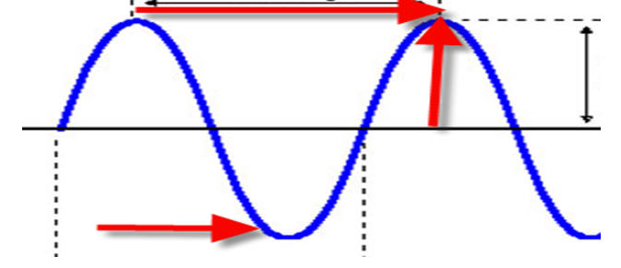
Wavelength
Crest
Amplitude
Trough

Slide 37
Types of waves
As a wave approaches (gets close to) the coast, the shape and slope (angle of the wave) of the shoreline region (area) determines the type of wave that forms.

Slide 38
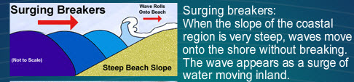
Types of waves
REMEMBER: Once a wave gets close to the shore, the top of the wave keeps moving forward even though the bottom part slows down because it is rubbing against the bottom.

Slide 39
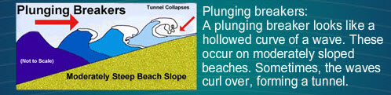
Types of waves
REMEMBER: Once a wave gets close to the shore, the top of the wave keeps moving forward even though the bottom part slows down because it is rubbing against the bottom.

Slide 40
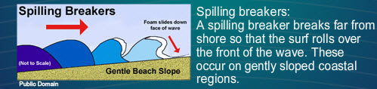
Types of waves
REMEMBER: Once a wave gets close to the shore, the top of the wave keeps moving forward even though the bottom part slows down because it is rubbing against the bottom.

Slide 41
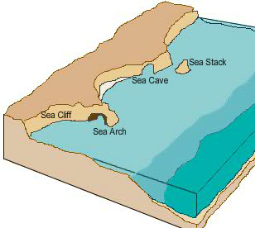
An erosional shoreline may contain the following features:

Slide 42
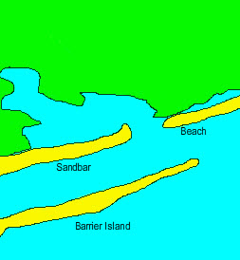
An depositional shoreline may contain the following features:

Slide 43
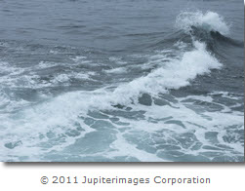
Tides
A result of the changes in water levels caused by waves .
Tides on Earth are caused by the gravitational interaction between the sun, Earth, and moon system.

Slide 44
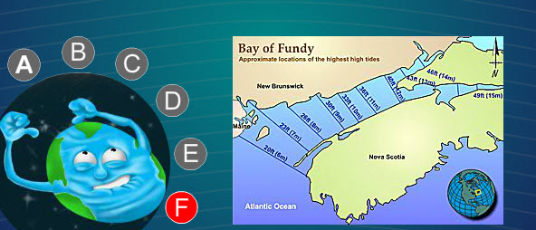
Influences on the Tides:
(Highlights from the interactive)
The sun and the moon pull on the Earth’s water, creating tidal bulges.
Gravity and inertial keep the Earth in orbit around the sun.
Solar and lunar days determine the timing of the gravitational effects.
The angle of the moon in the sky affects the tidal bulge.
Tide-generating forces are created by the pull of gravity from the sun and the moon.
Shoreline gravity can affect tides.

Slide 45


Types of tides:
Spring Tide
- occur when the sun, Earth, and moon are all in alignment.
(More gravitational attraction occurs)
Moon
Earth
Sun

Slide 46
Types of tides:
Neap Tide
- occur when the sun, Earth, and moon are all at right angles.
(Less gravitational attraction occurs)
Moon
Earth
Sun

Slide 47
Original thoughts on the solar system (and astronomy):
Claudius Ptolemy: Earth is the center.
He thought that because when you look at the sky at night, you can see all the stars moving around Earth. Therefore, Earth must be at the center.
Nicolaus Copernicus: The sun is the center of the solar system.
He thought that because of the observations that he had made.

Slide 48
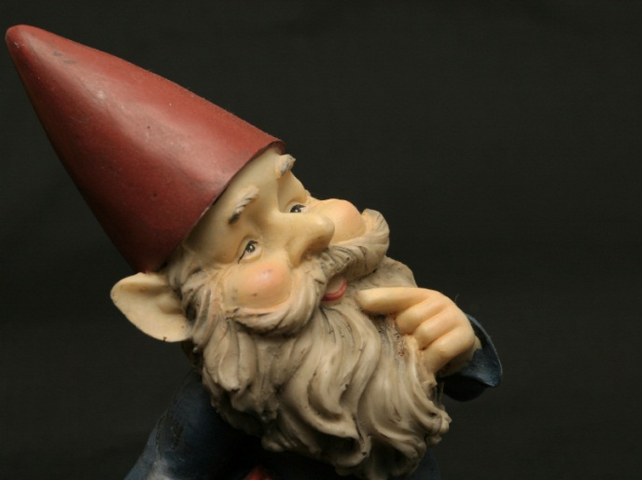
Solar System Models:
These were created to explain observations of how planets and other objects in the night sky moved.
The geocentric model put Earth at the center of the solar system.
The heliocentric model puts the sun at the center of the solar system.

Slide 49
VOCABULARY ALERT!
An object orbiting another object is called a satellite.
The length of time it takes a planet to complete its orbit defines that planet’s year and is called the revolution rate.
The length of time it takes a planet to complete one rotation defines that planet’s day and is called the rotation rate.

Slide 50

Kepler’s laws
Kepler’s laws allow you to calculate the shape and duration of a planet’s orbit.
**Please use the interactive activity on Discover page 2, “Kepler’s Laws” tab to help in your understanding of these three laws.

Slide 51
For there to be gravity… does there need to be air?

Slide 52

Gravity-
A force of attraction between two objects that depends on two things: mass and distance.
1.) The larger the mass the greater the gravitation attraction.
2.) The closer the two objects the stronger the attraction.
Air resistance is caused by the friction between a falling object and the particles in air. The amount of air resistance a falling object experiences is based on the shape of the object and the speed at which it falls.

Slide 53


Acceleration is the rate of change in velocity.
When we are talking about the acceleration of a falling object it would be: “… an increase in speed over time”.
Acceleration of a falling object is due to gravity. All objects fall at a constant rate, the only reason we see them falling different is due to other forces acting on the objects.
Positive acceleration can result from an increase in speed. Negative acceleration, also called deceleration, results from a decrease in speed.

Slide 54

Newton’s laws of Motion
1st law: An object in motion will remain in motion, at a constant velocity, unless an outside force acts on it. And an object at rest will remain at rest unless an outside force acts on it.
  Example:
This ball will sit here forever, and ever, and ever unless something acts on it; like someone kicks it.

Slide 55
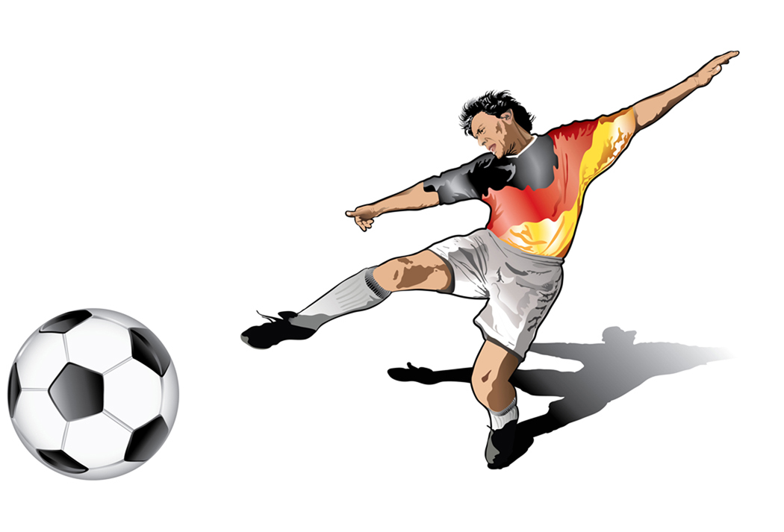
Outside force – a push!

Slide 56
2nd law: Force = mass x acceleration
Would the same "force” (push or pull) be used to move each guy below?
If no, why?

Slide 57
The less mass (the boy) the less force needed for acceleration.

Slide 58

The greater the mass (the sumo wrestler) the more force needed for acceleration.

Slide 59
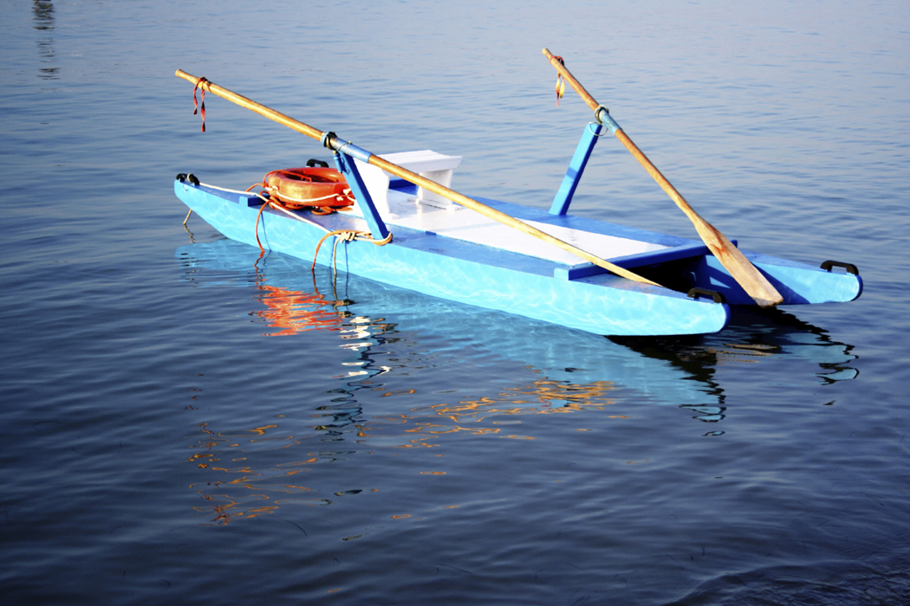
3rd law: For every force (action) there is an equal and opposite force (reaction).
Raft moves
Diver moves
Equal in speed (acceleration) and opposite in direction.

Slide 60
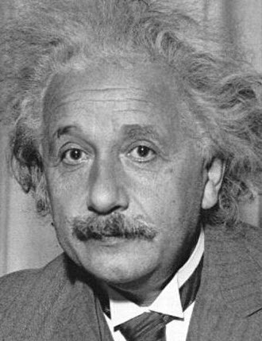
Einstein
Einstein says that time and space are intricately related.
Called the space-time continuum, time and space can be thought of as a sort of fabric. Objects within time and space will bend this “fabric,” creating a gravitational force.

Slide 61
Earth has a magnetic field, called the magnetosphere.
Earth’s magnetic field creates a sort of “shell” that protects Earth from much of the sun’s radiation.
Earth's magnetic field interacts with the radiation from the sun.
Earth’s atmosphere is filled with air molecules.
Ions from the sun collide with the air molecules in Earth’s atmosphere.
The molecules become excited and give off light as they calm down.
Auroras (a.k.a. = Northern/Southern Lights)

Slide 62
Properties of the sun
The sun is made of plasma.
Plasma is the fourth state of matter.
It comprises electrons and charged atoms, known as ions.
The sun is made up mostly of hydrogen and some helium gasses.
The sun makes up 99.9 percent of all the matter in the solar system.
(*That means that EVERYTHING else out there is only .1% of the total mass – so the sun is huge!)
The sun is nearly 110 times wider than Earth. About 1 million Earths would fit inside the sun.
The surface of the sun has a temperature of about 5,500 degrees Celsius. At the sun’s core, temperatures are about 15 million degrees Celsius.

Slide 63
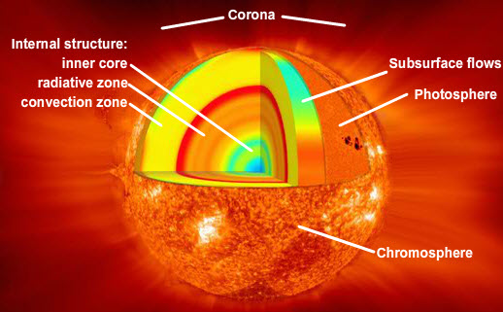
Layers of the sun
Lesson 3 – Discover pg. 1 – “Layers of the Sun” tab.

Slide 64
Nuclear fusion:
When atoms collide (under super high pressure and temperature), they can be squeezed so tightly that they fuse together.
->This fusion forms new elements.
Nuclear fission:
The opposite happens as well, when atoms split apart.

Slide 65
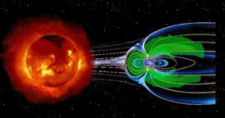
Earth has a magnetic field, called the magnetosphere.
Earth’s magnetic field creates a sort of “shell” that protects Earth from much of the sun’s radiation.
Earth's magnetic field interacts with the radiation from the sun.
Plasma from the sun, known as the solar wind, travels toward Earth.

Slide 66
CME: A coronal mass ejection, (CME), is a bubble of solar-wind gases shot from the sun’s surface.
Prominence: A loop-shaped plasma ejection formed in the sun’s atmosphere.
Sunspots: Each sunspot is a location where the magnetism of the sun creates a cooler region we perceive as a dark “blemish” on the sun’s photosphere.
(The sunspot is still shining, just not as brightly as the rest of the sun.)
Solar Flares: A sudden explosion of charged particles from the solar atmosphere.

Slide 67
Planet or a Dwarf planet?
What’s the difference you say…
A planet
-orbits around the sun
-has enough mass to be basically a round shape
-is not a satellite or moon of another object
-has enough gravity to clear away smaller objects near its orbit
A dwarf planet
-orbits around the sun (SAME)
-has sufficient mass to assume a nearly round shape (SAME)
-is not a satellite or moon of another object (SAME)
-does not have enough gravity to clear away smaller objects near its orbit (DIFFERENT)

Slide 68
Inner Planet Basics:
Rock planets (Terrestrial)
Few (or even no) moons
Close to the Sun
No rings around the planets
“Smaller” in size

Slide 69
Outer Planet Basics:
Gas planets (Jovian)
Lots of moons
FAR from the Sun
Have rings
Big planets

Slide 70
The Asteroid Belt
Basically it separates the inner and out planets from each other and there are about one million objects (asteroids) that make up the belt.
->If you added up (if it was even possible) the mass of all of the objects in the asteroid belt, they would even equal the mass of our moon.
An asteroid may be classified as rocky, metallic, or a combination of both.

Slide 71
Comets
A comet has a solid rocky core (center or nucleus) and is made of frozen gases on the surface.
Comets travel around the sun and when they travel close (they pass it), the frozen gases on the surface start to melt (from the hot temperatures of the sun), and we see (as a result of the solar wind blowing these melting gases) what appears to be a tail (which always points away from the sun, since the solar wind it blowing from the sun).

Slide 72
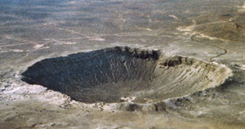
Meteors
They are just a streak of light that is formed when pieces of space debris (flying stuff / tiny pieces of rock), called meteoroids, burn up in Earth's atmosphere.
What we think of as shooting stars. ☺
When a meteor hits our atmosphere they rub together, when they do this causes friction. The friction causes the meteor to start to burn up and what we see is the light.
VOCABULARY ALERT!
Once a meteor hits Earth's surface, it is called a meteorite.
An impact crater forms when one object in space collides with another object.

Slide 73
Moon - Earth
Just like the Earth traveling around the sun, so does the moon around the Earth.
1. It travels in an elliptical (egg-shaped) orbit.
2. It is tilted (5 degree angle) as it orbits
3. It has a apogee (farthest distance from Earth) and perigee (closest distance to the Earth) in its orbit

Slide 74
Moon - Earth
During apogee: The moon appears normal or smaller.
During Perigee: The moon appears much larger than normal.

Slide 75

Earth is tilted either toward or away from the sun for almost half of the year.
When any potion of Earth is tilted toward the sun, the angle of solar radiation that strikes Earth’s surface is greater—there is less atmosphere for the sun’s radiation to travel through before it reaches Earth’s surface, and we see the sun rise higher in the sky. Hence, the tilt of Earth’s rotational axis is the reason Earth experiences seasonal changes.

Slide 76
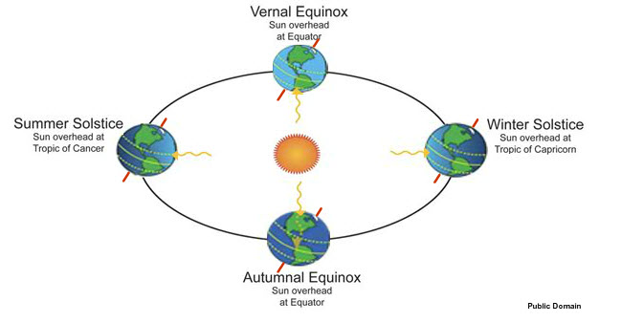
Northern hemisphere – summer (tilted toward the Sun – warmer)
Northern hemisphere – winter (tilted away from the Sun – colder)
Southern hemisphere – winter (tilted away from the Sun – colder)
Southern hemisphere – summer (tilted toward the Sun – warmer)

Slide 77
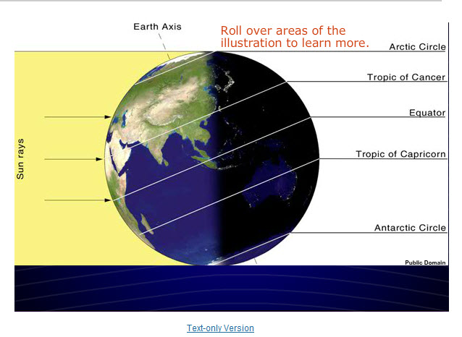

Slide 78
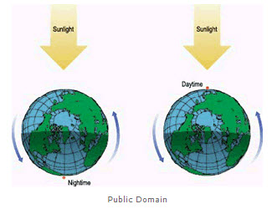
When light strikes the surface of an object, the object is illuminated (lite up/bright); if no light strikes the surface, the object is completely dark.
Day time (bright out)
Night time (dark out)

Slide 79
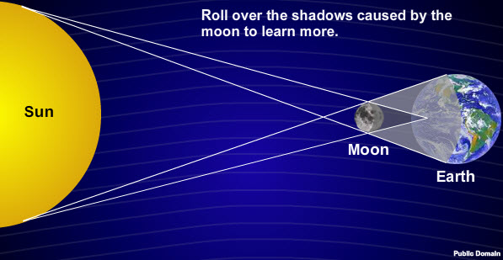
Check out the interactive on the Discover pg. 1, “Solar Eclipse 1” tab

Slide 80
Check out the interactive on the Discover pg. 1, “Solar Eclipse 1” tab
Umbra is the deepest and darkest part of a shadow.

Slide 81
Check out the interactive on the Discover pg. 1, “Solar Eclipse 1” tab
Penumbra forms where sunlight is partially blocked.
Umbra is the deepest and darkest part of a shadow.

Slide 82
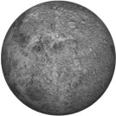
Solar Eclipse – the sun is blocked

Slide 83
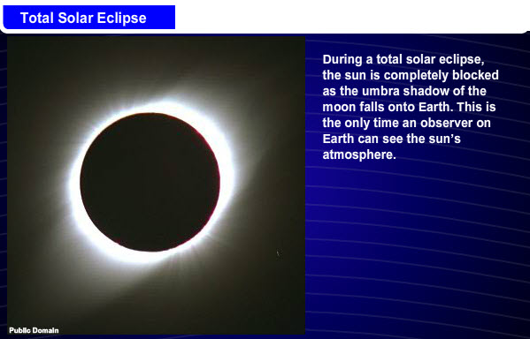
Total eclipse of the Sun

Slide 84
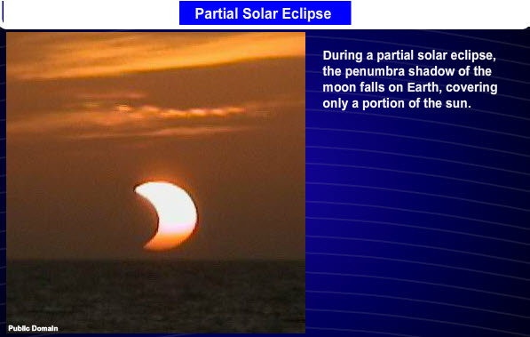
Partial eclipse of the Sun

Slide 85
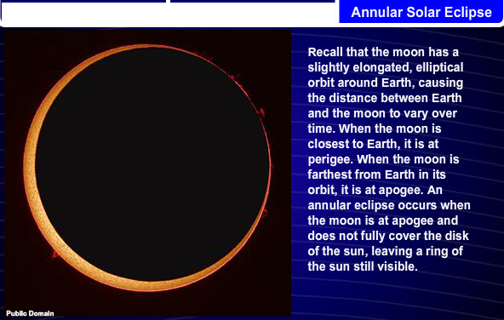
Annular eclipse of the Sun

Slide 86
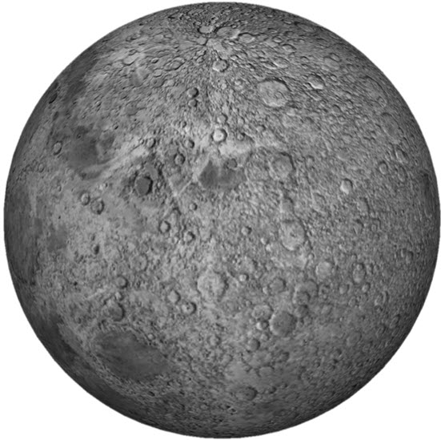
The Moon
At night we can see different shapes of the moon. This is called: moon phases.
What we are seeing is shadows that are cast on the moon.

Slide 87
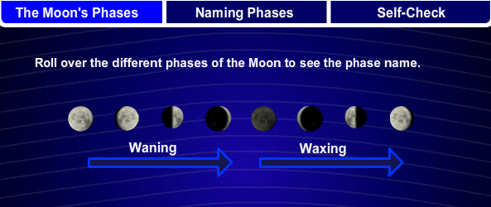
All of the moons “phases” have names.
According to:
1. The part of the moon a person can see
2. Whether the moon is waxing ("growing") or waning ("shrinking") compared to the observer.
**Please use the interactive on the Discover pg. 2, “Moon Phases” tab

Slide 88
Lunar Eclipse
The Earth’s shadow covers the moon.
Please do the interactive activity on Discover pg. 2, under the “Lunar eclipse” tab.

Slide 89
Review of the Earth’s spheres:
Biosphere: all living things on Earth
Cryosphere: all ice and glacial structures on Earth
Geosphere: the actual physical parts of Earth itself
Atmosphere: all the air that envelops Earth
Hydrosphere: all of the freshwater and saltwater resources of Earth

Slide 90
Layers of the Earth:
1.
2.
3.
4.

Slide 91
Layers of the Earth:
1. Crust
2. Mantle
3. Outer core
4. Inner core

Slide 92
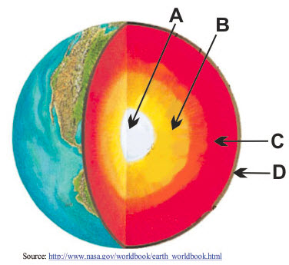
Which is which?

Slide 93
Which is which?
Inner core
Outer core
Mantle
Crust

Slide 94
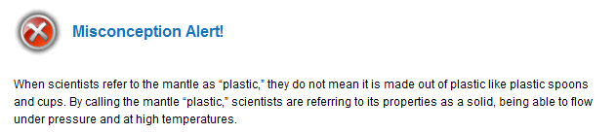
Layers of the Earth:
Layer | State of matter | Temperature | Thickness | Composition | Interesting Fact
Crust | Solid | varies | 5 – 75 km | varies | Oceanic crust is thinner
Mantle | Solid - plastic | 1,300 – 2,500 |  | peridotite | Can “flow” even though it’s a solid.
Outer Core | Liquid | 4,500 degrees Celsius | 2,200 km | iron | Creates a magnetic field
Inner Core | Solid | 5,000 degree Celsius | 1,250 km | iron

Slide 95
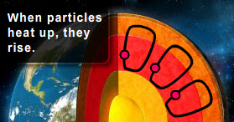
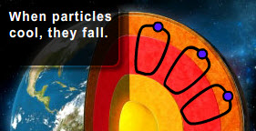
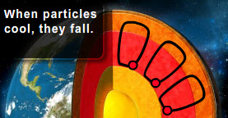
Convection currents in the mantle:
The inside of Earth is very hot. The heat creates a convection current within the mantle that flows from the core to the crust.
The current cools down as it approaches Earth's surface. It begins to move horizontally along the bottom of the crust.
As it continues to cool, it will descend toward the inner Earth, where the temperature increases. This increase in temperature causes the current to rise again.

Slide 96
Carbon cycle:
The movement of carbon (an element) between living and non-living things.
Elements, like carbon, are taken (or used) from one of Earth’s spheres and then used in living organisms. When the living organism dies, the elements (like carbon) are returned to one of the spheres. The elements are then available to be reused by other living organisms. This process happens over and over…

Slide 97
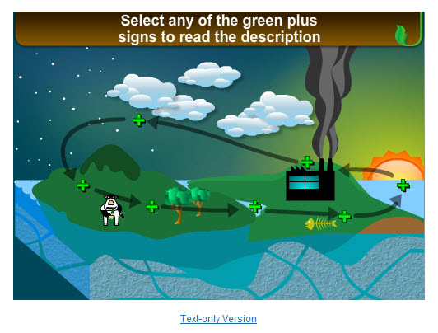
Carbon Cycle – the interactive below shows how the element moves through the different Earth spheres. Please go to Discover pg. 1 and complete this activity under the “Earth Cycles” tab.

Slide 98
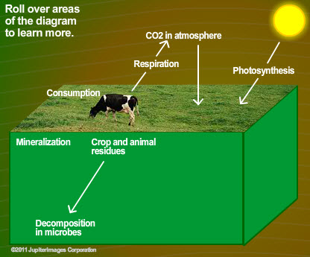
Short-Term Carbon Cycle:
The processing and re-distribution of the carbon in a relatively short period of time.

Slide 99
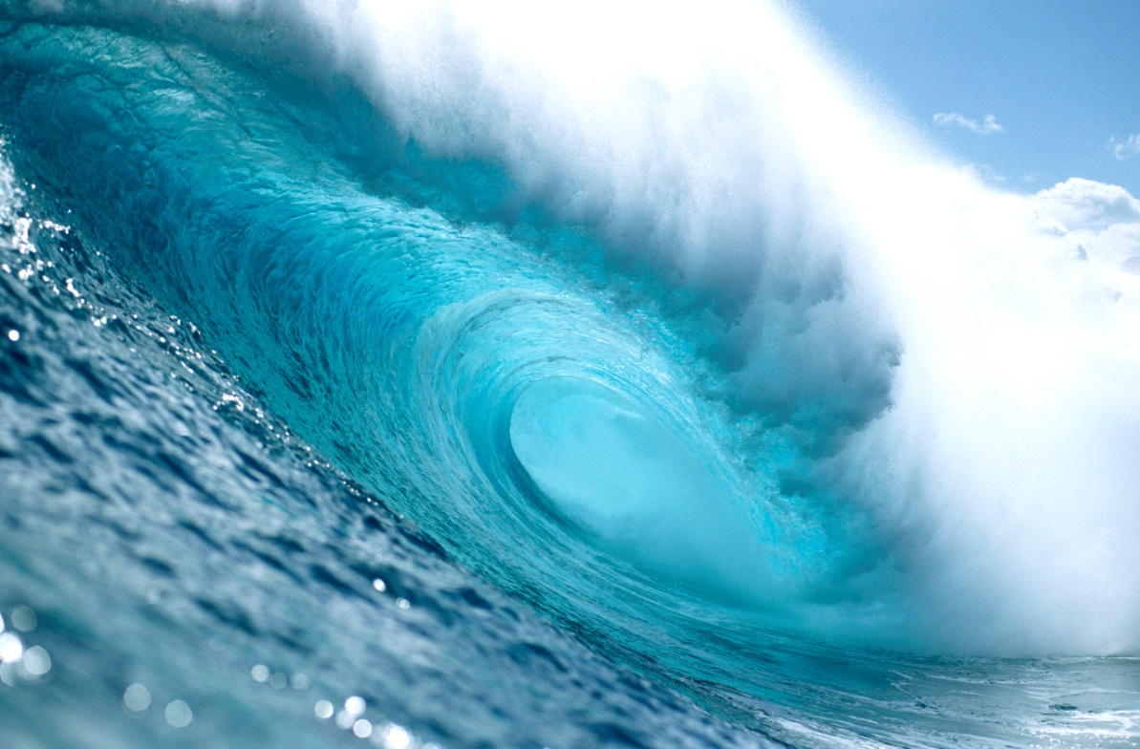

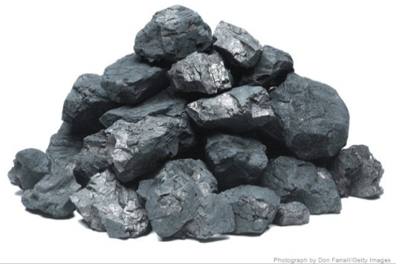

Long-Term Carbon Cycle:
The processing and re-distribution of the carbon over a long period of time.
This process occurs through many different methods: diffusion, photosynthesis, deforestation, respiration, excretion, extraction, and decomposition, etc.
**Please go through the tabs on Discover pg. 2**
Trees/plants
Ocean water, shells, and plants in the ocean
Rocks
Coal

Slide 100
Issues:
“Earth contains a lot of carbon. If all the carbon on Earth were released from its long-term storage in rocks, fossil fuels, and the deep ocean, the carbon cycle would be completely off balance.”
We must keep a balance between what is stored and what is released.
Unfortunately, carbon being released, in large amounts, into the atmosphere by people and we are not balancing that by the same amount of carbon being returned to long-term storage.
When we are releasing lots of carbon and the balance is off, this contributes to climate change.

Slide 101
QUESTION:
Alfred Wegener (a German scientist) asked a question;
Do the coastlines of continents separated today show evidence that they once matched?
If we went around the world and looked at all of the coastlines (on different continents) would we see things that would make us believe they used to fit together (the continents).

Slide 102

ANSWER:
Yes, they do.
Wegener (and other scientists) found matching animal fossils on coastlines of different continents and also matching geologic structures on different continents. From that discovery he developed the:
“Theory of Continental Drift”
Wegener proposed the idea that once upon a time all of the continents fit together like a puzzle, and were one massive continent called: Pangaea
http://www.historyforkids.org/scienceforkids/geology/platetectonics/

Slide 103

Continental Drift

Slide 104
In the beginning Wegener was wrong about “how” the plates moved from Pangaea to what we see today. He later he developed a new idea called:
The Theory of Plate Tectonics

Slide 105




Hotspots
Hotspots helped to support the theory of plate tectonics.
The plate moves (very slowly) over a “plume” which is releasing magma. As it cools it forms chains of islands.

Slide 106

What makes the plates move?
Convection Cells!

Slide 107

“The asthenosphere of Earth acts like a conveyor belt moving slabs of lithosphere.”
“Plates on Earth move as a result of convection deep within Earth. Convection in the mantle of Earth results from the rising of hot rock material and the sinking of cooler rock material. The constant rise and fall of material leads to the formation of convection cells.”
Complete the interactive on “Discover” pg. 2 “Mechanisms of Movement” tab.

Slide 108

Types of Plate Boundaries

Slide 109

Convergent Boundary
The plates come together… converge.
This creates:
MOUNTAINS
or
TRENCHES

Slide 110

Divergent Boundary
Plates move apart.
…diving away from each other.
This creates:
New crust is formed

Slide 111

Transform boundaries:
A fault.
When the plates move horizontally (one moves one way the other moves the opposite).

Slide 112

Tectonic Plates
Earth's surface has interlocking plates known as tectonic plates, or lithospheric plates.
“The movement of the plates breaks the crust in various locations known as faults.
A fault can, but does not necessarily, indicate the edge of a tectonic plate.”

Slide 113

About a fault:
The place where two segments of Earth’s crust come in contact with each other at a fault is called the fault plane. The fault plane is usually at an angle.
The footwall is the block of rock below the angle of the fault plane.
The hanging wall is the block of rock above the angle of the fault plane.
(*The location of the fault plane determines how each side of the fault is named.)

Slide 114
Movement of Faults
Normal Faults
Reverse Faults
Strike-Slip (Lateral) Faults

Slide 115


Movement of Faults
Normal Faults
Normal faults form as two segments of crust pull away from each other at divergent plate boundaries.
The hanging wall drops down relative to the footwall, or the footwall moves up relative to the hanging wall.
Normal faults form as a result of a type of stress known as tension stress.

Slide 116


Movement of Faults
Reverse Faults
Reverse faults are also known as thrust faults. These faults occur along convergent plate boundaries, where lithospheric plates come together.
In a reverse fault, the hanging wall is “thrust” up—that is, it moves up relative to the footwall.
Reverse faults form from a type of stress known as compression stress.

Slide 117


Movement of Faults
Strike-Slip (Lateral) Faults
Strike-slip faults, also known as lateral faults, occur where two blocks of crust move past each other in opposite directions.
Strike-slip faults are common along transform plate boundaries, where tectonic plates slide past each other.
Strike-slip faults form from a type of stress known as shear stress.

Slide 118

Ring of Fire – No, it’s not really a ring with fire around it; it’s the most seismically and volcanically active zone in the world. It surrounds the Pacific Ocean

Slide 119

Earthquakes
The upper part of the Earth’s crust is pretty breakable (they call this brittle). When it is under “stress” from movements below it can break; this is an earthquake.

Slide 120
Earthquakes
Earthquakes happen along boundaries (usually transform boundaries). When the rock breaks energy is released, this is called seismic energy or waves.
“A seismic wave is any ground movement that results from energy released during an earthquake. The point in the Earth’s crust where the rock ruptures is the focus. The point on Earth’s surface directly above the focus is the epicenter.“

Slide 121
Two main types of waves:
Body waves:
Surface waves

Slide 122
Waves
Body waves:
P-waves:
Primary waves or compression waves
Travel through the solid and liquid parts of Earth
Fastest earthquake waves
  Always the first waves to appear on a seismogram
Cause ground to move horizontally back and forth through compression.
P-waves bounce off the liquid core.

Slide 123
Body waves:
Waves
S-waves:
Secondary waves or shear waves
Can travel through Earth’s solid portions only
When they hit the liquid core, S-waves are no longer able to be detected.
  A shadow zone is created where earthquake waves are not detected
  S-waves are absorbed at the core.
Cause ground to move back and forth in an S-shaped pattern

Slide 124



Waves

Slide 125
Surface waves:
Waves
R-waves (Rayleigh waves)
Cause lots of damage to the surface of the Earth, especially to buildings
Have a rolling motion, like the waves of the ocean
L-waves (Love waves)
Cause lots of damage to the surface of the Earth, especially to buildings
Have a side-to-side motion similar to the movement of a snake

Slide 126


