Slide 1


Maternal and Child Health: Reducing Disparities for Sleep-Related Infant Deaths
Johns Hopkins Center for Injury Research and Policy Diné College

Slide 2
How this lecture fits into the course
This lesson builds from what would be covered in a Maternal and Child Health course by including injury broadly in the discussion of maternal and child health and doing a deep dive into Safe Sleep.

Slide 3
Part 1: Learning Objectives
In this lecture you will learn an introduction to injury prevention:
Describe injury using the medicine wheel public health model and distinguish intentional from unintentional injuries.
Identify key injury risk and protective factors in American Indian and Alaska Native communities.
Explain how Indigenous and Western approaches can support culturally grounded injury prevention and evaluation.
Notes:
Define injury and/or violence and describe the concepts of intentionality and mechanism as they relate to injury and/or violence.
Describe how injury and/or violence compare with other leading causes of morbidity and mortality and with regard to burdens on the population (e.g. incidence, cost, years of potential life lost, etc.)
Explain how injuries and/or violence are preventable.
Describe the disparity in the risks of injury and/or violence (e.g. differences by age, gender, race, ethnicity, education, location, access to economic resources, access to health care services, sexual orientation, creed, community norms, and the environment).
Describe the influence of a variety of factors (including age, gender, race, ethnicity, education, access to economic resources, sexual orientation, creed, community norms, access to health care services, and the environment) on injury and/or violence prevention.

Slide 4
Who taught you to care for children? Name them in the chat.
Notes:
Name Shout Out Activity: The slide has the following question written out: “Who taught you to care for children?” Ask them to type the names in the chat. This provides a burst of inspiration and activity.

Slide 5

Part 1: Injury 101
Play Recorded Lecture

Slide 6
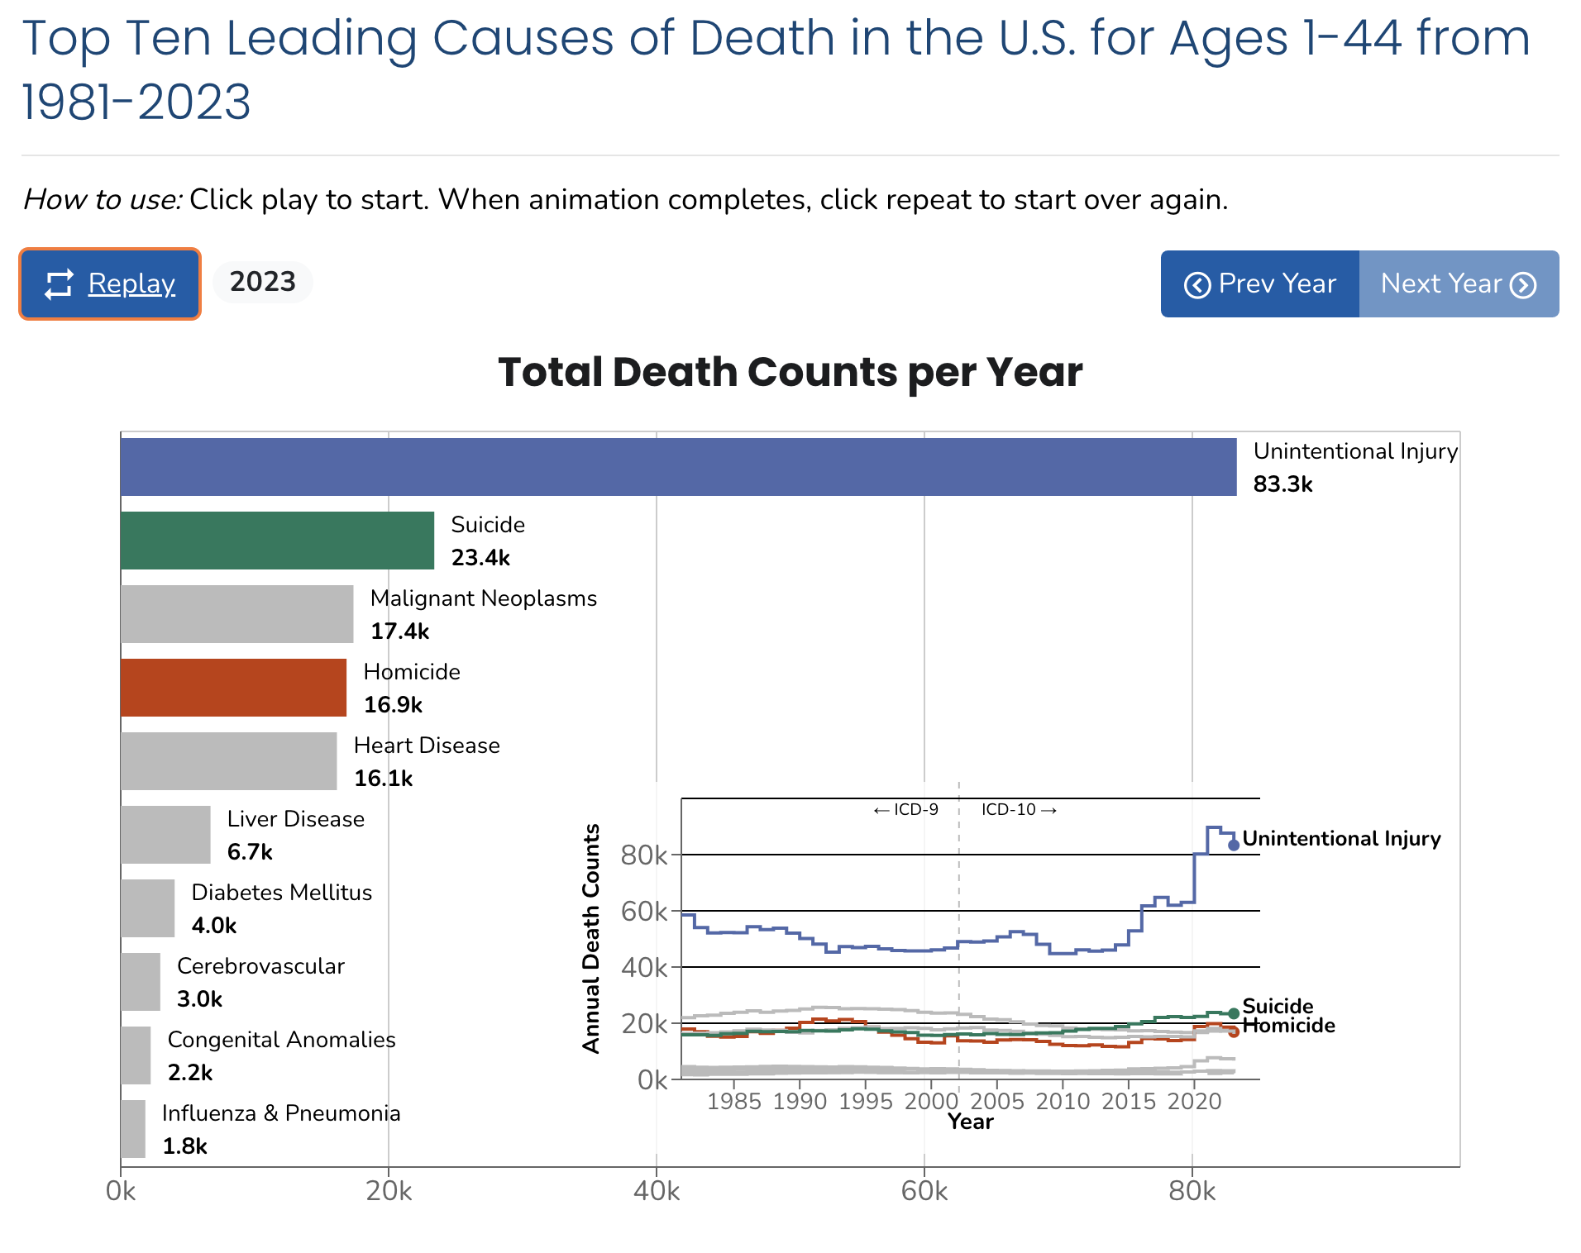
Link to animation:
https://wisqars.cdc.gov/animated-leading-causes/
Notes:
Optional activity if there is time. Description in Facilitator Guide.

Slide 7
Part 2: Reducing Disparities for Sleep Related Infant Deaths Learning Objectives
After this lecture, you will be able to:
Recognize the problem of infant sleep-related deaths nationally (and locally).
Identify recommendations to reduce infant sleep-related deaths and discuss structural barriers contributing to infant sleep-related disparities.
Describe the SAFE Start Project approach to reducing infant sleep-related deaths.

Slide 8
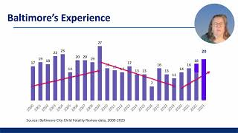
Part 2: Reducing Disparities for Sleep-Related Infant Deaths
Play Recorded Lecture
(youtube link)

Slide 9
DISCUSSION QUESTIONS
What caught your attention in today’s lesson?
What connections did you see in this lecture to your
maternal and child health
course?​
What do you see in your
community regarding safe
sleep practices?
Notes:
If the class will be going into different break out rooms, post the questions in the chat before initiating the breakout rooms. Inform the facilitators the time allowed and if there will be a person to give a summary of the small group discussion.

