Slide 1
Lesson 2: Morbidity and Mortality in HCV Co-infected People with HIV
Section 1: Epidemiologic Background of HIV/HCV Co-infection in the United States
July 2017

Slide 2
Authors and Funders
This presentation was prepared by Francine Cournos, MD, (Northeast/Caribbean AETC) and Cody Chastain, MD, (Southeast AETC) for the AETC National Coordinating Resource Center in July 2017.
This presentation is part of a curriculum developed by the AETC Program for the project: Jurisdictional Approach to Curing Hepatitis C among HIV/HCV Co-infected People of Color (HRSA 16-189), funded by the Secretary's Minority AIDS Initiative through the Health Resources and Services Administration HIV/AIDS Bureau.

Slide 3
Lesson Objectives
Understand the impact of HIV infection on the natural history and outcomes of HCV infection and the impact of HCV infection on the natural history and outcomes of HIV infection
Identify common causes of morbidity associated with HIV/HCV co-infection
Identify common causes of mortality associated with HIV/HCV co-infection, including available information on how that differs from having either infection alone
Review the unique vulnerabilities of people of color with HIV/HCV coinfection

Slide 4
HIV Increases Levels of HCV Viremia and Progression to Cirrhosis, Liver Failure, and Death¹⁻³
HIV is independently associated with advanced liver fibrosis and cirrhosis in persons with HCV
Several cases of rapid decline to end-stage liver disease in PLWH with recent HCV infection have been reported
Notes:
However, it’s very important to keep in mind that there is great variability among individual patients.

Slide 5
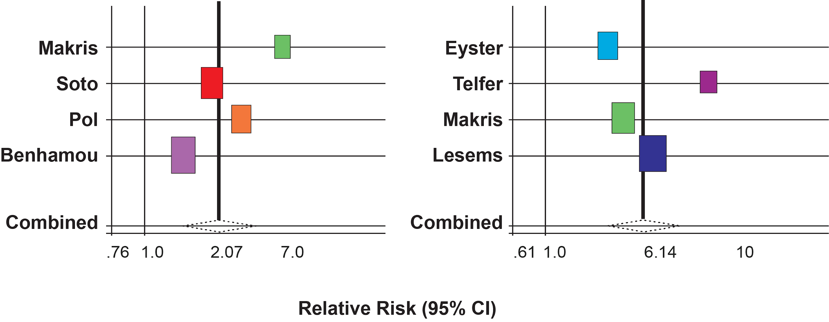
Meta-analysis of the Impact of HIV Infection on the Natural History of Untreated HCV Infection⁴
RR of Cirrhosis
RR of End Stage Liver Disease
Fierer, 2013
Notes:
This graph shows the impact of HIV infection on HCV infection prior to the availability of effective DAAs. On average, PLWH were twice as likely to develop cirrhosis from HCV infection when compared to people with HCV infection who were HIV negative; they were six times as likely to develop end stage liver disease.

Slide 6
Factors Associated with Fibrosis Progression in Co-infected Persons²
Nadir CD4 cell count
Higher HIV VL
Higher HCV VL
Alcohol consumption
Older age
Higher BMI
Notes:
Nadir refers to the lowest documented CD4 cell count.

Slide 7
Effects of HIV Infection on HCV Progression: Non-hepatic Effects⁵⁻¹²
Increased cardiovascular risk
Increased stroke risk
Increased renal disease risk
Increased risk of fractures
Cerebrospinal fluid HCV RNA correlates positively to neuroinflammation in PLWH

Slide 8
Mortality in Mono vs. Co-infection¹⁴
Study compared 265 people with HCV/HIV, 251 with HCV alone, 227 with HIV alone
Mortality over a 3-year period was:
17% in those HIV/HCV co-infected
9% in those with HIV alone
6% in those with HCV alone
In co-infected, mortality varied by race
Whites 31%
Blacks 15%
Notes:
This study predates current treatment recommendations and DAAs.

Slide 9
References
de Lédinghen V, Barreiro P, Foucher J, et al. Liver fibrosis on account of chronic hepatitis C is more severe in HIV-positive than HIV-negative patients despite antiretroviral therapy. J Viral Hepat. 2008 Jun;15(6):427-33. PubMed PMID: 18221303.
Kirk GD, Mehta SH, Astemborski J, et al. HIV, age, and the severity of hepatitis C virus-related liver disease: a cohort study. Ann Intern Med. 2013 May 7;158(9):658-66. PubMed PMID: 23440167.
Fierer DS, Dieterich DT, Fiel MI, et al. Rapid progression to decompensated cirrhosis, liver transplant, and death in HIV-infected men after primary hepatitis C virus infection. Clin Infect Dis. 2013 Apr;56(7):1038-43. PubMed PMID: 23264364.
Graham CS, Baden LR, Yu E, et al. Influence of human immunodeficiency virus infection on the course of hepatitis C virus infection: a meta-analysis. Clin Infect Dis. 2001 Aug 15;33(4):562-9. PubMed PMID: 11462196.
Slide modified from: Kim AY. Challenges in the Management and Treatment of HIV/HCV Coinfection. Slide 9: Nonhepatic effects of HCV in HIV. Presented at: An Advanced CME Live Course in HIV Pathogenesis, Antiretrovirals, and Other Selected Issues in HIV Disease Management, Washington, DC. 4/15/2016.
Borges AH, Hoy J, Florence E, et al. Antiretrovirals, Fractures, and Osteonecrosis in a Large European HIV Cohort. In: Program and abstracts of the 23rd Conference on Retroviruses and Opportunistic Infections; Feb 22-25, 2016; Boston. Abstract 46.
Kovari H, Weber R, Calmy AL, et al. Hepatitis C and the Risk of Non-Liver-Related Morbidity and Mortality in HIV+ Persons. In: Program and abstracts of the 23rd Conference on Retroviruses and Opportunistic Infections; Feb 22-25, 2016; Boston. Abstract 612.
Berenguer J, Alvaro-Meca A, Diaz A, Micheloud D, Resino S. Stroke in HIV-Infected Patients in the Combination Antiretroviral Therapy Era. 7.In: Program and abstracts of the 23rd Conference on Retroviruses and Opportunistic Infections; Feb 22-25, 2016; Boston. Abstract 639.
Clement ME, Park L, Navar AM, et al. Cardiovascular Disease Risk Model Comparison and Development in HIV-Infected Veterans. In: Program and abstracts of the 23rd Conference on Retroviruses and Opportunistic Infections; Feb 22-25, 2016; Boston. Abstract 642.
Shire N, Sherman K. Epidemiology of Hepatitis C Virus. A Battle on New Frontiers. Gastroenterology Clinics of North America [serial online]. December 1, 2015;44(Hepatitis C Virus: The Next Epidemic):699-716. Available from: ScienceDirect, Ipswich, MA. Accessed June 20, 2017.
Platt L, Easterbrook P, Vickerman P, et al. Articles: Prevalence and burden of HCV co-infection in people living with HIV: a global systematic review and meta-analysis. The Lancet Infectious Diseases [serial online]. July 1, 2016;16:797-808. Available from: ScienceDirect, Ipswich, MA. Accessed June 20, 2017.
Merriman, R.B. Nonalcoholic fatty liver disease and HIV infection. Curr HIV/AIDS Rep (2006) 3: 113.
Notes:
This study predates current treatment recommendations and DAAs.

Slide 10
Disclaimer and Permissions
Users are cautioned that because of the rapidly changing medical field, information could become out of date quickly.
You may use or present this slide set and other material in its entirely or incorporate into another presentation if you credit the author and/or source of the materials.
The complete HIV/HCV Co-infection: An AETC National Curriculum is available at: https://aidsetc.org/hivhcv

