Slide 1

The Pathways Enhancements
ANDREA HOFFMANN, DTM
andrea.hoffmann@toastmasters-95.org
Pathways Lead District 95 2025/2026
11/2025
Notes:
This workshop is designed to support all club officers—especially Vice Presidents Education—in understanding and communicating the Pathways Enhancements.

Slide 2


Pathways Enhancements
Since October 2025
Meeting Roles
Presentations
Notes:
The first key element of the Pathways Enhancements is that members are required to take on precisely defined meeting roles for all levels. This ensures meeting roles are filled more quickly and with greater enthusiasm, which greatly simplifies the organization tasks for both the Toastmaster and the VPE. Members also benefit from actively participating in these roles, and meetings become more dynamic and engaging when many members are involved. The second main element includes presentations from the educational series such as the Successful Club Series, the Better Speaker Series, and the Leadership Excellence Series. These presentations require minimal preparation in advance because the scripts and slides are already available. They provide valuable information about club life, giving speeches, and leadership aspects. As they take 10–15 minutes, these presentations are ideal for meetings where there aren’t enough scheduled speeches.

Slide 3
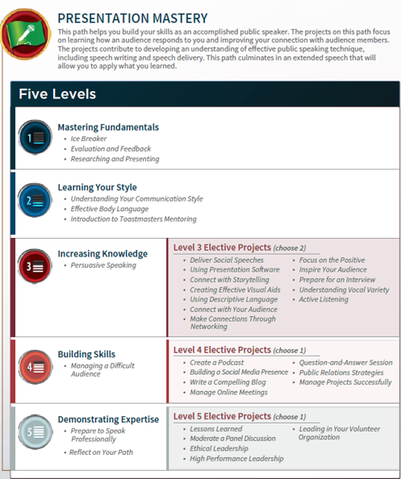






Pathways enhancements
Learning path structure
4 required projects
+ 3 required meeting roles
3 required projects
+ 4 required meeting roles
1 required project + 2 elective projects
+ 3 required meeting roles
+ 1 Successful Club Series presentation
1 required project + 1 elective project
+ 4 required meeting roles
+ 1 Successful Club Series pres. + 1 Better Speaker Series pres.
1 required project + 1 elective project
+ 7 required meeting roles
Reflect on Your Path
+ 1 Successful Club Series pres. + 1 Leadership Excellence Series pres.
Notes:
In the existing Pathways structure, members complete a total of 15 projects across five levels, with some being specific to the individual learning path, while others are elective and can be chosen freely at higher levels. With the Pathways Enhancements, there are additionally requirements to fulfill: a defined number of meeting roles for each level, and at the higher levels a presentation from the Successful Club Series. Levels 4 and 5 further include a presentation from the Better Speaker Series or the Leadership Excellence Series.

Slide 4
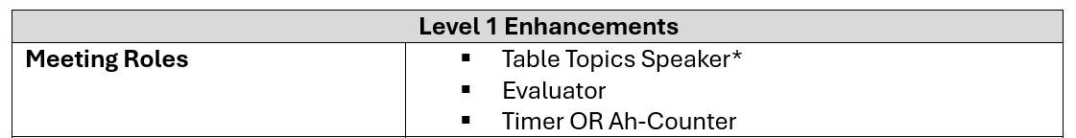
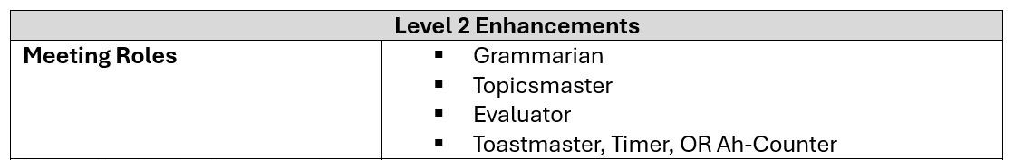
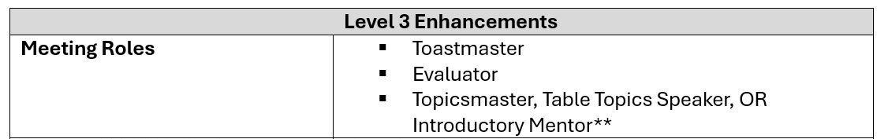
Meeting Roles
Notes:
First Enhancement: meeting roles. A notable point is that members will first take on the role of Table Topics speaker before they can deliver their first prepared speech — the Ice Breaker. Overall, the proposed rule seems reasonable, since a Table Topic speech is significantly shorter than a prepared speech and there are more speaking slots available for it. But a new member should not be prevented from giving the Ice Breaker speech just because they have not yet delivered an impromptu speech. The evaluator role has always been part of the Level 1 project “Evaluation and Feedback”, so that’s nothing new. And taking on the role of Timer or Ah-Counter once during the entire Level 1 should also be manageable. In Levels 2 and 3, four and three meeting roles must be undertaken, respectively, with one role always being selectable from multiple alternatives. The role of Introductory Mentor is new and listed as one of the alternative roles. As an Introductory Mentor, the member supports new members during a meeting in familiarizing themselves with the process and provides them with general information based on their own experiences.

Slide 5
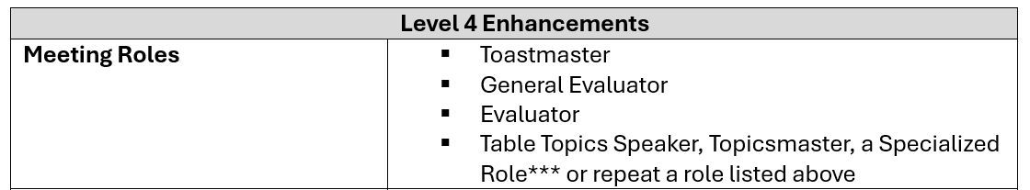
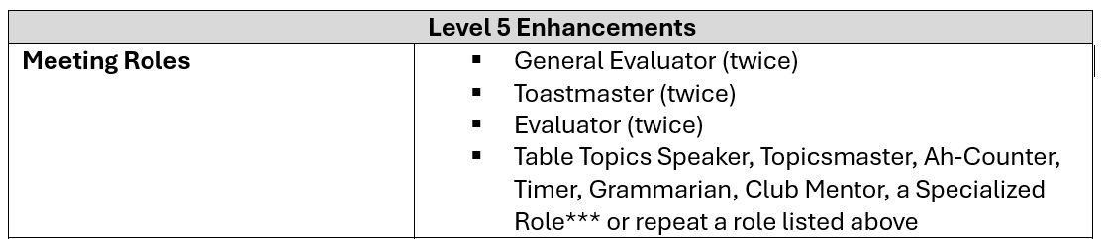
Meeting Roles
Notes:
In Level 4, members are required to take on four meeting roles, with multiple options available for the fourth role. A particularly important addition is a newly introduced Specialized Role. This role relates to an optional activity already existing in the own club that isn’t covered by the other listed roles—for example, “Tip of the Day,” “Joke of the Day,” “Quizmaster,” “Online or Hybrid Meeting Coordinator,” or any other unique roles the club might have. It could even be a special role created for a themed meeting. Between the completion of Level 4 and the completion of Level 5, a total of seven meeting roles must be fulfilled. Since the projects at higher levels are often more comprehensive, this requirement should not delay progress. However, if a member has already completed all projects of a higher level before finishing the lower one, it is reasonable to credit roles they fulfilled earlier at the lower level toward the higher level’s requirements. Members should be encouraged to take on meeting roles as much as possible, but this shouldn’t become an obstacle to completing a level.

Slide 6
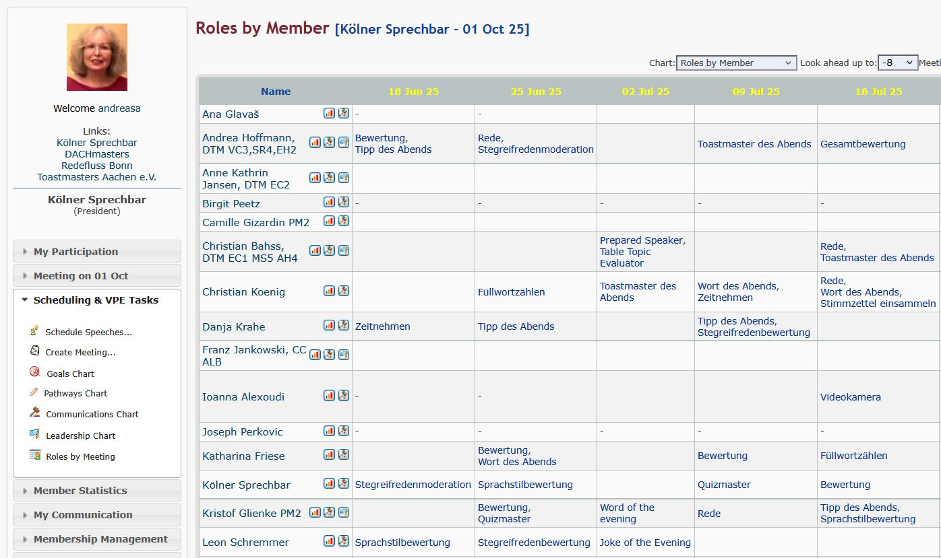
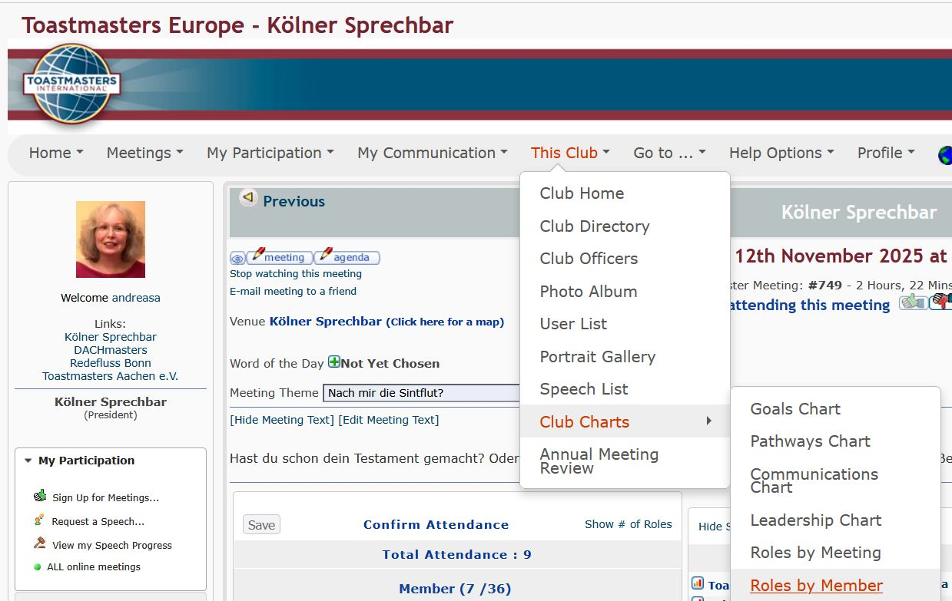
Track Meeting Roles in easySpeak
Notes:
What’s the best way to track meeting roles to determine if a member has fulfilled all the requirements for a particular level? There are two options: 1. The tracking by using EasySpeak, similar to recording speeches. The VPE can generate a summary called “Roles by Meeting.” In this overview, it is possible to select “Roles by Member” at the top center and view any number of past meetings. This way, all the roles a member has taken on within a defined time frame can be seen at a glance. It’s important to add the new Introductory Mentor role, and any specialized roles if applicable, to the meeting agenda so it can be tracked.

Slide 7
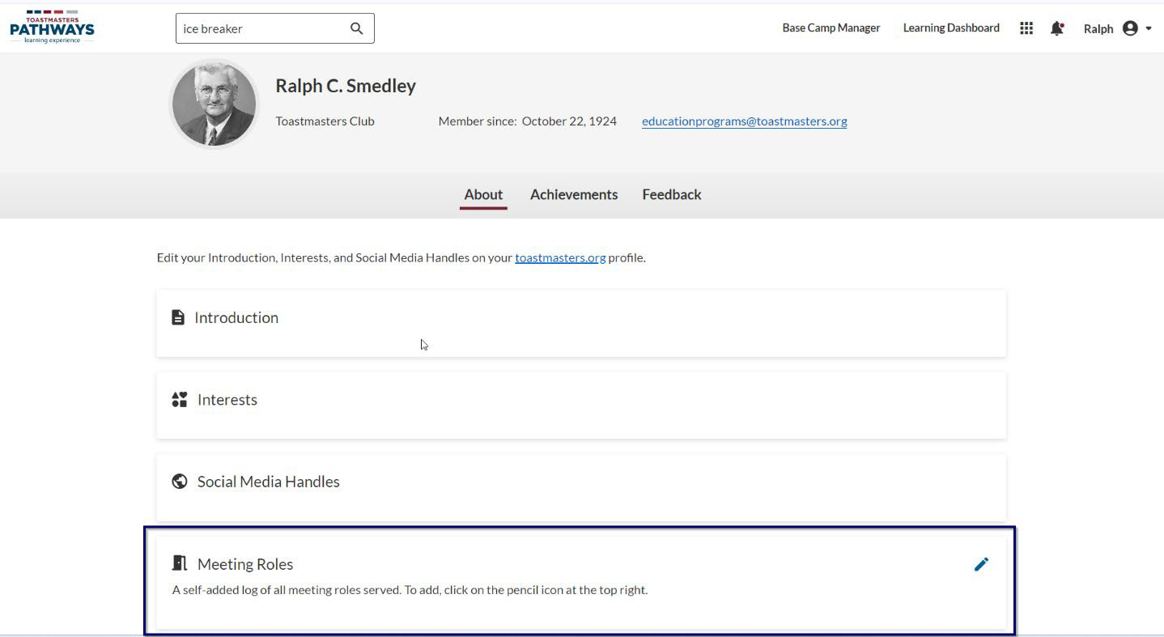
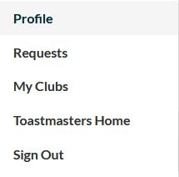
Track Meeting Roles in Base Camp
Notes:
The second option is to track meeting roles directly on Base Camp. Members can be encouraged to access their profiles in the top right corner and, at the bottom under the “Meeting Roles” section, update only the roles relevant to their current level.

Slide 8
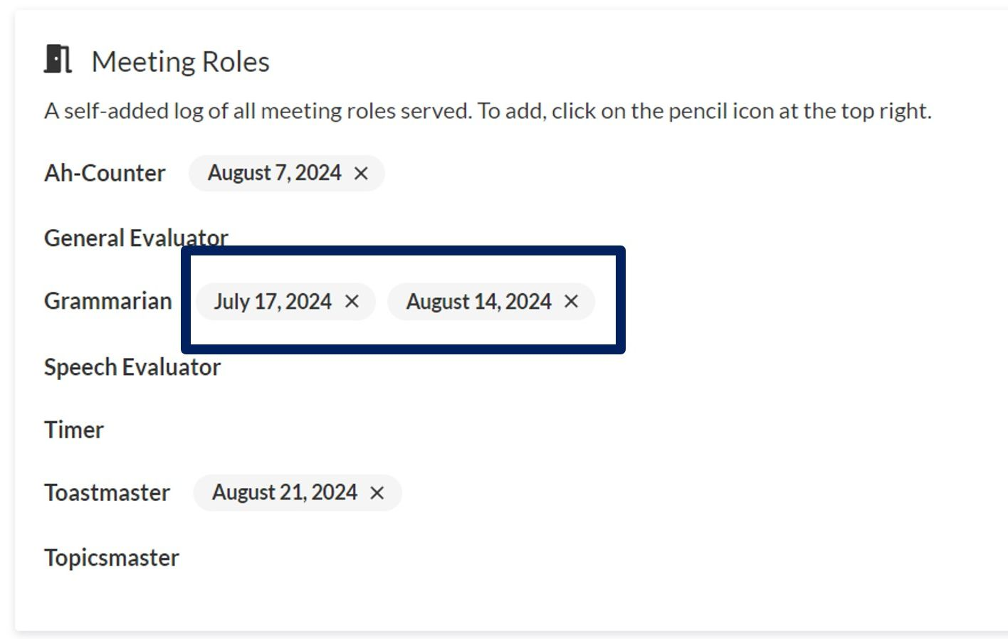
Track Meeting Roles in Base Camp
Notes:
Be aware that the Specialized Role and the role of Introductory Mentor are not. As Base Camp Managers, all club officers have access to members’ profiles and can review the roles entered there. Whichever method will be chosen is entirely up to each club. In any case, the club should know which method has been chosen. Tracking roles in either system doesn’t involve much additional effort.

Slide 9
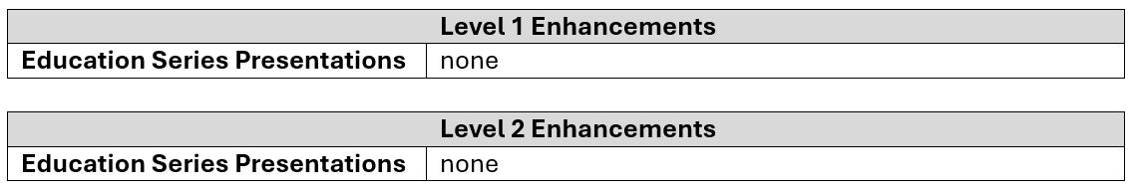
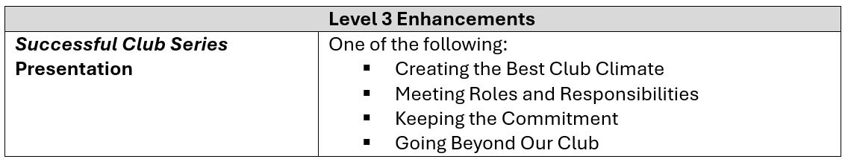
Presentations
Notes:
Second Enhancement: the additional presentations members are required to deliver at different levels. Levels 1 and 2 are not affected by this requirement. Starting from Level 3, and continuing through Levels 4 and 5, members must give one presentation chosen from the 11 available in the Successful Club Series. The available options are defined in more detail — in Level 3, members can choose from four specific presentations in this series. As their titles suggest, these presentations focus on key topics relevant to club life.

Slide 10
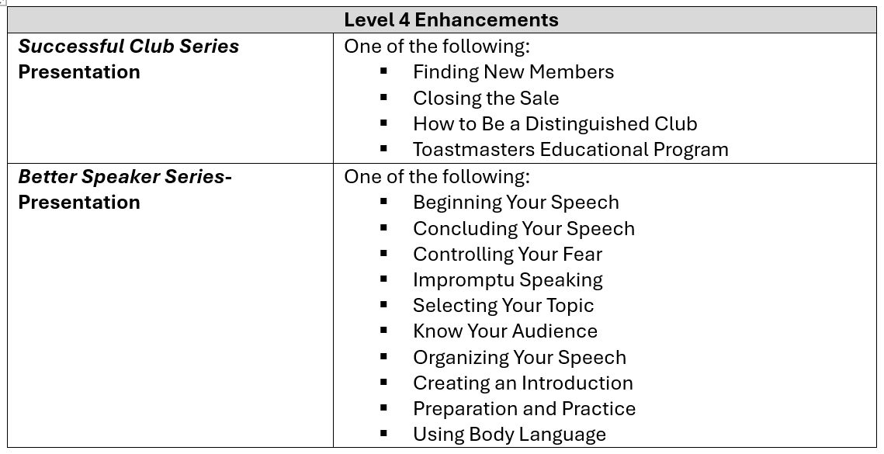
Presentations
Notes:
The same applies to Level 4: members are required to deliver one presentation from four options in the Successful Club Series. In addition, they must give one presentation from the Better Speaker Series, with the freedom to select any of the 10 available topics. These presentations are focused on enhancing personal speaking abilities.

Slide 11
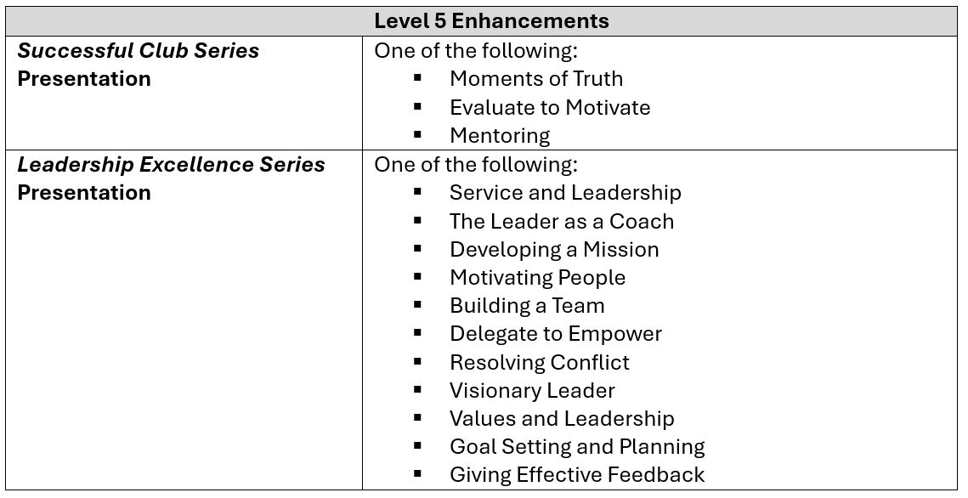
Presentations
Notes:
In Level 5, members must deliver one presentation from three options in the Successful Club Series. Additionally, they are required to give one presentation from the Leadership Excellence Series, with a choice among 11 topics—all focused on enhancing leadership skills.

Slide 12


Presentations of Education Series
Notes:
What’s special about these presentations is that the scripts and slides are already prepared. Members don’t have to spend a lot of time preparing them. They are helping to convey important content to the other participants and enrich the meeting experience.

Slide 13
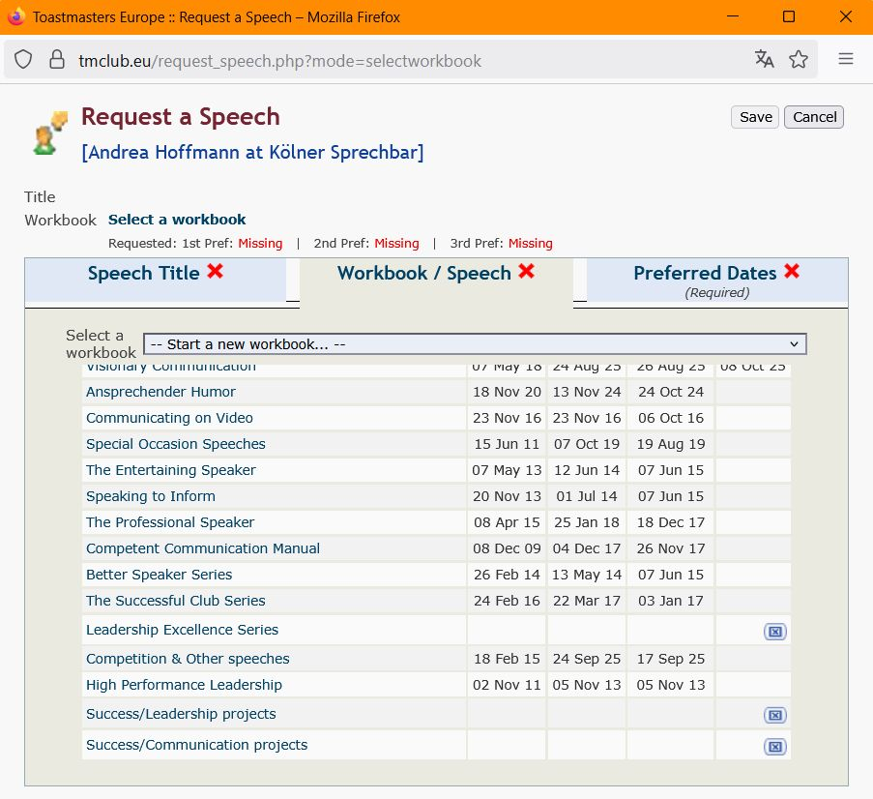
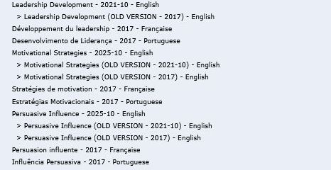
Request Presentation of the Series
Choose version 2025-10
Notes:
It is no problem to register the presentations in EasySpeak like the prepared speeches. Under “Workbook/Speech”, make sure to first select the **latest version. That is version 2025-10.

Slide 14
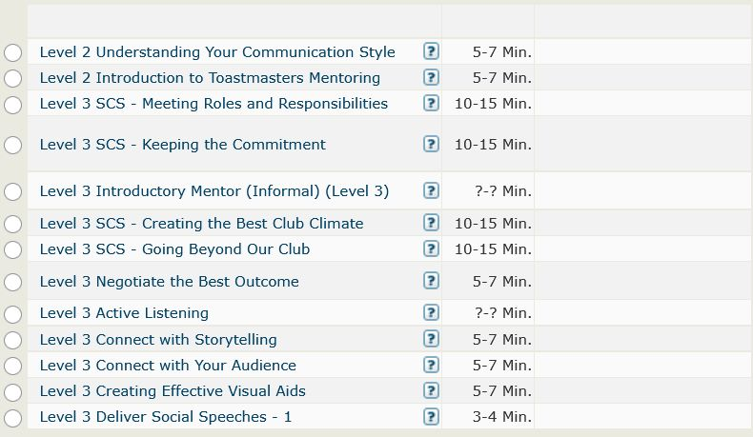
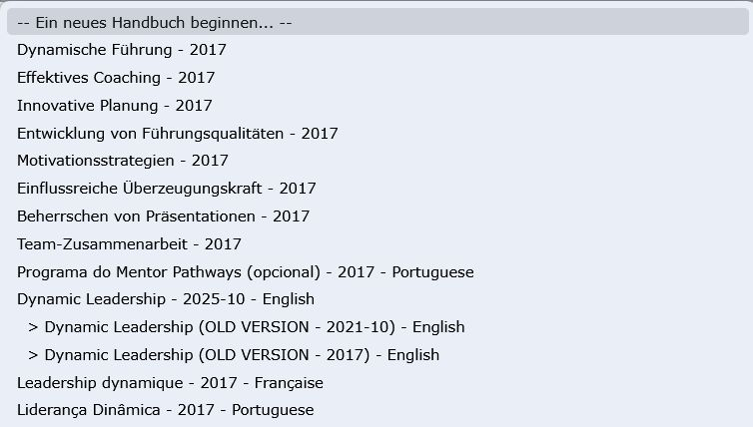
Request Presentation and Roles
Notes:
This version 2025-10 includes the corresponding presentations from the Educational Series in each level. This makes it very easy for members to request and track the presentations in EasySpeak in the same way as project speeches. In addition, roles can also be requested and documented here that aren’t part of the usual meeting agenda — for example, the ‘Introductory Mentor’ role.

Slide 15
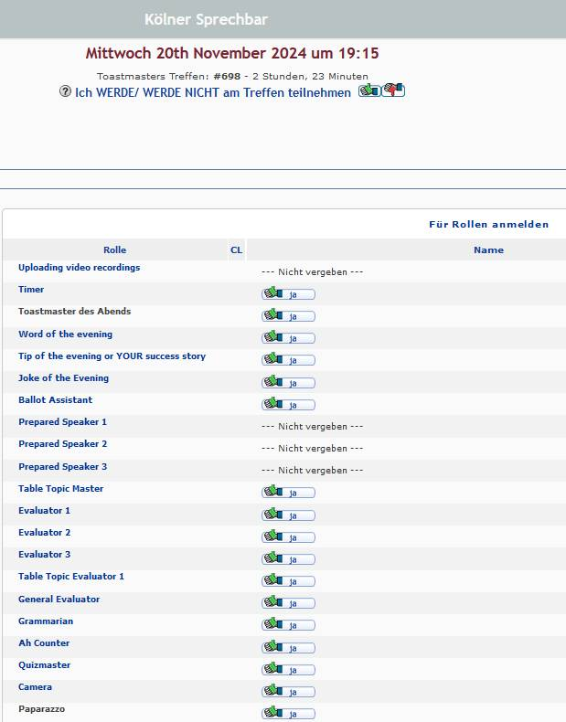
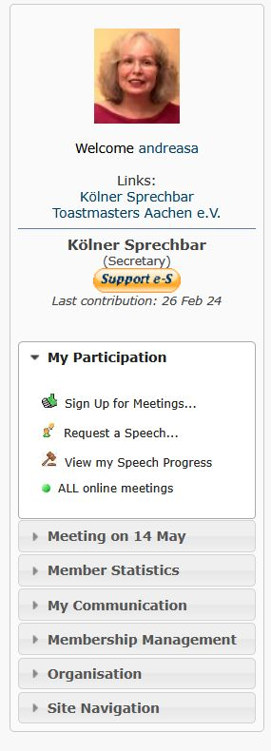
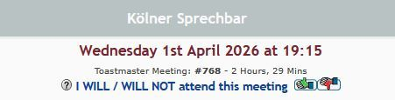
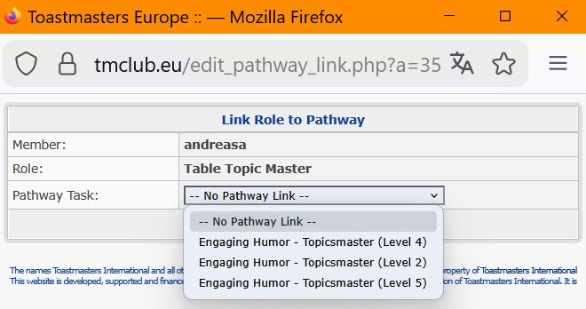
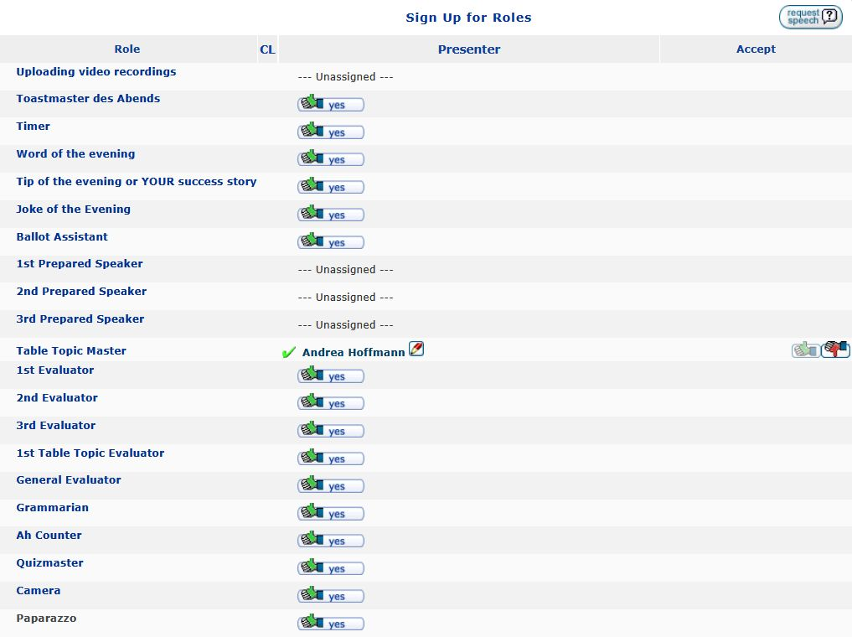
easySPEAK – documentation
Notes:
The meeting roles selected in the meeting agenda can also be easily assigned here to the level the member is currently working on, in order to meet the requirements of the Pathways enhancements. After the member sign up for a role, a pencil icon appears next to the member’s name. When the member click on it, a window opens in which the member can select the appropriate level of their path for the role they are signed up for. If the member has already completed a role in the past and has not yet assigned it to a level of their path, they can still do this afterwards. They simply have to go back to the meeting in which they carried out the role. There, next to their name and the role, they will again find the pencil icon, which they can use to open the level selection menu. Or you as a VPE can do so.

Slide 16
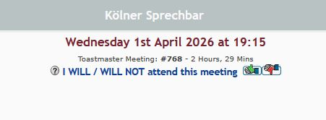
easySPEAK - documentation
Notes:
Anyone who wants to check which requirements have already been met for a particular level or for the entire path can click on ‘View my speech progress.’

Slide 17
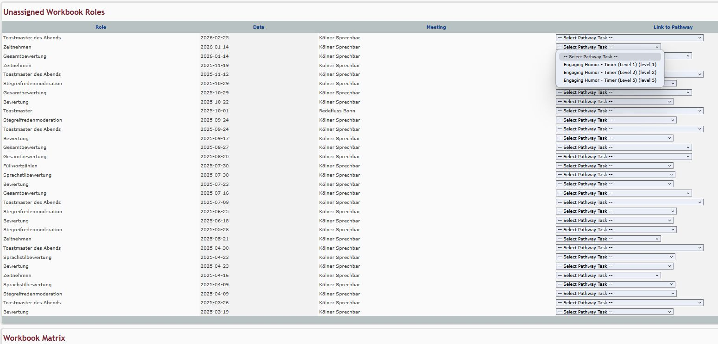
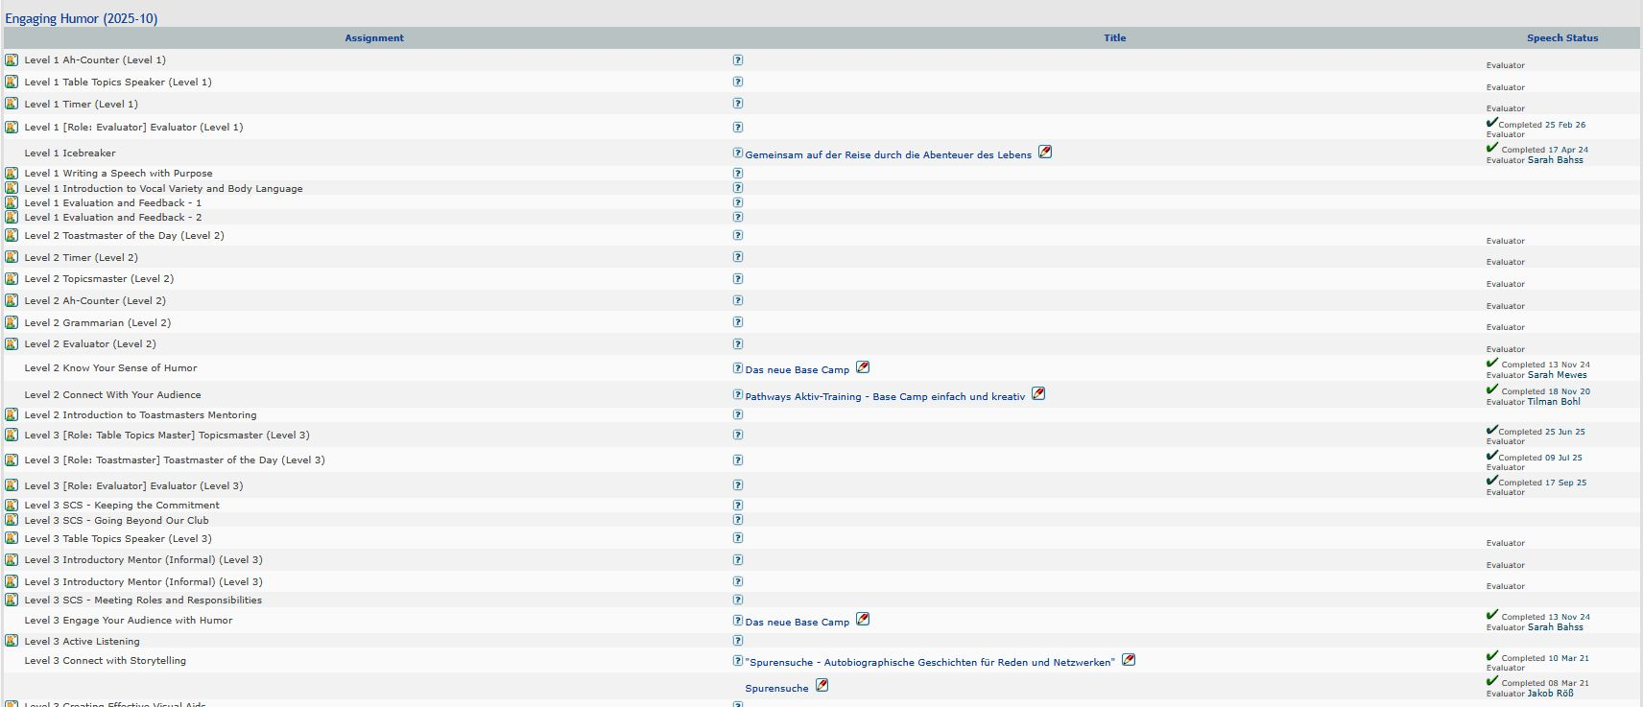
easySPEAK - documentation
Notes:
The workbook matrix for the path then appears, showing all the speeches, presentations, and meeting roles that have already been completed, as well as everything that is still missing to finish the path. This complete overview only appears if the English path in version 2025‑10 has been selected!

Slide 18
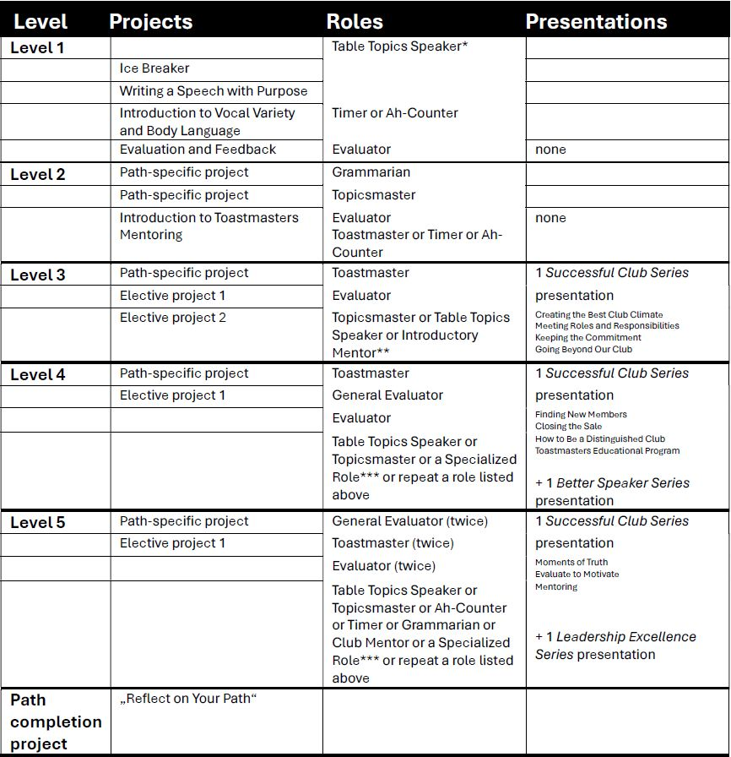
Overview Tasks in Levels
Notes:
In this overview, all projects, meeting roles and presentations of the Education Series are listed. Members can find this overview on the Pathways landing page of District 95. For new members, the Starter Manual was already updated by including this overview of all requirements for each level, ensuring that they have access to the relevant information from the very beginning. The updated Starter Manual is also presented on the Pathways landing page. (Additionally, an updated template for the onboarding slides has been created, allowing clubs to easily replace the slide with the Success Plan for meeting role fulfillment.)

Slide 19


Pathways Landing page D95
Weitere Informationen und Termine findest du unter:
https://toastmasters-95.org/toastmasters-pathways-learning/
oder scanne den QR-Code
Notes:
All updated and additional materials can be found on the District's Pathways page.

Slide 20
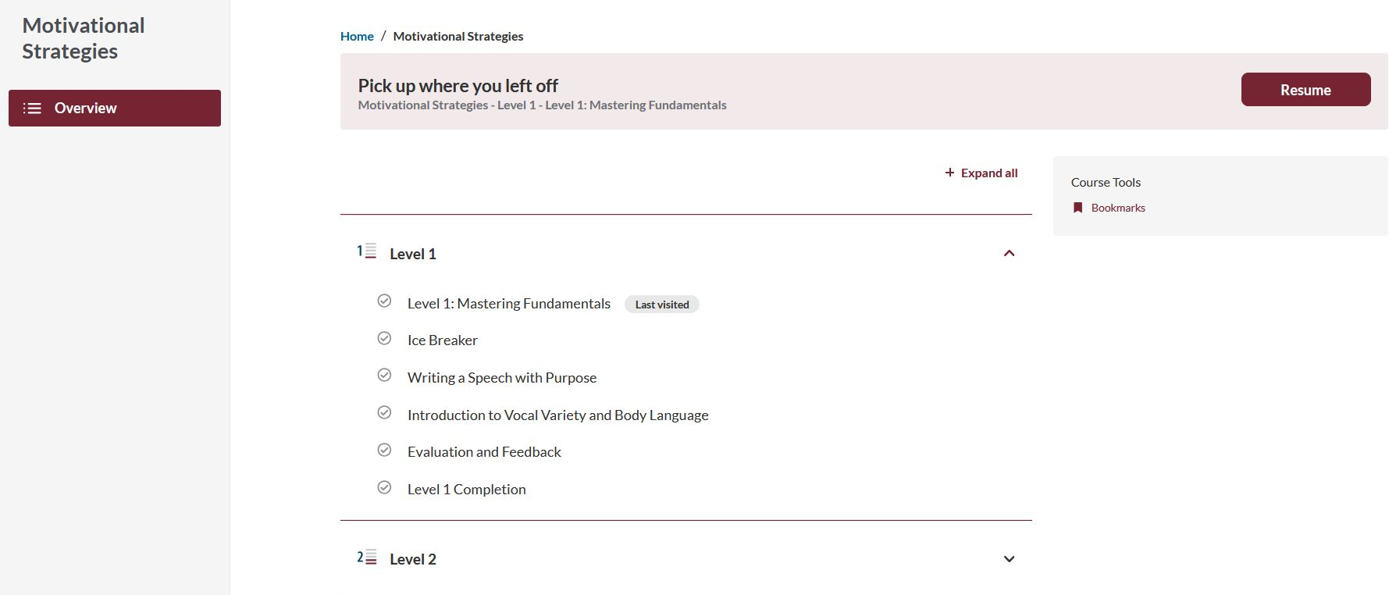
Overview page
Notes:
In Base Camp the Pathways Enhancements are visible on the overview page, displaying all the levels within that learning path. By expanding the level, an overview of all requirements for this level is displayed first. Important to note: This applies exclusively to the 6 English learning paths! Below that, all the projects associated with the level are visible as usual. When clicking on the first item, a page will open with all the requirements for this level.

Slide 21
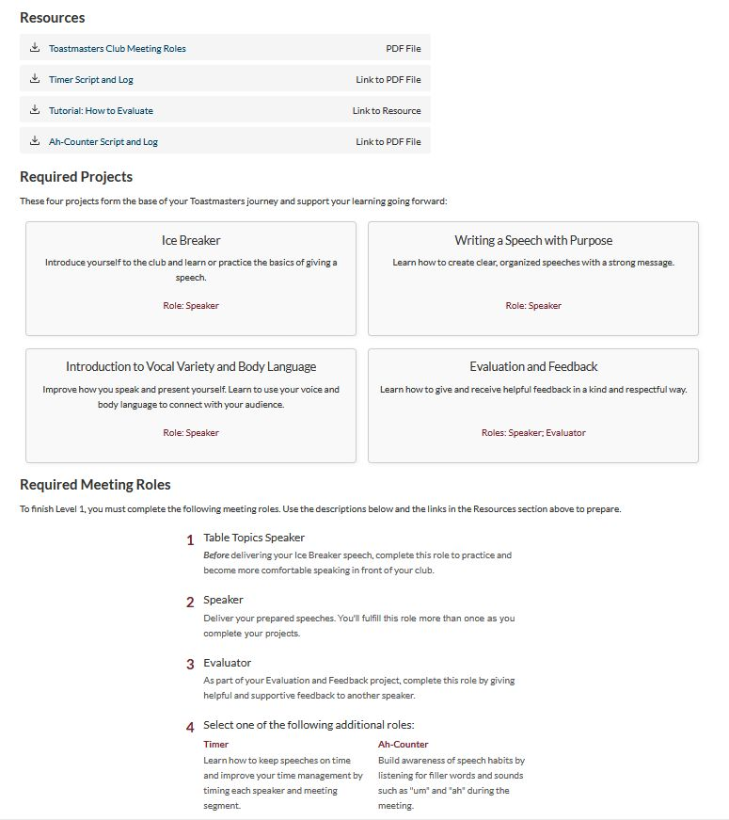
All requirements of the level
Notes:
This page begins with an explanation of the content and objectives of this level. Below, members will find resources available for download for this level. Following this, the Pathways projects are listed, along with the meeting roles and presentations of the Educational Series (onward level 3) that should be undertaken for this level. By clicking on "Learn more" for the presentation the members would like to deliver, they will be redirected to the Resources section of the TMI homepage, specifically to the area where they can download the presentation. Both the slides and the accompanying speaker notes will be available there. Additionally, the first page explains why the meeting roles complement the content of the projects in a meaningful way.

Slide 22
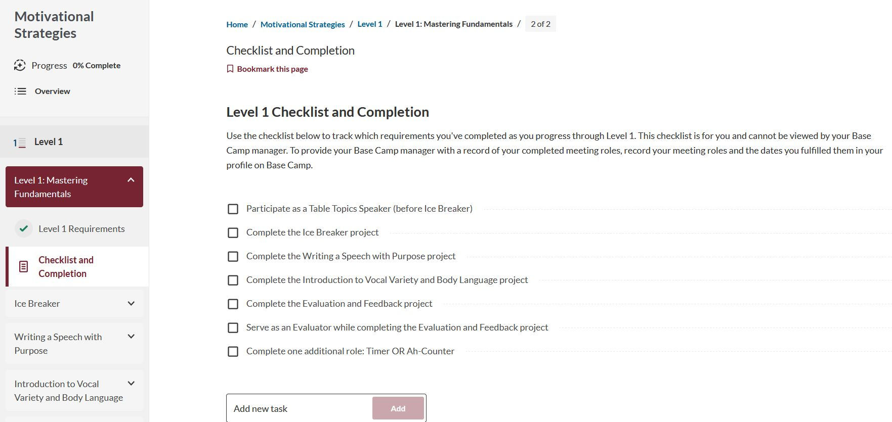
Checklist and Completion
Notes:
On the next page, members find a checklist of all the requirements for this level. Members need to check them off here! Only by doing so they can request a level completion later. Confirming the completion of all requirements for this level does not mean that members no longer need to mark the projects as completed or not submit a level completion request. It serves as a checklist to ensure that everything necessary for the completion of this level has been taken care of, especially the meeting roles and the presentations of the Educational Series. Below the checklist, members will find questions that they can answer to complete the level — but they don't have to. Afterward, they need to confirm the completion of all requirements here, so that’s visible in Base Camp they have fulfilled everything, not just the projects. After marking the requirements as completed an additional green checkmark will appear in the overview, and members will then be able to request the level completion.

