Slide 1


What Works Global Summit 2016
Putting Evidence To Work
What It Takes To Be An Effective School Principal
and
How to Build One: A Synthesis of Recent Evidence
Randy Keyworth

Slide 2
Research to Practice
in the Real-world
in Real-time
at Scale
using Evidence-based Practice
and Practice-based Evidence

Slide 3
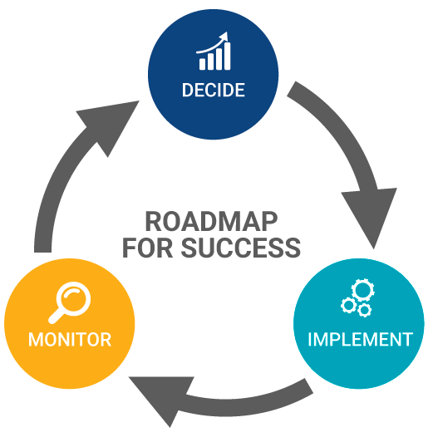
Evidence-Driven Practice in Real World Settings
EVIDENCE-BASED PRACTICE
What are our goals?
What is the best practice for reaching these goals?
How do we best implement this practice?
PRACTICE-BASED EVIDENCE
Are we doing the right things?
Are we doing them correctly?
Are we getting the right outcomes?
How can we improve?

Slide 4

Taking Principal Development to Scale: A Case Study
An Analysis of Principal Preparation, Evaluation and Support in the U.S.
www.winginstitute.org

Slide 5
What it takes to be an effective school principal and how to build one: a synthesis of recent evidence

Slide 6
What it takes to be an effective school principal and how to build one: a synthesis of recent evidence
A substantial amount of new research and evidence over the past twenty years resulting in:
solid bodies of evidence
• the impact effective principals have on student outcomes
• the skills and roles that make an effective principal
• the pedagogy, content, and systems for developing and supporting effective principals
• the strategies for implementing principal development systems that are effective and sustainable

Slide 7
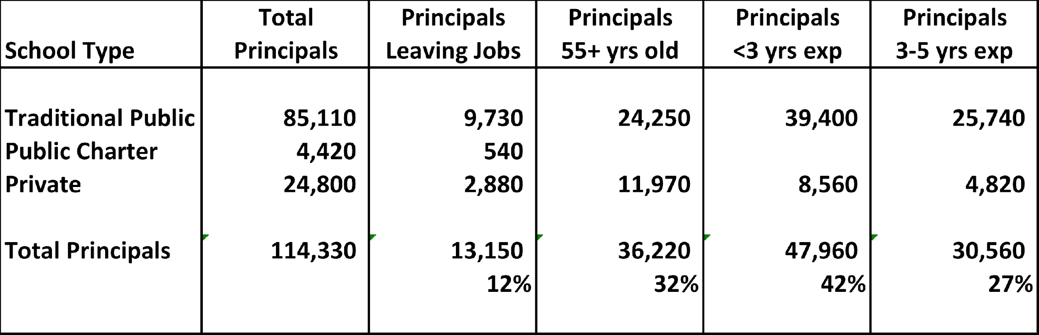
What it takes to be an effective school principal and how to build one: a synthesis of recent evidence
X
many
Solutions need to be taken “at scale”
SY 2012-13
Principal Attrition and Mobility, National Center for Education Statistics (2014)

Slide 8
What it takes to be an effective school principal and how to build many: a synthesis of recent evidence
Build a principal development “system” that is:
intentional vs. laissez-faire
based on science vs. ideology
supports a culture of ongoing performance feedback

Slide 9
Core Components of a Principal Development System
Evidence-based principal competency framework
Strategic and proactive recruitment / selection
Relevant and effective principal coursework
Experiential clinical school-based opportunities
Relevant and effective placement and on-the-job support
6. Robust data collection and continuous performance management
Rainwater Leadership Alliance Cheney, et.al. (2010)

Slide 10
Principal Development Universe: THE PLAYERS
University-based preparation programs
Virtually all school principals have advanced degrees
84% Masters Degrees 16% Doctorates OECE (2013)
27,289 M.A degrees 4,676 Ph.D. degrees NCES (2013)
Individual State Governments
Little standardization or accountability. Wide variability.
Federal Government
Various initiatives. Blocked by politics. More role in the future.
Individual Districts
Pilots and partnerships…very small scale.

Slide 11
1. Principal competency framework
  defines a set of skills, knowledge, and dispositions that a principal must have in order to drive high levels of student achievement for all children…
  is based on best available evidence and tied to standards for student outcomes…
  is integrated into and drives policies, practices, and standards related to every aspect principal development and support: professional development, recruitment, hiring, evaluation, licensure, resources, job descriptions…
  is a critical benchmark for performance management at the system level
  AIR, Wallace, Rainwater OECD (2008)

Slide 12
Principal competency framework: University Programs
‘’The typical course of study…
…has nothing to do with the job of being a principal
  …a nearly random collection of courses…
  …little more than a grab bag of survey courses”
Levine 2005
“Programs offer a …
…disparate array of courses and program elements
…without a governing set of competencies”
Cheney & Davis 2011
There are no standards nor accountability requirements for what happens in University programs

Slide 13
1. Principal competency framework: State Agencies
Principal Competency Standards
Principal Preparation Program Approval
  Set requirements School-based learning experiences
  Specific coursework Faculty qualifications
  Track performance outcomes
  Principal Licensure
  Initial licensure Renewal licensure
  Principal outcome data
  Briggs, et. al. (2013)

Slide 14
Principal competency framework: State Agencies
  State Performance Oversight of Principal Development
  • Only 27 states report including in their standards all 5 key elements that research shows are critical to effectiveness:
  recruiting and selecting teachers,
  developing and supporting teachers,
  assessing and rewarding teachers,
  implementing data-driven instruction, and
  (5) developing a positive school culture. Briggs, et. al. (2013)
  • Principal training programs, professional development programs, and principal evaluation systems vary significantly in their alignment with state leadership standards.
  Sun (2011)

Slide 15
Principal competency framework: State Agencies
STATE OUTCOME DATA
  19 states were unable to report how many people graduate from state-approved principal preparation programs in their state on an annual basis
  7 states could not report how many principal licenses are granted on an annual basis
Briggs et al., (2013)

Slide 16
Recruitment / Selection
Recruitment / Selection “Gateways”:
admission to UNIVERSITY GRADUATE PROGRAMS
selection via DISTRICT PIPELINE
acquisition & renewal of ADMINISTRATIVE LICENSES

Slide 17
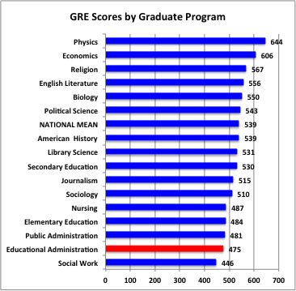
2. Recruitment / Selection: UNIVERSITY
ADMISSION AND GRADUATION STANDARDS
For all intents and purposes, the majority of educational administration programs admit nearly everyone who applies.
Levine 2005
Most programs are open enrollment programs and do not target or cultivate relationships with high-potential candidates. Instead, these programs passively accept who comes to them through their applicant pool.
Cheney & Davis 2011
Education Testing Service 2004

Slide 18
2-3. Recruitment / Selection: DISTRICT PIPELINE
Most recruiting and selection of principals is done internally…tends to be a very laissez-faire process…often valuing the following traditional qualifications…
Years of experience as a teacher
Years of experience as an Assistant Principal
Having a M.A. degree
Selectivity of principal’s college
Traditional principal training programs
Job-embedded principal training programs
Research on relationship between qualifications and effect on student performance.
(NYC, 1987 – 2007, employs well over 1,000 school principals)
(student test scores, absences and suspensions) Clark, Martorell, Rockoff (2009)
no effect
no effect *
no effect
no effect
no effect
small effect

Slide 19
2-3. Recruitment / Selection: ADMINISTRATIVE LICENSES
  7 states could not report how many principal licenses are granted annually
  Only 6 states require principals to demonstrate effectiveness to renew their licenses.
  In the 7 states where tenure is granted at the state level, leaders only need to serve for 2.5 years on average before being granted life tenure.
  Cheney & Davis (2012)

Slide 20
4. Relevant and practical coursework: Best Available Evidence
SUBJECT CONTENT:
Content is driven by relevant, practical and evidence-driven core competencies for principals. Jacobs (2004)
ADDRESSES IMMEDIATE ISSUES
Focus is on authentic concrete, everyday challenges faced by principals with real teachers, students, parents, schools. Elmore (2006)
ACTIVE ENGAGEMENT
Process encourages principal’s participation and collaboration in the learning process, feedback, and problem solving.
Gordon (2004)

Slide 21
4. Relevant and practical coursework: Best Available Evidence
LEADERSHIP SKILLS:
Training focuses on evidence-based, school practices. Blank & de las, Alas (2009)
MODELING (IN-SCHOOL):
Training uses guided practice to model lesson in the principal’s school with competence related tasks. (I do, we do, you do)
OBSERVATION (IN-SCHOOL):
Trainer observes principal’s performance at a level of frequency and specificity necessary to support and sustain skill acquisition

Slide 22
4. Relevant and practical coursework: Best Available Evidence
FREQUENT FEEDBACK (ON PRACTICE)
Feedback is given in a frequent, constructive, data-based, problem solving manner that encourages teacher collaboration
TRAINER SKILLS:
Trainers, instructors, coaches…have experience and expertise in social influence, teaching, and consultation (instruction, modeling, observation, feedback, etc.)
ONGOING FEEDBACK & SUPPORT:
Systems are in place to providing ongoing feedback and problem solving on principal performance.
National Implementation Research Network (2005)

Slide 23
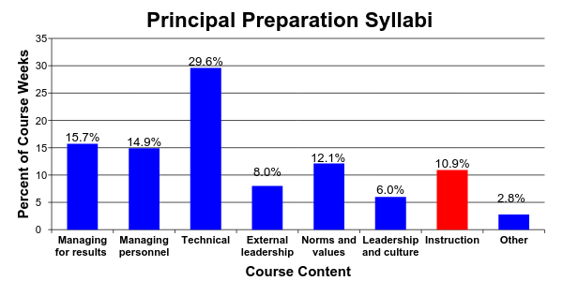
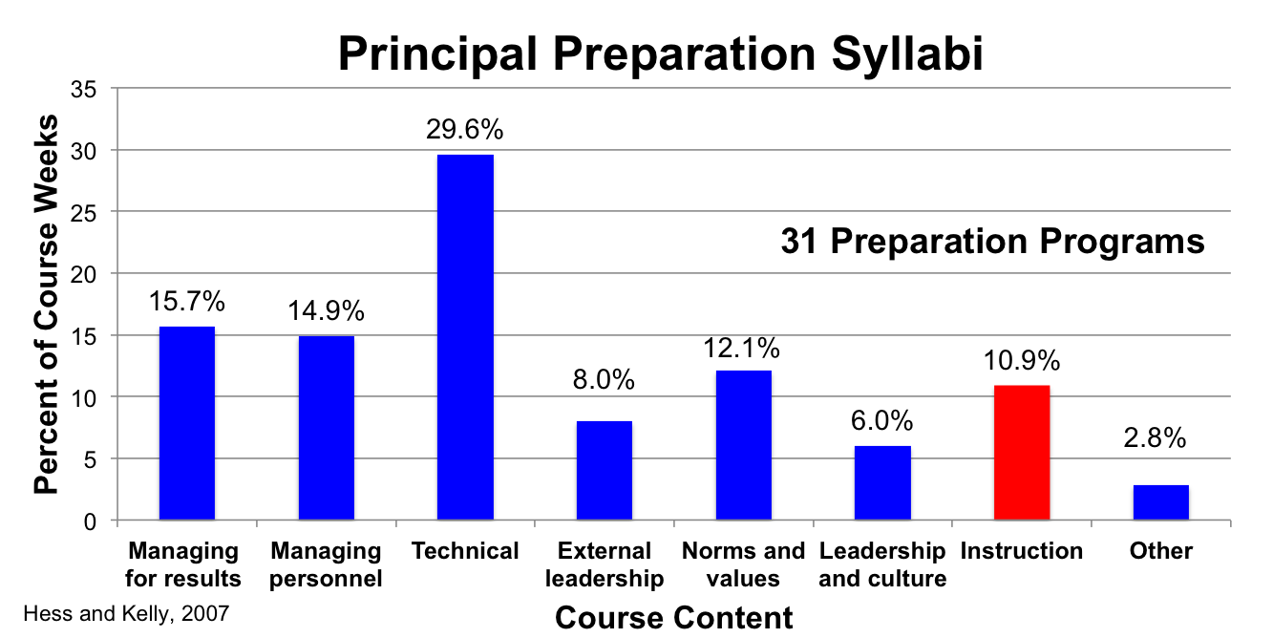
3. Relevant and effective coursework: University Programs
31 Preparation Programs
Hess and Kelly, 2007

Slide 24
3. Relevant and practical coursework: University Programs
Managing for results
• 2% of curricula addressed accountability as it relates to school management
• 5% addressed use of data, research, or technology as it relates to managing school improvement
Managing personnel
• 1% of curricula focused on systematic and “assertive” efforts to identify, enhance and reward teacher quality…the majority failed to mention termination or compensation at all.
Technical knowledge
• 7.4% data management and utilization
• 10% research skills
• 4.7% technology
Hess & Kelly (2007)

Slide 25
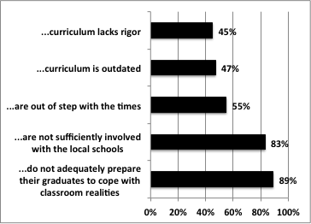
4. Relevant and practical coursework: University Programs
Schools of education…
Levine (2005)

Slide 26
4. Relevant and practical coursework: University Programs
PEDAGOGY
classes are predominately:
teacher-centered and lecture-styled
from a theoretical context
with little opportunity to practice critical leadership skills
and no content involving the real-life situations they are likely to confront on the job.
Cheney & Davis 2011

Slide 27
4. Relevant and practical coursework: University Programs
FACULTY
• the field depends too heavily on practitioners serving as part-time faculty
lack of instructional experience, knowledge of research, and rely on anecdotal “war stories”
• it employs too many full time professors who have minimal, if any, recent experience in the practice of school administration
only 8% of faculty who have had experience as school administrators
only 22% of deans who have had experience as school administrators
Levine (2005)

Slide 28
5. Experiential, clinical school-based opportunities: University Programs
Internship Mentors
• vague or unclear goals
• insufficient focus on instructional leadership and / or overemphasis on managerial role
• weak or non-existent training for mentors
• insufficient mentoring time or duration
The Wallace Foundation (2007)
• weak or non-existent evaluation of mentors
• weak or non-existent evaluation of principal interns
Southern Regional Education Board (2007)

Slide 29
6. Placement and on-the-job support
Principal Supervisors
Professional Development
Principal Feedback & Evaluation

Slide 30
6. Placement and on-the-job support: Supervision
Principal Supervisors
• Principal supervisors oversee an average of 24 schools, ranging from 6 to 67
• Districts by and large have not articulated an explicit set of principal supervisory competencies on which to base evaluations.
• Few districts select principal supervisors on the basis of their explicit results and measurable student achievement gains.
The Wallace Foundation and Council of the Great City Schools
Survey of 41 urban public school districts Corcoran. et al. (2012)

Slide 31
6. Placement and on-the-job support: Evaluation
INSTRUMENT CONTENT ANALYSIS
Learning Centered Leadership: A Behavior-Anchored Framework
(Vanderbilt Assessment of Leadership in Education)
high standards for student learning culture of learning
rigorous curriculum connections to external communities
quality instruction performance accountability
INSTRUMENT USAGE ANALYSIS
UTILITY: information is used to improvement performance
ACCURACY: instrument produces sound information about the principal’s performance (e.g. sound psychometric development)
The Wallace Foundation and Council of the Great City Schools. Survey of 65 Principal Assessment Instruments from 65 districts (43 states and DC)
Goldring, et.al. (2012)

Slide 32
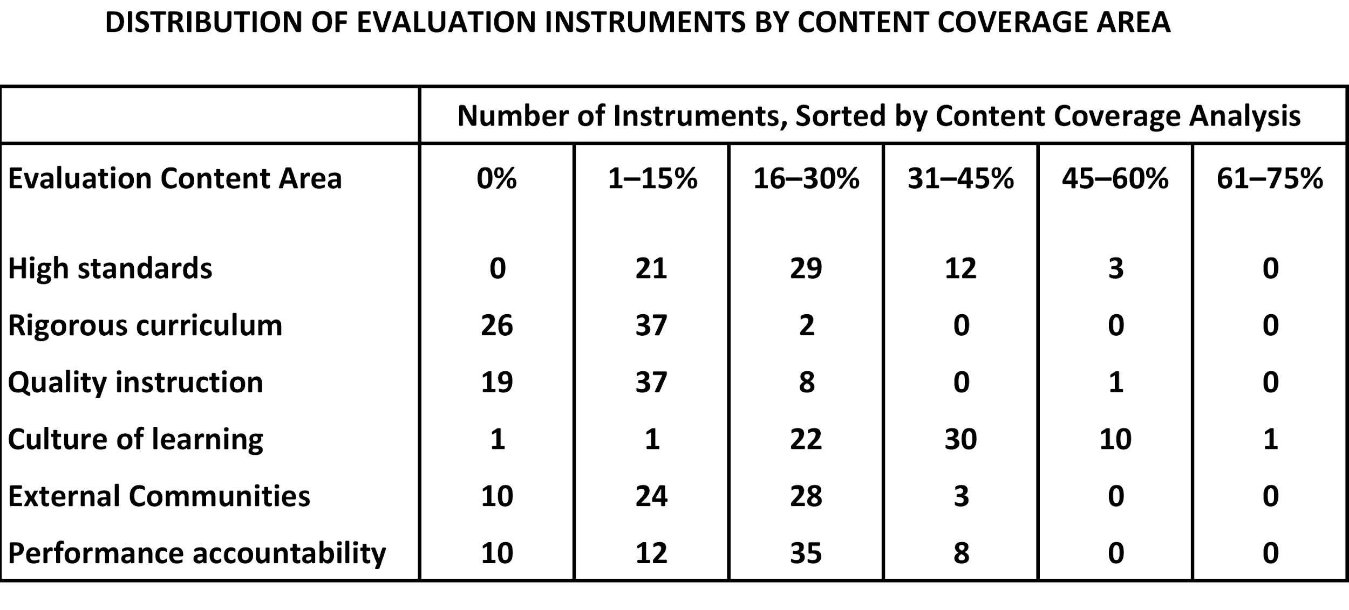
6. Placement and on-the-job support: Evaluation
CONTENT: Principal evaluation systems do not focus on the most critical items: student outcomes and teacher effectiveness
• only 25 instruments (38%) touched on all six core components
Goldring, et.al. (2012)

Slide 33
6. Placement and on-the-job support: Evaluation
UTILITY: Principal evaluation systems are not used effectively to improve principal performance
• 43% of the reviewed instruments failed to give leaders clear feedback on what they could be doing more or better to improve teaching and learning
• there are often inconsistent (or nonexistent) connections between evaluation and professional development plans
ACCURACY: Principal evaluation systems are not used effectively to improve principal performance
• evaluation systems are seldom based on clear performance standards
• there is little attention paid to the skills, qualifications, or authority of the reviewer
• few have been tested for important psychometric properties for validity and reliability
Goldring, et.al. (2012)

Slide 34
6. Placement and on-the-job support: Supervision
Professional Development
Professional development is generally not seen as sufficient to support school principals as instructional leaders.
The Wallace Foundation and Council of the Great City Schools , Corcoran. et.al. (2012)
Principal development opportunities are based more on “whims, fads, opportunism and ideology” than sound research and that while participation rates were high, it rarely lead to any changes in practice that had an impact on student achievement.
National Association of State Boards of Education, Sun (2011)

Slide 35
7. Robust data collection and continuous learning:
State Oversight
  Performance data
  • 19 states were unable to report how many people graduate from state-approved principal preparation programs in their state on an annual basis
  • 28 states report than neither the state nor principal preparation programs are required to collect any outcome data on principal preparation program graduates to know if they secure jobs, retain them, show impact on student achievement, or earn effective ratings on principal evaluations program
  • Universities typically do not track performance outcomes

Slide 36
Critical Core Components of Principal Preparation
Principal competency framework
Strategic and and proactive recruiting
Rigorous selection process
4. Relevant and practical coursework
5. Experiential, clinical school-based opportunities
6. Placement and on-the-job support
7. Robust data collection and continuous learning
Rainwater Leadership Alliance Cheney, et.al. (2010)
Poor
Poor
Poor
Poor
Poor
Poor
Poor

Slide 37
What’s next?
1. There is movement in the public policy level to recognize the changing role of school principal and the need to strengthen principal effectiveness standards, preparation program oversight, licensure and outcome data.
U.S. Department of Education
  National Association of State Boards of Education
  National Conference of State Legislators
  Education Commission of the States
  Council of State Chief School Officers
  National Association of Elementary School Principals
  National Association of Secondary School Principals

Slide 38
What’s next?
1. There is movement in the public policy level to recognize the changing role of school principal and the need to strengthen principal effectiveness standards, preparation program oversight, licensure and outcome data.
2. There is an increasing amount of research on principal competencies and principal preparation systems.
U.S. Department of Education is funding a large-scale randomized control trial evaluation of principal professional development beginning in 2015.
Rand studies on New Leaders performance outcomes

Slide 39
What’s next?
1. There is movement in the public policy level to recognize the changing role of school principal and the need to strengthen principal effectiveness standards, preparation program oversight, licensure and outcome data.
2. There is an increasing amount of research on principal competencies and principal preparation systems.
There are an increasing number of “exemplar” principal preparation programs and research organizations:
New Leaders, etc.
The Wallace Foundation Pipeline
Southern Regional Education Board

Slide 40
WWW.WINGINSTITUTE.ORG

