Slide 1
APPLICATION
TECHNOLOGY
Powerpoint Template
Presentation template by GoogleSlides.org

Slide 2
01
Organic
02
Media
CONTENTS
03
Social
04
Slideshare

Slide 3
01
Organic

Slide 4

Organic
Service
4
A complex idea can be conveyed with just
Our
5
Show and explain your web,
Powerpoint
3
I hope and I believe that this Template will your Time, Money and Reputation.
Our
2
Service
1
Show and explain your web, app or software projects using these gadget templates
A complex idea can be conveyed with just

Slide 5
Organic
Web
Design
Keynote
I hope and I believe that this Template will
Get a modern PowerPoint Presentation that
Easy to change colors, photos and Text.
Keynote
Web
Design
Easy to change colors, photos and Text.
I hope and I believe that this Template will
Get a modern PowerPoint Presentation that

Slide 6


Organic
Paint
Type your content here, or by copying your text, select Paste in this box and choose to keep only the text
Development
Project
Type your content here, or by copying your text, select Paste in this box and choose to keep only the text
NOW YOU CAN WRITE SOMETHING REALLY
AWESOME IN THIS AREA
Easy to change colors, photos and Text. Get a modern PowerPoint Presentation that is beautifully designed.
Easy to change colors, photos and Text. Get a modern PowerPoint Presentation that is beautifully designed.
Infographic
Easy to change colors, photos and Text. Get a modern PowerPoint Presentation that is beautifully designed.

Slide 7


Organic
Circle
Check
Easy to change colors, photos and Text. Get a modern PowerPoint Presentation that is beautifully designed.
Easy to change colors, photos and Text. Get a modern PowerPoint Presentation that is beautifully designed.
1
3
2
Make
Think
Far far away, behind the word mountains, far from the countries Vokalia and Consonantia, there live the blind texts.
4
Far far away, behind the word mountains, far from the countries Vokalia and Consonantia, there live the blind

Slide 8
02
Media

Slide 9


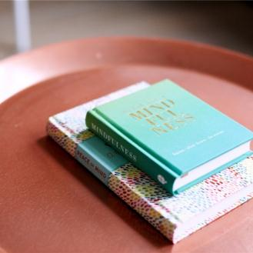
Media
Solutions
Meet
Team
Click on the button under the presentation
You will get a copy of this document on your Google
Click on the button under the presentation

Slide 10
Media
83%
91%
54%
45%
Devices
Overview
Web
Design
You will get a copy of this document on your Google Drive
You will get a copy of this document on your Google Drive and will be able to edit, add or delete slides.
You have to be signed in to your Google account.
You have to be signed in to your Google account.

Slide 11
Media
Cerenomy
Opening
Infographics
You have to be signed in to your Google account.
You have to be signed in to your Google account.
You will get a copy of this document on your Google Drive and will be able to edit, add or delete slides.
Click on the button under the presentation preview that says "Use as Google Slides Theme.

Slide 12
Media
Free
Speakers
Is the color of gold, butter and ripe lemons. In the spectrum of visible light,
Add or delete slides. You have to be signed in to your Google account.
Break
Time
Opening
We use well-known development methodologies to create a customized
Is the color of gold, butter and ripe lemons. In the spectrum of visible light, yellow is found between green and orange
Add or delete slides. You have to be signed in to your Google account.

Slide 13
03
Social

Slide 14


Social
Vision
We press play on your digital story. Using conceptual, digital design
Mission
We use well-known development methodologies to create a customized approach for each of

Slide 15
Social
85%
85%
85%
85%
85%
65%
65%
65%
65%
65%
Timeline
Services
Forum
About us
Our Values
We leverage digital tools, design and words, to become even more relevant.
Moving from creative ideas to solid strategy and execution, we help your target market resonate
Simple & Smooth, exactly how purchasing experiences should be
Moving from creative ideas to solid strategy and execution, we help your target market resonate
We leverage digital tools, design and words, to become even more relevant.

Slide 16

Social
Future
Simple & Smooth, exactly how purchasing experiences should be. We align with your users need to build and evolve a flowing shopping interface, one that slots easily into place with each step.
Pricing
Simple & Smooth, exactly how purchasing experiences should be. We align with your users need to build and evolve a flowing shopping interface, one that slots easily into place with each step.

Slide 17
Social
Annual 65%
Your audience relate and absorb information on different sensory levels. We know visual stories are amplified with the right words.
Meeting 65%
Your audience relate and absorb information on different sensory levels. We know visual stories are amplified with the right words. Sometimes it's easier to go old school, our copywriters prefer a good ball.
What we do? 65%
The user can make a presentation on a projector or computer, or print out the presentation to make a film. The user can make a presentation on a projector or computer, and can also make a presentation. You can also print out the presentation to make a film

Slide 18
04
Slideshare

Slide 19

Slideshare
Conferences
The user can make a presentation on a projector or computer, or print out the presentation to make a film. The user can make a presentation on a projector or computer, and can also make a presentation. You can also print out the presentation to make a film
The user can make a presentation on a projector or computer, or print out the presentation to make a film. The user can make a presentation on a projector or
1
Transport
Enter the comprehensive description of the above chart here, enter the comprehensive description of the above chart here, enter the comprehensive
2
Suggest
Enter the comprehensive description of the above chart here, enter the comprehensive description of the above chart here, enter the comprehensive

Slide 20
Slideshare
1
Send
4
Skills
We cannot help ourselves. We live at home, quiet, confined, and our feelings prey upon us. You are forced on exertion
It is a very sad thing that nowadays there is so little useless information.
2
Signature
5
Split
It is a very sad thing that nowadays there is so little useless information.
We certainly do not forget you as soon as you forget us. It is, perhaps, our fate rather than our merit.
3
Share
6
Success
We certainly do not forget you as soon as you forget us. It is, perhaps, our fate rather than our merit.
We cannot help ourselves. We live at home, quiet, confined, and our feelings prey upon us. You are forced on exertion

Slide 21
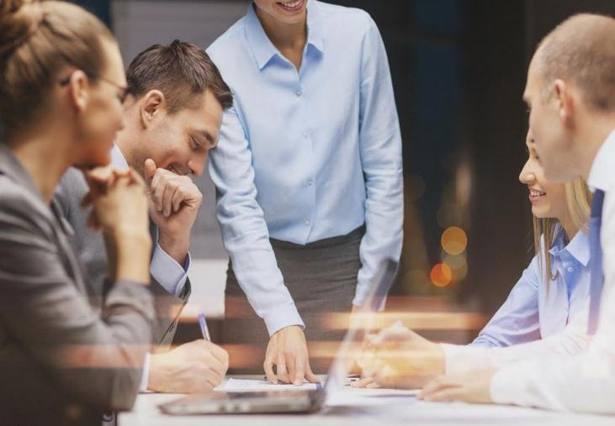


Slideshare
Schedule
You have always a profession, pursuits, business of some sort or other, to take you back into the world immediately, and continual occupation and change soon weaken impressions. All the privilege I claim for my own sex (it is not a very enviable one; you need not covet it), is that of loving longest, when existence or when hope is gone.
Lower
Lanage
I believe that people would be alive today if there were a death penalty. I believe that people would be alive today if there were a death penalty.
I believe that people would be alive today if there were a death penalty.

Slide 22

Slideshare
Annual
Genius hath electric power which earth can never tame. Lydia M. Child
Work
I feel very strongly that change is good because it stirs up the system. Ann Richards
Accept
Occupation
Be an encourager, the world has enough critics already. Always give your best never worry for results. Education is the most powerful weapon which you can use to change the world.
The time is now, the place is here. Stay in the present. You can do nothing to change the past, and the future will never come exactly as you plan or hope for. Dan Millman

Slide 23
THANK YOU !
Application Technology
Powerpoint Template
Presentation template by GoogleSlides.org

