Slide 1
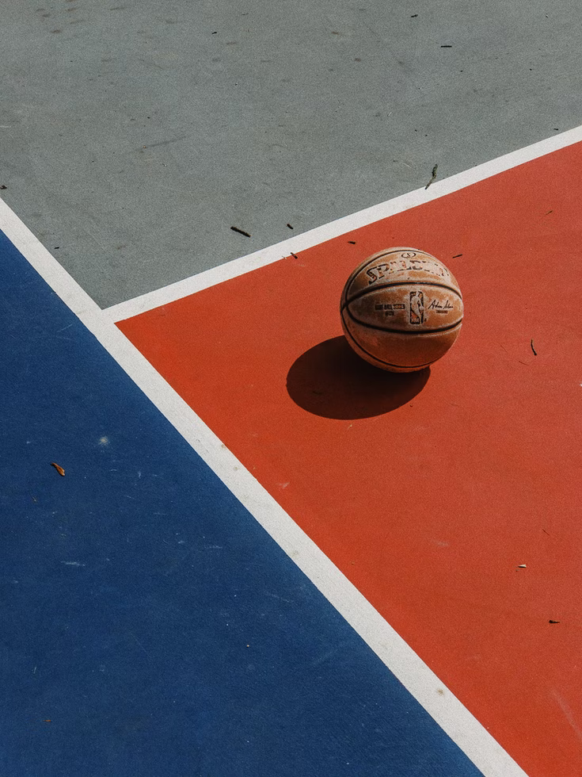
Basketb ll
Free Template

Slide 2
Whoa!
It could be the part of the presentation where you can introduce yourself. Keep it short and go straight to the point. Your audience will appreciate that

Slide 3
Table of contents
1
2
3
Bikes
Here you could describe the topic of the section
League of US bicyclists
Here you could describe the topic of the section
Benefits of bicycling
Here you could describe the topic of the section

Slide 4
Basketball Infographics
Venus
Mercury
Venus is terribly hot, even hotter than Mercury
Mercury is the smallest planet in the Solar System
Saturn
Earth
Saturn is a gas giant and has several rings
The Earth is the beautiful planet where we all live

Slide 5
Basketball Infographics
Saturn
Earth
Uranus
Mars
Saturn is a gas giant and has several rings
The Earth is the beautiful planet where we all live
Uranus is the seventh planet from the sun
Despite being red, Mars is actually a cold place
Jupiter
Mercury
Neptune
Venus
Jupiter is the biggest planet in the Solar System
Mercury is the smallest planet in the Solar System
Neptune is the farthest planet from the Sun
Venus is terribly hot, even hotter than Mercury

Slide 6
Basketball Infographics
1
2
3
4
Mars
Earth
Jupiter
Mercury
Despite being red, it’s actually a cold place full of iron oxide dust
It’s the only planet that harbors life in the Solar System
Jupiter is a gas giant and the biggest planet in the Solar System
Mercury is the closest planet to the Sun and the smallest one

Slide 7
Basketball Infographics
Mercury
Venus
Mercury is the smallest planet in the Solar System
Venus is terribly hot, even hotter than Mercury
Saturn
Mars
Saturn is a gas giant and has several rings
Despite being red, Mars is actually a cold place
Jupiter
Earth
Jupiter is the biggest planet in the Solar System
The Earth is the beautiful planet where we all live

Slide 8
Basketball Infographics
Venus
Venus has a beautiful name and is the second planet from the Sun
Mercury
Mercury is the closest planet to the Sun and the smallest one
Jupiter
Jupiter is a gas giant and the biggest planet in the Solar System
Mars
Despite being red, Mars is actually a cold place full of iron oxide dust

Slide 9
Basketball Infographics
Mercury
Mars
Mercury is the closest planet to the Sun and the smallest one
Despite being red, Mars is actually a cold place full of iron oxide dust
Jupiter
Venus
Jupiter is a gas giant and the biggest planet in the Solar System
Venus has a beautiful name and is the second planet from the Sun

Slide 10
Basketball Infographics
Mercury
Uranus
Venus
Jupiter
Mercury is the smallest planet in the Solar System
Uranus is the seventh planet from the Sun
Venus is terribly hot, even hotter than Mercury
Jupiter is the biggest planet in the Solar System
1
7
2
66
99
00
23
16
Earth
Neptune
Saturn
Mars
The Earth is the beautiful planet where we all live
Neptune is the farthest planet from the Sun
Saturn is a gas giant and has several rings
Despite being red, Mars is actually a cold place

Slide 11
Basketball Infographics
Why you should keep playing basketball
Venus
1
Venus has a beautiful name and is the second planet from the Sun
Mars
2
Despite being red, Mars is actually a cold place full of iron oxide dust
Mercury
3
Mercury is the closest planet to the Sun and the smallest one
extrêmement froid
Jupiter
4
Jupiter is a gas giant and the biggest planet in the Solar System

Slide 12
Basketball Infographics
Saturn
1
2
Venus
Saturn is a gas giant and has several rings
It is terribly hot, even hotter than Mercury
Jupiter
3
4
Earth
It’s the biggest planet in the Solar System
The Earth is the planet where we all live
Mars
5
6
Mercury
Despite being red, Mars is actually a cold place
It’s the smallest planet in the Solar System

Slide 13
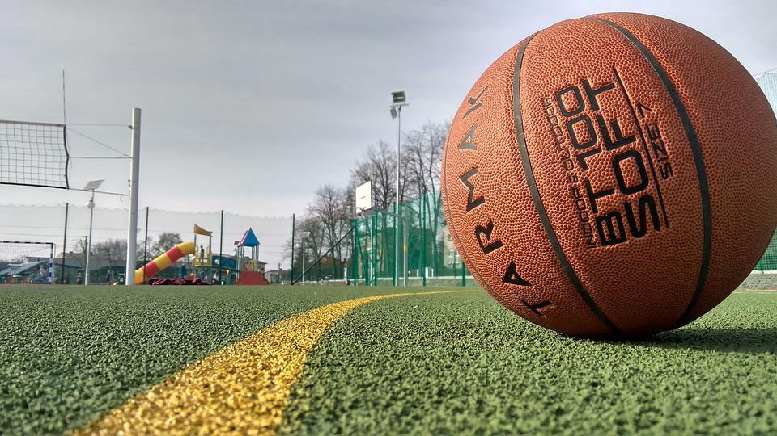
Awesome words
Because key words are great for catching your audience’s attention

Slide 14
You could use three columns, why not?
Mercury
Mercury is the smallest planet of them all
Venus
Venus has a beautiful name, but it’s very hot
Saturn
Yes, this is the ringed planet. It’s a gas giant

Slide 15
Equity, diversity & inclusion
Diversity
Despite being red, Mars is cold
Equity
Venus has a beautiful name
Inclusion
Diversity
Jupiter is the biggest planet
Despite being red, Mars is cold

Slide 16
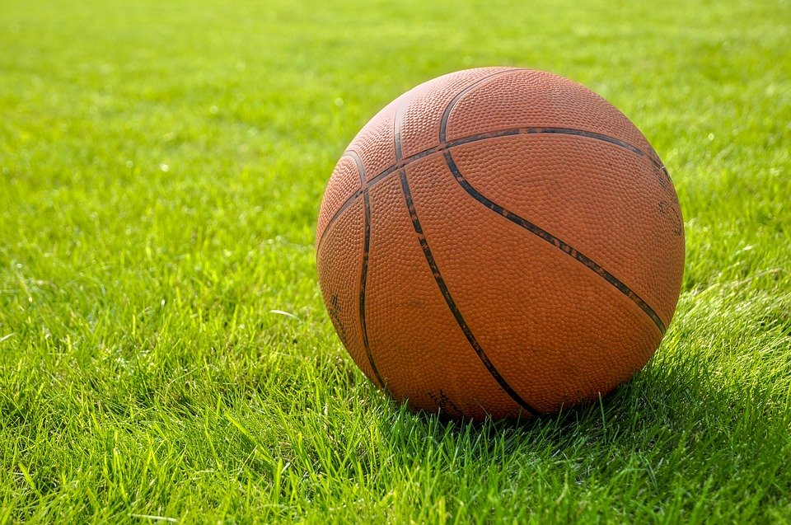
A picture is worth a thousand words

Slide 17
—Someone famous
“This is a quote. Words full of wisdom that someone important said and can make the reader get inspired”

Slide 18
Basketball Infographics
Mercury
Venus
Mercury is the smallest planet in the Solar System
Venus is terribly hot, even hotter than Mercury
Saturn
Mars
Saturn is a gas giant and has several rings
Despite being red, Mars is actually a cold place
Jupiter
Earth
Jupiter is the biggest planet in the Solar System
The Earth is the beautiful planet where we all live

Slide 19

Basketball Infographics
25%
25%
Saturn
Venus
Saturn is a gas giant and has several rings
Venus is terribly hot, even hotter than Mercury
25%
25%
Earth
Mars
The Earth is the beautiful planet where we all live
Follow the link in the graph to modify its data and then paste the new one here. For more info, click here
Despite being red, Mars is actually a cold place

Slide 20
Basketball Infographics
The best-selling basketball equipment in the world
Venus
Venus has a beautiful name and is the second planet from the Sun
Mercury
Mercury is the closest planet to the Sun and the smallest one
Mars
Despite being red, it’s actually a cold place full of iron oxide dust
Jupiter
It’s a gas giant and the biggest planet in the Solar System

Slide 21
Basketball Infographics
A
B
A
Mercury
C
Mercury is the closest planet to the Sun
B
Mars
Despite being red, it’s actually a cold place
C
Jupiter
It’s the biggest planet in the Solar System
D
Earth
D
The Earth is the planet where we all live

Slide 22
Basketball Infographics
1
2
3
4
Earth
Mars
Mercury
Saturn
The Earth is the beautiful planet where we all live
Despite being red, Mars is actually a cold place
Mercury is the smallest planet in the Solar System
Saturn is composed mostly of hydrogen and helium

Slide 23
How to prepare your bike
1
2
Saddle area
Mercury is the closest planet to the Sun
Wheels
Venus has a beautiful name, but it’s very hot

Slide 24
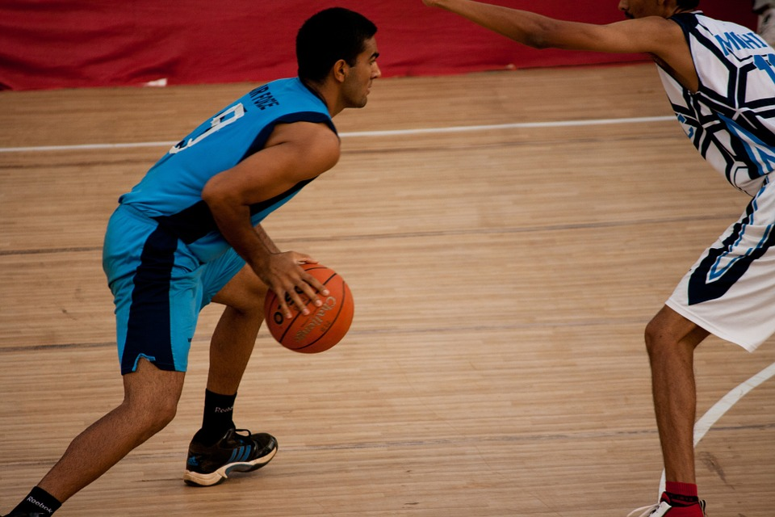
4,498,300,000
Big numbers catch your audience’s attention

Slide 25
Basketball Infographics
Jupiter
Mars
Mercury
Jupiter is a gas giant and the biggest planet in the Solar System
Despite being red, Mars is actually a cold place full of iron oxide dust
Mercury is the closest planet to the Sun and the smallest one

Slide 26
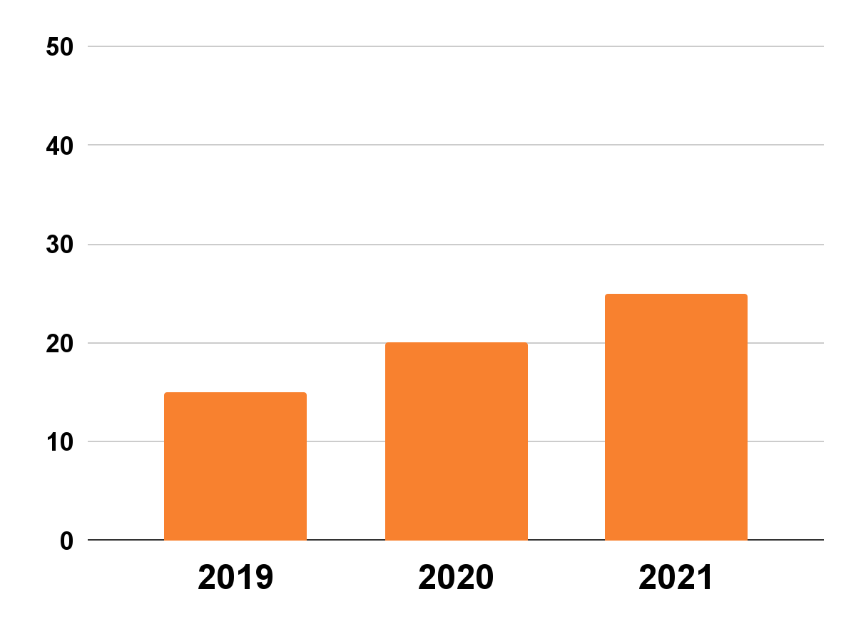
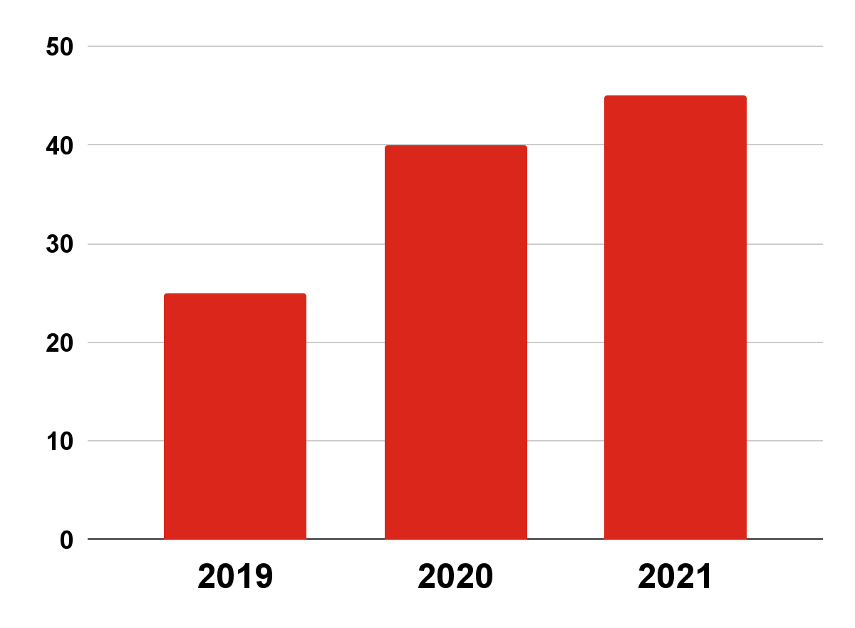
Basketball Infographics
The evolution of professional basketball players
15M
20M
25M
25M
40M
45M
Women
Men
Mercury is the smallest planet in the Solar System
The Earth is the beautiful planet where we all live
Follow the link in the graph to modify its data and then paste the new one here. For more info, click here

Slide 27
Our team
John James
Jane Doe
Here you can talk a bit about this person
Here you can talk a bit about this person
Jennifer Patterson
Jack John
Here you can talk a bit about this person
Here you can talk a bit about this person

Slide 28
Basketball Infographics
1 vs 1
Jupiter
Mercury
Jupiter is the fifth planet and and is the biggest one in the entire Solar System
The Earth is the third planet from the Sun and the only one that harbors life
Mars is full of iron oxide dust, which gives the planet its reddish cast
Mercury is the closest planet to the Sun and the smallest one
Saturn was named after the Roman god of wealth and agriculture
Venus is has high temperatures, it’s even hotter than Mercury

Slide 29
Thanks
Do you have any questions?
addyouremail@example.com
+91 620 421 838
yourcompany.com
Free Template

Slide 30
FUENTE
ELABORADO POR :
plantillaspowerpoint.org
IMAGES :
unsplash.com
pixabay.com
FONTS :
Fira Sans Extra Condensed
Roboto

Slide 31
RESOURCES

Slide 32
RESOURCES

Slide 33
RESOURCES

Slide 34
Fully Editable Icon Sets: A

Slide 35
Fully Editable Icon Sets: B

Slide 36
Fully Editable Icon Sets: C

