Slide 1
CPaaS MS Teams Direct Routing
September 2023

Slide 2
Problem Statement & Solution
Overview
Key Features
Value Propositions
Benefits
Snapshot
Success Stories

Slide 3
Problem Statement & Solution
Integration of traditional voice systems with modern communications & collaborative tools can be expensive and complex.​
Businesses are starting to switch up. They would want seamless interaction with their customers.
Businesses are generally looking at cutting back their expenditures. ​
No need for on-premise equipment/hardware that may need maintenance or support, freeing up your IT department for more value adding work​.
Combining fixed line numbers with MS Teams makes business number accessible to the employees on any device no matter where they are​.
Monthly Subscription model with no upfront investment required. Enjoy unlimited local/international calls.
accessibility
Accessibility
Remote Work
Cost

Slide 4
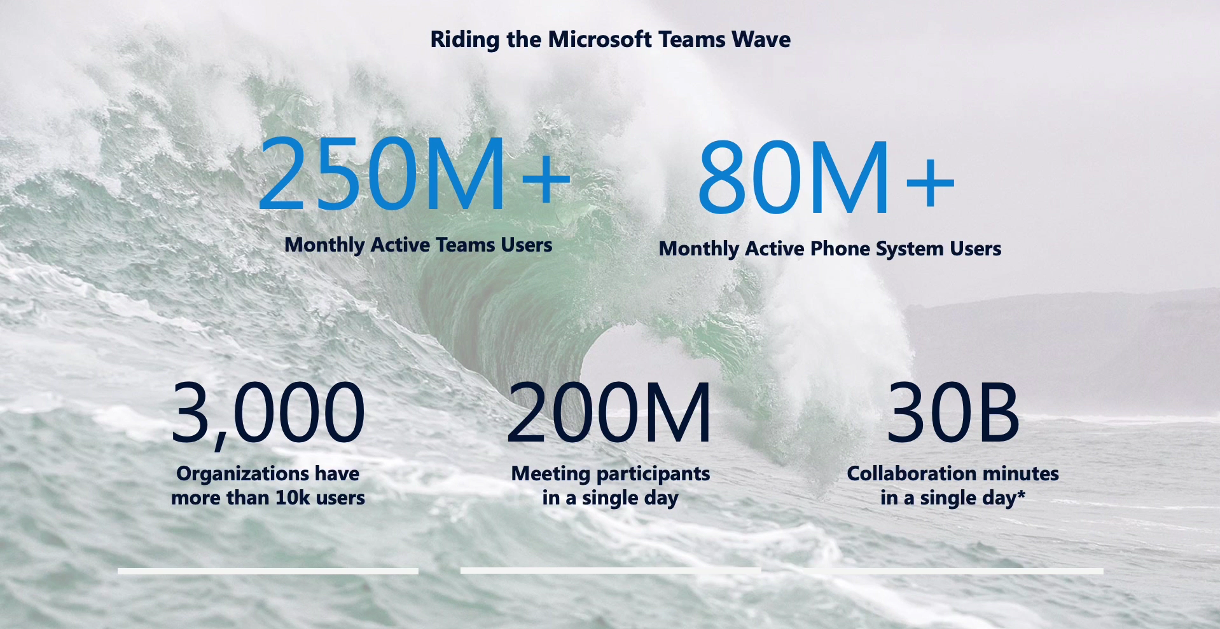
Notes:
Data as per Nov 2021

Slide 5
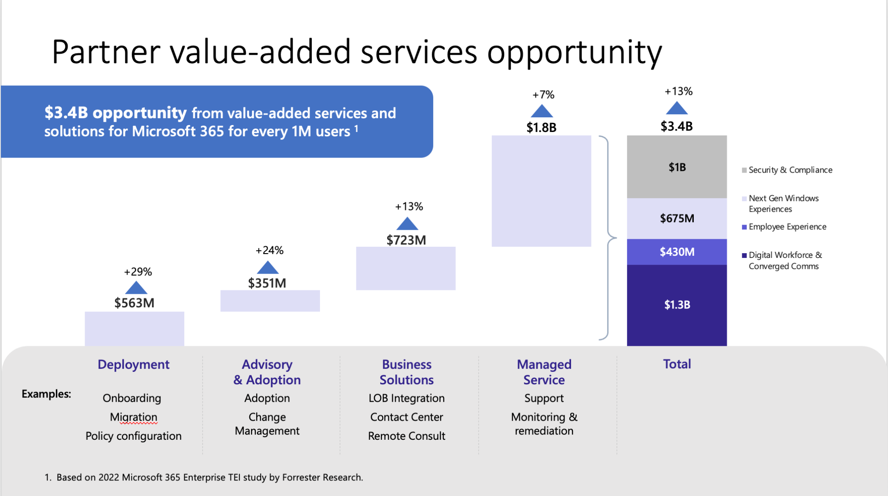
Notes:
Data as per Nov 2021

Slide 6
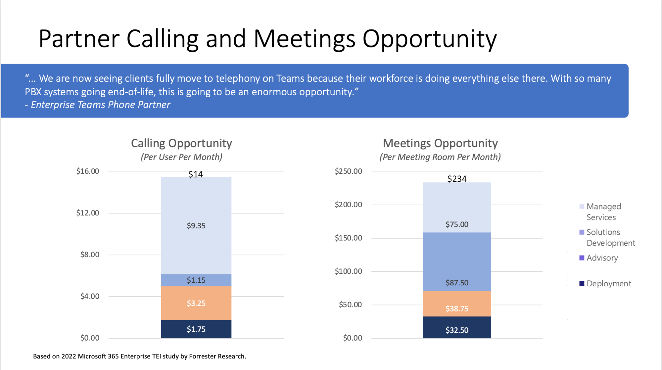
Notes:
Data as per Nov 2021

Slide 7
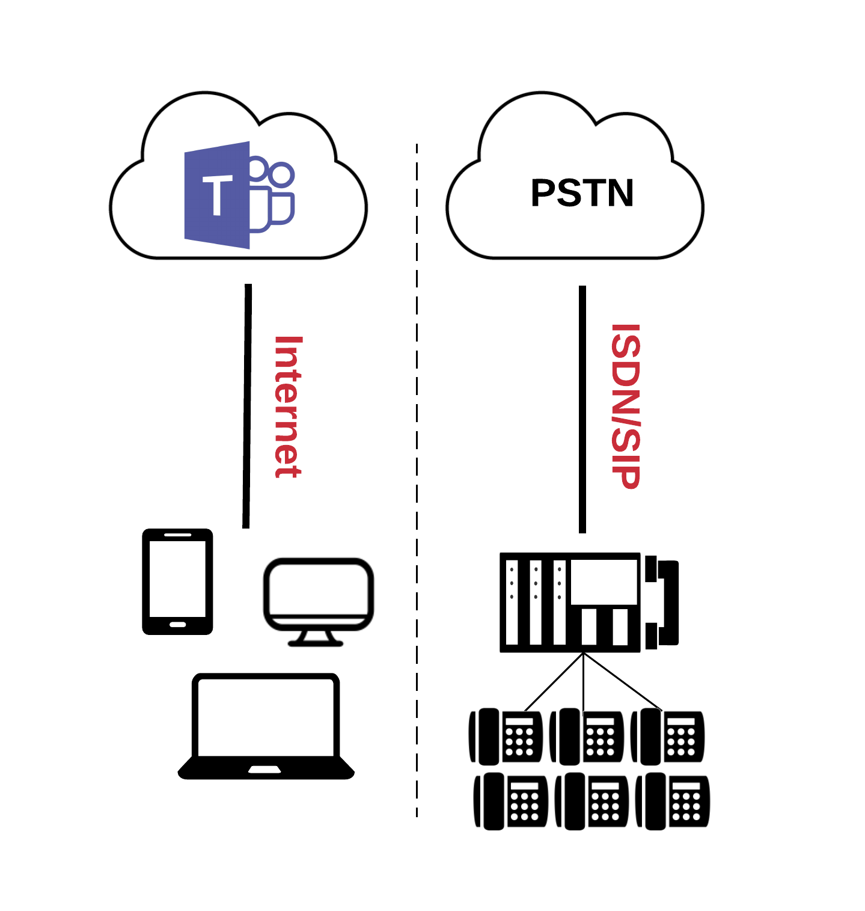
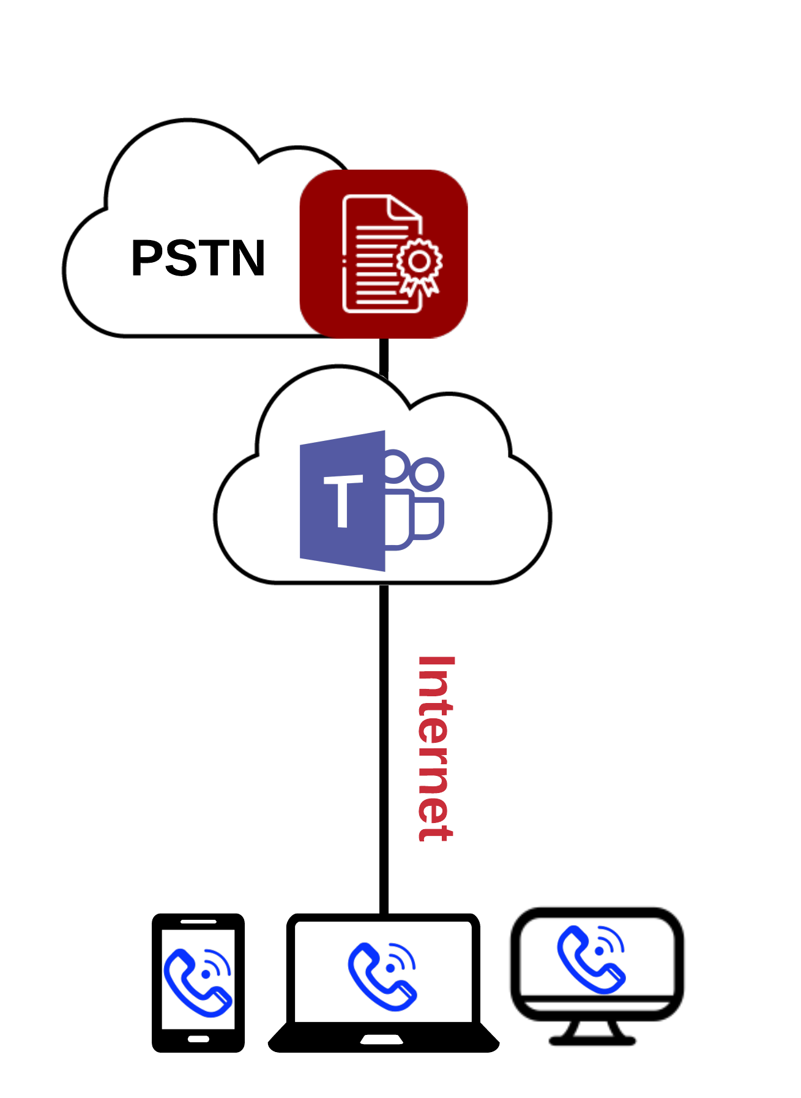
What is CPaaS MS Teams Direct Routing?
BEFORE
AFTER
MS Teams with Standalone IP-PBX Setup for PSTN Calls
MS Teams + CPaaS MS Teams Direct Routing
Internal
External
Calls to other Teams users are free.
But to make/receive telephone calls, a separate IP-PBX system is required
CPaaS
MS Teams Direct Routing enables businesses to make and receive PSTN calls to/from regular telephone number by simply using the MS Teams App.

Slide 8
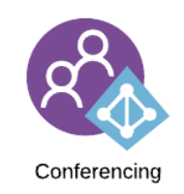

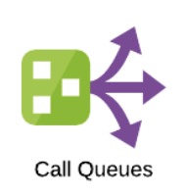
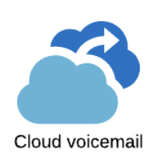
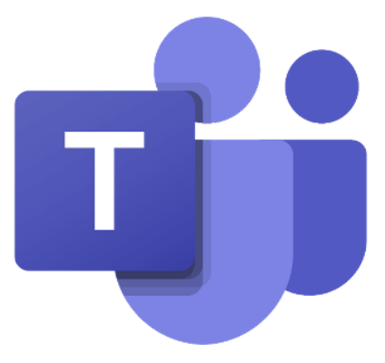
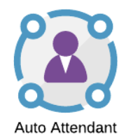
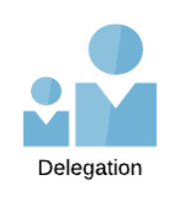
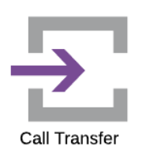
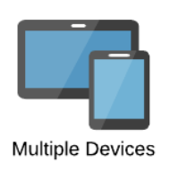

Key Features
As a cutting-edge communications solution, CPaaS MS Teams Direct Routing leverages advanced call features for businesses

Slide 9


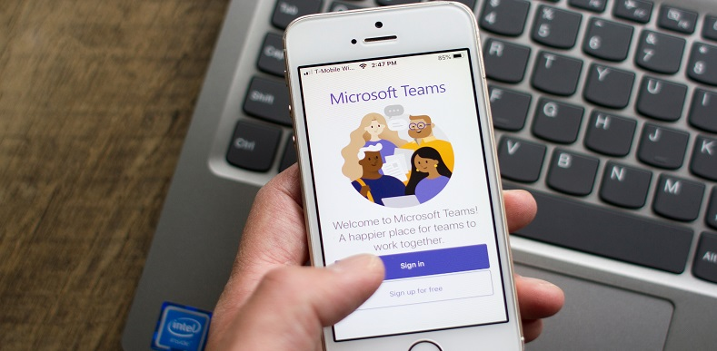
Value Propositions
Make Remote Working to a Whole new level!
Increase productivity with seamless access to easy voice calling (via PSTN) and MS Teams features all in one app.
Unify your workplace and combine your voice and collaboration tools with your MS office tools, all in one place.
Connect with your customers anytime, anywhere, across multiple devices of your choice, under a single business number​.

Slide 10

Why B3Networks CPaaS Teams Direct Routing?
Support Landline Numbers Convergence
Support for Hybrid Setup
Unrestricted scalability
99.9% SLA
Single point of
Contact and Responsibility
No Upfront
hardware investment

Slide 11
System Integration
Full Manual (dedicated SBC solution)
This option allows the customers to have their own SBC and custom FQDN.
Integration Type | Dedicated SBC Support | Customer FQDN Support | Require Microsoft Global Admin Access
Full Manual | ✅ | ✅ | ❌

Slide 12
Comparison of Integration Types
We offer 3 types of direct routing deployment options depending on customer security requirements.
Option 1: Full Automation
This option is recommended for most use cases. With this option, FQDN and SBC (Number) provisioning is automated via the CPaaS portal. The only manual portion is the PowerShell commands.
Option 2: Semi-Automation
Option 3: Full Manual (dedicated SBC solution)
This option allows the customers to have their own SBC and custom FQDN.
Option | Integration Type | Dedicated SBC Support | Customer FQDN Support | Require Microsoft Global Admin Access
1 | Full Automation | ❌ | ❌ | ✅
2 | Semi-Automation | ❌ | ❌ | ✅
3 | Full Manual | ✅ | ✅ | ❌

Slide 13
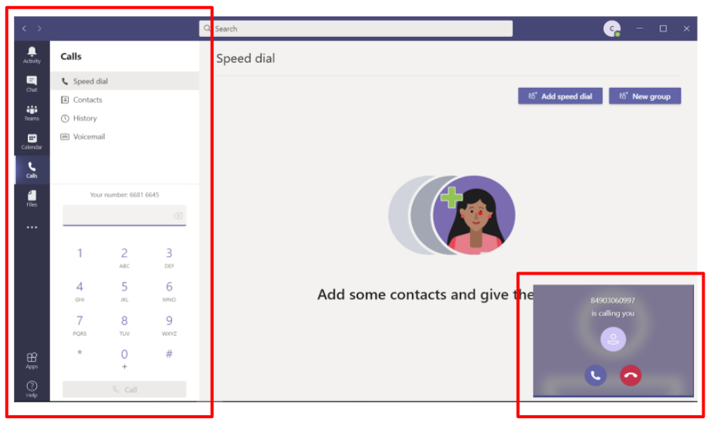
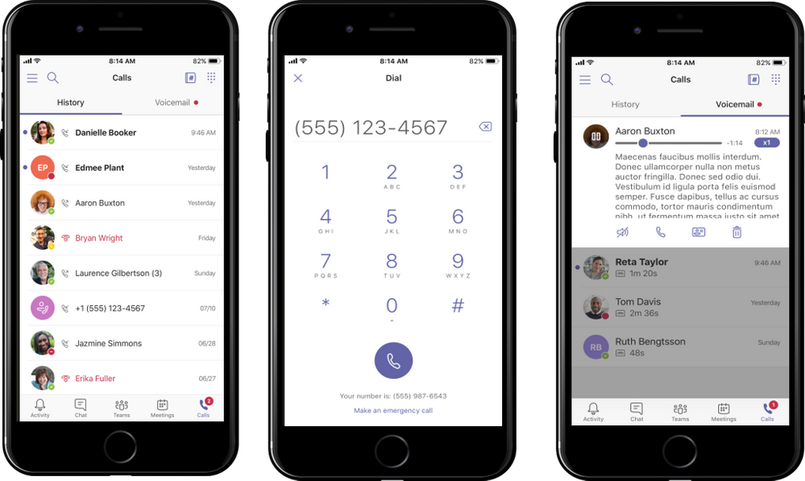
MS Teams User Interface
Computer/ Laptop
Smart Phone

Slide 14
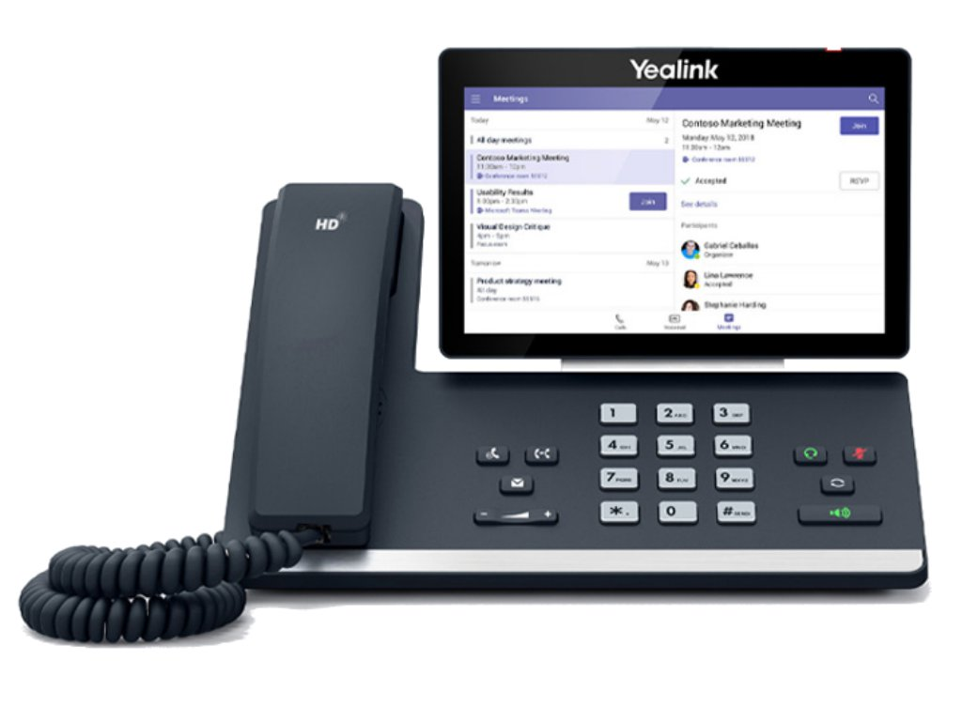
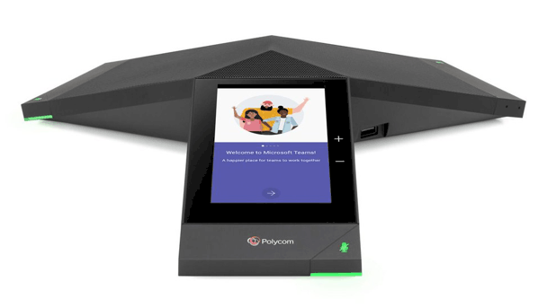
MS Teams User Interface (Cont’d)
IP Desk Phones

Slide 15
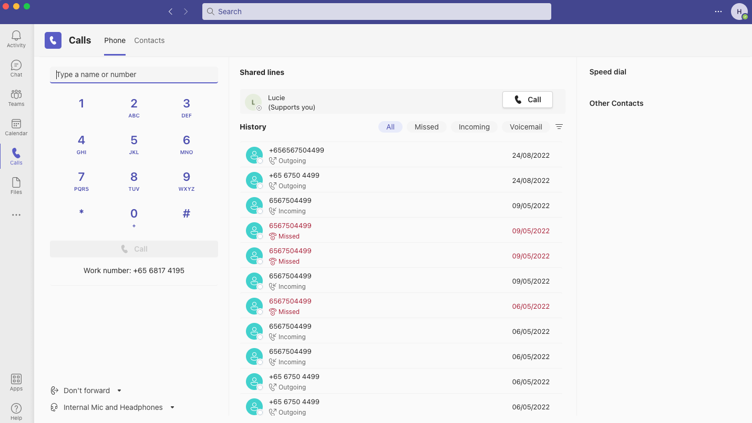
MS Teams User Interface (Cont’d)
Click on ‘Calls’ icon to access this calling screen
Your business phone number will be displayed here
You will be able to use this dial pad to make PSTN calls or you can also click on ‘Call contact’ on your user contacts​

Slide 16
Success Stories
Customer Requirements:
Our Solution:
Provide a unique Namespace for the SBC & FQDN
Result:
Meet Company’s security compliance with ability to fully manage the SBC as per their requirements.
Move the Mainline to Cloud and direct calls from their to staff’s mobile which is part of the CPaaS MS Teams Direct Routing mobile convergence feature.
Ensure the Teams Voice solutions complies with the Global Security policy set in the organisation.
Able to transfer calls in Main Line to staff’s mobile numbers.
Notes:
-

Slide 17
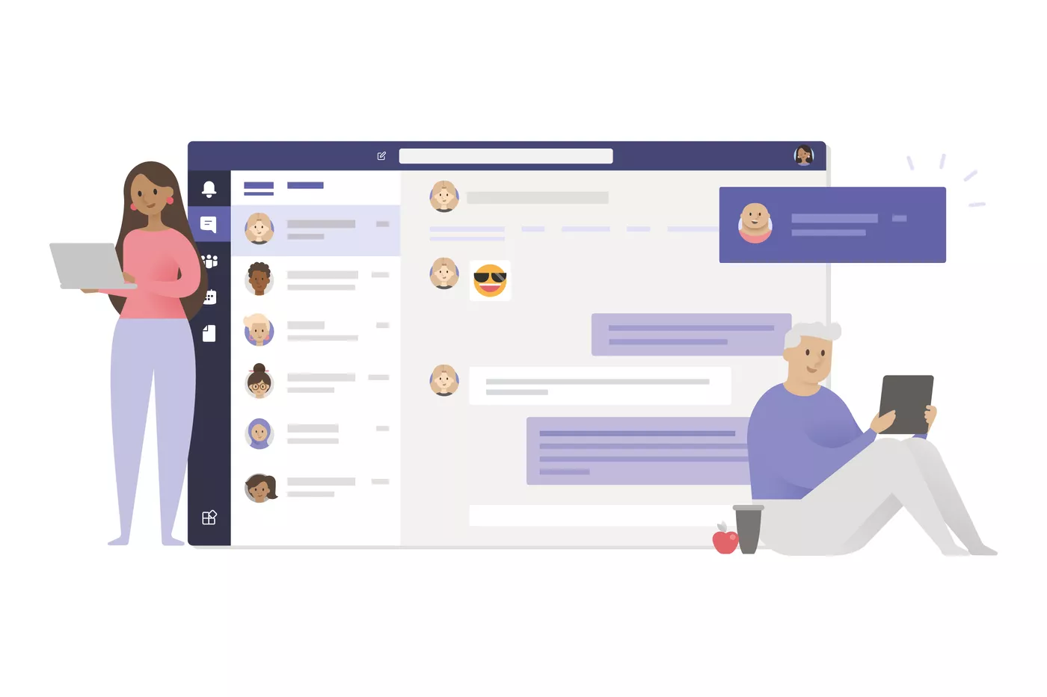






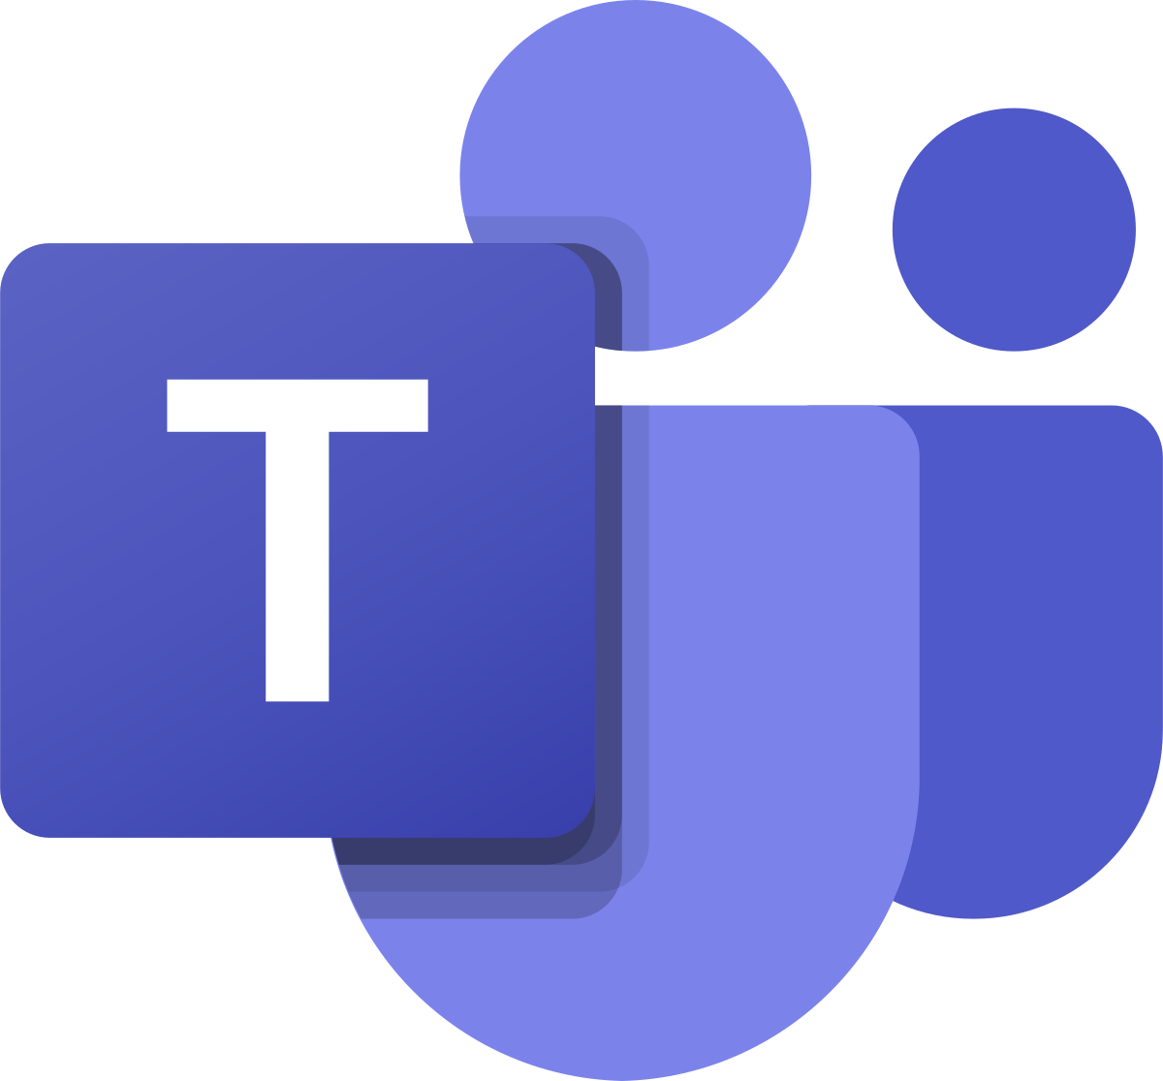
Success Stories
Teams User
Microsoft Certified SBC 1
Leased Lines 1
B3Networks Phone Exchange 1
Internet
B3networks / E1
High Availability Setup
B3Networks Phone Exchange 2
Microsoft Certified SBC 2
Leased Lines 2
Customer’s Teams Setup Tenant Location
Microsoft Teams Firewall and Bandwidth Requirements
Ports | UDP ports 3478 through 3481
IP addresses | 13.107.64.0/18, 52.112.0.0/14, and 52.120.0.0/14
Bandwidth (Audio) | 30 to 84 kbps

Slide 18
Success Stories
Customer Requirements:
Our Solution:
Provision and Deploy CPaaS MS Teams Direct Routing Solution.
Result:
CPaaS MS Teams Direct Routing Mobile Convergence feature ensured that employees could support clients from office, home or remote location.
This process moved to the cloud ensuring the install and deployment process was quicker by having it done in a single day.
At the onset of Covid, organizations having a large workforce wanted to support their end users and clients.
Able to deploy solution with a quicker turnaround time having no physical visitation.
Notes:
-

Slide 19
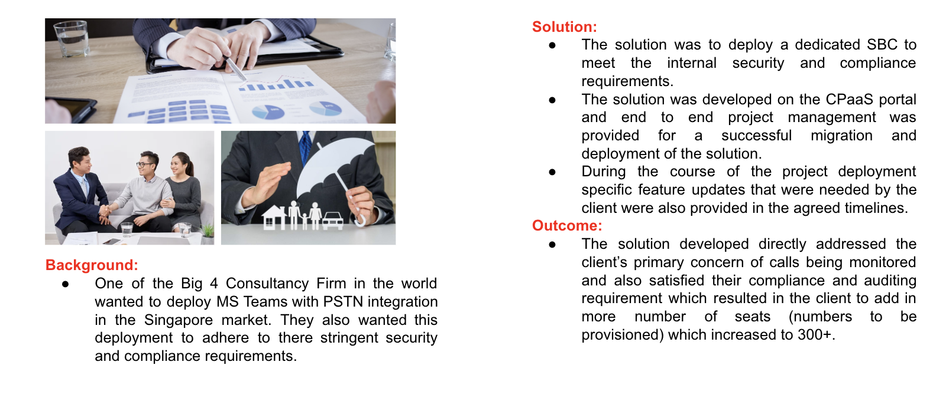
Success Stories
Notes:
-

Slide 20
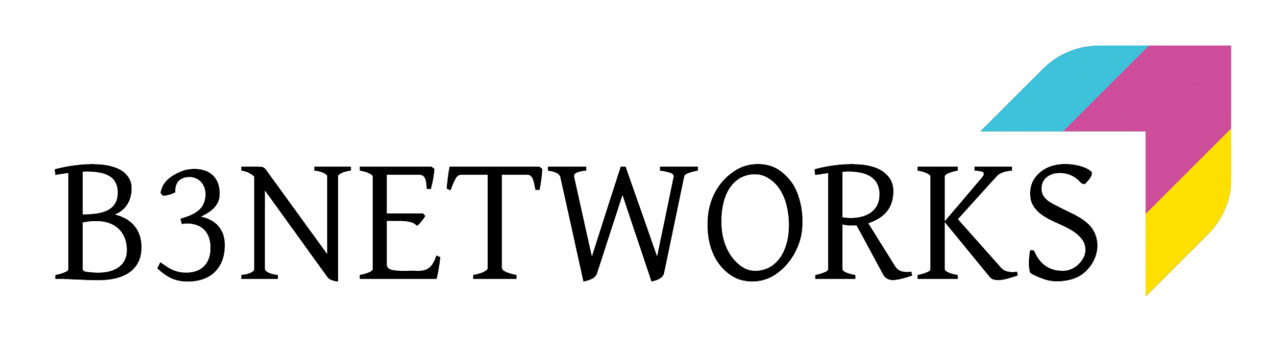


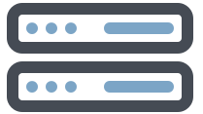


Success Stories
Customer Network
Users will be accessing the Phone Function on Microsoft Teams Apps and connecting to Microsoft Teams servers over the Internet.
B3Networks CPaaS Microsoft Teams Direct Routing Network
CPaaS Direct Routing is connected to Microsoft Teams via Microsoft Certified SBCs.
The SBCs is redundant and will only carry voice traffic.
Internet
Internet
B3Networks
PSTN Calls
Direct Routing
Microsoft Certified Session Border
Controller (SBCs)
B3Networks Networks
Microsoft Teams
Microsoft Teams
Users
External Phone Numbers

