Slide 1

Smartphone Apps
for Amateur Radio / Ham Radio
Oakland Radio Communications Association (ORCA)
Chris Adams, KJ6WEG
March 4, 2017

Slide 2
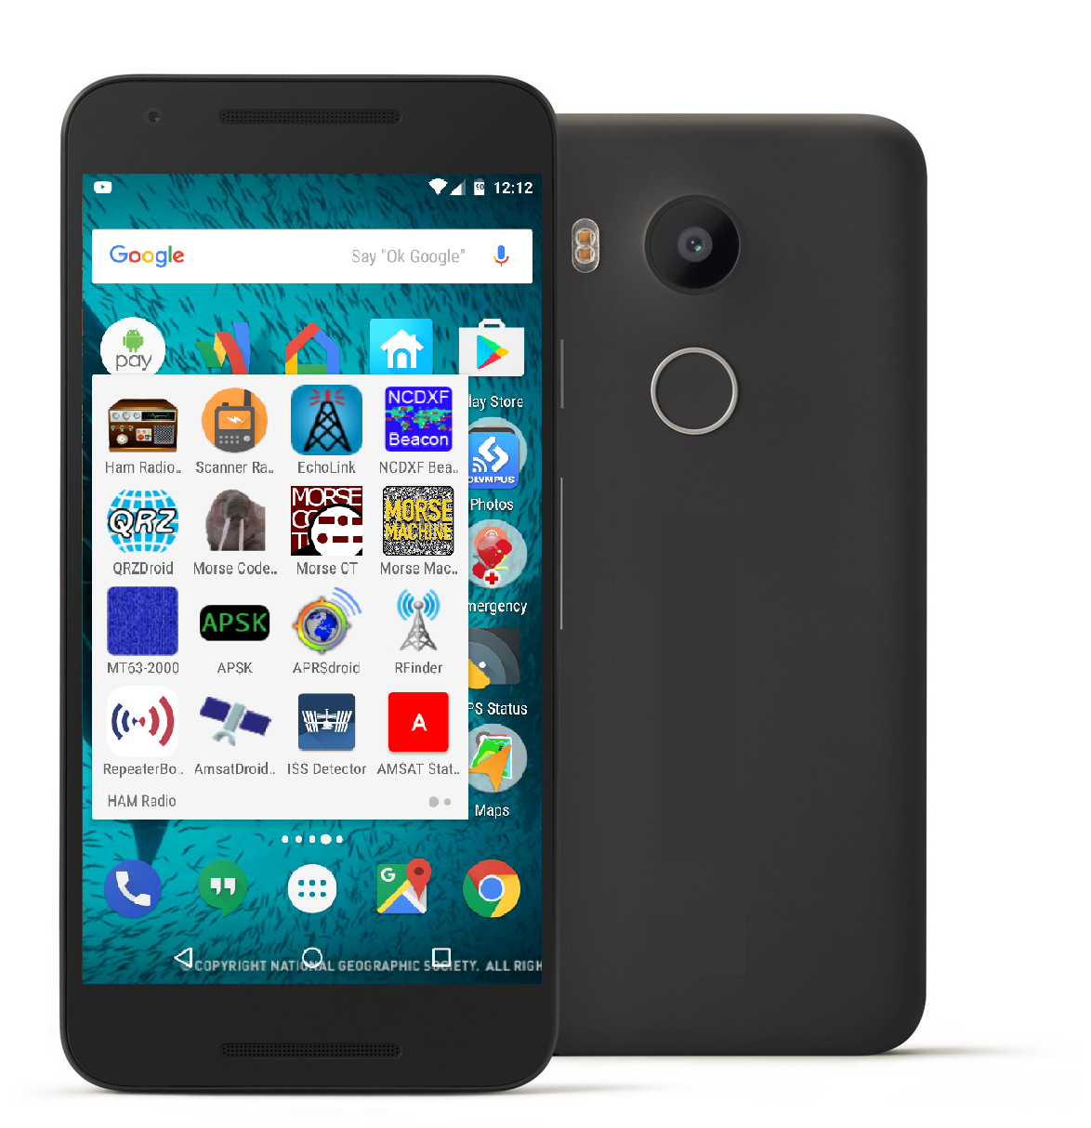
Apps for…
Operating and Listening
CW / Morse Code
Digital Modes
Summits On The Air (SOTA)
Tracking Satellites
License Exam Study
Information / Tools / Utilities
Other useful stuff
Developers to follow
iOS app suggestions
Lists of apps
Q&A

Slide 3
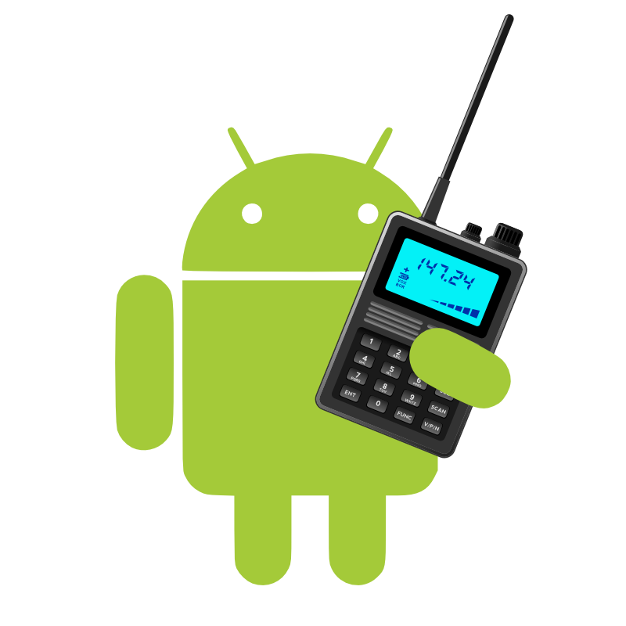

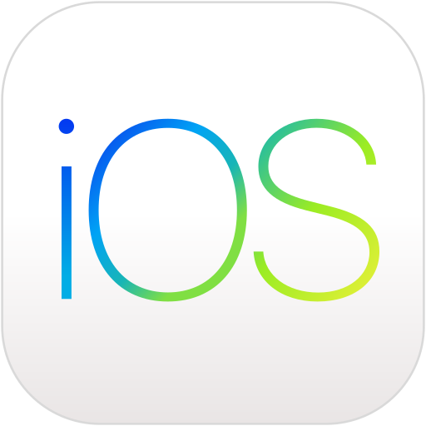
Caveats: incomplete list, mostly Android
This presentation lists apps that I have either tried myself, or have seen positive recommendations for. It is not an exhaustive review, just what I’ve come across so far, and I’m sure there are lots of other interesting and useful ham-related apps out there.
I will focus mostly on Android Apps, since that’s what I use and know. Most apps have a version for iOS (iPhone/iPad) too, or another iOS app with similar functionality.
The fine print: Feel free to reshare or re-use parts of this presentation, just please provide attribution to the creator, and a link back. (CC-BY-4.0)

Slide 4
Operating and Listening
Apps for...
Notes:
TX & RX

Slide 5





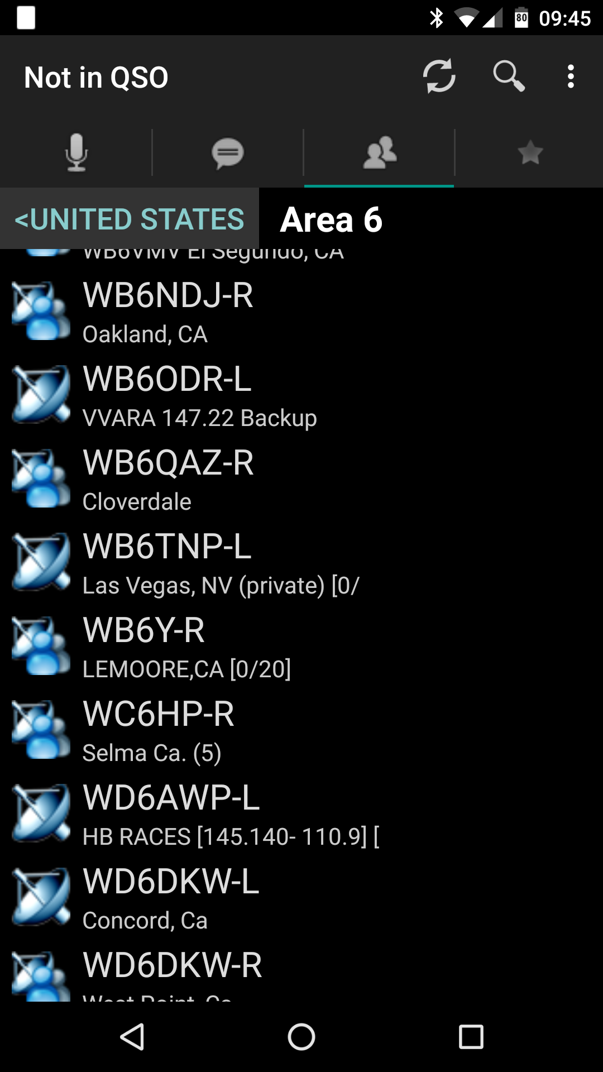
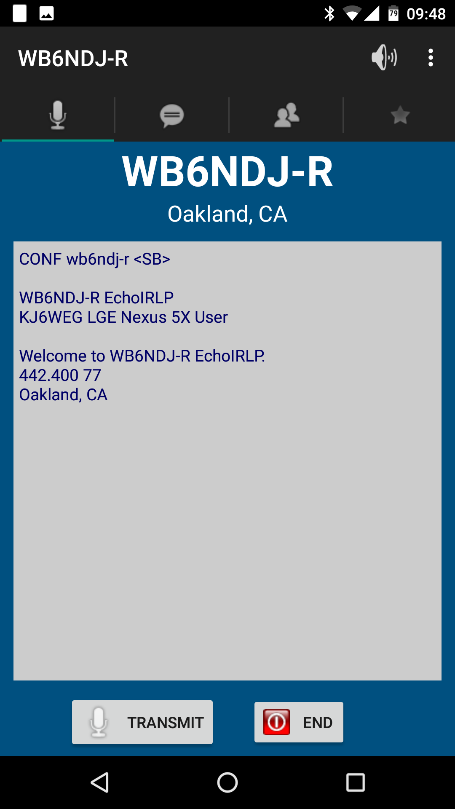
EchoLink
TX & RX via EchoLink system directly from phone or tablet
(no RF required like with IRLP)
Global list of nodes
One connection at a time per node
TIPs:
  Tap once to start TX, tap again to stop (different from PTT)
  On TX, pause before speaking
https://play.google.com/store/apps/details?id=org.echolink.android
https://itunes.apple.com/us/app/echolink/id350688562
http://www.echolink.org

Slide 6
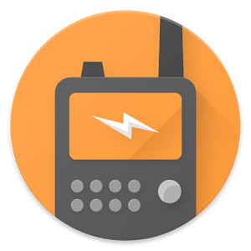

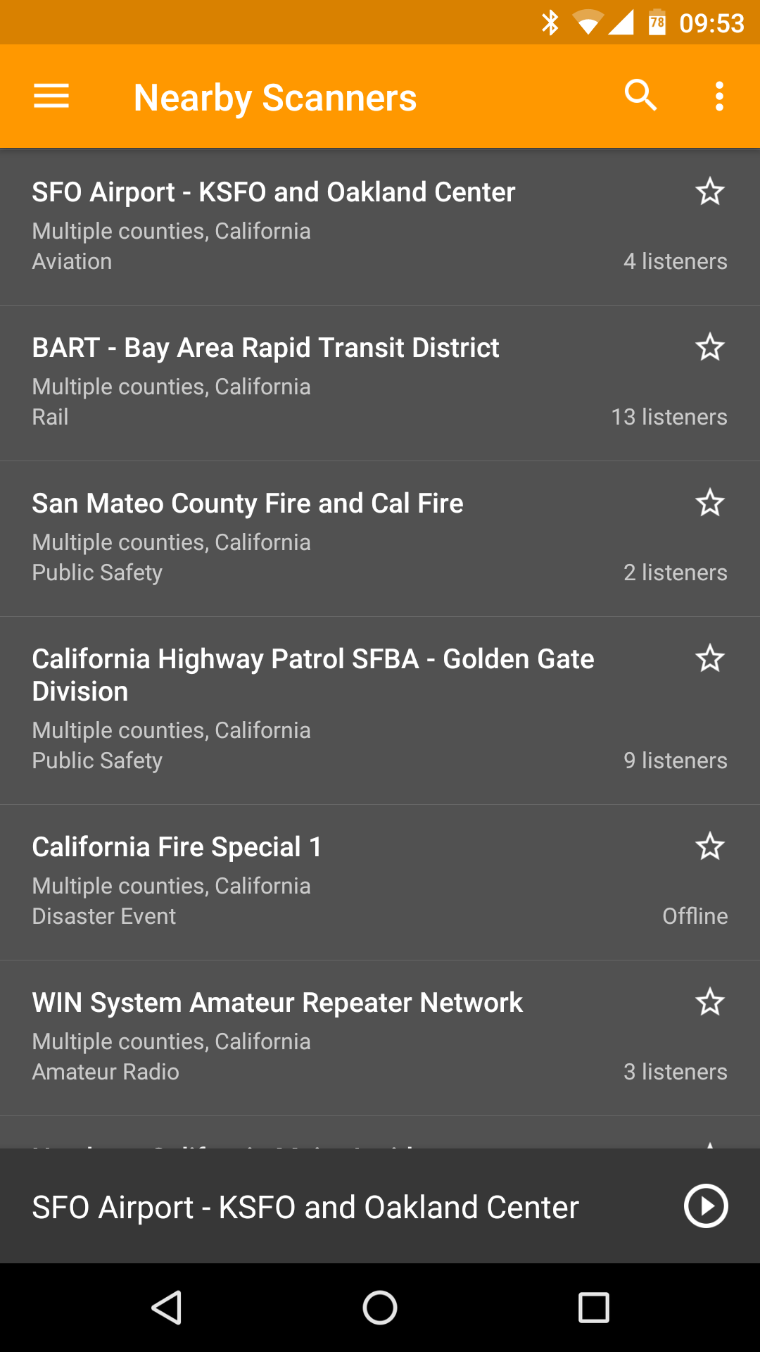
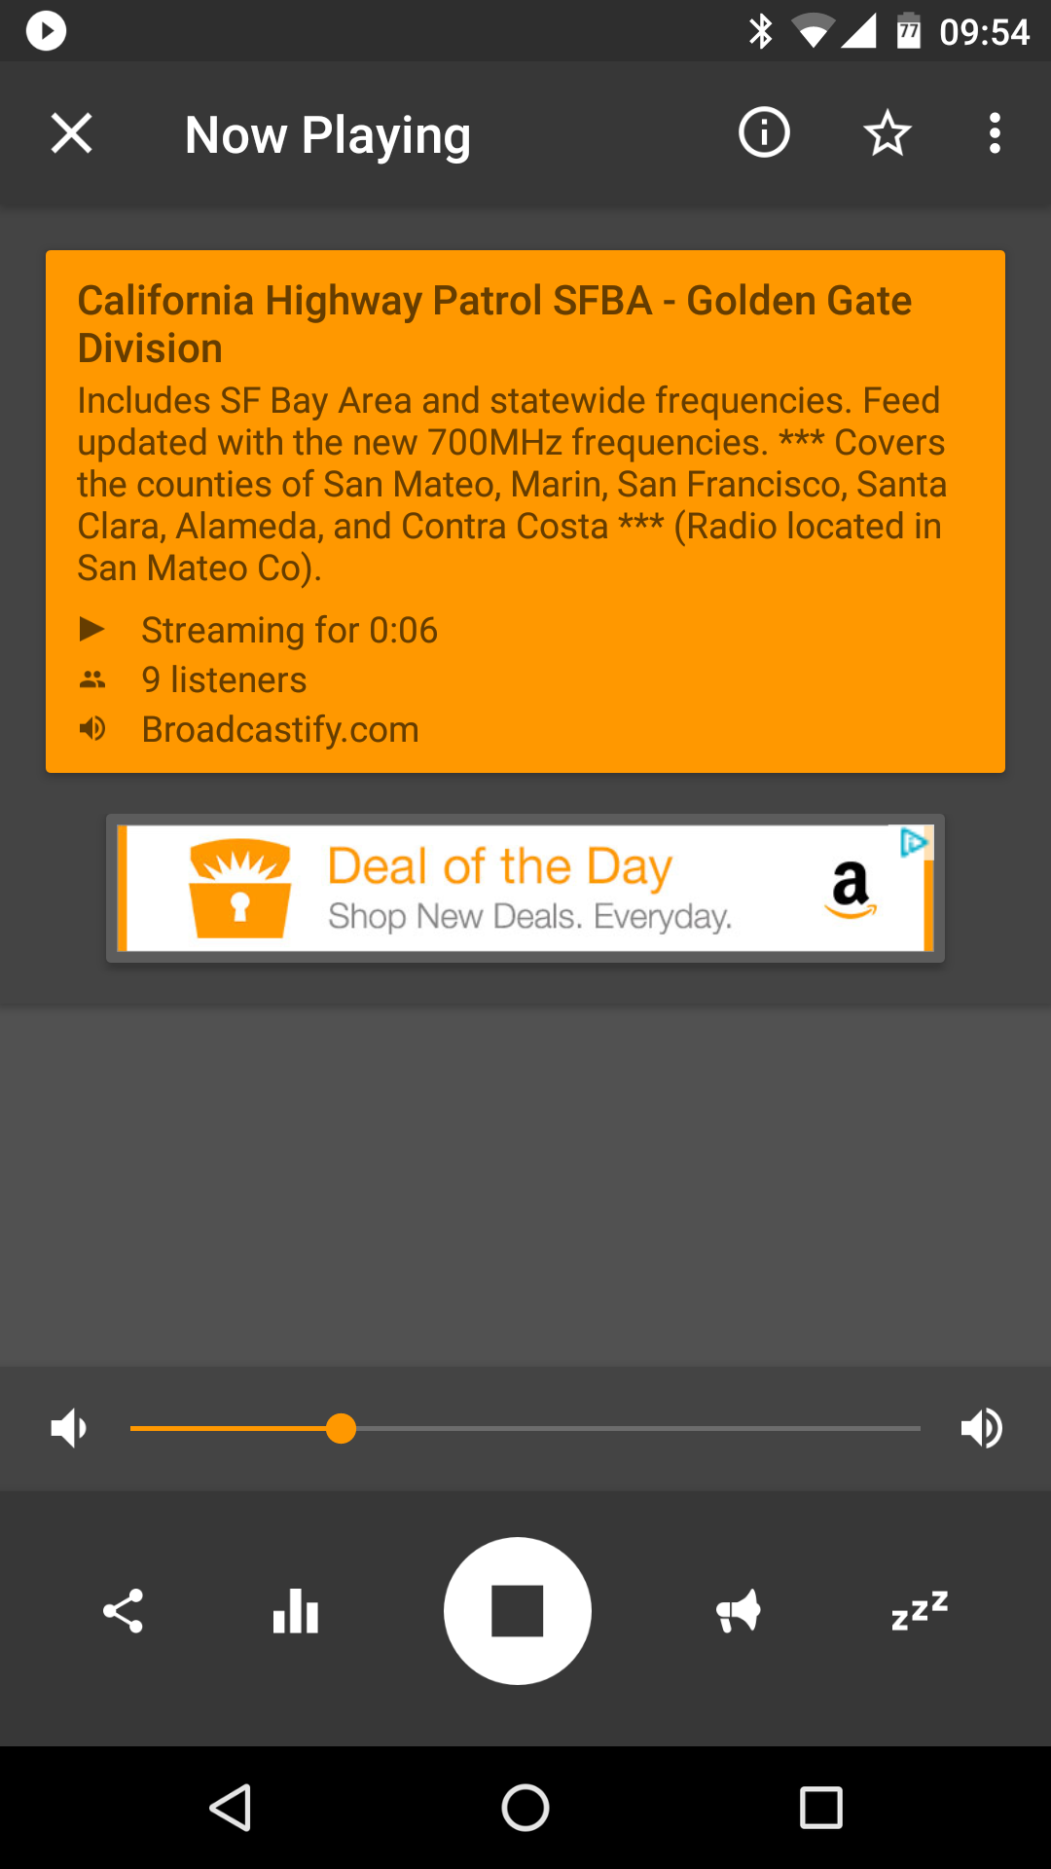
Scanner Radio
Listen to online streams
  Police/Fire/Ambulance
  Airports/ATC
  Amateur Repeaters/Systems
  etc.
Thousands of streams available
Many repeaters not online
Nearby, Favorites, Listener Alerts
https://play.google.com/store/apps/details?id=com.scannerradio
https://itunes.apple.com/us/app/scanner-radio-deluxe/id498405045
http://support.gordonedwards.net

Slide 7
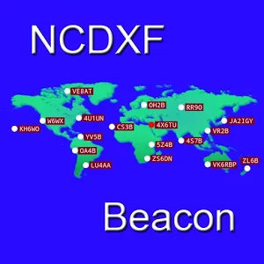
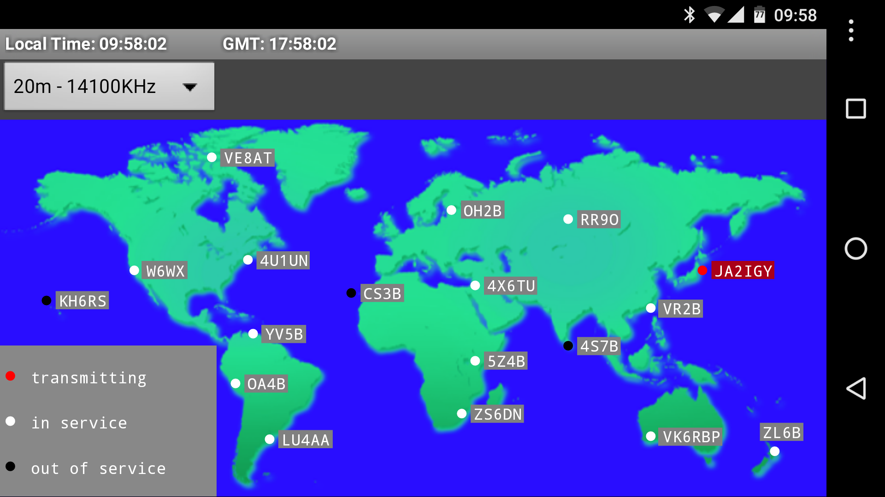
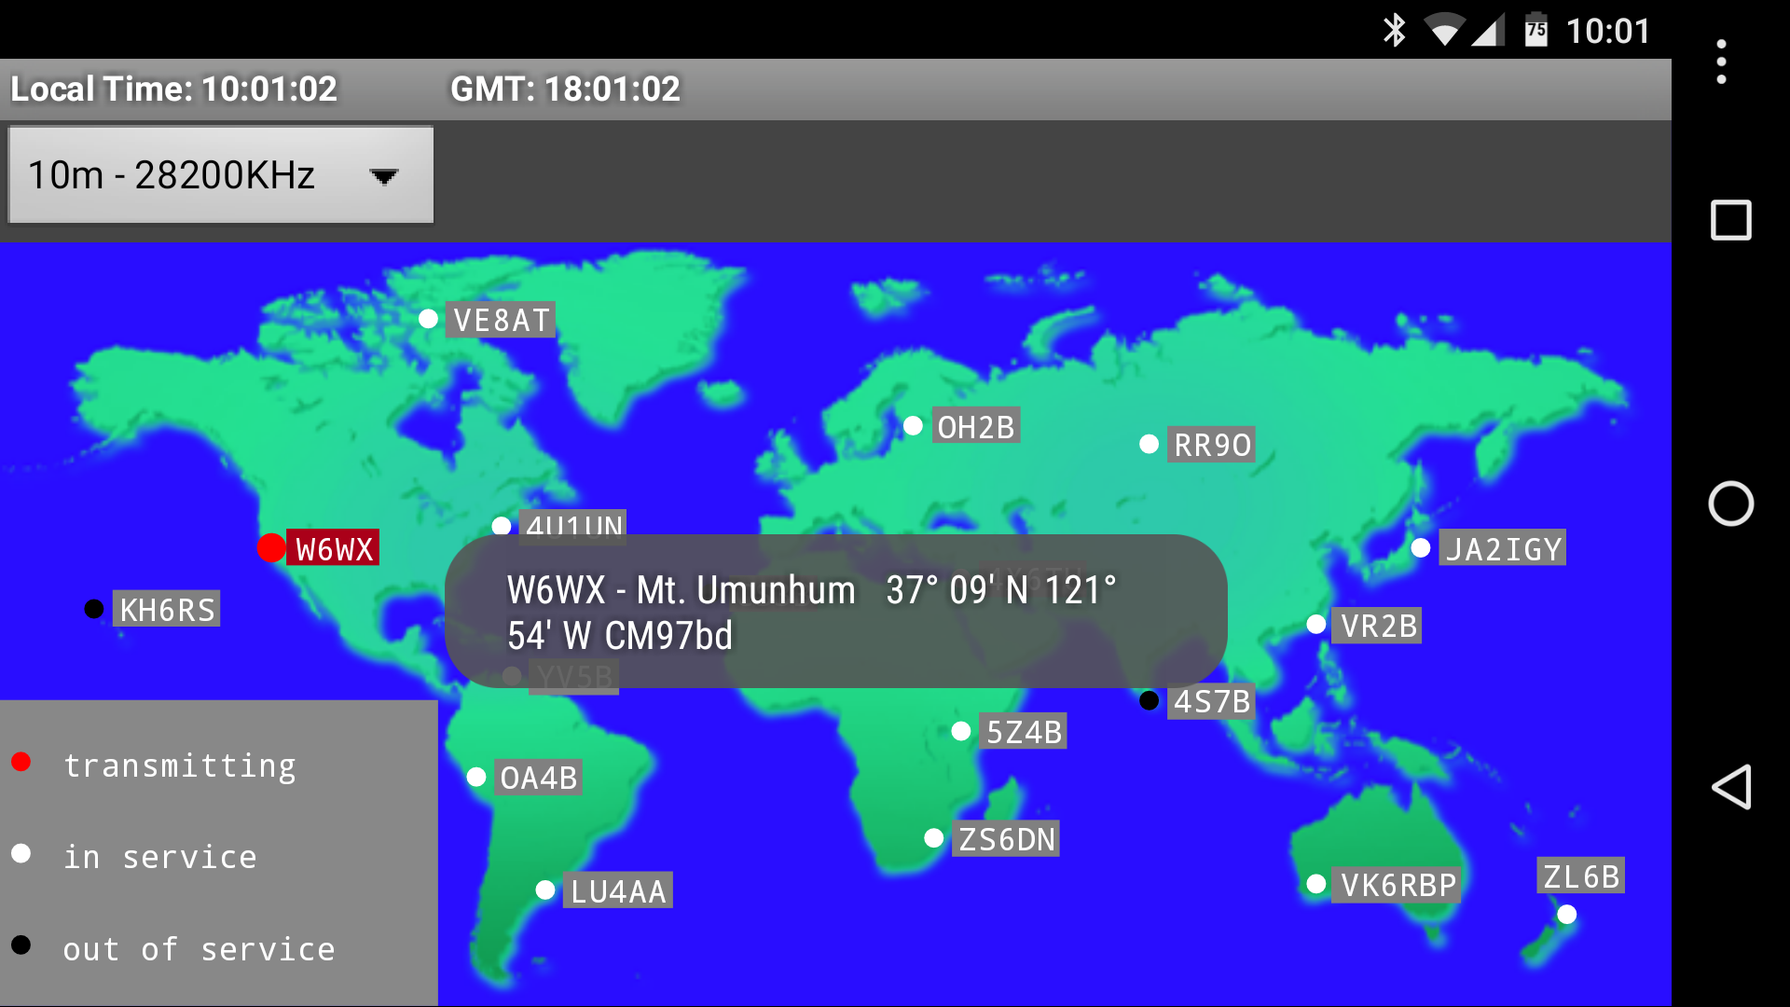
NCDXF Beacon
App provides realtime view of which beacon is currently transmitting
NCDXF beacons transmit 10 seconds, rotating around the world
Bands: 10,12,15,17,20m
Similar iOS app: BeaconAid-HF
https://play.google.com/store/apps/details?id=com.wolphi.clock
https://itunes.apple.com/us/app/beaconaid-hf/id307460004
http://www.ncdxf.org/beacon/beaconprograms.html

Slide 8
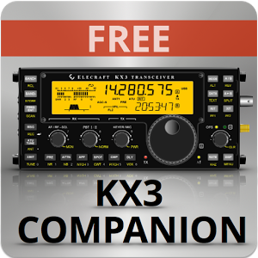
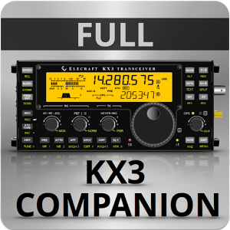

Rig-specific companion apps
KX3 Companion
- Free trial (5 minutes), Full version currently $6.99
- CW, PSK31 & RTTY: TX+RX w/ device keyboard
- Rig Control, Logging, QRZ.com, DXCluster
817 Companion
- Currently $4.49
- Rig Control, Logging, QRZ.com, DXCluster
- Panadapter support with kit

Slide 9
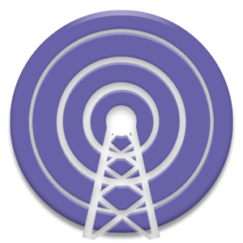
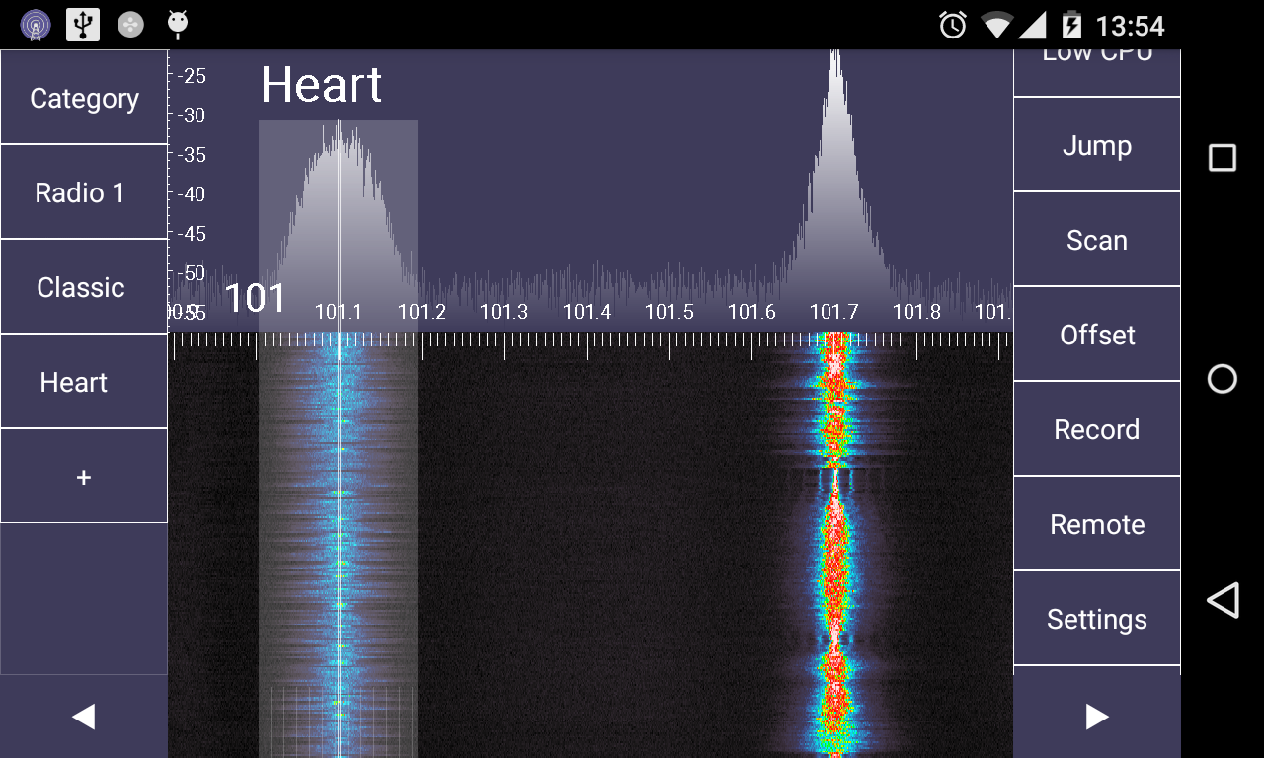
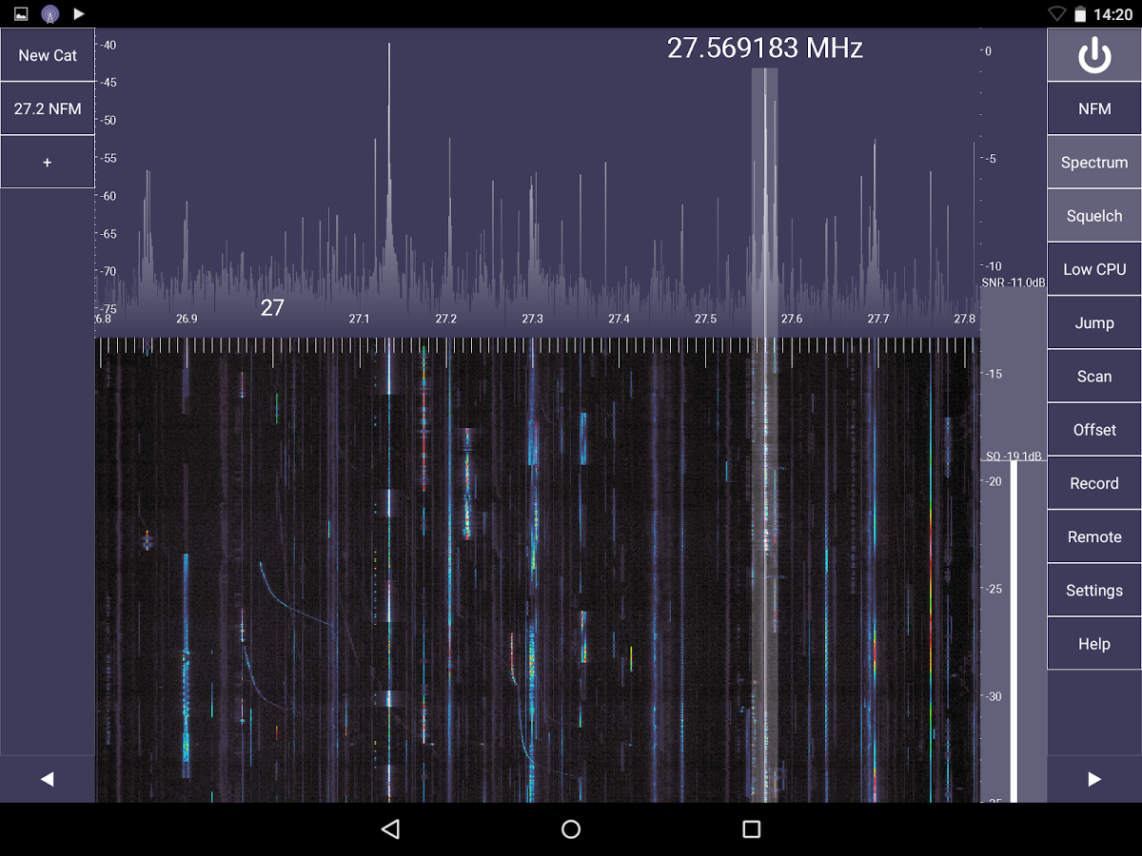
SDR Touch
RX & demodulate (listen to)
FM, AM, SSB, CW signals
Requires compatible USB DVB-T tuner and USB-OTG cable
Free version, $9.99 Pro version adds additional features
Several other SDR apps under development, including for iOS
https://play.google.com/store/apps/details?id=marto.androsdr2
http://sdrtouch.com/
RTL2832U Driver: https://play.google.com/store/apps/details?id=marto.rtl_tcp_andro
Pro version key: https://play.google.com/store/apps/details?id=marto.androsdr.key

Slide 10
CW / Morse Code
Apps for...

Slide 11

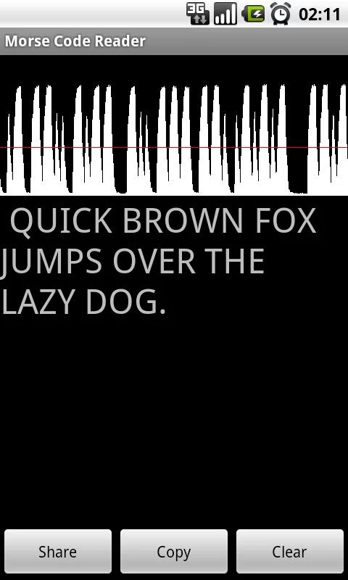
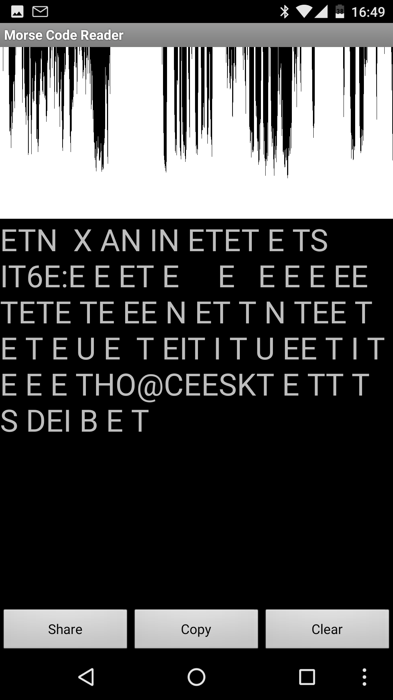
Morse Code Reader
Listens to device’s mic or audio-in
Detects and decodes dits & dahs
Works ok with low noise
Works poorly with ambient noise
Works poorly with RX noise
Listed here just because it was one of my first ham related apps
Android - numerous alternatives
iOS - numerous similar apps available
https://play.google.com/store/apps/details?id=org.jfedor.morsecode

Slide 12

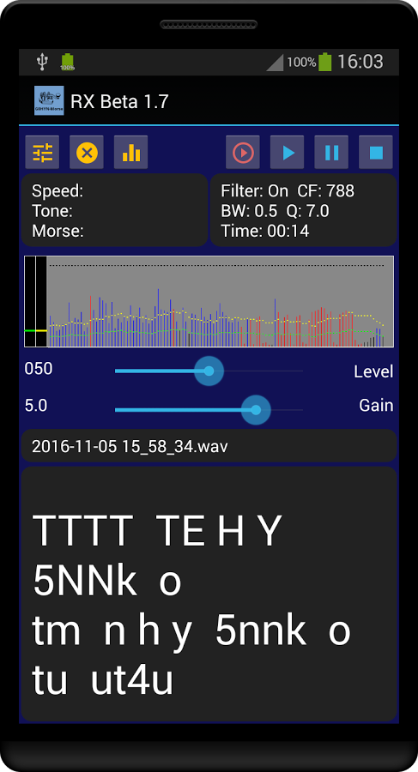
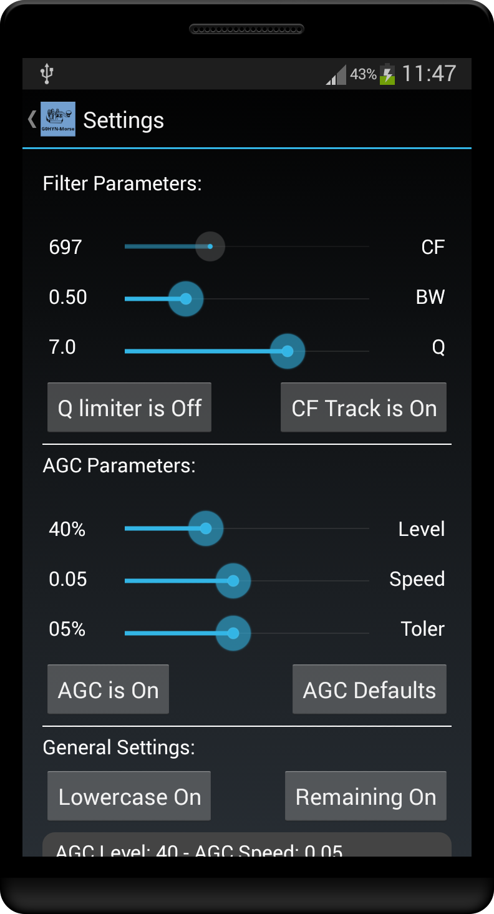
RX Morse
Decodes CW audio into plain text
Input via mic or cable interface
Free
https://play.google.com/store/apps/details?id=com.g0hyn.myrecorder
http://qsl.net/g0hyn/G0HYN-Reader/G0HYN-Reader.html

Slide 13

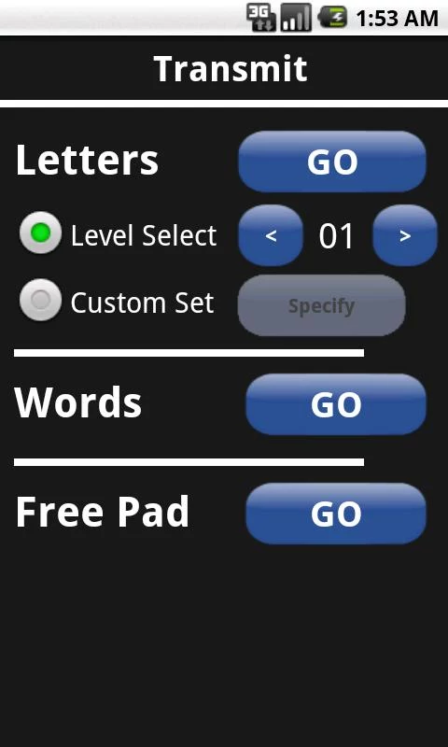
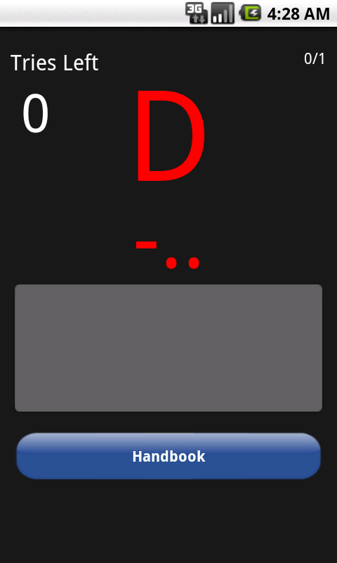
Morse Code Trainer
Basic morse code training
Letter training - TX & RX modes
Word training - TX only
Adjust speed, tone, sound effects
Free version & paid donation to remove ads ($1.00)
https://play.google.com/store/apps/details?id=hunt.morseDit

Slide 14

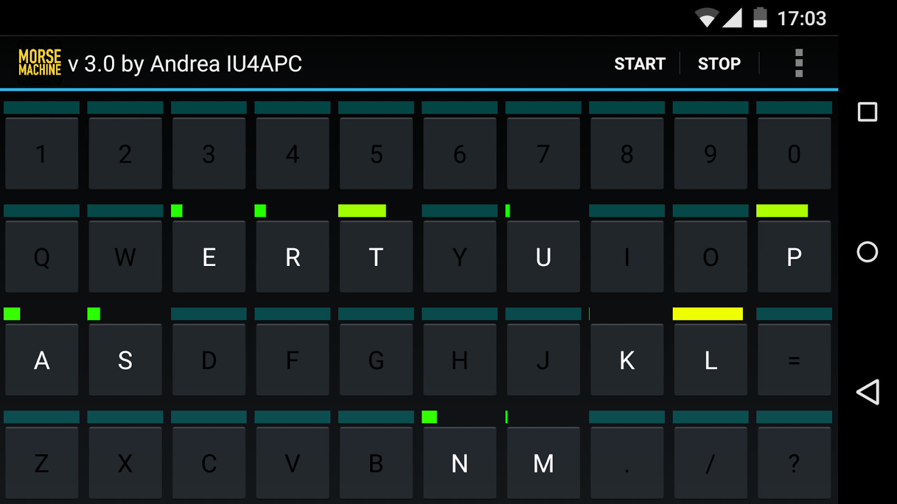
Morse Machine
Learn to receive CW
A game-like experience
Starts with two letters and adds more when it sees you’re ready
Adjusts to focus on what you need
Most engaging CW training app that I’ve tried so far
Well worth the low price ($0.99)
https://play.google.com/store/apps/details?id=com.iu4apc.morsemachine
https://alphapapacharlie.com/2015/01/26/morse-machine/

Slide 15

Many more CW apps out there!
All sorts of learning / training apps
Better automatic readers/decoders (quality costs $$)
Send & Receive CW via light!
etc!

Slide 16
Digital Modes
Apps for...

Slide 17

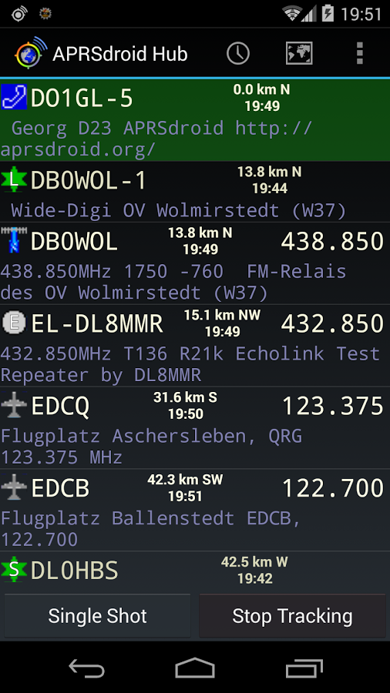
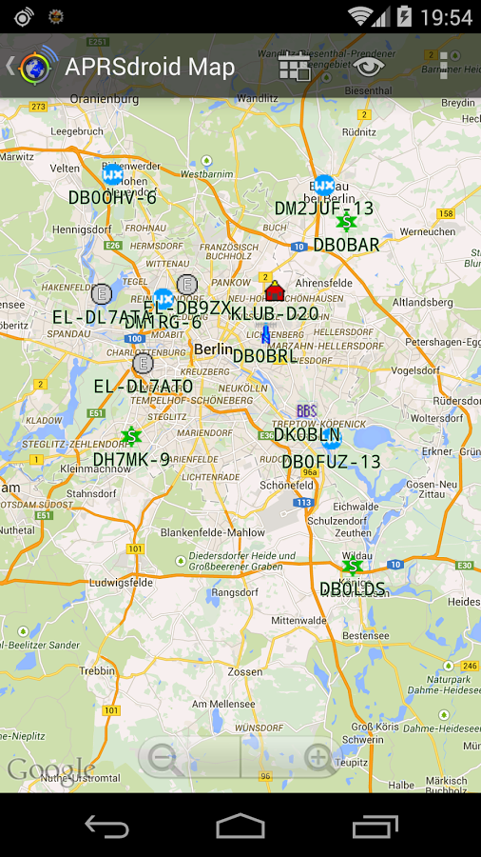
APRSdroid
APRS operating app
See nearby stations on list & map
Report position via internet
Beacon, tracking, messaging, etc.
Costs $4.95
Requires APRS-IS passcode (free)
Several iOS apps for APRS
https://play.google.com/store/apps/details?id=org.aprsdroid.app
https://aprsdroid.org/

Slide 18

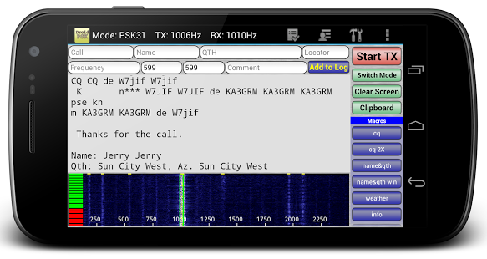
Droid PSK
Well reviewed app for PSK operation
Connect via phone mic & speakers
Decode & Encode
BPSK31 & BPSK63
Costs $5.49
I have not tried it yet
For iOS see PSK31 app ($2.99)
https://play.google.com/store/apps/details?id=com.wolphi.psk31
http://www.wolphi.com/ham-radio-apps/droidpsk/

Slide 19
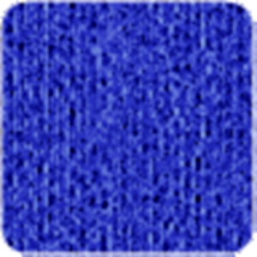


Other Digital Modes
MT63-2000
- Send & receive MT63-2000
- uses acoustic coupling to a radio
APSK
- RX Decoding only, through mic
DroidRTTY
- Decode & Encode RTTY
- uses phone mic & speakers, or wired connection
- Costs $5.49, I have not tried it yet.

Slide 20
Summits On The Air (SOTA)
Apps for...

Slide 21

Summits On The Air Apps
SOTAWatch (app)
https://play.google.com/store/apps/details?id=com.e71dx.sotawatch
SOTAWatch Spotlite v2 (web app / bookmark)
http://www.sota.org.uk/Spotlite
SOTAMaps (bookmark)
www.sotamaps.org
SOTA Spotter (app)
https://play.google.com/store/apps/details?id=ro.netroute.sotaspotter
http://www.sota.org.uk/

Slide 22
Tracking Satellites
Apps for...

Slide 23

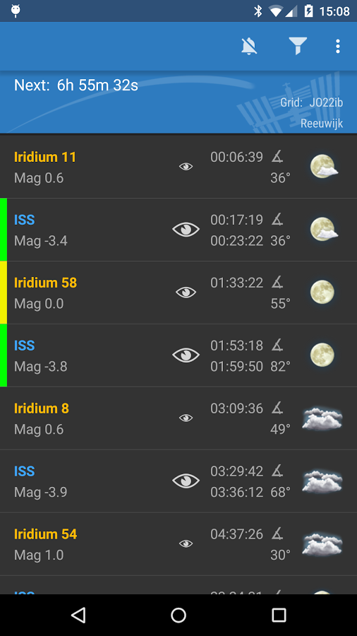
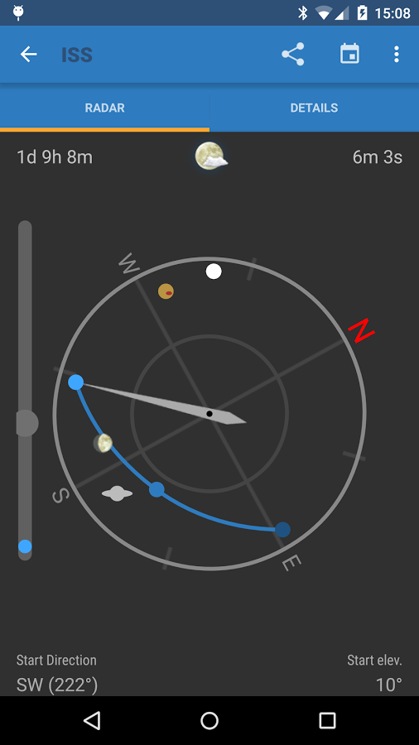
ISS Detector
Satellite Tracking
List of upcoming passes
Notifications / Alerts
Precise timing
Compass & Elevation view
Free: ISS & Iridium (visible flares)
Paid add-on datasets:
  Commets & Planets
  Amateur Radio satellites
  Famous objects (Hubble, Chinese SS)
https://play.google.com/store/apps/details?id=com.runar.issdetector
http://www.issdetector.com/

Slide 24

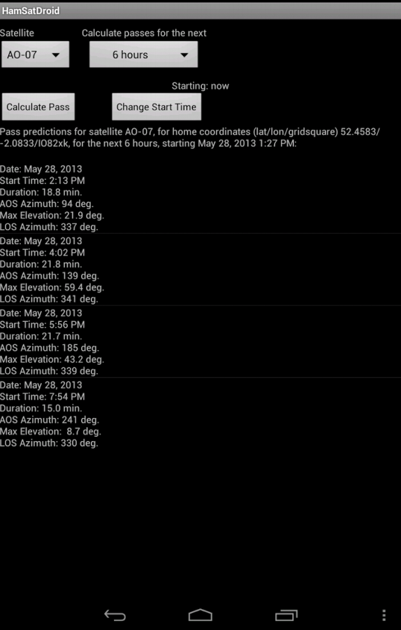
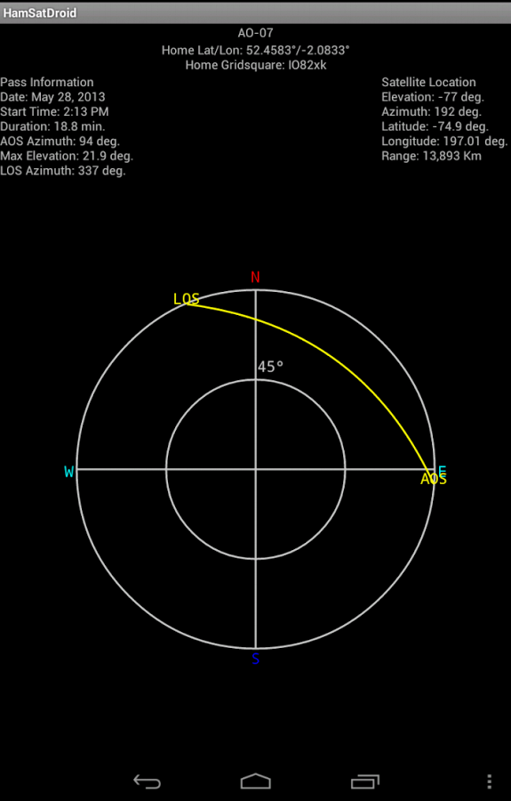
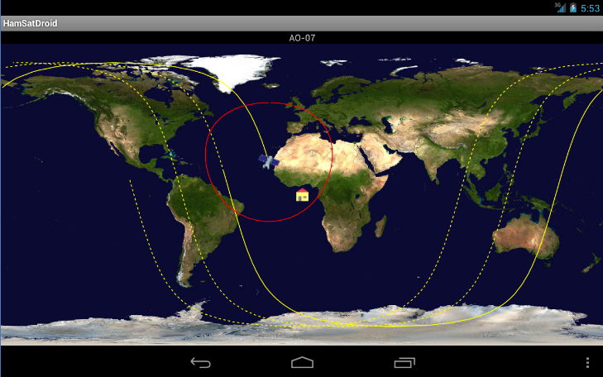
AmsatDroid
Free Ham Sat tracking
Have to know beforehand which satellite you want
https://play.google.com/store/apps/detailsid=uk.me.g4dpz.HamSatDroid
http://www.g4dpz.me.uk/

Slide 25

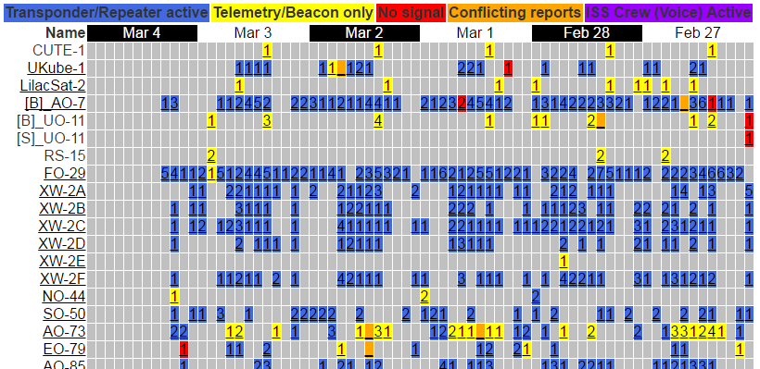
www.amsat.org/status/ (bookmark)
Great website for choosing amateur radio satellites
Recent status & reports
http://www.amsat.org/status/

Slide 26
License Exam Study
Apps for...

Slide 27

License Exam / Study / Test Prep
LOTS of test study apps out there
Search the Play Store or App Store
Use your favorite search engine
Look for online reviews from trusted sources

Slide 28
Information / Tools / Utilities
Apps for...

Slide 29
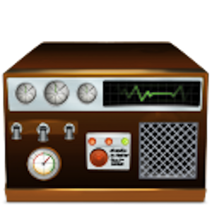
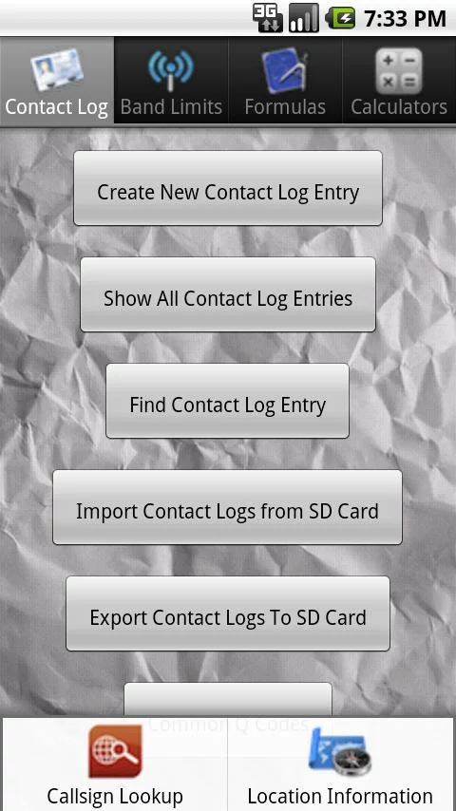
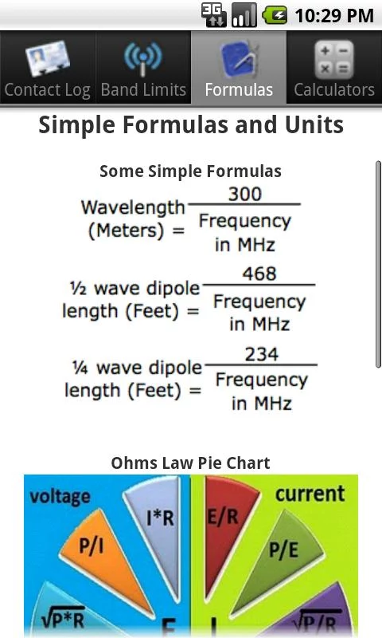
Ham Radio Tools
Includes a variety of tools...
Contact Log
Band Limits
Common Formulas
Antenna Calculators:
vertical, jpole, dipole, yagi
Common Q Codes
Callsign Search
Location Info
https://play.google.com/store/apps/details?id=chris.ham.radioTools

Slide 30
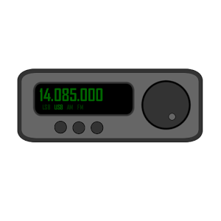
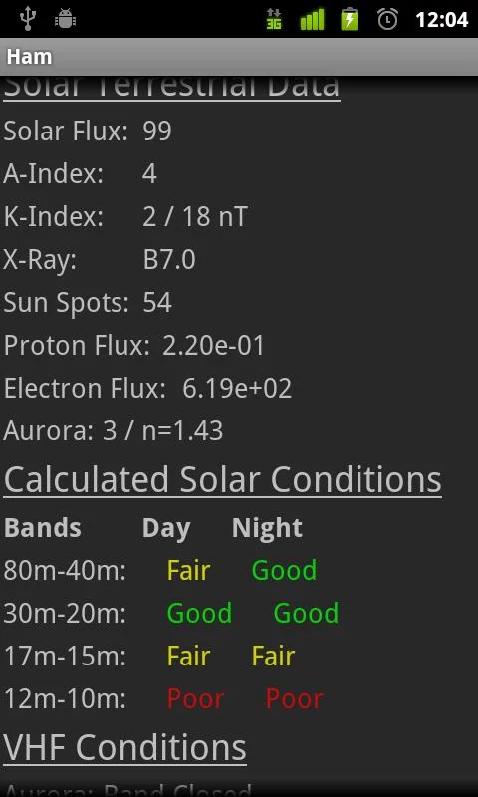
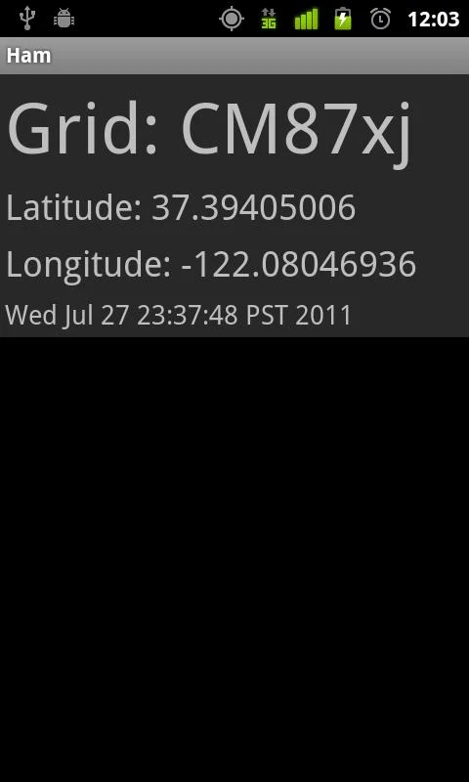
Ham
Basic, open-source app
Solar Conditions (from N0NBH, www.hamqsl.com/solar.html)
Maidenhead Grid Locator
Callsign Lookup (requires QRZ.com XML Subscription)
https://play.google.com/store/apps/details?id=com.smerty.ham
https://github.com/smerty

Slide 31
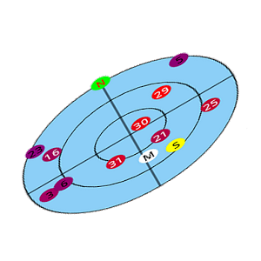
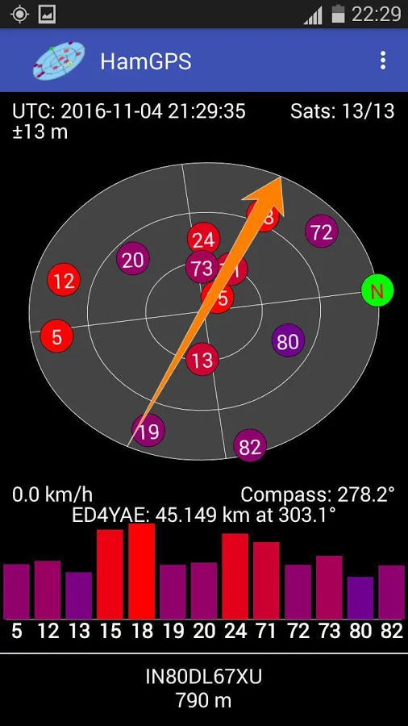
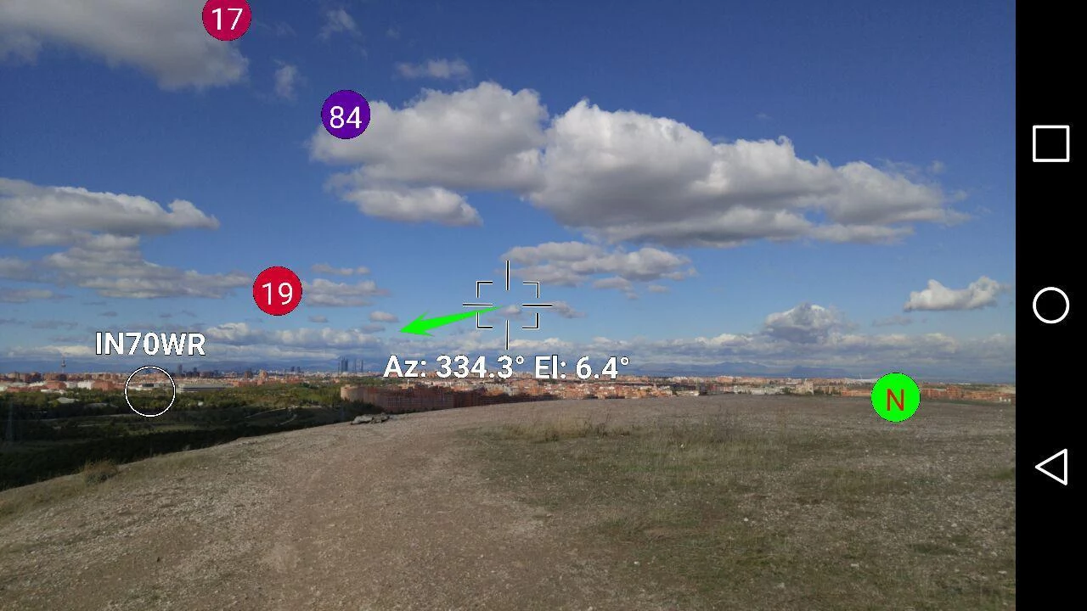
HamGPS
Basic app with good location data:
Grid Square (high accuracy, 10 digits)
GPS System Time
GPS Satellite Status
Compass readout
Device sensor data
Augmented reality
location viewer!
https://play.google.com/store/apps/details?id=ea4eoz.HamGPS
http://ea4eoz.blogspot.com/p/hamgps.html

Slide 32

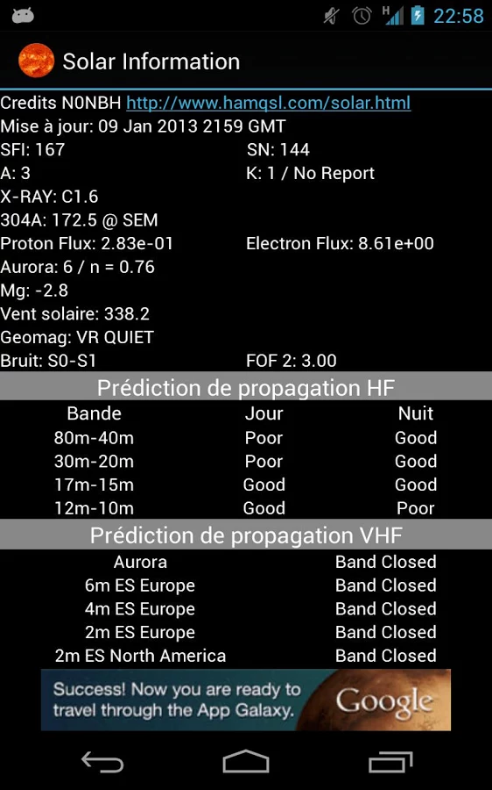
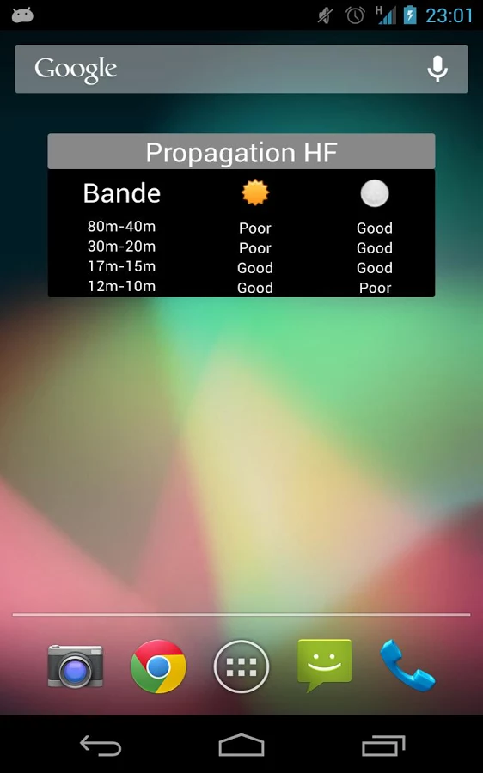
Solar data & HF propagation
“Solar Information” App
Solar Data comes from N0NBH: www.hamqsl.com/solar.html
HF & VHF Propagation estimates
https://play.google.com/store/apps/details?id=com.myHamAp.solarData
www.hamqsl.com/solar.html

Slide 33
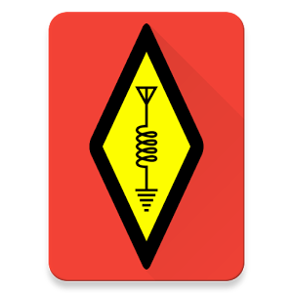
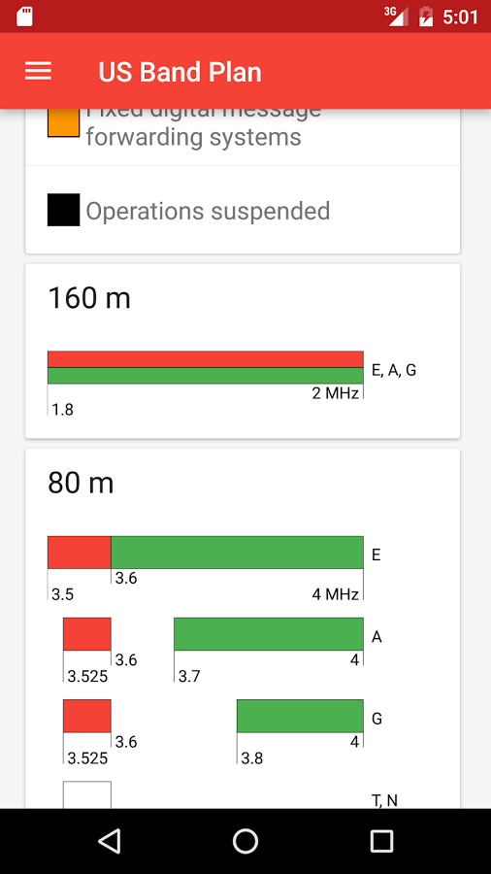
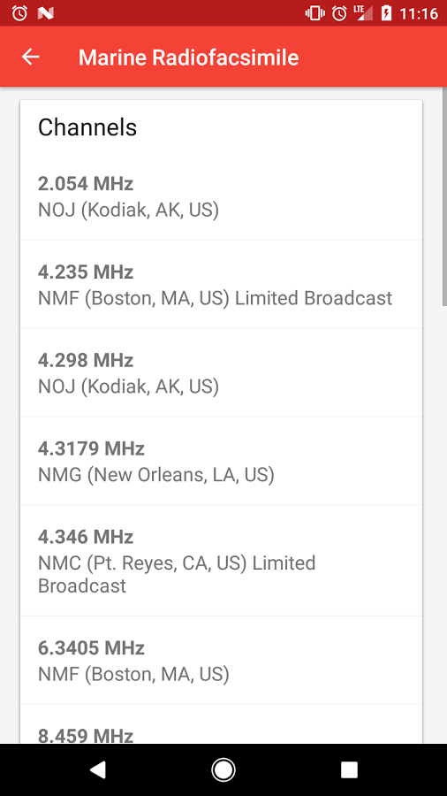
Ham Bands
US Amateur Radio Band Plan app
US Band Plan diagrams
Click for details & restrictions
Filter by license class!
Non-Ham bands (CB, FRS/GMRS, MURS, Marine, NIST, NOAA weather)
Callsign Lookup (via hamdb.org)
https://play.google.com/store/apps/details?id=com.kimbrelk.ham

Slide 34

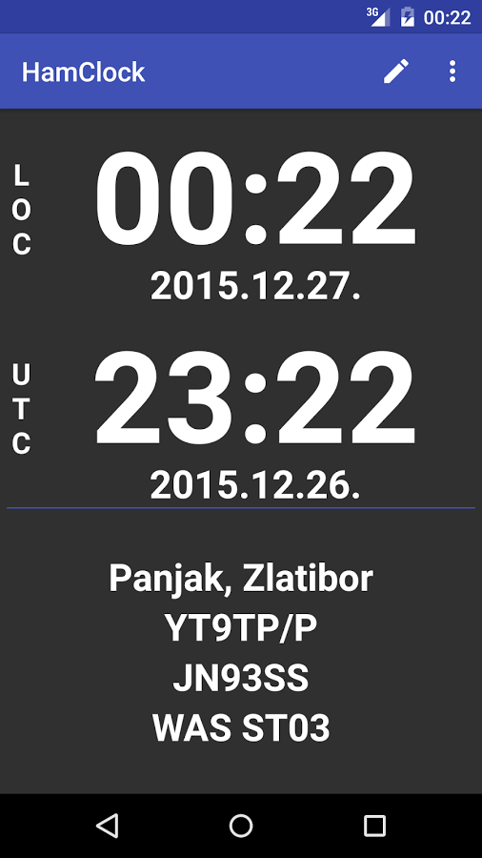
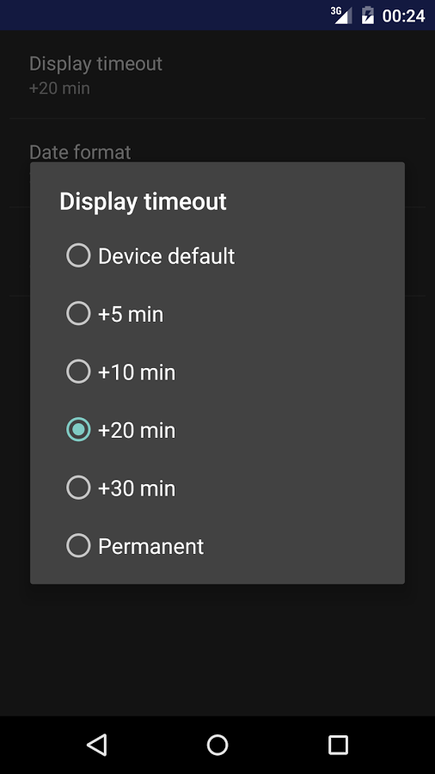
HamClock
Large display
UTC & Local time
Notes fields for operating reminders
https://play.google.com/store/apps/details?id=cc.kostic.hamclock

Slide 35

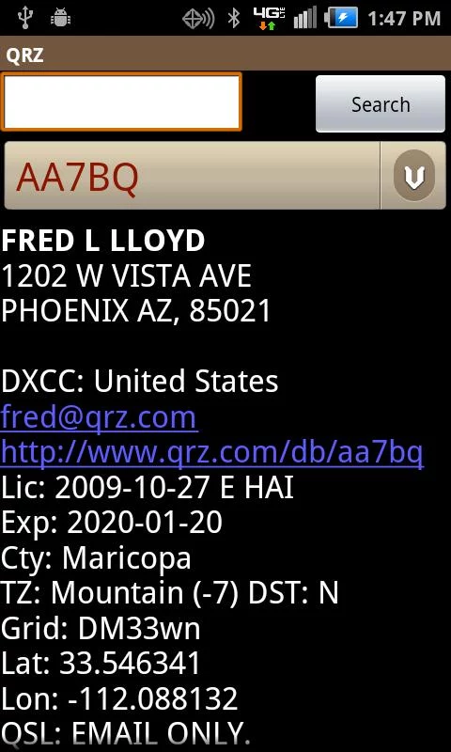

QRZDroid
Callsign lookup through QRZ.com
No subscription required
iOS version: “Callsign Search”
https://play.google.com/store/apps/details?id=com.qrz.database.callsign
https://itunes.apple.com/us/app/callsign-search/id680180116
https://www.qrz.com/

Slide 36



Pocket Prefix
Live DX Cluster
Callsign lookup
Heading & Distance display
I haven’t used this yet, but looks like a good cluster app
https://play.google.com/store/apps/details?id=g4swy.prefixdecoder.lite

Slide 37



RFinder
Nearby Repeater List
EchoLink Nodes
Callsign Lookup
Repeater maps w/ coverage
Repeater info update tool
Recently ARRL affiliated
App is free, BUT…
WWRD Subscription required $$
https://play.google.com/store/apps/details?id=com.w2cyk.android.rfinder
https://itunes.apple.com/us/app/rfinder-world-wide-repeater-directory/id505364515
http://www.rfinder.net/blog/

Slide 38



RepeaterBook
Nearby Repeaters List
Uses Open-Source repeater directory
BlueCat support (bluetooth CAT control - top repeater to tune)
https://play.google.com/store/apps/details?id=com.zbm2.repeaterbook
http://itunes.apple.com/us/artist/zbm2-software/id606820189
http://www.zbm2.com/

Slide 39



Ham Radio Podcasts Free
Ham Radio specific Podcast Player
Free and paid versions ($3.99)
https://play.google.com/store/apps/details?id=com.andromo.dev5592.app509392
http://www.holyoak.com/

Slide 40
Other useful stuff…
(non-ham-specific apps)
Notes:
General purpose apps that do useful things for ham activities

Slide 41



GPS Status & Toolbox
Best GPS app I’ve found
Satellite status
Location & Time
View all phone sensor data
Save locations / set waypoints
Navigate to waypoints
Free version, Pro cost $3.73
https://play.google.com/store/apps/details?id=com.eclipsim.gpsstatus2
https://mobiwia.com/gpsstatus

Slide 42



Wifi Analyzer
View WiFi access points / hotspots
View frequency usage
2.4GHz and 5GHz bands
Choose open frequencies for your hotspot
Get details on APs/hotspots
https://play.google.com/store/apps/details?id=com.farproc.wifi.analyzer
http://a.farproc.com/wifi-analyzer

Slide 43



Sound Analyser
Easily view audio spectrum
Variety of visualizations
Similar apps available for iOS
https://play.google.com/store/apps/details?id=com.zephyr.soundAnalyserPRO

Slide 44



Electro Droid
Electronics info & tools
LOTS of info options!
Free & Pro versions
iOS versions available
https://play.google.com/store/apps/details?id=it.android.demi.elettronica
https://itunes.apple.com/us/app/electrodroid-pro/id1146647134
http://electrodroid.it/

Slide 45
Almost done...

Slide 46

Apps I paid for (so far)
APRSdroid (APRS client) $ 4.95
Morse Machine for Ham Radio (learn CW) $ 0.99
ISS Detector - Extension Combo Pack
(satellite tracking datasets) $ 2.49
GPS Status - PRO key (no ads) $ 3.73
Total: $12.16
A lot cheaper than the HTC RFinder $749.00 ;-) ==>>
(smartphone/HT combos are starting to appear!!)

Slide 47
Android Developers to Watch
These devs both build numerous good quality Ham apps, though most cost $$.
Wolphi
Play store: play.google.com/store/apps/developer?id=Wolphi+LLC
Website: http://www.wolphi.com/ham-radio-apps/
Andrea Salvatore IU4APC
Play store: play.google.com/store/apps/developer?id=Andrea+Salvatore+IU4APC
Website: https://alphapapacharlie.com

Slide 48






iOS apps suggested by fellow club members
These are apps that club members said they use (or have seen) for iOS. Some are duplicates of those listed above. I have not verified any of these myself.
EchoLink (app store link)
Repeater Book (app store link)
Callsign Search by QRZ (app store link)
CommCat Mobile (app store link)
DX Toolbox (app store link)
Ham Radio Deocder Bundle (app store link)
more on next page...

Slide 49









More suggested iOS apps…
Amateur Radio Exam Prep: Extra (app store link)
SSTV Slow Scan TV (app store link)
Ham Sphere (app store link)
Ham I Am (app store link)
Q Codes Reference (app store link)
Scanner Radio Deluxe (app store link)
Smart SDR (for Flex Radio) (app store link)
WSPR Watch (app store link)
Remote Ham Radio (app store link)

Slide 50

A List of Lists of more apps
A few lists I found… can’t really vouch for any of them.
Some are Android only, some iOS only, some both:
The SWLing Post - The Best Amateur Radio and Shortwave apps for iOS and Android Smart Phones (Dec 2016) (link)
DX Zone - Software: Android (link)
G0HWC - The Android Ham radio apps (link)
KC0OIO / W0GAF presentation (pdf download)
DX Zone - Remote your radio article (link)
The KØNR Radio Site - iPhone apps list (2014): (link)
SCRA - Smartphone Apps: (link)

Slide 51
Thank you!
Ideas? Questions?
73 KJ6WEG

