Slide 1
Disclaimer: The information in the following slides are a guide to assist in the Sales Tax Registration Process. At the end of the registration process, there will be a submit button. Once submit is clicked, the business has registered with the state and is obligated to the state filing frequencies and, if any, fees and penalties. Businesses should contact Sales Tax and More before hitting submit if questions arise. Unfortunately, your registration process will need to start over as states typically have a timeout period. There is a fee associated with the assistance of the registration. If the slides show information that is not consistent with what is shown on the website, please contact us, and we will correct this information as quickly as possible. Call Sales Tax and More at (972) 737-4559 or email info@salestaxandmore.com

Slide 2
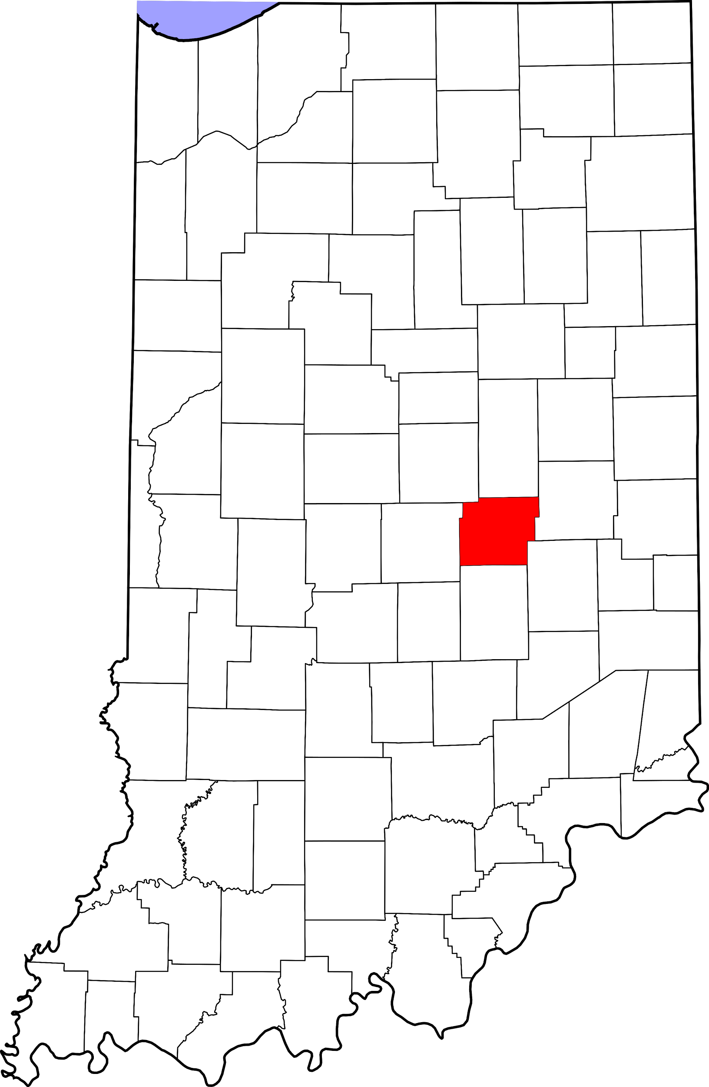
Indiana Sales Tax Registration Instructions
https://www.in.gov/dor/3731.htm
Choose Form BT - 1
Tax Type: Out-of-State Use Tax
https://www.salestaxandmore.com/

Slide 3
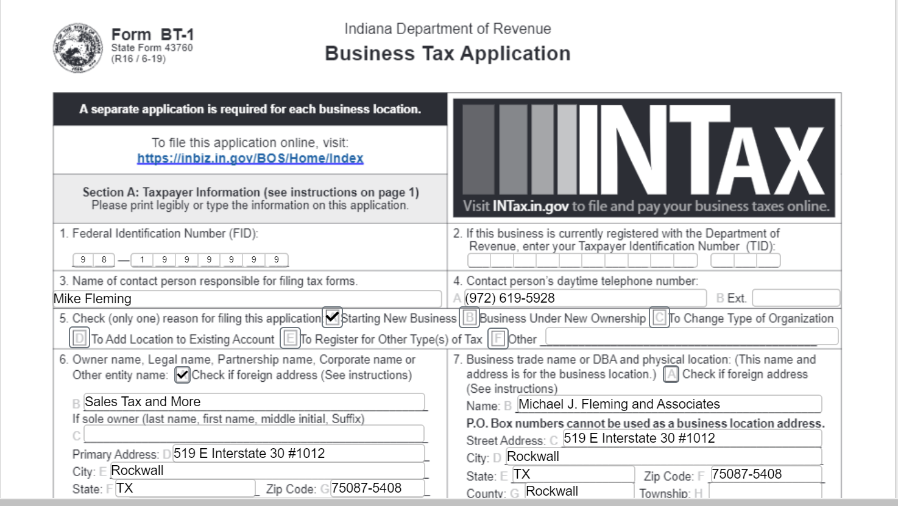
Sales Tax and More - IN Registration
Section A
Enter - FEIN
Typically skip
Enter - Contact person’s name
Enter - Contact person’s phone #
Check - Reason for filing
a) Check - If non-USA address
b) Enter - Name of Business
c) Enter - Sole owner or skip
d-h) Enter - Primary address
a) Check - If non-USA address
b) Enter - DBA name
c-h) Enter - Physical location of business
https://www.salestaxandmore.com/

Slide 4
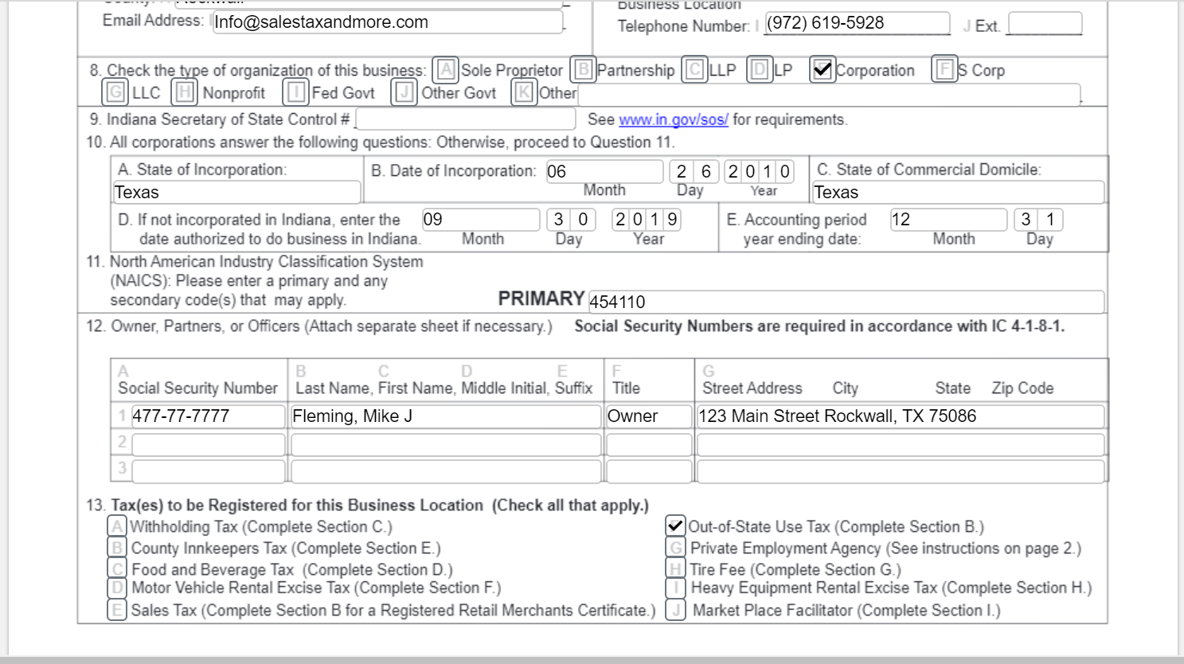
Sales Tax and More - IN Registration
6. Enter - Email address of contact person
7. Enter - Phone number of business location
8. Check - Type of business
9. Skip
10. Enter
a) State of Incorporation
b) Date of Incorporation
c) State of Domicile
d) Enter date to do business in
Indiana
e) Enter end of accounting
period
11. Enter - 454110, typically
12. a-g) Enter - Owner information
https://www.salestaxandmore.com/

Slide 5
Sales Tax and More - IN Registration
13. Leave blank, unless a marketplace facilitator
14. Check - Out of State Use Tax
https://www.salestaxandmore.com/

Slide 6
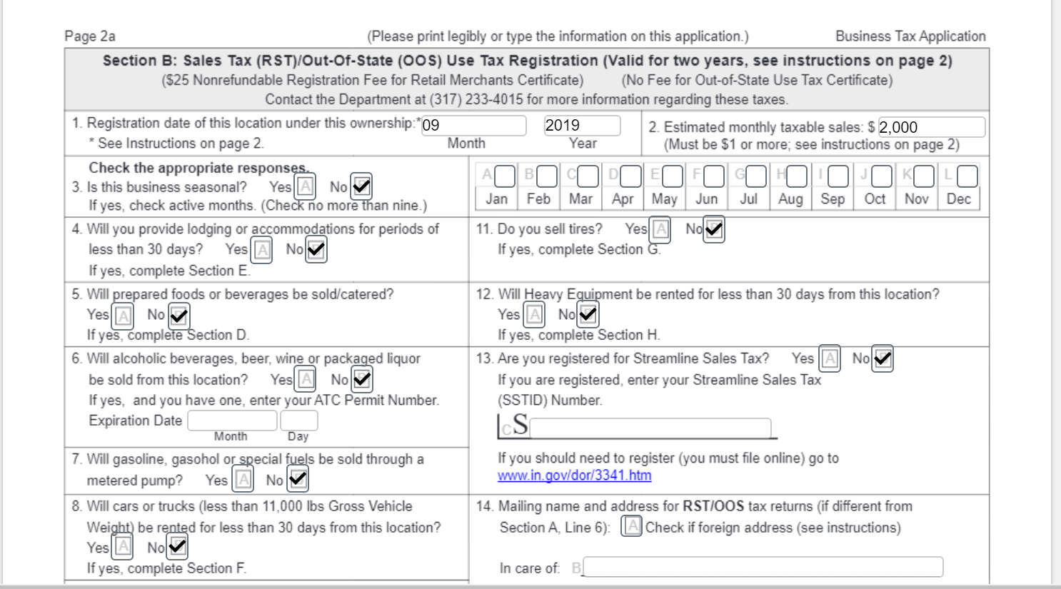
Sales Tax and More - IN Registration
Section B
Enter - Date sales begin in Indiana
Enter - Estimated dollar amounts for sales in Indiana
Check - No, typically for the next nine questions
14. Skip
https://www.salestaxandmore.com/

Slide 7
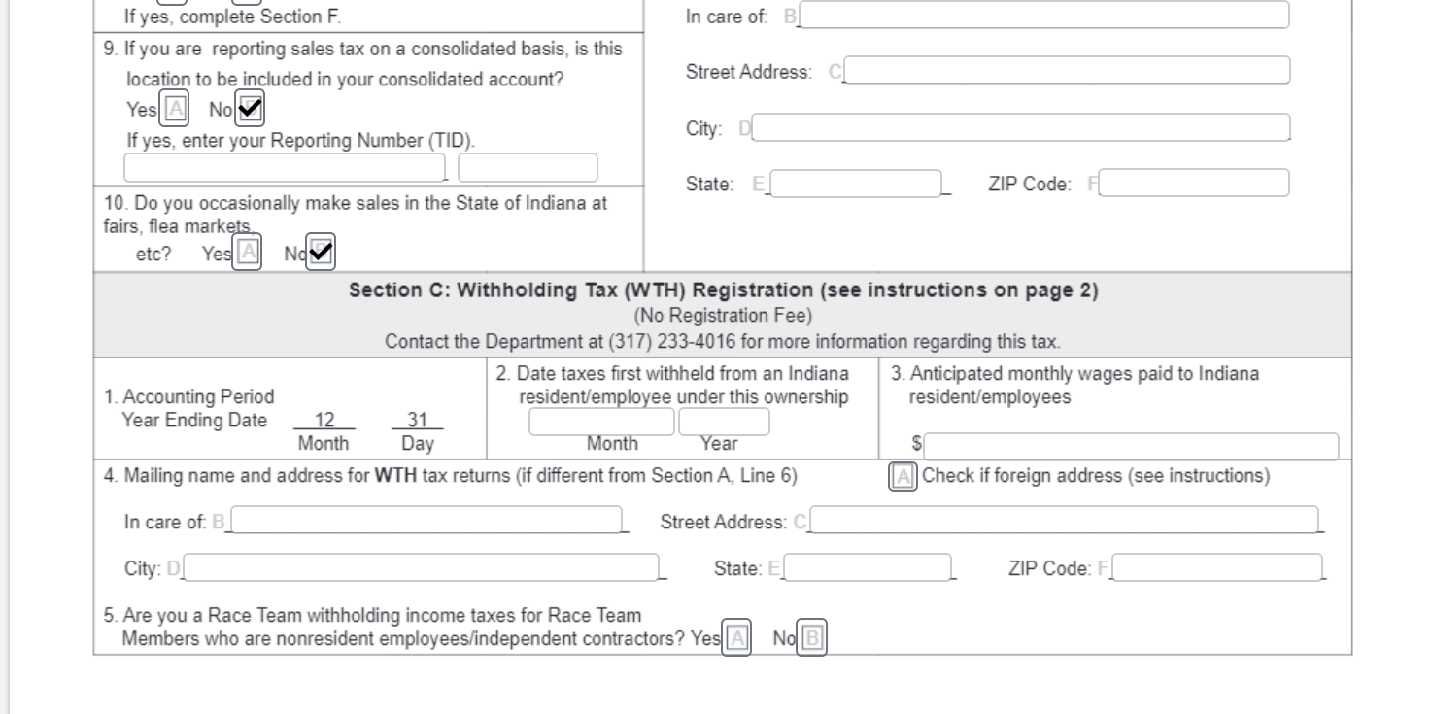
Sales Tax and More - IN Registration
9. & 10. Check - No
Section C
Enter - Date of accounting period
2-5. Skip
https://www.salestaxandmore.com/

Slide 8
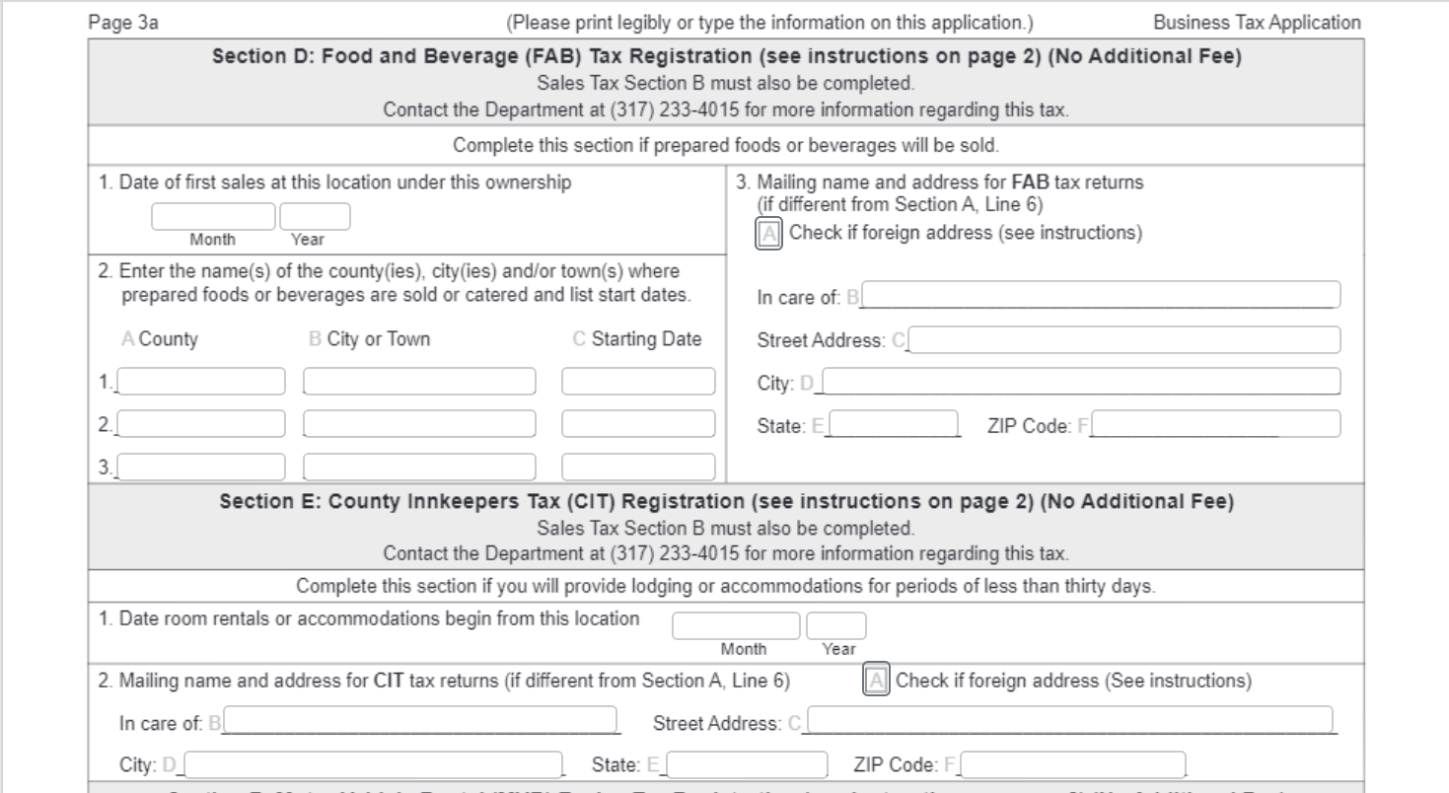
Sales Tax and More - IN Registration
Section D and E - Typically skip
https://www.salestaxandmore.com/

Slide 9
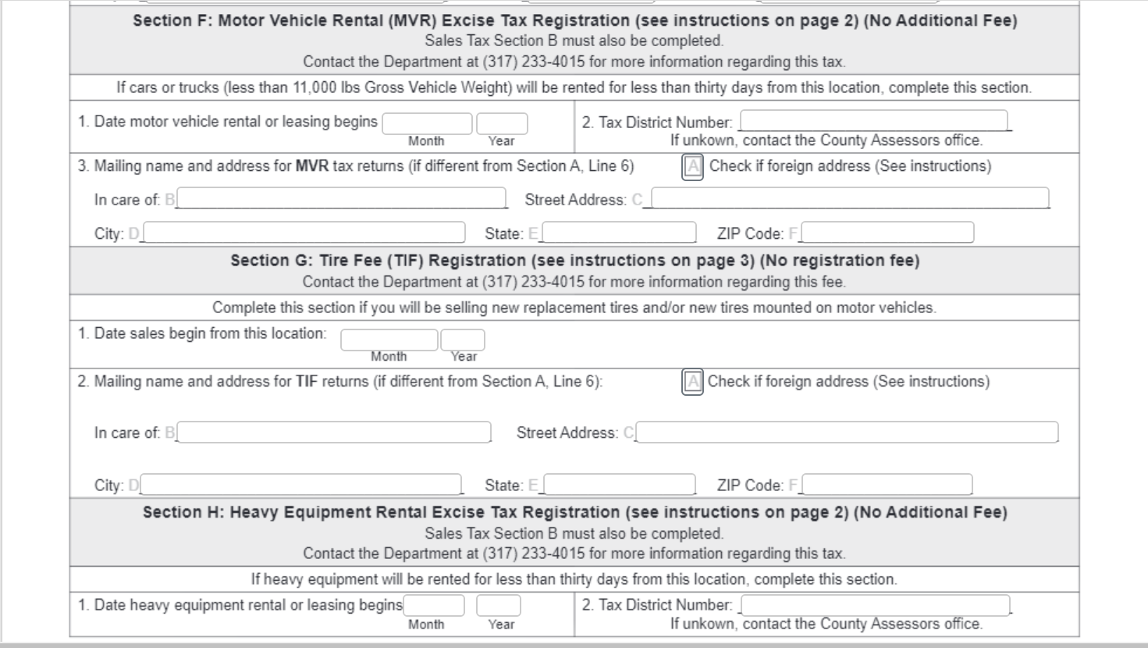
Sales Tax and More - IN Registration
Section F, G, and H - Typically skip
https://www.salestaxandmore.com/

Slide 10
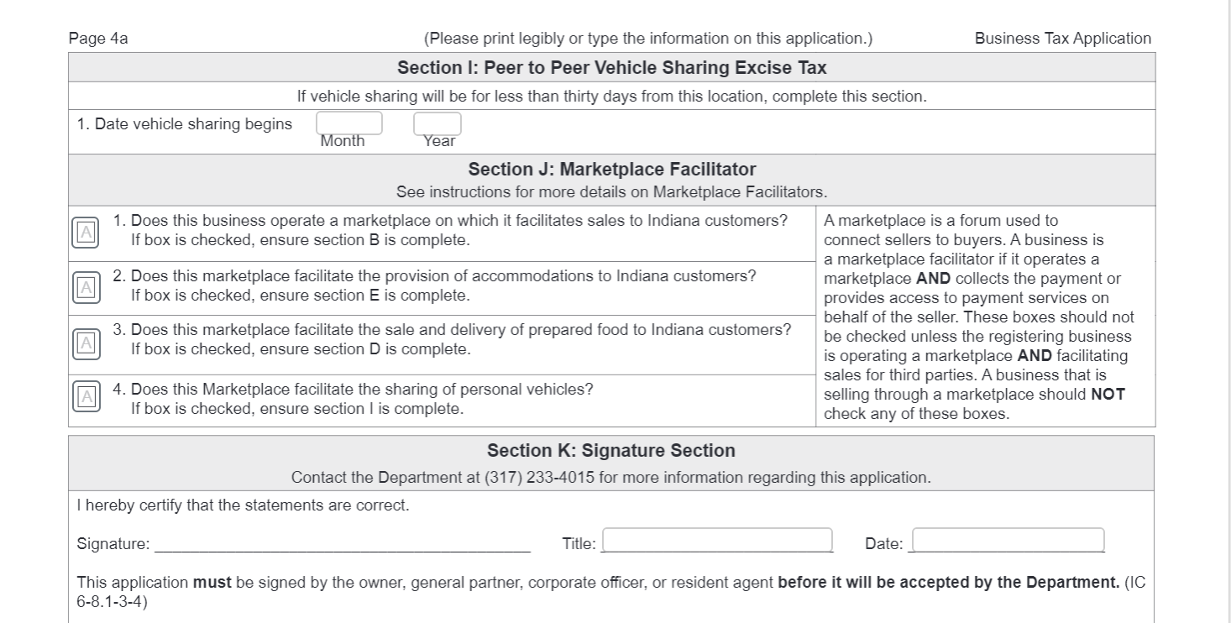
Sales Tax and More - IN Registration
Section I - Typically skip
Section J - Typically skip
Section K - Sign, Enter title of signee, and enter date of signature
https://www.salestaxandmore.com/

Slide 11
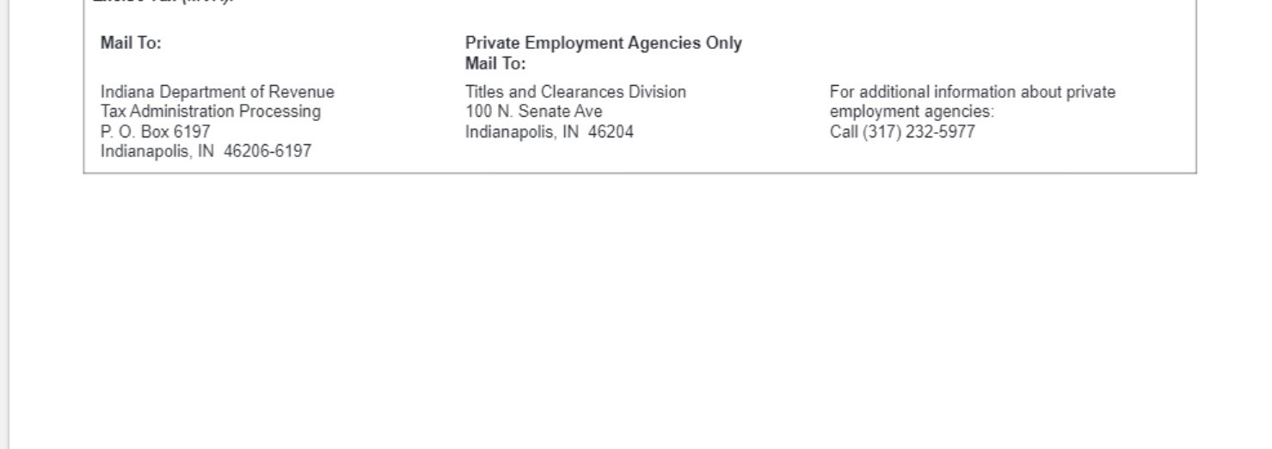
Sales Tax and More - IN Registration
Last step is to mail the BT-1 form to: Indiana Department of Revenue.
A letter should arrive in the mail with the sales tax permit number within the next three weeks. If a letter does not arrive, the telephone number to check on the BT-1 form is 317-232-2165.
Once the permit number is received it is then time to complete the online set up in Indiana.
https://www.salestaxandmore.com/

