Slide 1

Company
Portfolio
EaTemp.com

Slide 2
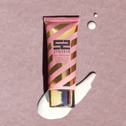
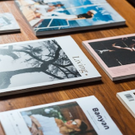
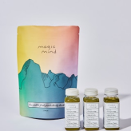
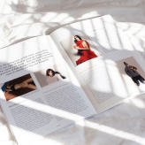
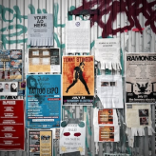
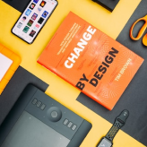
Contents
Promotional Products
A way to promote a brand and get products into the hands of customers
Brochures
A versatile tool for communicating information and promoting products or services.
Package Design
A way to make products stand out on shelves and communicate key information
Magazine
A way to create visually appealing, easy to read and effective communication tool
Posters
Large-scale designs that grab attention and make a statement
Brand Identity
A cohesive visual representation of a company's message and values

Slide 3
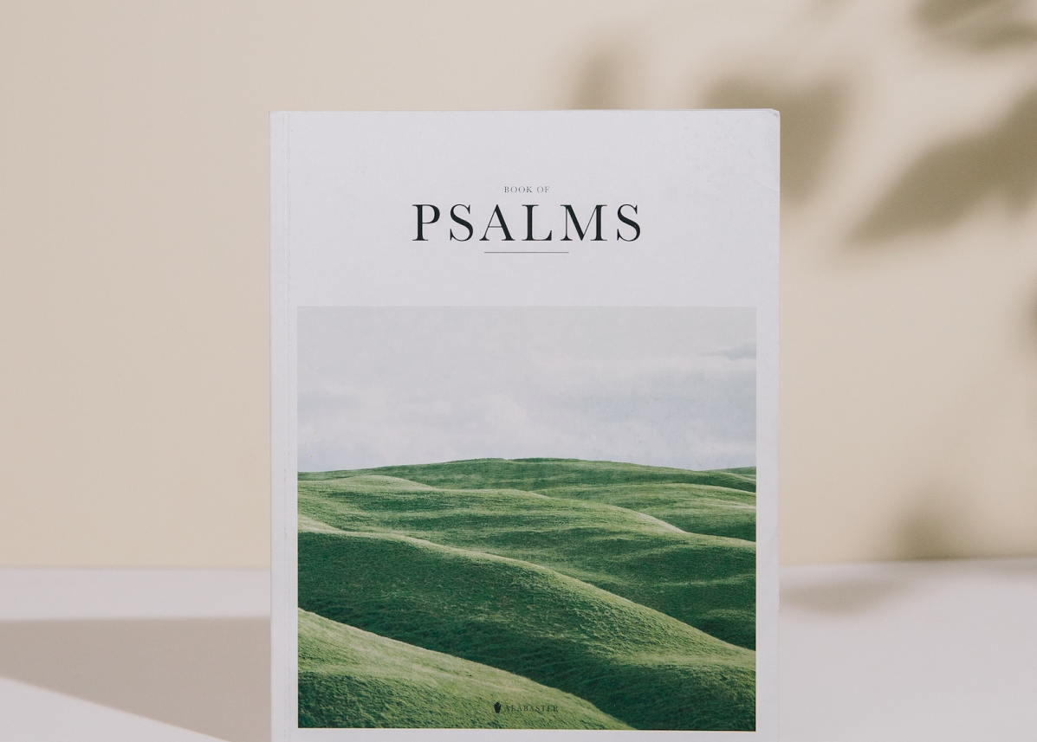
Brochures
EXPLORE THE BEAUTY OF NATURE
Client:
Nature's Paradise National Park
A brochure designed to showcase the natural beauty of Nature's Paradise National Park. The brochure includes information about the park's hiking trails, wildlife, and scenic vistas, as well as information on camping, picnicking, and other activities.
The brochure is designed to be visually stunning and informative, encouraging visitors to plan a trip to Nature's Paradise National Park and experience the beauty of nature for themselves.
Content:
  Welcome message from the park's manager
  Information about the park's history and geology
  Details on the park's hiking trails, including difficulty levels and trail maps

Slide 4
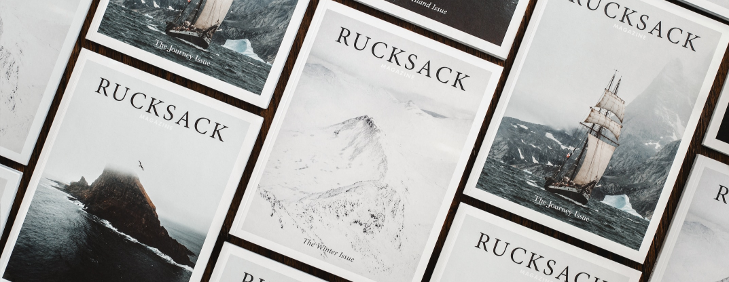
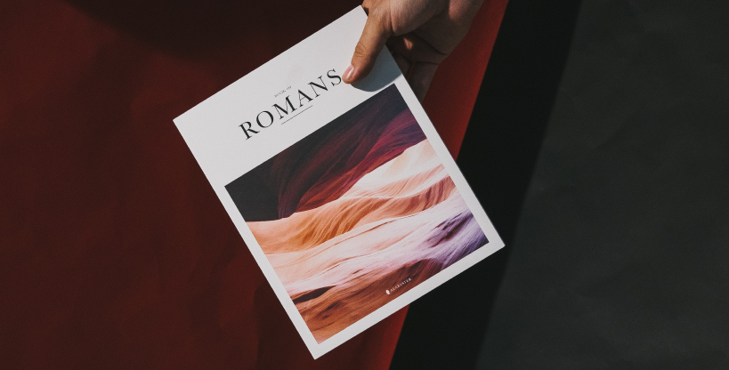
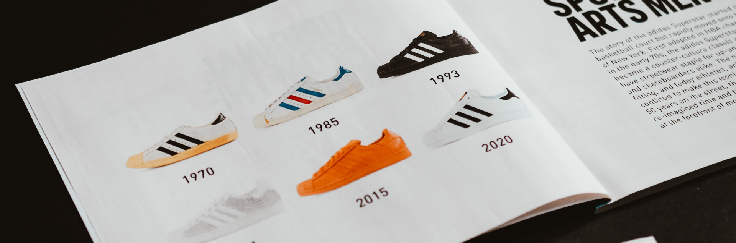

Slide 5
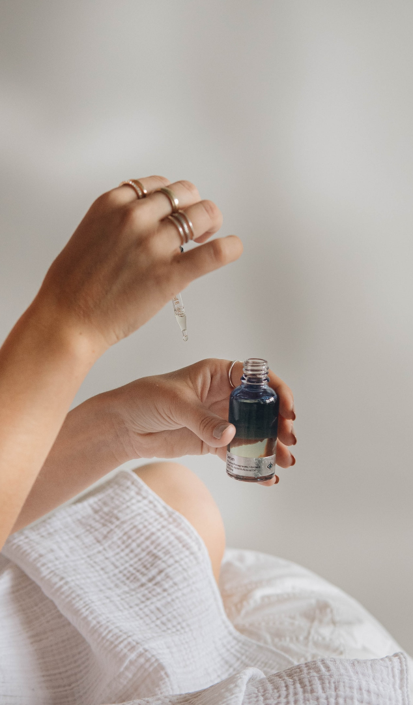
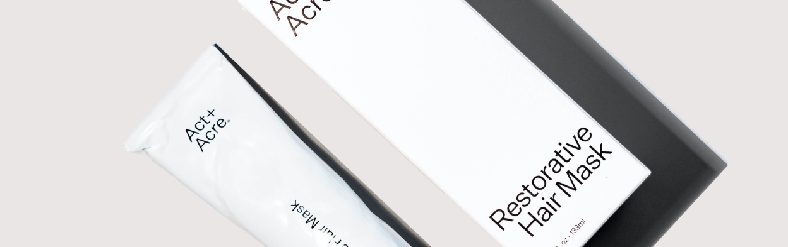
Promotional Products
CUSTOMIZED SKINCARE SET
Client:
Pure Radiance
Customized skincare set featuring the Pure Radiance logo and slogan "Radiant Skin, Radiant Life" for promotional use. The set includes a cleanser, toner, moisturizer, and eye cream all made with natural and organic ingredients.
This promotional product is a great way for Pure Radiance to increase brand awareness and get their logo and message in front of a wider audience. The skincare set is a practical item that will be used frequently by customers and will keep the brand on their mind.

Slide 6
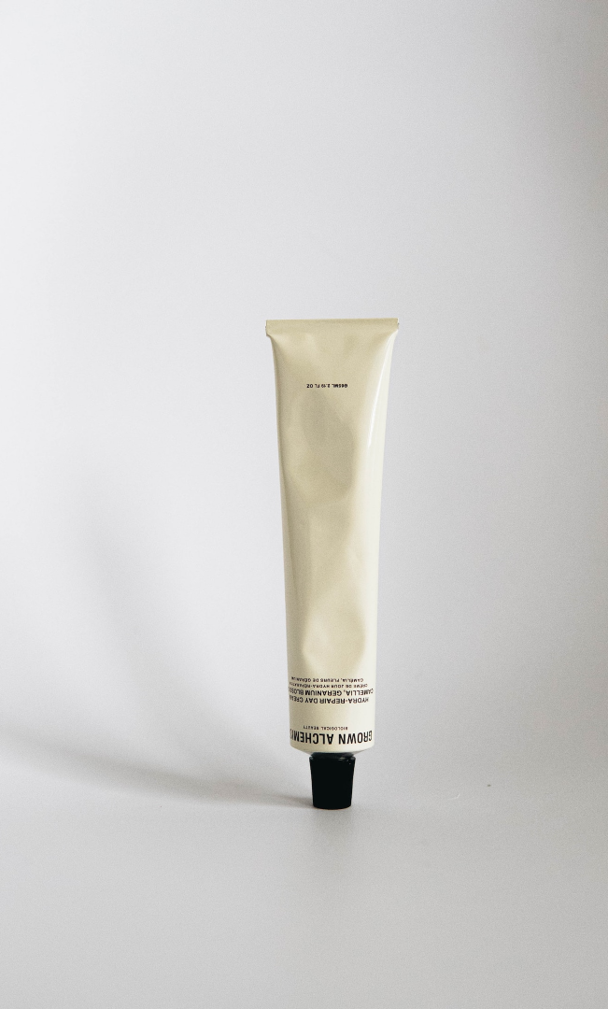
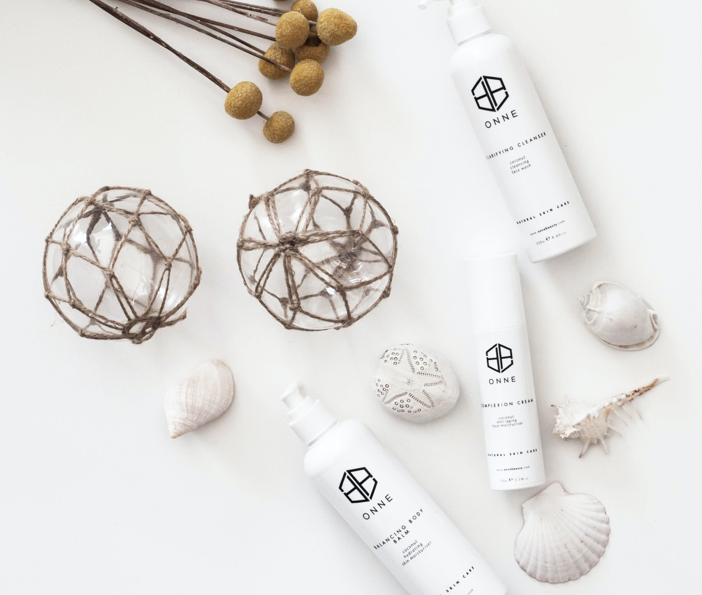

Slide 7
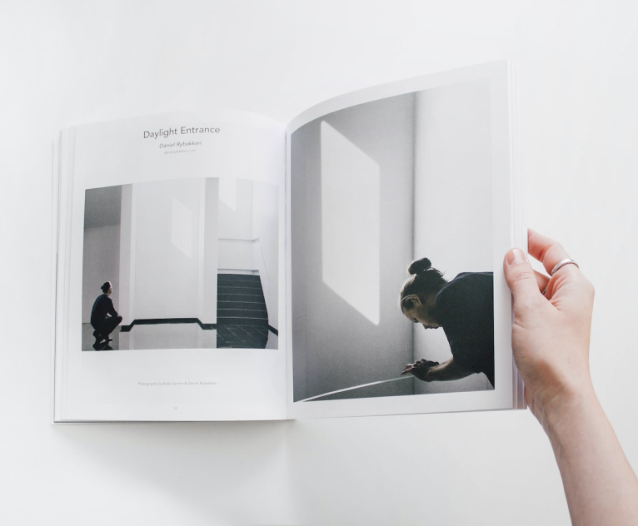
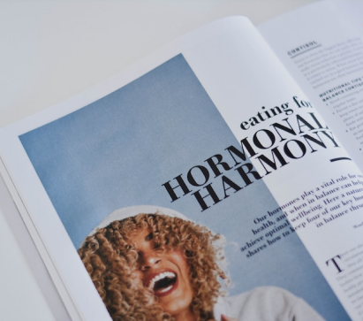
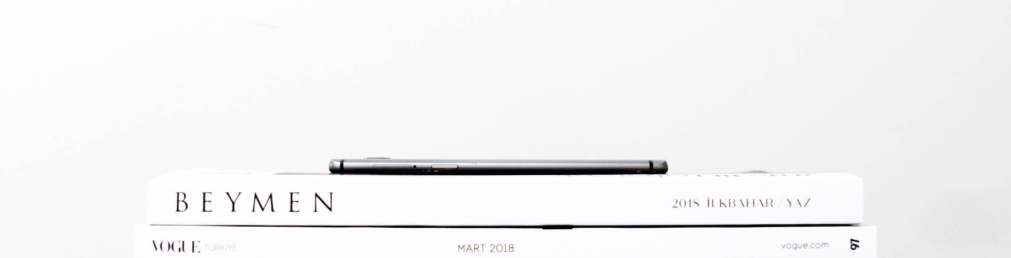
Magazine
THE MODERN TRAVELER
Client:
Luxe Travel magazine
A magazine designed to showcase the latest trends and destinations in luxury travel. Each issue features in-depth articles on the most sought-after vacation spots, as well as reviews of luxury hotels and resorts, and interviews with industry experts. The magazine also includes a section for travel tips and a calendar of upcoming events.
The magazine is designed to appeal to affluent and discerning travelers, providing them with the information they need to plan their next luxury vacation.

Slide 8
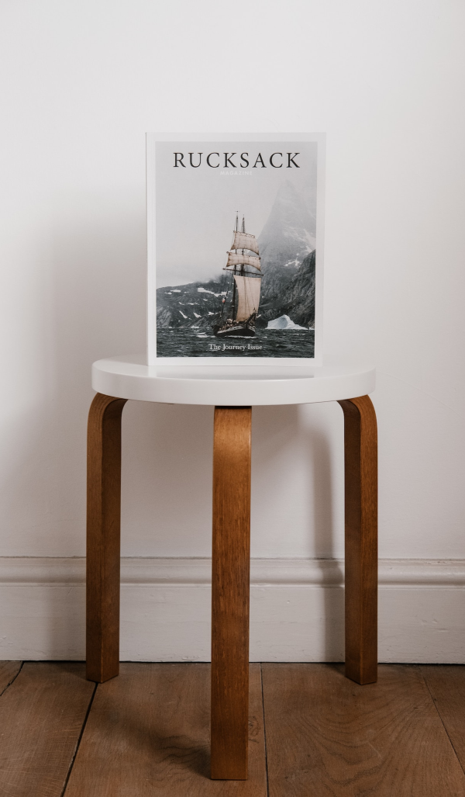
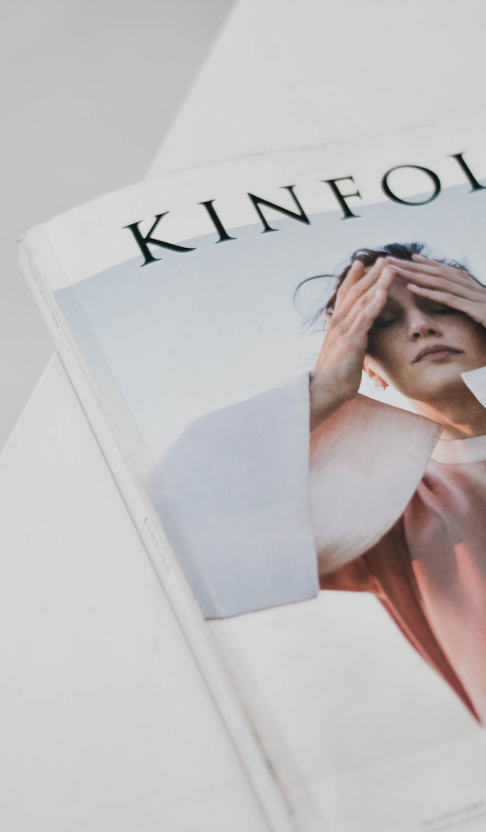
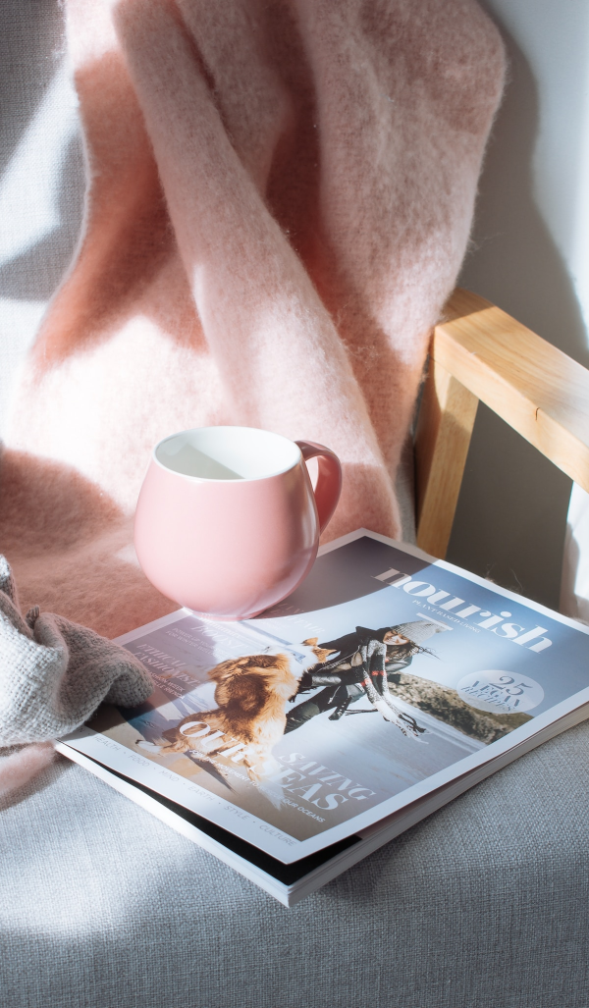

Slide 9
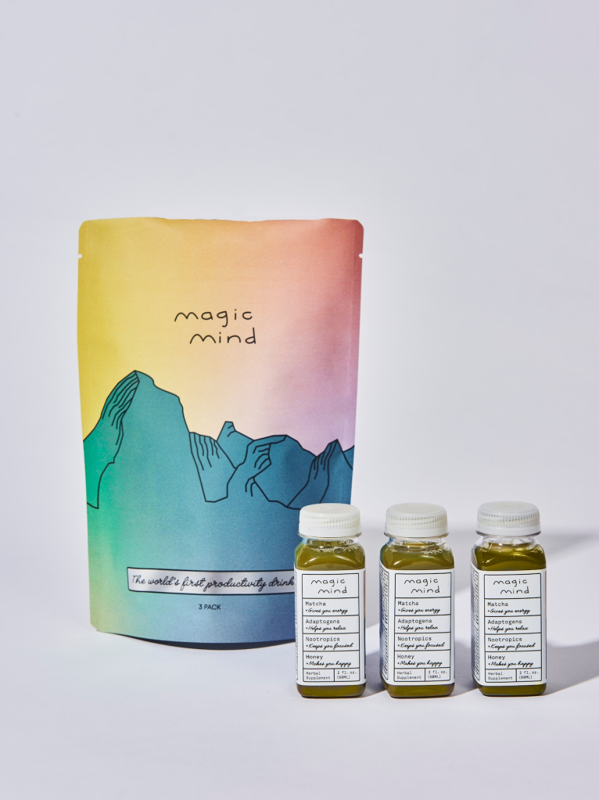
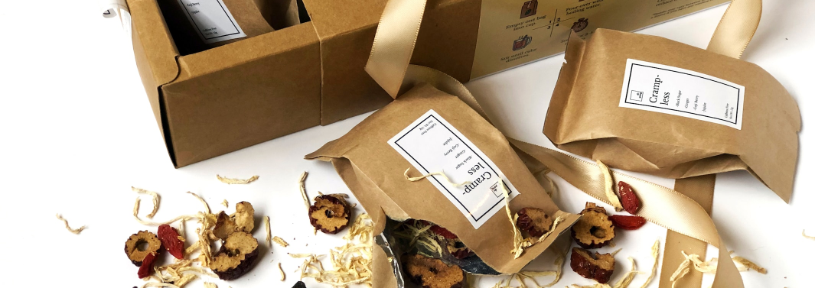
Package Design
PREMIUM LOOSE LEAF TEA
Client:
Royal Tea Co
A package design for Royal Tea Co.'s line of premium loose leaf tea. The tea is available in a variety of blends and flavors, including traditional and exotic blends.
This package design is created to appeal to tea lovers and connoisseurs, the design and the message of the packaging emphasizes the premium quality and the traditional elegance of the tea. The round metal tin is durable and reusable, making it an elegant and sustainable choice. The vintage floral pattern and the deep red color of the background gives a sense of luxury and tradition.

Slide 10
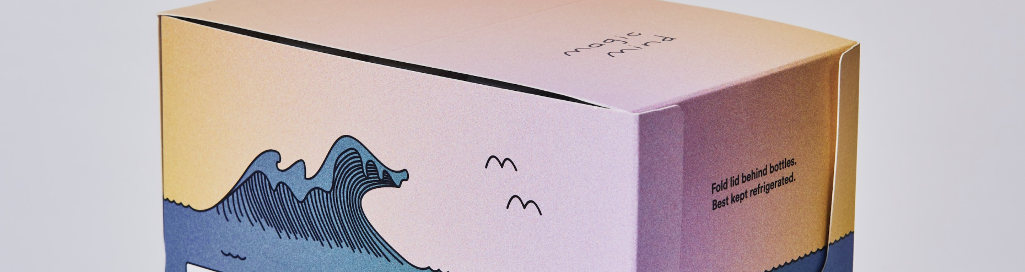
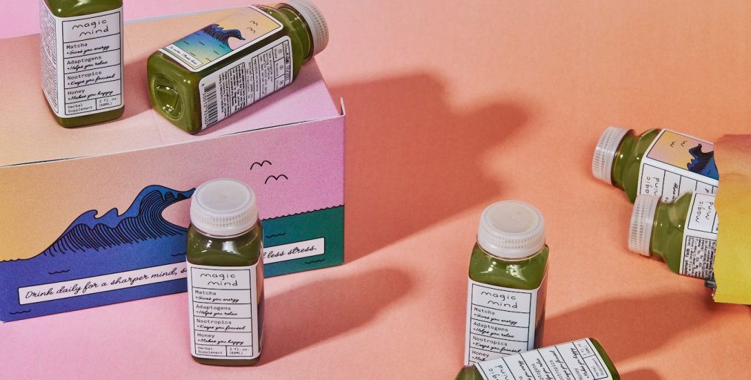
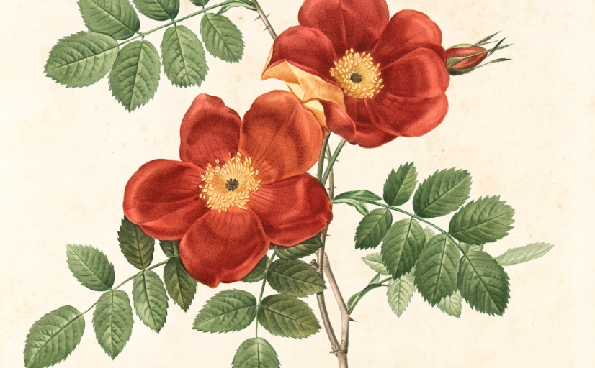

Slide 11
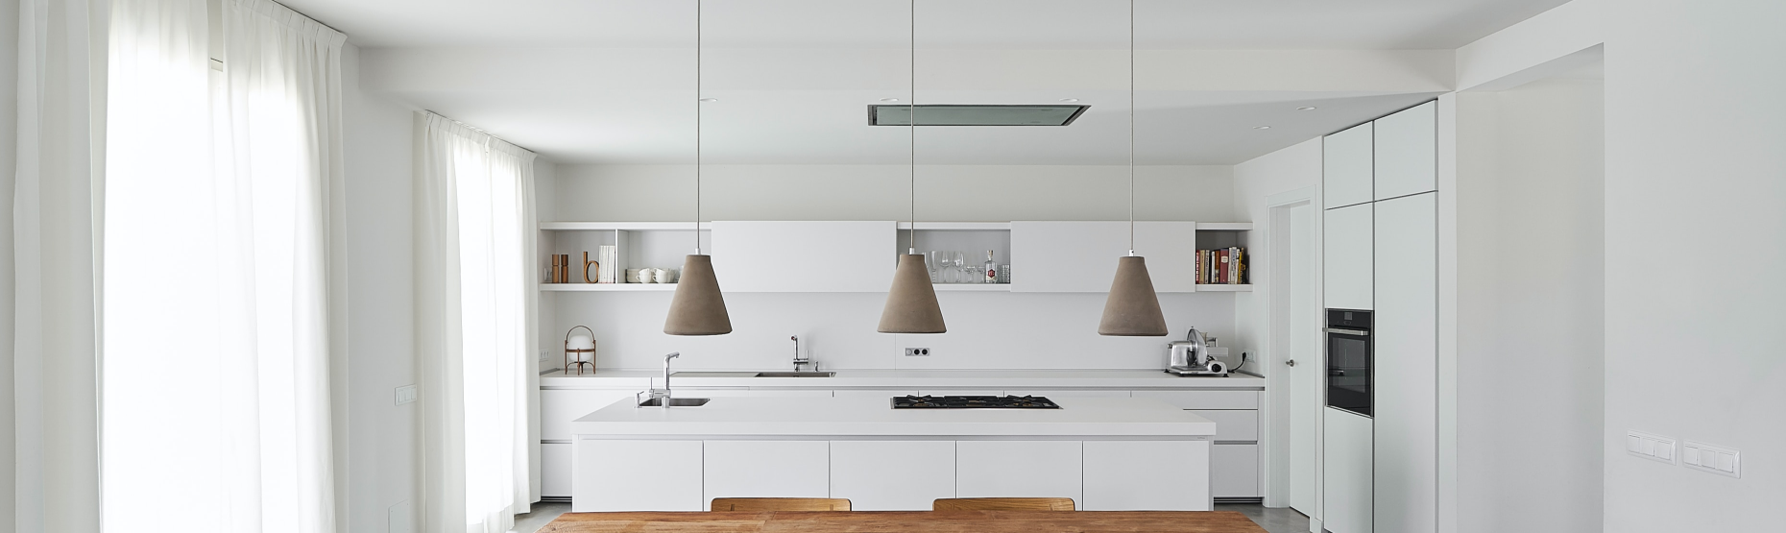
Brand Identity
GREEN EARTH LANDSCAPING
Client:
Green Earth
This package design is created to appeal to tea lovers and connoisseurs, the design and the message of the packaging emphasizes the premium quality and the traditional elegance of the tea. The round metal tin is durable and reusable, making it an elegant and sustainable choice. The vintage floral pattern and the deep red color of the background gives a sense
Industry:
Landscaping and outdoor services
Target audience:
Residential and commercial property owners

Slide 12
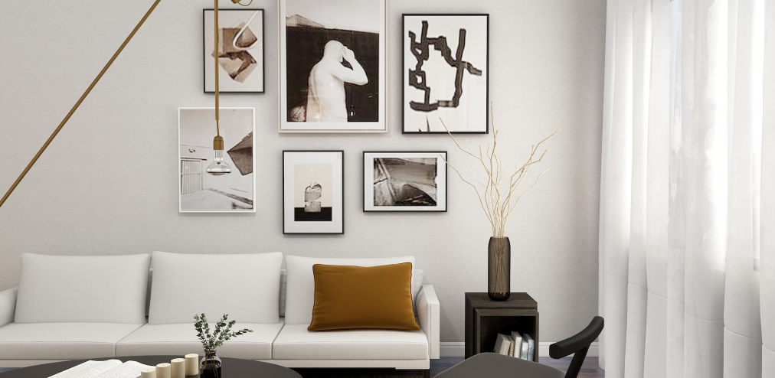
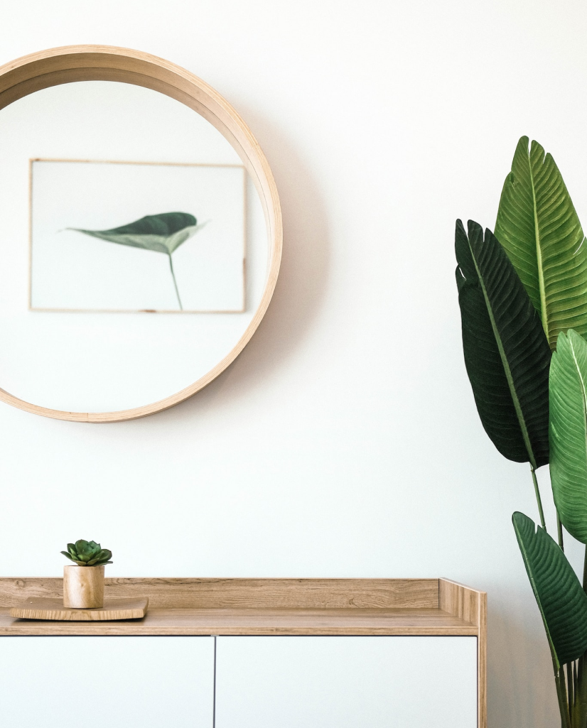


Slide 13
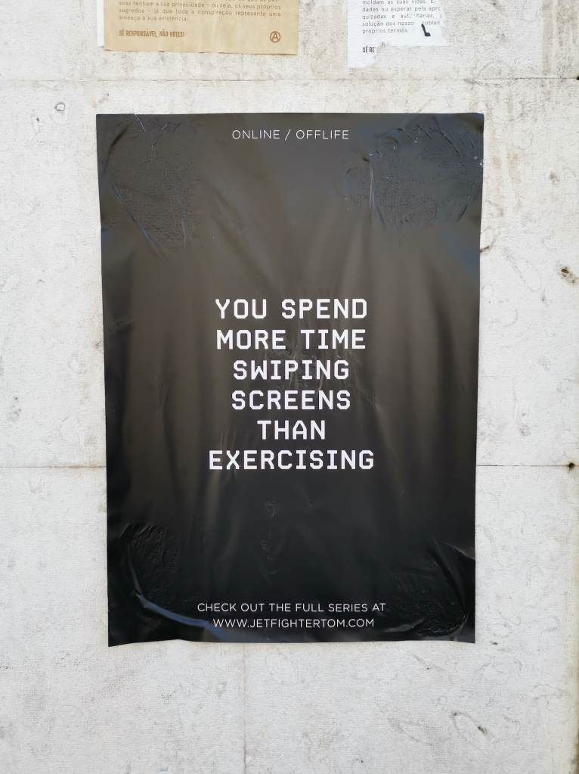
Posters
SUMMER SALE
Client:
Beachy Clothing Co.
A poster designed to advertise a summer sale for Beachy Clothing Co., a clothing store that specializes in beach and coastal-inspired clothing and accessories.
The poster is designed to be visually appealing and grab the attention of potential customers. The product images showcase the variety of clothing and accessories available at the store, making it clear what the customer can expect to find during the summer sale. The message and the typography are designed to be bold and easy to read, the color scheme is bright and summery, creating a sense of excitement and urgency to take advantage of the sale. The poster is intended to be used in store or in a street poster, to draw the attention of the passerby and drive

Slide 14
