Slide 1


DIGITAL
PRIVACY
PROTECT WHAT MATTERS MOST

Slide 2



PRIVACY BASICS
  UNDERSTANDING PERSONAL EXPOSURE
Digital privacy requires awareness of how personal information moves across apps, websites, and devices.
Strengthening protection means limiting unnecessary data sharing, reviewing permissions carefully, and using secure tools daily.
These habits help individuals maintain control, avoid tracking risks, and safeguard their online identity from exploitation or misuse in increasingly complex digital environments.

Slide 3
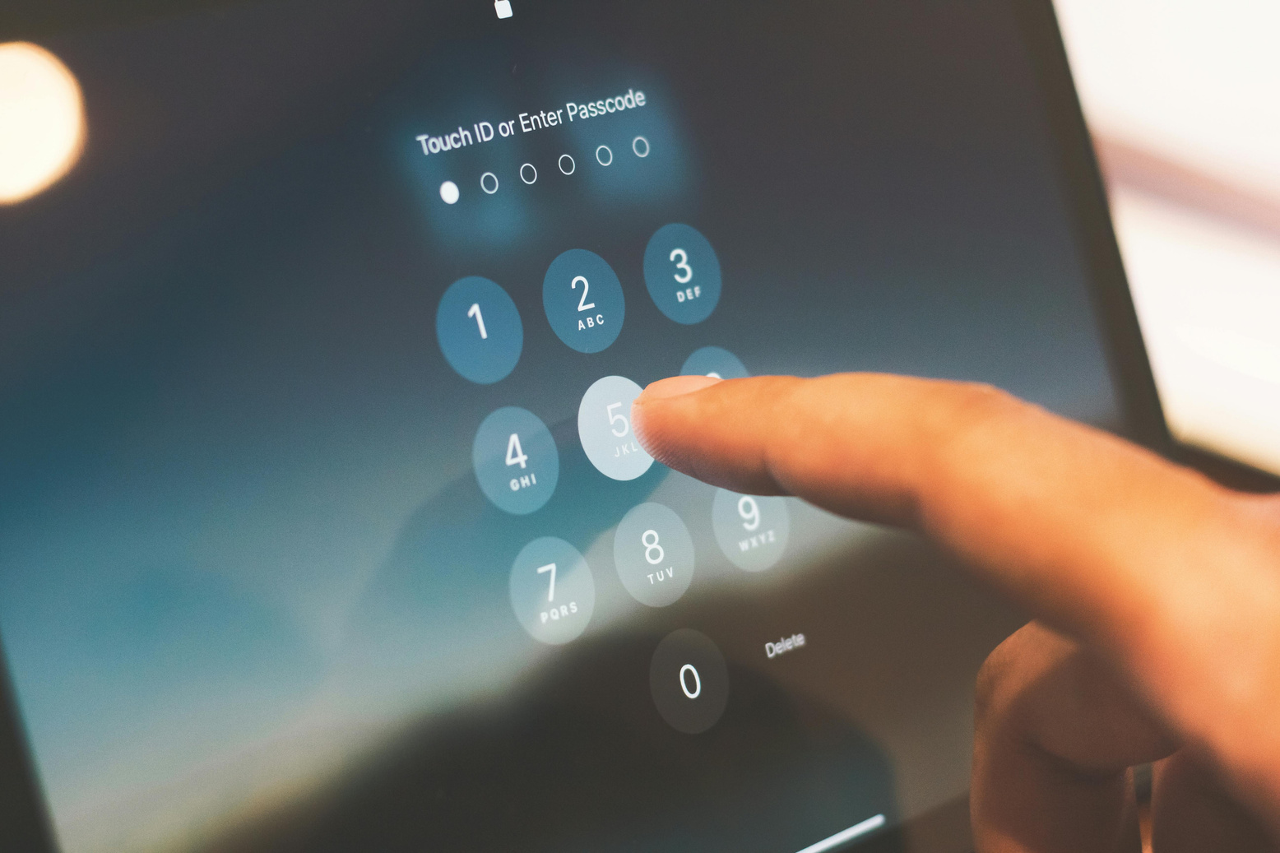


  IDENTIFYING DIGITAL THREATS
RISK FACTORS
Password Strength
Public Sharing
Using weak or repeated passwords increases vulnerability to unauthorized access. Strong, unique combinations supported by authentication tools significantly reduce attack success and protect vital personal accounts.
Posting sensitive details online exposes users to profiling and impersonation. Reducing unnecessary disclosure helps maintain boundaries and limits exploitation by malicious individuals or automated tracking systems.

Slide 4



DATA HANDLING
Many digital platforms collect data to personalize content, measure activity, and deliver advertisements. Understanding how this information is gathered allows users to evaluate risks, adjust settings, and reduce hidden tracking that often occurs without clear notification or consent.
  HOW PLATFORMS PROCESS INFORMATION
Improving awareness of data flows enables individuals to guard their privacy more effectively. Reviewing permissions, disabling unusable features, and choosing trustworthy applications strengthens protection against unauthorized usage or manipulation of sensitive personal information online.

Slide 5


Device Defense
Connection Safety
Behavior Awareness
  BUILDING STRONG PROTECTION
Keeping systems updated, enabling firewalls, and using secure login methods reduce exposure to malware. These habits enhance long-term digital protection and block unauthorized attempts to access sensitive information across personal devices.
Avoiding unsecured networks and using encrypted communication channels ensure safer browsing experiences. These preventive actions help limit interception risks and preserve privacy when working in public locations or unfamiliar environments.
Understanding how online habits create digital footprints encourages responsible choices. Adjusting browsing routines, recognizing suspicious links, and limiting exposure increase long-term safety and reduce opportunities for targeted attacks.
SECURITY LAYERS

Slide 6


PRACTICAL DEFENSIVE MEASURES
PROTECTION TOOLS
App Permissions
Reviewing apps regularly prevents unnecessary access to contacts, location, or storage, strengthening privacy boundaries effectively.
Secure Storage
Encrypting personal files ensures sensitive information remains protected from unauthorized access across devices and cloud services.
Safe Browsing
Avoiding suspicious websites reduces harmful downloads and trackers, improving daily digital safety significantly.
Account Settings
Adjusting visibility, review tools, and activity controls limits personal exposure across various online platforms effectively.

Slide 7


ONLINE HABITS
Practicing healthy digital habits helps reduce privacy risks. Limiting unnecessary app installations, turning off unused features, and managing notifications prevent excessive tracking. Careful posting, mindful browsing, and verifying sources ensure long-term security. These simple but consistent practices build stronger privacy foundations and keep personal information from circulating freely across online ecosystems.
  DAILY PROTECTIVE BEHAVIOR

Slide 8
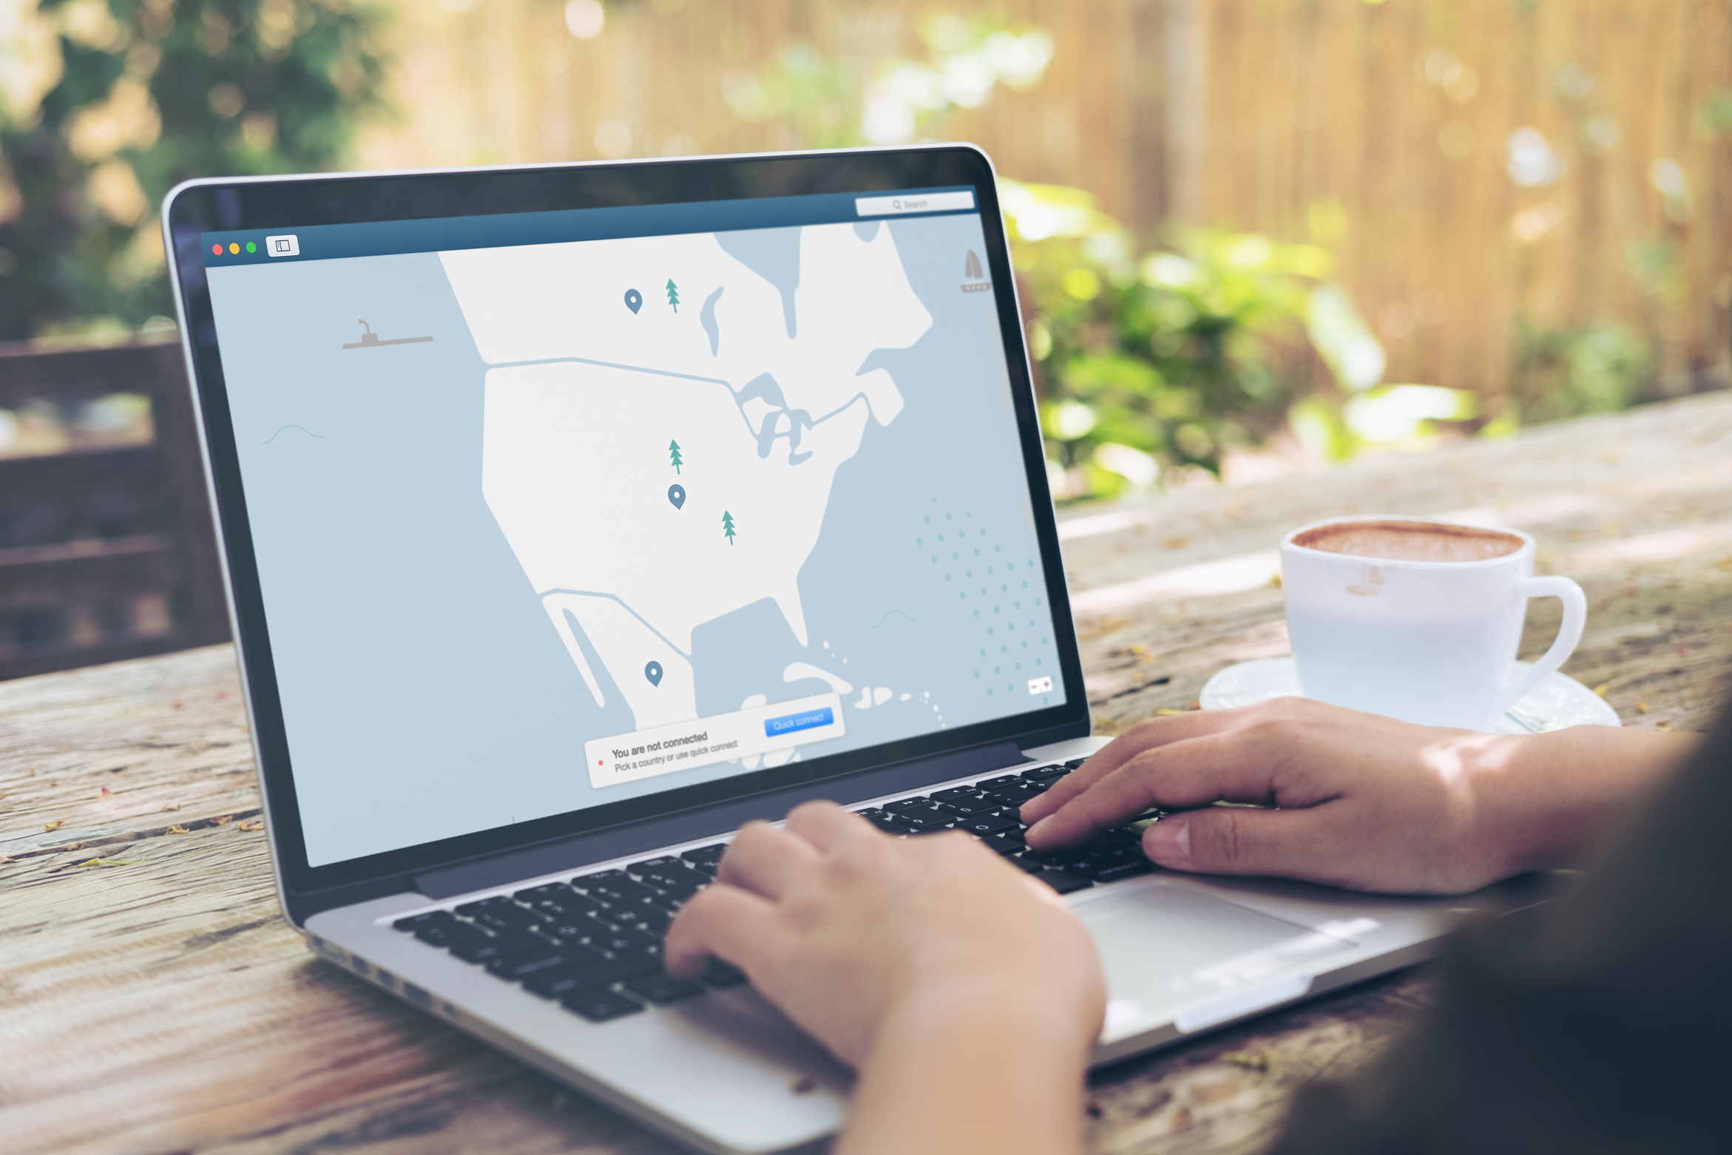

TRACKING CONTROL
  MANAGING DIGITAL FOOTPRINTS
Ad Preferences
Disabling personalized ads limits how platforms analyze interests and browsing patterns, giving users more control and reducing exposure to targeted marketing systems.
Cookie Review
Regularly clearing cookies and adjusting browser settings prevents companies from tracking behavior across websites, reducing unwanted profiling and improving personal privacy online.

Slide 9

PRIVACY FACTS
  SHORT INSIGHTS TO REMEMBER
Many applications gather background data even when unused, making regular permission checks essential for maintaining stronger personal privacy.
Public Wi-Fi exposes user activity to interception, increasing risks of stolen passwords, session hijacking, and unauthorized data collection.
Weak or reused passwords allow attackers to breach multiple accounts easily, making unique combinations crucial for long-term digital safety.

Slide 10



  UNDERSTANDING PROTECTION POLICIES
LEGAL RIGHTS
Privacy regulations provide users the right to access, correct, or delete their information. These rules demand transparency, ensuring organizations handle data responsibly and prevent unauthorized sharing across digital systems.
Clear legal frameworks encourage ethical data practices. Understanding these protections enables users to make informed choices, maintain control, and navigate online platforms with greater confidence and awareness of potential risks.

Slide 11


  STAY SAFE, STAY PRIVATE, AND TAKE CONTROL OF YOUR DIGITAL LIFE.
For further assistance or guidance, feel free to reach out.
Protecting your digital privacy requires consistent awareness and careful daily habits.
YOUR PRIVACY MATTERS
www.reallygreatsite.com
+123-456-7890
hello@reallygreatsite.com

