Slide 1

WATER RESOURCES

Slide 2
In this chapter we will study
Importance of water
Types of irrigation
Multi purpose river valley projects
National power grids
Rain harvesting tech

Slide 3
Importance;
❖ It is being used for irrigation
❖ Hydroelectricity power generation
❖ Industry
❖ Domestic use
❖ Transportation
❖ Fishery
❖ Recreational purpose

Slide 4
Irrigation:
Irrigation means supply of water to agriculture from canals Wells and tank artificially
Types:
❖ Well irrigation
❖ Canal irrigation
❖ Tank irrigation

Slide 5
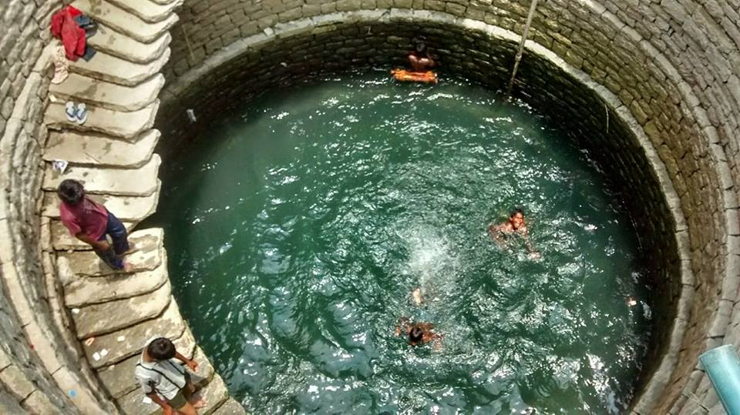
Well irrigation
❖ Supplying groundwater by digging or drilling Wells is called well irrigation
❖ More useful in low rainfall region
❖ Construction and maintenance easy
❖ Two types of well irrigation ie open well and bore well

Slide 6
❖ Open well: well is dug up in suitable agriculture land water is lifted from open well through manual power
❖ Tube well: about 33.7% of the total irrigated area comes under tube well irrigation

Slide 7
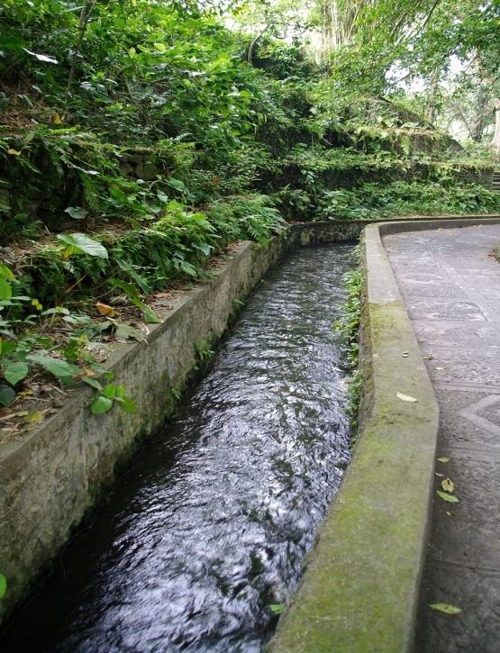
Canal irrigation
❖ India has world's largest Canal system
❖ There are two types flood canal and perennial canal
❖ water is drawn directly from rivers without build of dam is called flood canal
❖ Dams are constructed and water is stored in Reservoir and used for agriculture through the canal. these are perennial canal
❖ Extensively practiced in Uttar Pradesh Punjab Madhya Pradesh Bihar

Slide 8
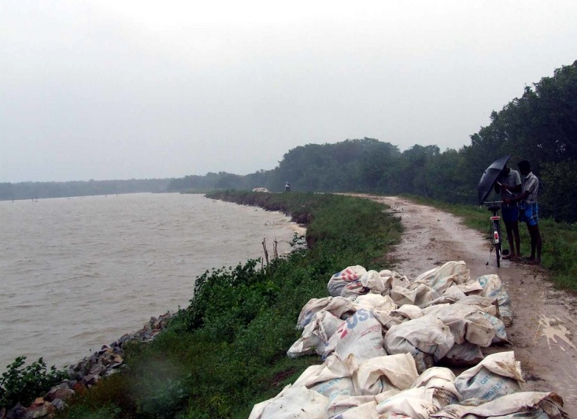
Tank irrigation
❖ It is a natural or manmade hallow on surface into which rainwater is collected
❖ Most of the times are non perennial
❖ mainly found in Tamil Nadu Andhra Pradesh Karnataka Rajasthan

Slide 9
Multipurpose river valley projects: Aims
❖ Irrigation
❖ Control of flood
❖ Generation of hydroelectricity
❖ Prevention of soil erosion

Slide 10
❖ Develop waterways and fishing
❖ Recreation facility
❖ Domestic purpose and industrial purpose
❖ Afforestation

Slide 11
Damodar river valley project
❖ The first river valley project of India.
❖ River Damodar is called sorrow of Bengal because of causing flood damage to crops human settlements
❖ It is constructed to control the flood

Slide 12
❖ The project jointly undertaken by Bihar and West Bengal
❖ There are four Dams at Tilaiya, Konar, Maithon and panchayat. There are three thermal power stations at Bokaro Durgapur Chandrapur

Slide 13
Bhakra Nangal project
❖ It is the joint venture of Punjab Haryana Rajasthan.it is built across the river Nangal
❖ Flood control is the main objective of this project
❖ 226 meter height it is the highest dam in India
❖ Govinda Sagara is the reservoir

Slide 14
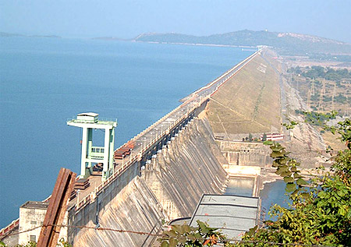
Hirakud project
❖ it is built across the river Mahanadi at Hirakud Orissa
❖ It is the longest dam in India
❖ flood control and irrigation are the main objectives
❖ Mahanadi is called sorrow of Orissa

Slide 15
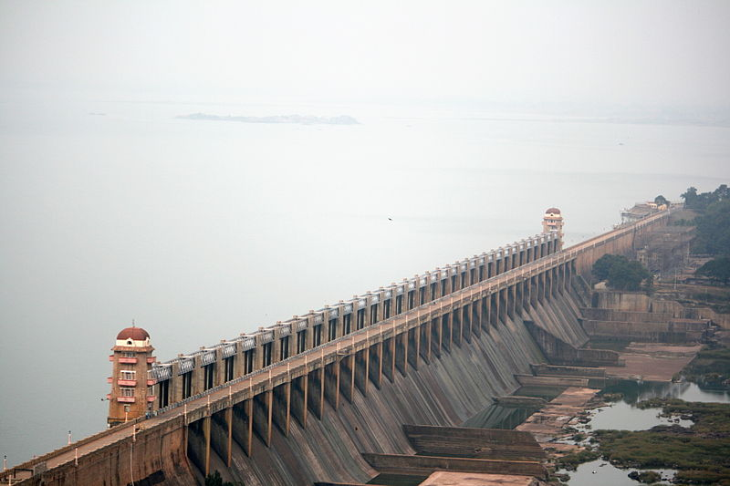
Tungabhadra project
❖ It is the joint venture of Karnataka and Andhra Pradesh
❖ Constructed across river Tungabhadra at Malappuram Hospital
❖ Pampa Sagara is the reservoir

Slide 16
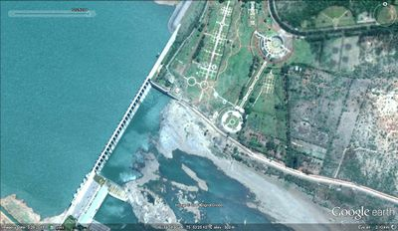
Upper Krishna project
❖ the biggest river valley project in North Karnataka it is constructed across Krishna river
❖ There are two dams constructed Alamatti and Narayanpur
❖ Bagalkot vijayapur Yadgir are benefited districts

Slide 17
Kosi project
❖ It is the International project and joint venture of India and Nepal
❖ this project is constructed across river Kosi in Hanuman Nagar Nepal
❖ Irrigation and flood control are the main objectives.
❖ Kosi is called sorrow of Bihar

Slide 18
Narmada valley project
❖ The dam is constructed between Gujarat and Madhya Pradesh
❖ This project is entangled with many controversies right from its inception.
❖ This project provides irrigation facility and hydroelectric power to North Gujarat Rajasthan and Maharashtra

Slide 19
The Nagarjuna Sagar project
❖ it is built across river Krishna at Nagarjunakonda Telangana
❖ irrigation and power generation are the main objectives of this project.

Slide 20
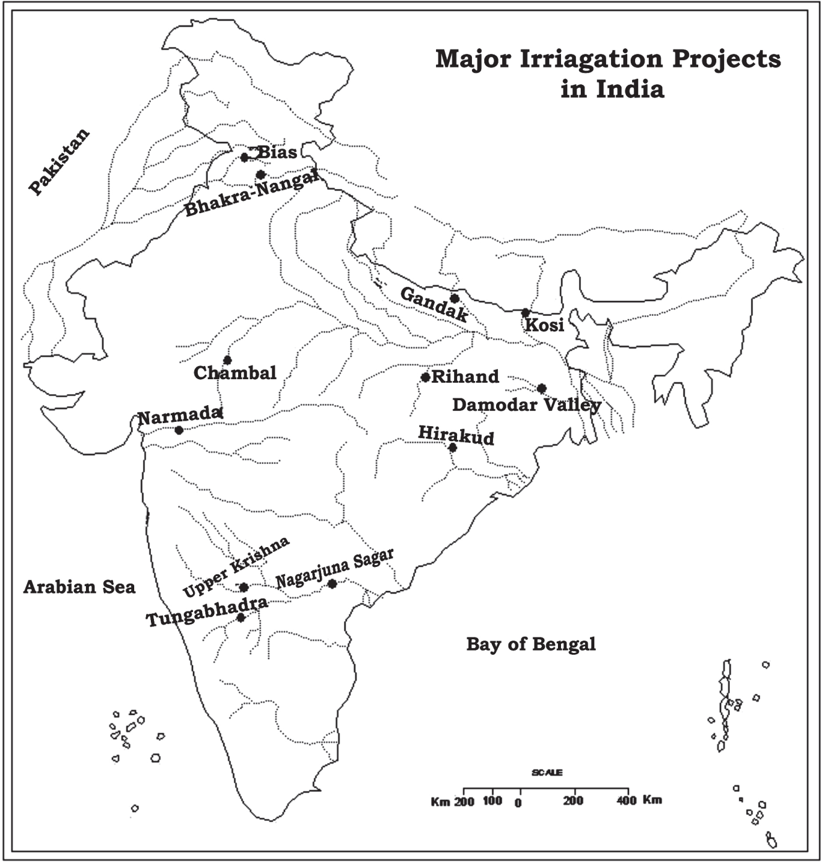

Slide 21
India's major hydroelectric power projects
❖ Karnataka- shivanasamudra and Kali
❖ Andhra Pradesh-nagarjun Sagar Sri sailam
❖ Madhya Pradesh-banasagar
❖ Maharashtra-Tata hydroelectric power project
❖ Orissa -Hirakud project
❖ Bihar-Kosi project
❖ Gujarat-kakrapara project and Kadana

Slide 22
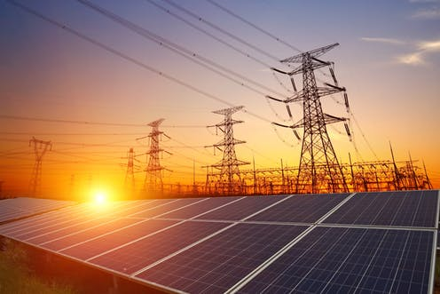
National Power grid:
❖ It's generates power from various sources
❖ To supply power from surplus States to deficit States a national power grid is established
❖ Excess power from any state can be supplied to any other power deficit state

Slide 23
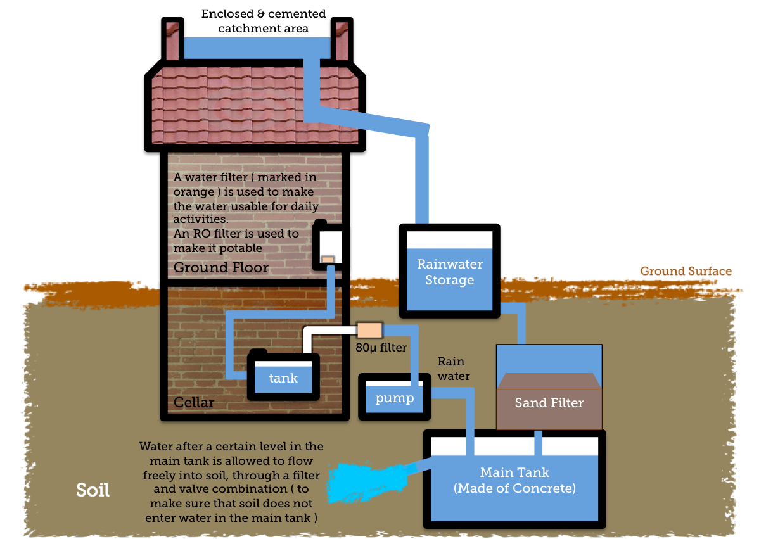
Rainwater harvesting
“Collection of rainwater is called rainwater harvesting”

Slide 24
There are two types of rainwater harvesting.
1. Collection of water at the place of rainfall
2. Collection of flowing rainwater
❖ It reduce the dependent on public water supply
❖ Increase of groundwater table

Slide 25


Thank you
Prepared by:
Praveen Banakar

