Slide 1

GRADE 1
Distance Learning Guide
Our recommendations for adapting Mystery Science lessons for socially distant classrooms and online distance learning.
We’ve assigned each lesson one of these labels:
Ready to Teach
These lessons have activities that only need minor modifications to eliminate partner work or shared supplies. For these activities, you can have students work solo without preparing extra supplies.
Adjust Supplies
These lessons also have activities that need small changes so students can work solo, but you’ll need to adjust the supply quantities. We suggest how to adjust the supplies.
Jump to a section:
Plant & Animal Superpowers
7 lessons
Spinning Sky
7 lessons
Lights & Sounds
6 lessons
Guide FAQs
Using your Mystery Pack
Demo Activity
These lessons have activities that require coordinated partner work or messy materials, so we recommend demonstrating the activity for students. Students can make detailed observations.
Substitute Activity
These lessons have activities that require specialized materials or adult help. We suggest an alternative activity to do instead.
1

Slide 2

GRADE 1
UNIT Plant & Animal Superpowers
View this unit here. | Teaching in the classroom | Teaching online
Lesson 1 How can you help a lost baby animal find its parents? | Have students do the activity solo. Provide each student with a copy of the Baby Bird A, B, and C printouts. | Have students do the activity at home. Send each student home with a copy of the Baby Bird A, B, and C printouts.
Lesson 2 Why do birds have beaks? | Set up an activity station to demo the Best Beak activity. Students can complete the Bird Beaks printout as they make observations. | Demo the activity over video conference with your students so they can make observations. Send each student home with a copy of the Bird Beaks printout (or assign the digital version).
Lesson 3 Why do baby ducks follow their mother? | Have students do the activity solo. No supply adjustments. | Have students do the activity at home. All supplies are digital.
Lesson 4 Why are polar bears white? | Students can do the first part of the activity as long as they maintain social distancing as they search for moths in the classroom. Students can work solo for the second part of the activity (where they color their own camouflaged moth). | Students at home may not be able to do the first part of the activity, but can observe Step 5 of the activity instead. Send each student home with a copy of the Color a Moth template (a digital version will not work) and have them complete the second part of the activity.
Ready to Teach
Ready to Teach
Ready to Teach
Adjust Supplies
2

Slide 3
GRADE 1
UNIT Plant & Animal Superpowers
View this unit here. | Teaching in the classroom | Teaching online
Lesson 5 Why do family members look alike? | Have students do the activity solo. Print out 1 copy of the Baby Animal Cards and 1 copy of the Parent Animal Cards for each student. Follow activity variation instructions in the Extensions. | Have students do the activity at home. Print a copy of the Baby Animal Cards and the Parent Animal Cards for each student. Cut out the cards and send home in an envelope. Follow activity variation instructions in the Extensions.
Lesson 6 Why don’t trees blow down in the wind? | Set up a few model umbrellas and have your students observe them. Then have each student imagine and draw their own umbrella design (instead of building one). If you have time, you can build a few of the students’ designs and test them out in the classroom! | Set up a few model umbrellas and demo over video conference so students can make observations. Then have each student imagine and draw their own umbrella design (instead of building one). If you have time, you can build a few of the students’ designs to test out over video!
Lesson 7 What do sunflowers do when you’re not looking? | This activity is already set up as a demonstration. Students will observe and discuss how a plant in a box responds to light. | This activity is already set up as a demonstration. Students will observe and discuss how a plant in a box responds to light.
Adjust Supplies
Demo Activity
Ready to Teach
3

Slide 4
GRADE 1
UNIT Spinning Sky
View this unit here. | Teaching in the classroom | Teaching online
Lesson 1 Could a statue’s shadow move? | We suggest setting up a station for each Gnome printout. Place a flashlight at each station. Sanitize between each use. | Set up the activity and demonstrate over video conference with your students so they can make observations. If students have a flashlight, have them explore shadows in their home.
Lesson 2 What does your shadow do when you’re not looking? | Students can complete the activity solo if they trace the shadow of an object, like a swing set or flag pole instead of their own shadows. No supply adjustments. | If possible, students can ask a helper at home to trace their shadows. Alternatively, have students trace the shadow of an object in their neighborhood at different times throughout the day (with adult supervision).
Lesson 3 How can the Sun help you if you’re lost? | Have students do the activity solo. No supply adjustments. | Have students do the activity at home. Send each student home a paper fastener and a prepared Sun Finder template (a digital version will not work).
Lesson 4 Why do you have to go to bed early in the summer? | Have students do the activity solo. No supply adjustments. | Send each student home with a copy of the Sunshine Summer Reader. As an alternative, you can assign the Read-Along digital story.
Demo Activity
Ready to Teach
Ready to Teach
Ready to Teach
4

Slide 5
GRADE 1
UNIT Spinning Sky
View this unit here. | Teaching in the classroom | Teaching online
Lesson 5 When can you see the full moon? | Have students do the activity solo. No supply adjustments. | Send each student home with: 1 pipe cleaner and 1 Moon Book printout (a digital version will not work). We suggest students use pencils and scissors from home.
Lesson 6 Why do the stars come out at night? | Students can complete Step 1 - Step 8 on their own. No supply adjustments. Demonstrate Step 9 - Step 14. Note: The results of the demo are shown in Step 15. | Send each student home with: 1 paper cup, 1 dot sticker and 1 Big Dipper Star printout (a digital version will not work). We suggest students use a push pin from home. Each student will also need a flashlight.
Lesson 7 How can stars help you if you get lost? | Have students do the activity solo. No supply adjustments. | Have students do the activity at home. All supplies are digital.
Ready to Teach
Ready to Teach
Ready to Teach
5

Slide 6
GRADE 1
UNIT Lights & Sounds
View this unit here. | Teaching in the classroom | Teaching online
Lesson 1 How do they make silly sounds in cartoons? | Have students do the activity solo. No supply adjustments. | Have students do the activity solo. No supply adjustments.
Lesson 2 Where do sounds come from? | Have students do the activity solo. No supply adjustments. | Have students do the activity solo. Send each student home with 3 feet of string or yarn.
Lesson 3 What if there were no windows? | Turn the sorting activity into a teacher demo where students sort objects into categories. The Paper Stained Glass activity can be completed with students working solo in the classroom. | Turn the sorting activity into a teacher demo where students sort objects into categories. Extension: Propose a scavenger hunt to find more objects that fit into the 3 categories! The Paper Stained Glass activity can be done at home if students have supplies and adult supervision.
Lesson 4 Can you see in the dark? | Make the classroom as dark as possible. From their seats, have students read words and signs around the room. Can they read them all? Can they identify the colors of the words? Turn on the lights. Ask students to read the words and signs. Which words and signs were the easiest to see in the dark? Which were the hardest? Did they get the colors right? | With adult supervision, have students observe street signs in their neighborhood at night and again in the daytime. Or, have students do this activity inside with the lights off and then on. Which words and objects are easiest to see in the dark? Which are the hardest to see?
Ready to Teach
Ready to Teach
Adjust Supplies
Substitute Activity
6

Slide 7
GRADE 1
UNIT Lights & Sounds
View this unit here. | Teaching in the classroom | Teaching online
Lesson 5 How could you send a secret message to someone far away? | Students will need a partner to complete the activity, but they can do it at a distance. No supply adjustments. | Students need a partner to do the activity, either working with someone at home or with a classmate over video conference. Send each student home with the Color Codes printout (a digital version will not work). Each student will also need a flashlight.
Lesson 6 How do boats find their way in the fog? | Have students do the activity solo. No supply adjustments. | Have students do the activity solo. Send each student home with 5 index cards.
Ready to Teach
Ready to Teach
7

Slide 8
GRADE 1
Guide FAQs
Additional recommendations for using this guide to adapt Mystery Science for socially distant classrooms and online distance learning.
Where should I start?
Spinning Sky is the easiest Grade 1 unit to adapt for distance learning, so we recommend starting with that unit.
What does it mean when the guide says students can work “solo”?
Our lessons are designed to get students talking and working together, but group work and sharing supplies is not advised at present. So, when we mention students working “solo,” we mean that students can work independently at home or in the classroom, without partners or sharing supplies.
Where can I find all of the printouts for the Grade 1 units?
To easily make packets of printouts for students, you can find all the printouts for each grade level here.
What if I skip some of the lessons in a unit?
If you omit lessons, we recommend reviewing the Grade 1 Planning Guide to see the concepts and standards covered in those lessons.
Will students need any additional supplies for the activities?
This guide lists the specialized supplies students need for each activity, but general classroom supplies (such as pencils, scissors, crayons, markers, and rulers) are not listed. We suggest checking the lesson supply lists to know which general supplies students will need.
8

Slide 9
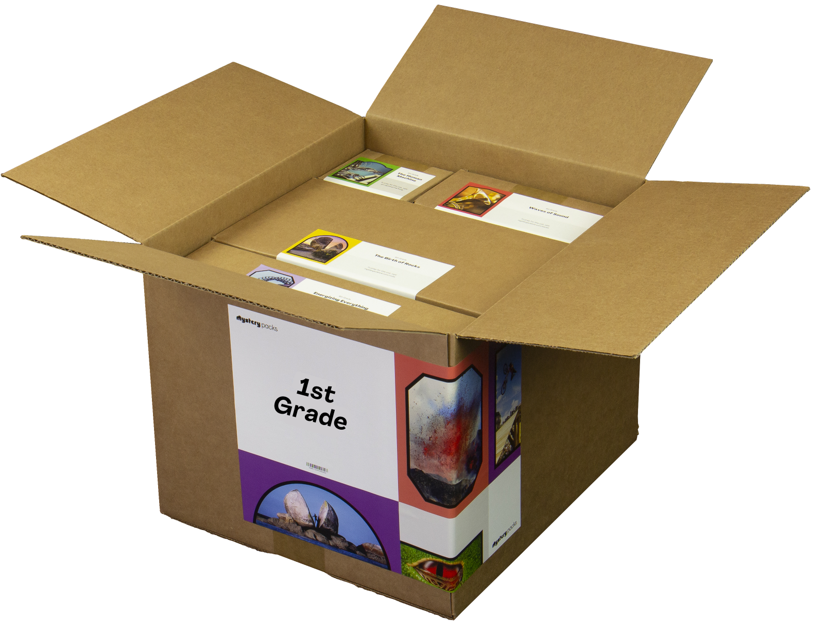
GRADE 1
Using Your Mystery Pack
Mystery Packs are supply kits that contain all the materials needed to teach Mystery Science for the entire year. Each box contains supplies for a class of 30 students.
Does my Mystery Pack contain enough supplies to send home?
For activities labeled Ready to Teach, there are enough supplies in your box for each student to have their own materials. For activities labeled Adjust Supplies, you’ll need some extra materials so that students can work on their own without sharing supplies.
What if I can’t send supplies home to students?
If students don’t have access to supplies, you can turn some activities into demonstrations and share via video conference. Students can participate by recording their observations.
What if I don’t use all of my supplies this year?
Don’t worry! You can still use your Mystery Pack next school year. You’ll just need to refill any supplies that you do use this year.
I don’t have a Mystery Pack. Can I still order one?
Yes! Packs are still available for purchase. You can learn more about Mystery Packs and how to get them here.
9

