Slide 1






Abstract Line
FREE PRESENTATION TEMPLATE

Slide 2






Welcome
Welcome to the world of fantasy! Join us on a journey to explore the mystical creatures, enchanted lands, and magical wonders that exist beyond our reality. Discover the wonders and secrets of this exciting realm and unlock the power of imagination.

Slide 3


1
Introduction
Table of Contents
The Extraordinary Realm
2
Encounters
3
Wonders
Unicorn Sightings
Wishes Granted
4
Magic
5
Adventure
Spellcasting
Happily Ever After
6
Conclusion
Embrace the Fantasy

Slide 4
Introduction
The Fantasy Realm: Uncovering the Secrets of the Imagination and the Magic that Lies Within

Slide 5


The Realm of the Extraordinary
Welcome to the Fantasy World, a realm of wonder and enchantment where anything is possible. Here, dragons breathe fire, unicorns prance through meadows, and rainbows shine brightly. This world is a place where wishes come true, where potions can be cursed and spells are cast. It's a place of treasure and adventure, where the impossible becomes possible. But the greatest treasure of all is the one that lies within.
The world of fantasy is a reflection of our deepest desires, our fondest dreams, and our wildest imaginations. It's a place where we can let go of the constraints of reality and explore the boundless possibilities of the human mind. In this introduction, we will delve into the mysteries of this realm, uncovering the magic and wonder that lies within. So come with us and let's embark on a journey through the Fantasy World.

Slide 6
Encounters
Encountering the Inhabitants of the Fantasy Realm: From the Enchanting to the Fearsome

Slide 7
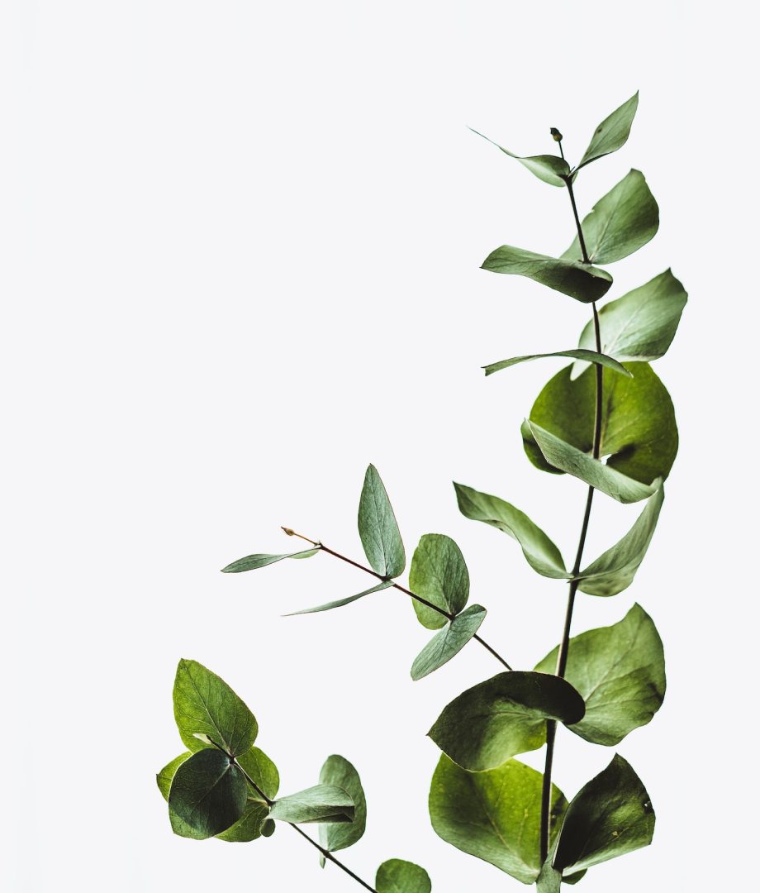



Unicorn Sightings
A record of the number of unicorns spotted in the fantasy realm and the beauty and mystery that surrounds these enchanting creatures.
Dragon Taming
A closer look at the art of taming dragons and the brave adventurers who dare to take on these fearsome creatures.

Slide 8





Unicorn Sightings
Dragon Taming
A record of the number of unicorns spotted in the fantasy realm and the beauty and mystery.
A closer look at the art of taming dragons and the brave adventurers who dare to take on these fearsome creatures.

Slide 9
Wonders
A sense of awe and amazement in the face of something extraordinary or unexpected.

Slide 10

Fantasy is the gateway to the impossible, the land where the ordinary becomes extraordinary, and the impossible becomes possible.
The Dream Weaver

Slide 11





In the Realm of Magic and Adventure, dragons are no longer fearsome beasts to be feared. They can be tamed and even become loyal companions to those brave enough to venture into the unknown. Similarly, unicorns, long considered to be mythical creatures, can now be sighted in this fantastical realm. The world is filled with endless possibilities and endless adventures.
Taming Dragons and Unicorns

Slide 12


The journey of self-discovery and the exploration of the human imagination are just as important as the creatures and wonders that populate this realm. Here, you can reflect on your deepest desires and fulfill your fondest dreams. The realm is a place where you can let go of the constraints of reality and explore the boundless possibilities of the mind.

Slide 13
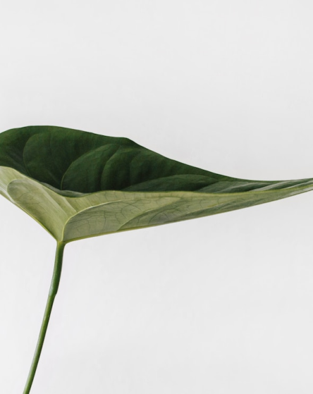
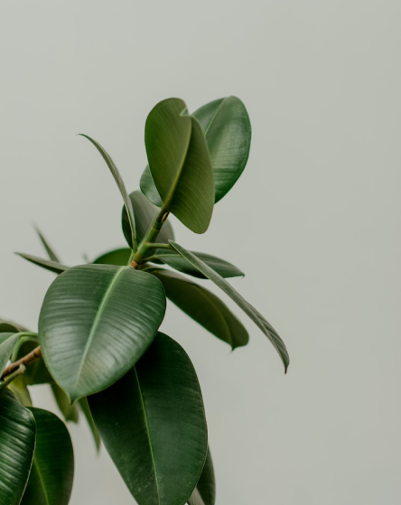

Exploration of the Inner Self:
A Journey of Self-Discovery

Slide 14




Dragon Taming Technique
The Art of Unicorn Sighting
A guide to taming and caring for dragons in the realm of magic.
Tips and tricks for spotting the elusive unicorns in their natural habitat.

Slide 15


The Magic of Dragons:
A Research
150
130
100

Slide 16

"The Evolution of the Unicorn" is a study exploring the historical, cultural, and mythical development of the iconic fantasy creature. From its ancient roots in Mediterranean mythology to its modern-day representation in popular culture, this research delves into the various interpretations and beliefs surrounding the mystical horse with a single horn. The goal is to understand the evolution of this captivating creature and its enduring place in human imagination.
The Evolution of the Unicorn

Slide 17







The Elves: A Glimpse into Their World
"The Art of Archery": Discover the intricacies of the Art of Archery as practiced by the graceful and precise elves.
"The Music of the Elves": Immerse yourself in the enchanting music of the elves, whose songs have the power to heal.
"The Life of an Elf": Learn about the customs and daily life of the elves, from their familial structure to their religious beliefs.

Slide 18

The Mermaid
Believed to have originated from ancient tales and legends, mermaids have been depicted in various cultures for centuries.
Mermaids are said to possess the ability to control the ocean and manipulate the tides with their singing voices.
Mermaids are often portrayed as having the upper body of a human and the tail of a fish.
Living in the ocean, mermaids are known to lead solitary lives and spend their days exploring the underwater world.

Slide 19


A magical being with the power to cast spells and create illusions, often sought for bringing wonder and magic into people's lives.
The Art of Enchantment

Slide 20

The Enchanter: Cast Spells, Create Illusions

Slide 21


Some Data
75%
Enchanted Creatures
possess the ability to cast spells.
60%
Magic-Wielding Individuals
practice the art of illusions.
90%
Spells Cast
are dark magic, foretelling danger.

Slide 22
Magic
A world of spellbinding wonders and mythical creatures where magic is the key to unlocking the impossible.

Slide 23
234,567
UNICORN SIGHTINGS
A tally of the number of unicorns spotted in the fantasy realm.

Slide 24

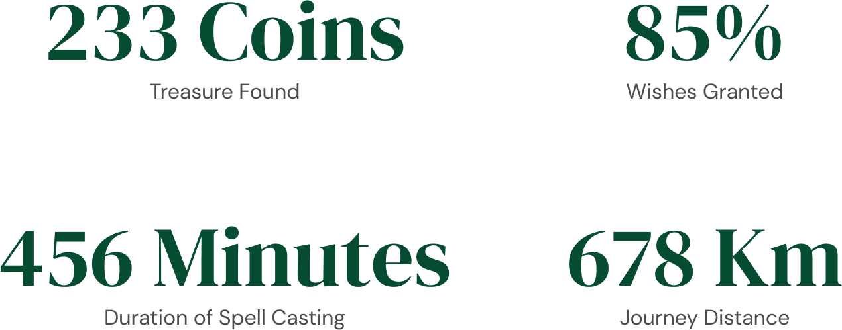


Slide 25
Some Graph
Treasure Found
Spell Progress
A record of the amount of treasure found per month
A record of the number of spells cast per year

Slide 26

A Magic Picture

Slide 27


Another Magic Picture

Slide 28


And Two Magic Pictures

Slide 29


Dragons: These mythical creatures are known for their fiery breath and massive size. They are often depicted as fearsome beasts, but some legends suggest that they can be tamed and even befriended.
Enchanters: Enchanters are magical beings who have the power to cast spells and create illusions. They are often sought after for their ability to bring wonder and magic into the lives of others.

Slide 30

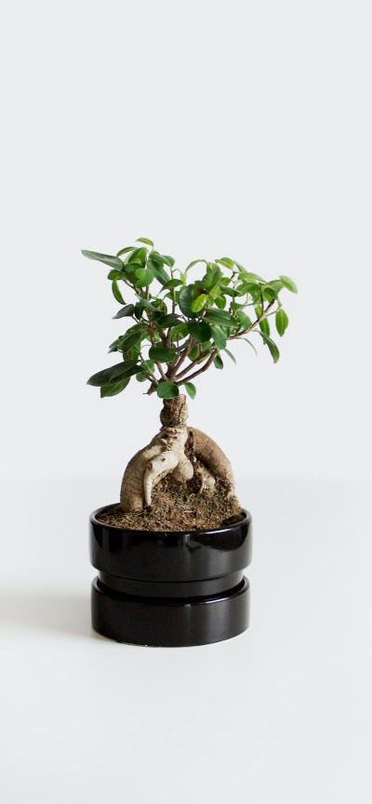



Slide 31

The mythical horses
These mythical horses are said to have a single horn on their forehead and are often associated with purity, grace, and magic. Some legends suggest that unicorns can only be seen by the pure of heart.
The Unicorns

Slide 32

The Enchanted Forest
A Journey Through the Realm of Magic and Wonder
  A world of mystery and enchantment awaits
  Explore the secrets of the Enchanted Forest
  Meet the magical beings that call this place home
  From fairies to unicorns, discover their stories and powers

Slide 33
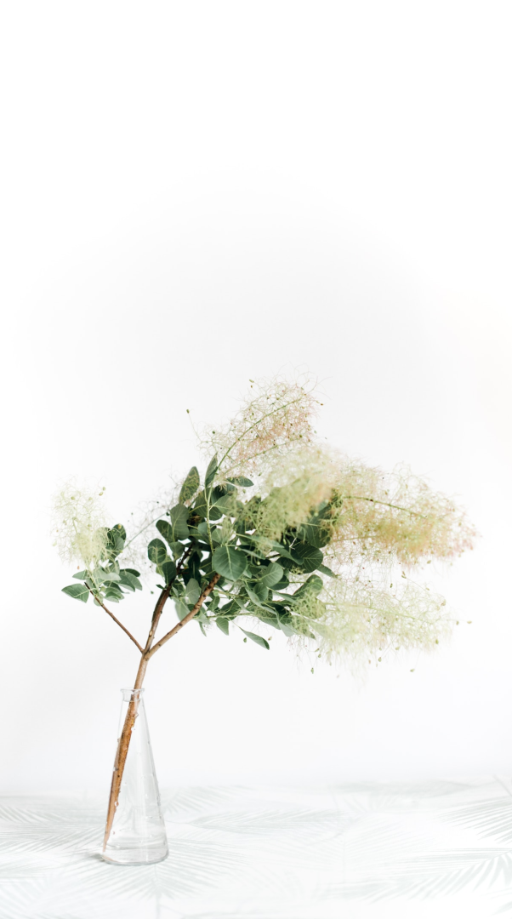
Discover the secrets
Find your own path
1
2
Explore the lush, vibrant forest and uncover the mysteries that lie within.
Choose your own path through the forest, and see where it takes you.
Meet the creatures
Uncover the magic
3
4
Encounter the mythical creatures that call the forest home, from talking animals to mischievous fairies.
Learn about the powerful magic that pervades the forest and how it affects all who enter.

Slide 34
The Castle of Shadows
The Crypt of the Forgotten
The Castle of Shadows is a mysterious and ominous place, shrouded in mystery and surrounded by darkness.
It is said to be the home of the evil witch, who uses her dark magic to terrorize the surrounding lands.
Despite the danger, many brave adventurers venture into the castle in search of treasure and adventure.
The Dungeon of Despair

Slide 35
Adventure
Embark on daring adventures, face challenging obstacles and discover hidden secrets in a realm full of limitless possibilities.

Slide 36

Fantasy Realm
The Enchanted Forest
A magical forest filled with talking animals and enchanted creatures.
The Crystal Caves
A network of underground caves filled with precious gems and crystals.
The Dragon's Lair
A dangerous and mysterious place where dragons reside.

Slide 37




The Timeline
Dragon
Unicorn
First dragon was successfully tamed
Large herd of unicorns migrated to the realm
Pool
Rainbow
A magical pool with power to grant wishes
Unusually large number of rainbows were sighted

Slide 38




The Infographic
Spellcasting Competition
Treasure
Hunt
Great
Adventure
A significant event in the history of the fantasy realm, in which the greatest spellcasters of the realm competed.
A significant event in the history of the fantasy realm, in which a massive treasure hunt was organized.
A notable year in the history of the fantasy realm, in which a large number of adventurers set out to explore.

Slide 39




The Table
QUEST
DIFFICULTY
REWARDS
Searching for the Holy Grail
High
Wealth and Prosperity
Retrieving the Golden Fleece
Medium
Treasure and Ancient Knowledge
Finding the Sorcerer's Stone
Low
Knowledge and Foresight

Slide 40
The Graph
25%
35%
Wishes Granted
Medieval-like Worlds
15%
25%
Dragon Appear
Chosen One

Slide 41



Our Team
Eldruin
Lunaria
Elementalen
The Fire Mage
The Moon Priestess
The Guardians

Slide 42
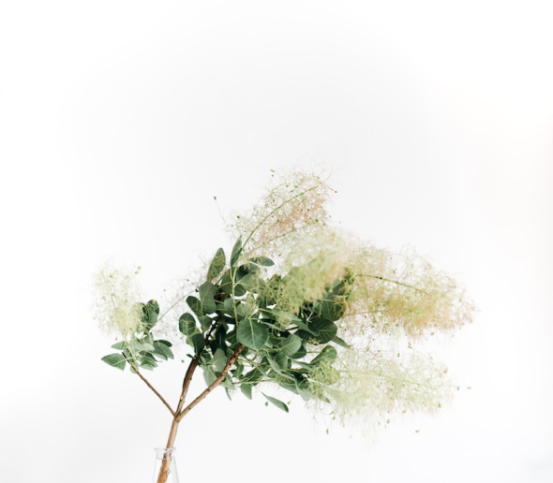
An Unforgettable Journey
An Adventure Awaits
Enter the mysterious world of the sea serpents, where danger and beauty intertwine.

Slide 43
Conclusion
Experience the magic and thrill of the extraordinary in the realm where anything is possible and every journey is unique.

Slide 44


Creatures of the Deep
Dangers Ahead
Discover the unique creatures that call the abyssal depths home, from fearsome sea dragons to enchanted mermaids.

Slide 45



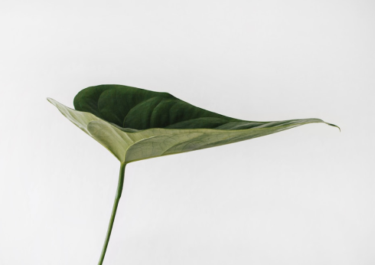


The Enchanted Ocean

Slide 46
The List
Dragons
Fire-breathing creatures that are often powerful and dangerous
Medieval-like Settings
Worlds with castles, knights, and feudal systems
Chosen One Trope
A hero chosen by destiny to save the world
Magic
An integral part of fantasy stories, can take many forms
The Best Curse
A curse that is unique, creative, and fits within the story
Unique Creatures
A variety of fantastical beings that inhabit the world

Slide 47
Thank You

