Slide 1

Welcome to ‘No Biscuits!’
23rd January 2025
Toplosentrala, Sofia

Slide 2

Notes:
So No Biscuits - how did it all begin?
This is where it started, in a bathroom of a hotel room in Central Asia about 8 years ago.
I had just showered, was wearing my towel when, I turned round, to my shock I found myself staring at an overweight, middle-aged man, who was losing his hair.
“Excuse me, but what are you doing in my bathroom?”
I was, of course, looking at my own reflection in the mirror.
And I said to myself “This…. is no longer acceptable.”
Will, we are going to lose weight. We are going on a diet.
Going on a diet? - Oh yes, of course you are.
We tried losing weight, we tried well. We tried for over a week and out into the next and over the hills and far away and do you know what? ….it was beautiful, …….a beautiful failure.
Why, I thought….why is it so difficult to lose weight, when that’s all that we really want to do?

Slide 3
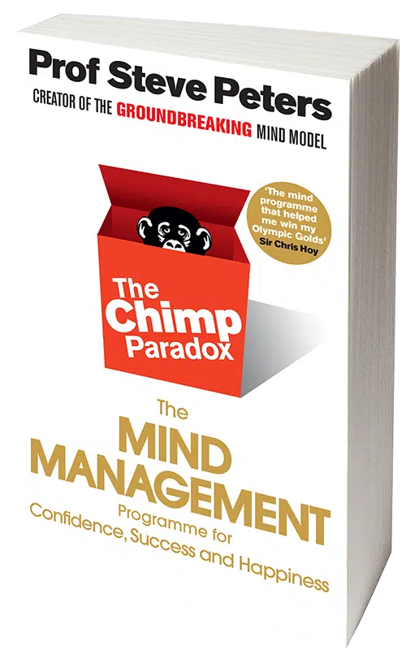
Notes:
I needed help - it came in the form of this book, written by Prof. Steve Peters.
In 2 minutes - if I explained the essence of the solution in this book - would you have any objections?
I need a volunteer for this and have agreed with Amelie, that she will help me. (Amelie comes forward and sits in chair)
The message of this book is that inside my head, your head, are three elements, the chimpanzee, the human and the computer.

Slide 4
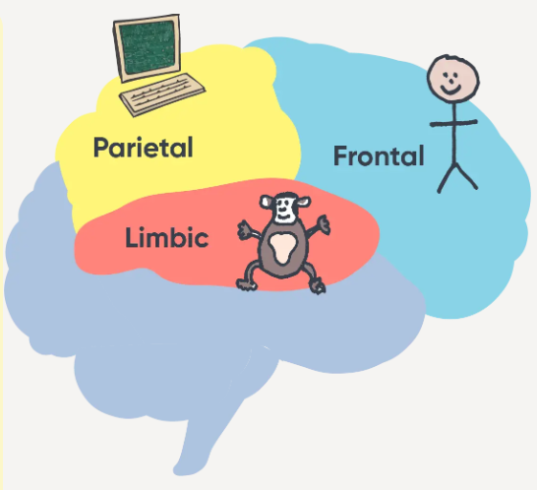




Notes:
So for this demo, I am the Chimpanzee, and we all have our Chimp, and as the Chimp, I am five times stronger than the human.

Slide 5
The Chimp:
lives in the moment, seeks survival
does not ask questions, it just acts
is set up to be either defensive or aggressive
will keep you alive, it is programmed for survival
it knows fight, flight or freeze
It is neither naughty nor good, it’s just the Chimp.
Notes:
This is what the Chimp does, he is primordial
It is neither naughty nor good, it’s just the Chimp.
He can of course, also just be asleep.

Slide 6
The Chimp is:
your ego
your emotions
your temptations
your survival mechanism
Notes:
It lives in your head together with the rational quiet human voice, the “human”.
Amelie represents the human, living in your head
This is the human, which you can recognise:

Slide 7
The Human:
can plan ahead
is reasonable
will compromise
can think strategically, rationally, sensibly
is everything that the Chimp is not.
Notes:
The human speaks quietly in your left ear, while the Chimp is shouting into the right one.
And 3rdly - there is the hard drive - the computer
The hard drive is just writing everything down and archiving it as memory in order to remember what to do next time.
The hard drive reminds you how you have reacted to every memorable historical event.
When something happens - the Chimp and the Human - in an instant, look at the pc to see what is written.
Someone cuts you up on the road………..what do you do? What did you do last time?
So…. if we want to change this dynamic….. and you have seriously to want to change it - we have to figure out a way to understand your Chimp and make a deal with it,

Slide 8
Summary
The Chimp - ego, very strong, loud, survival, yes or no, lives in the moment.
The Human - rational, calm, strategic, reasonable, 5 x weaker than Chimp.
The Hard Drive - records beliefs and memories, reactions to events, ensures repetition of reaction, encourages habitual behaviour.
Notes:
So 3 elements
This formula is just one way of managing thoughts and actions, but I use it as an illustration.

Slide 9
The Massimo Dutti Deal
Notes:
So, Will Stamper, 2018, overweight, back from Bishkek and having read The Chimp Paradox, I was ready to engage with the Chimp and briefly, the conversation with him went very much like this: Human, Chimp and PC taking notes:
Human - Chimp conversation, acted out by W and A
(Thank you, Amelie) Amelie sits down
You see, the Chimp won’t really negotiate, it’s black or white, yes or no.
I constructed a deal with sufficient Chimp wins – looking better, feeling better, receiving compliments; it was enough for Will’s Chimp.
It led me to the critical understanding that it’s the thinking that is the game.
The thinking is the foundation of everything, for long-term, real change.
Talking to the Chimp is only one solution and it’s not easy or quick to embed habit change through thought change – Andrew Huberman (neuroscientist at Stanford University says that it can take anything between 21 - 240 days, depending on the individual
So I am now asking you to think.

Slide 10
Life and Time
Notes:
Let’s talk a bit about this.
Now let’s just imagine that I was 64, obviously I am not that old (Amelie shouts)….but if I was….
Amelie said to me the other day, that after you know, have……crossed over, she will manage NB

Slide 11

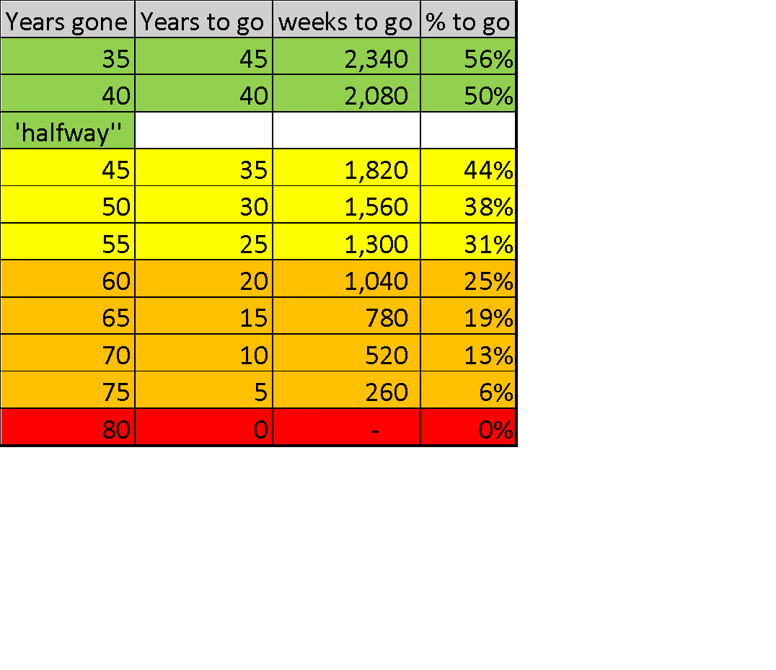
Notes:
The statistic in Western Europe is that the average lifespan is about 80 years. (It’s a bit higher for women, but averaged out it’s around 80)
At 64 years old, I would have just over 800 weeks left to run, to reach 80.
It’s hard to look ahead, but I am asking you to try, not 5 years, but 20 and more.

Slide 12
Life – a game of two halves
How are the last 10 -15 years going to look for you?
What do you want to be able to?
How soon do you think you should start to prepare?
Notes:
If we accept the statistic that in western europe the average lifespan, averaged also for men/women - it’s about 80 years.
So let’s use sport as the analogy and take years to equal minutes.
Say the game is 80 minutes long, like a rugby match - its 2 x 40 minute halves of a very physical game.
So if you’re under 40 years old, you are still in the first half, running around quite fast, full of energy, tackling people, working hard and hopefully avoiding injury and if you are injured - you are mostly recovering quite quickly.
In the second half up working up to 80 minutes, you will still need to play hard, but no one expects you to keep the pace the same, especially towards the end.
SECOND CLICK – TO REVEAL BULLET POINTS
We all want comfort from pain and in terms of our health and we may want life to be comfortably predictable - but in the last half of the game, it’s probably going to show, if you have trained or not.
If you are 65 or over and you have a fall and break your pelvis - the data from the US say that there is a 30% chance that you will be dead within 12 months - because you won’t have enough muscle mass to remain upright and move with stability and people then mentally give up, when they have lost then physical ability.
Peter Diamandis – discrepancy between life span and health span. 79 v 63. Genetics – 7-30% responsible

Slide 13
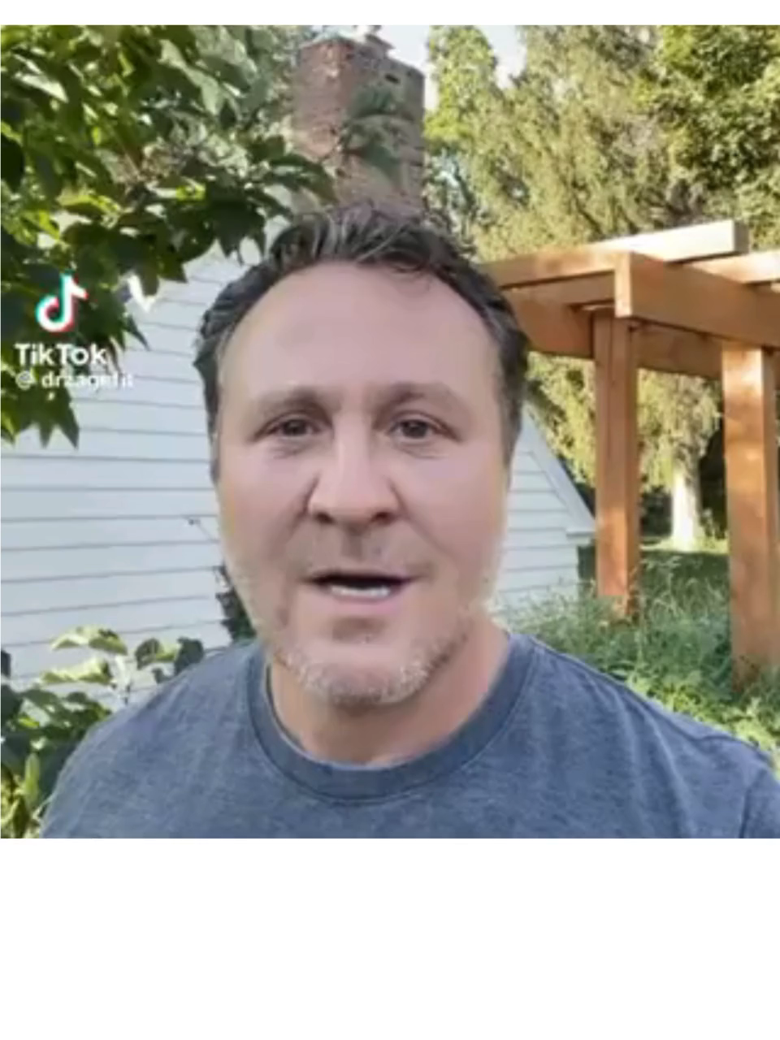
Dr Karrl Zarse
Notes:
Let’s listen very briefly to a US family doctor and what he has to say about growing old

Slide 14
Karl Zarse’s patients say:
I wish I had taken better care of myself.
I wish I had started early

Slide 15
Fundamentals
Notes:
I explained How NB began
I want to tell you why
Viktor Frankl – a psychologist and survivor of Auschwitz said When a man has a why, he can bear almost any how – why is linked to motivation
Fear was my short term motivation, the birth of a child at the age of 57, how am I going to provide for her until she is 18, when I will be 75.
Short term fear, short term stress is not necessarily a bad thing. If it becomes long term, it is a bad thing.
I was able to transform short term stress into long term opportunity or growth mode. It became a positive motivation.
When she gets married, I will dance with her at her wedding.
Next
So if I want to live longer, more importantly, I also want to be healthy longer.
The environment, I think today is quite hostile.
What do I mean. Let’s just take a supermarket, Lidl, Fantastico, it doesn’t matter
Tell the story
It’s about me – but it’s about kids, I wish I had known the things I know now when I was younger.
I want to give the younger generation the opportunity to understand the environment and actively protect themselves
I will leave it at that for now, but I consider the broader environment in which we live as not having our best interests at heart.
And so we need to be proactive in filtering out the negatives
We try to speak only in positive terms and I will explain why shortly
There is no judgement, you do what you can, it’s your project
No pressure
You can fail as much as you fail, every day brings a new start.
What is good is if you don’t give up
Let’s talk about a general problem Sugar

Slide 16
Sugar
Notes:
I once googled……
I was so naïve…

Slide 17


Slide 18
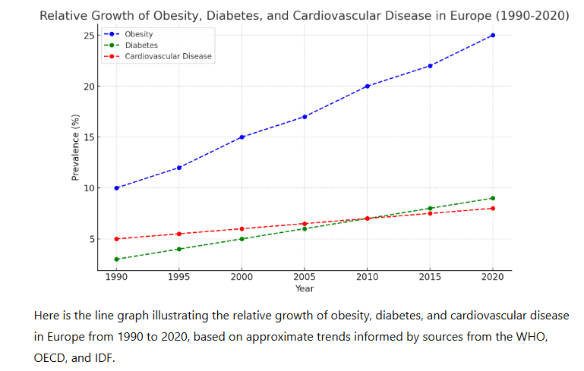
Notes:
By the way - people are not becoming healthier over the years, US life expectancy has started to decline.
4 ghost trains

Slide 19
Power of thought
3 Groups in experiment:
1 - Control – no activity
2 - Internal imagery visualization
3 - External imagery visualization
Controlled exercises:
15 minutes per day
5 times a week
6 weeks
Notes:
Before I finish, I want to leave you with one more piece of evidence: the power of your own consistent thought.

Slide 20
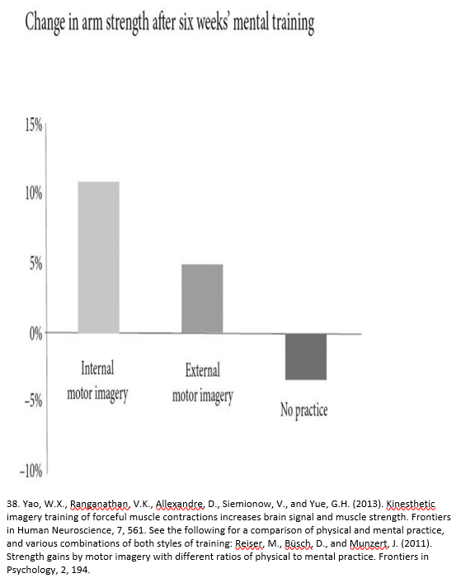
Change in arm strength after 6 weeks
mental training
11 %
5 %
-3%
Notes:
University College Dublin
Pay attention to the quality, intensity and direction of your thoughts.

Slide 21
So what is No Biscuits?
No Biscuits = knowing yourself, finding out what you want to achieve and being ready to do some work to achieve it.
No Biscuits is about you working to increase your long-term health span.
No Biscuits is about you building your strength, physically, psychologically and emotionally, ready for when you really need to deploy that strength.
Notes:
So what is No Biscuits all about? Let me start to explain
It’s all about making changes – if you need to or if you want to
Ask us about our motivations
Feel free to ask us about that in Questions and Answers

Slide 22
So how do you do it?
Find your motivation
Make a deal with the chimp
Take a long term view
Do small easy steps, every day
Be prepared to work – keep it simple, easy, with support
Notes:
Everyone is different, some will want to work individually, some in a group, you design it how you want, you build the goals, the timings, we can help you, but the energy has to come from you.

Slide 23
Marty Kendall – Optimising Nutrition
Dr Peter Attia– « Outlive »
Eckhart Tolle – Spiritual Teacher
Rhonda Patrick – ‘Found my Fitness’
BJ Fogg – « Tiny Habits »
Gary Brecka – Human biologist
Ethan Kross – Psychologist – « Chatter »
Steven Bartlett – Diary of a CEO podcast
Dr. Aseem Malhotra - Cardiologist
Dave Robson – The Expectation Effect
Jordan P Peterson – Clinical Psychologist – « 12 Rules for Life »
Dr David Unwin – Sugar Infographics
Justin /Stop spiking sugar – CGM food tests
Andrew Huberman - Neuroscientist
Steve Peters - Sports Psychologist – « Chimp Paradox »
Jessie Inchauspé - the Glucose Goddess
Bill Brydon – « The Body »
Prof. Tim Noakes – Low carb
Robert Sapolsky - « Behave »
Dr Rob Lustig – Cholesterol myth
Daniel Z Lieberman - « The Molecule of More»
Dr Amen – Neuro scientist, Psychiatrist
Dr Robert Cywes - Obesity specialist
Wim Hof – Extreme athlete (cold water and breathing)
Mel Robbins – Life Coach – 54321, Let Them
Jake Humphries, Damian Hughes - High Performance Podcast
Chris Williamson - Podcaster
Peter Glidden – Naturopath
Ryan Holliday – Stoics (Greek, Roman)
Zoe Harcombe – « No More Mr Fat Guy »
Tim Ferriss – « The Four Hour Body »
Viktor Freinkel – « Man’s Search for Meaning »
Notes:
The sources of information will be from a range of internationally medically proven expertise, information sources will always be referenced and cited, but you are also encouraged to do your own research and check out what we are offering.
We are not offering medical advice, but really helping you to change your thinking and then change your habits.
We are helping you to help yourself.

Slide 24
So how do you do it?
Your side:
You decide to launch a project, we call it No Biscuits, you call it what you like
You are your Project Director and Manager
We are your support mechanism, ideas, suggestions, tool box
The project lasts till you stop it, mine runs until I stop breathing.
Notes:
You have to do your part and we will do ours.

Slide 25
Nobiscuits.com
Today we launch:
Register to receive a NB newsletter to include tips, suggestions and updates and start a dialogue
Join a No Biscuits forum - we will have 3 - thinking, weight loss and exercise
Opportunity for 3-4 people to work on individual basis for a 4 month trial period, trial price (30 BGN per session – 45 mins)
Notes:
So what can No Biscuits do for you for now:
So we are in start up mode and in test phase.

Slide 26
Future development
Developing changing thinking - linked with everything
Nutrition, what you eat or drink
Exercise
Sleep
Breathing
Power of your thought
Meditation
Social interaction and relationships
Avoiding environmental toxicity
No Biscuits for kids?
Notes:
In future modules, will be programmes that contain ideas, suggestions, tips for a range of subjects

Slide 27
Mission Statement
“Narrowing the gap between health span and lifespan,whilst extending both”
Notes:
In future modules, will be programmes that contain ideas, suggestions, tips for a range of subjects

Slide 28
Participation and/or Collaboration?
Notes:
In future modules, will be programmes that contain ideas, suggestions, tips for a range of subjects

Slide 29
No Biscuits - Games and Picnic
18th May Sunday
Games for small kids, medium sized and big kids
and parents and grandparents
Good food, fresh air
Notes:
Coming up
Why - as a young father, frequenting playgrounds, what I observe is kids playing and parents on their phones, pushing the swings
Why - fun, community building, all inclusive.
Organised games for small kids, medium kids, and big kids
Food, which is non-processed, fresh air and bit of fun.
That’s what we are going to do, play games and eat non-processed, home made food in the fresh air. If it rains we will go home early.
Sneak preview of one of the games……………………..in the bar
Most of all thank you for coming. And I mean that from the heart of my bottom – sorry the bottom of my heart.
We are happy to take questions and if not to ask you questions.
You can write to us, you can viber or what’s app us.

