Slide 1
How to make informed financial decisions
This session is aimed at Key Stage Three (recommended for Year 7 or 8)

Slide 2
Unit outline
Session 1 | Session 2 | Session 3 | Session 4 | Session 5 | Session 6
How to open a bank account | How to read a bank statement | How to save money | How to use bank cards | How to manage debt | A guide to banking

Slide 3
Having a respectful learning environment
We will listen to each other respectfully
We will avoid making judgements or assumptions about others
We will comment on what has been said, not the person who has said it
We won’t put anyone on the spot and we have the right to pass
We will not share personal stories or ask personal questions
If there is a question that you do not wish to ask aloud, you can write it on a Post-it Note which will be collected throughout the session and answered at the end
Notes:
Teacher delivery
Students should be invited to ask questions and they should be provided with an opportunity to ask questions anonymously. It is useful to have a question box or allocated space on the whiteboard for students to share questions.
It is suggested that students are provided with post-its or slips to write their questions on and as the teacher circulates throughout the lesson these questions can be collected and answers throughout the session or using an allocated ‘question time’ at the end of the session.
Students can be invited to respond to questions asked by their peers. If responses to questions are based on personal preference or opinion, the teacher should be clear to preface any answers with this.

Slide 4
4
Session 3
How to save money

Slide 5
By the end of the session, I will be able to:
Identify why people need to save money
Assess different ways to save
Create a savings plan

Slide 6

What does ‘saving’ mean?
‘Saving’ means money set aside for future use and not spent immediately.
How easy is it to save money?

Slide 7








What do people save money for?
Which of these items might someone need to save up for?
Can you think of any other items?
Stretch: is this the same for all people?
Notes:
Teacher instruction
Possible answers and reasons:
• Paying unexpected bills or for emergencies
• Planning special events (e.g. a wedding)
• Planning to purchase big items (e.g. car, house, holiday, etc.)
• Reducing the need to borrow money
• Saving up for retirement when you’re not working anymore
• It feels good to save, and can reduce stress and anxiety around money
Extended questioning: consider a range of perspectives i.e. differences depending on age
• Which items are more important?
• Which items need a short term savings plan or a longer term saving plan?
• Which items could you delay buying for a while? Are there any benefits of delaying buying these items?
Challenge question: what is the difference between having a budget and saving?

Slide 8
What do people save money for?
Write a paragraph explaining why people might need to save money
Give examples of what they would save for
Describe how this might be different depending on somebody’s age, circumstances or beliefs

Slide 9
By the end of the session, I will be able to:
Identify why people need to save money
Assess different ways to save
Create a saving plan

Slide 10

How to save on the things you buy
Use price comparison sites
Find discount codes
Shop around for best deals
The heavyweight boxing world champion Tyson Fury and his wife enjoyed hunting for bargains during their local supermarket trip.
What other things could you do or look for to save money?
Explore ‘package deals’ e.g. buying a cinema pass rather than one off tickets
Saving when buying
Promotion code
Have a ‘one in,
one out’ policy
when you buy clothes
(and sell or donate
the one you’re
getting rid of)
Delayed gratification
Buy ‘pre-loved’ goods
Notes:
Teacher instruction
Possible answers:
Swap with friends
Purchasing on Vinted, eBay, Gumtree, although be aware of scams
Leave something in your online basket as may then be emailed a discount code
Use buy one get one free offers with a friend and halve the price
Buy in bulk when things are on offer
Look to sell clothes/items no longer need
Spend less
Look for cashback offers - the concept may need explaining
Discussion:
Do discount codes / buy one get one free encourage unnecessary purchases?
Develop discussion on delayed gratification - why might it be useful to wait before making a purchase
Original article: https://www.manchestereveningnews.co.uk/sport/boxing/tyson-fury-takes-wife-paris-28821237

Slide 11



How do people save money?
What are the different ways a young person can save money?
Where might they keep the money that they save?
What are the advantages and disadvantages of each method?
Notes:
Teacher instruction
Possible answers:
• Set a savings budget and put money aside each week or month
• Put cash into a money box
• Open a savings account

Slide 12
What is interest?
Money that is paid as a reward to savers or as a fee on borrowed money
Interest
Deposits
Customers
Bank
Loans
Interest
Notes:
Teacher explanation
Banks accept money (deposits) from customers and they also make loans (lend money) to customers.
They pay interest on deposits and charge interest loans. That helps them make a profit.

Slide 13

Smart saving
Put money into an account that pays interest (a percentage added to the money in the bank) – this might be paid monthly or yearly
Be even smarter by using an account that is tax free (ISA – Individual Savings Account) so that interest money isn’t lost on tax. You have to be 16 to open a cash ISA, but a Junior ISA can be opened by a parent or guardian
Savings in a bank account are protected by the Financial Services Compensation Scheme up to the value of £120,000 – if anything should happen to your bank, your money is safe

Slide 14

Calculating interest
If a customer deposits £100* earning 10% interest:
How much interest has she made at the end of the year?
How much money in total is in her account at the end of the year?
How do we work this out?
*Assuming no more money is taken out or deposited over the year
Notes:
Teacher explanation
Adaptive teaching: This example uses simple interest for calculations. For HAPs, compound interest can be introduced.
Compound interest: Instead of finding 2% on the deposit (amount paid in) of £100 each month, we can find 2% on the amount paid in PLUS the extra interest made on the Year before. E.g. in the SECOND YEAR. we find 2% on the amount earned in the FIRST YEAR which is £102. We do 2% on £102 (instead of 2% on £100). 2% on £102 is £102 x 0.02 = £2.04 (bigger than £2). So at the end of Year 2 there will be £102 + £2.04 = £104.04, instead of £104.
Example 2: Instead of finding 5% on the deposit (amount paid in) of £100 each month, we can find 5% on the amount paid in PLUS the extra interest made on the Year before. E.g. in the SECOND YEAR. we find 5% on the amount earned in the FIRST YEAR which is £105. We do 5% on £105 (instead of 5% on £100). 5% on £105 is £105 x 0.05 = £5.25 (bigger than £5). So at the end of Year 2 there will be £105 + £5.25 = £110.25, instead of £110.
Over time compound interest means money in the bank will grow faster than simple interest: watch the video to learn more: How Does Savings Account Interest Work? (please note the video has an American context)

Slide 15
Calculating interest
How much interest has she made at the end of the year?
To find 10% of £100, we calculate
0.10 x 100 =£10
2. How much money in total is in her account at the end of the year?
We add up the £100 deposit and the interest she makes.
£100 + £10 = £110

Slide 16

Calculating interest
Zara is choosing to put some money in a savings account.
She puts money into this account and gains interest on the money that she deposits (puts in).
1. How much interest has she made at the end of the year?
To find 2% of £200, we calculate
0.02 x 200 = £4
2. How much money in total is in her account at the end of the year?
We add up the £200 deposit and the interest she makes.
£200 + £4 = £204
If Zara deposits £200* earning 2% interest:
How much interest has she made at the end of the year?
How much money in total is in her account at the end of the year?
*Assuming no more money is taken out or deposited over the year
Optional video - watch to learn about compound interest - https://youtu.be/b7JL3EpsHPs
Notes:
Teacher explanation
Adaptive teaching: This example uses simple interest for calculations. For HAPs, compound interest can be introduced.
Compound interest: Instead of finding 2% on the deposit (amount paid in) of £100 each month, we can find 2% on the amount paid in PLUS the extra interest made on the Year before. E.g. in the SECOND YEAR. we find 2% on the amount earned in the FIRST YEAR which is £102. We do 2% on £102 (instead of 2% on £100). 2% on £102 is £102 x 0.02 = £2.04 (bigger than £2). So at the end of Year 2 there will be £102 + £2.04 = £104.04, instead of £104.
Example 2: Instead of finding 5% on the deposit (amount paid in) of £100 each month, we can find 5% on the amount paid in PLUS the extra interest made on the Year before. E.g. in the SECOND YEAR. we find 5% on the amount earned in the FIRST YEAR which is £105. We do 5% on £105 (instead of 5% on £100). 5% on £105 is £105 x 0.05 = £5.25 (bigger than £5). So at the end of Year 2 there will be £105 + £5.25 = £110.25, instead of £110.
Over time compound interest means money in the bank will grow faster than simple interest: watch the video to learn more: https://www.youtube.com/watch?v=8edPzh71RIQ (please note the video has an American context and FLIC will be making a video for the UK context)
https://www.youtube.com/watch?v=vIPhIi9KzAQ
https://www.youtube.com/watch?v=djBJmRH9lDo

Slide 17

Calculating interest
Notes:
Teacher explanation
Adaptive teaching: This example uses simple interest for calculations. For HAPs, compound interest can be introduced.
Compound interest: Instead of finding 2% on the deposit (amount paid in) of £100 each month, we can find 2% on the amount paid in PLUS the extra interest made on the Year before. E.g. in the SECOND YEAR. we find 2% on the amount earned in the FIRST YEAR which is £102. We do 2% on £102 (instead of 2% on £100). 2% on £102 is £102 x 0.02 = £2.04 (bigger than £2). So at the end of Year 2 there will be £102 + £2.04 = £104.04, instead of £104.
Example 2: Instead of finding 5% on the deposit (amount paid in) of £100 each month, we can find 5% on the amount paid in PLUS the extra interest made on the Year before. E.g. in the SECOND YEAR. we find 5% on the amount earned in the FIRST YEAR which is £105. We do 5% on £105 (instead of 5% on £100). 5% on £105 is £105 x 0.05 = £5.25 (bigger than £5). So at the end of Year 2 there will be £105 + £5.25 = £110.25, instead of £110.
Over time compound interest means money in the bank will grow faster than simple interest: watch the video to learn more: https://www.youtube.com/watch?v=8edPzh71RIQ (please note the video has an American context and FLIC will be making a video for the UK context)
https://www.youtube.com/watch?v=vIPhIi9KzAQ
https://www.youtube.com/watch?v=djBJmRH9lDo

Slide 18
How do people save money?
 | Put money in a cash box | Open a savings account
Advantages of using this method
Disadvantages of using this method
Items you would save for using this method?

Slide 19

Answers | how do people save money?
Putting money in a cash box
Advantages
Disadvantages
Immediate access: You have immediate access to your cash without any restrictions or waiting periods. This can be helpful in emergency situations.
Privacy: Keeping your money in a cash box provides a higher level of privacy compared to a bank account, as there are no records of your transactions.
No Fees: There are no account maintenance fees or minimum balance requirements associated with a cash box, unlike some bank accounts.
No interest: Money stored in a cash box doesn't earn any interest or grow over time, resulting in missed opportunities for financial growth.
Lack of documentation: Without proper documentation, it can be difficult to prove the source of the funds or their intended use.
Security Risks: Cash stored in a box is vulnerable to theft, loss due to fire or natural disasters, and accidental damage. This risk can be significant, especially if you keep a large amount of money.

Slide 20


Answers | how do people save money?
Open a savings account
Advantages
Disadvantages
Security: Banks provide a higher level of security for your money, including protection against theft, fire, and natural disasters. Your funds are also insured up to a certain limit by government-backed programs.
Interest Earnings: Savings accounts offer interest on the money you deposit, helping your funds grow over time. While interest rates can vary, it's still a better option for growing your money compared to a cash box.
Record Keeping: Banks provide clear records of your transactions, which can be helpful for budgeting, tax purposes, and tracking your financial history.
Fees and requirements: Some savings accounts come with fees, minimum balance requirements, and other conditions that can affect your overall returns. It's important to compare different account options before choosing one.
Limited access: While savings accounts offer convenient access, there might be limitations on the number of withdrawals or transfers you can make per month without incurring fees.
Market fluctuations: The interest rates offered by savings accounts can change over time based on economic conditions, potentially affecting your earnings.

Slide 21
By the end of the session, I will be able to:
Identify why people need to save money
Assess different ways to save
Create a saving plan

Slide 22




Saving goal
What sort of items would a
year 8 student be saving for?

Slide 23

Saving goal
If you set yourself a saving goal, it helps keep your financial decisions focused
It’s fine to save small amounts, regularly
If the saving goal is large, set some interim goals (and maybe some rewards to keep you motivated!)
Find a picture to put as your phone background, in your wallet or on your wall to remind you of your goal

Slide 24

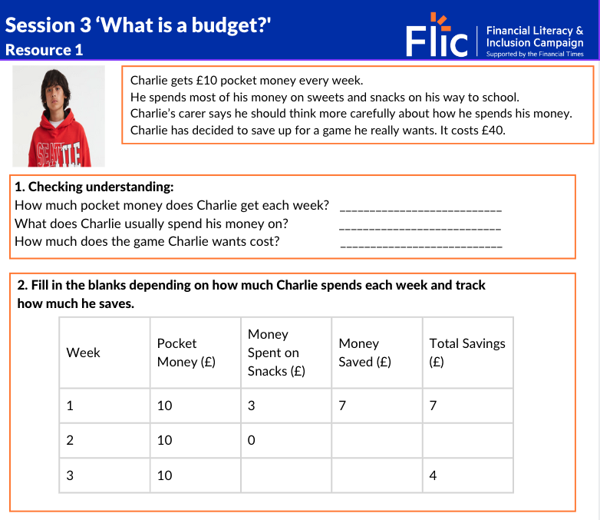
Create a saving goal
Charlie gets £10 pocket money every week.
He spends most of his money on sweets and snacks on his way to school.
Charlie’s carer says he should think more carefully about how he spends his money.
Charlie has decided to save up for a game he really wants. It costs £40.
Decide how much money Charlie will save each week.
How long will it take Charlie to save for this item?
Charlie wants to motivate himself to save by setting up rewards for himself when he reachers smaller amounts of his £40 goal. Write down 3 ideas of rewards Charlie could use.
Workbook exercises:
Personal reflection: have you ever saved up for something you needed or wanted to buy?

Slide 25
By the end of the session, I will be able to:
Identify why people need to save money
Assess different methods of saving money
Create a saving plan

Slide 26
Things to look out for
Minimum deposit – there may be a set amount of money needed to open the account
Interest rate – this can be fixed or variable, meaning it either stays the same or can change
Notice periods – you may not be able to get your money out instantly, or there’ll be a penalty fee if you do
Fixed time period – the account can only be held for a certain length of time, such as a year

Slide 27

Plan to save
Save first: don’t wait until the end of the month to save, as there might not be any money left
Use a saving goal - an item you really want
Have an amount in mind to save each month
Use a savings calculator, like the one on Moneyhelper.org.uk
There are some apps that round up transactions so that small amounts can be saved as a person spends e.g. if you spend £4.35 the app will round it to £5.00 and put the 65p into the savings account

Slide 28
How easy is it to save money?

Slide 29
Any questions?
?

Slide 30



Services available for people who have concerns about their personal finances
Citizens Advice – Debt and Money –
Links to advice on a number of topics, including financial difficulties, cost of living and communicating with creditors.
National Debtline – Debt and Money
A debt advice charity run by the Money Advice Trust, offering a free and confidential debt advice service.
Childline Helpline
0800 1111
Talk about anything.
Contact via phone / web
At school, you can speak with an adult you trust.
This could be your form tutor, head of year or the school’s safeguarding officer.

Slide 31
Links to learn more!
Articles to extend learning
Please visit the FLIC Learning Hub for further resources
Money - Best way to save for a child (2024)
Unbiased - Saving for children: the best ways to save for your child's future (2024)
How to make ISAs even nicer (Financial Times, September 2023)

