Slide 1

Zero-Touch Inmate
Monitoring
Real-Time Inmate Monitoring for Enhanced Safety
Demo Presentation

Slide 2

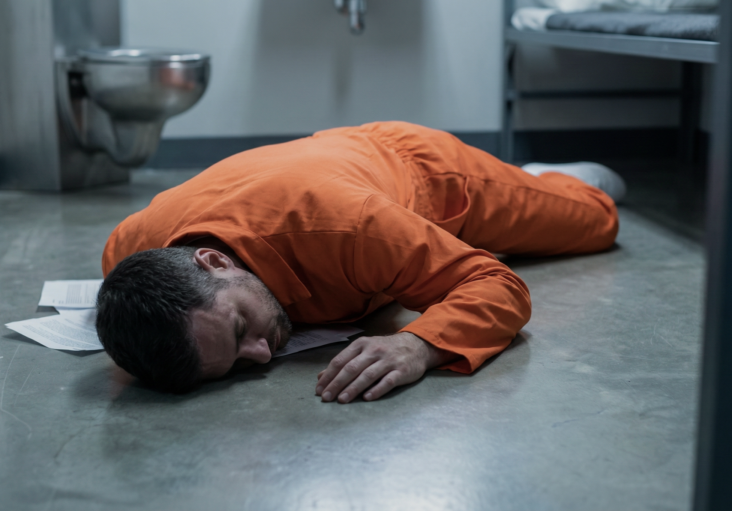
From the Frontlines
“Things can happen fast in terms of an overdose or suicide.”
- Jail Medical Staff in CA
“She was lying face down on a mat, we thought she was sleeping.”
- Jailer in KY
“I appreciate an extra set of eyes.”
- Sheriff in TX
“I like the 6-month data backup.”
- Chief Deputy in KS

Slide 3
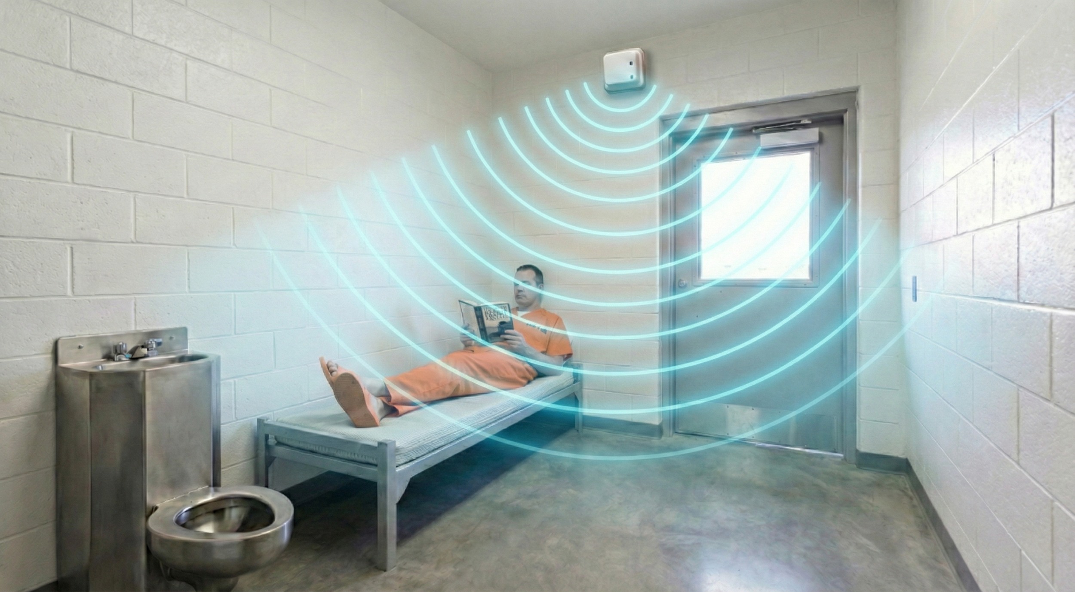
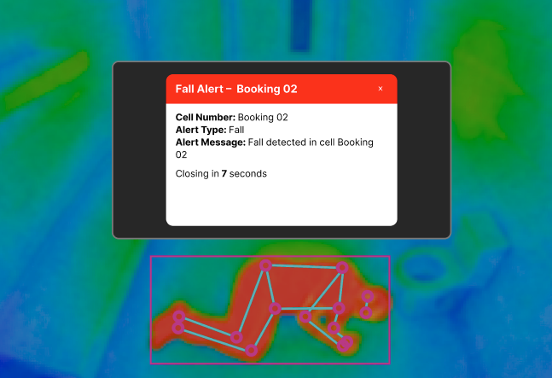
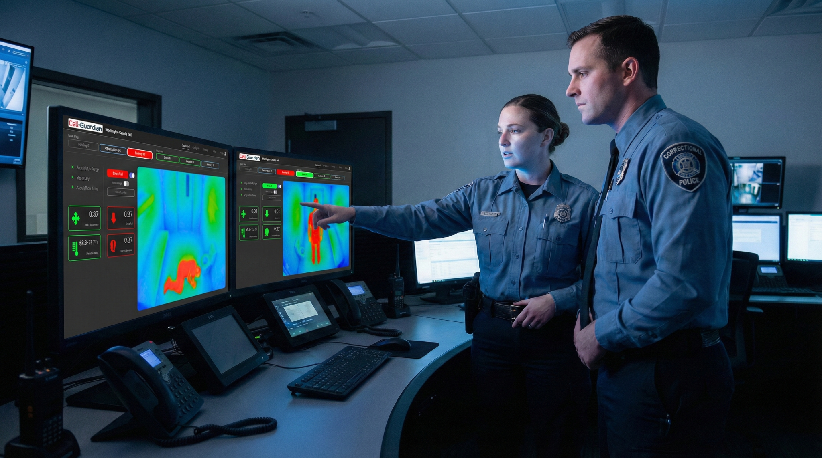


Introducing Cell-Guardian™
A better way to monitor and manage inmates’ health and well-being.
Zero-Touch Monitoring
No physical interaction
No wearable devices
Continuous monitoring
First 48 hours are critical
Incident Detection & Alerts
Vital Signs
Fall detection
Instant notification alerts
Incidents are time-stamped and documented for review
Operational Efficiency
Empower staff with better real-time information
Improve staff allocation
Reduce staff burnout
Reduce facility liabilities

Slide 4
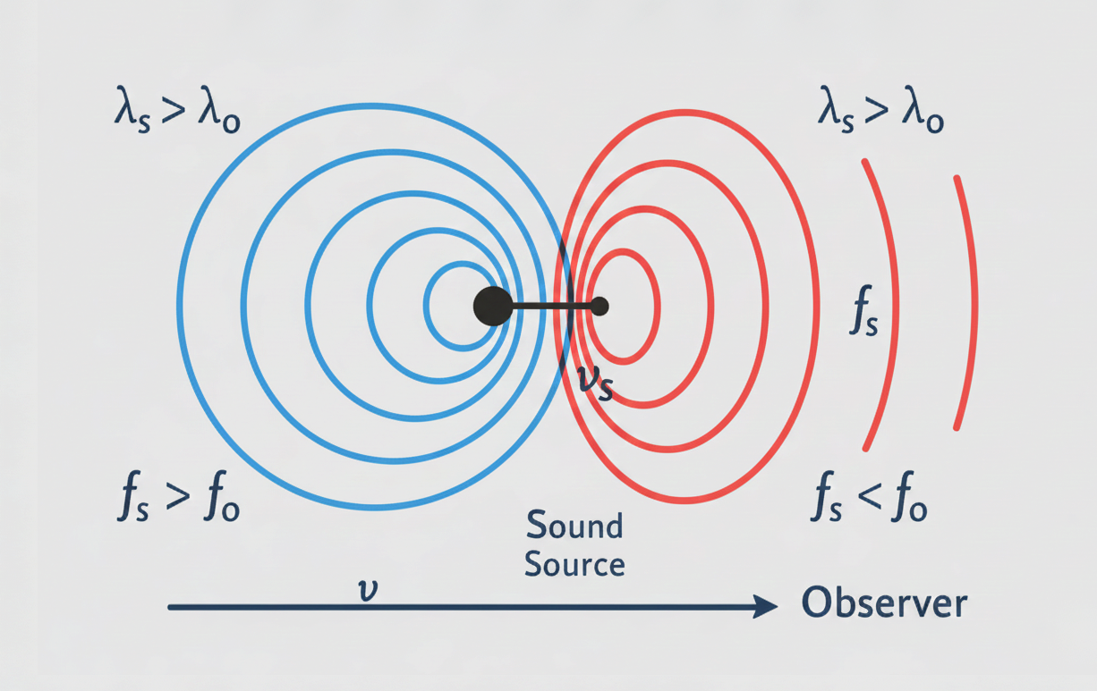
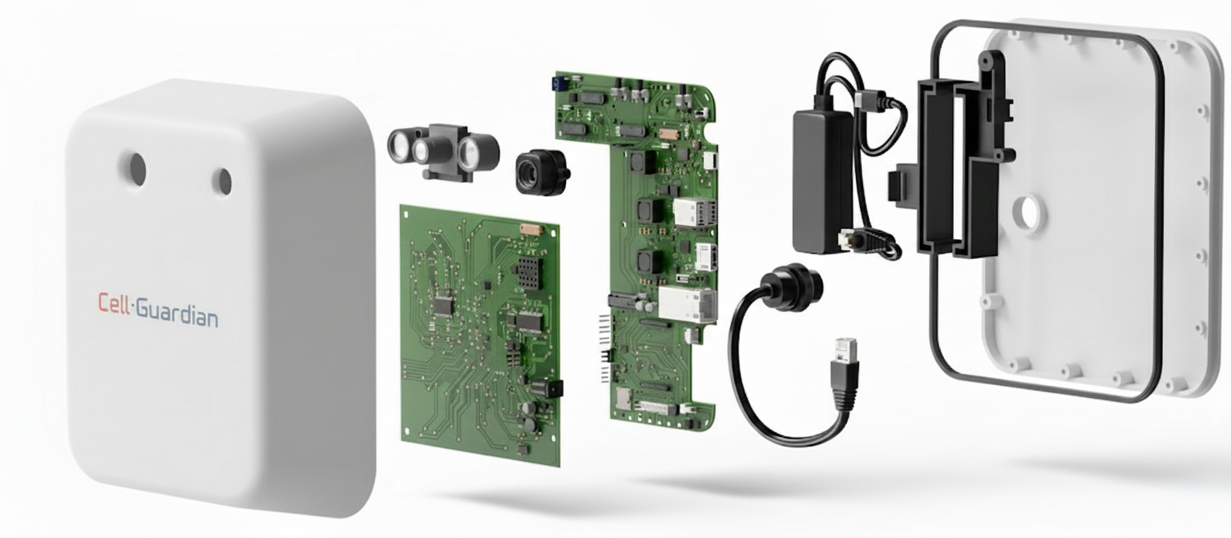
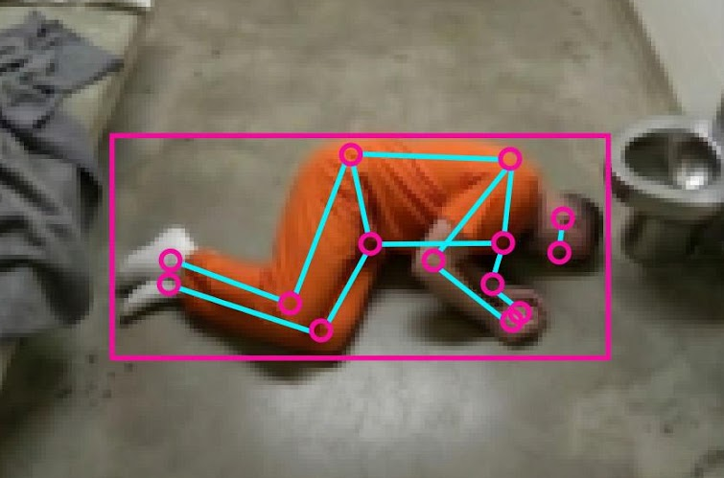



Sensor Fusion: Seeing what the Human Eye Can’t
Motion & Presence
Doppler radar identifies micro-movements, even through materials like blankets.
Distress Detection
Computer vision and advanced algorithms identify falls and potential medical emergencies in real-time.
Power over Ethernet (PoE) connections
Environmental Monitoring
Thermal camera tracks cell temperature and indicates occupancy.
Notes:
Add technical explanations of the terms above.

Slide 5
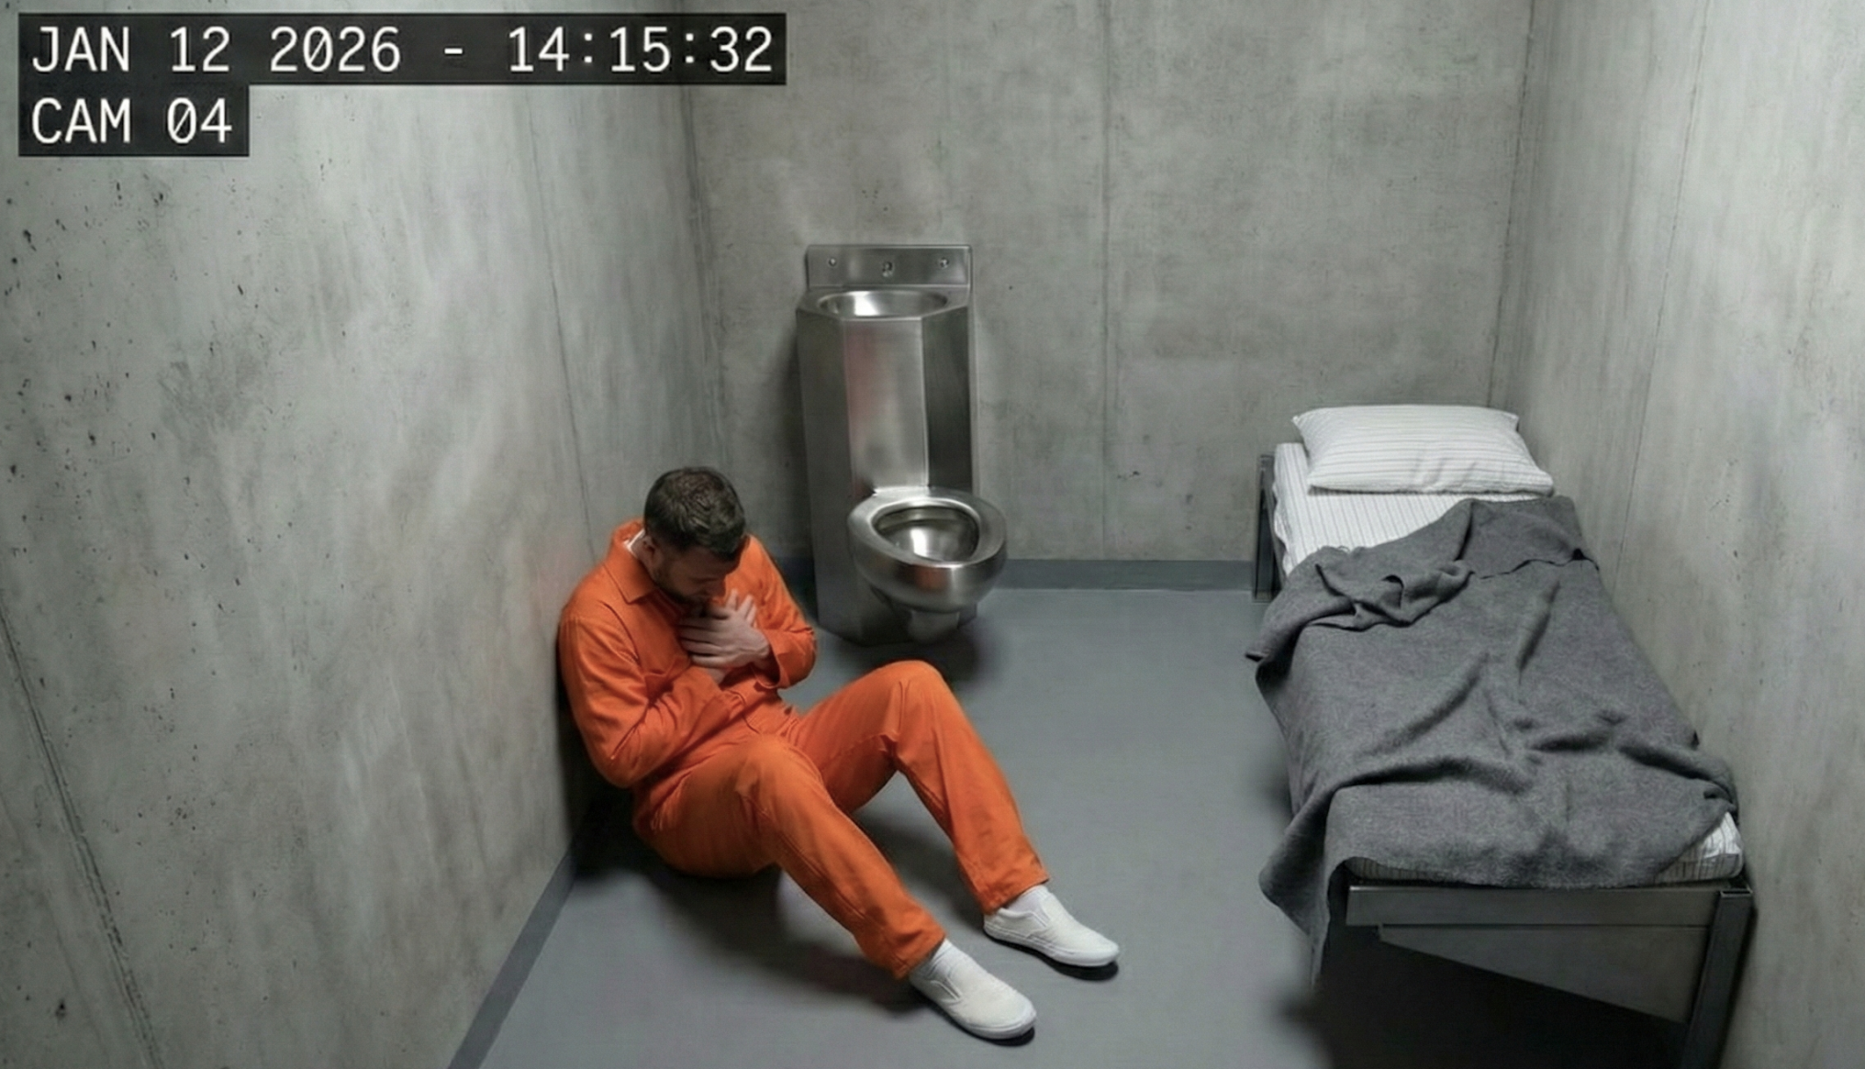
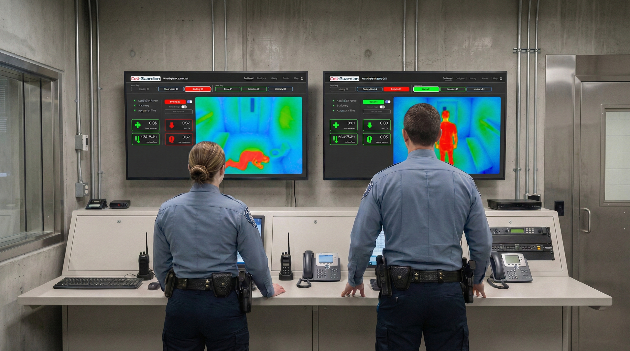
Verifiable Documentation: Objective Evidence for Every Alert
Time-Stamped Evidence
All incident alerts are automatically recorded and associated with a time-stamped video.
Documented Compliance
Create a digital record of all detected incidents.
Secure Cloud Storage
All event data is encrypted and saved for 6 months in a secure cloud environment for later review.

Slide 6

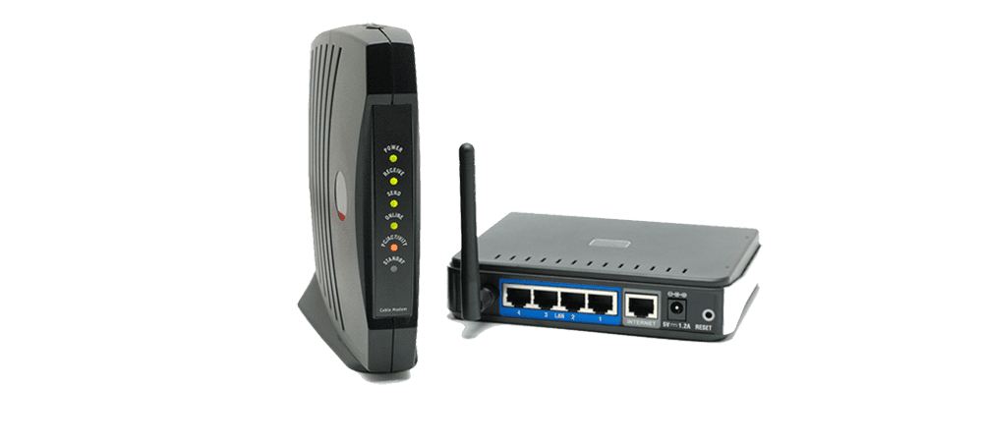
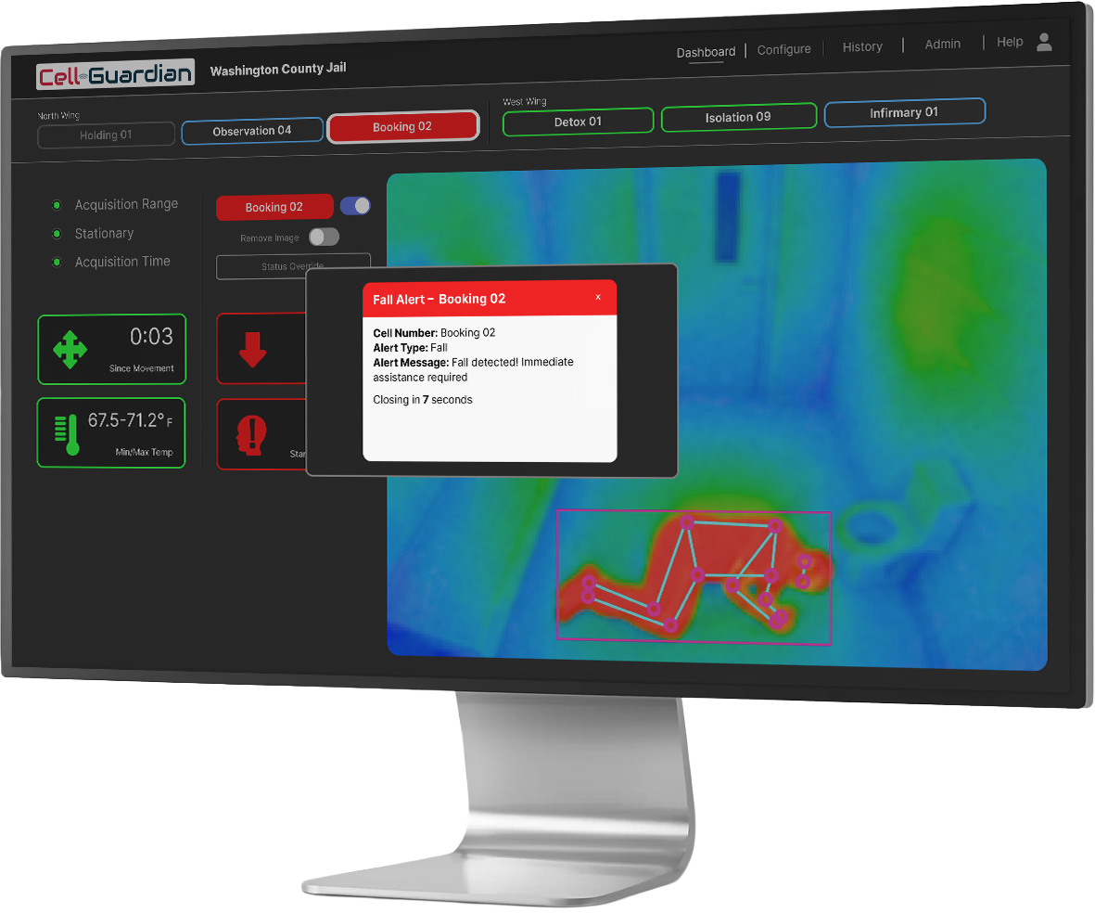
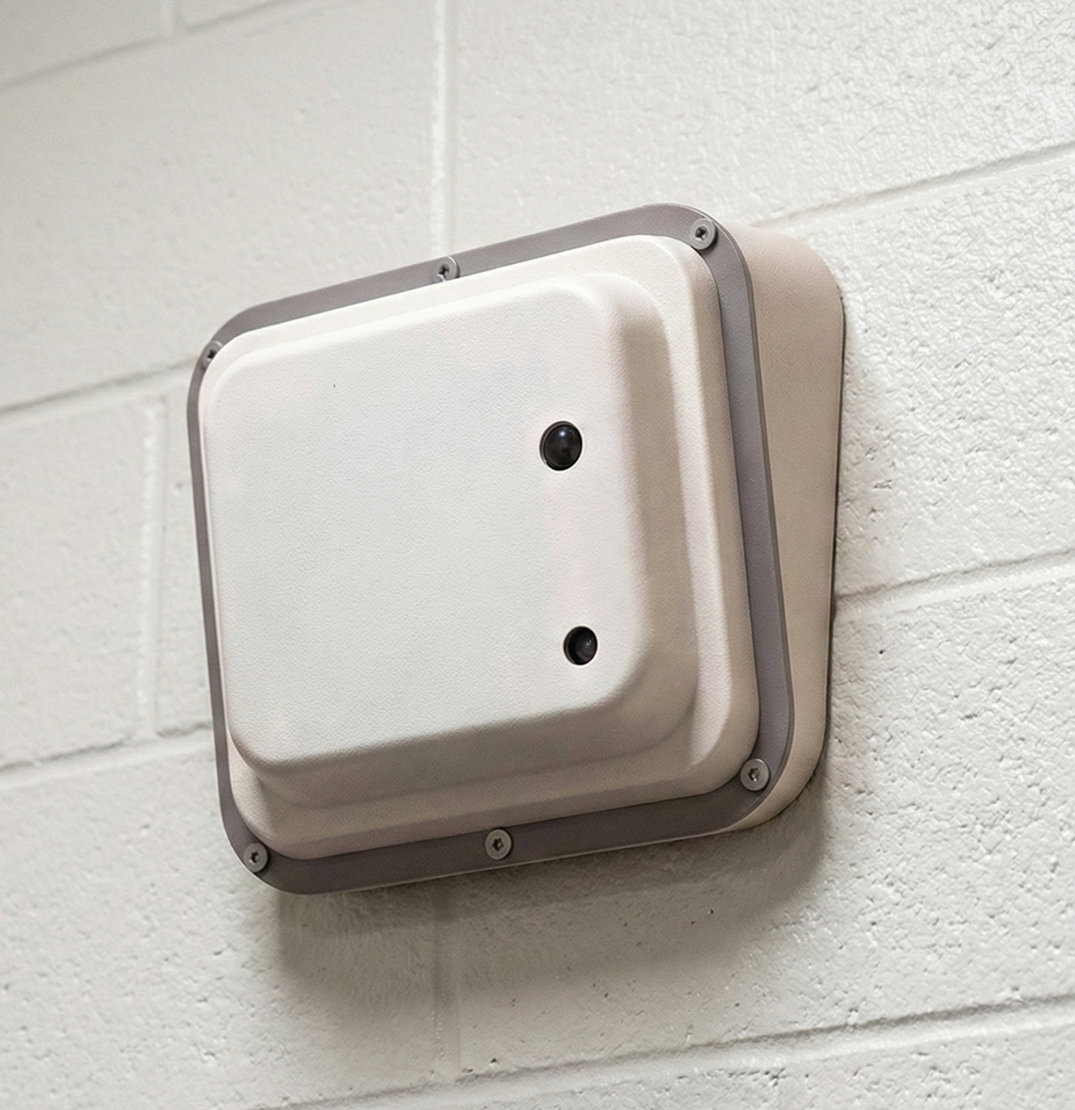
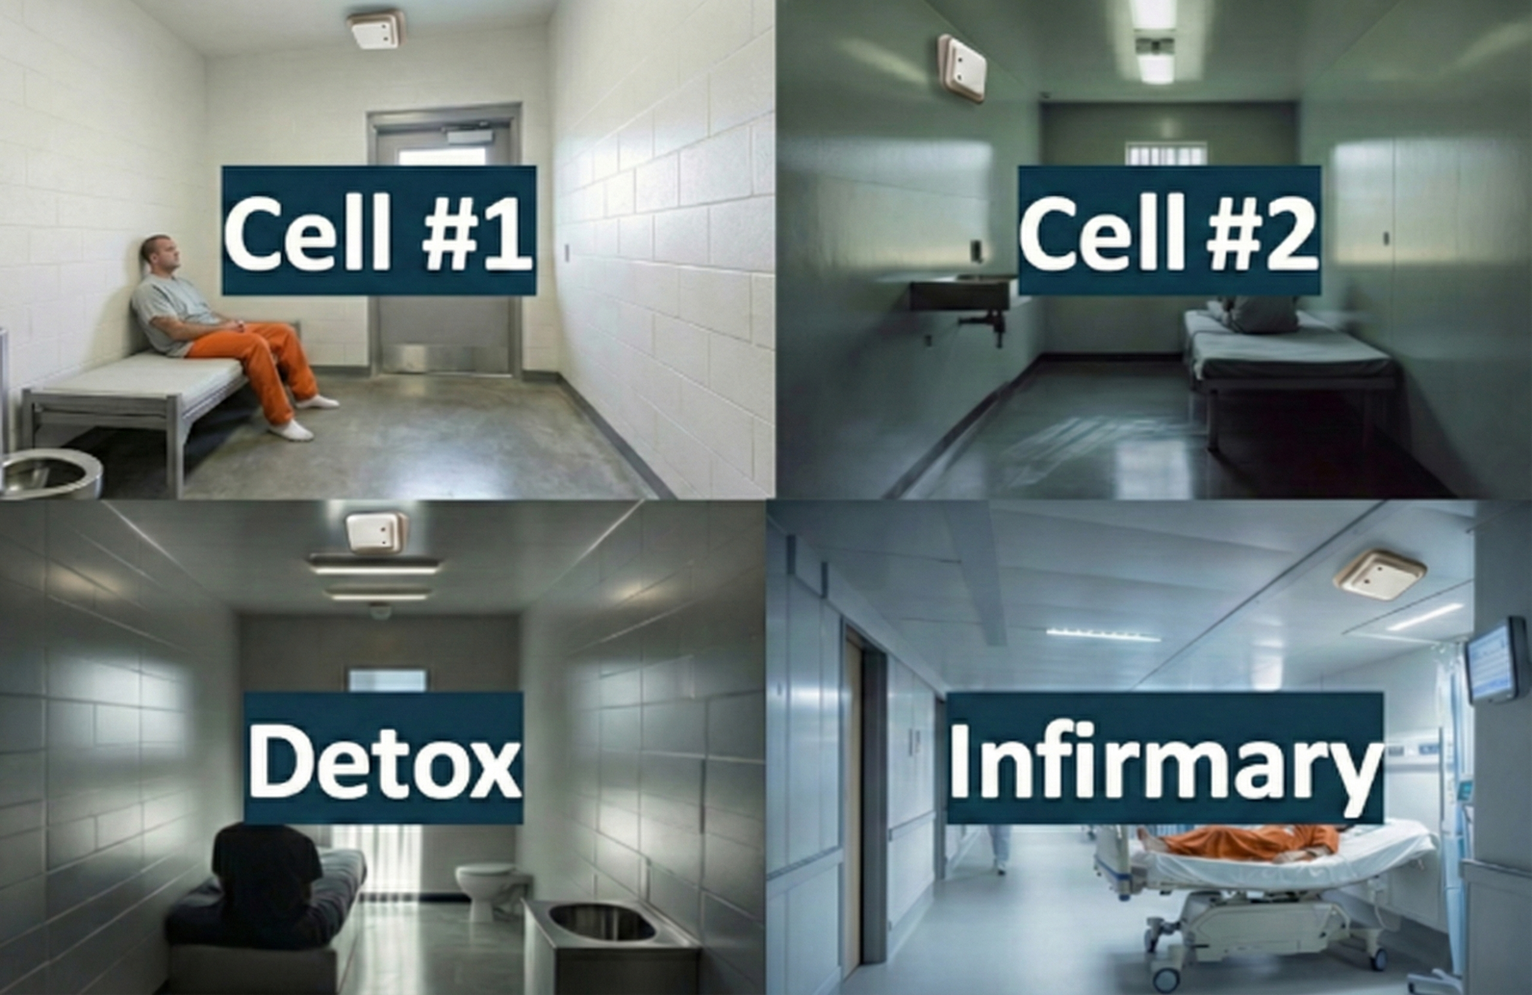
System Architecture
3
Secure Storage
Cell-Guardian Cloud Processing
Local Network
Secure Connection
Authentication and HTTPS
2
PoE
Secure Transfer
4
User Access in Control Center
Devices
1

Slide 7
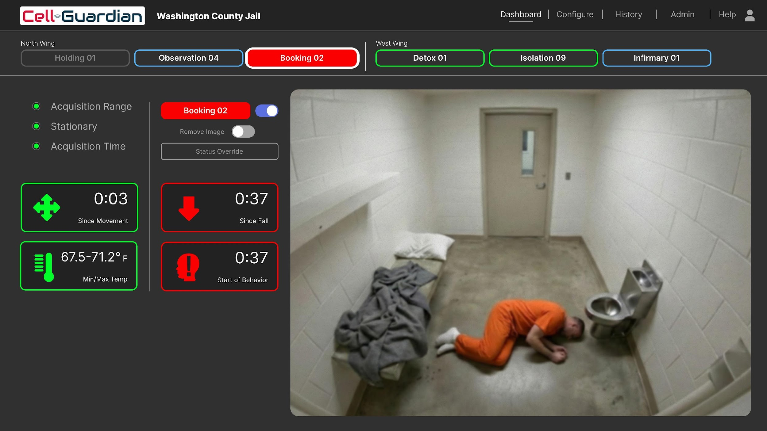
User Interface – Digital View

Slide 8
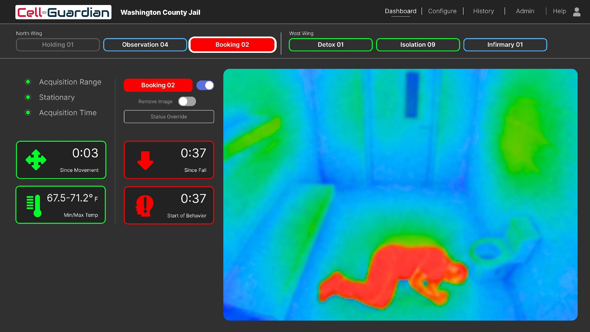
User Interface – Thermal View

Slide 9
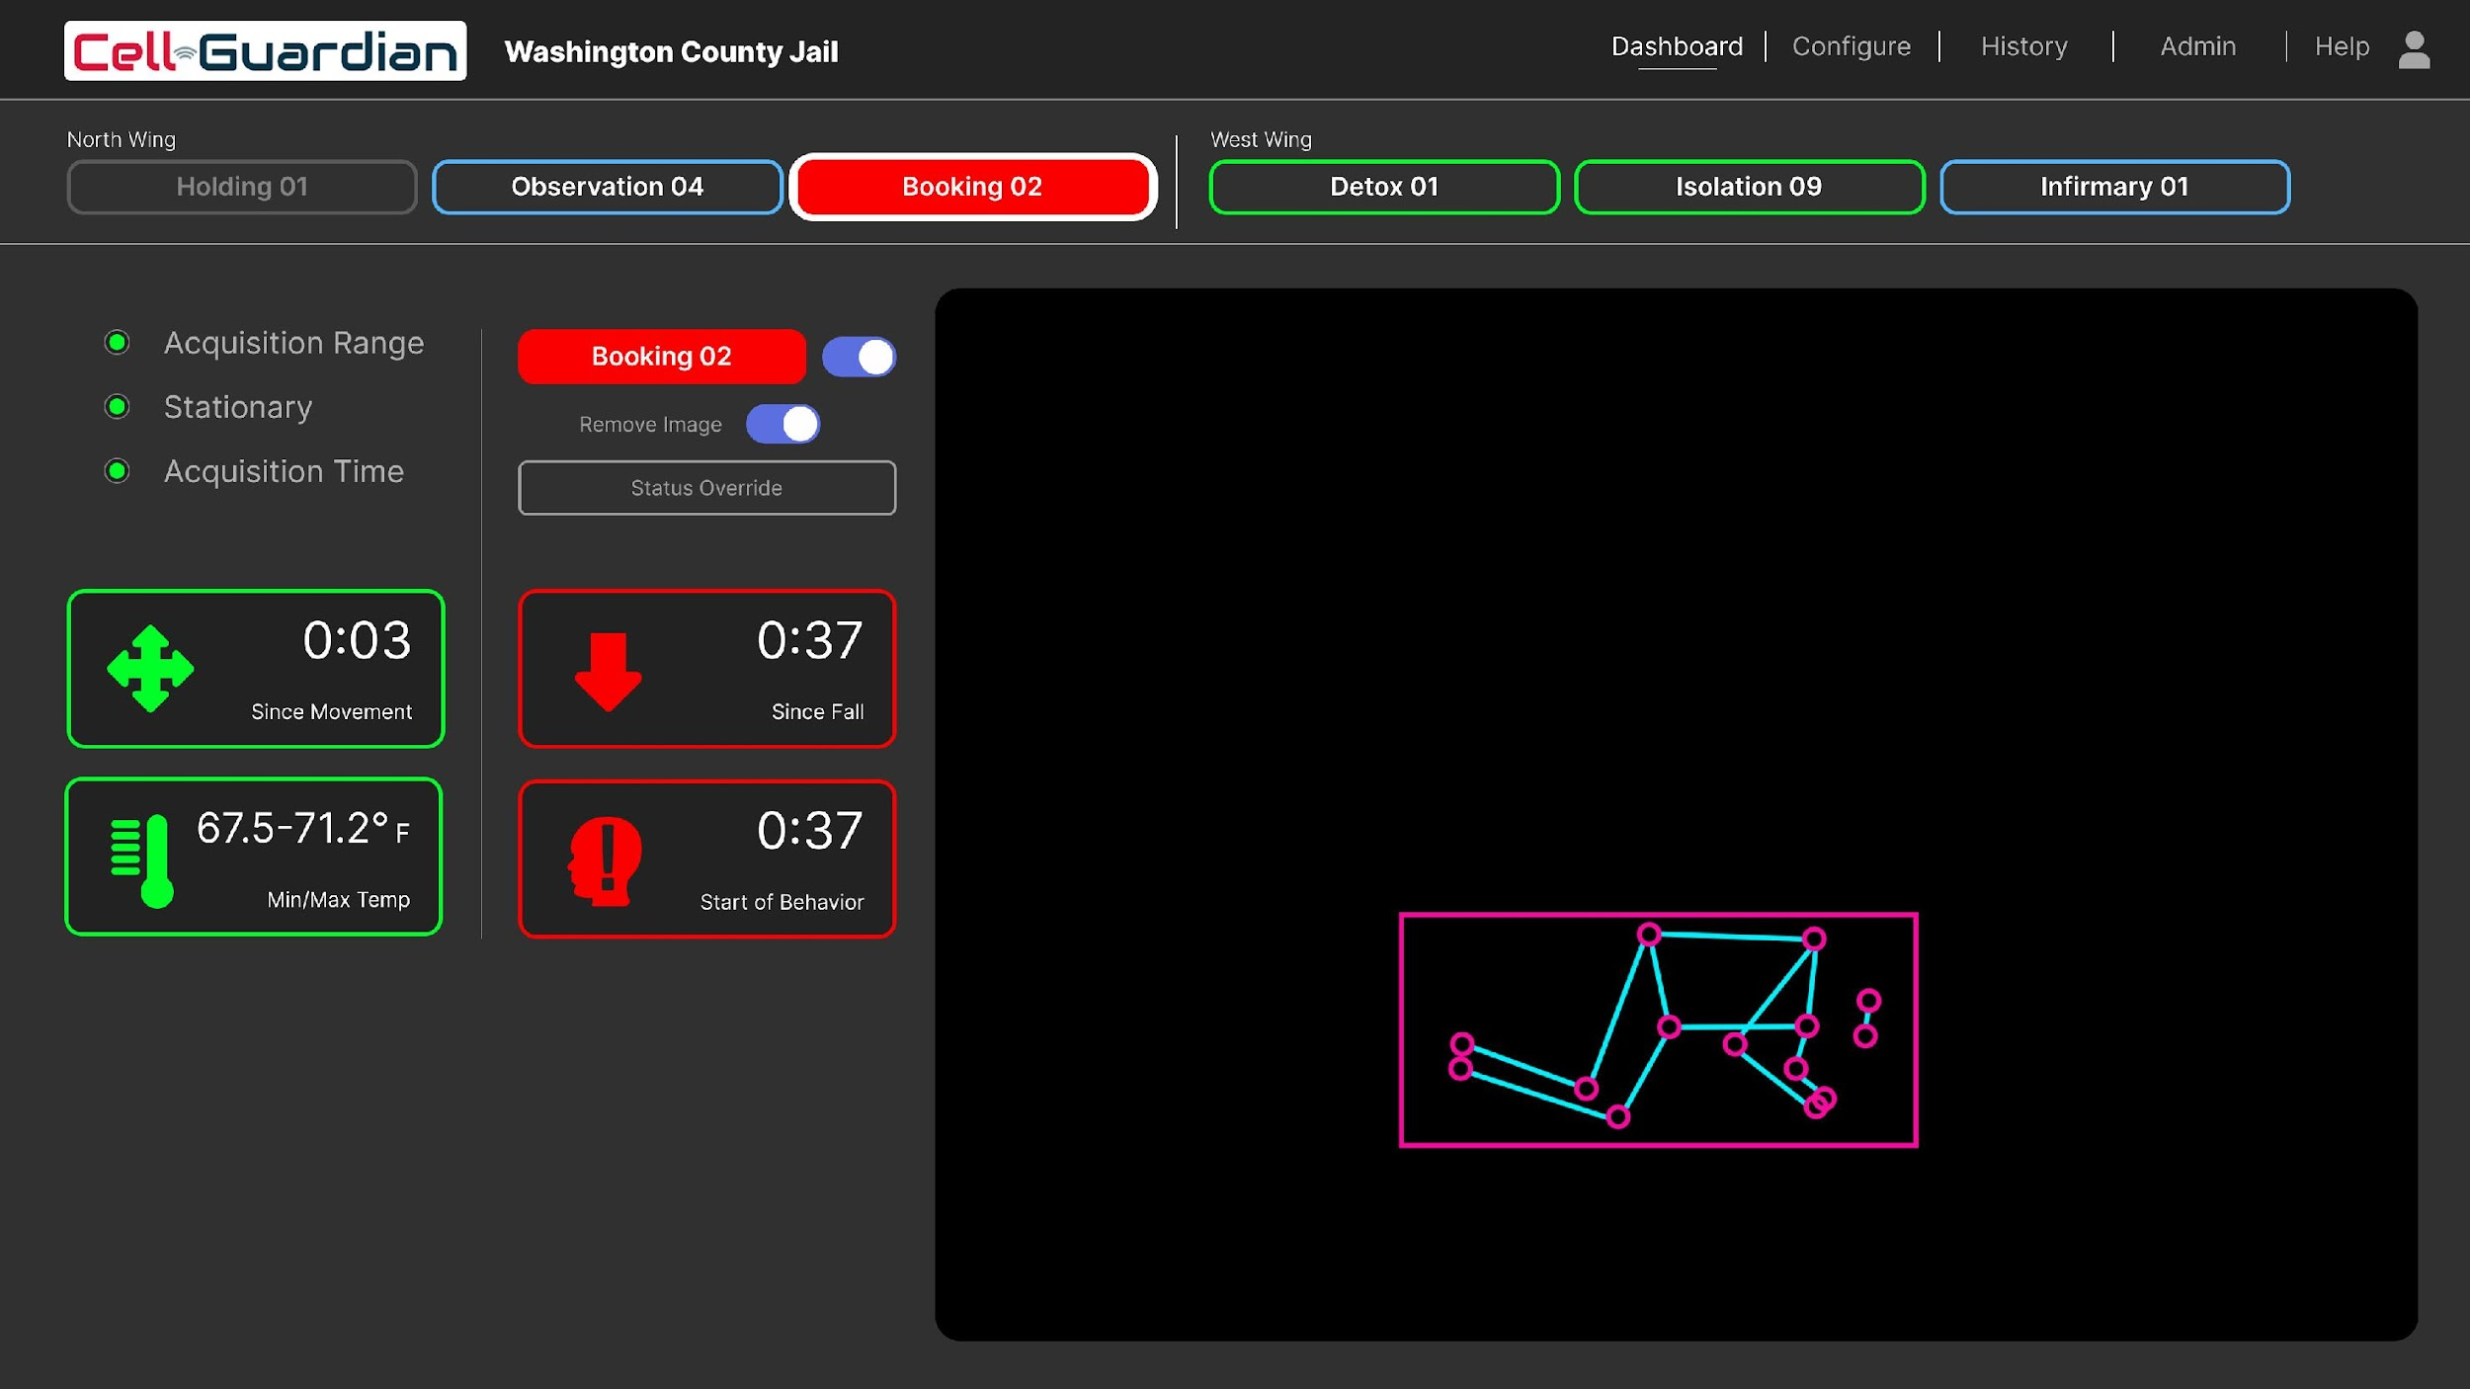
User Interface – Stickman

Slide 10
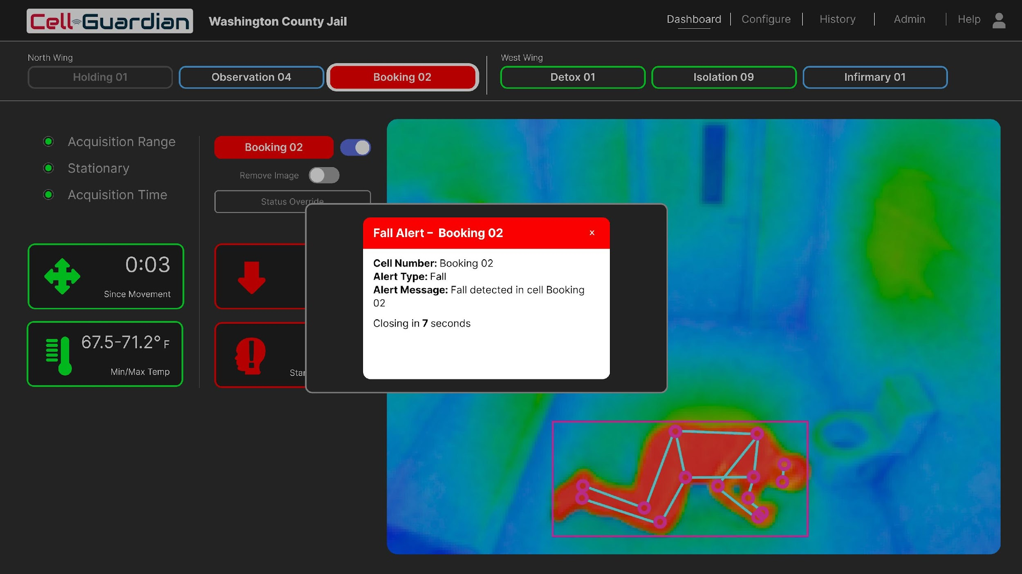
User Interface – Fall Detection

Slide 11
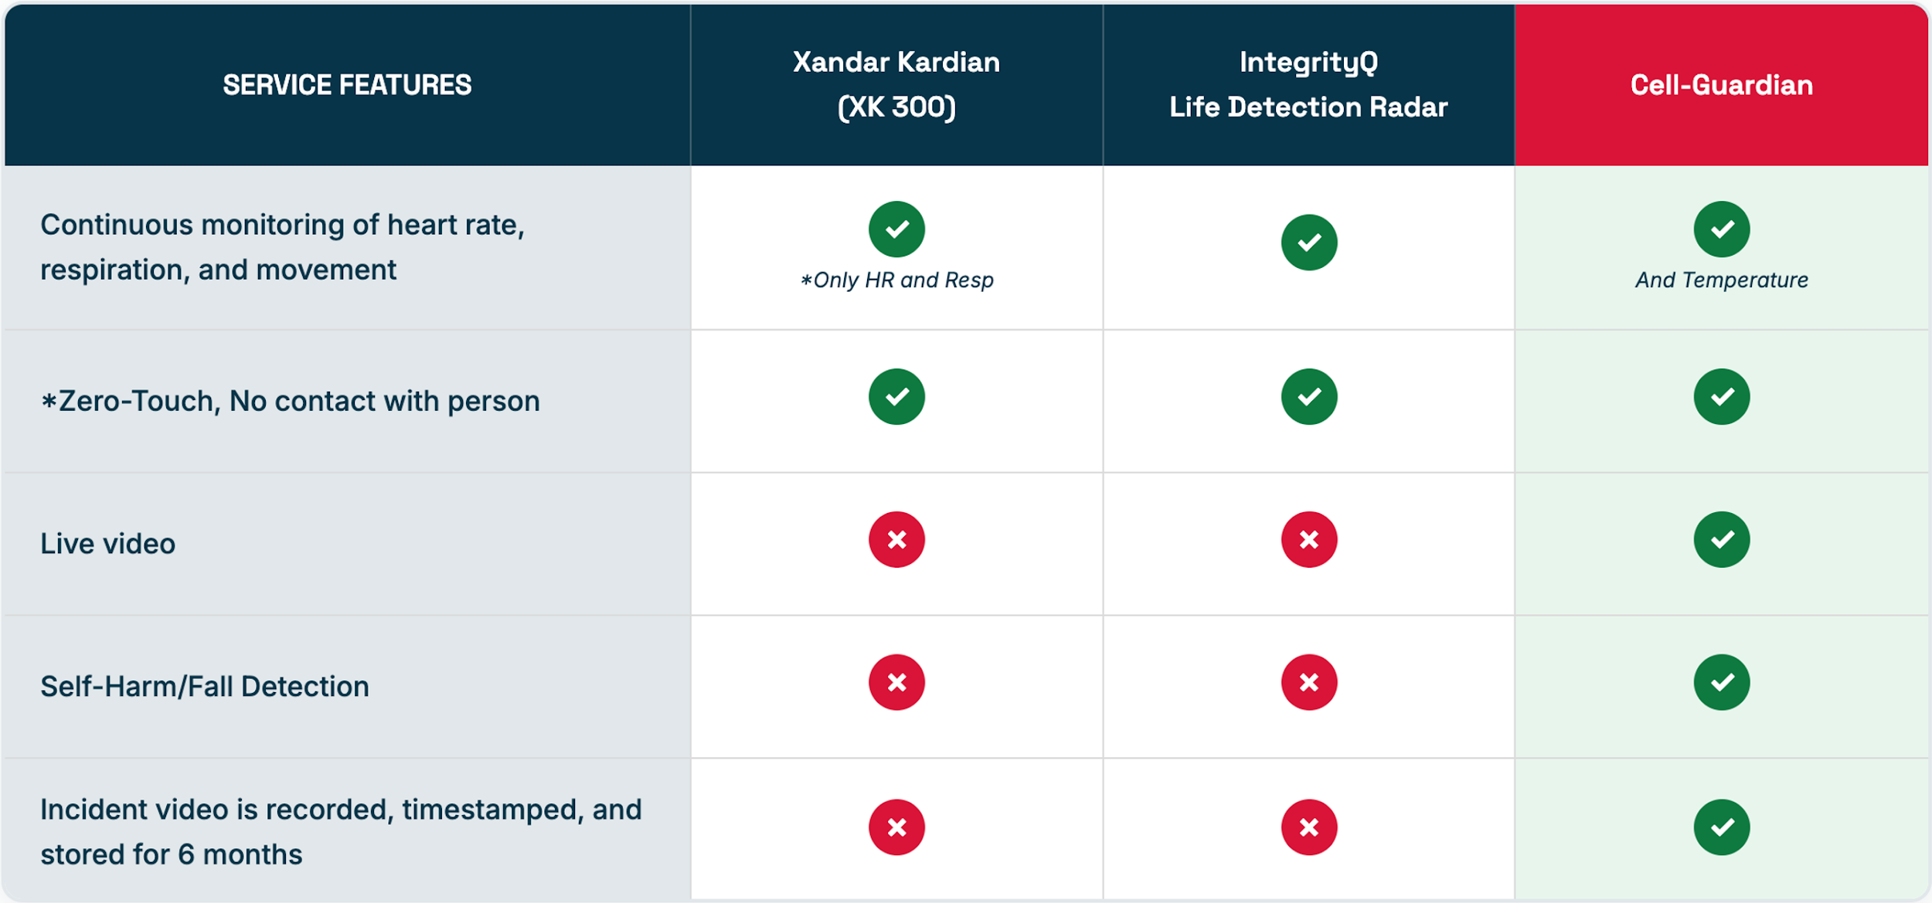
How Cell-Guardian Outperforms Competitors

Slide 12


Current Capabilities vs. Upcoming Upgrades
DEPLOYMENT READY | OPERATIONAL GUARDRAILS | 2026 ROADMAP
Zero-Touch Monitoring Continuous tracking of falls, occupancy, and micro-movements. | Single-Inmate Focus System is currently optimized for single-occupancy cells (10x10 ft). | Behavioral AI* Predictive alerts for suicide attempts and head-banging.
Wellness Oversight Real-time heart rate and respiration tracking. | Privacy Masking Automatic pixelation of toilet and shower areas to ensure inmate privacy. | Multi-Person* Expansion to track fighting and sexual assault in shared cells.
Evidence Vault Time-stamped incident logs with 6 months of secure cloud storage. | Vital Signs within a specific range Vitals are currently provided with an acceptable range to trigger alerts. | Class II FDA Medical-grade vitals for clinical decision support.
Tamper Detection Instant alerts if sensors are obscured or the unit is compromised. | Standard Connectivity Accessible via secure web browser; standalone from existing JMS. | *Ask about adding future upgrades
Note: Vital signs and behavioral analysis are planned upgrades pending final FDA Class II clearance. Current systems provide wellness oversight only.

Slide 13
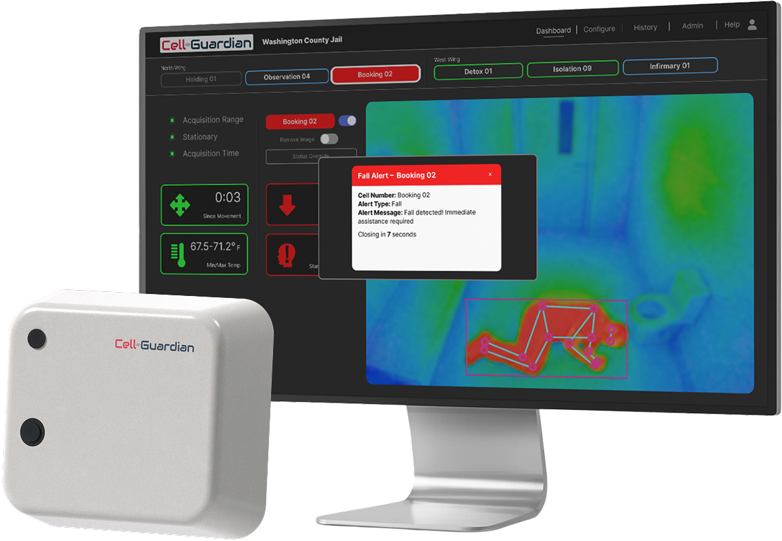










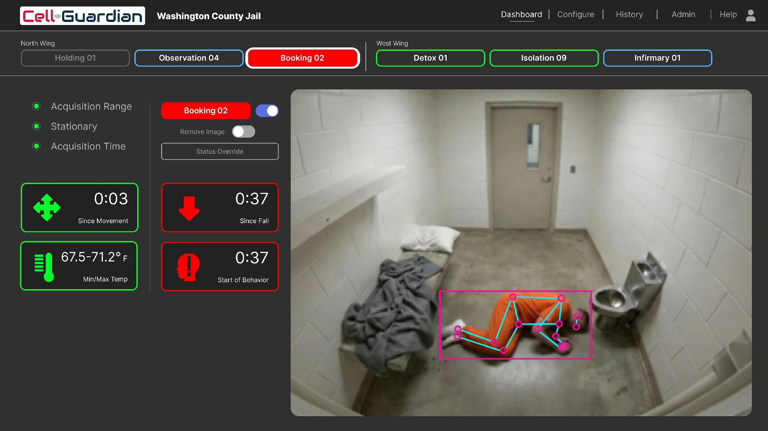


Cell-Guardian Summary
Health & Safety of Inmate
  24/7 Continuous Monitoring
  Motion & Occupancy Detection
  Respiratory & Heart Rate Detection*
  Room Temp. Detection
  Fall Detection
Technical Features
  Digital video, thermal or stick man
  Instant notification alerts
  Secure, tamper-proof, and water-resistant monitor unit
  Power over Ethernet (power & data)
  Incident recorder with time-stamped video and data logging
  Data saved for 6-months
  AWS most secure storage
*Medical Grade vitals pending FDA clearance

Slide 14
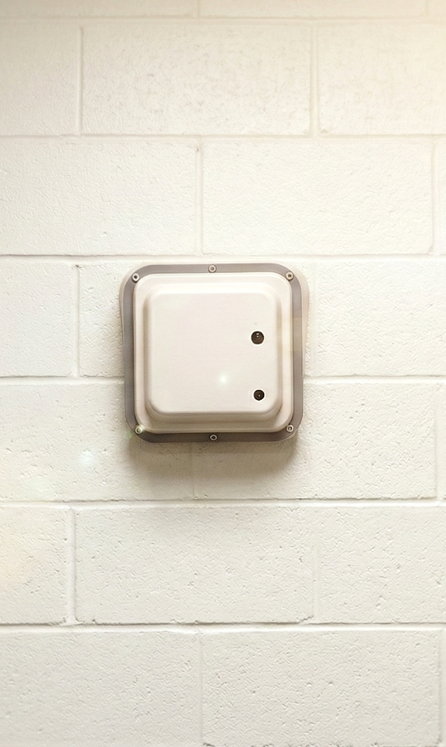
Purchase
Units Ordered | Unit Price | Savings
1 – 9 Units | $4,000 | —
10+ Units | $3,500 | Save $500/unit
One-Time Installation: $700 per device.
All-Inclusive Year 1: Price includes full warranty, software updates, and 6-month data storage.
Years 2+: Only $500/year per device for continued updates and secure storage.

Slide 15
Rent to Own
Program Detail | Subscription Terms (per device)
Fixed Monthly Rate | $129 per month
Path to Ownership | 48-Month Term (You own the hardware at month 48)
All-Inclusive Service | Includes full warranty, software updates, and cloud storage.
Evidence Retention | 6-Month Evidence Vault included for the full term.
Zero-Interruption Support | 24/7 dedicated customer service and firmware upgrades.
Post-Ownership Fee | Only $500/year per unit for continued data storage & updates.
One-Time Installation Cost: $700 per device.
Notes:
Post-Ownership Fee: $500/year = ~$42/month

Slide 16
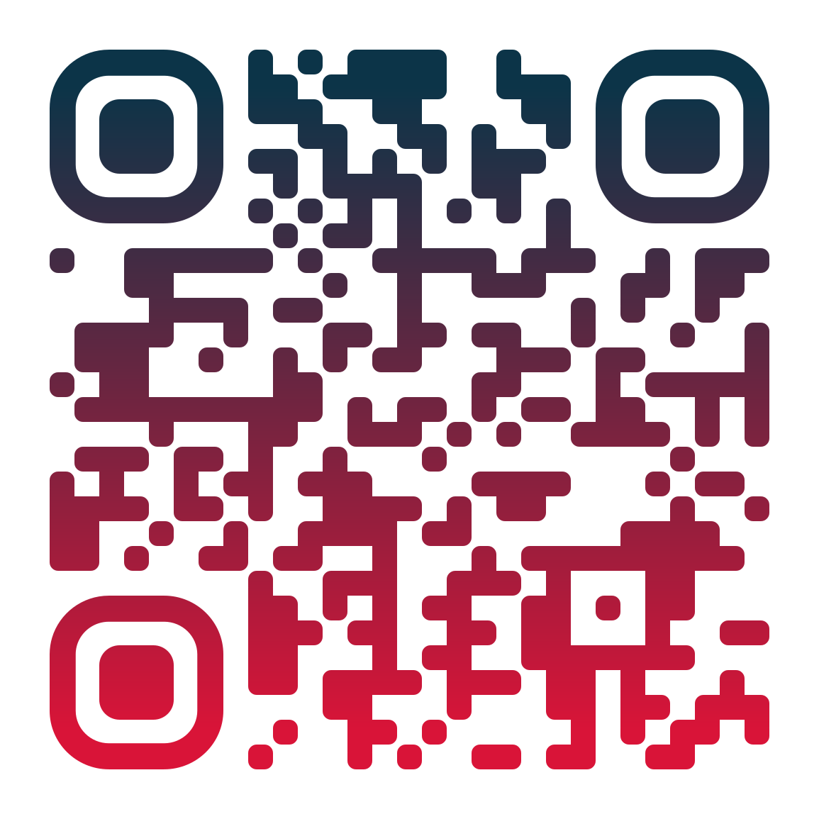
Contact Us
Kevin O’Connor
National Sales Director
303-552-7354
kevin.oconnor@cell-guardian.com
www.Cell-Guardian.com

Slide 17
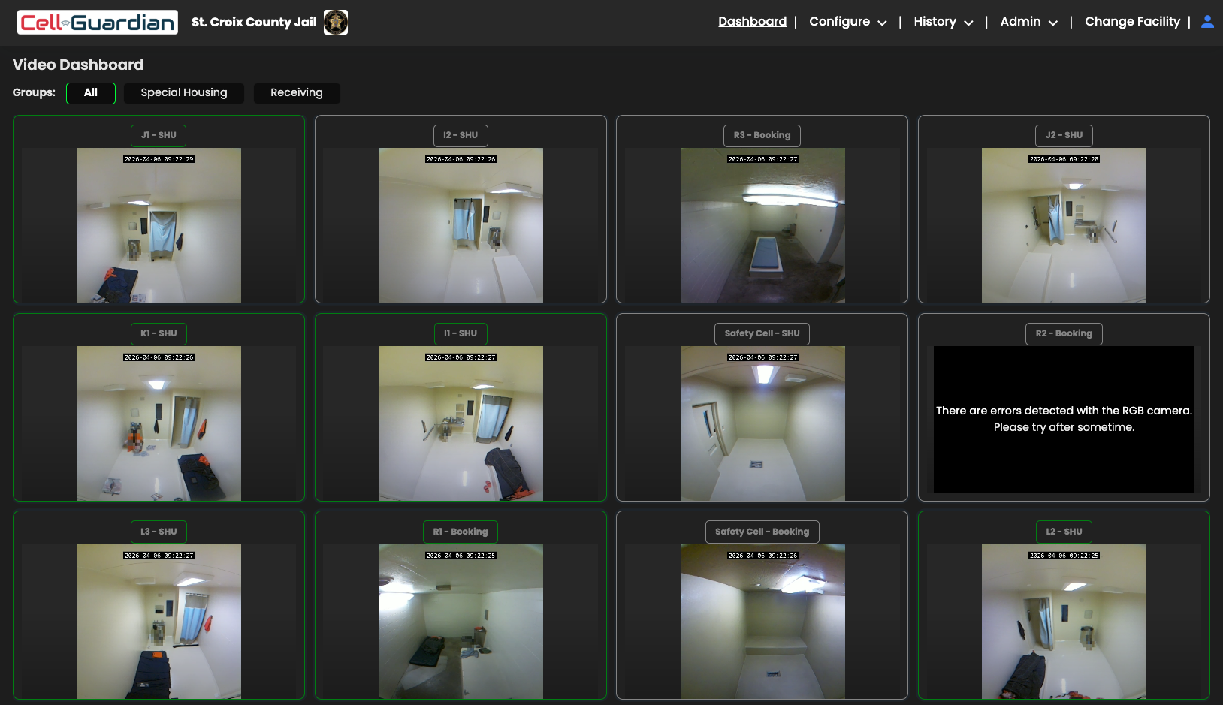
Grid View Dashboard

Slide 18
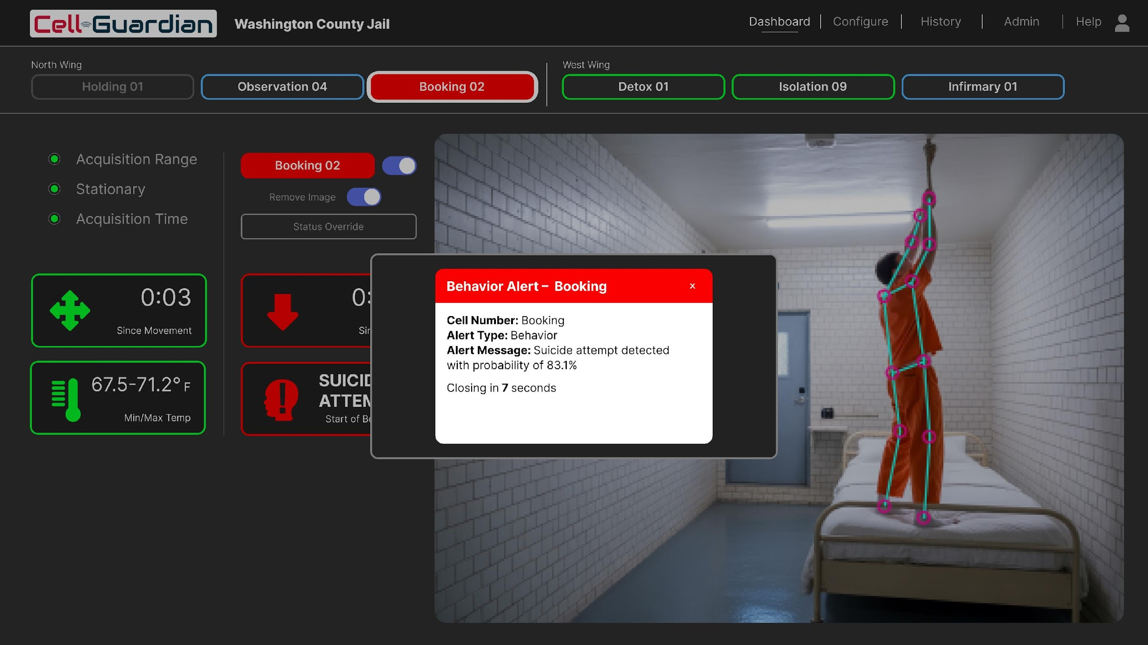
User Interface – Suicide Alert
(In development)

Slide 19
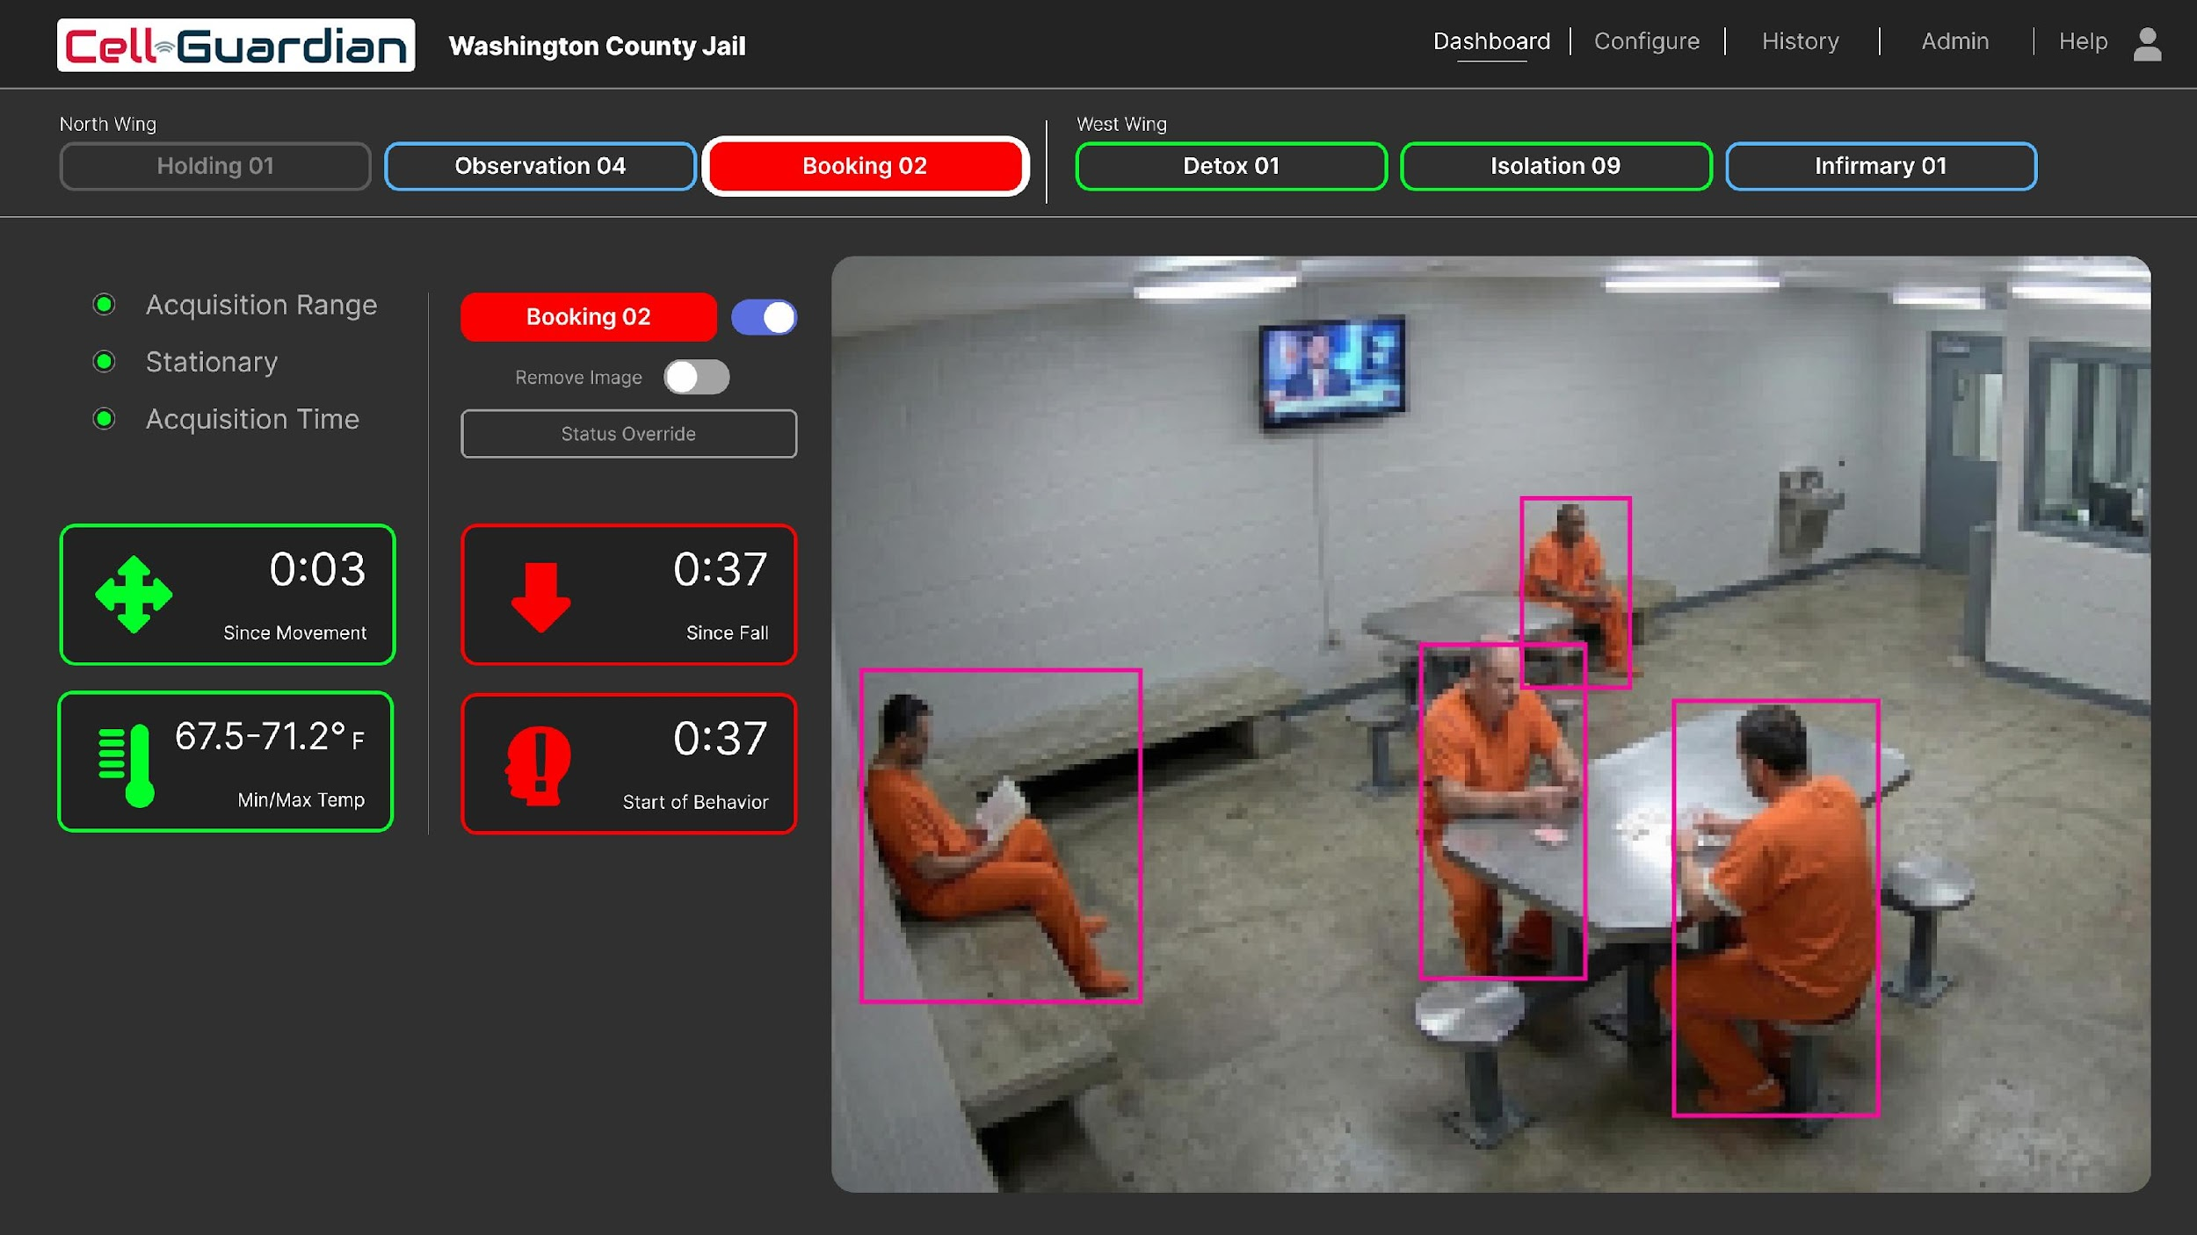
User Interface – Multiple Inmates
(In development)

Slide 20
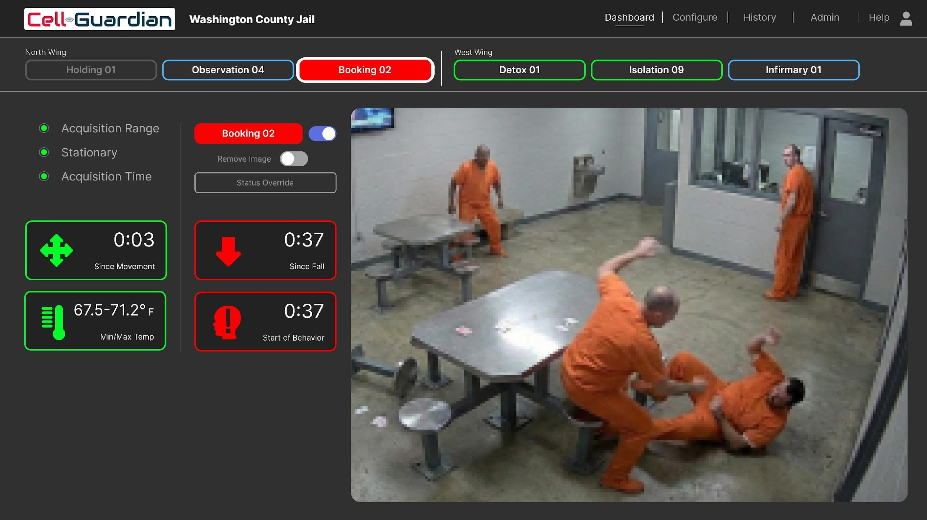
User Interface – Fighting & Sexual Assault
(In development)

Slide 21
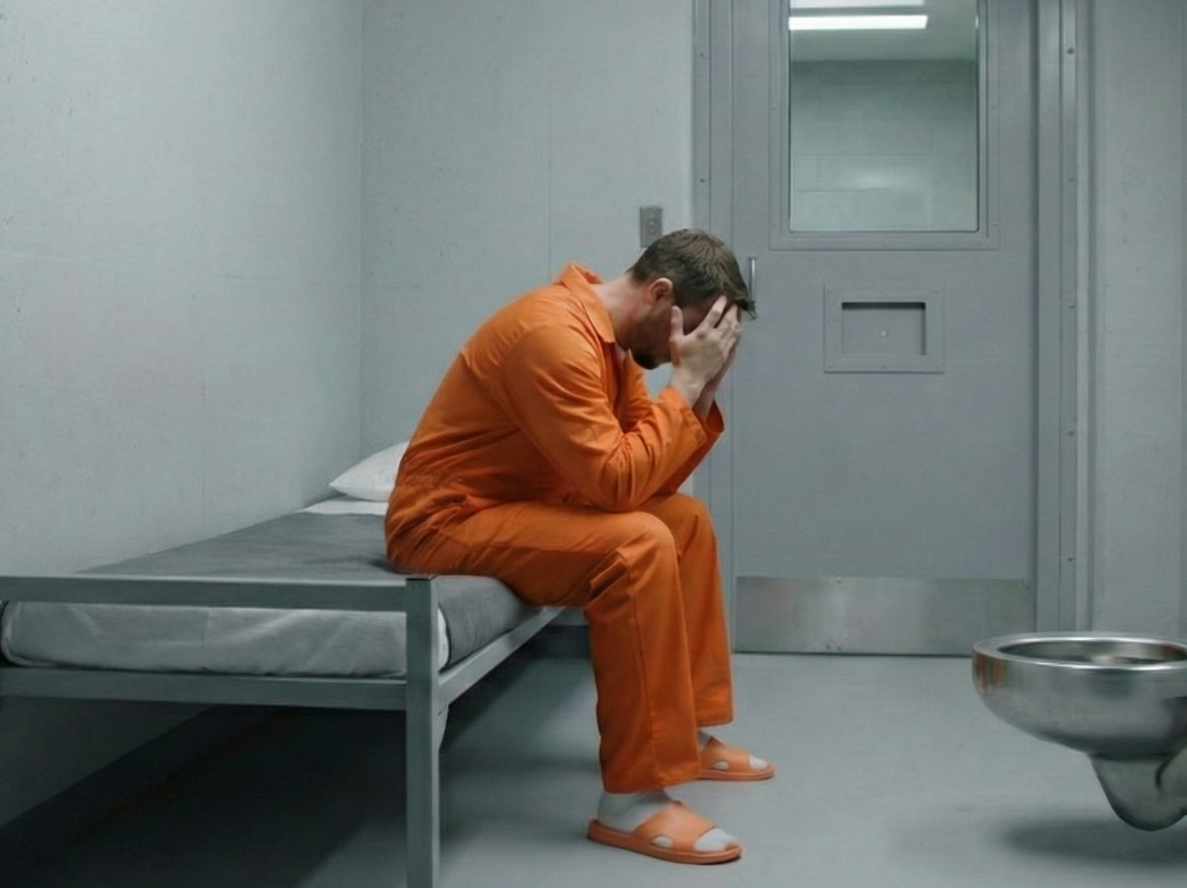
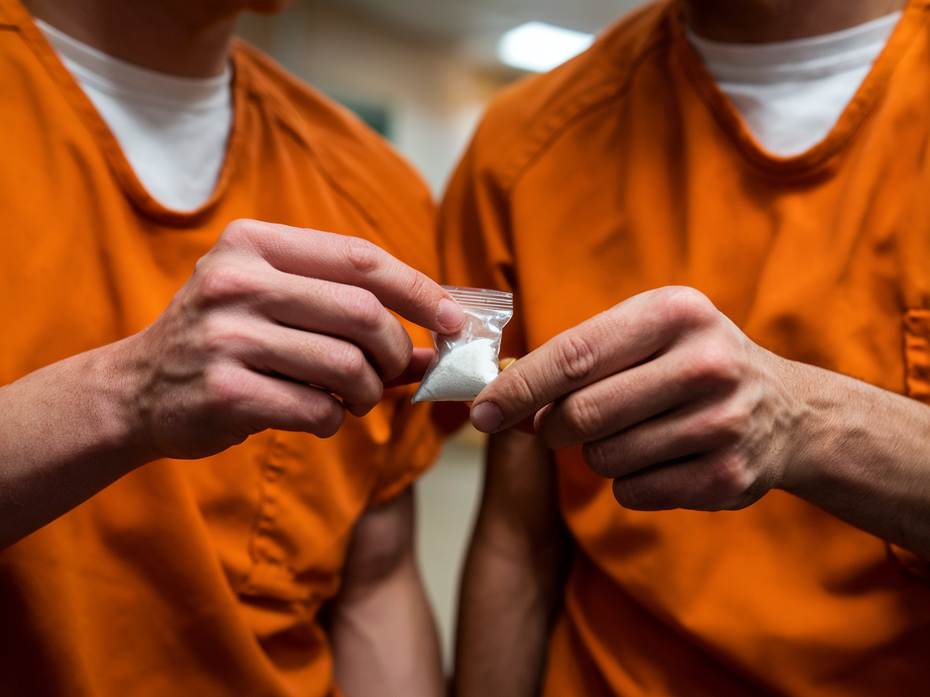

Inmate Monitoring Challenges
Delete
1 in 3 inmate deaths occur within first week of incarceration
Suicide & Self-Harm
Drug & Medical Issues
Legal Liabilities

Slide 22
Introducing Cell-Guardian™
A better way to monitor and manage inmates’ health and well-being.
Zero-Touch Monitoring
No physical interaction
No wearable devices
Continuous monitoring
First 48 hours are critical
Incident Detection & Alerts
Fall detection
Instant notification alerts
Incidents are time-stamped and documented for review
Operational Efficiency
Empower staff with better real-time information
Improve staff allocation
Reduce staff burnout
Reduce facility liabilities

