Slide 1

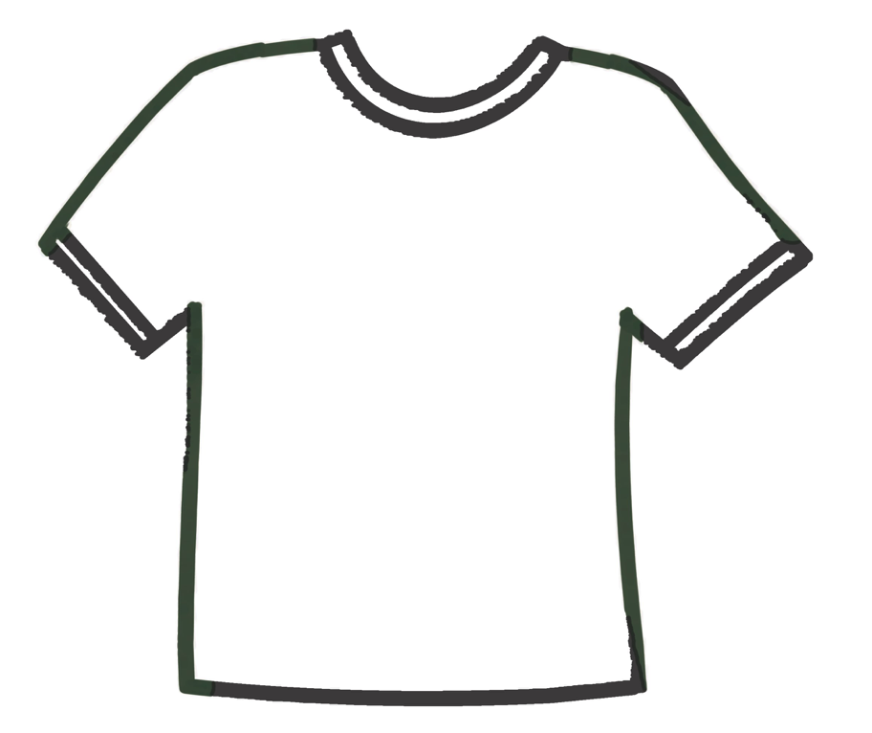

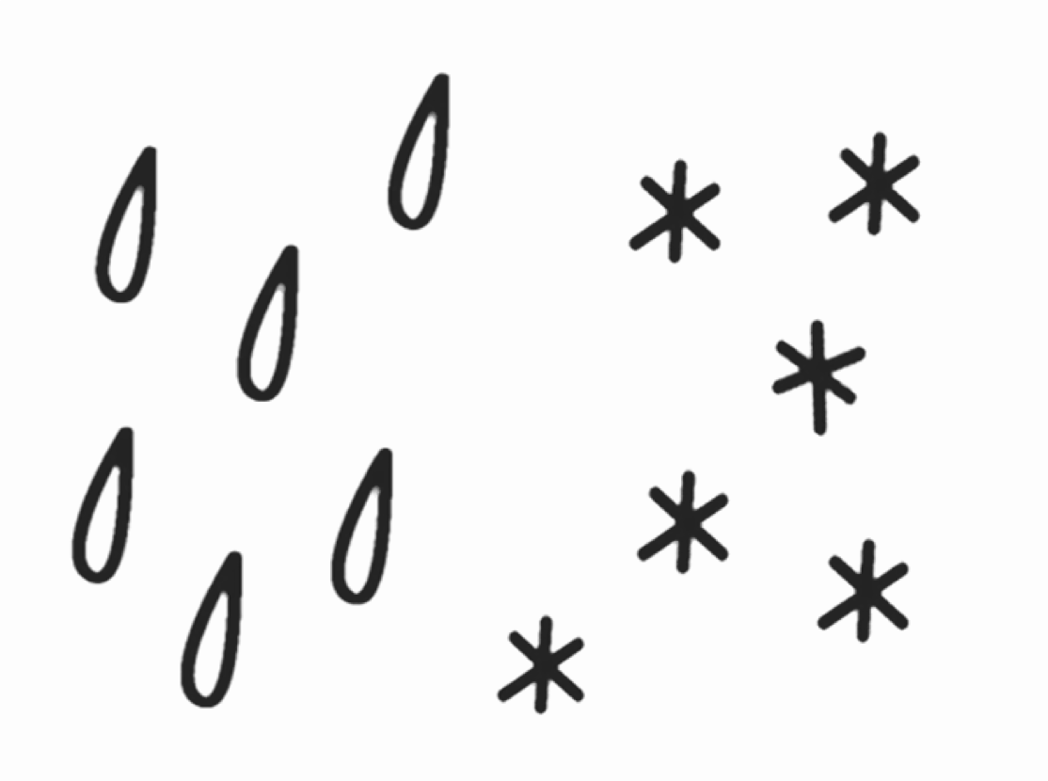

?
?
Nombre:
Fecha:
?
?
Have you ever watched a storm?

