Slide 1



April 2023
April Planner
Free Presentation Template

Slide 2















































































































Welcome
Welcome to the world of fantasy! Join us on a journey to explore the mystical creatures, enchanted lands, and magical wonders that exist beyond our reality. Discover the wonders and secrets of this exciting realm and unlock the power of imagination.

Slide 3


1
Monthly Overview
The Extraordinary Realm
Contents
2
Weekly planner
Unicorn Sightings
3
Daily planner
Wishes Granted

Slide 4


Monthly Overview
The Fantasy Realm: Uncovering the Secrets of the Imagination and the Magic that Lies Within

Slide 5


Overview
Welcome to the Fantasy World, a realm of wonder and enchantment where anything is possible. Here, dragons breathe fire, unicorns prance through meadows, and rainbows shine brightly. This world is a place where wishes come true, where potions can be cursed and spells are cast. It's a place of treasure and adventure, where the impossible becomes possible. But the greatest treasure of all is the one that lies within.
The world of fantasy is a reflection of our deepest desires, our fondest dreams, and our wildest imaginations. It's a place where we can let go of the constraints of reality and explore the boundless possibilities of the human mind. In this introduction, we will delve into the mysteries of this realm, uncovering the magic and wonder that lies within. So come with us and let's embark on a journey through the Fantasy World.

Slide 6



April’s Goal
  Embark on an adventure filled with magic and wonder
  Tame dragons, see unicorns and experience rainbows every day
  Discover yourself and unlock your imagination through exploration
  Experience the manifestation of your deepest desires and fondest dreams
  Leave reality behind and immerse yourself in a world of endless possibilities

Slide 7



Monthly tasks
Unicorn Sightings
Dragon Taming
A record of the number of unicorns spotted in the fantasy realm and the beauty and mystery that surrounds these enchanting creatures.
A closer look at the art of taming dragons and the brave adventurers who dare to take on these fearsome creatures.
Dragon Taming
Unicorn Sightings
A closer look at the art of taming dragons and the brave adventurers who dare to take on these fearsome creatures.
A record of the number of unicorns spotted in the fantasy realm and the beauty and mystery that surrounds these enchanting creatures.

Slide 8





Must Do
Unicorn Sightings
Dragon Taming
A record of the number of unicorns spotted in the fantasy realm and the beauty and mystery.
A closer look at the art of taming dragons and the brave adventurers who dare to take on these creatures.

Slide 9






















Fantasy is the gateway to the impossible, the land where the ordinary becomes extraordinary, and the impossible becomes possible. It is the realm of the imagination.
The Dream Weaver

Slide 10

April 2023
Mon | Tue | Wed | Thu | Fri | Sat | Sun
 |  |  |  |  | 1 | 2
3 | 4 | 5 | 6 | 7 | 8 | 9
10 | 11 | 12 | 13 | 14 | 15 | 16
17 | 18 | 19 | 20 | 21 | 22 | 23
24 | 25 | 26 | 27 | 28 | 29 | 30

Slide 11















To Do
Explore the mysteries of the ancient pyramids.
Discover the lost city of Atlantis.
Embark on a quest for the Fountain of Youth.
Search for hidden treasure in the depths of the ocean.
Uncover the secrets of the Bermuda Triangle.
Journey to the center of the Earth.
Seek out the legendary Sword in the Stone.
Investigate the Loch Ness Monster.
Find the cure for a rare and deadly disease.
Track down a notorious international spy.

Slide 12


April
May
W1
W2
W3
W4
W1
W2
W3
W4
Rare event causes unpredictable magic.
Humans acquire Crystal
Shimmering City established
Peasant discovers magical powers.
Grand celebration in hero's honor.
Kingdoms clash in conflict.

Slide 13
Weekly planner
The Fantasy Realm: Uncovering the Secrets of the Imagination and the Magic that Lies Within

Slide 14


Plan
1
Discover the secrets
2
Find your own path
Explore the lush, vibrant forest and uncover the mysteries that lie within.
Choose your own path through the forest, and see where it takes you.
3
Meet the creatures
4
Uncover the magic
Encounter the mythical creatures that call the forest home, from talking animals to fairies.
Learn about the powerful magic that pervades the forest and how it affects all who enter.

Slide 15


Mon
Tue
Wed
Thu
Fri
Sat
Sun
07:00
A rare eclipse occurs, causing strange and unpredictable magical effects across the land.
09:00
A group of adventurers sets out to recover an ancient artifact.
11:00
A volcanic eruption devastates a nearby city, forcing its inhabitants to flee to the safety.
13:00
A powerful sorcerer and a cunning thief cross paths, leading to an unlikely partnership.
15:00
An elf helps humans obtain the Crystal of the Unicorn from the Elven Forest.
17:00
The civilization of the Shimmering City is founded by a group of powerful wizards.

Slide 16








What to do
W2
W4
Shimmering City, conquest, Unicorn Crystal
Kingdom invaded, betrayal, hero's festival
Eclipse
Quest
Foundation
Transformation
W1
W3
Eclipse, quest for artifact, volcano disaster
War, curse from artifact, magic discovery

Slide 17


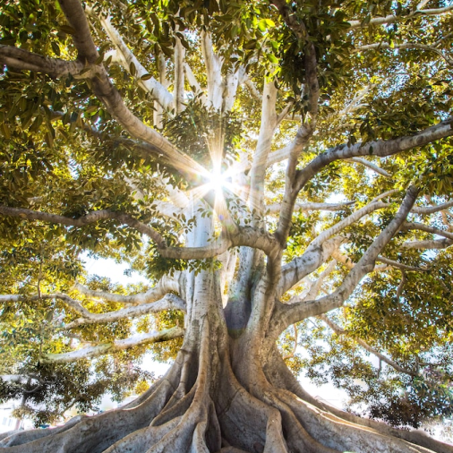


"The Art of Archery": Discover the intricacies of the Art of Archery as practiced by the graceful and precise elves.
Weekly Goal
"The Music of the Elves": Immerse yourself in the enchanting music of the elves, whose songs have the power to heal.

Slide 18






























Daily planner
The Fantasy Realm: Uncovering the Secrets of the Imagination and the Magic that Lies Within

Slide 19



A rare eclipse occurs, causing strange and unpredictable magical effects across the land.
07:00
09:00
A group of adventurers sets out to recover an ancient artifact.
11:00
A volcanic eruption devastates a nearby city, forcing its inhabitants to flee to the safety.
13:00
A powerful sorcerer and a cunning thief cross paths, leading to an unlikely partnership.
Daily Task
15:00
An elf helps humans obtain the Crystal of the Unicorn from the Elven Forest.
17:00
The civilization of the Shimmering City is founded by a group of powerful wizards.

Slide 20


Exploration Day
The Enchanted Forest
A magical forest filled with talking animals and enchanted creatures.
The Crystal Caves
A network of underground caves filled with precious gems and crystals.
The Dragon's Lair
A dangerous and mysterious place where dragons reside.

Slide 21




My Day
Unicorn Migration
Dragon Taming
Large herd of unicorns migrated to the realm
First dragon was successfully tamed
08:00
12:00
14:00
16:00
Enchanted Pool
Rainbow Sightings
A magical pool with power to grant wishes
Unusually large number of rainbows were sighted

Slide 22

Reminder
Dragons
Fire-breathing creatures that are often powerful and dangerous
Medieval-like Settings
Worlds with castles, knights, and feudal systems
Chosen One Trope
A hero chosen by destiny to save the world
Magic
An integral part of fantasy stories, can take many forms
The Best Curse
A curse that is unique, creative, and fits within the story
Unique Creatures
A variety of fantastical beings that inhabit the world

Slide 23







Thank you for choosing EaTemp
We offer free and high-quality slides templates for your presentations. We appreciate you choosing us and hope our templates have been helpful.
As a new website, we rely on your support to grow, so please help us by sharing our site with your friends and colleagues.
eatemp._
@eatemp
eatempofficial
@eatemp.official

