Slide 1

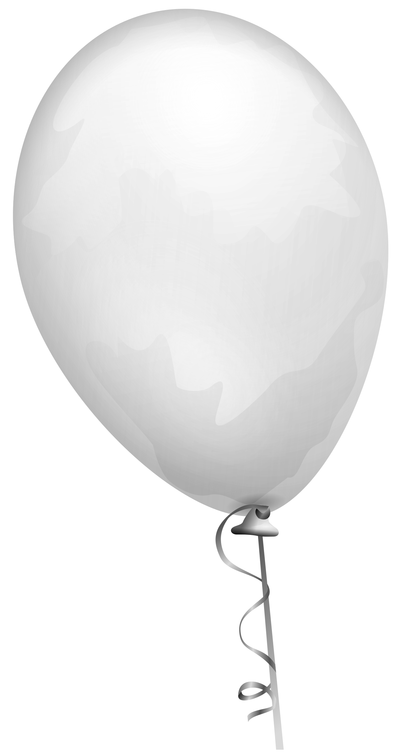






New Paper: Mission 1 Debrief
On your new paper write down 5 things you learned in social studies 1st semester.
Notes:
Animations< click to start 1 min before timer
WRONG AUDIO (THIS IS Day 1)

Slide 2
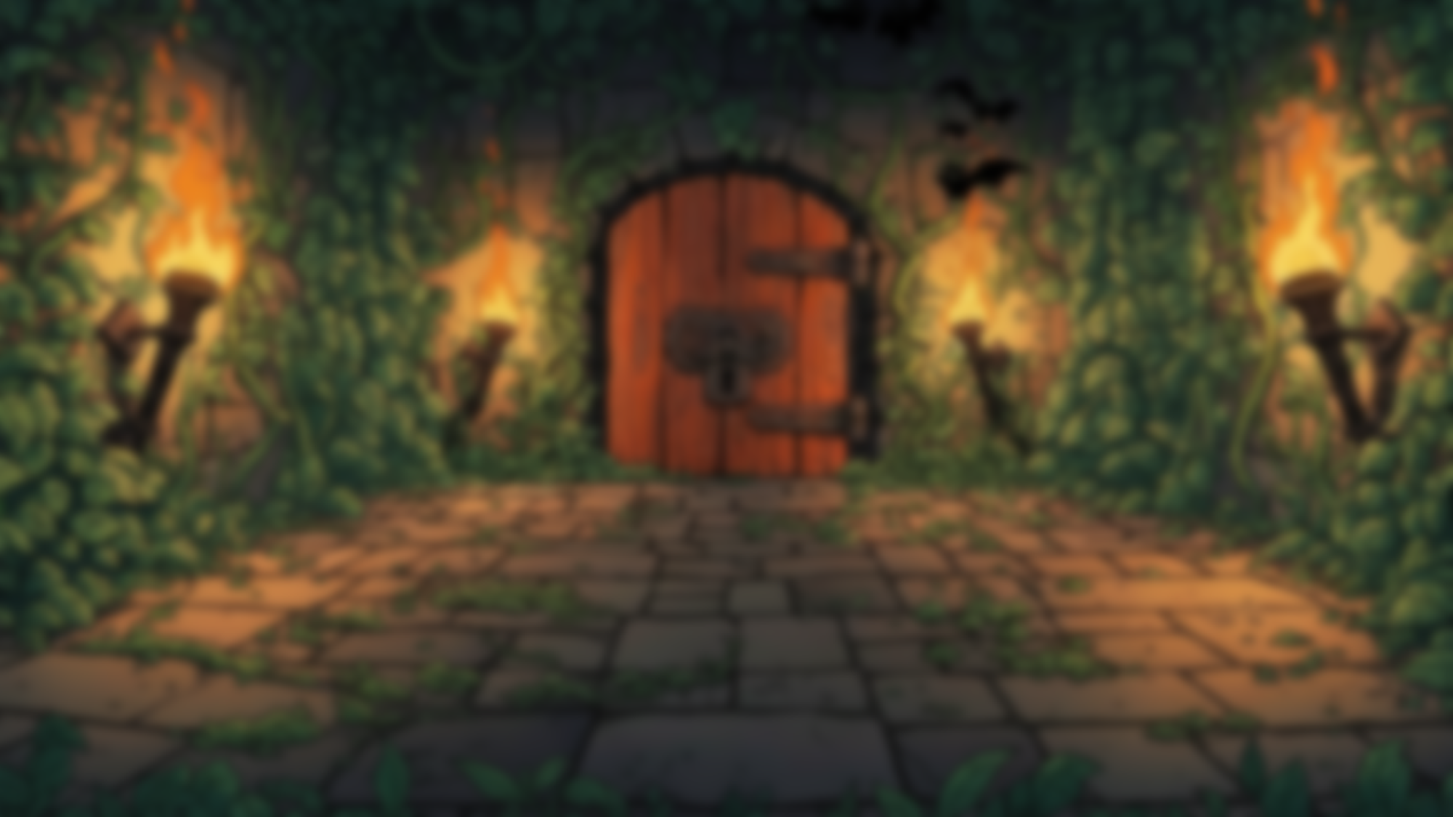

Be a student

Slide 3
Be a student
What does it take to be a football player in the NFL?

Slide 4
Be a student
What does it take to be a soldier in the army?

Slide 5
Be a student
What does it take to be a student?

Slide 6
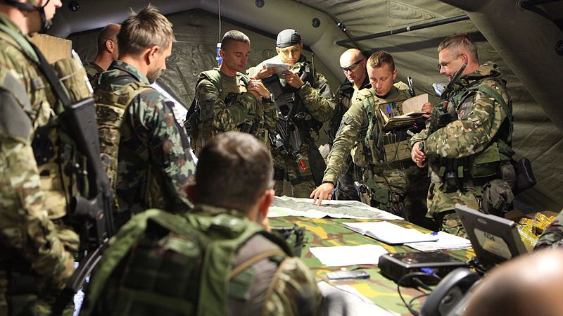
Mission Debrief

Slide 7
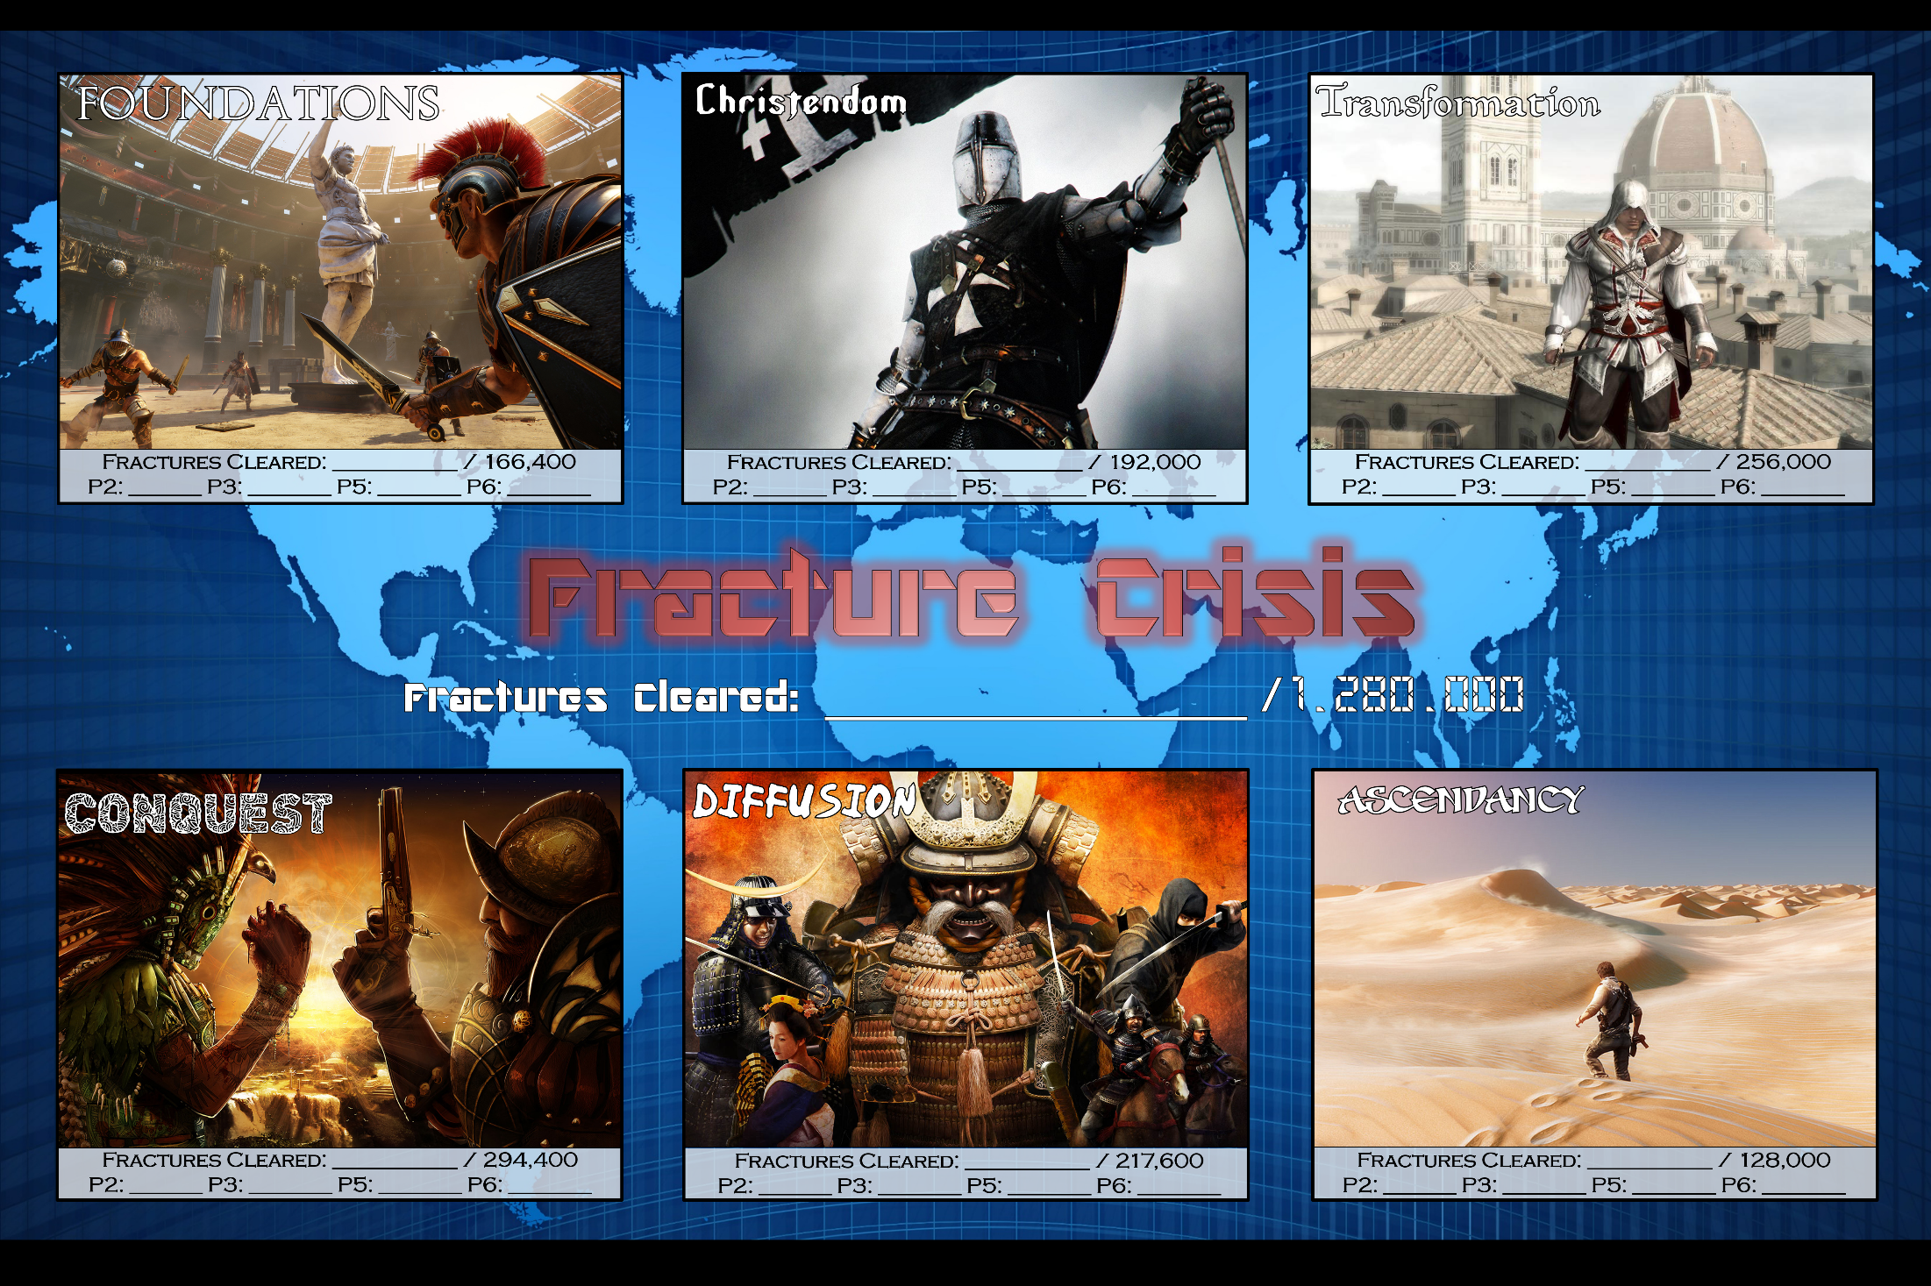
COMPLETED
COMPLETED
COMPLETED
166,400
192,000
256,000
The Story So Far…
Notes:
Terrorist stole a time machine.
He’s messing up history.
We’re trying to learn what really happened to stop it.

Slide 8
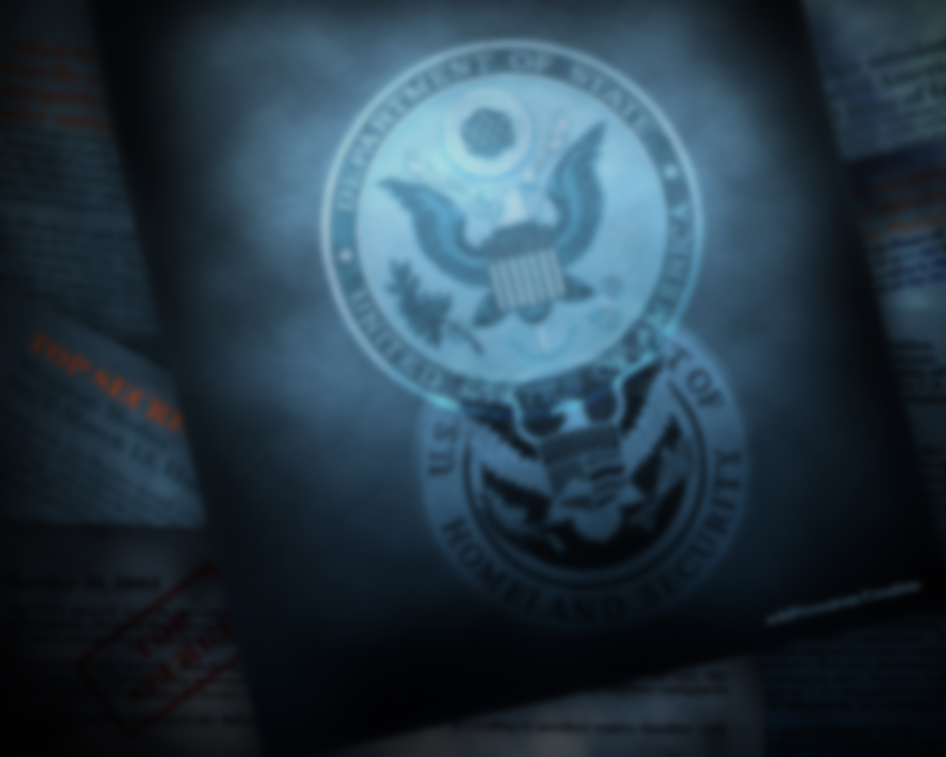

Some crazy things went down while you were on vacation. We thought we had the Fracture Crisis under control but apparently you didn't do as much as we'd hoped. The DTS prediction AI has started spitting out warnings about something coming in the future called "The Cataclysm." Unfortunately, we are already experiencing many negative effects. All of our records of your achievements so far have been wiped out.
Whoever is changing history is doing so faster than you are fixing it. Please remember the importance of your work.
If you do not keep the timeline historically accurate our world is doomed.

Slide 9
We cannot afford another failure. So, we’re starting you off with some training. We will not accept less than your best this time. Incomplete work? Not interested. Stick figure drawings? No way. Not numbering your answers? Forget it. We need your very best.
We’ve put together some challenges themed around each topic you learned about first semester to see what you can do!
Complete each challenge. Your entire group must complete it. Even one mistake disqualifies you from the round. Make sure everything is perfect!
Show us what you’ve got agents. Good luck!

Slide 10
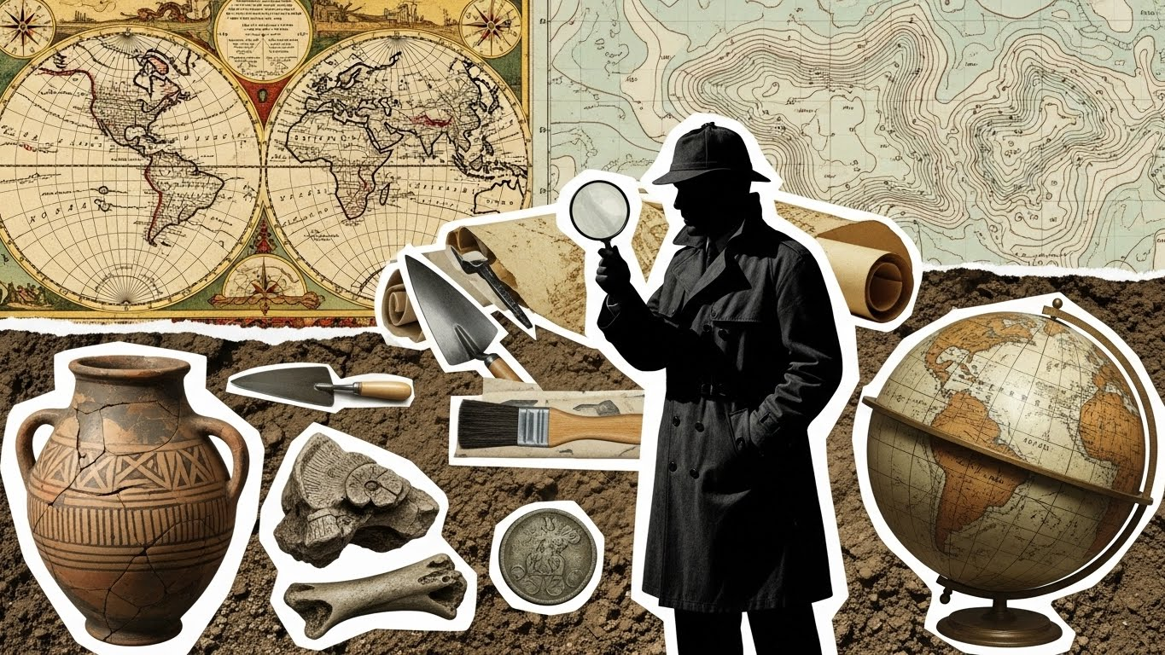


Slide 11

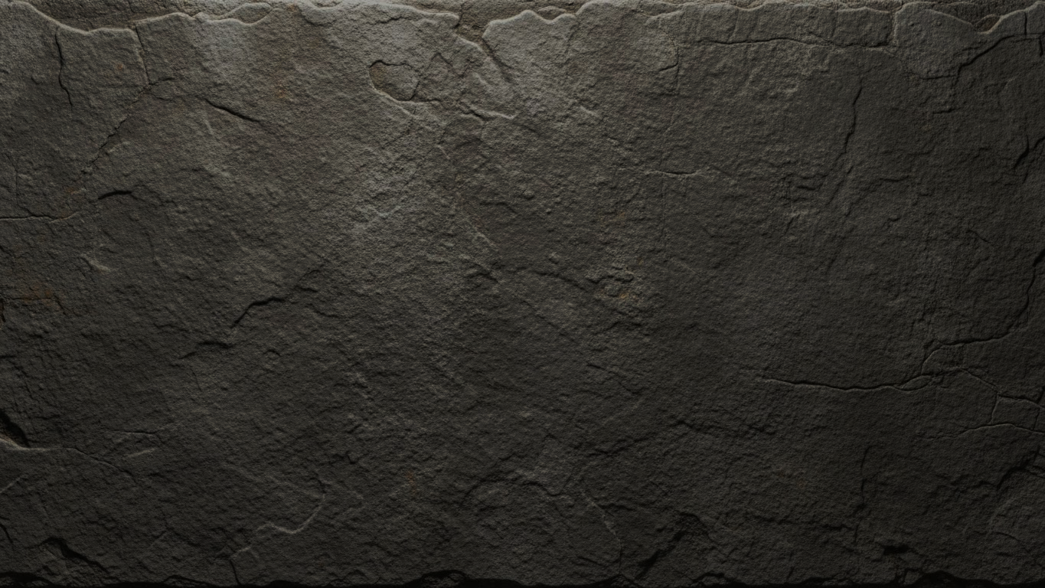
We began by learning about the foundations of history – how history is known, what it means, etc. If you don’t know the basics, how can you do anything else?
Challenge 1: Set up your paper properly.
-Heading in the top-right corner.
-Title at the top (Mission 1 Debrief)
-Welcome question answer
Hold your paper up in the air when you finish. First group with all members done wins!
G
O
!

Slide 12
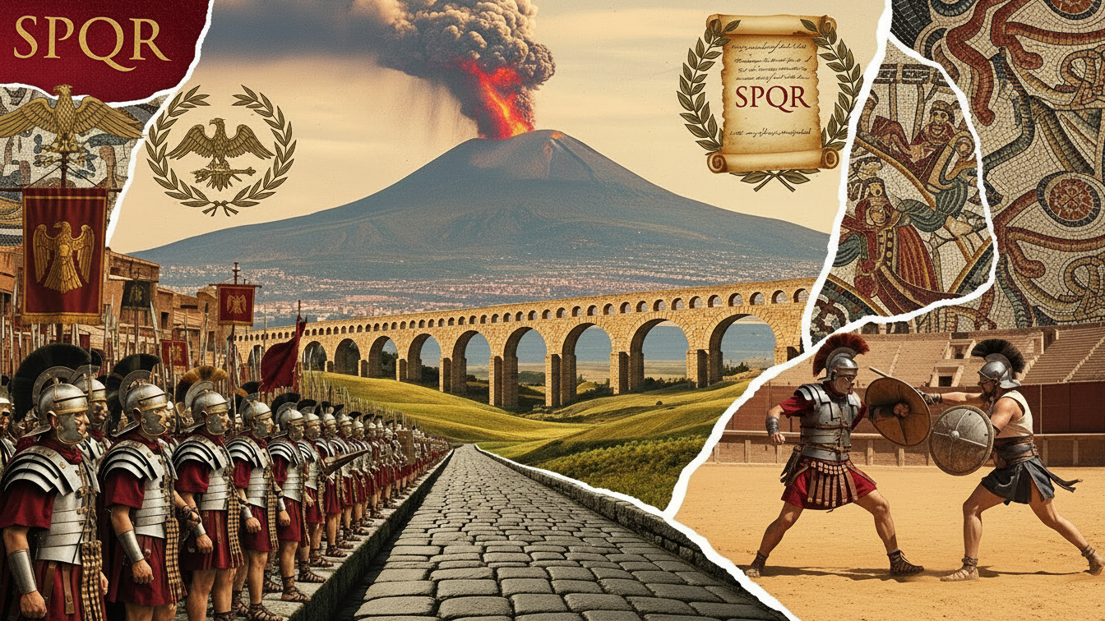


Slide 13
The first civilization we studied was Rome. We learned that Rome create a huge empire by building massive structures with incredible attention to detail. Whether it was the Colosseum, the aqueducts, or the roads the Romans completed each task to the highest standards.
Challenge 2: Each member of your group must write a different complete sentence. They should all be about something great, so how about Mr. Roughton?
G
O
!

Slide 14
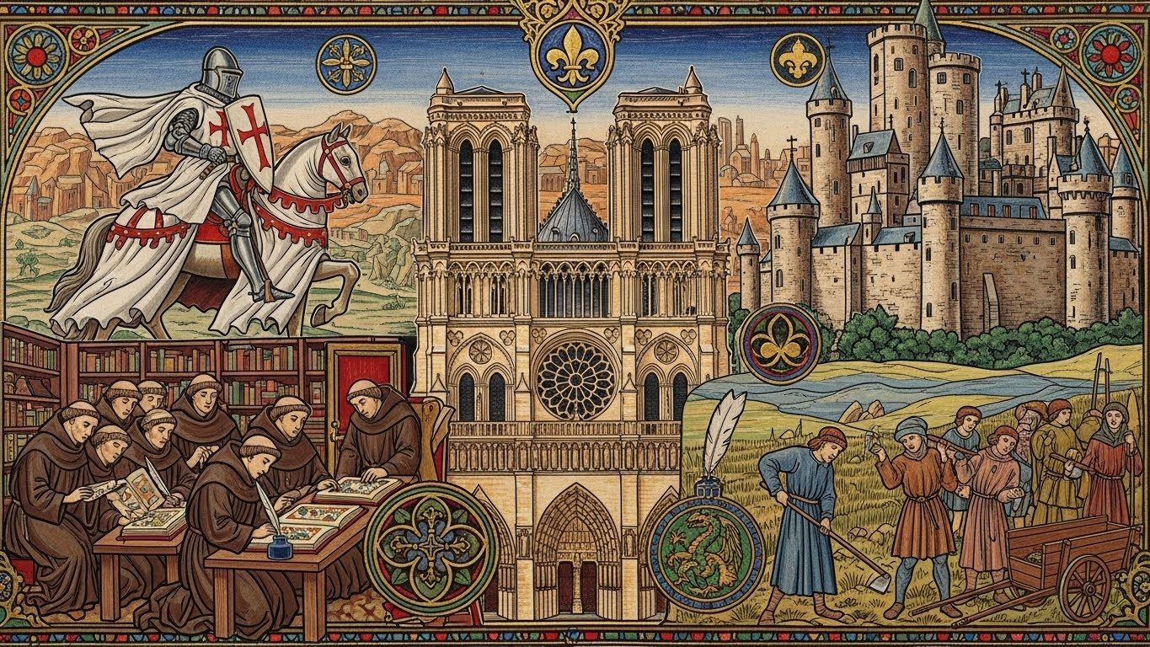


Slide 15
The Fall of Rome led to the chaos of the Dark Ages. Survival required strictly following the orders of society. Everyone had to do their jobs exactly as prescribed. Peasants had to grow crops, knight had to protect them and monks had to meticulously copy Bibles to ensure the preservation of culture and faith.
Challenge 3: Follow the directions on the next slide. The team who follows them the closest wins!
G
O
!
Notes:
Follow directions/copy a thing.

Slide 16
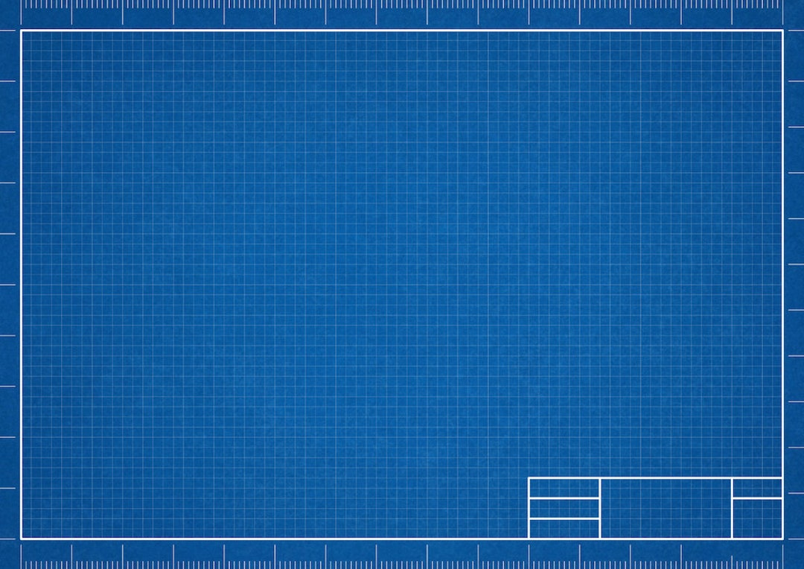
Turn your paper over and turn it sideways.
Draw a square exactly 3 inches on each side, in the bottom-center of your page.
Draw a tall rectangle inside the square, at the bottom near the middle.
Draw a line down the middle of the rectangle.
Draw a triangle on top of the square.
Draw a small circle on top of the triangle.

Slide 17
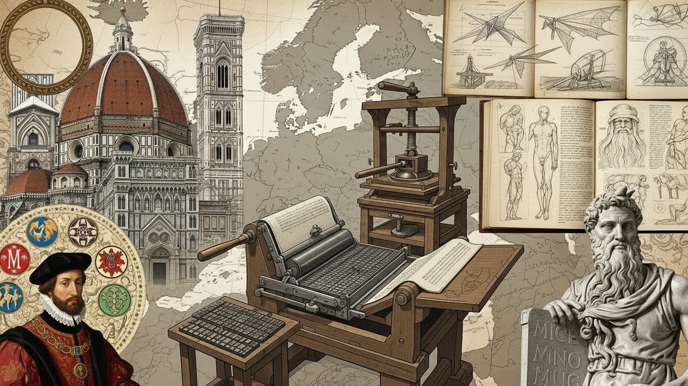

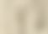

Slide 18
The despair of the Black Death drove a desire for rebirth among the people of Europe. They began to focus on humanism, the idea that humans can make the world a better place. They studied old books and worked to make their art more realistically represent life.
Challenge 4: Add details to make your drawing from the last challenge look realistic. Include a background, shading and perspective!
G
O
!
Notes:
OR I COULD DO MERIT AND ACHIEVEMENT HERE INSTEAD

Slide 19
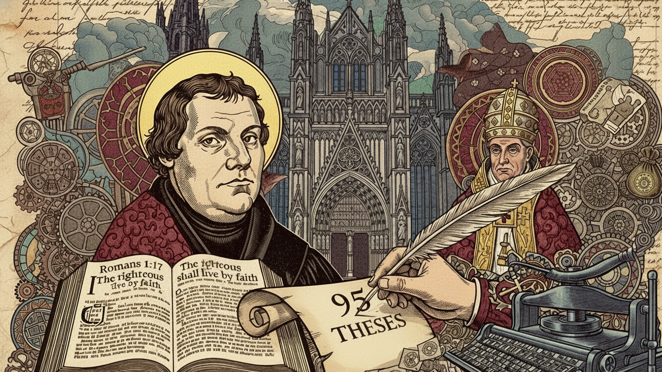


Slide 20
One of the most powerful changes in the Reformation was encouraging people to read the Bible for themselves. It’s one thing to hear information from someone else. It’s an entirely different thing to read it and learn it for yourself.
Challenge 5: Read the passage on the following slide silently. Be prepared to answer basic questions about it. Do whatever you need to do to ensure you focus carefully and remember the information. It is written at a 6th grade level.
G
O
!

Slide 21
An invention that allowed people to make many copies of written materials changed the Renaissance in big ways. Books and pamphlets became cheaper and easier to get, which meant that ideas from science, art, and ancient texts spread quickly across Europe. Artists, scientists, and thinkers could now share their work with more people, leading to new ideas and discoveries. This sharing of knowledge helped to spark a wave of creativity and learning. It also encouraged people to think for themselves and question old beliefs, which helped shape the future of European society.
This new machine also played a massive role in changing religion across Europe. Before it existed, most people could not own a holy book because they were too expensive and written in a language they didn't understand. Once this invention arrived, thousands of copies of the Bible were made in the everyday languages of the people. This meant that ordinary families could read and talk about faith for themselves instead of just listening to what they were told. When famous reformers wrote down their disagreements with the church, their ideas traveled to distant cities in just a few days. This made it impossible for leaders to hide new ideas, and it eventually led to the start of many new churches.

Slide 22
Answer the following your paper in complete sentences. You do not have to write the question. When you finish each question, hold your paper up in the air.
What invention is this passage about?
What are two ways this invention impacted Europe?
What time period was paragraph 1 about? What about paragraph 2?

Slide 23
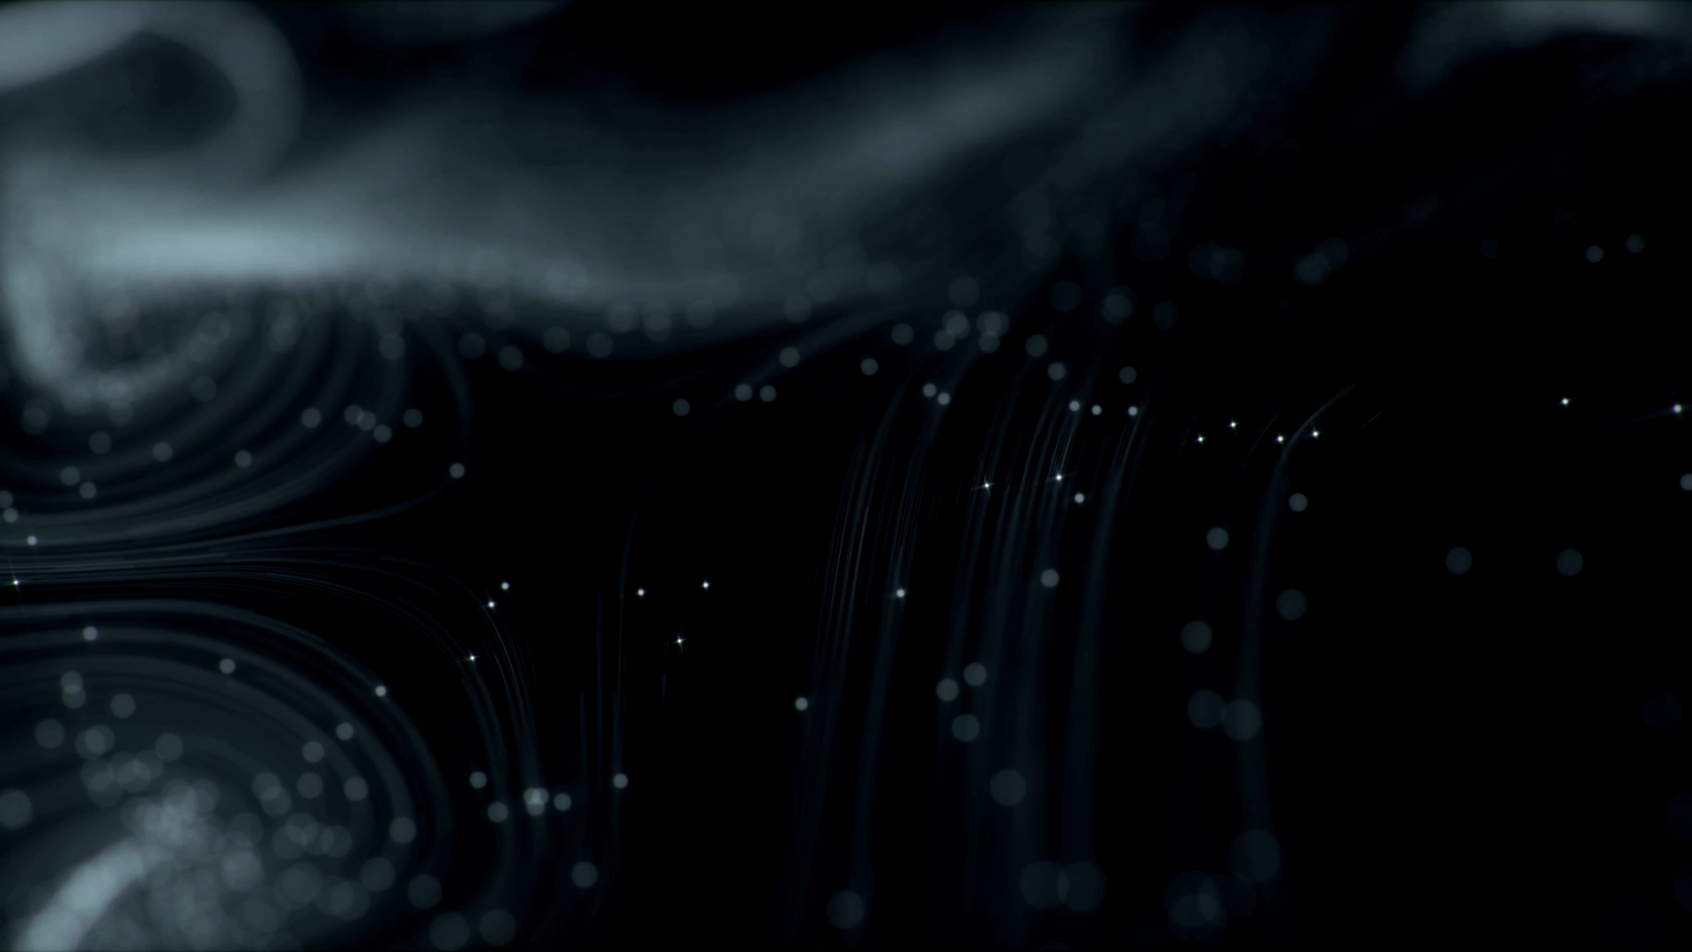

Notes:
You’re ready now!

Slide 24

Mexico: Explorers, Aztecs, Mayans, Inca
Asia: China, Japan and Mongolia
Middle East: Arabia, Persia, Muslims, Africa
Which upcoming unit are you most interested to learn about? Why?
Notes:
closing

