Slide 1


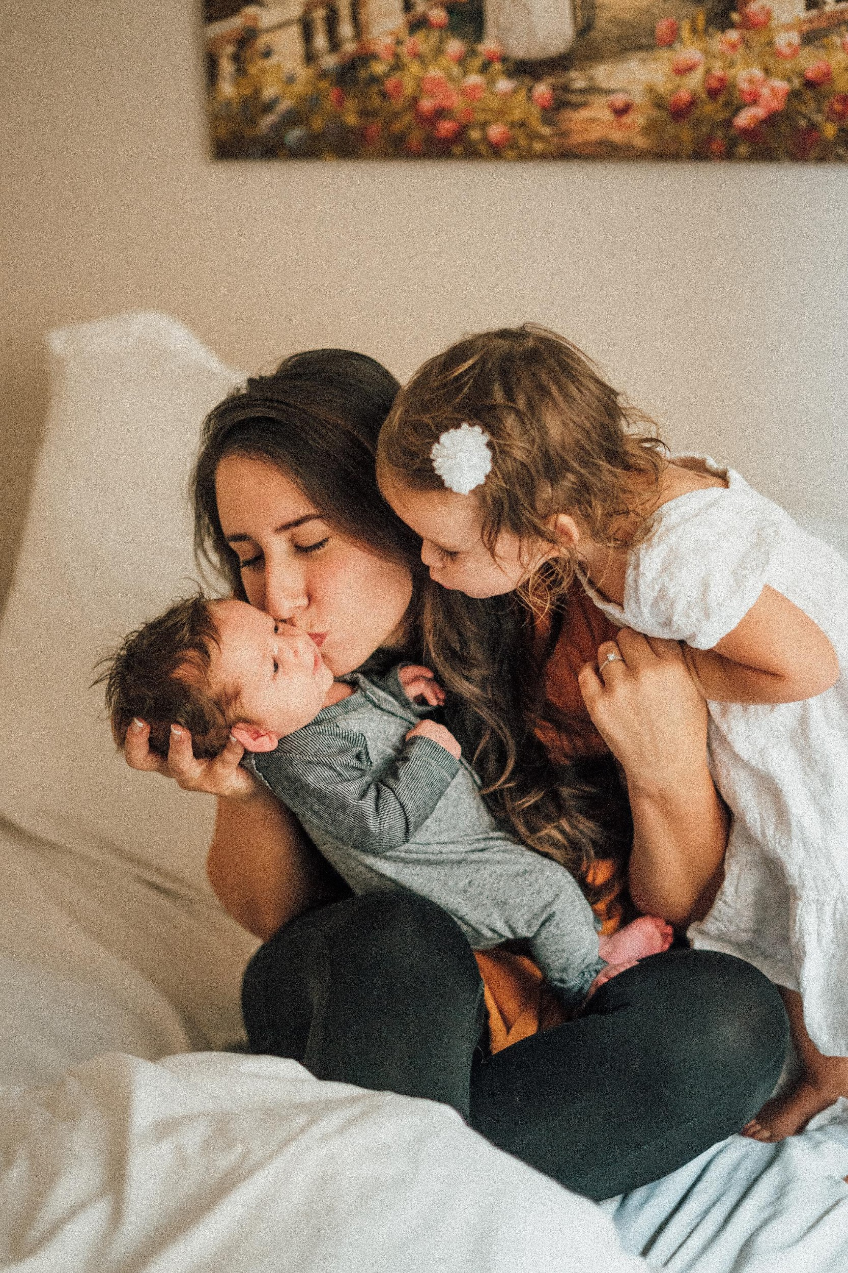
10
October
S | M | T | W | T | F | S
 |  |  | 1 | 2 | 3 | 4
5 | 6 | 7 | 8 | 9 | 10 | 11
12 | 13 | 14 | 15 | 16 | 17 | 18
19 | 20 | 21 | 22 | 23 | 24 | 25
26 | 27 | 28 | 29 | 30 | 31

Slide 2
NOVEMBER
S | M | T | W | T | F | S
 |  |  |  |  |  | 1
2 | 3 | 4 | 5 | 6 | 7 | 8
9 | 10 | 11 | 12 | 13 | 14 | 15
16 | 17 | 18 | 19 | 20 | 21 | 22
23 | 24 | 25 | 26 | 27 | 28 | 29
30
11

Slide 3
12
DECEMBER
S | M | T | W | T | F | S
 | 1 | 2 | 3 | 4 | 5 | 6
7 | 8 | 9 | 10 | 11 | 12 | 13
14 | 15 | 16 | 17 | 18 | 19 | 20
21 | 22 | 23 | 24 | 25 | 26 | 27
28 | 29 | 30 | 31

Slide 4
01
JANUARY
S | M | T | W | T | F | S
 |  |  |  | 1 | 2 | 3
4 | 5 | 6 | 7 | 8 | 9 | 10
11 | 12 | 13 | 14 | 15 | 16 | 17
18 | 19 | 20 | 21 | 22 | 23 | 24
25 | 26 | 27 | 28 | 29 | 30 | 31
Notes:
2021

Slide 5
02
FEBRUARY
S | M | T | W | T | F | S
1 | 2 | 3 | 4 | 5 | 6 | 7
8 | 9 | 10 | 11 | 12 | 13 | 14
15 | 16 | 17 | 18 | 19 | 20 | 21
22 | 23 | 24 | 25 | 26 | 27 | 28

Slide 6
03
MARCH
S | M | T | W | T | F | S
1 | 2 | 3 | 4 | 5 | 6 | 7
8 | 9 | 10 | 11 | 12 | 13 | 14
15 | 16 | 17 | 18 | 19 | 20 | 21
22 | 23 | 24 | 25 | 26 | 27 | 28
29 | 30 | 31

Slide 7
04
April
S | M | T | W | T | F | S
 |  |  | 1 | 2 | 3 | 4
5 | 6 | 7 | 8 | 9 | 10 | 11
12 | 13 | 14 | 15 | 16 | 17 | 18
19 | 20 | 21 | 22 | 23 | 24 | 25
26 | 27 | 28 | 29 | 30

Slide 8
05
MAY
S | M | T | W | T | F | S
 |  |  |  |  | 1 | 2
3 | 4 | 5 | 6 | 7 | 8 | 9
10 | 11 | 12 | 13 | 14 | 15 | 16
17 | 18 | 19 | 20 | 21 | 22 | 23
24 | 25 | 26 | 27 | 28 | 29 | 30
31

Slide 9
06
JUNE
S | M | T | W | T | F | S
 | 1 | 2 | 3 | 4 | 5 | 6
7 | 8 | 9 | 10 | 11 | 12 | 13
14 | 15 | 16 | 17 | 18 | 19 | 20
21 | 22 | 23 | 24 | 25 | 26 | 27
28 | 29 | 30

Slide 10
07
July
S | M | T | W | T | F | S
 |  |  | 1 | 2 | 3 | 4
5 | 6 | 7 | 8 | 9 | 10 | 11
12 | 13 | 14 | 15 | 16 | 17 | 18
19 | 20 | 21 | 22 | 23 | 24 | 25
26 | 27 | 28 | 29 | 30 | 31

Slide 11
08
AuGUST
S | M | T | W | T | F | S
 |  |  |  |  |  | 1
2 | 3 | 4 | 5 | 6 | 7 | 8
9 | 10 | 11 | 12 | 13 | 14 | 15
16 | 17 | 18 | 19 | 20 | 21 | 22
23 | 24 | 25 | 26 | 27 | 28 | 29
30 | 31

Slide 12
09
September
S | M | T | W | T | F | S
 |  | 1 | 2 | 3 | 4 | 5
6 | 7 | 8 | 9 | 10 | 11 | 12
13 | 14 | 15 | 16 | 17 | 18 | 19
20 | 21 | 22 | 23 | 24 | 25 | 26
27 | 28 | 29 | 30

