Slide 1
Using the dimensionality of chemical properties of water to estimate volume
Notes:
This unit will review the dimensions and units that are commonly used for quantifying water in the environment. To provide examples of the meaning of these dimensions and the conversion of units, we will also review the properties of water that are critical to the shaping of the landscape and its ecosystems.

Slide 2
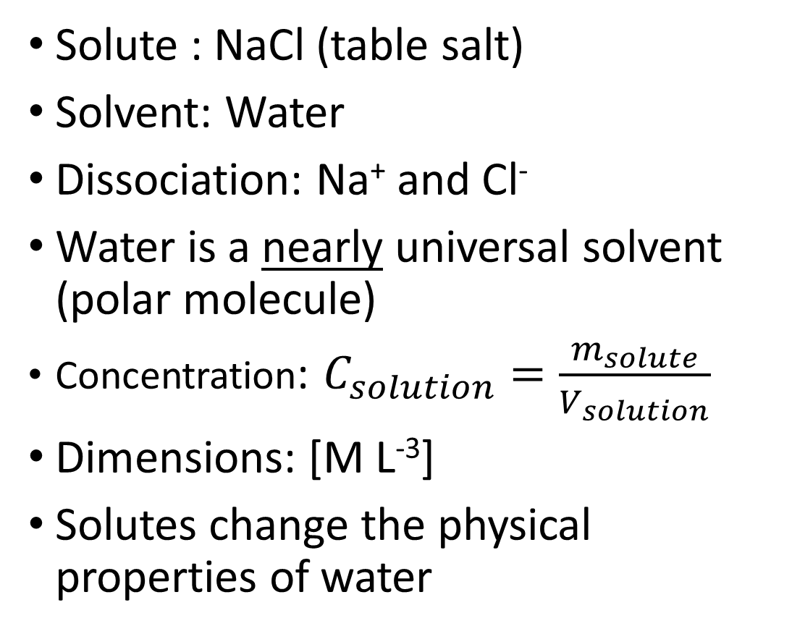
Chemistry of water: Solutions
Solute : NaCl (table salt)
Solvent: Water
Dissociation: Na⁺ and Cl⁻
Water is a nearly universal solvent (polar molecule)
Concentration: $C_{solution}=\frac{m_{solute}}{V_{solution}}$
Dimensions: [M L⁻³]
Solutes change the physical properties of water
NaCl
Notes:
Chemistry: Solutions
Understanding the chemistry of water (also known as “aqueous chemistry”) all starts with understanding solutions and how to quantify them. One of the best indicators of where water has been, and for how long, is determining what is or isn’t dissolved in the water.
There is actually more than one mechanism of dissolution, but lets start with dissociation. Let’s start with a solute (salt), and added to our solvent (water). When you add table salt to water, what happens? What kind of bond is there between sodium and chloride in salt?
As it turns out, this bond is not very hard to break, especially in a polar solvent like water. Therefore NaCl will completely dissociate in water.
Water is particularly good at dissociating ions because of its polar nature. In fact, water can dissolve just about any molecule that has a charge. For this reason, it is sometimes referred to as a “universal” solvent. However, absolutes are almost never true, and this is no exception. Molecules with no charge tend to have little to no attraction to the polarity of water. The fact that they have much more cohesion with molecules of their own type than with water molecules makes them “immiscible” and they will not dissolve in water without additional chemical additives.
Later in the class, we will talk more about the chemical activity that occurs with solutes. But for right now, the important thing to remember is that all of the physical properties of water we have talked about so far CHANGE when solutes are added to the water.
For example, can anyone say why we sometimes put salt on roads or sidewalks in the winter?

Slide 3
Chemistry of water: Solutions
DIMENSIONS DON’T TELL YOU EVERYTHING!
Concentration might be provided in different dimensions (molarity is
[L⁻³], molality is [M⁻¹], percent by volume is [1], etc.)
[M L⁻³] is not always concentration. These are also the dimensions of density.
Dimensions are abstract, so CONTEXT IS EVERYTHING!
NaCl
Notes:
Chemistry: Solutions
Understanding the chemistry of water (also known as “aqueous chemistry”) all starts with understanding solutions and how to quantify them. One of the best indicators of where water has been, and for how long, is determining what is or isn’t dissolved in the water.
There is actually more than one mechanism of dissolution, but lets start with dissociation. Let’s start with a solute (salt), and added to our solvent (water). When you add table salt to water, what happens? What kind of bond is there between sodium and chloride in salt?
As it turns out, this bond is not very hard to break, especially in a polar solvent like water. Therefore NaCl will completely dissociate in water.
Water is particularly good at dissociating ions because of its polar nature. In fact, water can dissolve just about any molecule that has a charge. For this reason, it is sometimes referred to as a “universal” solvent. However, absolutes are almost never true, and this is no exception. Molecules with no charge tend to have little to no attraction to the polarity of water. The fact that they have much more cohesion with molecules of their own type than with water molecules makes them “immiscible” and they will not dissolve in water without additional chemical additives.
Later in the class, we will talk more about the chemical activity that occurs with solutes. But for right now, the important thing to remember is that all of the physical properties of water we have talked about so far CHANGE when solutes are added to the water.
For example, can anyone say why we sometimes put salt on roads or sidewalks in the winter?

Slide 4
Physics of water: Electrical conductivity
NaCl
Units: μS cm⁻¹
Varies with dissolved solids and temperature
Temperature-corrected (to 25 °C), or “specific” conductivity normalizes for the effects of temperature
Notes:
Chemistry: Solutions
For our next lab, we are especially interested in how salt affects a physical property we haven’t talked about yet. Electrical Conductivity.
Electrical conductivity is the ability to carry a current of electrons when a given voltage is applied. Particularly in NaCl solutions, the more salt there is, more electrons net movement of electrons through the solution. This is why NaCl is sometimes called an “electrolyte”.

Slide 5
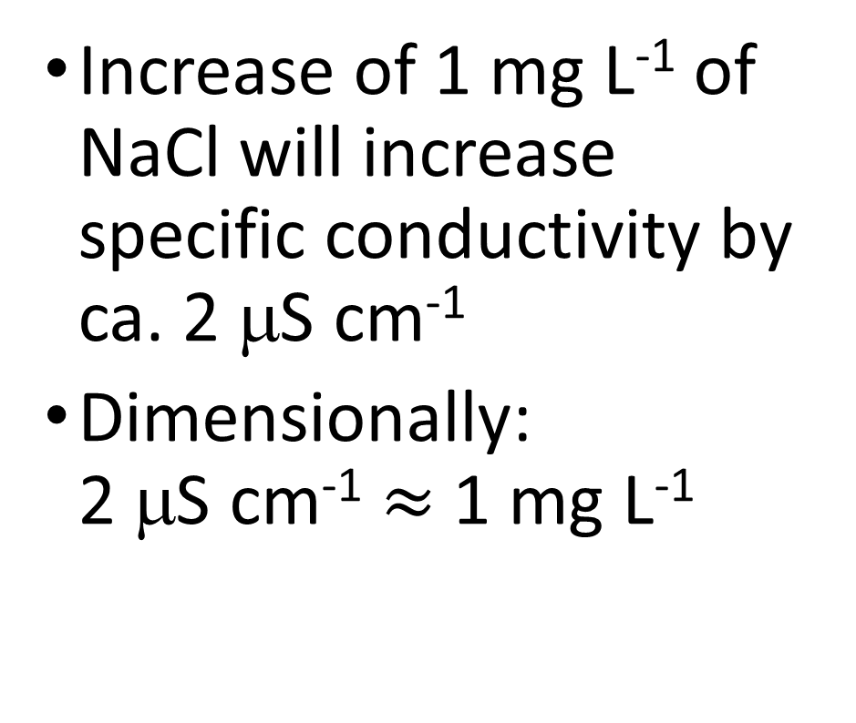
Relating electrical conductivity to solute concentration
NaCl
Increase of 1 mg L⁻¹ of NaCl will increase specific conductivity by ca. 2 μS cm⁻¹
Dimensionally:
2 μS cm⁻¹ $≈$ 1 mg L⁻¹
Notes:
Chemistry: Solutions
For our next lab, we are especially interested in how salt affects a physical property we haven’t talked about yet. Electrical Conductivity.
Electrical conductivity is the ability to carry a current of electrons when a given voltage is applied. Particularly in NaCl solutions, the more salt there is, more electrons net movement of electrons through the solution. This is why NaCl is sometimes called an “electrolyte”.

Slide 6
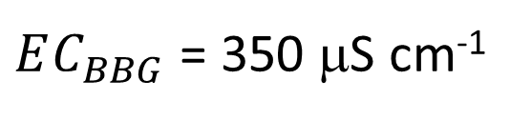
Measuring volume by dilution
$EC_{BBG}$ = 350 μS cm⁻¹
Conductivity
Meter
350 μS cm⁻¹
?
Notes:
Summarizes the calculations necessary to estimate the volume of water in a bucket by adding a known volume of salt to the bucket, dissolving the salt, and measuring the change in electrical conductivity before and after the salt is added.
$EC_{BBG}$ = Background electrical conductivity of water in the bucket (BEFORE adding salt)
$m_{NaCL}$ = Mass of salt added to the bucket
$EC_{BS}$ = Electrical conductivity of water in the bucket AFTER adding salt
$ΔEC$ = The change in EC (in this case increase) due to the addition of the salt to the water in the bucket

Slide 7
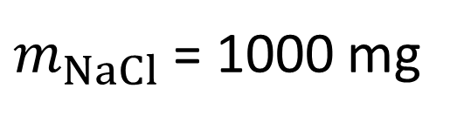
Measuring volume by dilution
$m_{NaCl}$ = 1000 mg
$EC_{BBG}$ = 350 μS cm⁻¹
NaCl
?
Notes:
Summarizes the calculations necessary to estimate the volume of water in a bucket by adding a known volume of salt to the bucket, dissolving the salt, and measuring the change in electrical conductivity before and after the salt is added.
$EC_{BBG}$ = Background electrical conductivity of water in the bucket (BEFORE adding salt)
$m_{NaCL}$ = Mass of salt added to the bucket
$EC_{BS}$ = Electrical conductivity of water in the bucket AFTER adding salt
$ΔEC$ = The change in EC (in this case increase) due to the addition of the salt to the water in the bucket

Slide 8
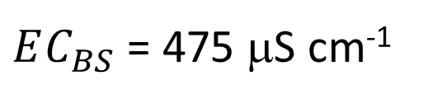
Measuring volume by dilution
$m_{NaCl}$ = 1000 mg
$EC_{BBG}$ = 350 μS cm⁻¹
$EC_{BS}$ = 475 μS cm⁻¹
Conductivity
Meter
475 μS cm⁻¹
?
Notes:
Summarizes the calculations necessary to estimate the volume of water in a bucket by adding a known volume of salt to the bucket, dissolving the salt, and measuring the change in electrical conductivity before and after the salt is added.
$EC_{BBG}$ = Background electrical conductivity of water in the bucket (BEFORE adding salt)
$m_{NaCL}$ = Mass of salt added to the bucket
$EC_{BS}$ = Electrical conductivity of water in the bucket AFTER adding salt
$ΔEC$ = The change in EC (in this case increase) due to the addition of the salt to the water in the bucket

Slide 9
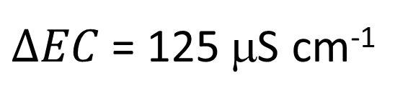
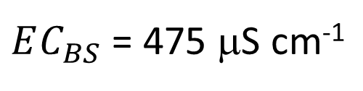
Measuring volume by dilution
$m_{NaCl}$ = 1000 mg
$EC_{BBG}$ = 350 μS cm⁻¹
$EC_{BS}$ = 475 μS cm⁻¹
$ΔEC$ = 125 μS cm⁻¹
Conductivity
Meter
475 μS cm⁻¹
?
Notes:
Summarizes the calculations necessary to estimate the volume of water in a bucket by adding a known volume of salt to the bucket, dissolving the salt, and measuring the change in electrical conductivity before and after the salt is added.
$EC_{BBG}$ = Background electrical conductivity of water in the bucket (BEFORE adding salt)
$m_{NaCL}$ = Mass of salt added to the bucket
$EC_{BS}$ = Electrical conductivity of water in the bucket AFTER adding salt
$ΔEC$ = The change in EC (in this case increase) due to the addition of the salt to the water in the bucket

Slide 10

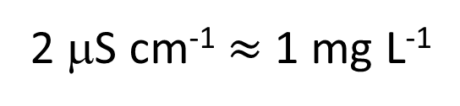
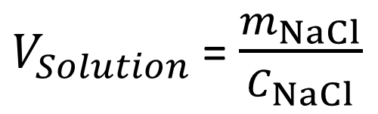
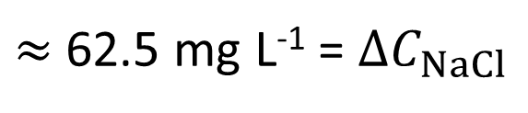
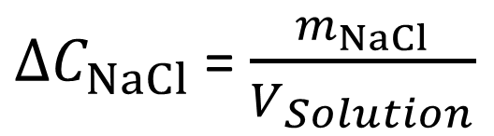
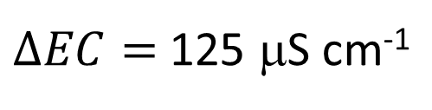
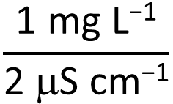
Measuring volume by dilution
$m_{NaCl}$ = 1000 mg
$EC_{BBG}$ = 350 μS cm⁻¹
Assuming salt is “conservative”
$EC_{BS}$ = 475 μS cm⁻¹
2 μS cm⁻¹ $≈$ 1 mg L⁻¹
$ΔEC$ = 125 μS cm⁻¹
$ΔEC=$ 125 μS cm⁻¹
$$\frac{\text{1 }\text{mg} \text{L}\text{−1}}{\text{2 }\text{m}\text{S} \text{cm}\text{−1}}$$
$≈$ 62.5 mg L⁻¹ = $ΔC_{NaCl}$
$ΔC_{NaCl}$ = $\frac{m_{NaCl}}{V_{Solution}}$
?
$$\text{= }\frac{\text{1000 }\text{mg} }{\text{62.5 }\text{mg} \text{L}\text{−1}}$$
$V_{Solution}$ = $\frac{m_{NaCl}}{C_{NaCl}}$
= 16 L
16 L
Assuming solution volume is equal to original water volume (salt adds negligible volume)
Notes:
Summarizes the calculations necessary to estimate the volume of water in a bucket by adding a known volume of salt to the bucket, dissolving the salt, and measuring the change in electrical conductivity before and after the salt is added.
$EC_{BBG}$ = Background electrical conductivity of water in the bucket (BEFORE adding salt)
$m_{NaCL}$ = Mass of salt added to the bucket
$EC_{BS}$ = Electrical conductivity of water in the bucket AFTER adding salt
$ΔEC$ = The change in EC (in this case increase) due to the addition of the salt to the water in the bucket

