Slide 1
HEAVEN
Free Template

Slide 2
TABLE OF CONTENTS
01
02
PRESENTATION
HISTORY
03
04
THE EVENT
CONCLUSION
Here you can describe the topic of the section
Here you can describe the topic of the section
Here you can describe the topic of the section
Here you can describe the topic of the section

Slide 3
01
PRESENTATION
You can enter a subtitle here if you need it

Slide 4
HOW ABOUT THE PERCENTAGES?
MERCURY
NEPTUNE
VENUS
100%
70%
25%
Mercury is the closest planet to the Sun
It is the farthest planet from the Sun
Venus has a very beautiful name

Slide 5
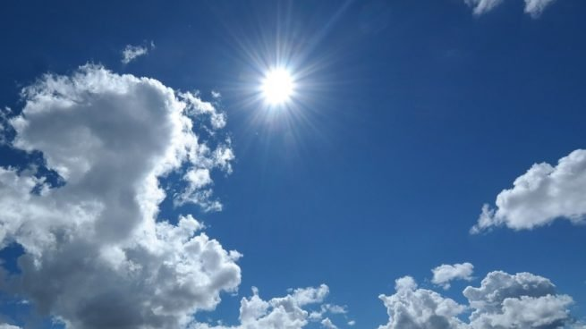
A PICTURE ALWAYS REINFORCES THE CONCEPT
Images reveal large amounts of data

Slide 6
149,675
Big numbers catch your audience’s attention

Slide 7
MAYBE YOU NEED TO DIVIDE
THE CONTENT
MERCURY
VENUS
Venus has a beautiful name and is the second planet from the Sun. It’s terribly hot
Mercury is the closest planet to the Sun and the smallest one in the Solar System

Slide 8
AWESOME WORDS
Because key words are great for catching your audience’s attention

Slide 9
02
HISTORY
You can enter a subtitle here if you need it

Slide 10
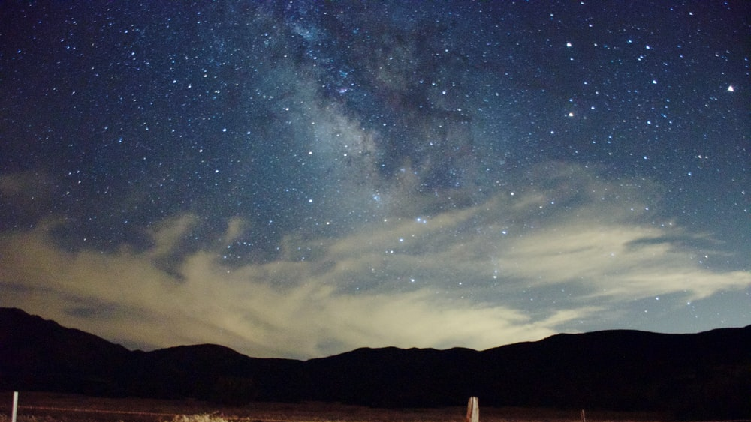
A PICTURE IS WORTH A THOUSAND WORDS

Slide 11
—SOMEONE FAMOUS
“This is a quote, words full of wisdom that someone important said and can make the reader get inspired.”

Slide 12
YOU CAN USE THREE COLUMNS
MARS
JUPITER
MERCURY
Despite being red, Mars is actually a very cold place
It’s a gas giant and the biggest planet in the Solar System
Mercury is the smallest one in the Solar System

Slide 13
WHAT DO YOU NEED TO ENJOY THE EVENT?
On April 14, step out of your home or office and take a few minutes to look up at the sky!
Relax and enjoy the the sky
Do some star gazing
Draw the night sky

Slide 14
333,000
24h 37m 23s
386,000 km
earths is the Sun’s mass
is Jupiter’s rotation period
is the distance between Earth and the Moon

Slide 15
THIS IS AN INFOGRAPHIC!
Mercury is the closest planet to the Sun
Venus is the second planet from the Sun
Saturn is a gas giant and has several rings
Mars is actually a cold place. It’s full of iron oxide dust
FULL MOON
FIRST QUARTER
NEW MOON
THIRD QUARTER
02
03
01
04

Slide 16
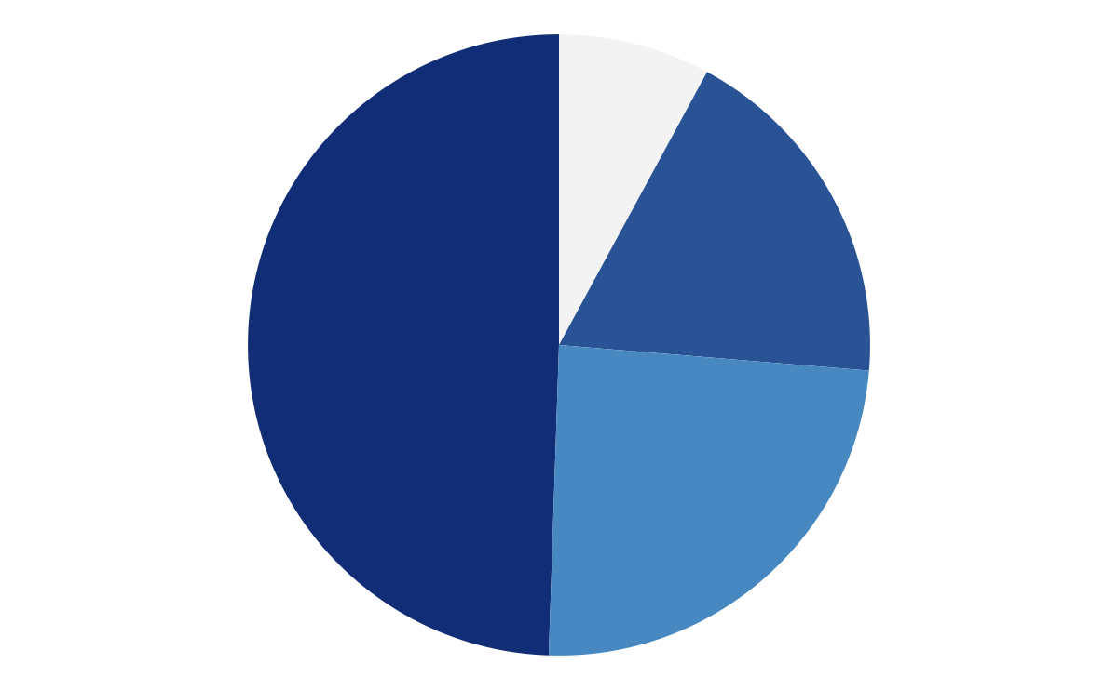
THIS IS A GRAPH
7.90%
MERCURY
18.40%
VENUS
49.50%
MARS
24.20%
JUPITER
It is the smallest planet in the Solar System
Venus is the second planet from the Sun
Despite being red, it is actually a cold place
It is the biggest planet in the Solar System
To modify this graph, click on it, follow the link, change the data and paste the new graph here

Slide 17
03
THE EVENT
You can enter a subtitle here if you need it

Slide 18
THIS IS A MAP!
NEPTUNE
Neptune is the farthest planet from the Sun
MERCURY
Mercury is the closest planet to the Sun
VENUS
Venus is the second planet from the Sun

Slide 19
A TIMELINE ALWAYS WORKS WELL
MERCURY
JUPITER
Mercury is the closest planet to the Sun
It is the biggest planet in the Solar System
01
02
03
04
MARS
VENUS
Despite being red, Mars is a cold place
Venus is the second planet from the Sun

Slide 20
THIS IS A MIND MAP
VENUS
MARS
MERCURY
JUPITER
Venus is the second planet from the Sun
Despite being red, Mars is a very cold place
Mercury is the smallest planet of them all
Jupiter is the biggest planet of them all

Slide 21
HOW TO CELEBRATE THIS DAY
Try bringing a blanket to the park so that you can lay down on it and look at the sky for some time
Watch birds go about their lives as if nothing of importance was going on down below
You might be motivated to take a trip to other places if you watch planes soaring high above

Slide 22
YOU CAN USE FOUR COLUMNS
MERCURY
VENUS
JUPITER
MARS
Mercury is the closest planet to the Sun
Venus is the second planet from the Sun
The planet is actually full of iron oxide dust
It is the biggest planet in the Solar System

Slide 23
A PICTURE ALWAYS REINFORCE THE CONCEPT
Images reveal large amounts of data, so remember: use an image instead of a long text

Slide 24
THIS IS ANOTHER TIMELINE
Mercury is the closest planet to the Sun
Venus is the second planet from the Sun
It is composed of hydrogen and helium
Mars is actually a cold place. It’s full of iron oxide dust
MERCURY
VENUS
SATURN
MARS
01
02
03
04

Slide 25
WHOA!
This can be the part of the presentation where you can tell an interesting anecdote or story

Slide 26
REVIEWING CONCEPTS IS A GOOD IDEA
MERCURY
MARS
VENUS
SATURN
NEPTUNE
JUPITER
Mercury is the smallest planet
Mars is actually a cold place
Venus is the second planet from the Sun
Saturn is a gas giant and has rings
Neptune is the fourth-largest planet
Jupiter is a gas giant and the biggest planet

Slide 27
OUR TEAM
JENNA CLARK
JOHN SMITH
Mercury is the closest planet to the Sun and the smallest one in the Solar System
Venus has a beautiful name and is the second planet from the Sun. It’s terribly hot

Slide 28
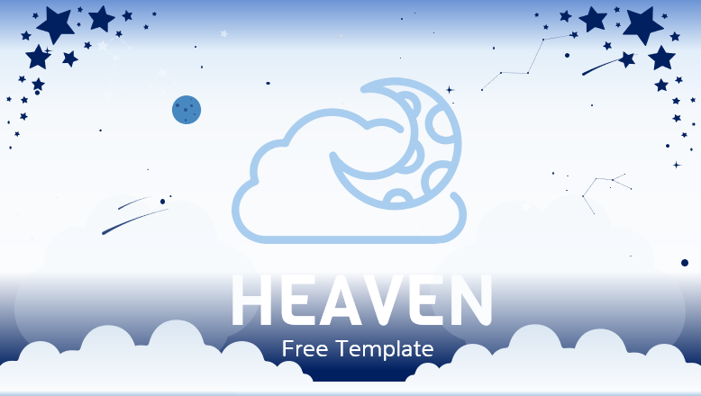
DESKTOP SOFTWARE
You can replace the image on the screen with your own work. Just delete this one, add yours and center it properly

Slide 29
THANKS!
Do you have any questions?
You can replace the image on the screen with your own work. Just delete this one, add yours and center it properly

Slide 30
Fuentes
ELABORADO POR : plantillaspowerpoint.org
IMAGES :
unsplash.com
okdiario.com
FONTS :
Viga

Slide 31
RESOURCES

Slide 32
ALTERNATIVE RESOURCES

Slide 33
ALTERNATIVE RESOURCES

Slide 34
Fully Editable Icon Sets: A

Slide 35
Fully Editable Icon Sets: B

Slide 36
Fully Editable Icon Sets: C

