Slide 1
An Expanded Model of Evidence-based Practice in Special Education
Randy Keyworth
Jack States
Ronnie Detrich
Wing Institute

Slide 2
Evidence-based: Why Now?
No Child Left Behind (NCLB) language calls for interventions to be based on scientific research.
There are over 100 references in the language of NCLB to scientific research.
As with many federal policies there is no clear definition of what constitutes evidence-based.
The term evidence-based is not well defined in the professional literature.
There is no consensus on what constitutes evidence.

Slide 3
An Expanded Model of Evidence-based Practice
The purpose of this paper is to define the primary components of an evidence-based culture, their functions, and how they relate to each other.

Slide 4














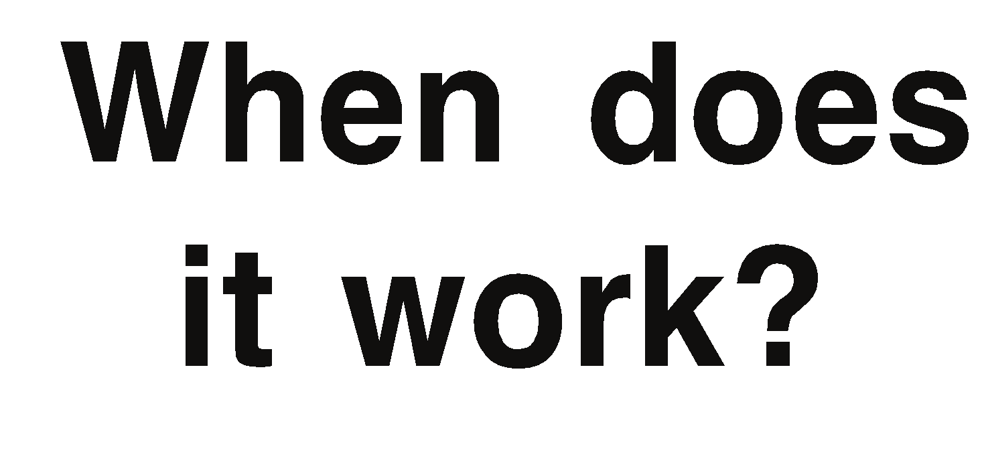





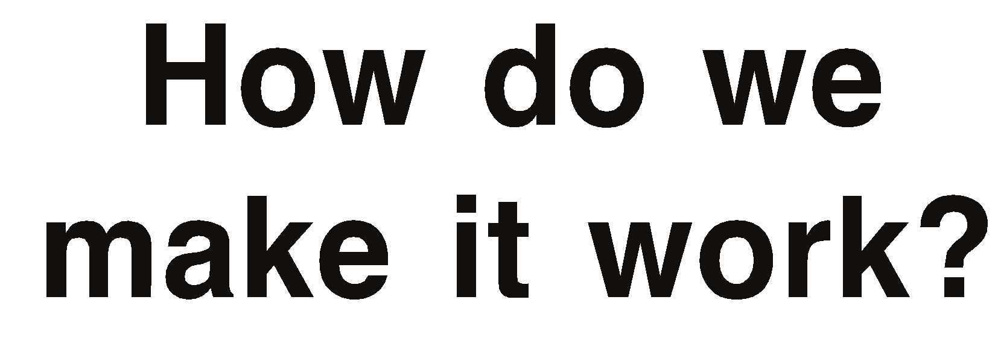
Research to Practice
Evidence-based Education
Research
Replicability
Sustainability
Practice

Slide 5




Efficacy Research (What Works?)
Research
What works?
What works?
Replicability
Primary concern is demonstration relationship between independent and dependent variable (causal relations).
Precision is key to unambiguous statement of causation.
Experimentally controlled so threats to internal validity are minimized.
Currently, this is the most common form of published educational research.
When does it work?
How do we make it work?
Sustainability
Is it working?
Practice

Slide 6
Characteristics of Efficacy research
Research
What works?
What works?
Replicability
Conducted in highly controlled settings
Implemented by well trained change agents.
Relatively small N
Not always easy to immediately translate to practice.
When does it work?
How do we make it work?
Sustainability
Is it working?
Practice

Slide 7
Effectiveness Research (When Does it Work?)
Research
What works?
Replicability
Overall goal is taking interventions to scale and evaluating the robustness when implemented in more typical practice settings.
Primarily concerned with answering questions of external validity or generality of effects.
For whom does the intervention work?
In what settings can it work?
What are the necessary minimum conditions for an intervention to be effective?
What are limitations and constraints on the impact?
When does it work?
When does it work?
How do we make it work?
Sustainability
Is it working?
Practice

Slide 8
Effectiveness Research (When Does it Work?)
Research
What works?
Replicability
Efficacy research informs effectiveness research.
Suggests specific dimensions to examine:
Parameters of independent variable.
Extensions to different subject populations.
Extensions to different settings.
Extensions to different change agents.
Rigor is still critical.
Precision of impact on independent variable may be reduced as a function of change of evaluation methods and changes in unit of analysis (impact on classroom rather than individual student).
Efficacy research has established the power of the independent variable in more precise manner than may be possible with effectiveness research.
When does it work?
When does it work?
How do we make it work?
Sustainability
Is it working?
Practice

Slide 9
Establishing an Evidence-base
No single study is sufficient to demonstrate that an intervention is effective.
Science depends on both direct and systematic replication.
Currently, there is no consensus about the quantity or quality of evidence necessary to establish an intervention is evidence-based.
What Works Clearinghouse suggests:
Randomized trials in at least two settings.
Many subjects (150 per condition).
Settings similar to decision maker’s school.
If conditions met then meets criteria for strong evidence.
If conditions not met then may meet criteria for possible evidence.
If does not meet criteria for possible evidence, then conclude that the intervention is not supported by meaningful evidence.
No mention of single subject research methods.

Slide 10
Implementation (How do we make it work?)
Research
What works?
Replicability
The primary question is how to place an intervention within a specific context.
Very little research on how to move evidence-based interventions into practice settings.
Until questions around implementation are answered the ultimate promise of evidence-based education will go unfulfilled.
One of most important tasks of implementation is analyze contingencies operating on various stakeholders in practice settings and how they influence adoption and sustainability of an intervention.
When does it work?
How do we make it work?
How do we make it work?
Sustainability
Is it working?
Practice

Slide 11
Implementation: Some of the questions
Research
What works?
Replicability
How do we increase the interest in evidence-based interventions in practice settings?
What organizational features are necessary to support evidence-based interventions?
What steps are necessary to move practitioners to an evidence-based intervention after a history with other interventions?
How do we write policy and regulations so that it is possible to implement evidence-based interventions at a broad level?
When does it work?
How do we make it work?
How do we make it work?
Sustainability
Is it working?
Practice

Slide 12
Performance Monitoring (Is it Working?)
Research
What works?
Replicability
Effectiveness research guides us to implement specific interventions in specific settings to solve specific problems.
Generalizing from effectiveness research to a particular setting is always a leap in deductive logic and confidence is less than 1.0.
To assure that the intervention is actually being effective must monitor the impact of the intervention in the setting (practice-based evidence).
If ineffective must change one or more components of the intervention until positive effects are accomplished.
When does it work?
How do we make it work?
Sustainability
Is it working?
Is it working?
Practice

Slide 13
Performance Monitoring (Is it Working?)
Research
What works?
Replicability
Performance monitoring is informed by efficacy and effectiveness research but it also informs both efficacy and effectiveness research.
Identifies areas where a new intervention is required because it is not effective under some conditions.
Identifies populations, settings, conditions that may be boundary conditions for an intervention unless it is modified in some way.
When does it work?
How do we make it work?
Sustainability
Is it working?
Is it working?
Practice

Slide 14
Performance Monitoring
Research
What works?
Replicability
Ultimately, in special education the unit of analysis is the individual student so it is fundamental that data reflect performance at this level rather than aggregate measures.
Performance measures should meet acceptable criteria so that we can have reasonable confidence in the data.
Must choose measures that reflect important outcomes and can be linked to other important outcomes.
Curriculum based measurement is a well-established method for sampling academic performance of individual students.
Currently, IEP defines important goals and what is to be measured.
Little evidence that goals are selected through systematic process or that measures are reliable and valid.
When does it work?
How do we make it work?
Sustainability
Is it working?
Is it working?
Practice

Slide 15
Building an Evidence-based Culture through a Gap Analysis
The function of a Gap Analysis is to identify the gap between current performance and desired performance; the contingencies that account for the gap; and interventions that will close the gap.
Through analysis can develop a scope and sequence for interventions so that evidence-based culture can develop.

Slide 16
Example of Gap Analysis
Goal | Current Conditions | Contingencies | Intervention
All interventions in special education are evidence-based. | Many interventions have no empirical basis. Interventions selected by teacher and other professionals responsible for implementation. Reflect training and preferences rather than empirical basis. | No systematic process to inform decision makers of evidence-based interventions in a particular area. Parents can influence nature of intervention through advocacy. No quality control system. | Establish data base of evidence-based interventions (best available evidence). Work with parents to select from an array of evidence-based procedures. Establish QA system that reviews interventions.

Slide 17
Summary
Evidence-based education is more than simply having the evidence.
Not all of the necessary components for an evidence-based culture are well established.
Powerful contingencies are in place to mitigate against moving toward evidence-based education.
Analysis of these contingencies through a Gap Analysis can provide some guidance as how to proceed.
Active intervention will be required.

