Slide 1

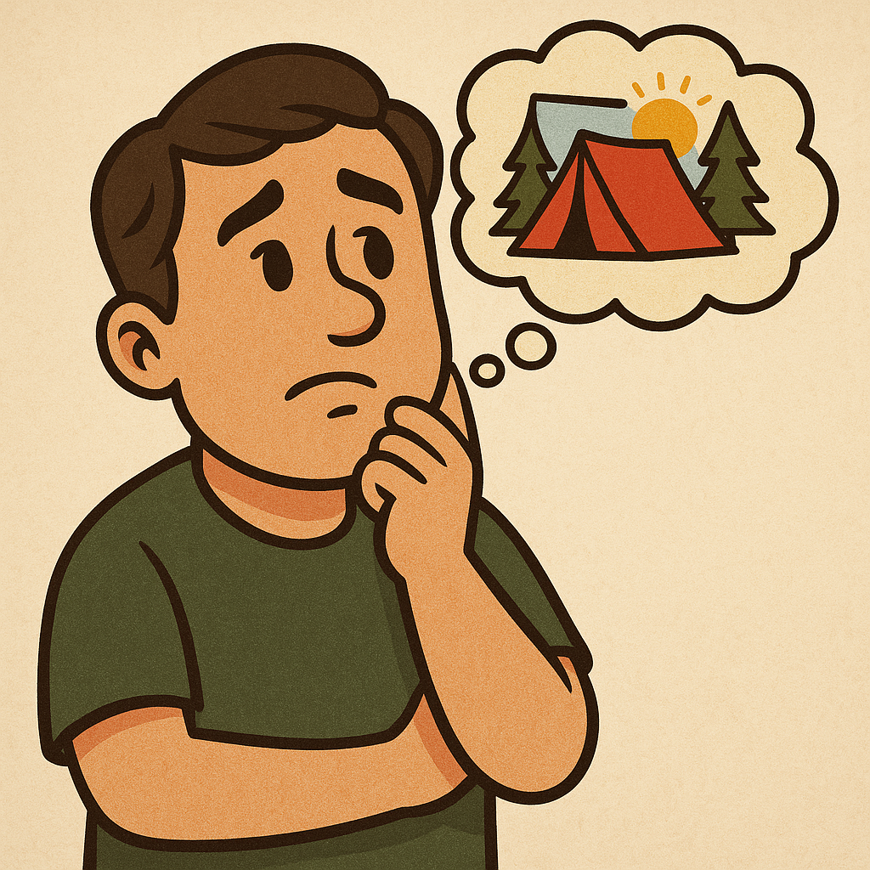




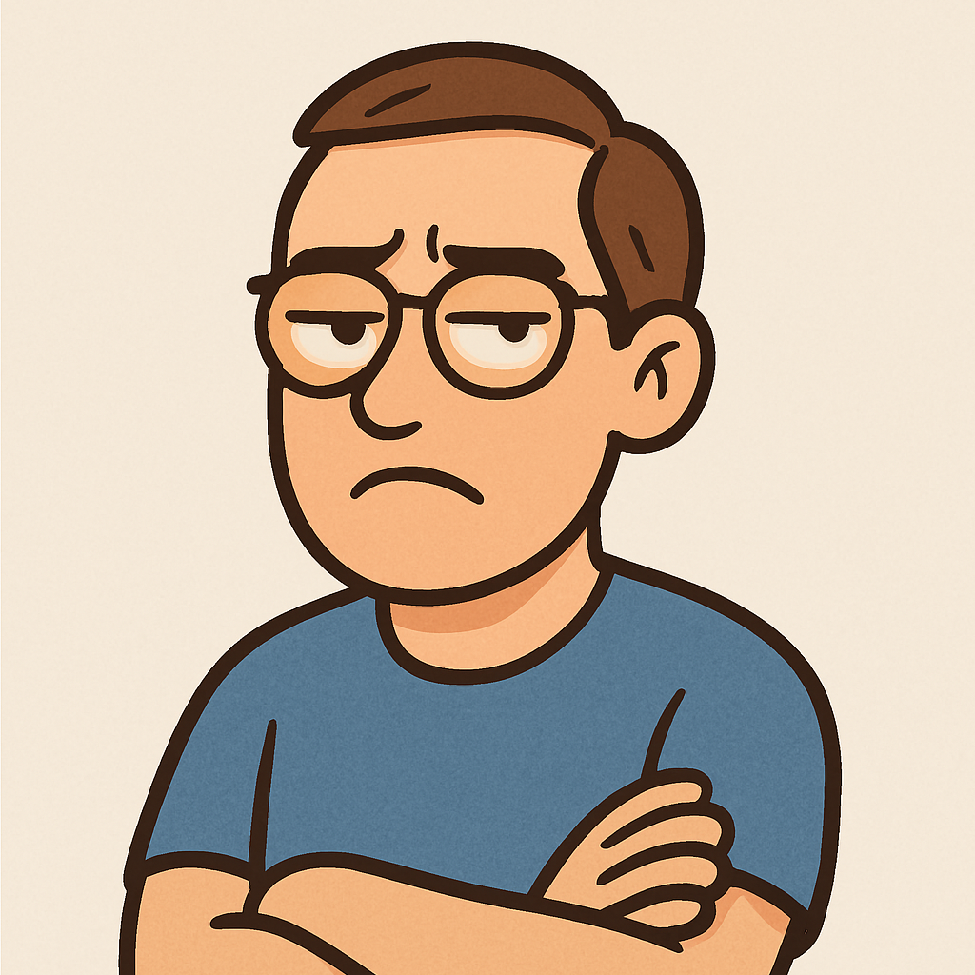

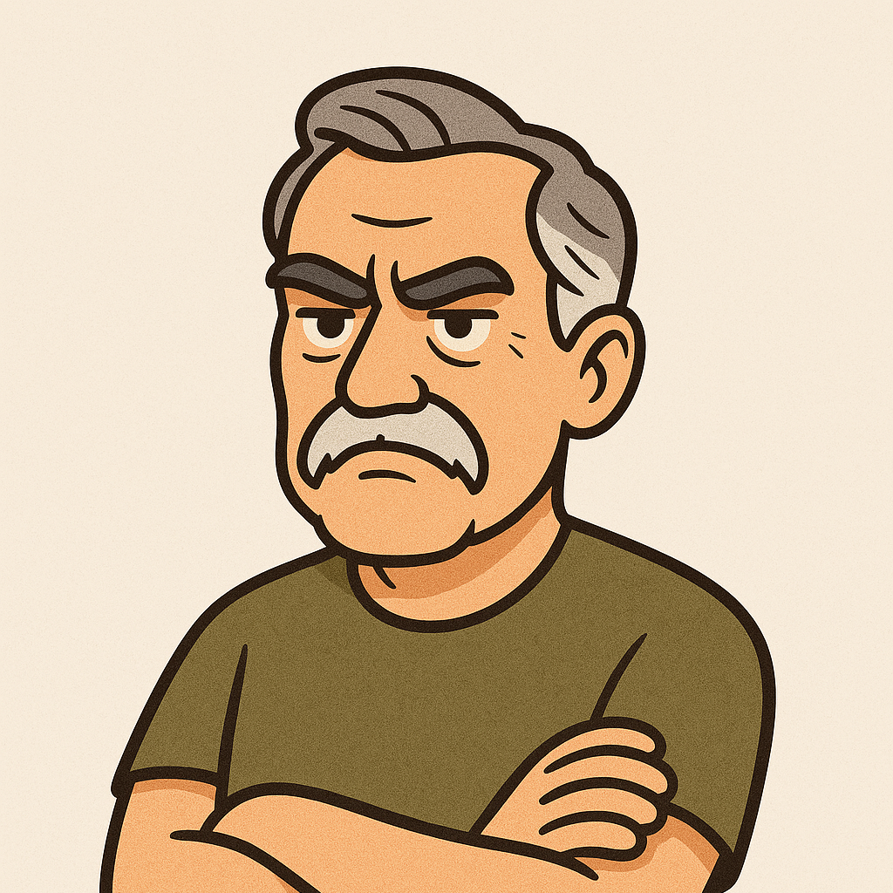
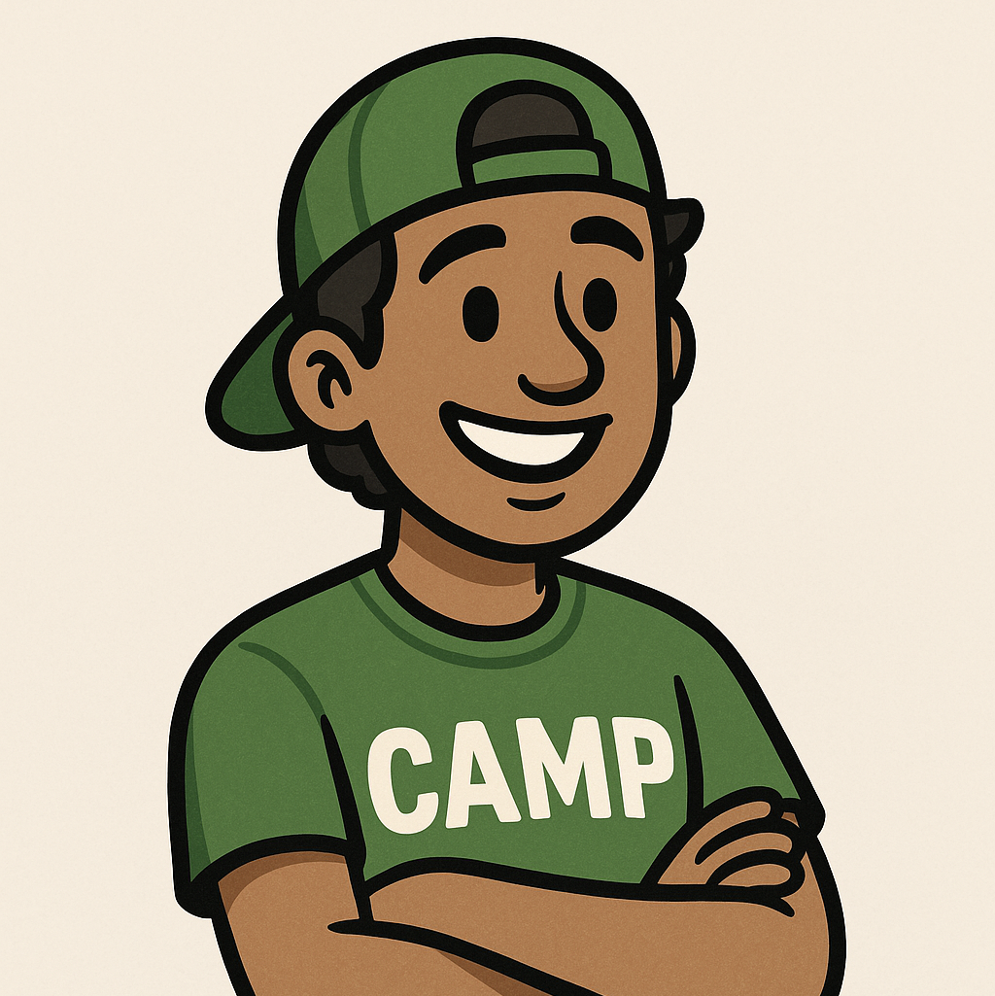

Slide 2

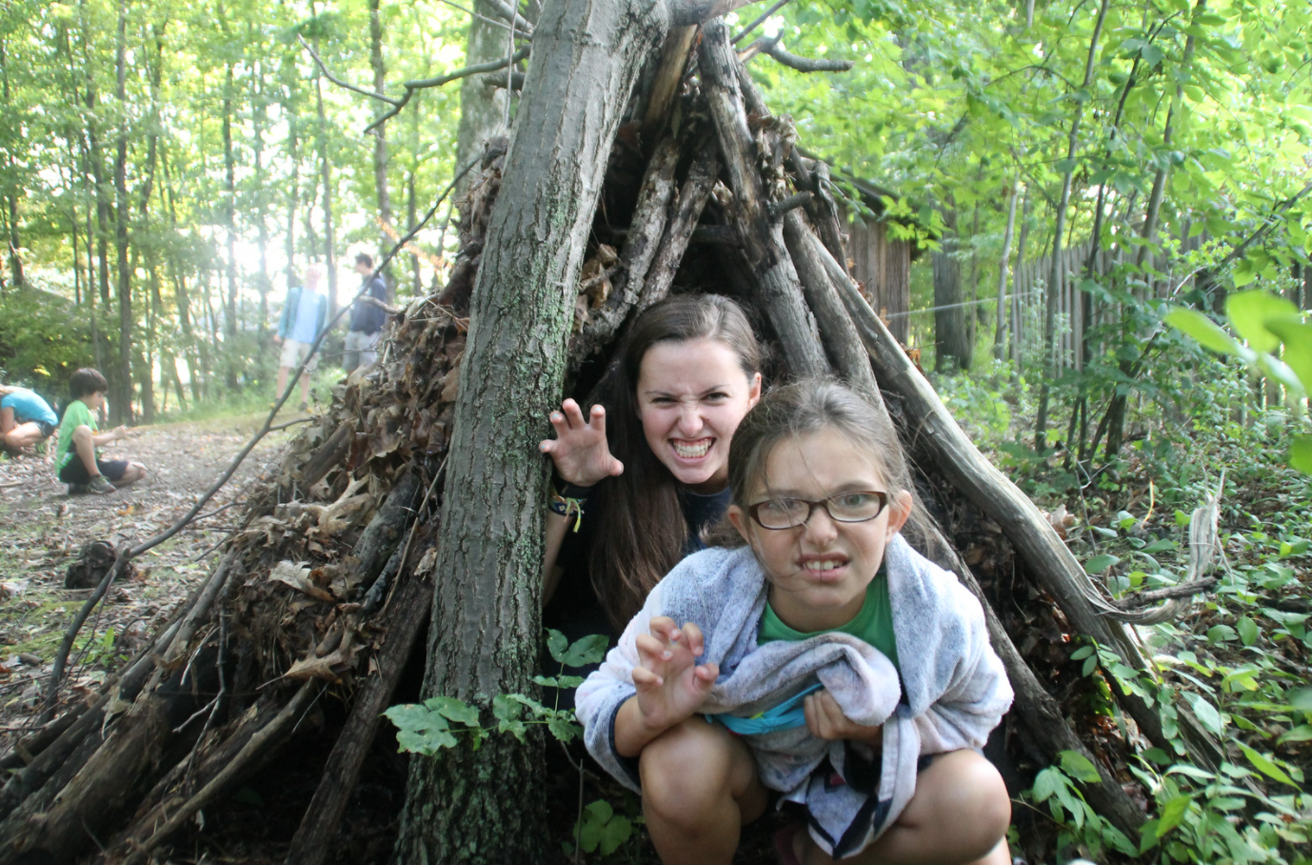
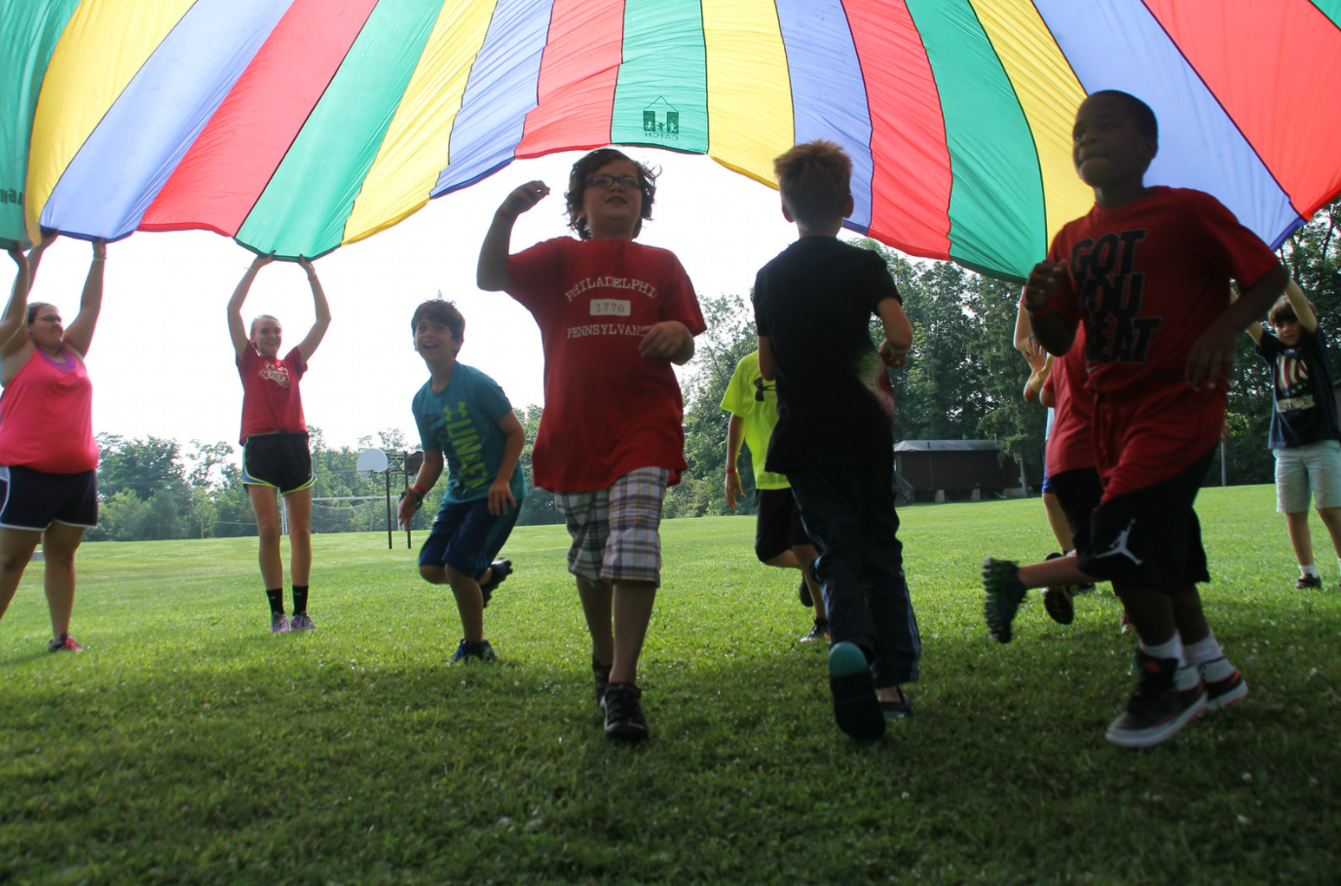
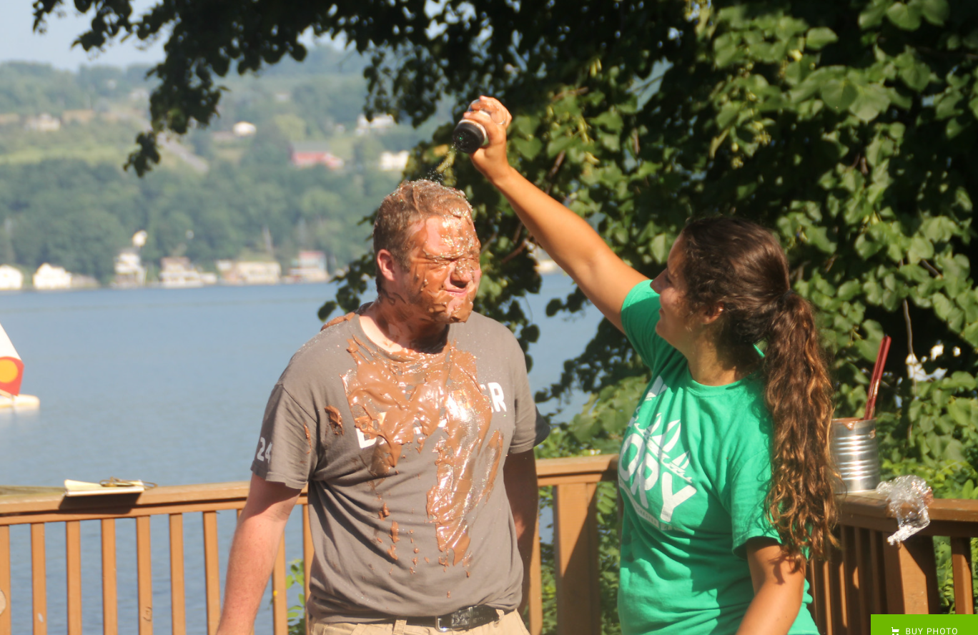
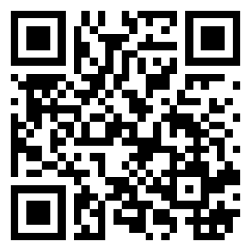
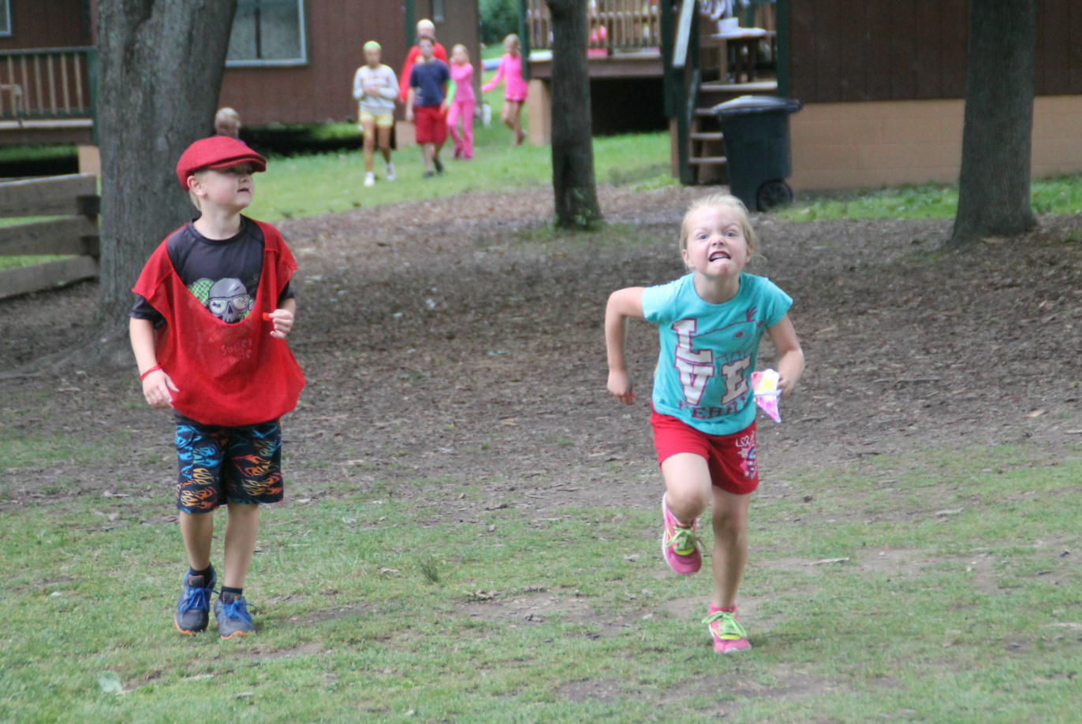
BUILDING ALUMNI ASSOCIATIONS
That Drive Engagement and Support
Dave Ghidiu
daveghidiu@gmail.com
Finger Lakes Community College
Aaron Proietti
proietti@gmail.com
Today’s Innovator
2ksummer.com
Notes:
https://unsplash.com/photos/nx3N6enkY_k
https://unsplash.com/photos/XMGaBN4fM58
https://unsplash.com/photos/w55SpMmoPgE
https://unsplash.com/photos/mGFJIUD9yiM
https://pixabay.com/vectors/movie-film-negative-cinema-146704/

Slide 3


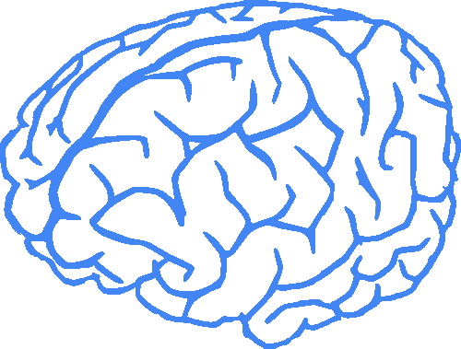
House Rules
P
x
Notes:
Descriptive, not prescriptive - meant to evoke ponder and wonder
No hands
Brain - https://pixabay.com/vectors/brain-human-anatomy-outline-25606/
Brain 2 - https://publicdomainvectors.org/en/free-clipart/Vector-clip-art-of-human-brain-in-2-colors/21877.html
Hand - https://iconscout.com/icon/hand-867
DNA - https://pixabay.com/vectors/gene-icon-genetics-icon-dna-icon-3184531/

Slide 4
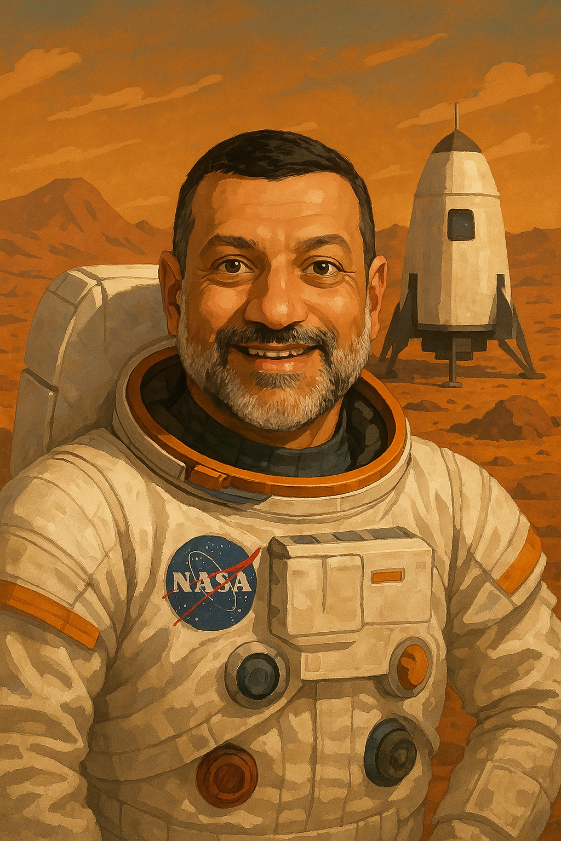
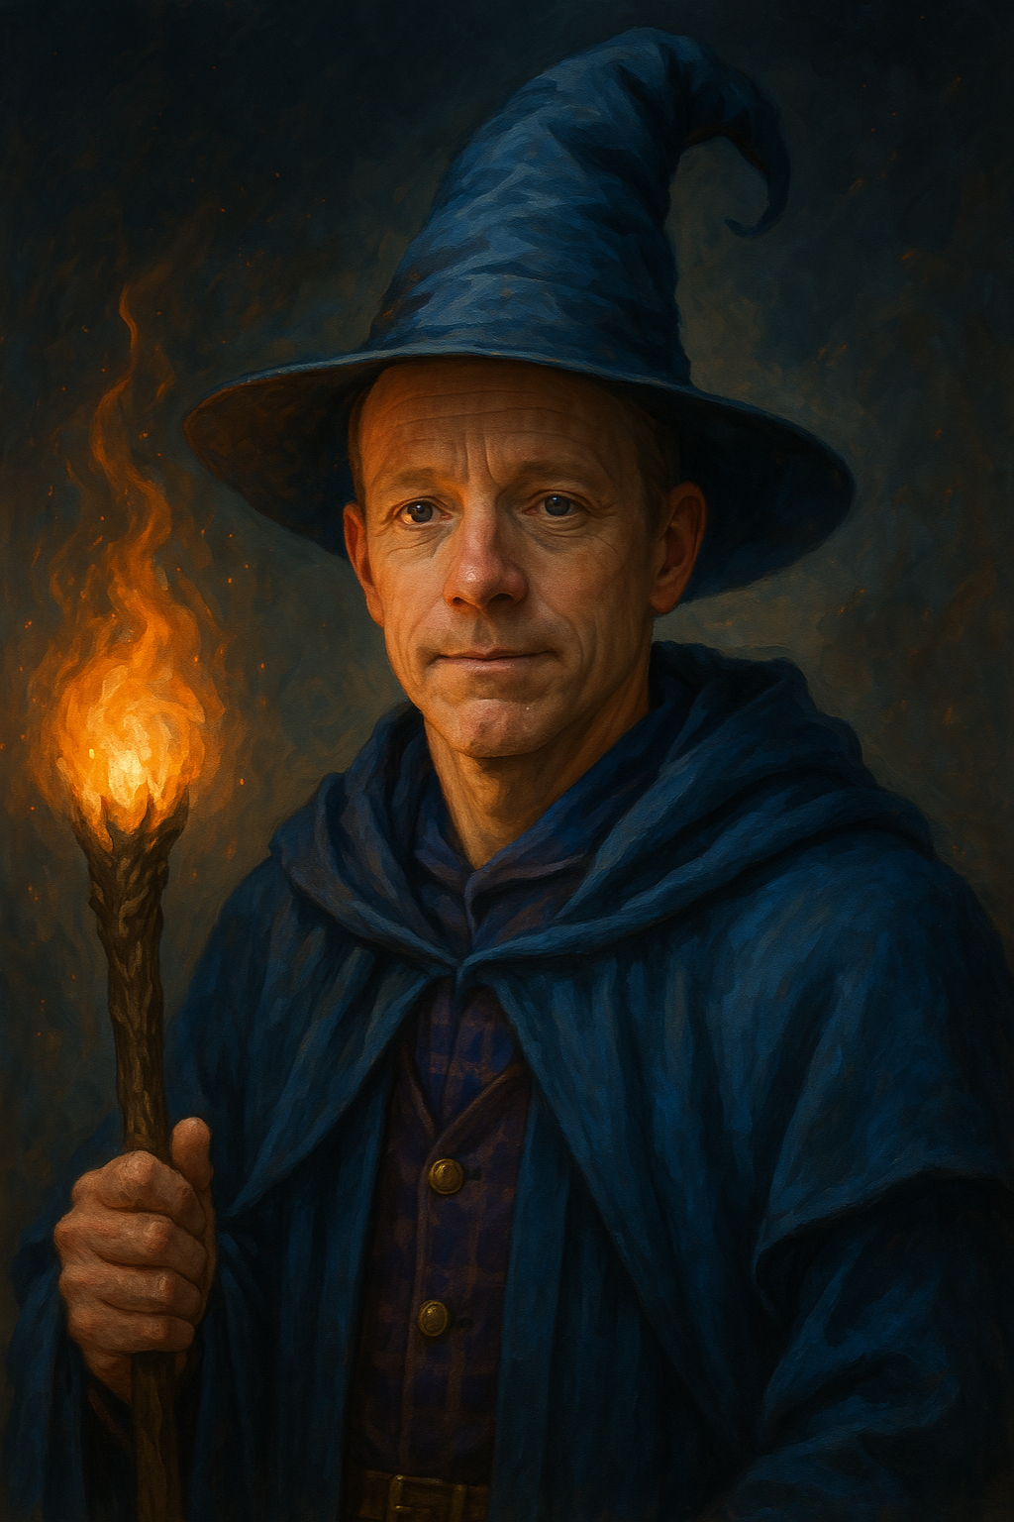
AARON DAVE

Slide 5
DISCUSSION OBJECTIVES
Why alumni associations matter and how they drive engagement/support.
Key insights into alumni behaviors and motivations for giving.
Practical strategies and ideas for building vibrant alumni networks.

Slide 6
How Alumni Associations Can Drive Real Support

Slide 7
IDENTITY
Alumni associations sustain identity over time.
The alumni association becomes a living memory bank—a way to preserve and activate that identity long after the summers end.
People support what they feel part of.
Notes:
AP

Slide 8
VOLUNTEERISM
Volunteerism is philanthropy.
When we treat alumni volunteerism with the same care and gratitude as monetary giving, we grow trust and deepen involvement.
Recognized volunteers become loyal champions.

Slide 9
BELONGING
Alumni want belonging before they want a donation form. One of the most common disconnects: alumni want connection, but camp leaders want contributions. Relationships come first.
Connection first, contribution follows naturally.

Slide 10
INNOVATION
Alumni associations thrive when they invite ideas, support, and leadership from outside the usual circle. Reaching out to less-involved alumni often uncovers new energy, skills, and perspectives.
Inclusion fuels innovation, engagement, and support.

Slide 11
Alumni Archetypes

Slide 12
The “Community Champion”
Key Traits
Highly invested in the camp’s culture and mission
Sees the alumni community as an extended family
Often volunteers, attends events, and actively leads initiatives
Motivations
Desire to preserve and pass on the camp’s legacy
Gains personal fulfillment from contributing and being recognized as a leader
Engagement Opportunities: Committee roles, event-planning tasks, encourage them to invite their networks, serve as ambassadors on social media, and champion campaigns

Slide 13
The “Nostalgic Lurker”
Key Traits
Fond memories of camp but limited day-to-day connection
Rarely engages with camp communications but still feels a warm sentimental attachment
Doesn’t immediately see how to get involved or why it matters
Motivations
Feels nostalgic about past experiences and friendships
Might engage around milestone anniversaries or reunion events
Personal Invitation: Direct outreach for a low-commitment opportunity, like a casual alumni meet-up or a digital “memory share.”
Notes:
DRG

Slide 14
The “Transactionally Engaged”
Key Traits
Willing to give financially or sponsor initiatives, but less interested in social or community-building aspects
Views support largely as a way to “give back” but expects clear results and acknowledgment
Motivations
Strong sense of loyalty but primarily sees involvement as a philanthropic act
Looks for measurable impact (e.g., scholarship funding, infrastructure improvements)
Tailored Communication: Offer meaningful recognition or updates about funded projects, so they see the ROI of their contributions
Notes:
DRG

Slide 15
The “Casual Connector”
Key Traits
Enjoys socializing and networking with other alums, but doesn’t want heavy responsibilities
Prefers fun, low-pressure events like happy hours, reunions, or online gatherings
Motivations
Stays engaged if the experience is enjoyable and convenient
Primarily driven by friendships and lighthearted social connections
Short-Term Volunteer Roles: Quick bursts of help (e.g., set-up for an event) rather than ongoing leadership
Notes:
DRG

Slide 16
The “Sporadic Superfan”
Key Traits
Periods of intense involvement (volunteering or donating) followed by lulls of limited engagement
Engagement spikes around certain times (e.g., personal life milestones, camp anniversaries)
Motivations
Emotional attachments triggered by specific life events or camp-related celebrations
Enjoys contributing when they feel personally connected, but may drop off when other life priorities arise
Invite at the Right Time, Offer the Right Fit: Use life or camp milestones to reconnect—and provide flexible ways to get involved.
Notes:
DRG

Slide 17
The “Detached Doubter”
Key Traits
Minimal sense of community affiliation; might question the camp’s current relevance or leadership
Often feels their camp experience is in the past and doesn’t see the ongoing value of staying connected
Motivations
May have had neutral or mixed experiences at camp, or simply moved on in life
Needs a strong reason to see how the alumni association benefits them or future campers
One-on-One Connection: A personal ask from a respected peer or staff member can break through skepticism
Notes:
DRG

Slide 18
The “Glory Days Guardian”
Key Traits
Minimal sense of community affiliation; might Deeply attached to their version of camp—usually from 20–40 years ago
Skeptical or openly critical of any changes to traditions, staff, programming, or facilities
Motivations
Strong identity tied to the past version of camp
Often feels like a protector of legacy—but can become a gatekeeper instead
Offer Low-Stakes Involvement: They may be unlikely to adapt, but they still care. Give them roles that tap into pride without requiring philosophical alignment—like sponsoring scholarships named after beloved former staff
Notes:
DRG

Slide 19
The “Embedded Alum”
Key Traits
Often overlooked as part of the alumni community because they’re “still around”
Balances respect for tradition with firsthand insight into what today’s campers need
Motivations
Committed to evolving camp for the next generation
Craves connection to alumni they look up to—staff they admired, legends they heard about, people who shaped camp’s legacy
Equip Them as Alumni Ambassadors: Support them in creating bridges—helping current staff identify as alumni and showing older alumni what camp has become.
Notes:
DRG

Slide 20
Show & Tell

Slide 21
DIGITAL ENGAGEMENT
Cory.camp website
Home for 100th artifacts
Cory News
March Madness Brackets
Cory-tine ❤
Cample
Virtual Programs
Social Media
www.2ksummer.com

Slide 22
OTHER ENGAGEMENT ACTIVITIES
History and Legacy Preservation
Alumni Visits
Reunion Design/Hosting
Holiday Parties
Summer Involvement (Training, Banquets, Checkout Table)
Volunteer Weekends
Staff Thank Yous
Awards and Recognition
www.2ksummer.com

Slide 23
ORGANIZATIONAL INFRASTRUCTURE
Behavioral Covenants
Governance/Association Charter
Open Association Meetings
Database Management
Gear Sales
www.2ksummer.com

Slide 24





SHOW & TELL
The camp database is not our database
If you are chasing down all campers, you might not be chasing a reality
We don't reach out to minors
ANYONE who has been at camp is an alumni
www.2ksummer.com
How do you work in tandem with an association (YMCA)?
We have monthly activities!
Interview alumni and write article about them!
ALUMNI WEEK at the end of the summer!

Slide 25
The Amazing Hawaiian Race • Art Heist • Asteroid Mining • Battleship • Bermuda Triangle • Biosphere • Camp Cory • Jeopardy • Carnival • Casino • Catch that Caveman • Civilizations • Clue • The Cory Classic • Cory Commando • Counselor Auction • Counselor Hunt • Crackerjack • Da Vinci Code • Dastardly Deeds • Dinner Party - Luau • Discovery of Fire • Do Automatons Dream of Electric Sheep • Dominate the Caribbean • Eco Challenge • Elf the Game • Enter the Machines • Escape from Temple Tikal • Escape from TX5000 • Espionage • Evil Amulet • Exodus from Africa • Fairytale Challenge • Family Feud • Find the Hollywood 10 • Fix the Master Harvester Master 39000 • Fix the Time Machine • The Flight to Neverland • Fortz • Fountain of Youths • Future War • Gamehenge • Gold Rush • Great Bear Hunt • Great Quest of the Elves • Gulliver's Travels • In the Shadow of the Colosseum • Insane Inventions • Iran-Contra Affair • The Island • Jaws • Journey of Lewis and Clark • Jungle Escape • Jungle Raid • Jurassic Game Hunters • Lord of the Rings • Lost City of Atlantis • Lost in Atlantis • Lost in the Renaissance • Mindbender • Murder Mystery Dinner • Musical Challenge • The Occupation Game • Proxy War • Quest for the Holy Grail • Raft Building • Raiders of the Lost Cup • Reef Escape • Robot Wrestling Match • Roman Civil War • Safari Tour • Save the Bearded Lady • Scavenger Hunt • Science Fair • Scramble for Africa • Security Clearance • Shipwrecked • Slay the Dragon, Save the Princess • Soccer Game • Spaceship Race • Staff Show • Survival • Talent Show • Temple Run Game • Tony Hawk, Pro Skater • Trojan Horse Hunt • Tuesday Down on the Bayou • US National Parks Scavenger Hunt • Viking Raiders • Vinland Bound, A historically accurate account • Wagons East • Wanted Dead or Alive • War for the Trees • Water Olympics • Where in the World? • Why, I could be a Star Now! • World Cup Soccer • World Dominion • XGames Challenge
2ksummer.com

Slide 26
Thank you
Please fill out the survey

Slide 27
BUILDING ALUMNI ASSOCIATIONS
That Drive Engagement and Support
Dave Ghidiu
daveghidiu@gmail.com
Finger Lakes Community College
Aaron Proietti
proietti@gmail.com
Today’s Innovator
2ksummer.com
Notes:
https://unsplash.com/photos/nx3N6enkY_k
https://unsplash.com/photos/XMGaBN4fM58
https://unsplash.com/photos/w55SpMmoPgE
https://unsplash.com/photos/mGFJIUD9yiM
https://pixabay.com/vectors/movie-film-negative-cinema-146704/

