Slide 1
FLORAL ATMOSPHERIC
Presentation Template
www.freepptbackgrounds.net

Slide 2
CONTENTS
1
3
Accept
Add
2
4
Advertisement
Advise

Slide 3
1
ACCEPT

Slide 4
Accept
Fixing Fixture
A complex idea can be conveyed with just a single still image, namely making it possible to absorb large amounts of data quickly.
Authorize
I hope and I believe that this Template will your Time,
Ultimate Time
Show and explain your web
Approve
A complex idea can be conveyed with just a single
Bill
Show and explain your web

Slide 5
Accept
01
Show and explain your web, app or software projects using these
02
I hope and I believe that this Template will your Time
03
Easy to change colors, photos and Text.
04
Show and explain your web, app or software projects using these
05
I hope and I believe that this Template will your Time

Slide 6
Accept
Approve
You will get a
copy of this
document on
Apply
Easy to change
, photos and Text.
Agenda
Click on the button
under the
presentation
Advise
Easy to change
, photos and Text.
01
02
03
04

Slide 7
Accept
Basic
You will get a copy of this document on your Google Drive and will be able to edit, add or delete slides.
Semi-Pro
You have to be signed in to your Google account.
Professional
You will get a copy of this document on your Google Drive and will be able to edit, add or delete slides.
Enthusiast
You have to be signed in to your Google account..
$500
$1000
$1500
$2500

Slide 8
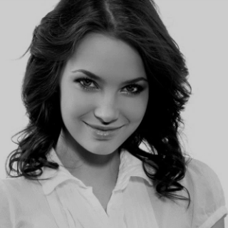
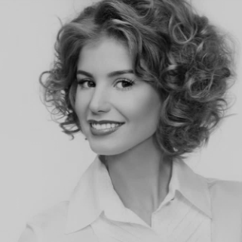
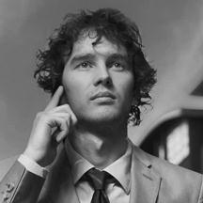
Accept
Julian Herpina
Derpina Herpington
CEO
Chief Editor
Google account. in PowerPoint. Remember to download and install the fonts used in this
Add or delete slides. You have to be signed in to your
Derp Herpington
Julian Derpington
Executive Manager
Sales Manager
Google account. in PowerPoint. Remember to download and install the fonts used in this
Is the color of gold, butter and ripe lemons. In the spectrum of visible light, yellow is found between green and orange.

Slide 9
2
ADD

Slide 10
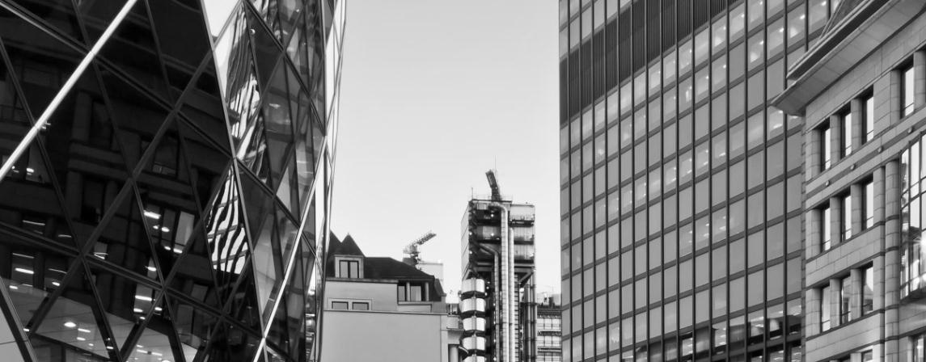
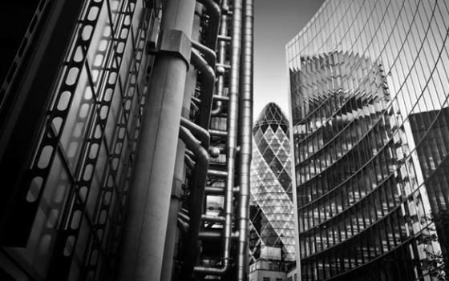
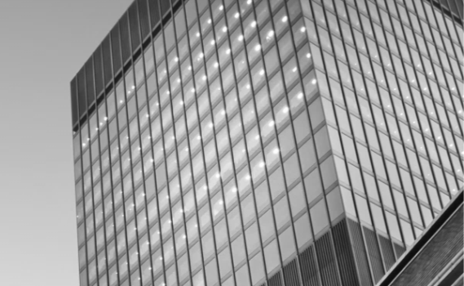
Add
Add or delete slides. You have to be signed in to your Google account. in PowerPoint. Remember to download and install the fonts used in this presentation (you’ll find the links to the font files needed in the Presentation design slide)
Super Project 01
Super company
We use well-known development methodologies

Slide 11
Add
01
02
03
04
Buy
Budget
Brand
Bill
This allows us to achieve high quality outcomes and full transparency towards.
In the spectrum of visible light, yellow is found between green and orange.
This allows us to achieve high quality outcomes and full transparency towards.
In the spectrum of visible light, yellow is found between green and orange.

Slide 12
Add
Certification
01
02
Calculate
This allows us to achieve high quality outcomes and full transparency towards.
We use well-known development methodologies to create a customized approach for each of the projects.
Choose
03
04
Cancel
We use well-known development methodologies to create a customized approach for each of the projects.
This allows us to achieve high quality outcomes and full transparency towards.

Slide 13
Add
Moving from creative ideas to
We press play on your digital story.
Commissi
Confirm
Customer
Date
We press play on your digital story.
Moving from creative ideas to solid

Slide 14
Add
1Simple & Smooth, exactly how purchasing experiences should be. We align with your users need to build and evolve
2. Your audience relate and absorb information on different sensory levels.
48%
65%
3The user can demonstrate on a projector or computer, or print the presentation and make it into a film to be used in a wider field. Using PowerPoint
27%
12%

Slide 15
3
ADVERTISEMENT

Slide 16
Advertisement
Portfolio II
The user can make a presentation on a projector or computer, or print out the presentation to make a film. The user can make a presentation on a projector or computer
Portfolio IV
The user can demonstrate on a projector or computer, or print the presentation and make it into a film to be used in a wider field. Using PowerPoint
Portfolio I
The user can demonstrate on a projector or computer, or print the presentation and make it into a film to be used in a wider field. Using PowerPoint
Portfolio III
Enter the comprehensive description of the above chart here, enter the comprehensive description of the above chart here
Portfolio V
The user can make a presentation on a projector or computer, or print out the presentation to make a film. The user can make a presentation on a projector or computer
Your audience relate and absorb information on different sensory levels. We know visual stories are amplified with the right words. Sometimes it's easier to go old school, our copywriters prefer a good ball.

Slide 17
Advertisement
Description
Decision
We certainly do not forget you as soon as you forget us. It is, perhaps, our fate
It is a very sad thing that nowadays there is so little useless information.
Department
Decide
We cannot help ourselves. We live at home, quiet, confined, and our feelings prey upon us.
We cannot help ourselves. We live at home, quiet, confined, and our feelings prey upon us.
Deliver
Deadline
It is a very sad thing that nowadays there is so little useless information.
We certainly do not forget you as soon as you forget us. It is, perhaps, our fate

Slide 18
Advertisement
+
+
=
Dispatch
Dismiss
Difference
Develop
You are forced on exertion. You have always a profession, pursuits, business of some sort or other, to
I believe that people would be alive today if there were a death penalty. Nancy Reagan
You are forced on exertion. You have always a profession, pursuits, business of some sort or other, to
I believe that people would be alive today if there were a death penalty. Nancy Reagan

Slide 19
Advertisement
Exchange
Employ
The time is now, the place is here. Stay in the present.
All the privilege I claim for my own sex (it is not a very enviable one; you need not covet it)
Equipment
Education
I believe that people would be alive today if there were a death penalty. Nancy Reagan
The time is now, the place is here. Stay in the present.
Encourage
Distribute
All the privilege I claim for my own sex (it is not a very enviable one; you need not covet it)
I believe that people would be alive today if there were a death penalty. Nancy Reagan

Slide 20
Advertisement
Fix
Feedback
I feel very strongly that change is good because it stirs up the system. Ann Richards
Genius hath electric power which earth can never tame. Lydia M. Child
2001
2005
2010
2015
2020
Facilities
Explanation
Experience
Genius hath electric power which earth can never tame. Lydia M. Child
I feel very strongly that change is good because it stirs up the system. Ann Richards
A large income is the best recipe for happiness I ever heard of.

Slide 21
4
ADVISE

Slide 22
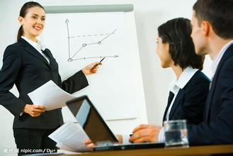
Advertisement
G
Goal
H
Hearing
Woe be to him that reads but one book.
A large income is the best recipe for happiness I ever heard of.
G
Growth
F
Fund
Woe be to him that reads but one book.
A large income is the best recipe for happiness I ever heard of.

Slide 23
Advertisement
Install
Inform
Enjoy the little things in life, because one day you will look back and realize they were the big things.
Woe be to him that reads but one book. George Herbert
Industry
Woe be to him that reads but one book. George Herbert
Enjoy the little things in life, because one day you will look back and realize they were the big
Increase
Improve

Slide 24
Advertisement
Inventory
Everyone wants, happiness. No one wants pain. But you can’t have a rainbow without
Invoice
Instructions
God sometimes removes people from your life to protect you. Do not run after them.
God sometimes removes people from your life to protect you. Do not run after them.

Slide 25
Advertisement
Tech
Always give your best never
worry for results.
Startup
Be an encourager, the
world has enough critics already.
Knowledge
Be an encourager, the world
has enough critics already.
Join
Always give your best never
worry for results

Slide 26
Advertisement
Energy
Education
Be an encourager, the world has enough critics already.
Always give your best never worry for results.
Fashion
Public
Always give your best never worry for results.
Be an encourager, the world has enough critics already.
Finance
NGO
Always give your best never worry for results.
Always give your best never worry for results.

Slide 27
THANK YOU !
Floral Atmospheric PTT Backgrounds
www.freepptbackgrounds.net

