Slide 1


Crisis Prevention and De-Escalation
Created by the CCR and SPED Departments’
Behavior Teams
Notes:
Time: 30s
Objective: Title Slide to introduce the PL
Talking Points:
This PL comes from a collaboration of the CCR and SPED departments to have cohesive district wide message.

Slide 2
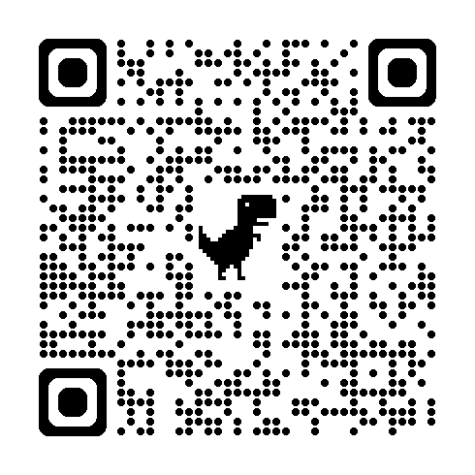
Please Scan the QR Code and Complete the Form to Record Your Session Attendance

Slide 3


Objectives
Evaluate our mindset
Identify crisis behaviors
Analyze the crisis cycle
Understand how to prevent and de-escalate crisis
Notes:
Time: 1 minute
Objective: Introduce the objectives of the PL
Talking Points:
Our goal by the end of this professional learning opportunity is for you to:
Evaluate our mindset when it comes to students in crisis
Identify what crisis behaviors can look like
We will analyze the crisis cycle at each stage and what we do as staff to respond
And we will dive deeper into understanding how to prevent and de-escalate crisis

Slide 4
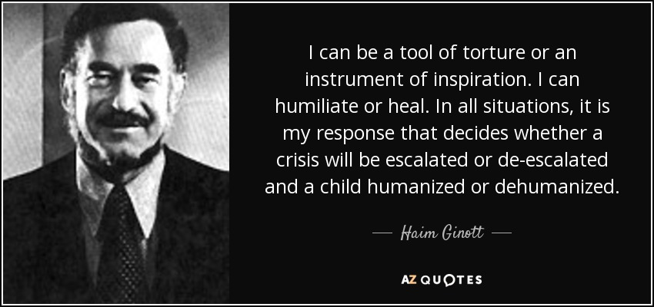

Shared Norms and Mindset
Meeting Norms
Be on time and prepared
Stay engaged
Growth Mindset
Notes:
Time: 2 Minutes
Objective: Set the norms and mindset for the PL
Talking Points:
Go over the meeting norms.
What do we mean when we say growth mindset?
Fixed vs Growth Mindset with our students
A fixed mindset is when you assumes that the student knows what is right and is choosing not to do it
A growth mindset is when you understand that the student may have the need for further instruction and support
Some questions to keep in mind throughout the training:
Think about what your WHY is. What drives you as an educator?
How do you approach your day?
What are your assumptions about student behavior?
What is your biggest mindset barrier?
Ask a participant to read the quote and then ask another participant to explain what that means to them in the context of their classroom.

Slide 5

Crisis Behaviors
Notes:
Time: 30s
Objective: Introduce the section on crisis behaviors
Talking Points:
In this section we will define behavior and what crisis behaviors can look like.

Slide 6
What is Behavior?
Behavior is communication
Behavior is learned
Any behavior that occurs repeatedly is serving some function for the individual
Behavior can be changed
Notes:
Time: 3 minutes
Objective: Define behavior
Talking Points:
Behavior is communication and communication is a basic need all people have. If a person can’t communicate what they want and/or need, behaviors are developed to ensure that those needs are met. These behaviors have been reinforced and taught the person that the behavior will get them what they want.
There are four basic functions of behavior that are utilized by behavior experts and are researched based. These include escape/avoid, attention, tangible or access, and automatic reinforcement or sensory stimulation. Finally, because behavior is functional, it can be taught and changed.
We want to point out that there is no “power and control”, because it is not a research based function of behavior, but rather, power and control is something a person does/uses in order to get or avoid something. It is part of the behavior, not the function.
We want to focus more energy on encouraging responsible (desired) behavior rather than on trying to reduce inappropriate behavior

Slide 7
Types of Challenging Behaviors
Internalizing
Socially withdrawn
Reluctant to participate
Shy or anxious
Externalizing
Disruptive
Aggressive
Defiant
Notes:
Time: 1 Minute
Objective: Identify what challenging behaviors are and that they can be in control showing these behaviors
Talking Points:
Internalizing Behaviors
These behaviors are directed inwards and can be more difficult to detect initially.
Examples include social withdrawal, reluctance to participate, excessive shyness or anxiety.
Students may appear sad, overwhelmed, have rapid mood changes or cry easily.
Internalizing behaviors can indicate underlying depression, trauma or other mental health concerns.
Be aware of changes in typical behavior like declining academic performance, missed assignments, excessive absences.
Don't overlook these "quiet" behaviors as they can escalate to more severe internalizing issues.
Externalizing Behaviors
These behaviors are directed outwardly towards the external environment.
May present as disruptive, defiant, aggressive, impulsive or hyperactive behaviors.
Examples: talking out, not following instructions, destroying property, verbal/physical aggression.
Externalizing behaviors are often more visible and demand immediate attention/intervention.
However, they can be a expression of underlying needs, traumas or skill deficits.
Without proper support, they can intensify and lead to disciplinary issues or safety risks.

Slide 8
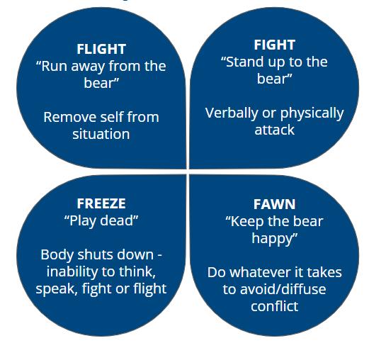
The Trauma Response
Externalizing→
←Internalizing
Schmidt NB, Richey JA, Zvolensky MJ, Maner JK. Exploring human freeze responses to a threat stressor. J Behav Ther Exp Psychiatry. 2008 Sep;39(3):292-304. doi: 10.1016/j.jbtep.2007.08.002. Epub 2007 Aug 12. PMID: 17880916; PMCID: PMC2489204.
Notes:
Time: 2 Minutes
Objective: Discuss the relationship between trauma and crisis
Talking Points:
Trauma and the Crisis Cycle:
Students who have experienced trauma, whether from abuse, neglect, violence, or other adverse childhood experiences, are more susceptible to exhibiting crisis reactions.
Trauma can dysregulate the brain's stress response system, making someone more likely to perceive threats and react with intense fight, flight, freeze, or fawn behaviors.
Traumatic events can become encoded in the brain and body, causing triggers that re-activate the trauma response even in seemingly minor situations.
Fight/Flight Connections:
Students with trauma histories may have a overactive fight-or-flight response, reacting aggressively or impulsively fleeing at the slightest signal of potential danger or stress.
This hypervigilance stems from their brain and body being on high alert, primed to protect itself from perceived threats.
Freeze Response:
The freeze response can be especially prevalent for students who have experienced complex trauma or repeated traumatic events.
Freezing up and dissociating from reality may have been an essential coping mechanism to survive trauma in the past.
This disconnection from the present moment can persist long after the trauma has ceased.
Fawn Response:
Children in abusive or unpredictable home environments may develop an excessive fawning response to placate potential threats.
Doing whatever it takes to keep an abuser "happy" becomes an automatic survival strategy.
This learned people-pleasing carries over and manifests as excessive eagerness to obey or diffuse any conflicts.
It's critical for educators to have trauma-informed practices that recognize how trauma impacts student behaviors and crisis responses. Providing a predictable environment, clear expectations, calming strategies, and connecting students to your social workers and counselors can help prevent and de-escalate crisis cycles rooted in trauma.

Slide 9
When Challenging Behaviors Turn into a Crisis
Dysregulation
Out of control of their bodies and their actions
Student’s are in the ‘Red Zone’
Notes:
Time: 1 Minute
Objective: Identify what crisis behaviors could look like
Talking Points:
It's crucial to have systems to identify students exhibiting internalizing or externalizing crisis behaviors early. Refer to appropriate behavioral interventions, such as counseling, wraparound supports or other resources to de-escalate crises and address root causes proactively.

Slide 10
Questions to Ask Yourself
Is it skill or will?
Notes:
Time: 1 minute
Objective: Have participants reflect on questions to keep in mind working with a student in crisis or with challenging behavior
Talking Points:
When our students do not know the expectation, then they will engage in unexpected behaviors.
Also encouraging educators to think about a student’s morning, a student’s home life and what they are coming from. They may not have been taught the simplest of behaviors or “manners” those are things we can be sensitive to and help train and teach the student to engage in more prosocial and life skills

Slide 11
Setting Event is used to describe the events that momentarily change the value of reinforcers and punishers in a student's life.
The events that students experience as reinforcing and punishing are always changing based on both the presence and absence of many different environmental and social situations.
ABCs and Setting Events
Antecedent
What happened before the behavior?
Behavior
What was the behavior?
Consequence
What was the result of the behavior?
Let’s think of some instances where setting events have impacted our behavior.
Notes:
Time: 2 min
Objective: Emphasize the setting event in the ABC’s
Talking Points: Some students come to school elevated or already in crisis, make sure we are preparing for that and planning for quick re-escalation - make sure the student’s needs are met.

Slide 12


Setting Events
Setting Event
Changed Student Behavior
Setting Event:
Let’s think of some instances where setting events have impacted our behavior.
Notes:
Time: 2 minutes
Objective: Identifying Setting Events
Talking Points: Can you think of instances where setting events have impacted your own behavior? Have them share out. Some examples are below:
Headache
Traffic in the morning
Not taking medication
Did not sleep that night
Forgot your morning coffee

Slide 13
Questions to Ask Yourself
Is it skill or will?
Is it environmental or is it an individual student issue?
Notes:
Time: 1 minute
Objective: Have participants reflect on questions to keep in mind working with a student in crisis or with challenging behavior
Talking Points:
When our students do not know the expectation, then they will engage in unexpected behaviors.
Also encouraging educators to think about a student’s morning, a student’s home life and what they are coming from. They may not have been taught the simplest of behaviors or “manners” those are things we can be sensitive to and help train and teach the student to engage in more prosocial and life skills

Slide 14
Classroom Setup
Classroom Management
Environmental Setup
Preventative Measures
Interpersonal relationships
PBIS
Educator Handbook
Are other students showing this behavior?
Notes:
Time: 2 min
Objective: Emphasize the classroom setup and how the classroom runs can affect behaviors
Talking Points:
Does your classroom invite positive behaviors ?
Do you have expectations posted and review them frequently ?
What do you do for preventative measures in your classroom to prevent these challenging behaviors?
What do the relationships look like in your classroom? Between you and the student or between the students?
Are other students showing this behavior? Is it just one student or is it something you need to change for multiple students?

Slide 15
Questions to Ask Yourself
How am I responding to the behavior?
Notes:
Time: 1 minute
Objective: Have participants reflect on questions to keep in mind working with a student in crisis or with challenging behavior
Talking Points:
When our students do not know the expectation, then they will engage in unexpected behaviors.
Also encouraging educators to think about a student’s morning, a student’s home life and what they are coming from. They may not have been taught the simplest of behaviors or “manners” those are things we can be sensitive to and help train and teach the student to engage in more prosocial and life skills

Slide 16
Our Student’s Mindset
Behavior communicates that a need is not being met. What is your student seeking?
When we know what our students are seeking then we can tailor our interventions and support to what drives the student – The Function!
Think of a student who isn’t your toughest but is starting to struggle.
What do you think they are they seeking?
Connection?
Confidence?
Regulation?
3 R’s
Relationship
Meaningful connection
Responsibility
Sense of self-worth, efficacy, and competence
Regulation
Take in stimuli and manage emotional and behavioral responses
Souers, K., & Hall, P. A. (2019). Relationship, responsibility, and regulation: Trauma-invested practices for Fostering Resilient Learners. ASCD.
Notes:
Time: 3 min
Objective: Understanding mindset
Talking Points:
Behavior is communication. Challenging behavior communicates a need that is not being met.We need to take in account what’s our student’s mindset and when they are exhibiting challenging behavior, what are they seeking?
There are 3 R’s that students seek. Relationship - They are seeking meaningful connection, Responsibility - They are seeking a sense of self-worth, efficacy and competence, and Regulation - They are seeking stimuli to support managing their emotional and behavioral responses.
Taking in account the 3R’s and figuring out what the student is seeking can help us tailor our interventions to support the student getting their needs met.
Often times when presented with challenging behaviors, we create plans that have a multitude of interventions, but it’s important to be mindful of what the student needs to make sure the interventions are tailored to them.
For example: If a student is seeking a meaningful connection, does providing with breaks meet that need? Breaks would separate the student from others and therefore not targeting what the student is seeking.
Take a moment to think about a student you’ve had in class that exhibited challenging behaviors. What do you think they are seeking?

Slide 17
How We View Our Students
Switching from using their weaknesses to define them to using their strengths to support them.
Strength-Base Model
Restorying Students
Reframing perceived deficits as strengths.
Valuing Student
Differences
Embrace another's difference so they can lean into their strengths and talents – Learn and grow from each other.
Rufo, Jenna M. & Causton, J., (2022), Reimagining Special Education: Using Inclusion Framework to Build Equity and Support All Students. Brooks Publishing.
Notes:
Time: 8 min
Objective: Shifting our view of students
Talking Points:
When working with our students we have to shift how we view them, especially students with challenging behaviors and academic challenges. We must remember that kids do well if they can.
We can shift our view of our students by using a Strength-Based Model, Restorying Students, and Valuing Student Differences.
The Strength-Based Model - For students with challenging behavior, they spend the majority of their days being corrected to do what is “right”. We miss out on many opportunities to give them a change to nurture talents and skills. Carving out time an space to help students develop and build upon what they are interested in and good at. This helps you to approach students with love and respect, and it helps you build their confidence so that they feel successful and confident in school. For many students, this may be a first. We have to shift our view from only focusing on the challenging behavior to creating positive student profile. This profile should be used to create new ways and opportunities for the student to build on their stretches and interests allowing them to feel successful and connected in your classroom community.
Restorying Students involves taking in what we know about the student and changing the way we view it. For example: a student continually lashes out during ELA. She has a specific learning disability in reading and is an english language learner. We can take this information to restory her challenging behavior as communication. We can restory this student by noting the following: They don’t feel confident in their reading skills. They don’t know who to ask for or doesn’t have the opportunity to to access accommodations. She doesn’t feel like she can succeed in ELA and that she doesn’t belong. Our story about the student shifts from “the student uses behavior to get out of work” to understanding that she is communicating a need for success, connection, and belonging.
Valuing Student Differences is key to building a safe and supportive learning environment for all students. As students notice something different about a peer, they become curious about the their peer’s difference. If we ware building a safe and supportive learning environment, we support our students in learning what the difference means for how to engage and connect with their peer. In turn, students embrace their peer and their differences. The same goes for us as educators.
When we shift our thinking about students, it changes the way that we view them and it’s often in a more positive light and can helps us approach them in a more supportive manner.

Slide 18

Power Struggles
Notes:
Time: 2 min
Objective: Introduce Power Struggles
Talking Points:
How many of you have engaged in a conversation like this with a student? A family member?
When we engage in conversation around a challenging behavior, no one wins. Spoiler Alert: Despite Kevin wishing his family away, in the end, they miss each other and are happy to be back together.
It’s best to utilize strategies to avoid power struggles. If we avoid them, we are more likely to de-escalate the situation and avoid challenging behavior becoming more intense.

Slide 19
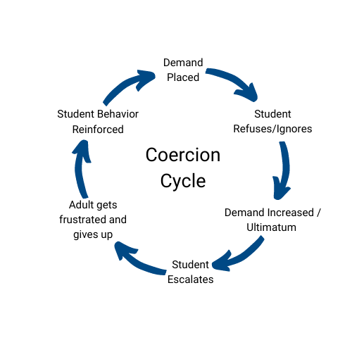
Coercion Cycle
(A.K.A Power Struggles)
Disengaging Tactics
Interrupting Tactics
De-Escalation Tactics
Notes:
Time:
Objective:
Talking Points:
Coercion cycles AKA Power struggles
Disengaging Tactics
Use brief, simple stress-reduction technique before responding
Respond in a neutral manner
Be Brief
Avoid reacting in a confrontational manner
Interrupting Tactics
Divert the student’s attention
Remove the student from the setting
Allow the student a cool down
Paraphrase their essential points of concern
Ask open-ended questions to better help understand
What happened?
How did this make you feel?
Avoid Why
De-Escalation Tactics
Replace negative words in teacher requests with positive words
Use non-verbal strategies
Acknowledge that the student is in control - they can make their behavioral choices
Understand pos and neg consequences
Offer a face-saving opportunity
How can we work this out?
Use humor - Use caution!
Label the emotion
Prompts the student to the core feeling
Consider what are they communicating?
Using behavior to convey a message

Slide 20
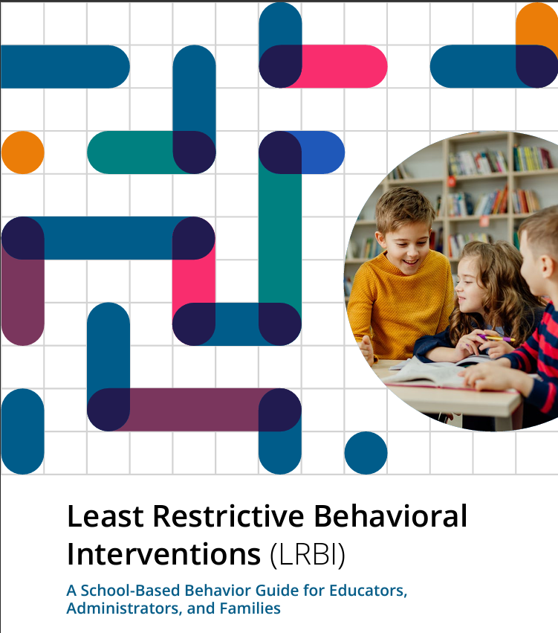
The Crisis Cycle
USBE LRBI
Notes:
Time: 1 Minute
Objective: Disclaimer on this information all comes from the LRBI
Talking Points:
The information in this portion of the training comes from the Least Restrictive Behavioral Interventions (LRBI) Technical Assistance Manual released from the Utah State Board of Education (USBE) in 2023. It is a guide and support for ALL teachers. You can find the manual on their website schools.utah.gov. The section covered throughout these modules is found in Chapter 7, pages 158 - 172.

Slide 21
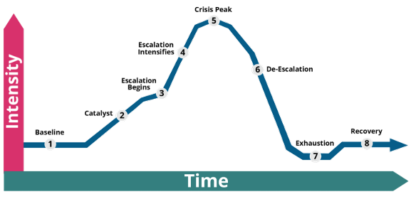
The Crisis Cycle
Notes:
Time: 5 Minutes
Objective: Identify the different section of the crisis cycle
Talking Points:
The crisis cycle is a model of how an individual responds to acute distress. Acute distress may be caused by many different sorts of circumstances, such as one highly stressful event, one or more moderately stressful events, one or more ongoing stressful events, or some combination of these circumstances. Each phase in the crisis cycle is distinct and predictable, although the exact behaviors present in each phase will vary from one individual to the next. The appropriate response from staff will change based on the individual’s phase, so it’s critical that staff involved in supporting a student in a crisis are all trained in the crisis cycle and can recognize each phase when it occurs.
The crisis cycle is based on time and intensity. Each of these variables will differ from student to student.
The first portion of the crisis cycle is baseline, this will be the typical behaviors seen day to day for this student.
The next portion is the catalyst, where something has occurred to trigger the student into the behavioral crisis cycle.
In an early intervention does not prevent further progress into the crisis cycle, the student will begin escalating.
Student may then intensifying their behaviors before they enter the crisis peak. Escalation can be successfully interrupted with the right response from staff, causing the individual to move across to the de-escalation side of the cycle.
The crisis peak is when safety is highest priority and must be supported before de-escalation can begin.
Interfering with the process of de-escalation can cause the individual to move back to the escalation side of the cycle and begin re-escalating.
After the student has successfully de-escalated, they may be physically and emotionally drained causing exhaustion.
The crisis cycle does not end until the individual has fully de-escalated and recovered—a process which takes time and patience even under ideal circumstances. An individual in the crisis cycle should never be pressured to de-escalate quickly as this will lead to re-escalation.
Now let us look at what behaviors can look like during each phase and the appropriate adult response.

Slide 22
Crisis Cycle and Adult Response Activity
Get into groups of 3-4
On the next slide, take the next 10 minutes to put together the crisis cycle
We will then debrief the correct order
Notes:
Time: 15 Minutes
Objective: Engage in an activity to understand the components of the crisis cycle
Talking Points: Read through and follow the slide

Slide 23
The Crisis Cycle
Crisis Cycle Terms:
Baseline, Catalyst, Escalation Begins, Escalation Intensifies, Crisis Peak, De-Escalation, Exhaustion, Recovery
Notes:
Time: 15 Minutes
Objective: Identify the different section of the crisis cycle
Talking Points:
Have teams fill in the correct terms to the crisis cycle and discuss in groups. The Crisis Cycle Terms are listed below on the slide

Slide 24

Prevention Strategies
Notes:
Time: 3 Minutes
Objective: Set up the section on preventions strategies
Talking Points:
Effective prevention work involves building the skills of students and staff to create the sort of learning environment in which a crisis is unlikely.
Previous chapters have discussed several important preventive strategies that reduce the likelihood of a crisis, including social and emotional learning practices, restorative practices, and trauma-informed practices.
To build students’ skills, teachers should use awareness of student characteristics (e.g., strengths, needs, behavioral antecedents, home environment) to design instruction and other elements of classroom management; to build staff skills, administrators should use awareness of staff needs to inform professional learning. Teachers should also consider proactively teaching students skills they may benefit from using in a stressful situation (e.g., deep breathing).
This allows teachers to remind students to use their skills during times of stress, which may prevent a student from escalating to higher phases of the crisis cycle or even prevent them from entering the crisis cycle in the first place. Classroom management is also a vital part of crisis prevention.
Teaching and reteaching expectations, rules, and procedures can help students feel a sense of safety and mastery in their learning environment.

Slide 25
The Crisis Cycle
Notes:
Time: 2 Minutes
Objective:
Talking Points:

Slide 26
Strategies for Prevention
Supporting students in regulation strategies can include:
Deep breathing
Mindfulness
Progressive muscle relaxation
Requesting/Taking a break in the classroom
Staff should become aware of their own triggers for dysregulation
pbis.org/resource/strategies-for-de-escalating-student-behavior-in-the-classroom.
Notes:
Time: 1 minute
Objective: Identify strategies for prevention
Talking Points:
For Students:
Regulation strategies can include deep breathing, mindfulness, progressive muscle relaxation, and requesting/taking a break in the classroom.
Emotional scales, such as a 0-10 “feelings thermometer,” can be used to teach students to rate their feelings/ stress/anxiety and prompt coping and relaxation strategies.
For Staff:
Become aware of your own triggers for dysregulation.
Use self-prompting strategies (e.g., visual reminders, timers) to prompt regular use of regulation strategies.
Teacher resources: Habits of Effective Classroom Practice; Don’t Discipline Hangry: 3 Steps to a Better Classroom (see resources page)

Slide 27
The Crisis Cycle
Notes:
Time: 2 Minutes
Objective:
Talking Points:

Slide 28
Strategies for Redirection
Choice
“You can complete the worksheet independently or with a partner. Which would you prefer?”
Re-direction
“Andy, try starting on the second section and come back to that one.”
Co-Regulation
“Rosa, I want to make sure you are okay. I see that you are angry because your face is red, and your fists are clenched. When I feel angry, I like to take three deep breaths and count to 10. Watch me and we can do it together.”
Prompt Regulation Routines
“Would it help to use your 4-square breathing?”
pbis.org/resource/strategies-for-de-escalating-student-behavior-in-the-classroom.
Notes:
Time: 2 minutes
Objective: Identify strategies for redirection
Talking Points:
Some of these strategies are second nature for some educators - focus on prevention! PBIS etc.
While prevention is essential, proactive approaches and strategies are not always successful in preventing escalation.
When challenging behaviors persist, disrupt the learning environment, and increase in intensity, we call this the escalation phase.
Students can display escalating behaviors during agitation and/or acceleration phases of escalation.
Agitation occurs when a student presents challenging behavior that is slightly elevated in intensity, such as persistent talking out of turn after being given a verbal reminder, wandering the classroom during instruction, or making inappropriate comments to peers.
As always, educators monitor their use of redirection strategies to ensure they (a) quickly fade the use of redirection by enhancing prevention approaches (e.g., prompt student to use regulation strategy before entering a challenging routine) and (b) avoid accidental reinforcement (e.g., inadvertently increasing escalated behavior by regularly providing attention during escalation).

Slide 29

De-Escalation Strategies
Notes:
Time: 1 Minute
Objective: Disclaimer on this information all comes from the the national center on PBIS
Talking Points:
This portion of the training comes from the Strategies for De-Escalating Student Behavior in the Classroom Practice Brief released from the National Technical Assistance Center on Positive Behavioral Interventions and Supports (PBIS) in 2022. You can find the brief on their website pbis.org/resource/strategies-for-de-escalating-student-behavior-in-the-classroom.

Slide 30
The Crisis Cycle
Notes:
Time: 2 Minutes
Objective:
Talking Points:

Slide 31
Strategies for De-Escalation
Reminders of Regulation Routine
Point to deep breathing poster in classroom: “John, remember our deep breathing strategy.”
Provide Space
Continue to actively supervise student while moving around the classroom to check in with other students. Teacher moves close to student: “Jamie, you seem frustrated. You are welcome to take time to cool down in the break space.”
Co-Regulation with Limited Words
“Mica, you’re crying. Let’s grab some tissues and sit down together.”
pbis.org/resource/strategies-for-de-escalating-student-behavior-in-the-classroom.
Notes:
Time: 2 Minutes
Objective: Discuss strategies for de-escalation
Talking Points:
Escalation occurs when initial strategies are ineffective, and the student moves into a higher level of dysregulation.
Students often move faster through their escalation cycle in the acceleration phase and present increasingly disruptive behaviors such as inappropriate language (e.g., swearing), property destruction (e.g., tearing up work and classroom materials), and verbal harassment (e.g., threatening peers).
This higher level of challenging behavior can often still be effectively de-escalated to prevent a crisis situation, but students may be less responsive.
During this phase, educators can attempt de-escalation using strategies such as:
Reminders of regulation routines: Provide student with reminder (verbal or visual) using minimal verbal directions to prompt mastered regulation or calming routine. Reminders should be brief and provided using a neutral tone and may be delivered privately.
Provide space: Give the student room while remaining close enough to monitor behavior. When signs of dysregulation occur, prompt student to go to a break space or safe space to cool down
Co-regulation with limited words: again, assist students in regulating their emotions by expressing empathy, acknowledging and labeling their emotions, modeling desired behavior, and providing positive reinforcement for following expectations BUT USE FEWER WORDS than previously attempted at re-direction phase.

Slide 32
The Crisis Cycle
Notes:
Time: 2 Minutes
Objective:
Talking Points:

Slide 33
Strategies for Crisis Response
Maintain Safety
Use Minimal Words and Demands
“Thank you for sitting down, Piper.”
Stay Calm
Ask to leave the space if there are other adults in the room to supervise the student(s). Take 3 deep breaths before talking to student. Notice your heart rate and remind yourself to relax.
pbis.org/resource/strategies-for-de-escalating-student-behavior-in-the-classroom.
Notes:
Time: 2 Minutes
Objective: Discuss strategies for crisis response
Talking Points:
Crisis is the peak of dysregulation.
A student in crisis is often unable to regulate their behavior independently and may need support to get out of the flight, fight or freeze response mode.
For example, during a crisis, a student might engage in highly disruptive behaviors (e.g., yelling/screaming at teachers or peers) or present a safety concern (e.g., throwing classroom materials, attempting to harm themselves or others).
While the signs and signals of escalation may have happened quickly and may seem to come out of nowhere, there are often triggering events that educators can identify, which led to the student being dysregulated.
In this phase, the goal is to maintain the safety of all and prevent further escalation, while supporting the student until they are ready for recovery.
When addressing a student in crisis it is critical for staff to have a well-rehearsed crisis support routine to maintain adult regulation and help ensure consistent implementation of the crisis plan. Your crisis support routine should prioritize district approved crisis responses (e.g., communication protocols, safety protocols), which may incorporate the following strategies to maximize student safety.
Maintain safety with district approved protocol: Minimizing risk of harm to the student or others by following district-approved crisis protocols to request support and maintain safety. Be familiar with the teams available in the school (Crisis team, Tier 3 team, Administration, etc.) and established protocols, in order to be prepared to make that call when the time comes. Refer to individual student/school building crisis plan for details
Use minimal words and demands: When a student is in crisis, they often struggle to listen and attend to directions due to their physiological arousal. This is not the time to present consequences for behavior, instead provide space and calm for the student, limiting words and demands.
Stay calm: Attend to your own state of physiological arousal and practice self-regulation strategies. If you find yourself escalating and additional supports are available/it is safe to do so, take a break from the situation to regain calm. Remember, you cannot use your skills to regulate the intensity of the situation if you are experiencing behavior escalation.

Slide 34
The Crisis Cycle
Notes:
Time: 2 Minutes
Objective:
Talking Points:

Slide 35
Strategies for Re-Entry
It’s Over. Now what? Teacher and Student Mindset
You must be ready to accept that student back into the classroom/space/activity
The student must be ready to come back to the classroom/space/activity
The classroom environment must be ready to accept the student back
Are you ok?
Is the student ok?
Is the space ok?
Notes:
Time: 3 min
Objective: Discuss Re-entry strategies for students, teacher, and the environment
Talking Points:
After a crisis, a lot of emotions can be felt by everyone involved. It’s important to take in account the mindset of the student who was in crisis, the students and adults involved, and the environment.
As the teacher you must be ready to welcome that student back into the classroom/space/activity. Ask yourself, are you ok?
The student who was in crisis must also be ready to come back to the classroom/space/activity. Is the student ok?
The environment must be ready to accept the student back. Is the space ok? Is it put back together and calm. Are the other students calm?
When we are ready and the space is to accept the student who is ready back, we are setting up for success.
If we reintroduce the student back to an environment and people that are not ready, then we are introducing everyone to an environment that isn’t viewed as safe and supportive.
An environment that isn’t safe and supportive often sets the student and us up for failure.

Slide 36
Strategies for Crisis Recovery
Welcome Student
“Leela, welcome! We are so happy to have you back in class. Take a seat at your desk.”
Re-integrate
“Quinn, I am on the third paragraph of our reading page. The expectation is that you will sit at your desk quietly and read along or draw while I read aloud.”
Focus on Present
Refraining from making comments about behavioral incident or reviewing consequences right away.
pbis.org/resource/strategies-for-de-escalating-student-behavior-in-the-classroom.
Notes:
Time: 5 Minutes
Objective: Discuss strategies for crisis recovery
Talking Points:
De-escalation following a crisis can be thought of in two stages.
Re-integration is huge to signal to the student you forgive their behaviors because you know they are human.
Focus on the behaviors not the “student being bad”
First, there is the immediate period of recovery following an intense behavioral incident, during which both staff and the student (and often their peers) need to regulate, reinstate calm, and resume typical classroom activities.
Focus on your student’s preferences, if they are coming in embarrassed welcome them in and continue the lesson. If they need help getting back on track do so discreetly and try to keep the pace of the lesson and the classroom the same.

Slide 37
When is a Crisis Plan needed?
Pattern of behavior
Behaviors that present safety risks
Notes:
Time: 2 Minutes
Objective: Identify when a crisis plan may be needed for a student
Talking Points:
Patterns of intense emotional/behavioral escalation:
Look for students who frequently exhibit extreme emotional outbursts or loss of behavioral control
Note if these escalations seem disproportionate to the triggering event
Pay attention to cycles or patterns where behaviors rapidly intensify from baseline to crisis level
Behaviors that present safety risks:
Any behaviors that pose a serious risk of harm or injury to the student or others necessitate a crisis plan
Examples: physical aggression, self-injurious behaviors, elopement, verbal threats of violence
A plan is needed to prioritize safety and prevent dangerous escalations
The key is identifying the patterns that indicate typical classroom management strategies are insufficient in addressing a student's severe, repetitive challenging behaviors. Looking at the patterns, underlying needs and risks will reveal when a comprehensive crisis plan and individualized supports are crucial.

Slide 38
Components of a Crisis Plan
Proactive strategies and accommodations
De-escalation protocol and safe space
Crisis team roles and action plan
Post-crisis procedures and debriefing
Notes:
Time: 3 minutes
Objective: Identify the components of a crisis plan
Talking Points:
Proactive strategies and accommodations:
Include personalized supports, coping strategies, modifications and prevention techniques proactively
Examples: breaks, sensory tools, counseling, movement outlets, check-ins, schedule changes
Designed to reduce the likelihood of crises occurring in the first place
De-escalation protocol and safe space:
Detailed steps for staff to safely de-escalate crises once behaviors begin escalating
Identify a safe, low-stimulation space the student can access to regain control
Clear expectations, scripts and strategies matched to that student's needs
Crisis team roles and action plan:
Specify the school team members involved and their roles/responsibilities during a crisis
Physical and staff management, monitoring, contacting family, emergency protocols
Prioritizing physical safety, trauma-informed practices, care for student's dignity
Post-crisis procedures and debriefing:
Steps for re-integrating the student after the crisis has resolved
Processing and repairing relationships, assessing precipitating factors
Revising and updating the plan based on any new information or strategies needed
Having a comprehensive, data-driven crisis plan in place proactively prepares schools to safely and effectively support students exhibiting intense, unresolved patterns of challenging behavior. It centralizes all stakeholders around consistent strategies tailored to that individual's needs.
A student does not need an IEP for a crisis plan!

Slide 39
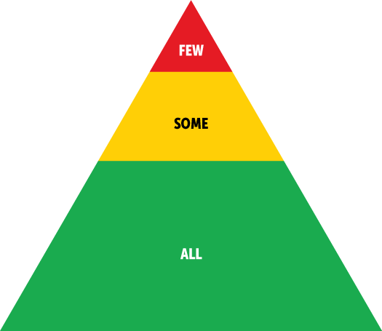
A Comprehensive Approach
MTSS
PBIS
Notes:
Time: 3 Minutes
Objective: Discuss the importance of MTSS and PBIS when thinking about preventing and supporting crisis
Talking Points:
This training covered the crisis management and intervention procedures from the USBE's LRBI manual Chapter 7 including the crisis cycle, prevention and de-escalation techniques and roles and documentation.
Our goal in Granite School District is to prevent behavioral crises before reaching that level of intervention.
Following a multi-tiered system of support, or MTSS, is crucial starting with our Tier I supports. School-Wide PBIS is used to establish positive school culture and climate, clearly define expectations and use data-driven practices to meet students' needs.
Effective classroom Management is another preventative support. Creating a positive, predictable classroom environment, using evidence-based instructional and behavioral practices, and actively engaging students in meaningful learning are components of effective classroom management.
The last prevention strategy following the MTSS process is teaching emotional regulation skills. We want to make sure we are explicitly teaching our students emotional literacy and regulation strategies, providing safe spaces and building resilience, problem-solving, and self-management skills
By implementing preventative PBIS practices, strong classroom management, and direct emotional regulation instruction we create positive conditions where disruptive behaviors are less likely to escalate into crisis situations
However, when crises do occur, we must follow the skills outlined in this training and the LRBI guidelines to prioritize safety for all.

Slide 40
What is your behavior plan for this year?
Notes:
Time: 5 Minutes
Objective: Wrap up presentation and give time to think what they will do this school year to support behaviors.
Talking Points:
What will you do this year to support students with challenging behaviors? Whole class, groups (tier II) or individual (tier III)?
Reflect and write it in your guided notes and then you are free to leave!
If you have any questions regarding this presentation, please follow the QR code link at the bottom of your guided notes to ask the district behavior specialists.
Thank you!.
Total: Roughly 100 min

