Slide 1
Happy Holidays!

Slide 2

HELLO! I’M...
You can add your name, title and a little background. Right click the image and replace it with your own.

Slide 3
TABLE OF CONTENTS
01 - Dogs
02 - Cats
03 - Elephants
04 - Kangaroos
05 - Pandas
06 - Koalas
We will talk about this first.
We will talk about this second.
Then, we will talk about this.
After that we will talk about this.
We will also talk about this.
And we will talk about this last.

Slide 4
WE WILL TALK ABOUT THIS FIRST.
Add a brief introduction of your section here.
Let’s dive in and get to know some interesting facts about animals!

Slide 5
DID YOU KNOW?
Did you know that elephants can sense storms?
Elephants may be able to detect a thunderstorm from hundreds of miles away, and will head towards it, looking for water.

Slide 6
DID YOU KNOW?
Did you know that dogs can smell your feelings?
Dogs can pick up on subtle changes in your scent, which can help him figure out how you are feeling, such as by smelling your perspiration when you become nervous or fearful.
Did you know that a cat uses its whiskers as feelers to determine if a space is too small to squeeze through?
Also, cats love to sleep. A fifteen-year-old cat has probably spent ten years of its life sleeping.

Slide 7
Clearly, animals know more than we think, and think a great deal more than we know.
Irene M. Pepperberg

Slide 8
DID YOU KNOW?
Pandas don’t hibernate.
When winter approaches, they head lower down their mountain homes to warmer temperatures, where they continue to chomp away on bamboo!
There are more kangaroos than humans in Australia.
It is estimated that more than 50 million kangaroos live there. They are Australia’s national symbol and appear on postage stamps, coins, and airplanes.
Koalas are even more lazy than cats.
Koalas don’t have much energy and, when not feasting on leaves, they spend their time dozing in the branches. Believe it or not, they can sleep for up to 18 hours a day!

Slide 9
VERY INTERESTING FACTS!
This is where you section ends. Duplicate this set of slides as many times you need to go over all your sections.

Slide 10
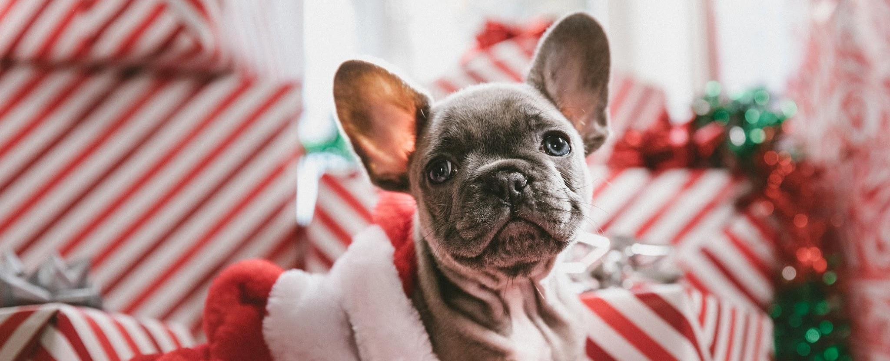
DOGS CAN SMELL YOUR FEELINGS.
Dogs can pick up on subtle changes in your scent, which can help him figure out how you are feeling, such as by smelling your perspiration when you become nervous or fearful.

Slide 11
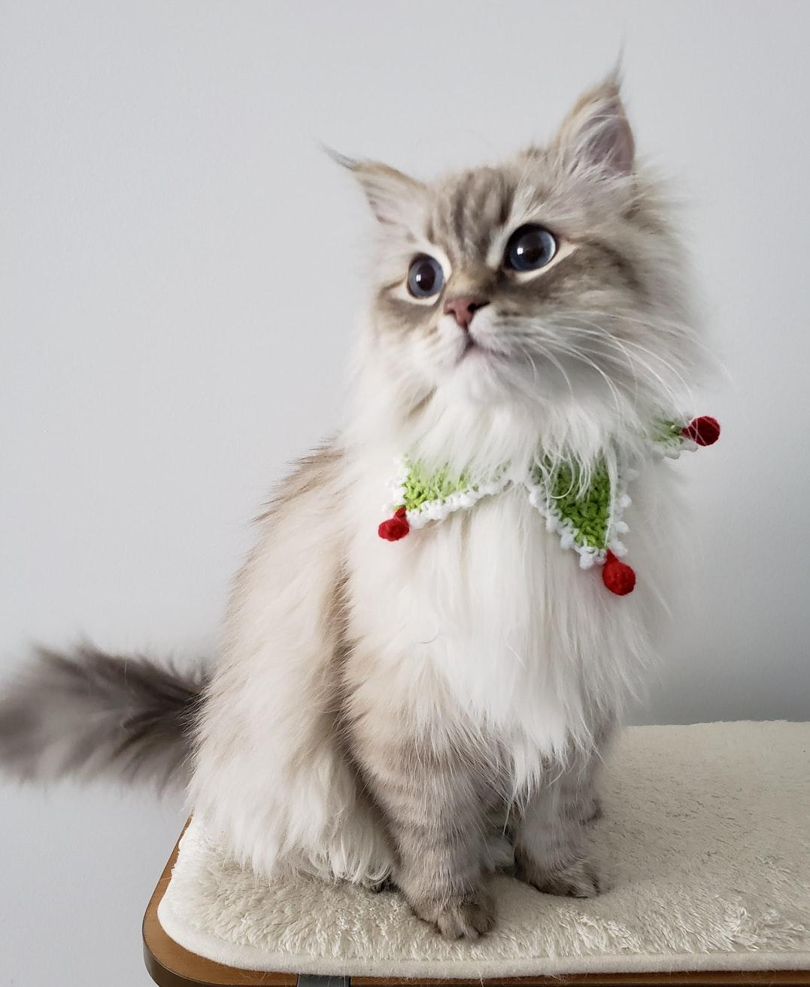
CATS LOVE TO SLEEP.
A fifteen-year-old cat has probably spent ten years of its life sleeping.
Also, cats use their whiskers as feelers to determine if a space is too small to squeeze through.

Slide 12
SOME FACTS ABOUT MY CATS
100%
25%
75%
Of my cats are adorable.
Traveled by plane. Twice!
Are females.

Slide 13
LET’S REVIEW SOME FACTS.
Elephants
Pandas
Cats
Elephants can sense storms.
Pandas don’t hibernate.
Cats use their whiskers as feelers.
Dogs
Kangaroos
Koalas
Dogs can smell your feelings.
There are more kangaroos than humans in Australia.
Koalas are even more lazy than cats.

Slide 14
PRESENTING A WEB OR AN APP?
If you are presenting a website, an internet product or an app, you can place a screenshot of it here.

Slide 15
PRESENTING A WEB OR AN APP?
If you are presenting a website, an internet product or an app, you can place a screenshot of it here.

Slide 16
THANK YOU!
Do you have any questions?
hello@mail.com
555-111-222
mydomain.com

Slide 17

MONDAY, DECEMBER 6TH.
Announcements
Materials
Check list
Would you rather...
Something here.
Something else here.
And a third thing here.
Duplicate the check mark.
And the check boxes.
Far far away, behind the word mountains, far from the countries Vokalia and Consonantia, there live the blind texts.
Separated they live in Bookmarks Grove right at the coast of the Semantics, a large language ocean.

Slide 21
CREDITS.
Presentation Template: SlidesMania
Sample Images: Unsplash
Fonts used in this presentation: Happy Monkey and Mountains of Christmas

Slide 22
Editable Icons

