Slide 1
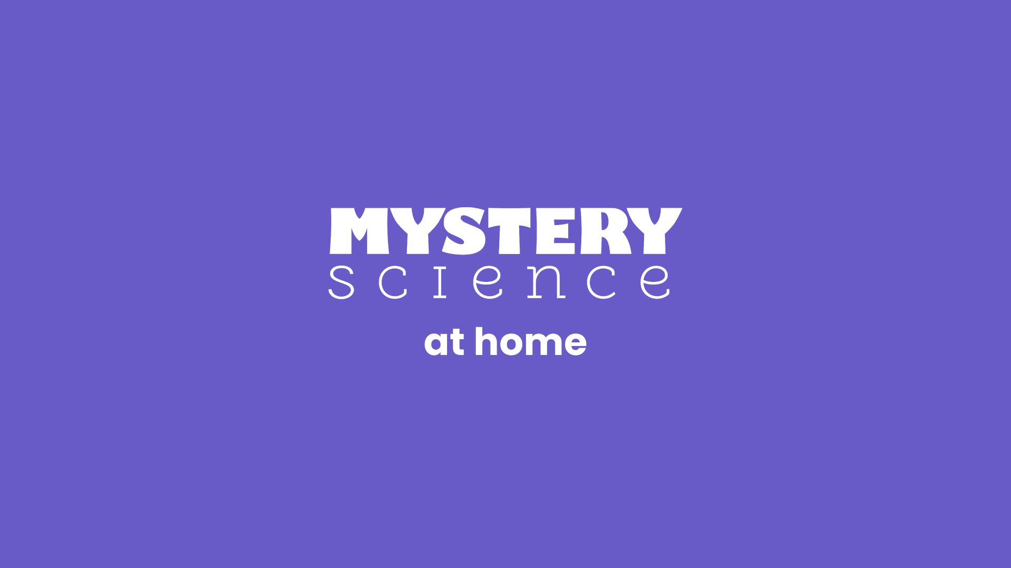

Slide 2
We’re here to help.
We know school closures and distance learning pose new challenges for teachers, students and families.
This guide highlights some Mystery Science features that can save you time and help make remote learning more engaging and enjoyable for everyone.
Have fun & stay curious!

Slide 3
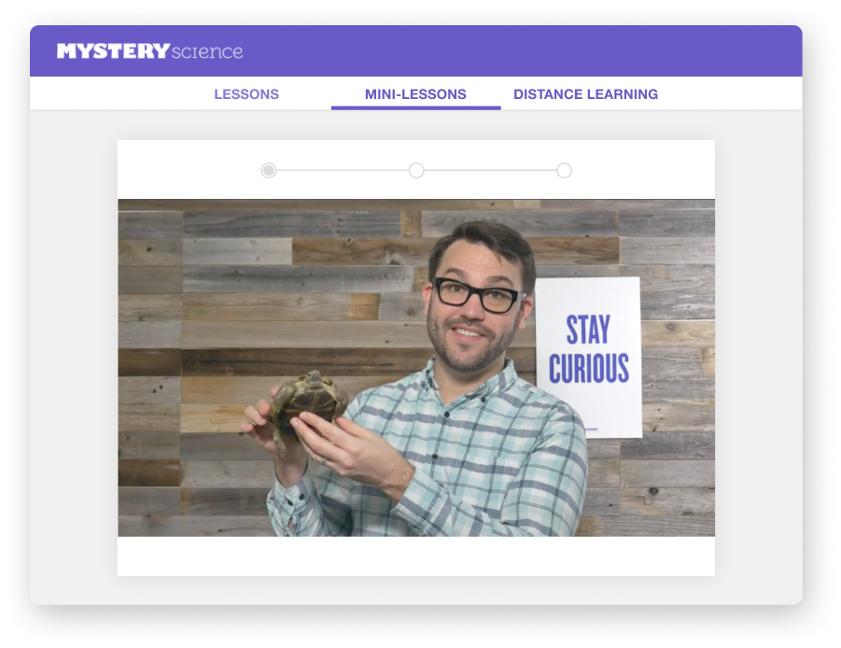
Mystery Science + Distance Learning
Shareable, no-login lessons
Share videos directly with students —no student accounts necessary
Built-in narration by a master teacher
Engaging video lessons and activities led by Doug, our expert Science teacher
Assignable on Google Classroom
Digital handouts, assessments, at-home extension activities—all at your fingertips
and ready to assign

Slide 4
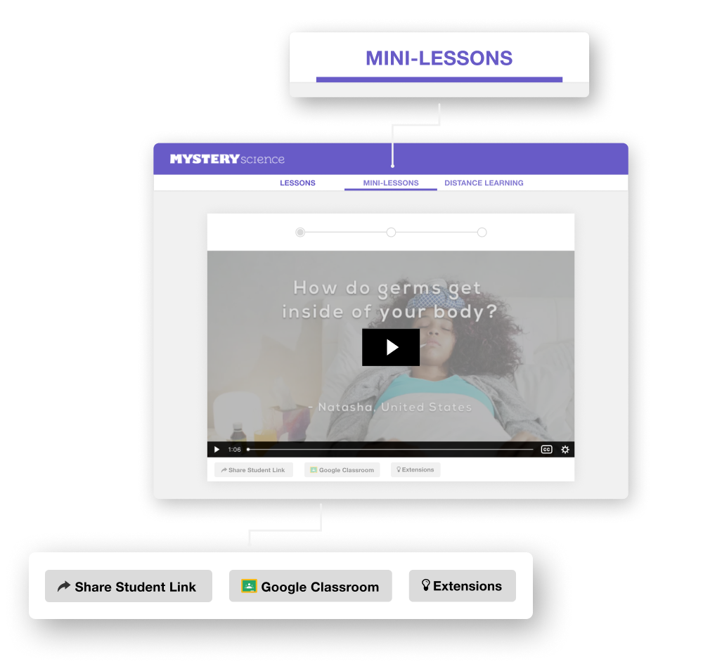
Mini-lessons are easy for students at home
Short video lessons that answer real kids’ questions
Discussion questions to encourage reflection
NEW! Extension questions and bonus activities
NEW! Google Classroom integration

Slide 5
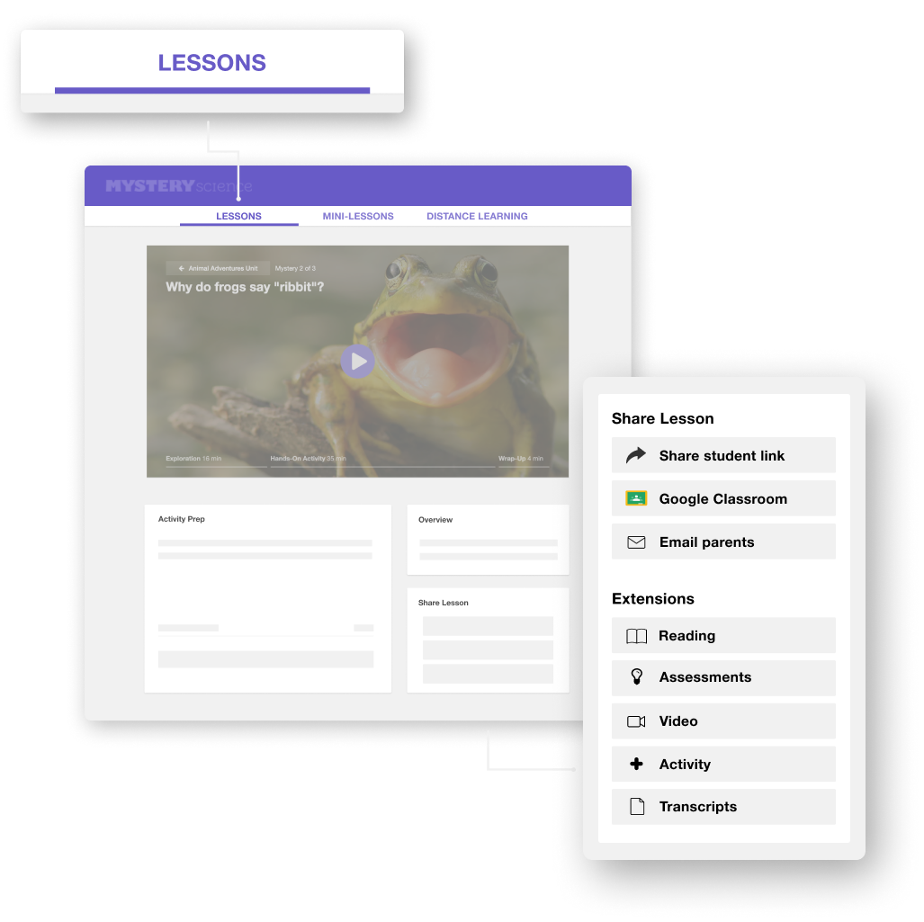
Standards-aligned lessons if you have more time
Full, standards-aligned lessons + hands-on activities
NEW! Digital assessments that collect student responses
NEW! Digital handouts that students can fill in — no printing required
NEW! Google Classroom integration
NEW! Choose which parts of a lesson to send students via Student Link

Slide 6
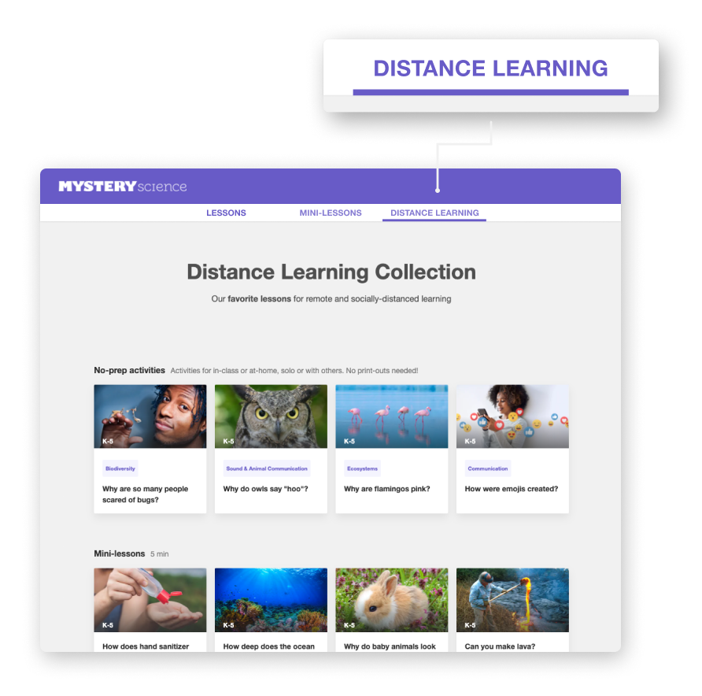
A curated Distance Learning Collection
Browse a selection of our favorite lessons for remote learning
Find engaging lessons to fit any schedule
NEW! No-prep activities that students can do solo in-class or at home (zero printing required!)

Slide 7
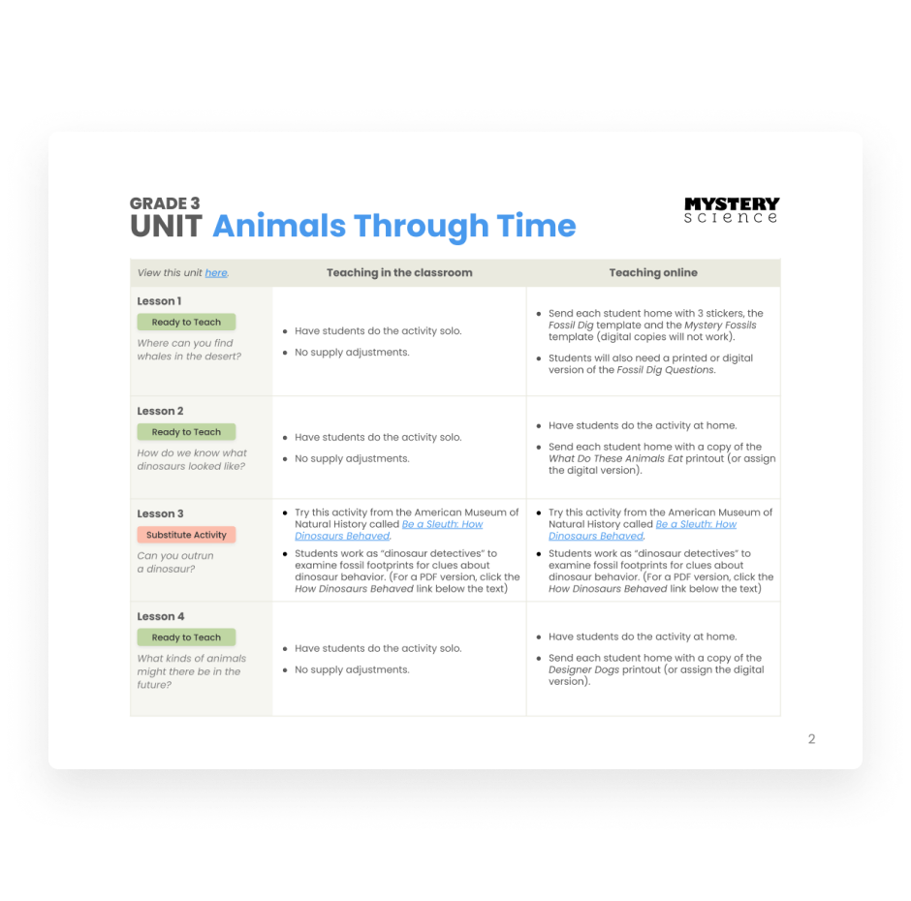
Guides and suggestions for adapting lessons
Distance Learning Guide PDFs for each grade level with suggestions for adapting our standards-aligned lesson activities
NEW! You’ll also see these ideas for “COVID-19 Adaptations” on the lesson pages of our website

Slide 8

Ready to get started?
Here’s how:
Choose a lesson.
Select Google Classroom or Share Student Link.
Assign lesson to students at home.
Go find a lesson:
STANDARDS-ALIGNED LESSONS
MINI-LESSONS
DISTANCE LEARNING COLLECTION
Want to see more remote learning features? See our Distance Learning How-to Guide.

Slide 9

Distance Learning How-To Guide

Slide 10
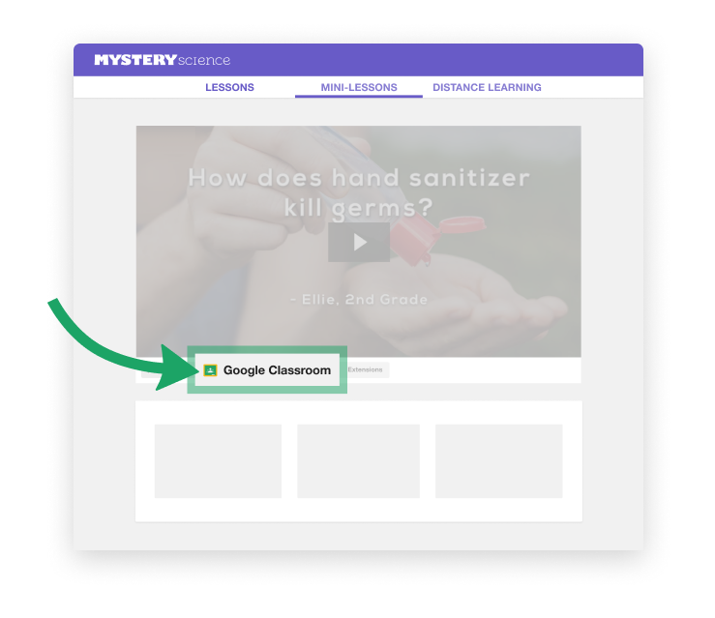
HOW TO ASSIGN Mini-Lesson Videos
Click the Google Classroom button to quickly share videos with students.
Not using Google Classroom?
No problem - simply copy and paste the Student Link to share the video.

Slide 11
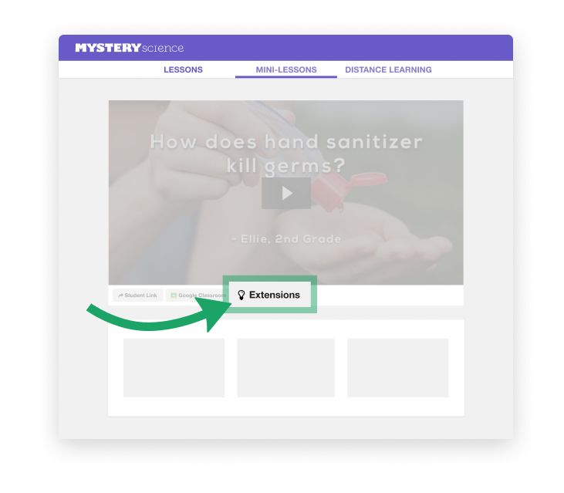
HOW TO ASSIGN Mini-Lesson Activities
Click on Extensions to assign follow-up questions and simple, offline activities.
These questions are automatically added to the instructions when you assign them in Google Classroom.
Or, copy and paste them into any document, assignment or email.
Notes:
Image pointing to the extensions button

Slide 12
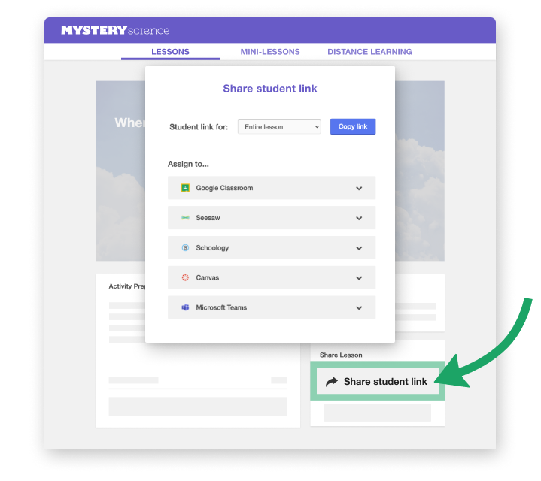
HOW TO ASSIGN
Standards- aligned Lessons
Click Share student link button on the lesson page to share the video with students.
New! You can now choose which parts of the lesson to share with students. Share the entire lesson or just the section you need!

Slide 13
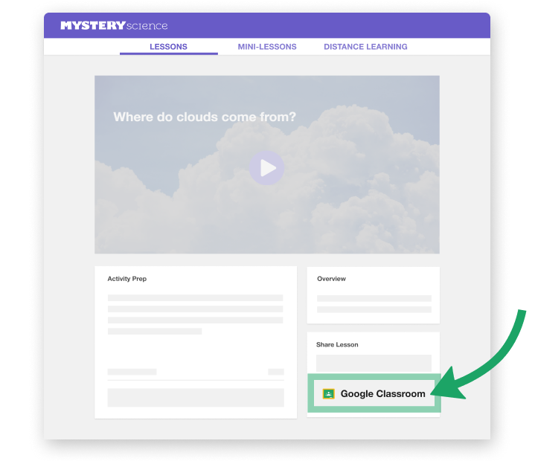
HOW TO ASSIGN
Standards- aligned Lessons
Or, click the Google Classroom button to assign lesson on Google Classroom.
Not using Google Classroom?
No problem - click Share student link to see instructions for sharing lessons on other platforms.

Slide 14
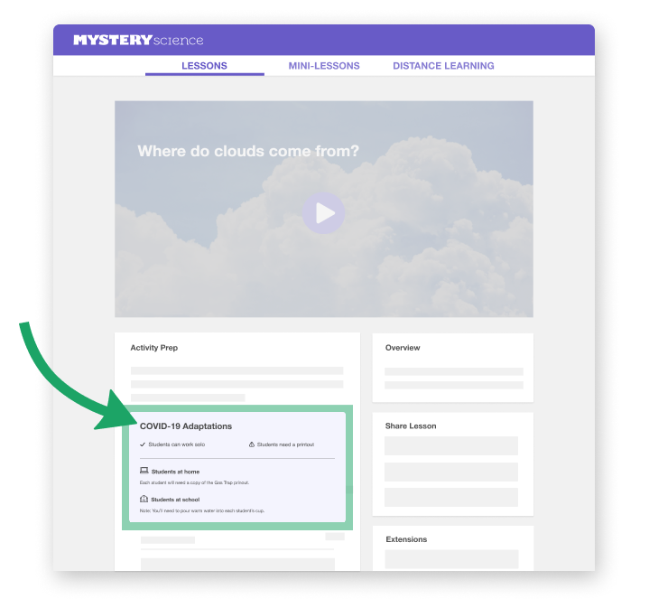
HOW TO ADAPT
Hands-on Activities
Our standards-aligned lessons include hands-on activities, but we know it’s tough to teach them remotely!
Look at the Covid-19 Adaptations section to see our suggestions for adapting each lesson activity.

Slide 15
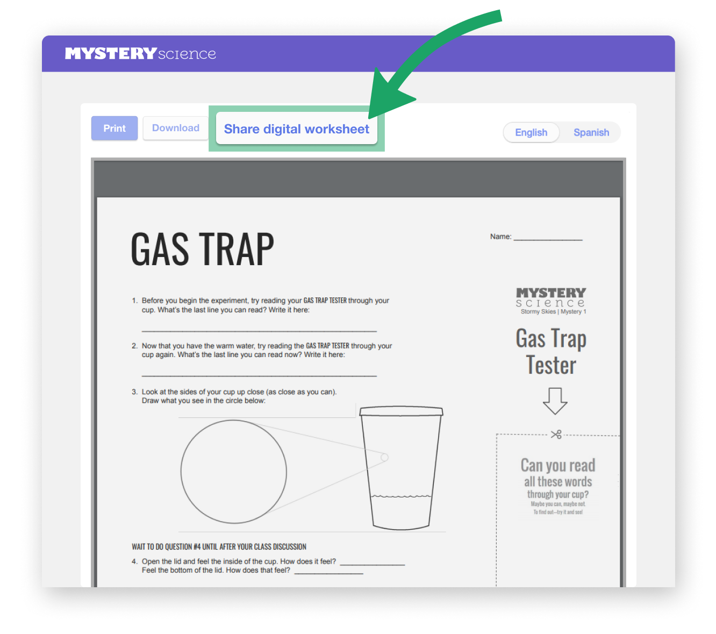
HOW TO ASSIGN
Digital
Handouts
Students can type on editable documents as if they were writing on a handout.
Open any handout document, and click Share digital worksheet.
This will save a copy of the document to your Google Drive to assign in Google Classroom.

Slide 16
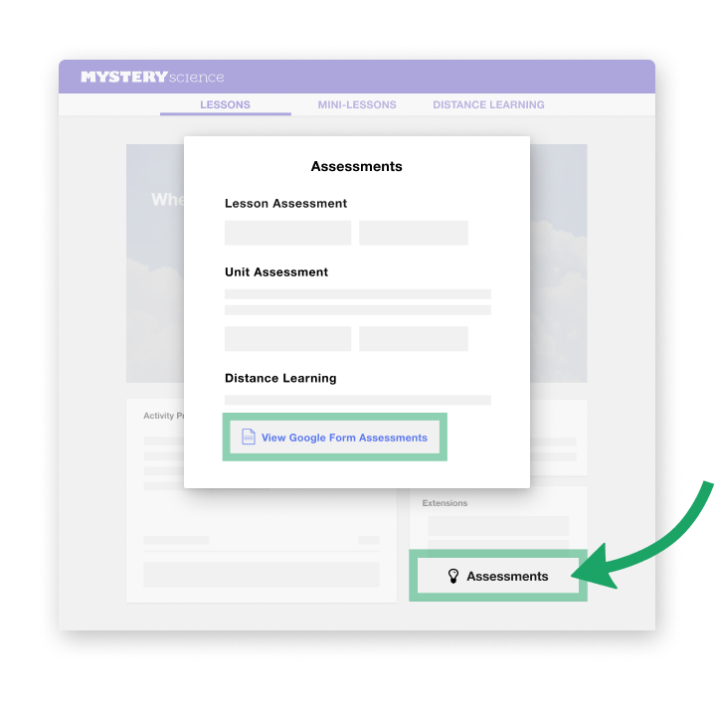
HOW TO ASSIGN
Google Forms Assessments
Click on Assessments (under Extensions on the lesson page).
Find Google Forms assessments under Distance Learning.
Or, click HERE to access all of our assessments in the Google Forms format.

Slide 17
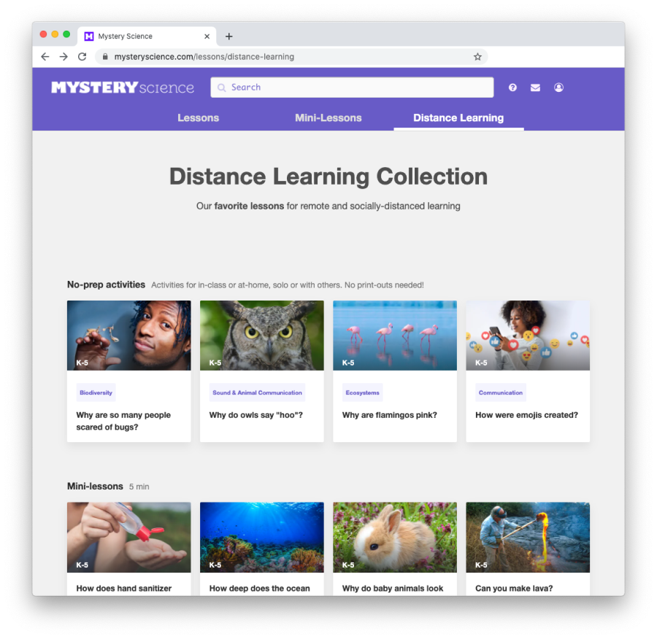
More to explore!
Not sure where to start?
Browse our curated list of the easiest science lessons to do at home.
Looking for offline options?
From our community of creative teachers, some offline activities aligned to grade levels and Mystery Science units.
Looking for extra activities?
From our friends at Seesaw and the Minnesota Zoo, a list of activities aligned to popular Mystery Science mini-lessons.

