Slide 1




GUIDE TO HIV PREVENTION CASCADES
March 2026
Notes:
1

Slide 2

This guide provides an overview of four different
HIV prevention cascades and key considerations for adapting and populating them.
We hope this guide can serve as a resource for stakeholders interested in data-based decision-making to strengthen HIV prevention programming.
If you would like to provide feedback on the tool,
please fill out this short survey here
NEXT
SLIDE
Notes:
1

Slide 3


Before
You Begin
This presentation is interactive and
designed for an engaging, guided experience.
For the best viewing experience:
Open the file in Presentation or Full Screen mode.
2. Use the navigation buttons to move between sections.
3. Click on the cascade buttons to explore different data
views and insights.
Enjoy exploring the HIV Prevention Cascades,
where each section reveals a deeper layer of
insight into how data drives precision programming.
Get
Started
Notes:
1

Slide 4

There is an urgent need for precision programming in HIV prevention responses.
INTRODUCTION
Despite major advances in HIV prevention, 1.3 million people acquired HIV worldwide in 2024 —well above the targets needed to end the epidemic by 2030*
Closing this gap demands prioritisation and data-guided decisions to improve national responses and monitor results, especially
when resources are tight.
Precision programming enables programmes to target and reach the right populations with the right interventions at the right time.
However, identifying tools that accurately pinpoint priority locations and populations continues to be a significant challenge.
*UNAIDS Fact Sheet 2025
NEXT
SLIDE
Notes:
1

Slide 5
HIV prevention cascades serve as powerful tools for data-based decision-making, enabling precision programming.
INTRODUCTION
Cascades are structured frameworks that visually present how individuals or populations move
step-by-step through a series of health services or interventions. In HIV prevention, they are used
to track progress from awareness to consistent, correct use of prevention methods.
Cascades focus on individuals or populations, helping programmes reach people who are often
missed and improve overall effectiveness. They can reveal gaps in prevention efforts, track
programme performance over time and guide resource allocations to improve outcomes.
Interest in HIV prevention cascades has grown, but choosing which cascade to use
when, and knowing how to populate the right cascade requires careful consideration.
When interpreting cascade results, it is important to account for the complexities
of real-world programming. HIV prevention cascades often need to consider:
  Multiple interventions with varying frequencies, efficacies, and user acceptability;
  Diverse groups of people who are vulnerable to HIV acquisition,
  including those in high-incidence settings; and
  The shifting levels of risk and need for protection over time.
Further, cascades should be interpreted alongside contextual data, such as on social and behavioral factors.
NEXT
SLIDE
Notes:
1

Slide 6




Stakeholders can use HIV prevention
cascades to set targets, monitor progress,
and drive advocacy.
Policymakers
and Funders
Programme Managers
Researchers
and Academics
To pinpoint prevention gaps and equity issues.
To advocate for policy and funding shifts
using evidence.
Ensure accountability
and efficient resource allocation.
To monitor programme performance and identify bottlenecks.
To support planning
and resource allocations.
To set realistic, measurable targets
and track progress toward national and global goals.
To study the impact of different prevention strategies.
To evaluate the effectiveness
of interventions across different populations.
To generate evidence
to inform programme
design and policy change
Clinicians and healthcare providers can use HIV prevention cascades to pinpoint where individuals disengage from care and improve retention. Prevention cascades also guide providers’ practice by informing the decisions of programme managers and funders.
NEXT
SLIDE
Notes:
4

Slide 7

There are different types of HIV prevention cascades;
we present four cascades that are commonly used in practice.
UNAIDS
This cascade examines how many people were reached by prevention methods, focusing on monitoring reach, coverage, uptake, and usage of at least one prevention method within specific populations.
UNAIDS Basic
cascade
EPC
This cascade assesses how many people were effectively covered by a prevention method,
utilising a programme science approach to evaluate effective coverage.
Effective programme coverage cascade
CPC
This cascade investigates where and why
individuals drop out of the prevention cascade
by systematically evaluating the effectiveness of HIV prevention programmes
HIV combination prevention cascade
CoPCT
This cascade explores how the entire HIV response system connect by tracking individual engagement with HIV services across the continuum of care.
HIV continuum
of prevention, care,
and treatment cascade
NEXT
SLIDE
Notes:
6

Slide 8



Navigate between the following cascades:
Click on the boxes for each of the four main
cascades to explore them in detail.
This guide is designed to help you navigate the four cascades, explore key sections within each, and decide which one to use
UNAIDS
  UNAIDS BASIC CASCADE
EPC
  EFFECTIVE PROGRAMME COVERAGE CASCADE (EPC)
CPC
  HIV COMBINATION PREVENTION CASCADE (CPC)
CoPCT
  HIV CONTINUUM OF PREVENTION, CARE, AND TREATMENT CASCADE
Explore specific sections:
Within each cascade's section, you can click
on boxes to explore different aspects, such as:
  INDICATORS
  DATA REQUIREMENTS
  STEPS TO ADAPT AND POPULATE THE CASCADE
  CONSIDERATIONS
  COUNTRY APPLICATIONS
Return to the main library:
You can click the "Back to Cascades Library" button at the bottom of each page to return to the main selection screen.
NEXT
SLIDE
Notes:
7

Slide 9


Explore each cascade by clicking on
the relevant button:
UNAIDS
UNAIDS Basic
Cascade
*Click to see more
Effective Programme Coverage Cascade
EPC
*Click to see more
CPC
HIV Combination
Prevention Cascade
*Click to see more
CoPCT
HIV Continuum of Prevention, Care, and Treatment Cascade
*Click to see more
NEXT
SLIDE
Notes:
8

Slide 10






BASIC HIV PREVENTION CASCADE
UNAIDS Basic Cascade
UNAIDS
EPC
CPC
CoPCT
This cascade serves as the foundational model, primarily providing a snapshot of the reach of HIV prevention services.
EXPLORE OTHER ASPECTS OF THE
CASCADE BY CLICKING ON EACH BOX
The main function of the cascade is to answer the question: “How many people were reached by
the prevention method”.
INDICATORS
Target Audience: HIV prevention programme managers at national
and subnational levels, including implementing partners, overseeing
the implementation, administration, and monitoring and evaluation of HIV prevention programmes.
STEPS TO ADAPT AND
POPULATE THE CASCADE
CONSIDERATIONS
DATA REQUIREMENTS
The basic HIV prevention cascade focuses on
monitoring the reach/coverage, uptake and use
of at least one prevention method in specific populations and geographical areas at a
specified point in time.
COUNTRY APPLICATION
CLICK BACK TO CASCADES LIBRARY
Notes:
9

Slide 11
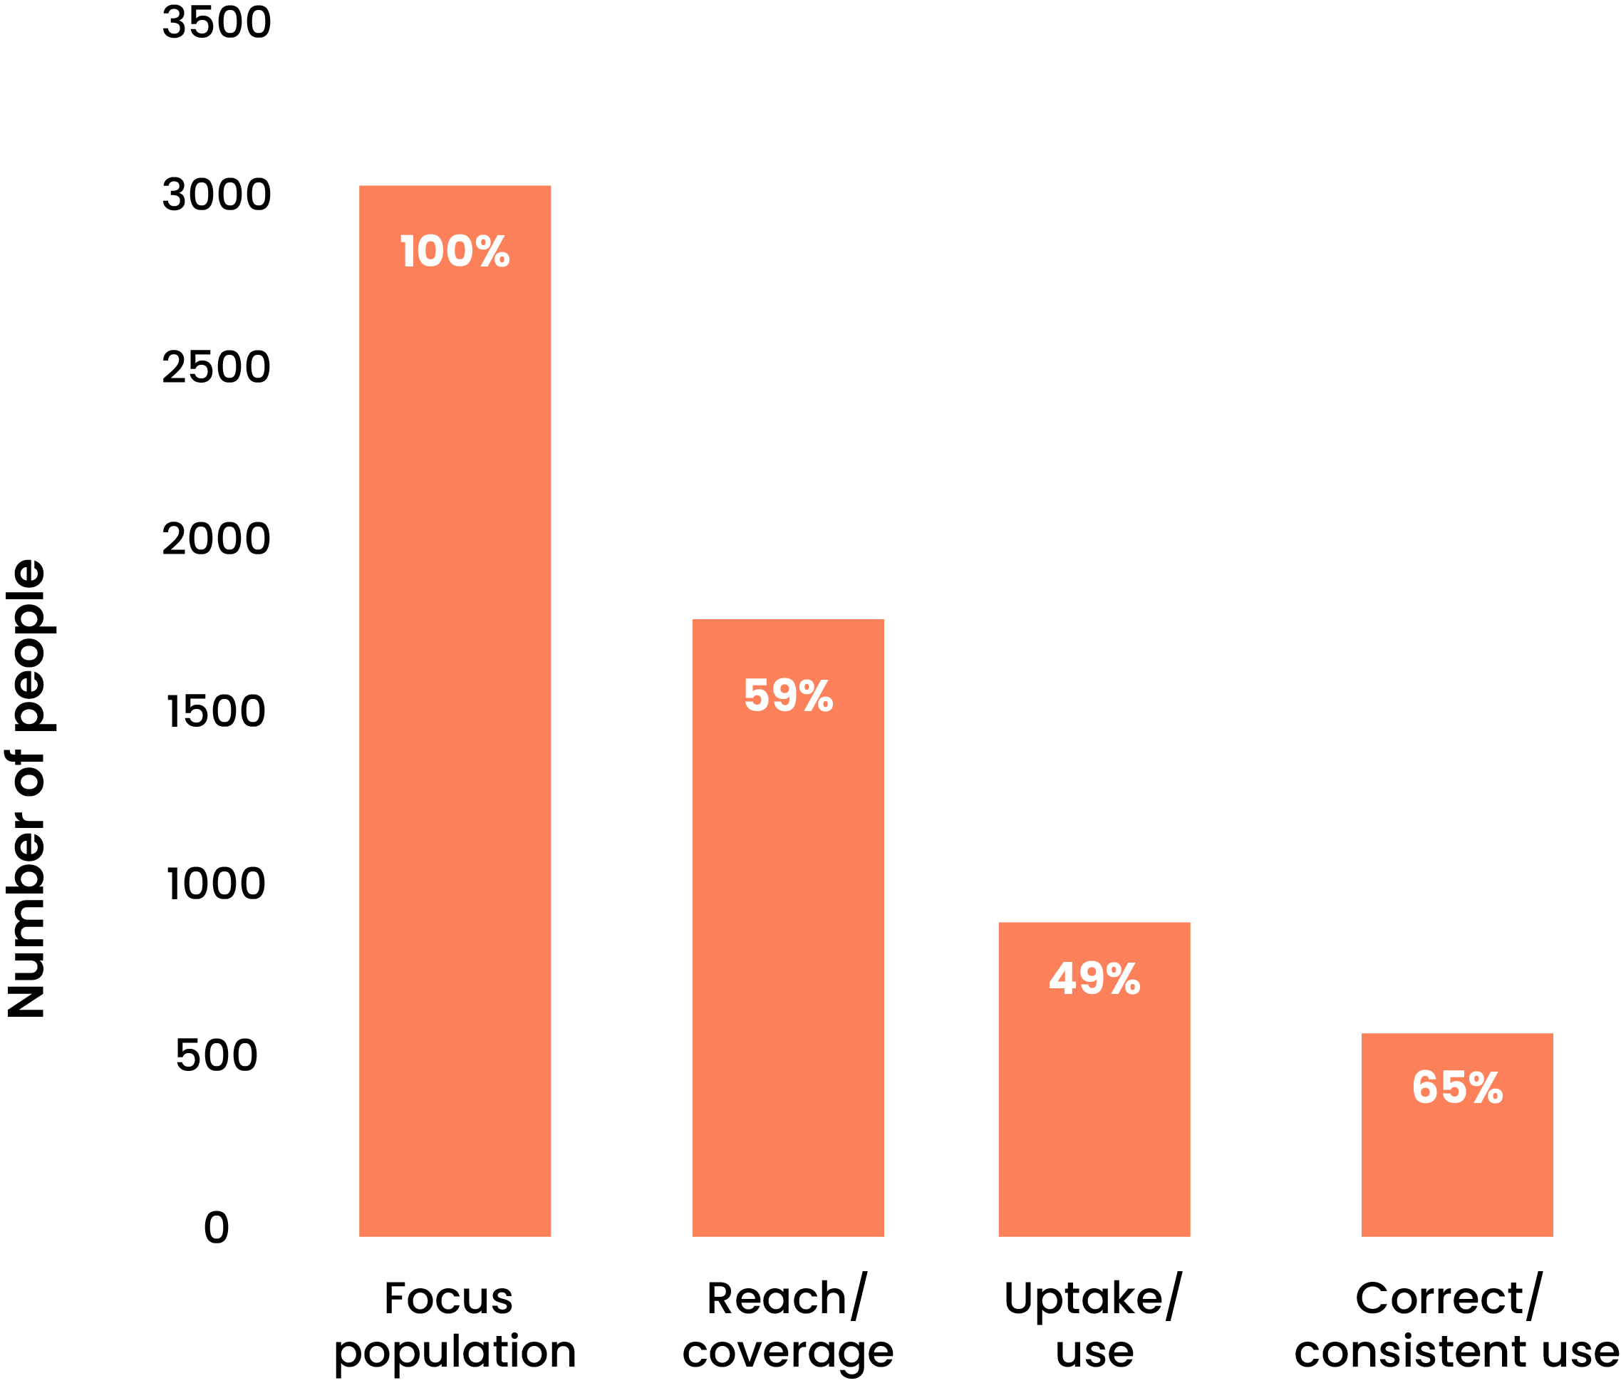


BASIC HIV PREVENTION CASCADE
Indicators
UNAIDS
EPC
CPC
CoPCT
Indicators for this cascade focus on measuring “reach” of a particular intervention amongst a particular population group.
The basic prevention cascade
comprises the following indicators:
FOCUS POPULATION:
The size of the total population of interest.
The total focus population would be the number of those who
are HIV uninfected, most at risk for HIV at the time of creating
the cascade and in need of a particular prevention method or package of prevention methods.
REACH/COVERAGE:
The extent to which a prevention method is delivered
to the focus population, i.e. the extent to which those
in need of a prevention method to receive it
(reflecting 'supply’ and 'access' aspects).
UPTAKE /USE:
The extent to which the prevention method
is taken up or used by the focus population.
CORRECT/CONSISTENT USE:
The number of people who used the prevention method(s)
who used it as prescribed/indicated in a specific timeframe.
For oral PrEP, the focus is on correct and consistent use.
BACK TO CASCADES LIBRARY
NEXT
SLIDE
Notes:
9

Slide 12
BASIC HIV PREVENTION CASCADE
Steps to adapt and populate the cascade
UNAIDS
EPC
CPC
CoPCT
Populating this cascade involves several steps, summarised below, with extra guidance on Step 2 - a key part in the process.
Define the focus population and prevention
method you aim to target
STEP 1
Define and measure the cascade indicators
*Click here to find out
more about STEP 2
STEP 2
Identify the gaps between the different cascade steps and
investigate why they occur and compare the results with
targets, over time, other geographical areas, or populations
(if indicator definitions are similar).
STEP 3
Based on the reasons for the gaps, develop
strategies for improving cascade performance
STEP 4
BACK TO CASCADES LIBRARY
NEXT
SLIDE
Notes:
9

Slide 13
BASIC HIV PREVENTION CASCADE
Steps to adapt and populate the cascade
UNAIDS
EPC
CPC
CoPCT
STEP 2: Defining and measuring the cascade indicators
It is important to establish a clear definition for each indicator (the numerator and denominator) and measure accordingly.
CASCADE INDICATOR | INDICATOR DEFINITIONS
FOCUS POPULATION | Numerator: The size estimate of the total population of interest in a country or subnational area at a specified point in time. Denominator: 100%
REACH/ COVERAGE | Numerator: Number of people in the focus population receiving one or more quality assured prevention methods in a specified timeframe according to national guidelines. Denominator: Number of people in the focus population (size estimation from the previous indicator)
UPTAKE/ USE | Numerator: Number of people reached/covered who took up/used the prevention method(s) in a specified timeframe. Denominator: Number of people in the focus population receiving one or more prevention methods in a specified timeframe (numerator from the previous indicator).
CORRECT / CONSISTENT USE | Numerator: Number of people who used the prevention method(s) as prescribed/indicated in a specified timeframe. Denominator: Number of people reached/covered who took up/used the prevention method(s) in a specified timeframe (numerator from the previous indicator)
BACK TO CASCADES LIBRARY
NEXT
SLIDE
Notes:
9

Slide 14



BASIC HIV PREVENTION CASCADE
Considerations
UNAIDS
EPC
CPC
CoPCT
The Basic HIV prevention cascade should be considered when the goal is to assess the reach of HIV prevention services.
Consider using the basic HIV
prevention cascade when you:
However, you may
encounter challenges when:
  Aim to assess service reach across various
  dimensions of service delivery, including supply,
  access and demand.
  Intend to populate a cascade for a single
  prevention method and population group at a time.
  Have routine data from HIV prevention programmes
  (both governmental and non-governmental)
  or survey data when no program data is available.
  Require a tool for planning, advocacy, target setting,
  and understanding gaps across the prevention pillars.
  Capturing 'consistent use' when the indicator data originate from a different source than previous steps
  in the cascade and due to potential 'social desirability' bias.
BACK TO CASCADES LIBRARY
NEXT
SLIDE
Notes:
9

Slide 15
BASIC HIV PREVENTION CASCADE
Data Requirements
UNAIDS
EPC
CPC
CoPCT
Routine program data is the preferred option, but countries can also utilise behavioural surveillance data to inform indicators.
Focus population:
Uptake/ Use:
Population size estimate using a range of methods, including census, enumeration, behavioural surveillance, population surveys, programme mapping, capture-recapture method, multiplier method, network scale-up method
and community informant and observation methods
Routine programme data (preferred option), data from international reporting (e.g. World Health Organization (WHO), Monitoring, Evaluation, and Reporting (MER), Global AIDS Monitoring (GAM)) and behavioural surveillance data.
Correct / Consistent use:
Reach / Coverage
Routine programme data (preferred option) and behavioural surveillance (e.g. IBBS, DHS, PHIA, AIS, MIC, polling booth surveys).
Routine programme data that can count individual people
reached during the period; and/or behavioural surveillance data
E.g. Integrated Biological and Behavioral Surveys (IBBS),
Demographic and Health Surveys (DHS),
Population-based HIV Impact Assessments (PHIA),
AIDS Indicator Surveys (AIS),
Multiple Indicator Cluster Surveys (MICS),
Polling booth surveys and small area surveys.
BACK TO CASCADES LIBRARY
NEXT
SLIDE
Notes:
9

Slide 16
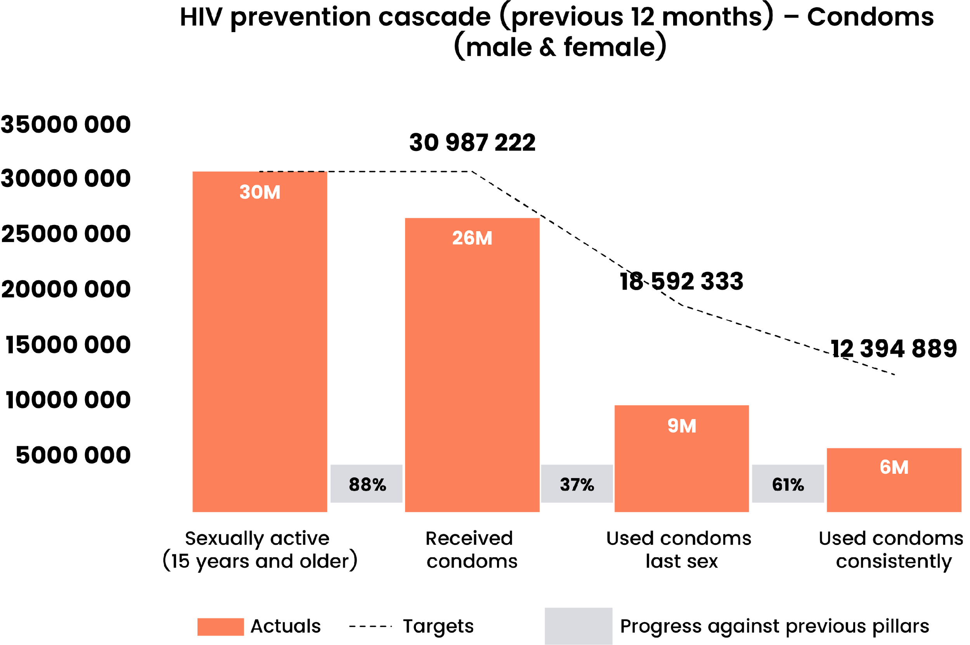
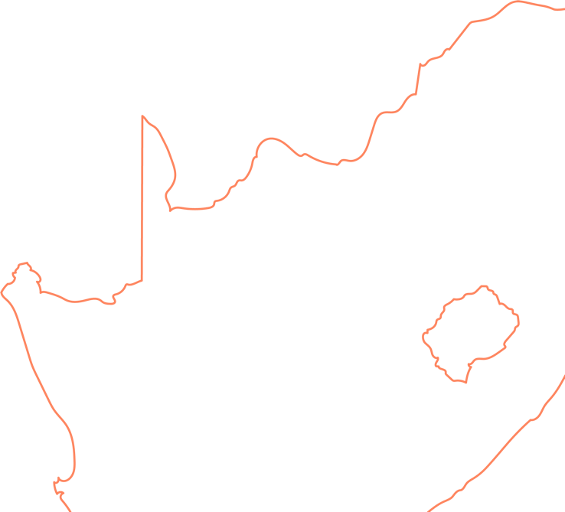

BASIC HIV PREVENTION CASCADE
Country Application
UNAIDS
EPC
CPC
CoPCT
South Africa developed an HIV prevention cascade to track condom use amongst men and women who are
15 and older and sexually active.
  The cascade indicates that 86% of the target population received condoms.
  Of those who received condoms, only one-third
  (37%) used a condom at last sex.
  Of those using condoms at last sex, more than
  half of them were using them consistently.
This cascade shows that condom service delivery is high, but actual uptake is low. This information shows that demand creation activities are essential.
Source: Adapted from the HIV Prevention Cascades and Breakdown of New HIV Infections to Drive Prioritisation validation meeting. (2024, November). South Africa.
Click here to learn more about the basic prevention cascade
BACK TO CASCADES LIBRARY
NEXT
SLIDE
Notes:
9

Slide 17





EFFECTIVE PROGRAMME COVERAGE CASCADE
Effective Programme
UNAIDS
EPC
CPC
CoPCT
Coverage Cascade
EXPLORE OTHER ASPECTS OF THE
CASCADE BY CLICKING ON EACH BOX
This cascade goes beyond service delivery to assess programme coverage.
INDICATORS
The main function of the cascade is to answer the question: “How many people were effectively
covered by a prevention method?"
STEPS TO ADAPT AND
POPULATE THE CASCADE
Target Audience: HIV prevention programme managers
at national and subnational levels, including implementing partners, overseeing the implementation, administration,
and monitoring and evaluation of HIV prevention programmes.
CONSIDERATIONS
DATA REQUIREMENTS
The Effective Programme Coverage (EPC)
cascade uses a programme science approach.
It moves beyond simply counting users who
have received an intervention to measuring
the proportion of the target population that is effectively protected.
COUNTRY APPLICATION
CLICK BACK TO CASCADES LIBRARY
Notes:
9

Slide 18
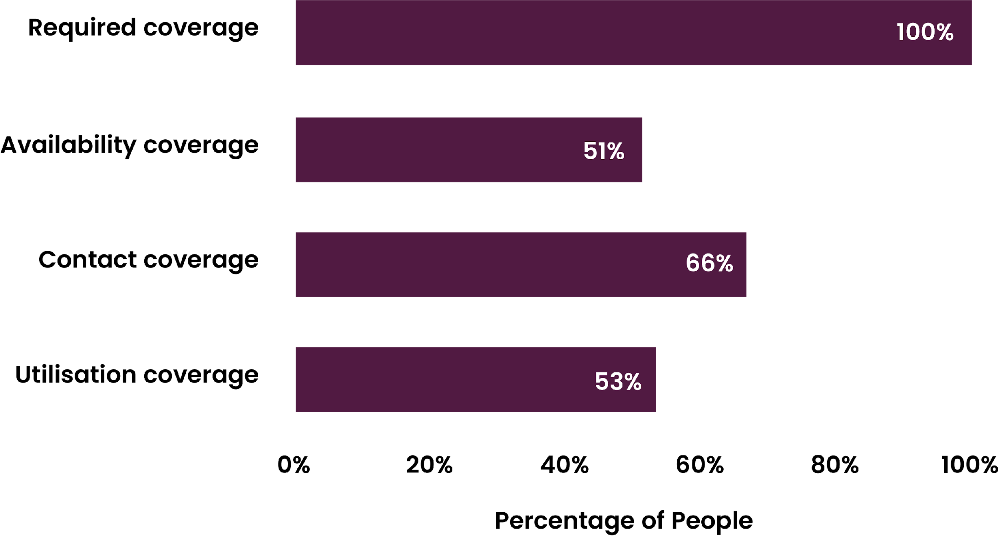
EFFECTIVE PROGRAMME COVERAGE CASCADE
Indicators
UNAIDS
EPC
CPC
CoPCT
REQUIRED COVERAGE:
Indicators for this cascade focus on measuring “effective coverage” of a particular intervention amongst a particular population group.
The proportion of the target population that requires the health intervention as per national guidelines. For example, this can be set at 100% of all female sex workers (FSW) and men who have sex with men (MSM) for condoms.
AVAILABILITY COVERAGE
Measures if appropriate services are available to priority groups or geographies. For instance, in surveys: “During the past month, was
there a time you intended to use a condom but could not because it
wasn’t available?” Availability can also be assessed through condom
stock-out reports in health facilities (HMIS data).
CONTACT COVERAGE:
Measures how well service delivery platforms engage users. For example, contact coverage can be assessed by asking, “In the last 3 months, were you met by a peer educator from the programme?” in population-based surveys, or by analysing HMIS data on condoms received from peer educators, assuming condoms are mainly distributed free through these channels.
UTILISATION COVERAGE
Measures the actual use of services by users. For example, utilisation coverag can be measured by adding a question like "During the past 3 months, was there any occasion when you had sex with any paying client/sexual partner using a condom?" in a population-based survey or using the indicator from HMIS, received condoms as per their need.
BACK TO CASCADES LIBRARY
NEXT
SLIDE
Notes:
9

Slide 19
EFFECTIVE PROGRAMME COVERAGE CASCADE
Steps to adapt and populate the cascade
UNAIDS
EPC
CPC
CoPCT
Populating this cascade involves several steps, summarised below,
with extra guidance on Step 2 – a key part in the process.
Define the focus population and prevention method
you aim to target
STEP 1
Define and measure the cascade indicators
*Click here to find out
more about STEP 2
STEP 2
Identify the gaps between the different cascade steps and
investigate why they occur and compare the results with
targets, over time, other geographical areas, or populations
(if indicator definitions are similar).
STEP 3
Based on the reasons for the gaps, develop
strategies for improving cascade performance
STEP 4
BACK TO CASCADES LIBRARY
NEXT
SLIDE
Notes:
9

Slide 20
EFFECTIVE PROGRAMME COVERAGE CASCADE
Steps to adapt and populate the cascade
UNAIDS
EPC
CPC
CoPCT
STEP 2: Defining and measuring the cascade indicators
It is important to establish a clear definition for each indicator (the numerator and denominator) and measure accordingly.
CASCADE INDICATOR | INDICATOR DEFINITIONS
REQUIRED COVERAGE | The number of the target population needing the intervention based on national guidelines (100%).
AVAILABILITY COVERAGE | Numerator: The number of people in the target of population for whom the intervention is available. Denominator: The number of people in the target population needing the intervention based on national coverage requirements (required coverage)
CONTACT COVERAGE | Numerator: The number of people in the target population that come in contact with the intervention. Denominator: The number of people in the target population needing the intervention based on national coverage requirements
UTILISATION COVERAGE | Numerator: The number of people in the target population that actually use the intervention​. Denominator: The number of people in the target population needing the intervention based on national coverage requirements
BACK TO CASCADES LIBRARY
NEXT
SLIDE
Notes:
9

Slide 21


EFFECTIVE PROGRAMME COVERAGE CASCADE
Considerations
UNAIDS
EPC
CPC
CoPCT
The EPC cascade should be considered when the goal is to achieve population level impact through optimising coverage
Consider using the Effective Programme Coverage cascade when you:
However, you may
encounter challenges when:
  Aim to assess specific coverage domains
  (required, availability, contact, and utilisation) to
  identify gaps and develop targeted solutions.
  Intend to use it as a flexible monitoring framework that can
  be applied to different HIV prevention services like condoms, PrEP, etc.
  Plan to use evidence from the gap analyses to feed back
  into the programme and adjust the implementation strategy.
  Remember to consider how the broader context –
  such a political , legal, and social factors - influence
  the programme’s coverage at each step of the cascade.
  Using existing data, as the available data may not have been collected to measure each domain of coverage cascade.
BACK TO CASCADES LIBRARY
NEXT
SLIDE
Notes:
9

Slide 22
EFFECTIVE PROGRAMME COVERAGE CASCADE
Data Requirements
UNAIDS
EPC
CPC
CoPCT
The EPC cascade requires combining quantitative data from routine and periodic
surveys with qualitative data to understand both what is happening and why.
Survey data:
Routine data:
This data is collected through methods like the Polling Booth Survey (PBS) and individual Bio-behavioural surveys (BBS) to measure specific coverage levels. This is collected every 1-5 years.
Availability data: Survey questions are needed to assess if a service was unavailable when needed to the population of interest
Contact data: Survey questions are needed to assess whether
the population came in contact with the programme to access
the service being measured
Utilisation data: Survey questions are needed to assess
whether the service was utilised by the population of interest
This is data collected routinely by programmes,
very often by implementing partner or by a national programme
through HMIS. This is normally collected monthly or quarterly
Availability data: Indicator in HMIS to assess if
services/commodities being measured are available or if there was no stock out
Contact data: Indicator in HMIS to assess programme (facility or community) contact with the population of interest
Utilisation data: Indicator in HMIS to assess whether
the service was utilised by the population of interest
Qualitative Data:
To understand the reasons behind gaps identified in the cascade, qualitative data is necessary. This can be collected formally through a qualitative research process or
through routine programme consultations with users. Qualitative data can be also
gathered to develop solutions to address the gaps
Programme and Contextual Data:
This includes information about the services and the environment the programme and the populations operate in. this is important
to understand the gaps and to devise solutions
BACK TO CASCADES LIBRARY
NEXT
SLIDE
Notes:
9

Slide 23
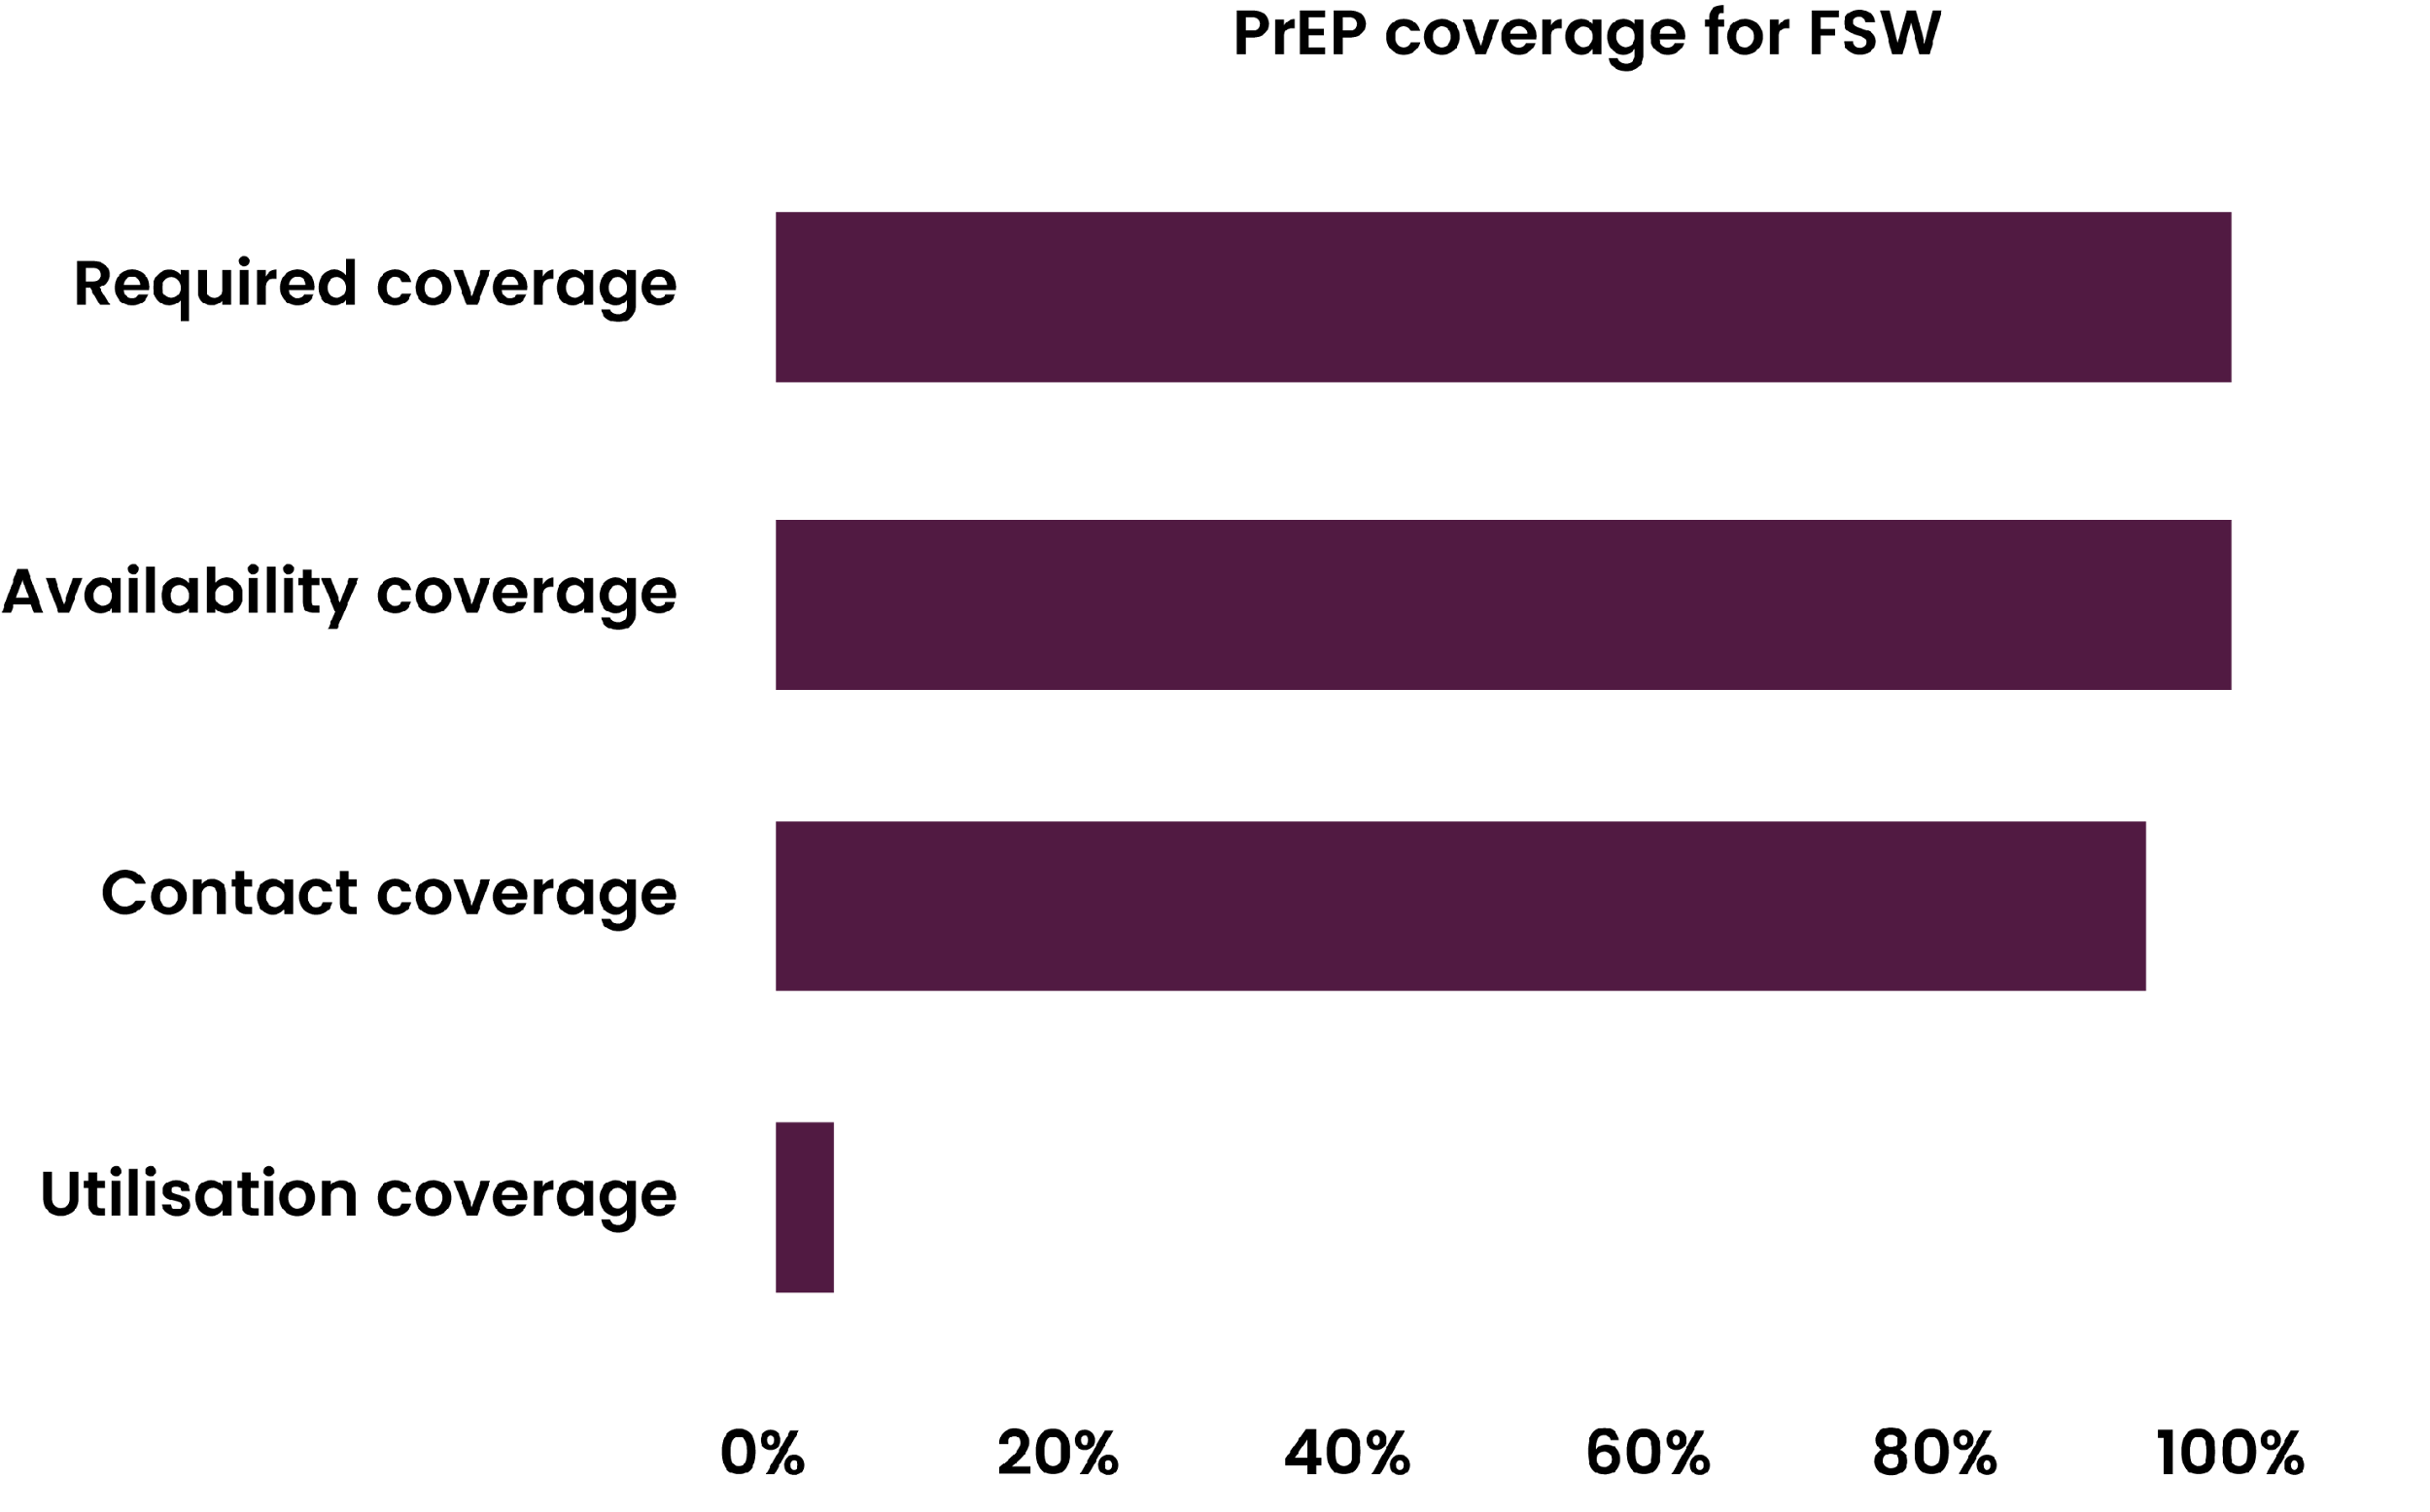


EFFECTIVE PROGRAMME COVERAGE CASCADE
Country Application
UNAIDS
EPC
CPC
CoPCT
In a study on PrEP for FSW in Nairobi, Kenya, the
EPC cascade was applied to measure dimension of programme coverage and understand factors contributing to gaps in HIV prevention programmes.
  While required, availability, and coverage was high (>90%),
  utilisation coverage was very low (only 4.4%).
  The EPC cascade was effective in showing that the biggest hurdle to a successful PrEP strategy was at the utilisation level.
  This finding was reinforced through qualitative data collection.
  Developing the EPC cascade and supplementing with qualitative data enabled a better understanding for
  low PrEP and the development
  of effective interventions.
Source: Bhattacharjee, P., McClarty, L., Isac, S., et al. (2024). Applying the Effective Programme Coverage framework to assess gaps in HIV prevention programmes for female sex workers and men who have sex with men in Nairobi, Kenya: Findings from an expanded Polling Booth Survey. JIAS, 27(Suppl 2), e26240.
Click here to learn more about the application of the
Effective Programme Coverage framework in Kenya
BACK TO CASCADES LIBRARY
NEXT
SLIDE
Notes:
9

Slide 24

EFFECTIVE PROGRAMME COVERAGE CASCADE
There is another approach proposed by Demographic and Health Surveys (DHS) for measuring effective coverage.
UNAIDS
EPC
CPC
CoPCT
DHS has proposed another method for measuring effective programme coverage. The key purpose
of this cascade is to answer the question “Does this intervention offer a health benefit”.
To do this, it integrates measures of quality and effectiveness alongside reach into a single metric
of "effective coverage."
BACK TO CASCADES LIBRARY
NEXT
SLIDE
Notes:
9

Slide 25
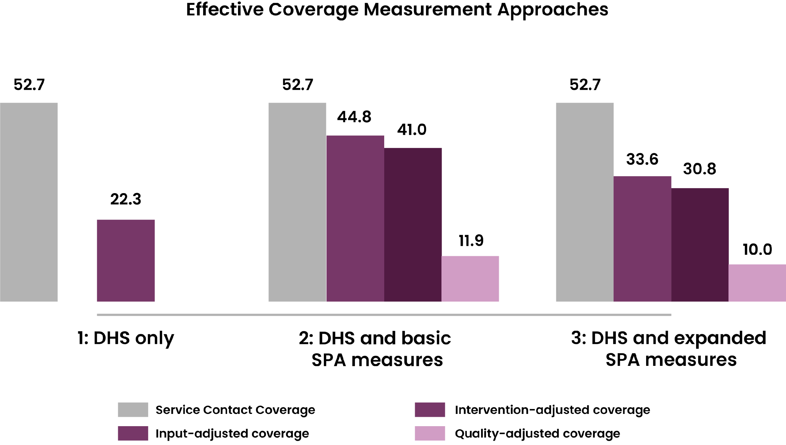
EFFECTIVE PROGRAMME COVERAGE CASCADE
Measuring effective coverage
UNAIDS
EPC
CPC
CoPCT
THERE ARE THREE PRIMARY APPROACHES
PROPOSED BY DHS FOR THE CASCADE.
The first, the DHS-only approach, offers a basic snapshot of service
reach by relying exclusively on self-reported data from Demographic
and Health Surveys (DHS). While this method is useful in contexts
where facility-level data are unavailable, it may be limited in accuracy.
To achieve a more comprehensive and precise understanding of
quality-adjusted coverage it is generally recommended to incorporate health facility assessment data from Service Provision Assessments (SPA).
Two such approaches combine DHS data with SPA information:
  one uses basic SPA measures focused on health facility readiness
  and process quality, and
  the other integrates an expanded set of SPA indicators to provide
  a broader evaluation.
The choice among these approaches depends largely on the availability
of data and the desired level of detail in estimating effective coverage.
Source: Riese, S., Assaf, S., & Pullum, T. (2021). Measurement approaches for effective coverage estimation (DHS Methodological Reports No. 31). ICF.
BACK TO CASCADES LIBRARY
NEXT
SLIDE

Slide 26
EFFECTIVE PROGRAMME COVERAGE CASCADE
Measuring effective coverage
UNAIDS
EPC
CPC
CoPCT
THE INDICATORS FOR THIS CASCADE INCLUDE:
The DHS-only approach for measuring effective coverage
was applied in Haiti, Malawi, Nepal, Senegal, and Tanzania for Antenatal Care (ANC)
and sick childcare.
This approach provided basic measures of service
contact and some intervention coverage. However,
it could not offer insights into service readiness or comprehensive process quality for sick childcare.
The reliance on self-reported data meant that results
for ANC were likely to overestimate quality-adjusted coverage, whereas for sick childcare, it could lead to an underestimation
of intervention-adjusted coverage due to the inflated denominator of children with symptoms rather than
diagnosed illnesses
  Target population: All who need a service or intervention
  Service contact coverage: Proportion of the population
  in need who visit a health service
  Input-adjusted coverage: Proportion who visit a health
  facility that is ‘ready’ (all necessary inputs are available)
  to deliver the required services among those in need
  Intervention coverage: Proportion of the target
  population who receive a needed health intervention
  Quality-adjusted coverage: Proportion of the target population receiving the service according to recommended standards
*This cascade is most appropriate for services that are offered through health facilities.
Click here to learn more about the
DHS Effective Coverage Estimation
BACK TO CASCADES LIBRARY
NEXT
SLIDE

Slide 27




HIV COMBINATION PREVENTION CASCADE (CPC)
HIV Combination Prevention Cascade
UNAIDS
EPC
CPC
CoPCT
This cascade pinpoints specific reasons for programme failure from a user perspective.
EXPLORE OTHER ASPECTS OF THE
CASCADE BY CLICKING ON EACH BOX
The main function of the cascade is to answer the question:
"Where and why are individuals dropping off?"
CORE CASCADES
Target Audience: HIV prevention programme managers at national and subnational levels, including implementing partners, overseeing the implementation, administration, and monitoring and evaluation of HIV prevention programmes.
EXPANDED CASCADE
THERE ARE TWO-LEVEL FORMULATIONS FOR THE CASCADE:
Core Cascade
Provides a high-level view of gaps in HIV prevention use across countries or groups to guide advocacy and resource allocation.
STEPS TO ADAPT AND
POPULATE THE CASCADE
Extended cascade
Explains the reasons behind these gaps (e.g. lack of knowledge
or risk perception) and identifies interventions to address them.
CONSIDERATIONS
The HIV-CPC framework is designed to systematically assess and enhance the effectiveness of HIV prevention programmes. It outlines sequential steps that individuals within priority populations must navigate - from initial motivation to access and effectiveness use of prevention methods - thereby identifying specific gaps and underlying reasons at each stage.
DATA REQUIREMENTS
COUNTRY APPLICATION
CLICK BACK TO CASCADES LIBRARY
Notes:
9

Slide 28
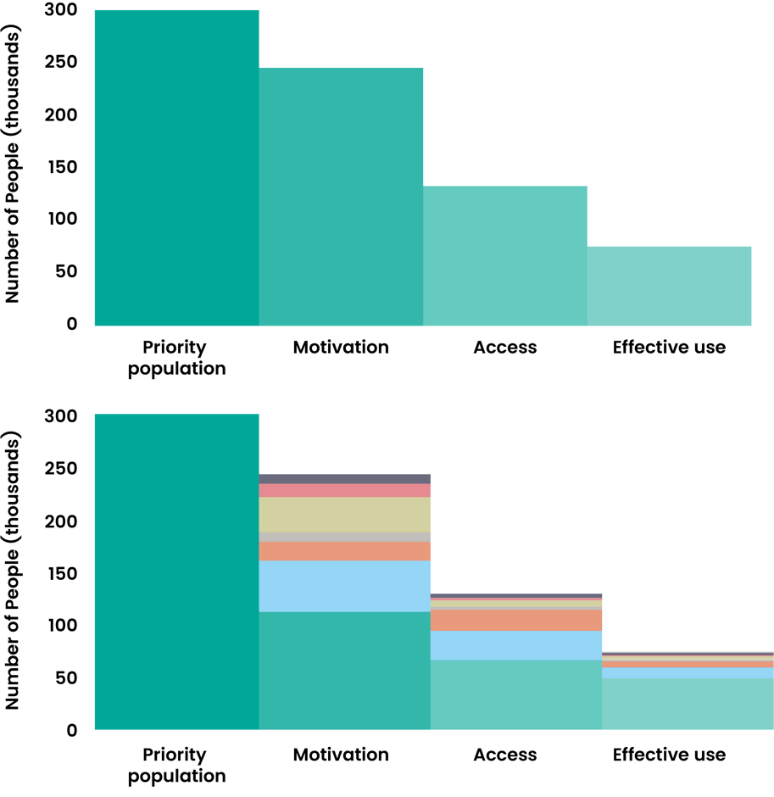
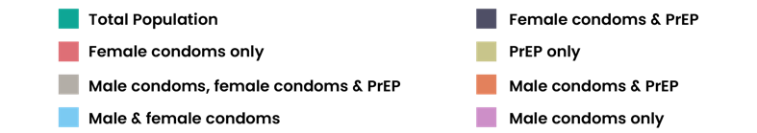
HIV COMBINATION PREVENTION CASCADE (CPC)
Core Cascade
UNAIDS
EPC
CPC
CoPCT
CLICK HERE TO VIEW EXTENDED CASCADES
PURPOSE OF THE CORE CASCADE:
To measure, report, and compare the use of primary HIV prevention methods across different populations and countries in a standardised way.
To track progress towards achieving the UNAIDS target of 95% coverage of effective HIV prevention methods for those at risk.
CORE CASCADE INDICATORS:
The core cascade measure four key stages:
Priority population: The total number of individuals within a specific
group who are at risk of HIV and would benefit from a prevention method.
Motivation: The percentage of the priority population that expresses a desire or intention to use a prevention method.
Access: The percentage of those who are motivated and are also
able to access the prevention method.
Effective Use: The percentage of those with access who are currently
and correctly using the prevention method.
Combination prevention is central to the HIV-CPC model, as the cascade
measures the use of one or more effective prevention methods.
The “effective use” stage reflects the proportion of people using at least one method, alone or in combination, providing a holistic view of the prevention landscape rather than focusing on single interventions.
BACK TO CASCADES LIBRARY
NEXT
SLIDE
Notes:
9

Slide 29
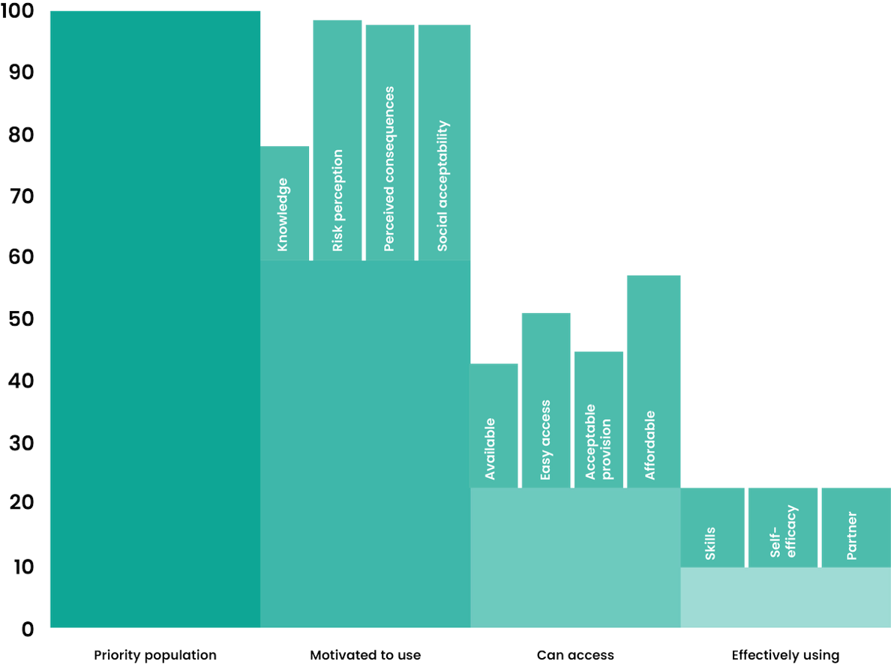
HIV COMBINATION PREVENTION CASCADE (CPC)
Extended Cascade
UNAIDS
EPC
CPC
CoPCT
CLICK HERE TO VIEW CORE CASCADES
Purpose of the extended cascade:
To identify the underlying barriers that prevent people from moving from
one stage of the core cascade to the next.
To inform the design of targeted, multi-level intervention that address the
specific reasons for gas in motivation, access, or effective use.
Extended cascade indicators:
The extended cascade breaks down the drop-offs
between the core indicators into more specific reasons:
Examples of reasons for lack of motivation:
  Lack of knowledge about prevention methods
  Low perception of personal risk
  Fear of negative consequences (e.g., side effects, social stigma)
  Lack of social acceptability or prohibitive social norms
  Examples of reasons for lack of access:
  Lack of availability of the prevention method
  Services are not easy to access (e.g., distance, hours)
  The provision of services is not acceptable
  (e.g., lack of privacy, judgmental staff)
  Lack of affordability
  Examples of reasons for lack of effective use:
  Lack of skills to use the method correctly
  Low self-efficacy or confidence in one's ability to use the method
  Lack of partner support or cooperation
BACK TO CASCADES LIBRARY
NEXT
SLIDE
Notes:
9

Slide 30
HIV COMBINATION PREVENTION CASCADE (CPC)
Steps to adapt and populate the cascade
UNAIDS
EPC
CPC
CoPCT
Populating this cascade involves several steps, summarised below,
with extra guidance on Step 2 - a key part in the process.
Define the focus population and
prevention method you aim to target
STEP 1
Define and measure the HIV Prevention
cascade for the chosen population - main bars
*Click here to find out more about STEP 2
STEP 2
Populate the explanatory sub bars
STEP 3
Measure the individual prevention method
motivation, access and use
STEP 4
Analyse the gaps within the core cascade
to develop the extended cascade
STEP 5
BACK TO CASCADES LIBRARY
NEXT
SLIDE
Notes:
9

Slide 31
HIV COMBINATION PREVENTION CASCADE (CPC)
Steps to adapt and populate the cascade
UNAIDS
EPC
CPC
CoPCT
STEP 2: Defining and measuring the cascade indicators
It is important to establish a clear definition for each indicator (the numerator and denominator) and measure accordingly.
CASCADE INDICATOR | INDICATOR DEFINITION
PRIORITY POPULATION | The number of individuals in the population of interest who would benefit from HIV prevention methods (100%)
MOTIVATION | Numerator: Number of individuals reporting to be motivated to use a prevention method Denominator: Number of individuals in priority population
ACCESS | Numerator: Number of individuals reporting to be motivated to use and have access to a prevention method. Denominator: Number of individuals in priority population
USE | Numerator: Number of individuals reporting to be motivated to use, have access to, and effectively using a prevention method Denominator: Number of individuals in priority population
BACK TO CASCADES LIBRARY
NEXT
SLIDE
Notes:
9

Slide 32

HIV COMBINATION PREVENTION CASCADE (CPC)
Considerations
UNAIDS
EPC
CPC
CoPCT
The HIV Combination Prevention cascade should be considered when the
goal is to understand specific service delivery gaps and underlying individual-level reasons for gaps.
Consider using the HIV
prevention cascade when you:
However, you may
encounter challenges when:
  Aim to adapt and populate a cascade that provides comparable information across prevention methods.
  Need a generic design that allows for the creation of a single combination cascade for high-level monitoring (comparing to international targets).
  Seek to identify service delivery gaps in prevention programmes by leveraging the cascade’s explanatory framework.
  The cascade has limited flexibility to accommodate method-specific programme cascades. Nevertheless, individual prevention methods can still be reflected through separate, programme-specific cascades using routine programme data.
BACK TO CASCADES LIBRARY
NEXT
SLIDE
Notes:
9

Slide 33
HIV COMBINATION PREVENTION CASCADE (CPC)
Data Requirements
UNAIDS
EPC
CPC
CoPCT
Population-Based Surveys are the preferred data source
for a complete picture of prevention needs and gaps
DATA SOURCES:
Population-Based Surveys (e.g. DHS):
This is the preferred data source for the HIV-CPC. It provides a representative sample of the entire population,
including those not reached by existing health programmes. This allows for a complete picture of prevention needs and gaps.
Programme data:
While useful for routine monitoring, it is often incomplete as it only captures individuals who have already interacted with a program.
DATA REQUIREMENTS:
To measure the cascade, a small number of additional questions need to be incorporated into existing population surveys.
For the core cascade:
Questions that assess desire to use a method, ability to access it, and current use.
For the extended cascade:
More detailed questions about knowledge, risk perception, specific barriers to access, and factors affecting correct and consistent use.
BACK TO CASCADES LIBRARY
NEXT
SLIDE
Notes:
9

Slide 34
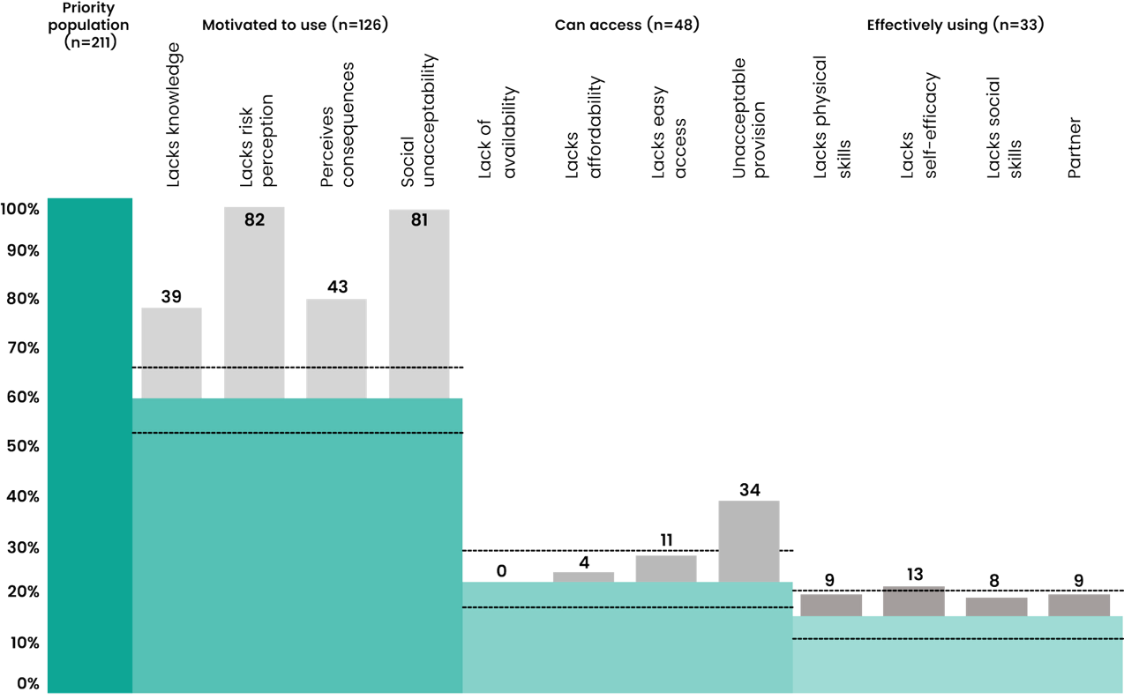


HIV COMBINATION PREVENTION CASCADE (CPC)
Country Application
UNAIDS
EPC
CPC
CoPCT
‘Extended’ Harare HIV Prevention Cascade
In Zimbabwe, HIV prevention cascades have been used as a diagnostic tool to pinpoint specific barriers preventing young people from using prevention methods.
  For adolescent girls and young women, the cascade revealed that low-risk perception and poor access were barriers to PrEP uptake.
  This insight let to the creation of an interactive counselling game and a text messaging system to improve both uptake and consistent use, as well as community-led interventions to tackle broader social obstacles.
  For young men, the cascade highlighted two main obstacles to voluntary medical male circumcision: lack
  of motivation and poor access.
  This led to the design of an intervention which used financial incentives and education to engage young
  men in PrEP services.
Source: Moorhouse, L., Imai-Eaton, J. W., Dadirai, T., et al. Measurement and interpretation of the Harare HIV combination prevention cascade in priority populations: A population survey of adolescent girls and young women and young men in Zimbabwe.
Click here to learn more about the Harare HIV Combination Prevention Cascade
BACK TO CASCADES LIBRARY
NEXT
SLIDE
Notes:
9

Slide 35




HIV CONTINUUM OF PREVENTION, CARE, AND TREATMENT CASCADE (COPCT)
HIV Continuum of Prevention,
UNAIDS
EPC
CPC
CoPCT
Care, and Treatment Cascade
EXPLORE OTHER ASPECTS OF THE
CASCADE BY CLICKING ON EACH BOX
This cascade is a system-wide map that links
HIV prevention with treatment for PLHIV.
INDICATORS
The main function of the cascade is to answer the question: "How does the entire HIV response system connect?"
STEPS TO ADAPT AND
POPULATE THE CASCADE
Target Audience: Policy makers and Programme managers.
CONSIDERATIONS
The HIV CoPCT cascade visually tracks how individuals engage with HIV services across the continuum of care. It highlights where people drop off - revealing system “leaks” - so that implementers can target interventions and resources more effectively. By identifying these gaps, the cascade supports efforts to improve health outcomes, reduce community viral load, and prevent new infections, contributing to progress toward the 90-90-90 goals.
DATA REQUIREMENTS
COUNTRY APPLICATION
CLICK BACK TO CASCADES LIBRARY
Notes:
9

Slide 36
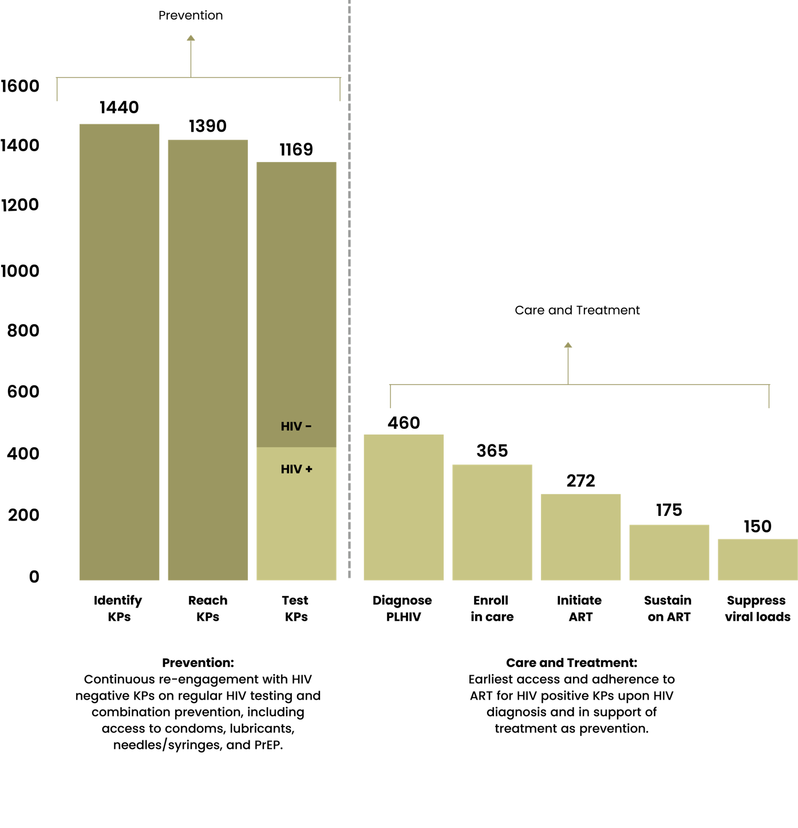
HIV CONTINUUM OF PREVENTION, CARE, AND TREATMENT CASCADE (COPCT)
Indicators
UNAIDS
EPC
CPC
CoPCT
THE COPCT CASCADE INVOLVES
THE FOLLOWING INDICATORS:
INDICATORS:
Key populations:
Number of people in a specific KP group in each locality
(size estimation)
Reach key populations:
Number and percentage of individual KPs reached with
prevention interventions by community outreach workers
or through other programming
Diagnose PLHIV:
Number and percentage of KPs who received HIV testing and counselling and their test results
Enroll in care:
Number and percentage of KPs living with HIV enrolled in clinical care
Initiate ART:
Number and percentage of HIV-positive KPs enrolled on ART in accordance with nationally approved protocol or WHO standards
Sustain on ART:
Number and percentage of HIV-positive KPs known to
be alive and on treatment 12 months after initiation of ART
Suppress viral load:
Number and percentage of HIV-positive KPs on ART
tested with suppressed viral load (<1000 copies/ml)
BACK TO CASCADES LIBRARY
NEXT
SLIDE
Notes:
9

Slide 37
HIV CONTINUUM OF PREVENTION, CARE, AND TREATMENT CASCADE (COPCT)
Steps to adapt and populate the cascade
UNAIDS
EPC
CPC
CoPCT
Populating this cascade involves several steps, summarised below,
with extra guidance on Step 2 – a key part in the process.
Define your objective: Define the target
population you aim to focus on.
STEP 1
Define and measure the cascade steps
*Click here to find out more about STEP 2
STEP 2
Review cascade data, identify leaks and investigate
why they occur (access, uptake barriers, structural
barriers, data quality issues).
STEP 3
Based on the reasons for the gaps, develop
strategies for improving cascade performance.
STEP 4
BACK TO CASCADES LIBRARY
NEXT
SLIDE
Notes:
9

Slide 38
HIV CONTINUUM OF PREVENTION, CARE, AND TREATMENT CASCADE (COPCT)
Steps to adapt and populate the cascade
UNAIDS
EPC
CPC
CoPCT
STEP 2: Defining and measuring the cascade indicators
It is important to establish a clear definition for each indicator and measure accordingly.
CASCADE STEP | INDICATOR DEFINITION
IDENTIFY KEY POPULATIONS | Number of people in a specific KP group in a given locality (size estimation)
REACH KEY POPULATIONS | Numerator: Number of individual, specific KPs reached with prevention interventions by community outreach workers or through other programming Denominator: Number of people in a specific KP group estimated in a given locality (size estimation from previous indicator).
TEST KEY POPULATIONS | Numerator: Number of KPs who received HTC and their test results Denominator: Number of KPs reached by community outreach workers or through other programming.
DIAGNOSE PLHIV | Numerator: Number of KPs who received HIV-positive test results and post-test counselling Denominator: Number of KPs who received HTC and their test results
ENROLL IN CARE | Numerator: Number of HIV-positive KPs enrolled in clinical care (including pre-ART and ART) Denominator: Number of KPs who received HIV-positive test results and post-test counselling
INITIATE ART | Numerator: Number of HIV-positive KPs enrolled on ART in accordance with nationally approved protocol or WHO standards Denominator: Number of HIV-positive KPs enrolled in clinical care
SUSTAIN ON ART | Numerator: Number of HIV-positive KPs known to be alive and on treatment 12 months after initiation of ART Denominator: Number of HIV-positive KPs receiving ART in accordance with nationally approved protocol or WHO standards
SUPPRESS VIRAL LOAD | Numerator: Number of HIV-positive KPs on ART tested with suppressed viral load (<1000 copies/ml) Denominator: Number of HIV-positive KPs known to be alive and on treatment 12 months after initiation of ART
BACK TO CASCADES LIBRARY
NEXT
SLIDE
Notes:
9

Slide 39

HIV CONTINUUM OF PREVENTION, CARE, AND TREATMENT CASCADE (COPCT)
Considerations
UNAIDS
EPC
CPC
CoPCT
The CoPCT cascade should be considered when the goal is to have an overview of the continuum of prevention, care, and treatment
Consider using the HIV CoPCT
cascade when you:
However, you may
encounter challenges when:
  Need to identify gaps or leaks in your HIV service delivery. The cascade is a powerful tool for pinpointing where individuals are lost to follow-up along the continuum of prevention, care and treatment.
  Aim to improve outcomes for key populations. The ultimate goal of the cascade is to guide efforts toward achieving viral suppression, and it helps focus on the specific needs and barriers faced
  by these groups.
  Linking between different services. Even if individual services are strong, people may be lost to follow-up if there are poor connections and referral systems between outreach, testing, diagnosis, and
  treatment programmes.
  Aggregated data may hide disparities among different
  key population groups.
BACK TO CASCADES LIBRARY
NEXT
SLIDE
Notes:
9

Slide 40
HIV CONTINUUM OF PREVENTION, CARE, AND TREATMENT CASCADE (COPCT)
Data Requirements
UNAIDS
EPC
CPC
CoPCT
The indicators for the CoPCT cascade require diverse sources to get a
comprehensive understanding of the HIV prevention, care, and treatment continuum.
  General population open-cohort serosurvey: includes data on HIV infection status;
  sexual behaviour; availability, uptake and adherence to HIV services.
  Identify key populations: Size estimates of key populations in specific areas
  Reach key populations: Databases of organisations providing outreach,
  e.g., community based KP organisations
  Test key populations: Databases of organisations providing HIV testing services,
  e.g., community-based KP organisations, government clinics and hospitals
  Diagnose PLHIV: Databases of organisations providing HIV testing services,
  e.g., community-based KP organisations, government clinics and hospitals
  Enrol in care: Databases of organisations providing HIV testing services,
  e.g., community-based KP organisations, government clinics and hospitals
  Initiate ART: Local and national ARV client databases
  Sustain on ART: Local and national ARV client databases
  Suppress viral load: Local and national ARV client databases
BACK TO CASCADES LIBRARY
NEXT
SLIDE
Notes:
9

Slide 41
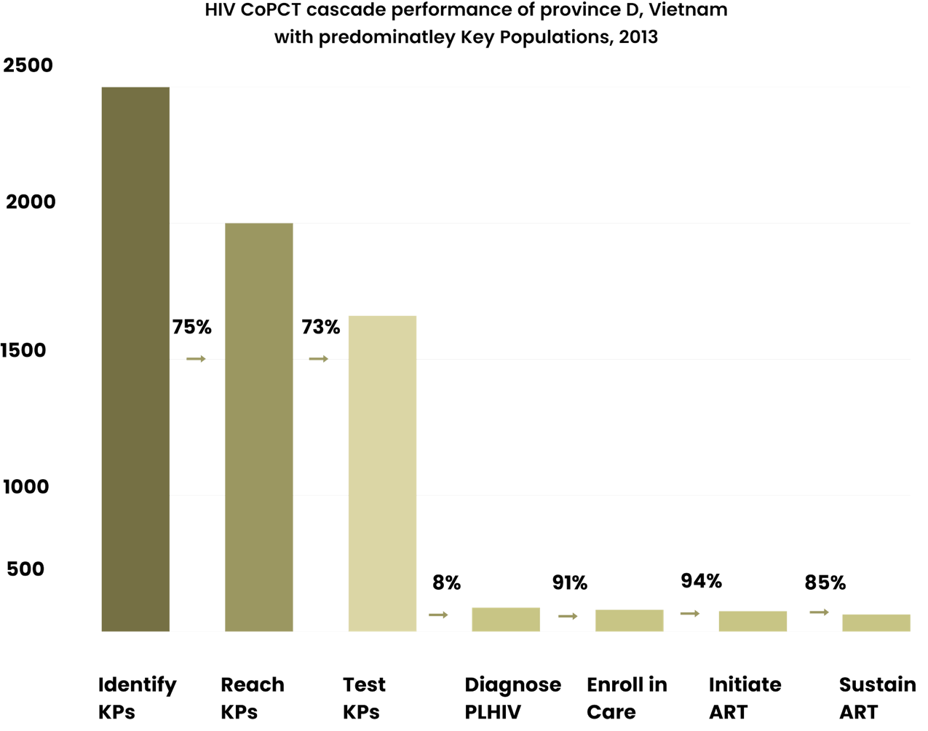


HIV CONTINUUM OF PREVENTION, CARE, AND TREATMENT CASCADE (COPCT)
Country Application
UNAIDS
EPC
CPC
CoPCT
In a Vietnamese province with a highly concentrated HIV epidemic, the full HIV CoPCT cascade was used to assess how well key populations were reached with prevention and care services.
  The cascade showed very high retention rates for enrolment in care (91%), initiation of ART (94%), and sustaining on ART (85%).
  It also visually pinpointed significant drop-offs in the
  early stages of HIV prevention (identifying, reaching,
  and testing key populations).
  These findings guided strategic interventions
  and resource allocation to close these gaps.
Source: USAID, FHI 360, & LINKAGES. (2015). HIV cascade framework for key populations.
Click here to learn more about the CoPCT cascade
BACK TO CASCADES LIBRARY
NEXT
SLIDE
Notes:
9

Slide 42
Cascades Summary
Cascades Summary
UNAIDS
EPC
CPC
CoPCT
CASCADE
UNAIDS
EPC
CPC
CoPCT
QUESTION
How many people were reached
by the prevention method?
How many people were effectively reached by a prevention method?
Where and why are individuals dropping off the prevention cascade?
How does the entire HIV
response system connect?
FOCUS
The basic HIV prevention cascade focuses on monitoring the reach/coverage, uptake and use
of at least one prevention method
in specific populations and
geographical areas at a specified
point in time.
The EPC framework uses a programme science approach. It focuses on understanding effective coverage.
It is combined with qualitative research to understand reasons for gaps to develop targeted, evidence-based solutions.
The HIV-CPC framework systematically assesses HIV prevention effectiveness by mapping the steps priority populations take—from motivation to access and effective use—helping identify gaps and understand the underlying individual-level reasons for gaps.
The HIV CoPCT cascade visually tracks how individuals engage with HIV services across the continuum of care. It highlights where people drop off at different levels - revealing system gaps - so that implementers can target interventions and resources more effectively.
UNIQUE
ADVANTAGES
AND LIMITATIONS
The UNAIDS Basic Cascade approach reveals major gaps in programming, however, expanded cascade frameworks or other analytical tools may be used to understand the
reasons for these gaps.
The EPC provides a measure of programme impact and health system performance. The EPC focuses on the aggregated outcome, providing a powerful metric for evaluating if a programme is achieving its intended public health goal.
The CPC offers a detailed, step-by-step diagnostic focused on the individual’s prevention journey. By pinpointing where people drop off (e.g., low motivation or poor adherence), it enables targeted interventions to address specific gaps.
The CoPCT offers a holistic view by linking HIV prevention for people not living with HIV with the care and treatment cascade for PLHIV, tracking individuals from testing through prevention, care, retention, and viral suppression.
GENERAL CONSIDERATION
  There are ethical and safety concerns with data collection. Identifying individuals as members of a key population may expose them to stigma, discrimination, or even legal repercussions. Data collection must be handled with care to ensure confidentiality and safety.
  There may be challenges in determining denominators for the cascade indicators at a particular point in time, as they are likely to change over time (non linear process).
  Routine population survey data required by the method may not be available or could be outdated.
BACK TO CASCADES LIBRARY
NEXT
SLIDE
Notes:
35

Slide 43




How i2i can support you in adapting and populating prevention cascades
If you are looking to adapt and populate a HIV prevention cascade, i2i can provide the following support:
  Link you to a peer country: We can link you to a peer country that has completed prevention cascades to learn from their experience and collaborate through a Link & Learn session.
  Link you to an expert: We can link you to experts who have adapted and populated preventions cascades, ask questions and get support in completing your cascades.
  Share additional resources: We can support you in navigating available resources to effectively complete a cascade.
By leveraging these tools and support, stakeholders can significantly improve the monitoring, evaluation, and
strategic planning of HIV prevention programmes.
For further information or support on how to use or apply this tool, contact: info.i2i@genesis-analytics.com
BACK TO CASCADES LIBRARY
LAST
SLIDE
Notes:
36

Slide 44
References
UNAIDS. (2021). Creating HIV prevention cascades: Operational guidance on a tool for monitoring programmes.
Joint United Nations Programme on HIV/AIDS (UNAIDS). https://www.unaids.org/en/resources/documents/2021/20211125_creating-hiv-prevention-cascades
Bhattacharjee P, McClarty L, Isac S, Kimani J, Emmanuel F, Kabuti R, Kinyua A, Kombo BK, Owek C, Musyoki H, Kiplagat A, Arimi P, Shaw SY, Gandhi M, Malone S, Blanchard J, Garnett G, Becker ML. Applying the Effective Programme Coverage framework to assess gaps in HIV prevention programmes for female sex workers and men who have sex with men in Nairobi, Kenya: findings from an expanded Polling Booth Survey. J Int AIDS Soc. 2024. https://doi.org/10.1002/jia2.26240
Riese, Sara, Shireen Assaf, and Thomas Pullum. 2021. Measurement Approaches for Effective Coverage Estimation.
DHS Methodological Reports No. 31. Rockville, Maryland, USA: ICF. https://dhsprogram.com/pubs/pdf/MR31/MR31.pdf
Louisa Moorhouse, Jeffrey W. Imai-Eaton, Tawanda Dadirai, Rufurwokuda Maswera, Tafadzwa Museka, Phyllis Mandizvidza, Freedom Dzamatira, Blessing Tsenesa, Timothy B Hallett, Constance Nyamukapa, Simon Gregson.Measurement and interpretation of the Harare HIV combination prevention cascade in priority populations: A population survey of adolescent girls and young women and young men in Zimbabwe. https://pubmed.ncbi.nlm.nih.gov/39830272/
South to South HIV Prevention Learning Network. (2024, June 6). SSLN Webinar | HIV prevention cascade hosted by Zimbabwe. https://www.hivinterchange.com/
FHI 360/LINKAGES. (2015). HIV cascade framework for key populations: Across the continuum of HIV services for key populations (USAID/PEPFAR). https://www.fhi360.org/wp-content/uploads/drupal/documents/linkages-hiv-cascade-framework-oct15.pdf
BACK TO CASCADES LIBRARY
LAST
SLIDE
Notes:
36

Slide 45
To learn more about HIV prevention cascades, explore these key resources:
Hargreaves JR, Delany-Moretlwe S, Hallett TB, Johnson S, Kapiga S, Bhattacharjee P, Dallabetta G, Garnett GP. The HIV prevention cascade: integrating theories of epidemiological, behavioural, and social science into programme design and monitoring. Lancet HIV. 2016. https://www.thelancet.com/journals/lanhiv/article/PIIS2352-3018(16)30063-7/fulltext
Schaefer R, Gregson S, Fearon E, Hensen B, Hallett TB, Hargreaves JR. HIV prevention cascades:
A unifying framework to replicate the successes of treatment cascades. Lancet HIV. 2019. https://pmc.ncbi.nlm.nih.gov/articles/PMC7025885/
Krishnaratne S, Hensen B, Cordes J, Enstone J, Hargreaves JR. Interventions to strengthen
the HIV prevention cascade: a systematic review of reviews. Lancet HIV. 2016. https://pubmed.ncbi.nlm.nih.gov/27365205/
Learn more about Insight 2 Implementation and the South-to-South HIV
Prevention Learning Network (SSLN) here: https://www.hivinterchange.com/
BACK TO CASCADES LIBRARY
LAST
SLIDE
Notes:
36

Slide 46

Acknowledgements
This content was collated with the expertise of Tamika Fellows; Rediet Gebrehiwot; Lekoetse Mahao; Lulama Lunika; and Sanyukta Mathur
We are grateful for the careful reviews
by Ayesha Ismail; Sarah Magni; Kerry Mangold; Parinita Bhattacharjee; and Leigh McClarty
Suggested citation:
Insight 2 Implementation (2025): An offering of the SSLN. Guide to HIV Prevention Cascades
DOI: 10.5281/zenodo.17598782
Notes:
37

