Slide 1


Što imaš u
ormaru?

Slide 2
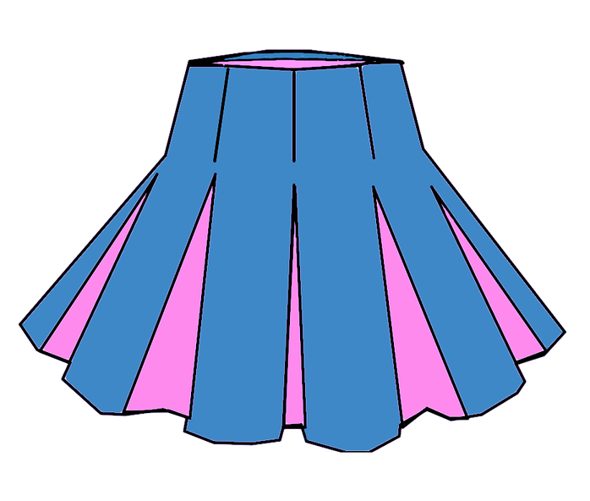
Gdje su moje stvari?
Look at the following set of pictures on slide #3. Place them in the appropriate category by writing the corresponding word of the item in the chart below.
When you are done, meet with another classmate. Ask them where do they keep each of the items. Drag and drop each item in the appropriate column (slide #4). Compare your charts and check if you got everything right.
Na primjer:
Moja suknja je u ormaru.
*Submit your video recording through our LMS.

Slide 3

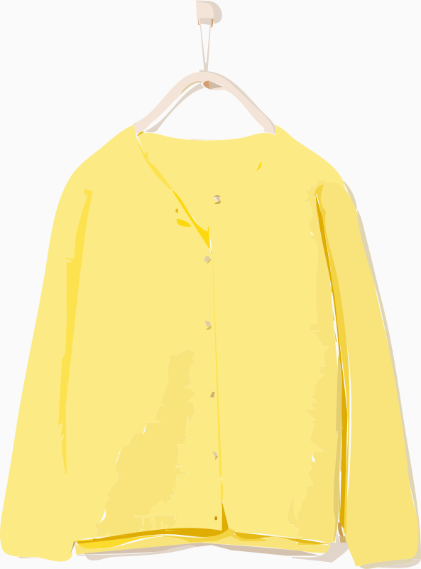
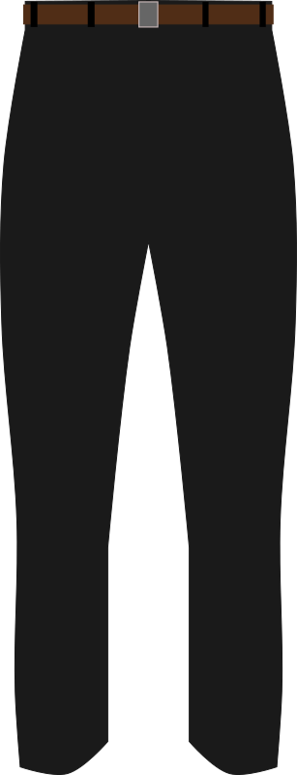

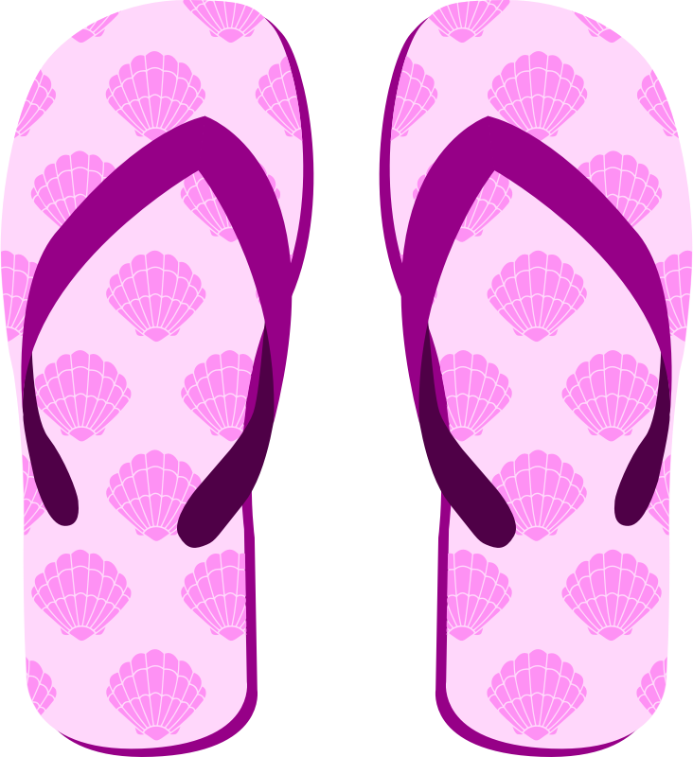
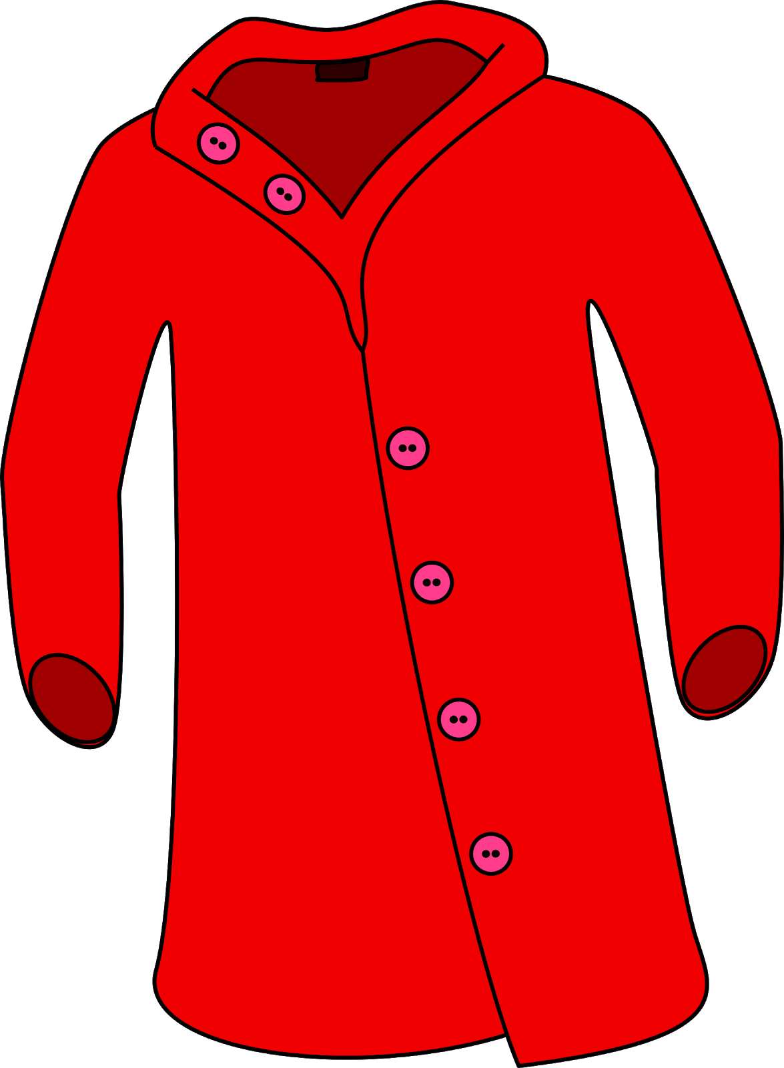
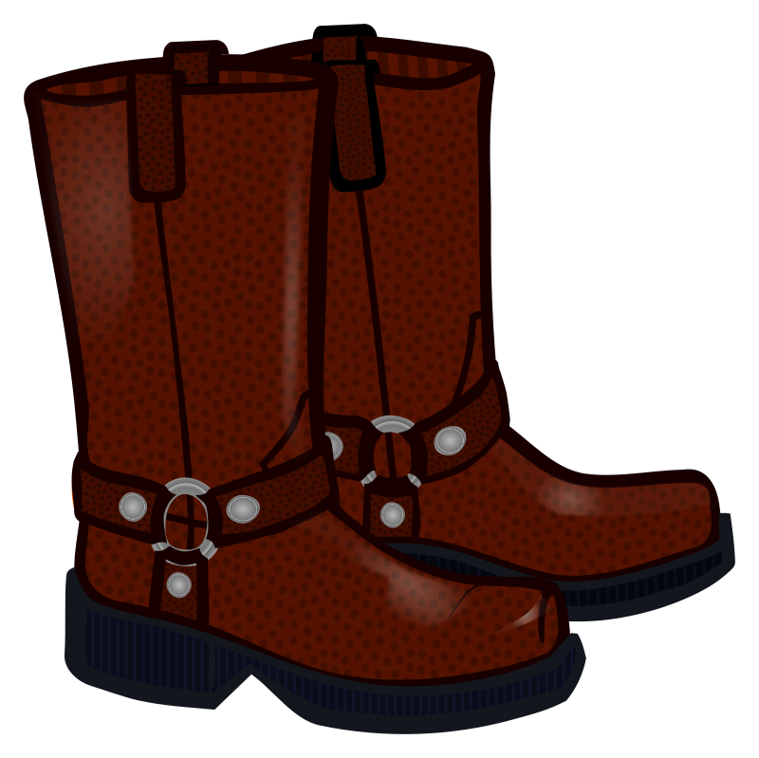
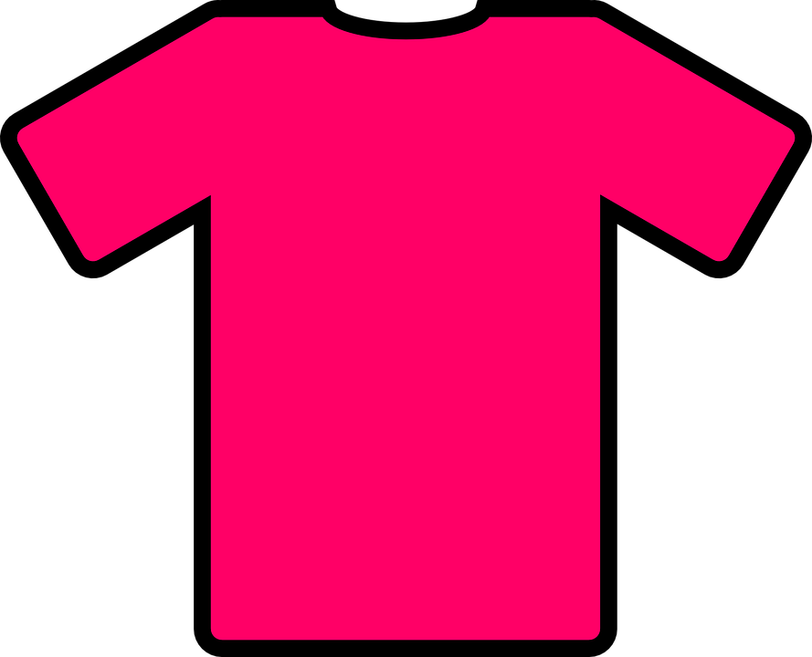
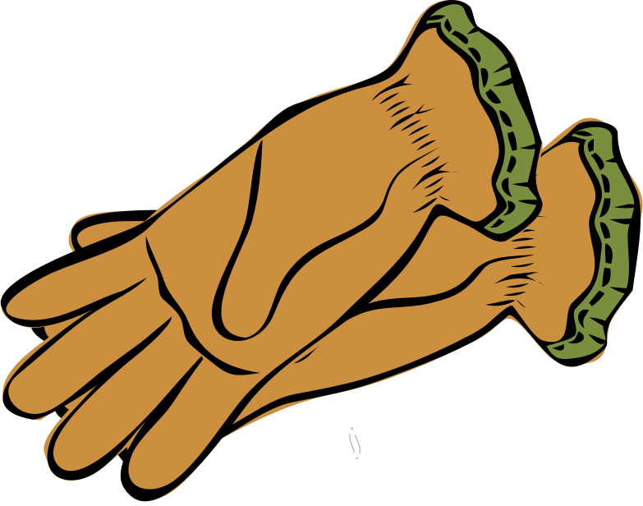
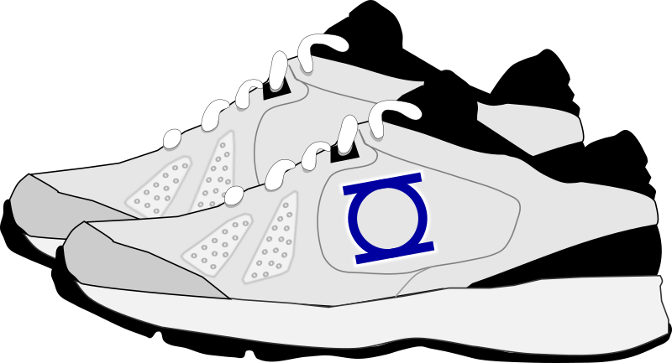

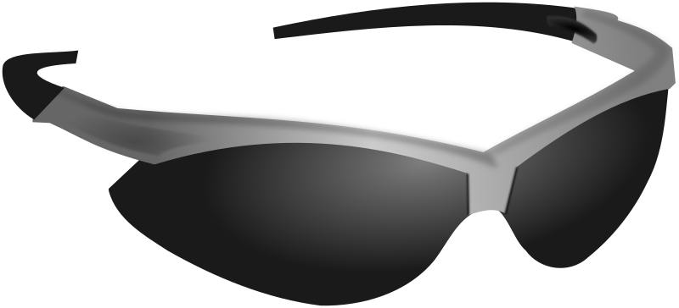
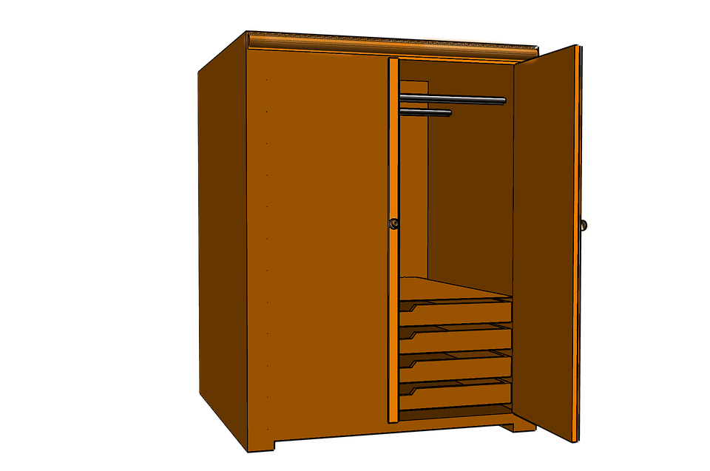

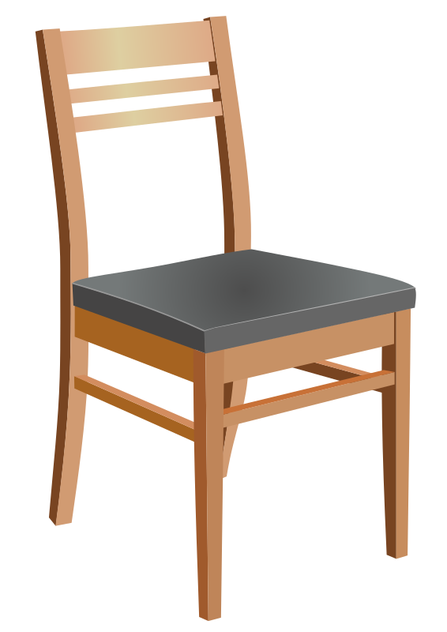
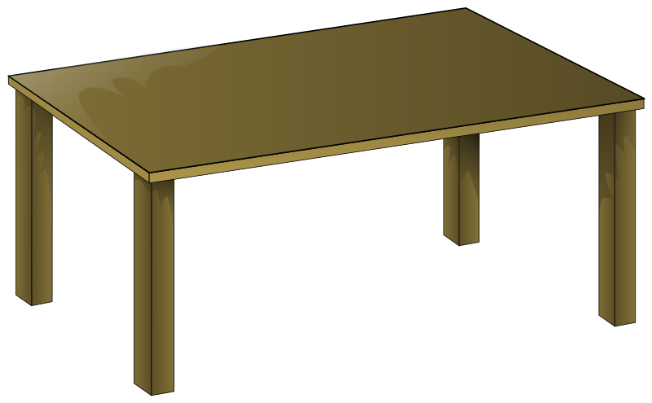
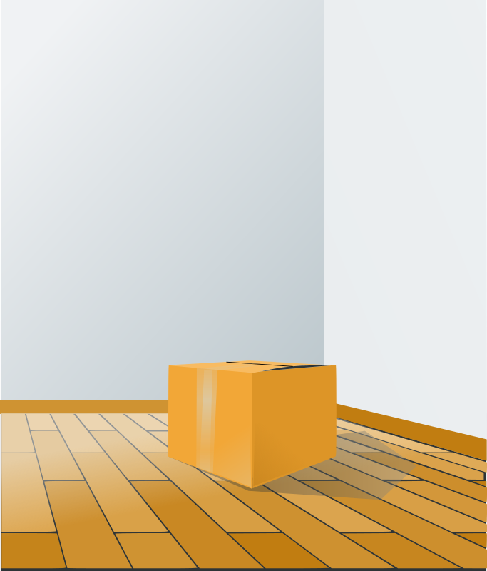
Moje stvari su…
u ormaru | na krevetu | na stolici | na stolu | na podu
Notes:
https://www.maxpixel.net/Closet-Cupboard-Storage-Cabinet-Wardrobe-Furniture-3300326
https://openclipart.org/detail/244911/brown-bed-with-brown-blanket
https://openclipart.org/detail/167460/wooden-chair
https://openclipart.org/detail/26282/wooden-table
https://openclipart.org/detail/60751/box-over-wood-floor

Slide 4
Gdje su tvoje stvari?
Based on what your classmate tells you, drag and drop each item in the appropriate column.
u ormaru | na krevetu | na stolici | na stolu | na podu
Notes:
https://www.maxpixel.net/Closet-Cupboard-Storage-Cabinet-Wardrobe-Furniture-3300326
https://openclipart.org/detail/244911/brown-bed-with-brown-blanket
https://openclipart.org/detail/167460/wooden-chair
https://openclipart.org/detail/26282/wooden-table
https://openclipart.org/detail/60751/box-over-wood-floor

Slide 5
Image attributions for applicable slides are listed on the slide they appear. All other images used on slideshow in the public domain and no not require attribution.
Links to image sources are in the speaker notes for each slide.

Slide 6

This work is licensed under Creative Commons Attribution-ShareAlike 4.0 License

