Slide 1
How to plan for the world of work
This session is aimed at Key Stage Four (recommended for Year 10)

Slide 2
Unit outline
Session 1 | Session 2 | Session 3 | Session 4 | Session 5 | Session 6
Professional services careers | Apprenticeships | Entrepreneurship | Understanding gig work and employment rights | Speaking up at work | Creating a career plan

Slide 3
Having a respectful learning environment
We will listen to each other respectfully
We will avoid making judgements or assumptions about others
We will comment on what has been said, not the person who has said it
We won’t put anyone on the spot and we have the right to pass
We will not share personal stories or ask personal questions
If there is a question that you do not wish to ask aloud, you can write it on a post-it note which will be collected throughout the session and answered at the end
Notes:
Teacher delivery
Students should be invited to ask questions and they should be provided with an opportunity to ask questions anonymously. It is useful to have a question box or allocated space on the whiteboard for students to share questions.
It is suggested that students are provided with post-its or slips to write their questions on and as the teacher circulates throughout the lesson these questions can be collected and answers throughout the session or using an allocated ‘question time’ at the end of the session.
Students can be invited to respond to questions asked by their peers. If responses to questions are based on personal preference or opinion, the teacher should be clear to preface any answers with this.

Slide 4
4
Session 4:
Understanding gig work and your rights

Slide 5
By the end of the session, I will be able to:
Describe key characteristics of the gig economy
Understand workers’ rights and how they relate to the gig economy
Assess the protection of workers rights in the gig economy

Slide 6

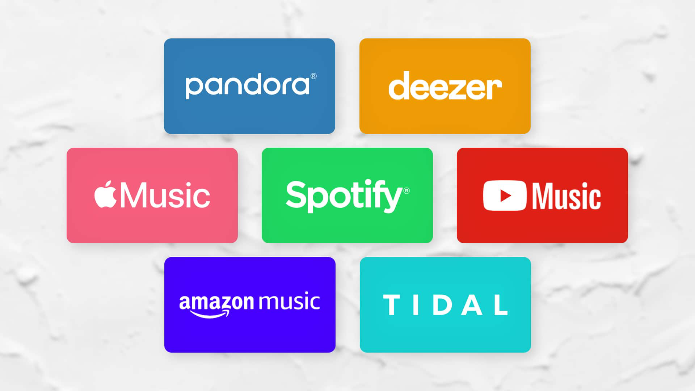


Starter: discussion
Discussion with your partner:
How do musicians earn a living?
Consider factors such as hours of work, pay and employment rights.
Stretch: how might this be similar to the work of a delivery driver?
ⓘ Musicians now rely far more on live gigs and merchandise sales, as record sales have declined since the rise of online streaming.
Notes:
Teacher delivery
Present question to students and take a small handful of responses. Students should identify record sales, streaming, and live performances. As soon as a student identifies live performances, stick with this theme. Use the prompt questions below to deepen understanding of where the term ‘gig economy’ comes from.
Prompt questions
How might musicians earn money if they have not released a new song or album in a while?
Are live performances a stable source of income?
Would this be the same for all musicians?
What characteristics would determine whether live performances will be a stable source of income?
Teacher explanation
The term ‘gig economy’ comes from the idea of live performances, with each individual piece of work that a person engages in being similar to a gig. It is used to describe aspects of the labour market that rely heavily on short-term contracts/freelance work, rather than permanent jobs.

Slide 7
Working as a musician is one type of job in the gig economy…
ⓘ The gig economy has its name because work is done in short-term, flexible jobs: similar to “gigs” in music, where a gig means a single performance or job.

Slide 8
Activity: on the table, tick each characteristic as either gig worker or employee
Employee ✅
Gig worker ✅
Resource 1: Part 1

Slide 9
Working characteristic | Employee | Gig worker
Works as an independent contractor or freelancer
Has a permanent, ongoing job
Usually paid per task or project
Receives benefits (holiday pay, pension, sick pay)
Uses digital platforms or apps to find work
Fixed hours and location set by employer
Can choose when and where to work
Regular, predictable income
High flexibility and independence
Work is short-term or project-based
Answers

Slide 10
Working characteristic | Employee | Gig worker
Works as an independent contractor or freelancer |  | ✅
Has a permanent, ongoing job | ✅
Usually paid per task or project |  | ✅
Receives benefits (holiday pay, pension, sick pay) | ✅
Uses digital platforms or apps to find work |  | ✅
Fixed hours and location set by employer | ✅
Can choose when and where to work |  | ✅
Regular, predictable income | ✅
High flexibility and independence |  | ✅
Work is short-term or project-based |  | ✅

Slide 11









Gig work opportunities
TaskRabbit: Chores, DIY projects
eBay: marketplace
Uber: taxi
Fiverr: freelance services marketplace
Etsy: sell handmade or vintage items
Deliveroo: food delivery
Just Eat: food delivery
AirBnb: rent out your house
Depop: sell used clothes

Slide 12

Gig work opportunities
Where on this scale might someone earn money from these platforms?
Side hustle
Anything else in between
Main source of income

Slide 13
Who might gig work suit?
For each person, explain two ways that gig work might support their goals
The side-hustler
The semi-retiree
The creative student
The career transitioner
Use the next slide to help write your answer
Notes:
Learning Outcome: written a paragraph explaining what type of gig work people in different situations may use.

Slide 14
Key words: gig economy
Use these key concepts to help write your sentences:
evenings and weekends - passion project - hobbies - freelance – remote work – side hustle – flexibility – contract work – self-employed – digital nomad – on-demand – task-based – independent – platform work project-based – autonomy – freedom – temporary work – flexible hours
Notes:
Learning Outcome: written a paragraph explaining what type of gig work people in different situations may use.

Slide 15
Who might gig work suit?
1. The side-hustler
→ Already has a 9-5 job but needs extra income.
→ Likely to prefer evening or weekend work (e.g. Uber driving, food delivery).
3. The semi-retiree
→ Wants to supplement a pension or keep busy.
→ Part-time, lower-intensity gigs (e.g. tutoring, pet sitting, Airbnb hosting).
2. The creative student
→ Flexible schedule, looking for income that fits around studies.
→ Passion projects and portfolio building.
4. The career transitioner
→ Exploring new fields or between jobs.
→ Uses gig work (e.g. freelance projects, TaskRabbit) as a stepping stone.
Notes:
Teacher notes:

Slide 16

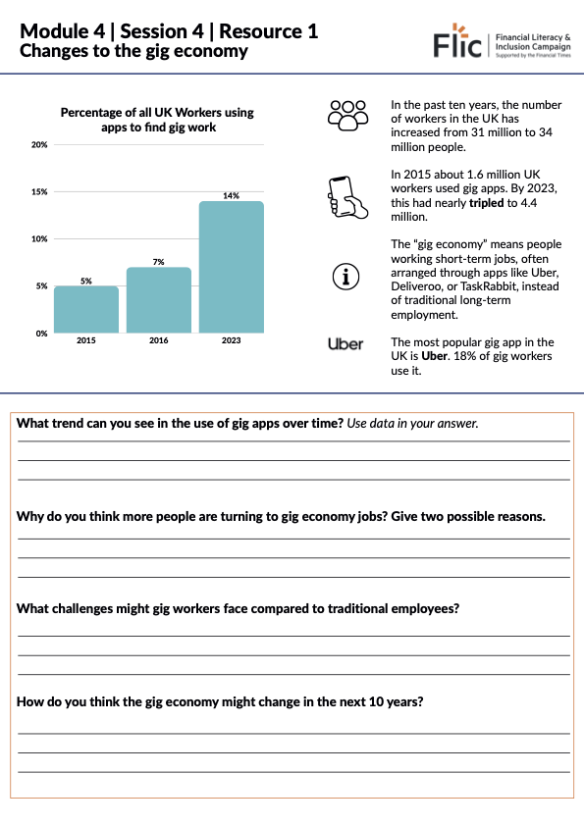
Changes to the gig economy
Resource 1: consider graph → answer questions
What trend can you see in the use of gig apps over time? Use data in your answer.
Why do you think more people are turning to gig economy jobs? Give two possible reasons.
What challenges might gig workers face compared to traditional employees?
How do you think the gig economy might change in the next 10 years?
Resource 1: Changes to the gig economy

Slide 17
Changes to the gig economy
Resource 1: consider graph → answer questions
Trend: weekly gig app use rose from 4.7% in 2016 → 9.6% in 2019 → 16% in 2023.
Reasons: flexible work, easy access via apps.
Challenges: less job security, no benefits.
Future: likely growth, possible new worker protections.
Resource 1: Changes to the gig economy

Slide 18
By the end of the session, I will be able to:
Describe changes to the gig economy
Understand workers’ rights and how they relate to the gig economy
Assess the protection of workers rights in the gig economy

Slide 19
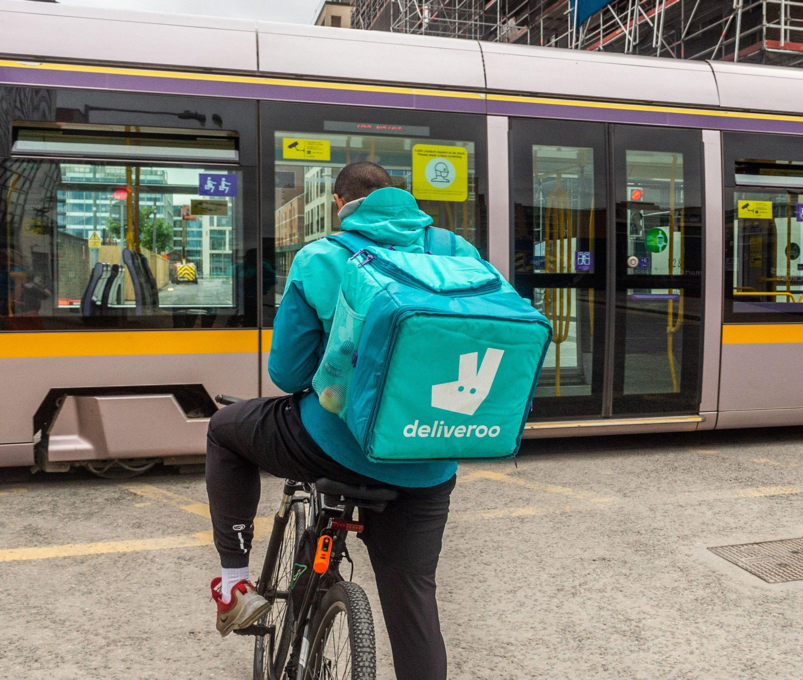
1: Read Dave’s story
Dave works as a delivery driver for Deliveroo. He likes that he can choose his own hours and work extra shifts when he wants to earn more money.
Dave is about to have a baby so he’s been trying to save as much as he can.
However, his back has been seriously hurting again from an old injury, and he’s worried about taking time off to rest and recover.

Slide 20

2: Dave’s story - questions
Dave works as a delivery rider for Deliveroo. He likes that he can choose his own hours and work extra shifts when he wants to earn more money.
Dave is about to have a baby so he’s been trying to save as much as he can.
However, his back has been seriously hurting again from an old injury, and he’s worried about taking time off to rest and recover.
Questions to consider:
How might being a delivery rider be beneficial for Dave’s situation?
What are the challenges of being a delivery rider?
If Dave takes a day off sick, what happens to his income?
Will any of the highlighted points impact on his pay?
Would you like to work in a gig job like Dave’s? Why or why not?
Notes:
1. How might being a delivery rider be beneficial for Dave’s situation?
Can choose when to work: flexible hours.
Can take on extra shifts to earn more.
Can plan work around family or personal life.
2. What are the challenges of being a delivery rider?
No guaranteed income.
No sick pay or holiday pay.
Physically demanding: his back pain affects earning ability.
3. If Dave takes a day off sick, what happens to his income?
He won’t earn money for that day.
No employer to cover sick pay.
May fall behind on savings goals.
4. Will any of the highlighted points impact on his pay?
Yes: taking time off or working fewer hours reduces pay (refer to previous teaching on gig economy)
Extra hours or busy times can increase income.
Income depends on how much and when he works.
5. Would you like to work in a gig job like Dave’s? Why or why not?
Discuss trade-offs: freedom vs. security.
Explore opposing views

Slide 21
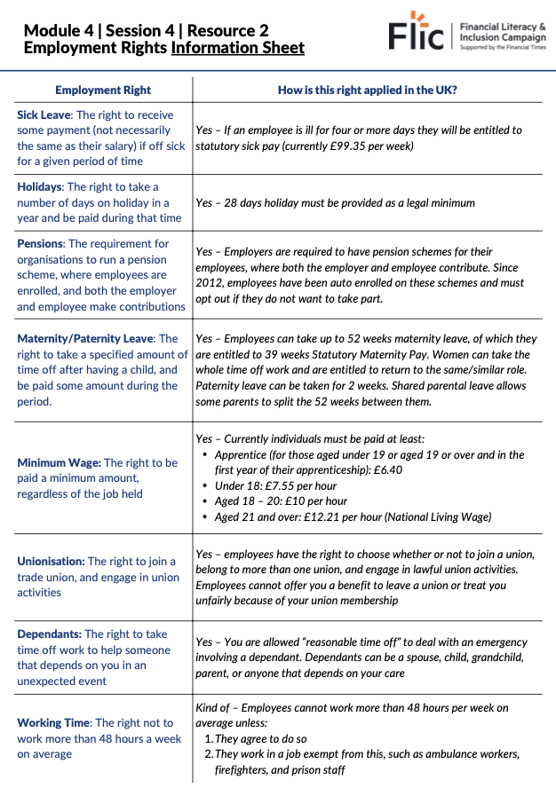




Employment rights
Read the information sheet which explains how each employment right works in the UK.
Should Dave get a full-time job?
Resource 2: Employment Rights

Slide 22
True or false?
Employees in the UK are entitled to statutory sick pay if they are ill for four or more days.
UK workers must be given at least 28 days of paid holiday each year.
Employers in the UK are not required to provide pension schemes for their employees.
Employees can take up to 52 weeks of maternity leave in the UK.
The minimum wage is the same for all employees regardless of age.
UK employees have the right to join a trade union.
Employees are not allowed any time off to care for dependants in emergencies.
Workers in the UK generally cannot work more than 48 hours per week unless they agree to do so.

Slide 23
True or false?
Employees in the UK are entitled to statutory sick pay if they are ill for four or more days.
True
False

Slide 24
True or false?
Employees in the UK are entitled to statutory sick pay if they are ill for four or more days.
True
False

Slide 25
True or false?
UK workers must be given at least 28 days of paid holiday each year.
True
False

Slide 26
True or false?
UK workers must be given at least 28 days of paid holiday each year.
True
False

Slide 27
True or false?
Employers in the UK are not required to provide pension schemes for their employees.
True
False

Slide 28
True or false?
Employers in the UK are not required to provide pension schemes for their employees.
True
False
Employers are required to provide pension schemes with contributions.

Slide 29
True or false?
Employees can take up to 52 weeks of maternity leave in the UK.
True
False

Slide 30
True or false?
Employees can take up to 52 weeks of maternity leave in the UK.
True
False

Slide 31
True or false?
The minimum wage is the same for all employees regardless of age.
True
False

Slide 32
True or false?
The minimum wage is the same for all employees regardless of age.
True
False
The minimum wage varies by age and apprenticeship status.

Slide 33
True or false?
UK employees have the right to join a trade union.
True
False

Slide 34
True or false?
UK employees have the right to join a trade union.
True
False

Slide 35
True or false?
Employees are not allowed any time off to care for dependants in emergencies.
True
False

Slide 36
True or false?
Employees are not allowed any time off to care for dependants in emergencies.
True
False
Employees can take reasonable time off to care for dependants in emergencies.

Slide 37
True or false?
Workers in the UK generally cannot work more than 48 hours per week unless they agree to do so.
True
False

Slide 38
True or false?
Workers in the UK generally cannot work more than 48 hours per week unless they agree to do so.
True
False

Slide 39
Summarising discussion
Based on what we now know, discuss as a class:
Is Dave better off with a full-time job?
Do we think Dave should get a full time job?

Slide 40
By the end of the session, I will be able to:
Describe changes to the gig economy
Understand workers’ rights and how they relate to the gig economy
Assess the protection of workers rights in the gig economy

Slide 41
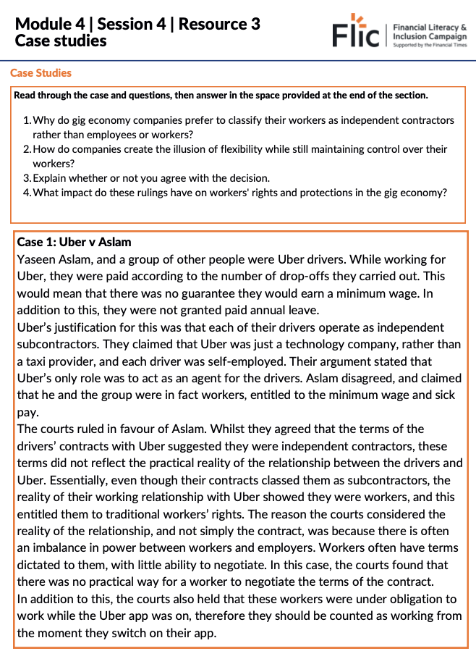
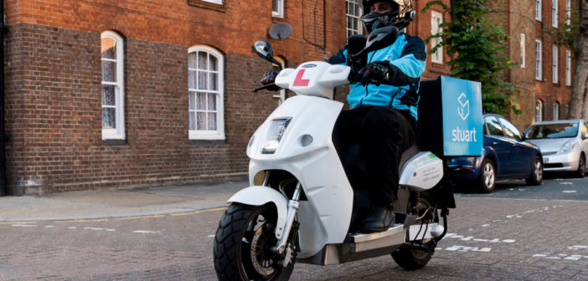

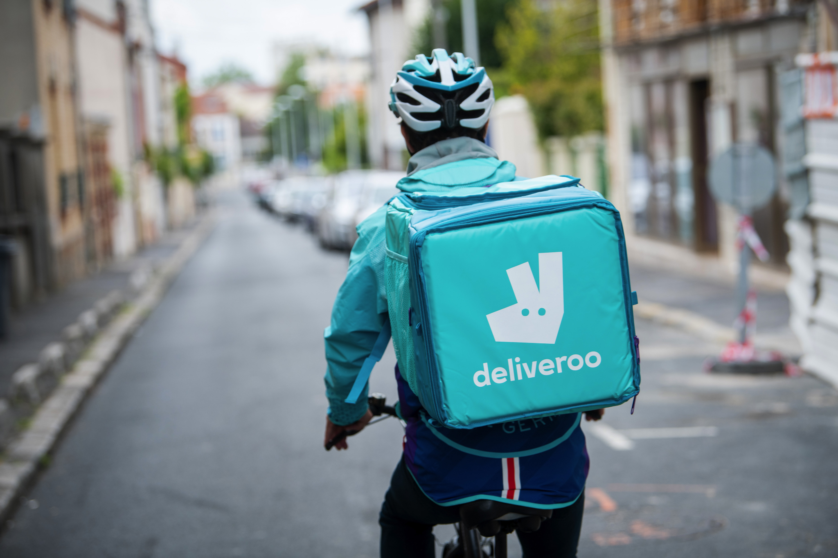
Case studies
The gig economy has created challenges, especially between companies and workers. Many of these challenges have gone to court, shaping the relationship between them.
You’ll be assigned a number (1 or 2) linked to a specific case. Read the case and answer the questions on the worksheet.
Summarise: Do you think this was fair or not? How does this make you feel about working for Uber?
Resource 3: Gig Economy Case Studies
Notes:
Teacher delivery
Allow 10 minutes for students to read through the case study and answer the 4 questions. Allow a further 5 minutes to go through the feedback for each case study, drawing feedback from different students in the class.
Prompt Question
Once all feedback has been gathered from the class, challenge a student to describe the difference between the Deliveroo and Stuart Delivery case. You can use supporting questions such as:
What was the difference in outcome between the two cases?
What was the key reason as to why the verdict was reached in each case?
By doing this, students should come to an understanding that the ability to substitute the worker is key to determining whether or not someone is classed as a worker.
Teacher explanation
In order to highlight the point made through the prompt question above, you can explain that in the Deliveroo case, the person was able to choose a substitute out of a wide range of people (essentially anyone they knew) whereas in the Stuart Delivery case, the substitute had to be someone registered with Stuart Delivery, which limited their ability to substitute, and put more onus on them personally to fulfil the job. As such, this is why the Stuart Delivery driver was classed as a worker and the Deliveroo driver was not.

Slide 42

Plenary
What are the three most important messages that you’ll take away from this lesson?
You have one minute to summarise what you have learnt today.
No hesitating, repeating or long pauses.

Slide 43
By the end of the session, I will be able to:
Describe changes to the gig economy
Understand workers’ rights and how they relate to the gig economy
Assess financial vulnerability in the gig economy

Slide 44
Key points from today
Many gig economy companies label workers as independent contractors to reduce costs and increase profits.
These companies often present themselves as tech firms, not employers.
Courts may assess the actual worker-company relationship, not just the contract.
If a worker can be easily replaced, they may not be seen as a worker and won’t have certain rights.
This is the key difference between the Deliveroo and Stuart Delivery cases.

Slide 45
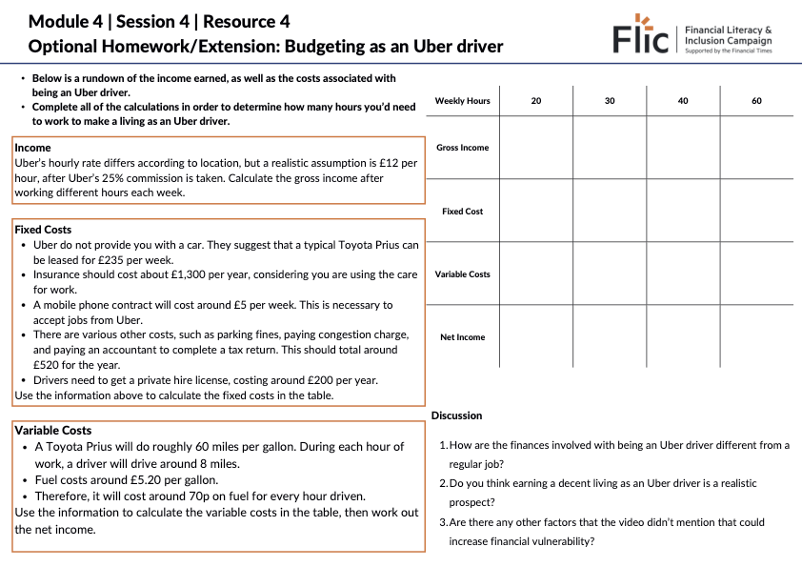
Finances of an Uber Driver:
Homework / extension
Task:
Use the worksheet to work out the net income of an Uber driver working different hours in a week
Resource 4 - Budgeting as an Uber driver

Slide 46
Any questions?
?

Slide 47



Services available for people who have concerns about their rights at work
Money Helper - Work
Gov UK - Workplace rights
Citizens Advice - Work
At school, you can speak with an adult you trust.
This could be your form tutor, head of year or the school’s safeguarding officer

Slide 48
Links to learn more!
Articles to extend learning
Please visit the FLIC Learning Hub for further resources
Types of employment
Self-employed gig workers holiday rights.
PocketSkill: a platform for young people to earn money for their passions

