Slide 1





www.reallygreatsite.com
Studio Shodwe
VINTAGE MUSIC
Presentation
Start Slide

Slide 2

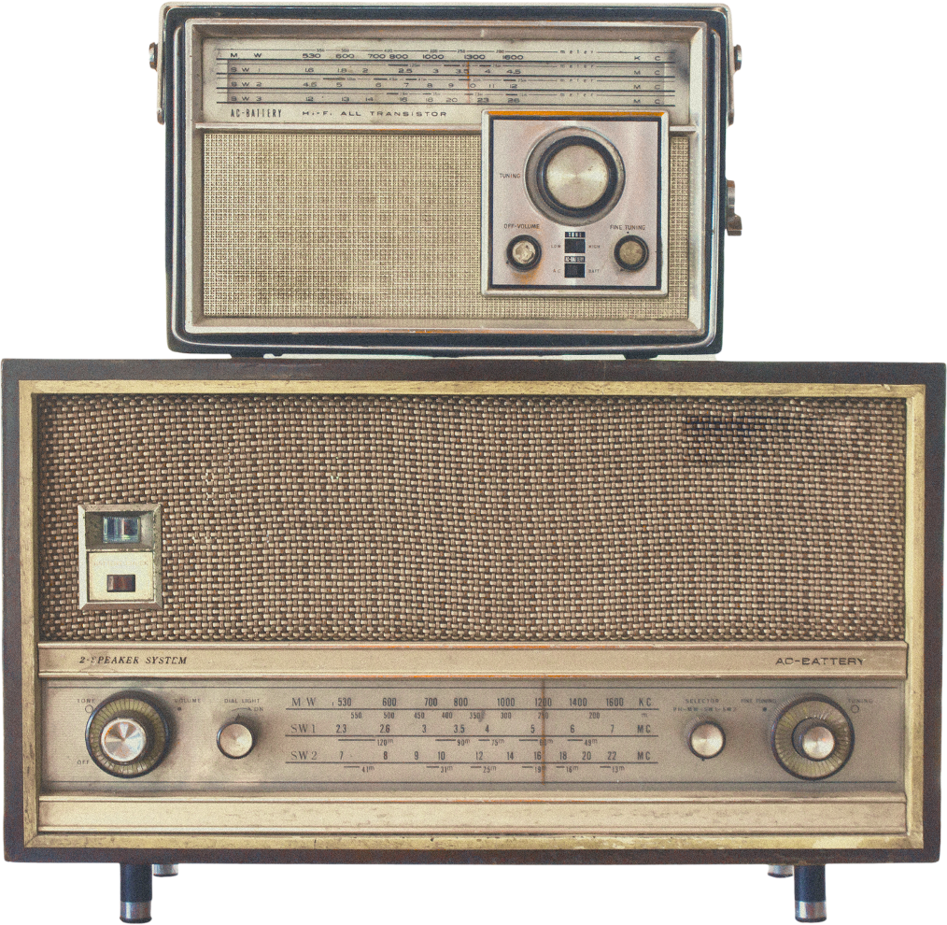
Studio Shodwe
www.reallygreatsite.com
By Lars Peeters
Music Presentation
Introduction Vintage Music
About Music Vintage
Vintage music refers to music from past eras that shaped today’s soundscapes, typically ranging from the 1920s jazz age to the classic rock era of the 1970s. It is characterized not only by its distinct melodies and instrumentation but also by the cultural

Slide 3
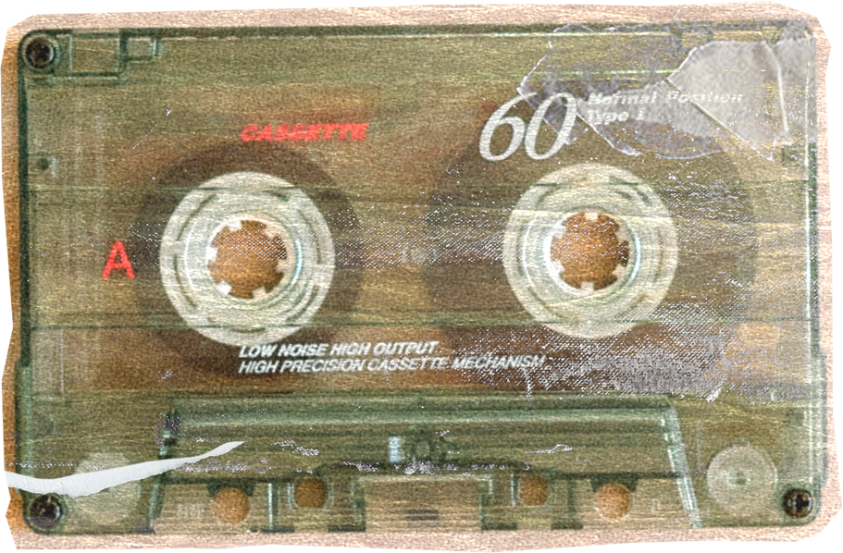
Studio Shodwe
www.reallygreatsite.com
By Lars Peeters
Music Presentation
The Birth of Jazz
01
02
Global Spread
Early Performers
They captured real-life struggles and joy, influencing nearly every music genre that followed.
Jazz and blues emerged from African-American communities in the early 20th century,
See More
See More

Slide 4
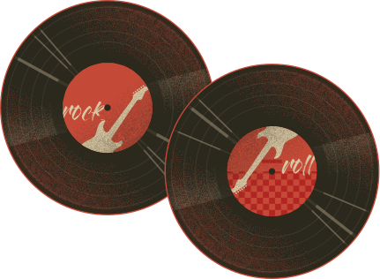
Studio Shodwe
www.reallygreatsite.com
By Lars Peeters
Radio Popularity
Music Presentation
423,000,000+
Swing Era of the 1930s and 40s
Swing music brought a lively, energetic beat that dominated dance halls. It was a unifying sound during tough times
Dance Culture
78,000,000+

Slide 5
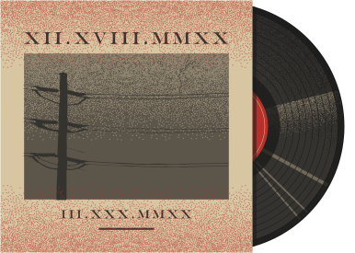
Studio Shodwe
www.reallygreatsite.com
By Lars Peeters
Music Presentation
Rock ’n’ Roll Revolution
Rebellion
Iconic Artists
Youth Culture
Fashion Influence
The 1950s introduced rock ’n’ roll, blending blues, gospel, and rhythm into a powerful sound.

Slide 6
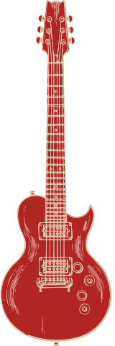
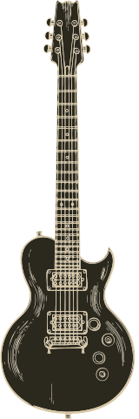
Studio Shodwe
www.reallygreatsite.com
By Lars Peeters
Music Presentation
Folk Revival of the 1960s
Protest Songs
Acoustic Sound
The folk revival connected music to political and social activism, addressing civil rights and anti-war movements. Acoustic guitars and poetic lyrics gave people a voice for change.
Iconic Singers
Next Slide

Slide 7

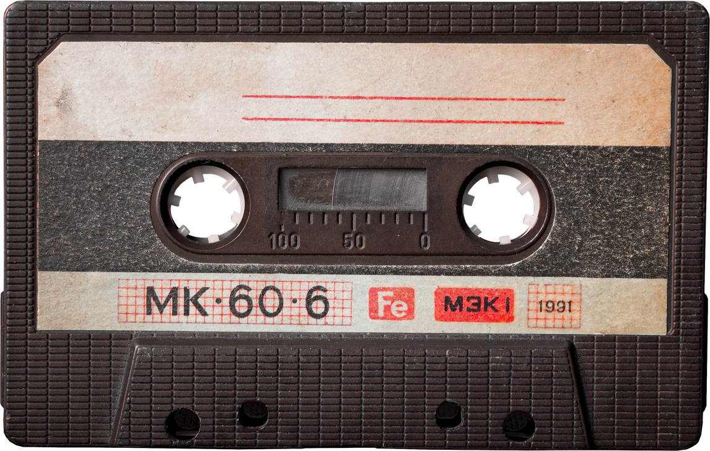
Studio Shodwe
www.reallygreatsite.com
By Lars Peeters
Woodstock Festival
Music Presentation
Psychedelic Movement
Experimentation
The late 1960s birthed psychedelic rock, known for experimental sounds, distorted guitars, and vibrant visuals. It aligned with counterculture and spiritual exploration.
Visual Aesthetics

Slide 8
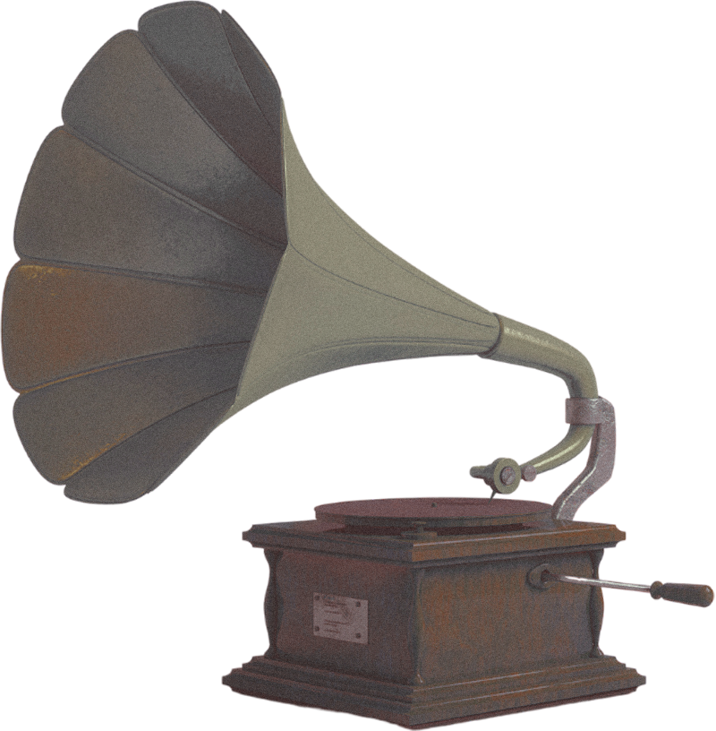


Studio Shodwe
www.reallygreatsite.com
By Lars Peeters
Music Presentation
Motown and Music
Motown created a polished, soulful sound that became the soundtrack of America. It celebrated Black artistry while achieving mainstream popularity.
Classic rock defined the 1970s with loud guitars, powerful vocals, and legendary bands that filled stadiums. It was an era where music became not just entertainment but a lifestyle.
Danceable Rhythms
Vocal Harmony

Slide 9
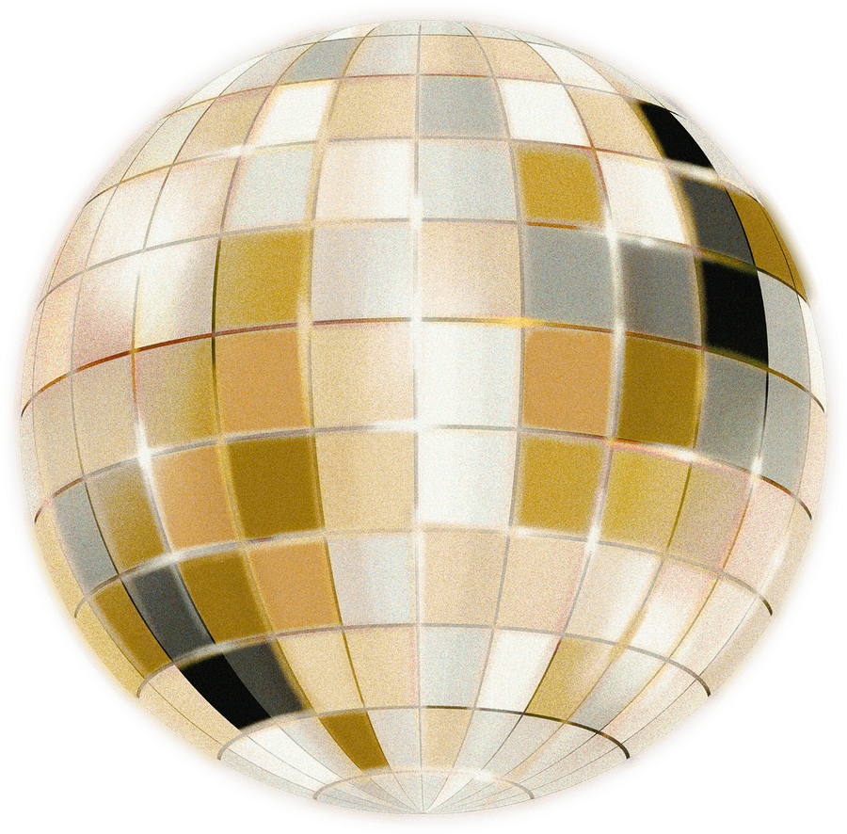
Studio Shodwe
www.reallygreatsite.com
By Lars Peeters
Music Presentation
Disco Fever of the Late 1970s
Influence of Technology on Vintage Music
Disco was all about rhythm, glamour, and nightlife. With its infectious beats, disco dominated clubs, shaping dance culture worldwide.
Technology shaped how people consumed vintage music. From vinyl players to radio waves, the accessibility of music spread across households, making stars out of musicians worldwide.

Slide 10
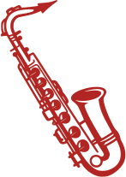
Studio Shodwe
www.reallygreatsite.com
By Lars Peeters
Music Presentation
Lasting Fashion Statements
Fashion and Lifestyle in Vintage Music
Each music era influenced how people dressed and lived. Rockabilly inspired leather jackets, hippies embraced colorful bohemian looks
8940k
Point One
Point Two
Vintage music wasn’t only entertainment; it was activism and cultural
Collectors treasure vintage music, keeping alive the warmth of vinyl and the history

Slide 11

THANK YOU
Studio Shodwe
www.reallygreatsite.com
By Lars Peeters
Music Presentation
89,00+
673,00+
My Album
My Songs

