Slide 1


Principals Professional Learning
March 2025
Notes:
Bryce/Karly

Slide 2


Supporting Students with Disabilities and Multilingual Learners
Notes:
Bryce/Karly
Welcome
Review of the topic:
Combined March and April PPL so we have a lot of information to cover. Please consider this presentation more of a resource guide, rather than a presentation slide deck. Please come back and explore independently.

Slide 3

Objectives
Understand the unique needs of students with disabilities and multilingual learners.
Identify strategies to provide access and opportunity to learning and resources.
Learn how to foster a supportive school environment that promotes academic and social success.
Notes:
Bryce/Karly

Slide 4

Shared Norms
Meeting Norms
Be on time and prepared
Stay engaged
Speak your truth
Assume best intent
Don’t take offense
Notes:
Bryce/Karly

Slide 5
Why Does This Matter?
Academic Achievement:
Providing the right supports improves outcomes for all students (Shinn, 2021).
Opportunity & Access:
Ensuring all students have the tools they need to succeed.
Legal and Ethical Responsibilities:
Schools are required to provide FAPE (Free Appropriate Public Education) and meaningful language access (IDEA, 2004; ESSA, 2015).
Notes:
Bryce/Karly
1 minute
No New Ideas. You have heard this before - we are discussing foundational concepts for all learners.

Slide 6


Slide 7

It is not our differences that divide us. It is our inability to recognize, accept, and celebrate those differences.
-Audre Lorde
Notes:
Bryce/Karly
When we read this, what does this mean to you?

Slide 8






Understanding Our Students
Stages of Language Acquisition
All students are in the process of learning and acquiring proficiency in academic language.
Needs:
Language support
Cultural relevance
Academic language
Social and emotional support
Student Assets:
Their story
Cognitive strengths
Linguistic and communication skills
Experiences
Advanced fluency
Intermediate fluency
Speech emergence
Early production
Pre-production
Can Do Descriptors
Notes:
Justine/Mike
1 minute
All students have needs and bring assets to the classroom.
The WIDA Can Dos can be used to plan scaffolds and supports for all students.
All students are learning a language at some level.

Slide 9
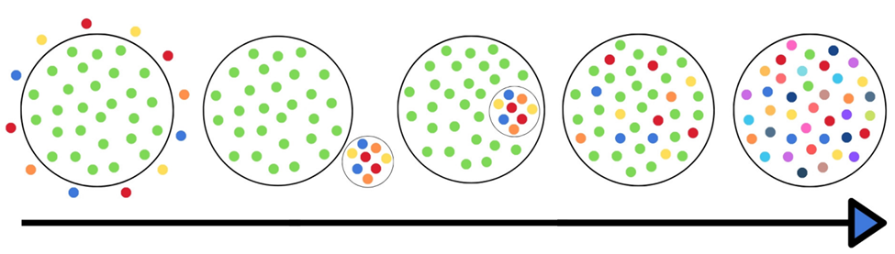
Understanding the Needs Students
The education system has changed significantly over time
We can not expect to educate students the way we saw it done when we were in school
1960 1976 1982 Today
Notes:
SpEd Coordinator
1 minute
Represents the progression of inclusion over time. Not educated, educated outside of traditional schools, educated in schools but separately, shift toward inclusion, eventually everyone’s strengths and weaknesses and provide the support they need.
The shift has been driven largely by legislation, but also research and understanding
It is still a work in progress

Slide 10


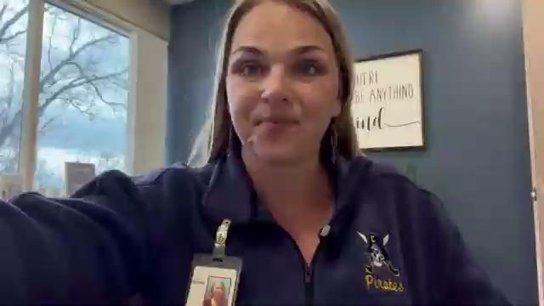
The Role of Principals in Supporting All Students
Set expectations for a supportive and legally compliant school climate.
Ensure access to appropriate instructional supports.
Promote professional development for staff on best practices (Universal Design for Learning, Accommodations and Modifications).
Notes:
DEAO Coordinator
(Elem/Sec)
10 min
Secondary -
Tyler Howe - 1 Day Testing
Josh LeRoy - Full Staff ESL Endorsement - Video by Mindy about this topic
Elementary
Karly - Whole School Day Testing at Walker- Discussion
Many of you have invited us in to share about Flashlight 360, or instructional strategies, or joined PLCs, etc. - All great ways to support your MLs, and really, all students

Slide 11
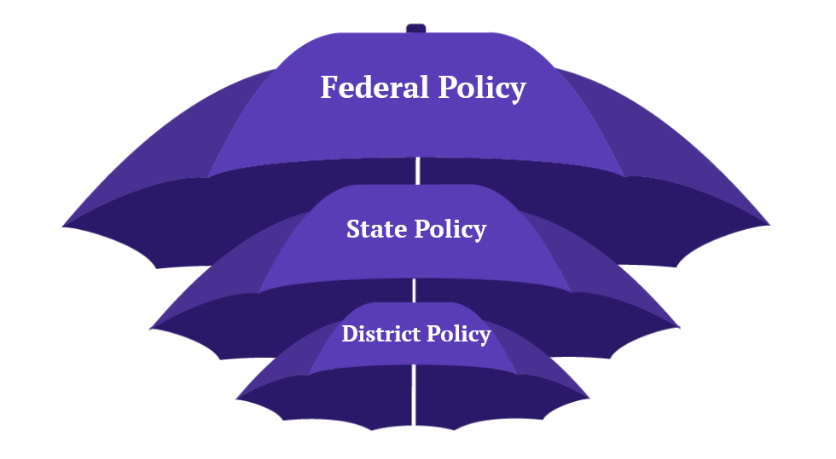
Special Education and English Learner Legal Requirements
Individuals with Disabilities Education Act (IDEA) and Section 504.
Every Student Succeeds Act (ESSA) requirements for multilingual learners.
*US Dept of ED supports
implementation and compliance
with Federal Law. Without ED,
the law still exists, but we will have
fewer supports – all the requirements
remain.*
Notes:
Bryce/Karly
1 minute
We have federal, state, and district policies that kind of nest together. Our support may go away for some, but our requirements and responsibilities are still there.

Slide 12
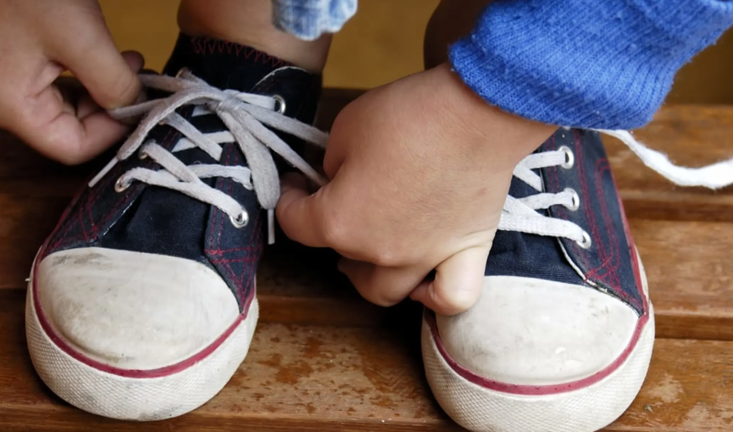
Notes:
Now we’re going to “teach you to tie your shoes” - no rolling your eyes! We’ll be able to hear it! :)

Slide 13


Universal Design for Learning & Sheltered Instruction Observation Protocol
Quick Tips:
Use multimedia - videos, images, and interactive apps
Provide choice - student choose how to demonstrate learning
Scaffold learning - break down complex tasks into manageable steps.
Pre-teach vocabulary - introduce key terms before the lesson
Use sentence frames - support language production
Frequent checks for understanding - informal and formal formative assessments
UDL
An educational framework that aims to accommodate all learners by providing flexible methods of content deliver, engagement, and expression.
Multiple Means of Representation
Multiple Means of Action and Expression
Multiple Means of Engagement
SIOP
Research based instructional model designed to make academic content accessible to multilingual learners while also supporting students with disabilities.
Lesson preparation
Comprehensible Input
Interaction
Assessing Student Understanding
UDL Guidelines
SIOP Model
Good teaching for ALL learners
Notes:
SpEd
Time: 3 Minutes
Talking Points:
Discuss how to foster an inclusive classroom and differentiation

Slide 14
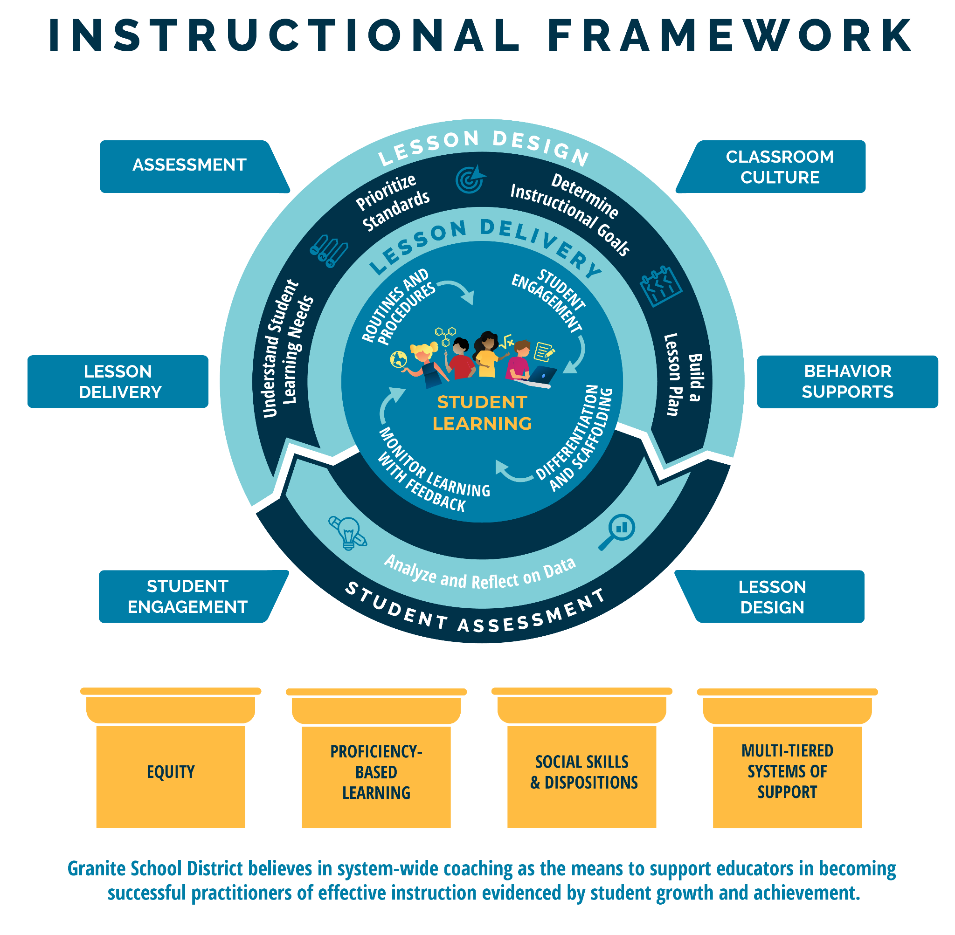
Notes:
SPED Coordinator:
-We overlay UDL and SIOP strategies over our instructional framework.
-It fits under lesson design, student engagement, and lesson delivery

Slide 15

Student Engagement and Belonging
Clear Structures and Routines
Establish clear routines & Procedures
Set up of the physical environment
Implement consistent rules/expectations
Be predictable and proactive
The role of engagement in academic success (Goodenow, 1993).
Strategies to support students who may feel isolated or struggle with participation.
Notes:
SpEd
Time: 5 minutes
Objective: Discuss how to use clear structure and routines to support neurodivergent behavior
Talking Points:
Many neurodivergent students, such as those with ADHD or autism, benefit greatly from having predictable routines and a structured environment. This helps reduce anxiety, increase focus, and provide a sense of security.
Establish Clear Routines:
Have a consistent schedule for daily activities like Circle Time, centers/stations, snack, etc. Review and preview this schedule frequently.
Use visual schedules with pictures/icons representing each activity. This reinforces the routine.
Give reminders before transitioning between activities, such as a 5-minute warning.
Set Up the Physical Environment:
Keep the classroom organized and minimize clutter which can be distracting.
Clearly define spaces for different activities like reading, working independently, group work.
Use visual boundaries like taped areas or labels to reinforce these zones.
Provide a quiet, low-stimulation space for the student to retreat when feeling overwhelmed.
Implement Consistent Rules/Expectations:
Have a few simple, positively-stated rules like "Listen Actively" or "Respect Others' Space."
Review and reinforce these rules consistently. Use visuals to represent them.
Develop and directly teach clear procedures for routines like lining up, transitions, etc.
Use a consistent signal or cue for getting students' attention.
Be Predictable and Proactive:
Follow routines and procedures consistently so the student knows what to expect.
Provide advance warning before transitions or changes in routine.
Pre-teach new routines or procedures using visuals and modeling before implementing.
Develop and directly teach strategies for self-regulation like deep breaths, stretching, etc.
Providing this type of structure, consistency and preparation can go a long way in creating an environment where a neurodivergent student can successfully focus, participate and feel secure.

Slide 16
Activity: Table Talk
Instructions:
What is the biggest barrier in your building (right now) preventing teachers from meeting the needs of SwD and MLs?
What is your main strategy for addressing it?
Share with your table how it is going? (is it working?, is it not?)
Notes:
Bryce/Karly
10 min - 5 for table talk and 5 for share out
What challenges did you identify?
How can schools proactively address accessibility barriers?

Slide 17

Supporting Special Education in Schools
Elementary Secondary
Notes:
Bryce/Karly
10 min - 5 for table talk and 5 for share out
What challenges did you identify?
How can schools proactively address accessibility barriers?

Slide 18
I have come to a frightening conclusion that I am the decisive element in the classroom. It is my personal approach that creates the climate. It’s my daily mood that makes the weather. As a teacher, I possess a tremendous power to make a child’s life miserable or joyous. I can be a tool of torture or an instrument of inspiration. I can humiliate or heal. In all situations, it is my response that decides whether a crisis will be escalated or de-escalated and a child humanized or dehumanized.
Haim Ginott
Notes:
Mike/Justine
Choose a principal to read the quote.

Slide 19

Building Strong Student-Teacher Relationships
Foster belonging in the classroom
Understand neurodiversity
Build positive relationships
Implement accommodations and supports
Promote self-advocacy and self-regulation
Importance of trust and connection for student success.
Strategies for relationship-building with students with disabilities and MLs.
Foster an Inclusive Classroom
Notes:
Mike/Justine
If you’ve met one student with… you have only met one student with…
With autism
From Iraq
Home language other than English
With ADHD

Slide 20

Strategies
Provide clear structure and routines
Visual aids and concrete examples
Allow movement breaks
Teach self-regulation techniques
Foster an inclusive and accepting classroom culture
Notes:
Mike/Justine
High leverage strategies that will support ALL students.

Slide 21
Visual Aids and Concrete Examples
Visual schedules
Graphic Organizers
Manipulatives or hands-on materials
Model
Be as explicit as possible
Notes:
Bryce/Karly
Time: 5 minutes
Objective: Discuss how to use visual aids to support neurodivergent behavior
Talking Points:
Visual aids and concrete examples are extremely beneficial for neurodivergent learners who often think in more visual, literal, and hands-on ways. Here are some strategies to implement:
Visual Aids
Use picture/icon schedules to represent the daily routine and transitions
Create visual checklists or directions with both words and images for tasks
Provide graphic organizers like webs, flowcharts, and Venn diagrams
Use videos, photographs, diagrams and models to illustrate concepts
Color code materials for different subjects or activities
Allow neurodivergent students to doodle or use manipulatives while listening
Concrete Examples
Connect abstract ideas to real, physical objects or experiences
Use analogies and metaphors that create mental pictures
Provide hands-on materials like blocks, beads, or clay to learn concepts kinesthetically
Give tangible, relatable examples from the student's life
Act out stories, vocabulary words, or concepts through gestures and role-play
Go on field trips or bring concrete objects into the classroom to illustrate lessons
The more senses engaged and connections made to tangible references, the better neurodivergent students can understand and retain the information.
Modeling
Explicitly model steps, expectations, and procedures using "think-alouds"
Demonstrate what an exemplar of work looks like, pointing out key features
Role play social situations, like conversations or responding to triggers
Be as explicit and literal as possible, avoiding idioms or excessive abstractions. Ask the student to explain back the directions to ensure understanding.
The goal is to make learning multi-sensory, engaging multiple pathways to the brain. With consistent use of visuals and concrete tangible examples, neurodivergent students can make sense of material more easily.

Slide 22
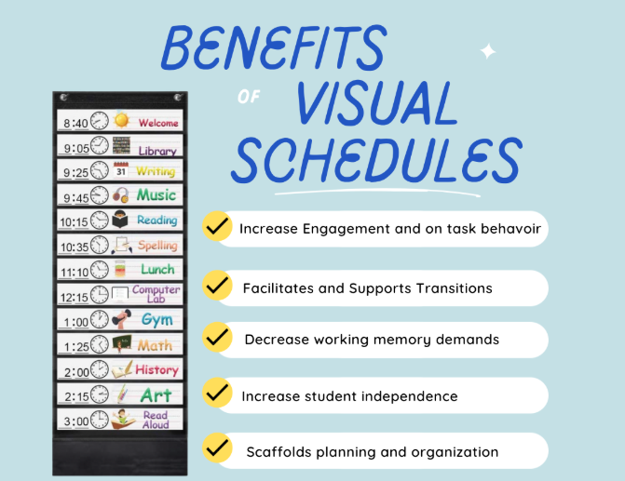
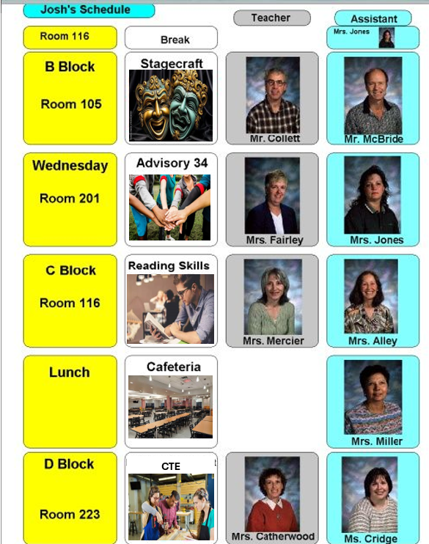
Visual Schedules
Notes:
Bryce/Karly
Time: 1 Minute
Objective: Show examples of visual schedules
Talking Points:
Here are some examples of individualized visual schedules.
Notice on the first one there are rules outlined as well as reinforcement on one sheet to keep an individual student’s behavior plan easy to follow and support.
The secondary example has photos of the faculty that will be in the room for each class, this may be a very useful support for some students.

Slide 23

Visual Support In Action
Notes:
Bryce/Karly
Time: 2 Minutes
Objective: Show a video example of how to use visual supports
Talking Points:
Notice how the teacher checks for understanding with the student using a visual support after each reviewed piece of the schedule.
The teacher also has the student proximity for ease of access to support with the visual schedule.

Slide 24
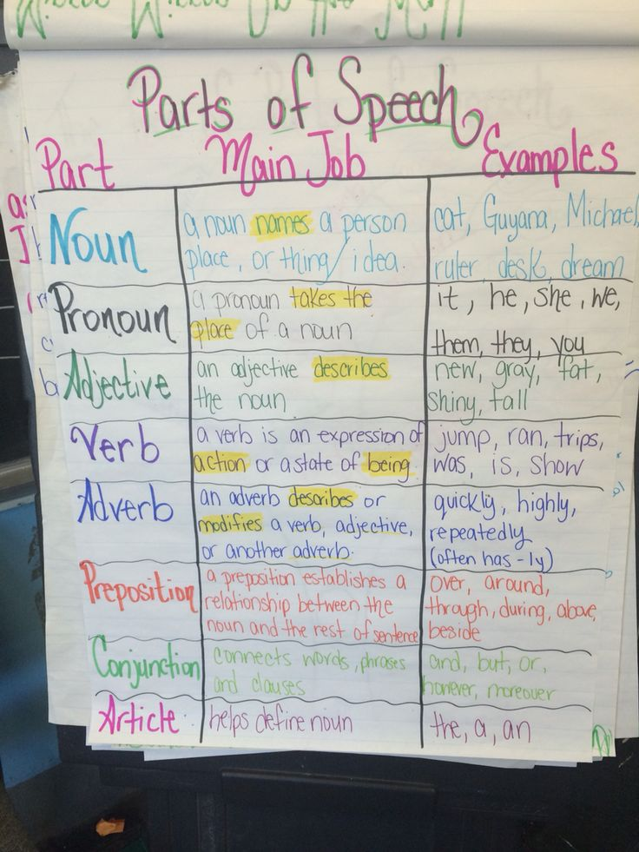
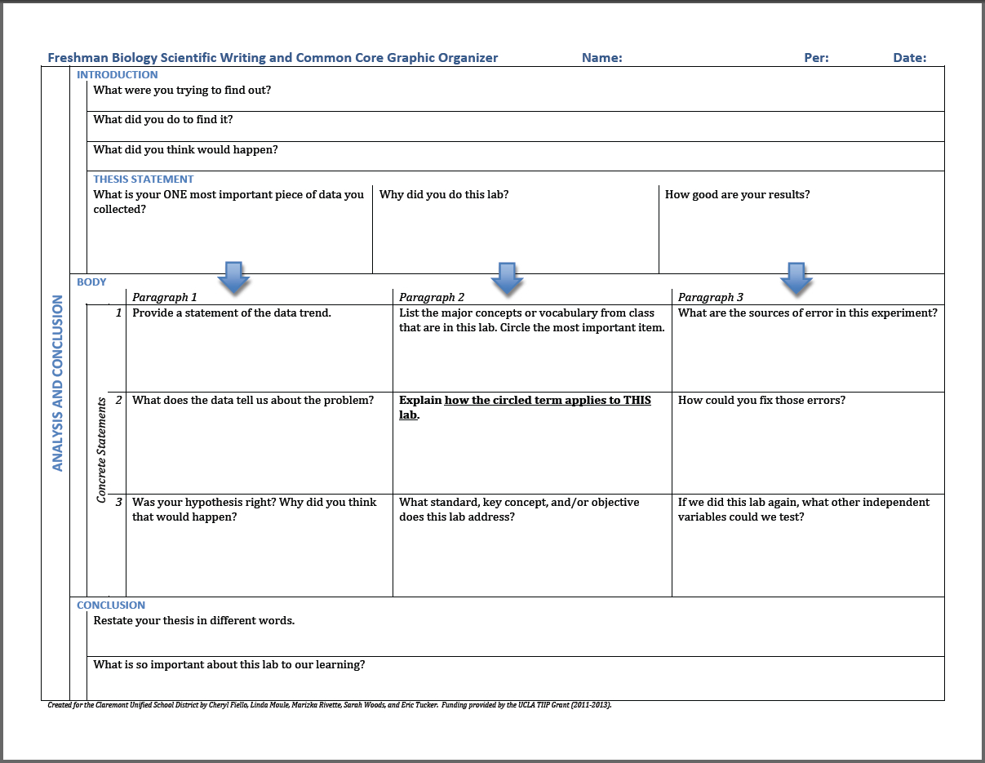
Graphic Organizers
Notes:
Bryce/Karly
Time: 1 Minute
Objective: Show examples of graphic organizers
Talking Points:
Graphic organizers are another great way to support neurodivergent students and can be used in elementary through secondary.
Knowing your individual student’s needs will help you identify what kind of graphic organizer would be the most supportive.

Slide 25
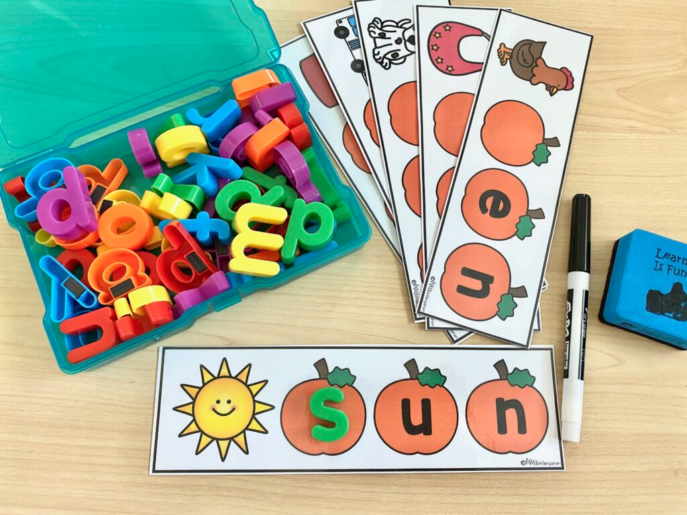

Manipulatives
Notes:
Bryce/Karly
Time: 5 Minutes
Objective: Show examples of visual manipulatives
Talking Points:
Manipulatives are another visual way to support neurodivergent students with grasping academic concepts. There are many manipulatives for different subject matter.
Turn to your neighbor and answer these questions together and in your guided notes:
What are you currently using in your classroom for visual learning?
What is something you could use in your classroom to support not only the neurodivergent students, but all students?
Share out with the group - pick 3 people to share

Slide 26

Explicit Feedback
Why explicit feedback is important:
Clarifies expectations
Reinforces desired behaviors
Supports skill development
Strategies for giving explicit feedback:
Be specific and descriptive
Focus on observable behaviors
Provide feedback promptly
Offer suggestions for improvement
Notes:
Bryce/Karly
Time: 3 Minutes
Objective: Describe explicit feedback - academically
Talking Points:
Be specific and descriptive
Avoid vague phrases like "good job" or "pay attention"
Describe the specific behavior: "You raised your hand and waited patiently for your turn"
Focus on observable behaviors
Comment on what you see and hear rather than perceived attitudes
"I noticed you tapping your pencil" rather than "You seem unfocused"
Provide feedback promptly
Don't wait too long to give the feedback
Look for moments to give feedback privately if needed
Offer suggestions for improvement
Don't just point out what to change, give alternative strategies
"Next time you can try using a fidget object to keep your hands busy"

Slide 27

Scaffolding and Differentiation
Scaffolds are temporary supports that move students from one step in a lesson to the next. Examples of scaffolding techniques include visual cues, charts, strategic questioning, formula sheets, and pre-teaching vocabulary words.
Differentiation is presenting material in a way that makes lessons and learning accessible to students. Differentiation is commonly understood to mean adapting lessons and materials to meet the needs of a student or a small group of students.
Notes:
Bryce/Karly
Time: 5 minutes
Objective: Discuss how to use scaffolding and differentiation to support diverse learners in the classroom.
Talking Points:
Students come to the classroom with different backgrounds, abilities, and learning needs. Scaffolding and differentiation are essential strategies to ensure that all students can access, engage with, and master the content.
Scaffolding: Providing Temporary Support to Build Independence
Break Down Tasks:
Chunk complex tasks into manageable steps.
Provide guided practice before expecting independent work.
Use Visual and Verbal Supports:
Anchor learning with graphic organizers, sentence starters, and step-by-step checklists.
Model expectations with think-alouds, demonstrations, and examples.
Offer Gradual Release of Responsibility:
Start with teacher-led instruction, move to guided practice, and then transition to independent work.
Use peer support or small-group instruction to reinforce concepts before full independence.
Differentiation: Meeting Students Where They Are
Content (What Students Learn):
Provide multiple ways to access information (videos, texts at different reading levels, hands-on experiences).
Use tiered assignments to adjust difficulty based on student readiness.
Process (How Students Learn):
Offer flexible grouping: small groups, partners, or independent learning.
Allow choices in how students engage with material (discussion, projects, hands-on practice).
Product (How Students Show Their Learning):
Provide multiple options for demonstrating understanding (oral presentations, written responses, creative projects).
Adjust expectations based on students’ individual strengths and needs.
Be Proactive and Responsive
Use formative assessments (exit tickets, quick checks) to guide instruction.
Provide timely feedback and adjust support based on student progress.
Encourage student self-reflection and goal-setting to promote independence.
By intentionally scaffolding learning and differentiating instruction, we can create a more inclusive and effective learning environment where all students feel supported and challenged.

Slide 28
Scaffolding Examples | Differentiation Examples
Graphic Organizers | Graphic Organizers
Visuals; Cue Cards | Group Work - cooperative learning
Manipulatives | Manipulatives
Reference Charts/Cards | Project vs. Report
Strategic Questioning & Prompting | Comic Strips vs. Story
Reading Passages/Stories aloud | Peer Tutoring
Providing Hints or Prompts | Choice Board; Choices
Lots of Examples | Use of Technology
Teacher Modeling and Think-alouds | Guided Notes
Graph Paper / Grid Paper | Task Cards vs. Worksheets
Use of Technology / Translation | Brain Breaks; Activities Changes
Cue Cards | Visuals; Cue Cards
Gamification of Learning | Gamification of Learning
Class Discussion | Oral Work vs. Written
Sentence Starters / Stems | Sentence Starters / Stems
Notes:
Bryce/Karly
The goals of scaffolding and differentiation
The goals of scaffolding and differentiation are the same: both strategies help children learn and achieve. Teachers can use them separately or in combination within the same class and during the same lesson.
Bryce will make a venn diagram

Slide 29



Addressing Unkind Language and Behavior
Additional Tips:
Stay calm & composed - your tone and body language should convey that you are taking the situation seriously but are in control of the situation.
Empathy & Active Listening - acknowledge feelings, but also explain why their words were harmful to others.
Set Clear Expectations for Behavior - Make sure all students and staff understand the behavior expectations. Review them regularly.
Interrupting:
Step in immediately when you observe unkind language.
Calmly and firmly stop the conversation and make it clear that the language of behavior is inappropriate.
“I don’t like words like that.”
Questioning:
Use questioning to help the person reflect on their behavior and words.
Ask open-ended questions that encourage reflection and critical thinking.
“Can you help me understand why you said that?”
Educating:
Provide context to educate about the harmful effects of unkind language.
Explain why the language or behavior is harmful.
“The term you used is harmful because…”
When others speak up, amplify their voices.
***Provide support for victims.***
Addressing Unkind Language Desk Tent
Notes:
Bryce/Karly
Resource from Learning for Justice (website)

Slide 30
Thank You!
Thank you for the work you are doing, for the careful language you use, for including all students in your activities, and for showing up to love and support students each day.
Thank you for modeling empathy with students and teachers.
Thank you for being willing to work with all students.

Slide 31
Final Thoughts & Action Planning:
Instructions:
At your table, discuss strategies you are utilizing in your school (what's working and what is not)
What are 3 concrete steps you can take to better support students with disabilities and MLs?
What one step or strategy will you implement at your school tomorrow?
How will you share this information with your staff?
Notes:
Karly/Bryce
If needed….

Slide 32
Resources for Continued Learning
WIDA Administrator Supplement: WIDA English Language Development Standards Framework Implementation Guide
¡ColorínColorado!
National Clearinghouse for English Language Acquisition
Speak Up at School

Slide 33
For more support…
Karly Chavez Bryce Day
Associate Director - DEAO Director of Special Education
kchavez@graniteschools.org bbday@graniteschools.org
We have amazing coaches and specialists in our departments, ready to help!

