Slide 1
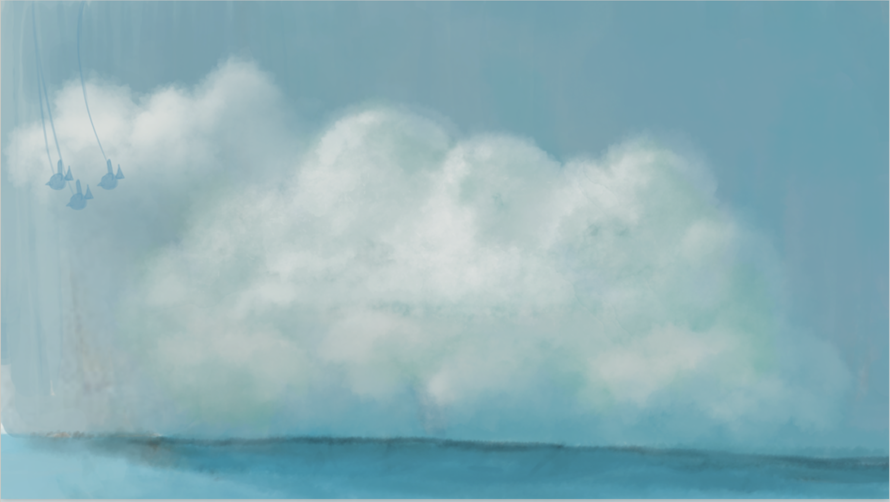
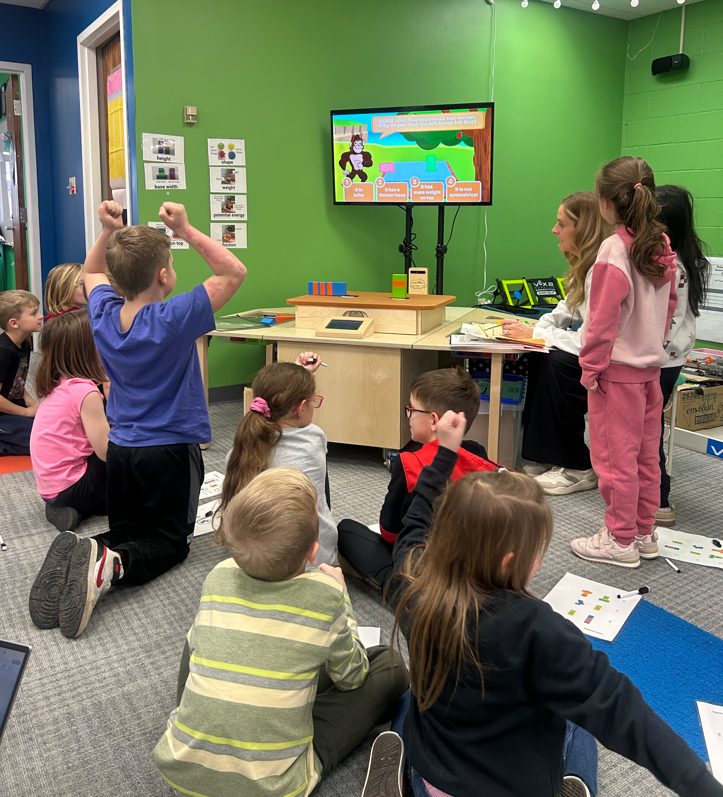
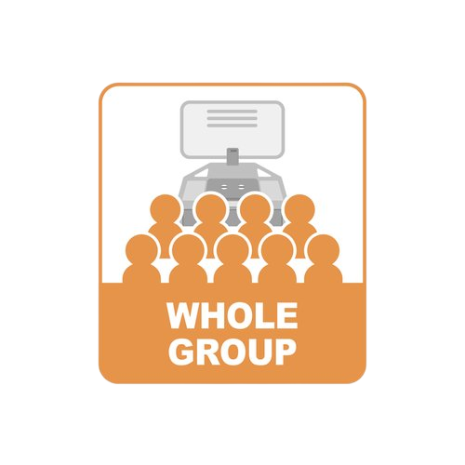
W E L C O M E
Little Engineers!
L2: Exploring the Scientific
Method and Earthquakes
L3: Using Scientific Method
to Explore Stability
EarthShake
Lessons 2 & 3

Slide 2
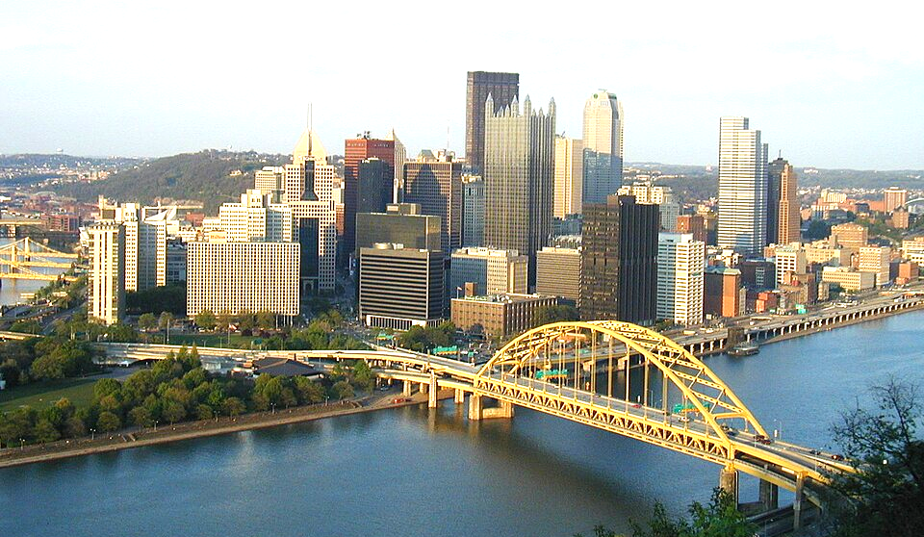
Fun Fact!
Did you know that Pittsburgh is called the City of Bridges?
Lesson 2
Notes:
CAN CONNECT THIS TO YOUR CITY!
This is a great place to add real-world connections for your students. Add some pictures of building/bridges/structures that your students will recognize and a fun fact. Bridges are vibrating
Pittsburgh connection - during steel industry to carrying trucks - accompany weight

Slide 3
Why so many bridges?
There are many rivers. To connect different
locations and to transport people
and goods you need bridges!
Challenge: Make them strong for carrying
weight and vibrations!
Lesson 2
Notes:
This is a great place to add real-world connections for your students. Add some pictures of building/bridges/structures that your students will recognize and a fun fact. Bridges are vibrating
Pittsburgh connection - during steel industry to carrying trucks - accompany weight

Slide 4
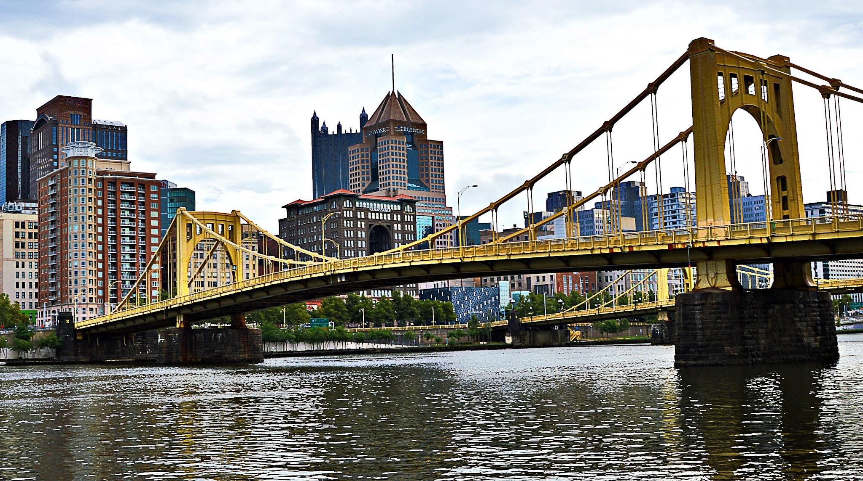
Think About It…
What job title do people have that build bridges or buildings ?
Lesson 2

Slide 5


Watch the Video: Listen for different types of Engineers
Lesson 2

Slide 6
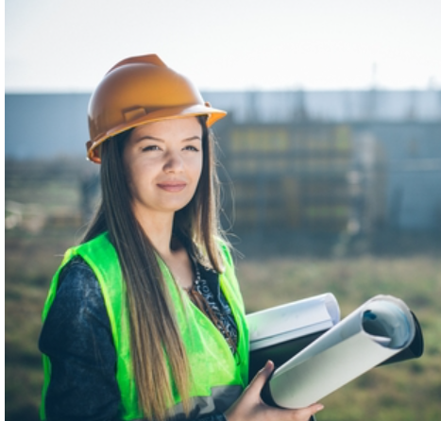
What does a Civil Engineer Do?
Lesson 2

Slide 7
Science Words to know
Earthquake
Civil Engineer
Stability
Lesson 2

Slide 8
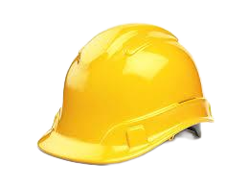
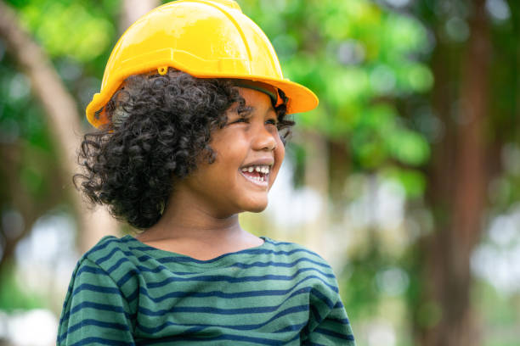
We will be wearing our scientist hats!
Gesture with your hand
Lesson 2

Slide 9
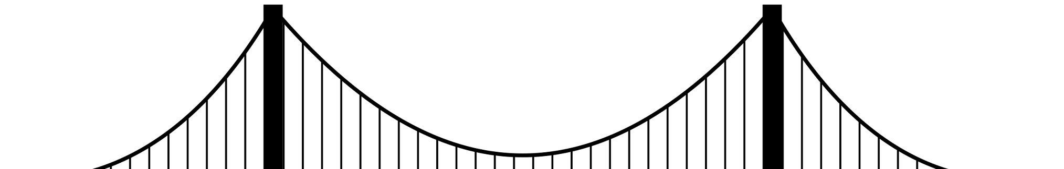
Civil Engineers need to use the
Scientific Method
to solve complex problems in order to make sure structures are stable and safe.
Lesson 2

Slide 10



The Scientific Method has 3 Parts!
Predict
Observe
Explain
Make an Educated Guess
Watch how something is done
Use our
Science Words to discuss what we observed
Lesson 2

Slide 11

Let’s try out the
Scientific Method!
Lesson 2

Slide 12
The Scientific Method has 3 Parts!
Predict
Which ball will go down faster or will they reach at the same time?
Lesson 2

Slide 13
The Scientific Method has 3 Parts!
Observe
Drop the balls and observe
what happens
Lesson 2

Slide 14
The Scientific Method has 3 Parts!
Explain
Why do you think this happened?
Lesson 2

Slide 15
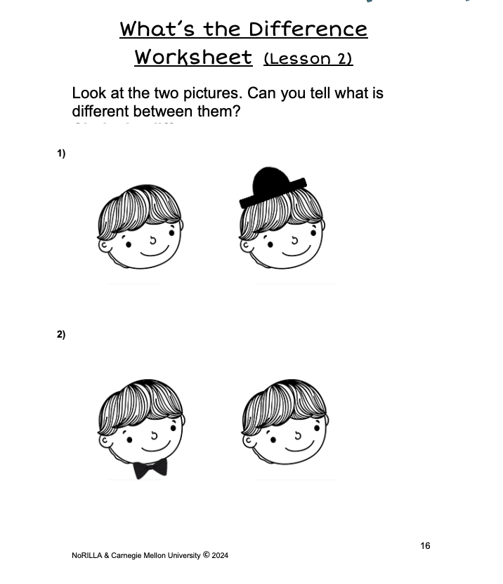
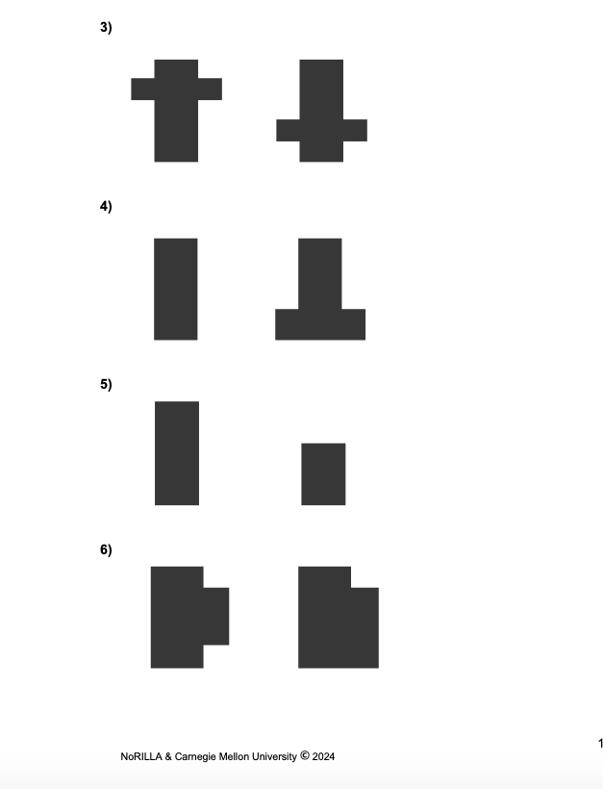
What’s the Difference?
Recommended for younger students.
Lesson 2
Notes:
THIS SLIDE CAN BE USED FOR YOUNGER KIDS (K-1)

Slide 16
Which are the three parts of the Scientific Method?
1)
2)
3)
Listen
Predict
Draw
Play
Explain
Show
Observe
Lesson 2
Notes:
RECAP. Standard 3.5.K-2.T Students who demonstrate understanding can demonstrate that designs have requirements.

Slide 17
What are the three parts of the Scientific Method?
Predict
1)
2)
3)
Observe
Explain
Lesson 2
Notes:
RECAP. Standard 3.5.K-2.T Students who demonstrate understanding can demonstrate that designs have requirements.

Slide 18
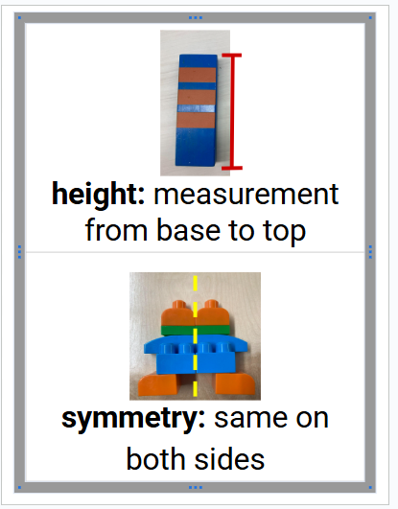
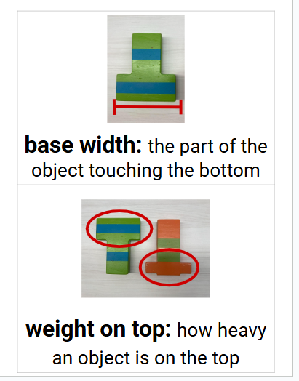
Science Words to Know
Lesson 3

Slide 19

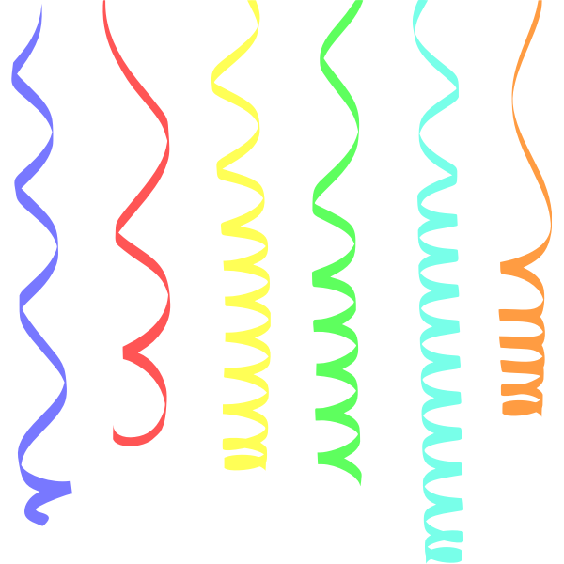
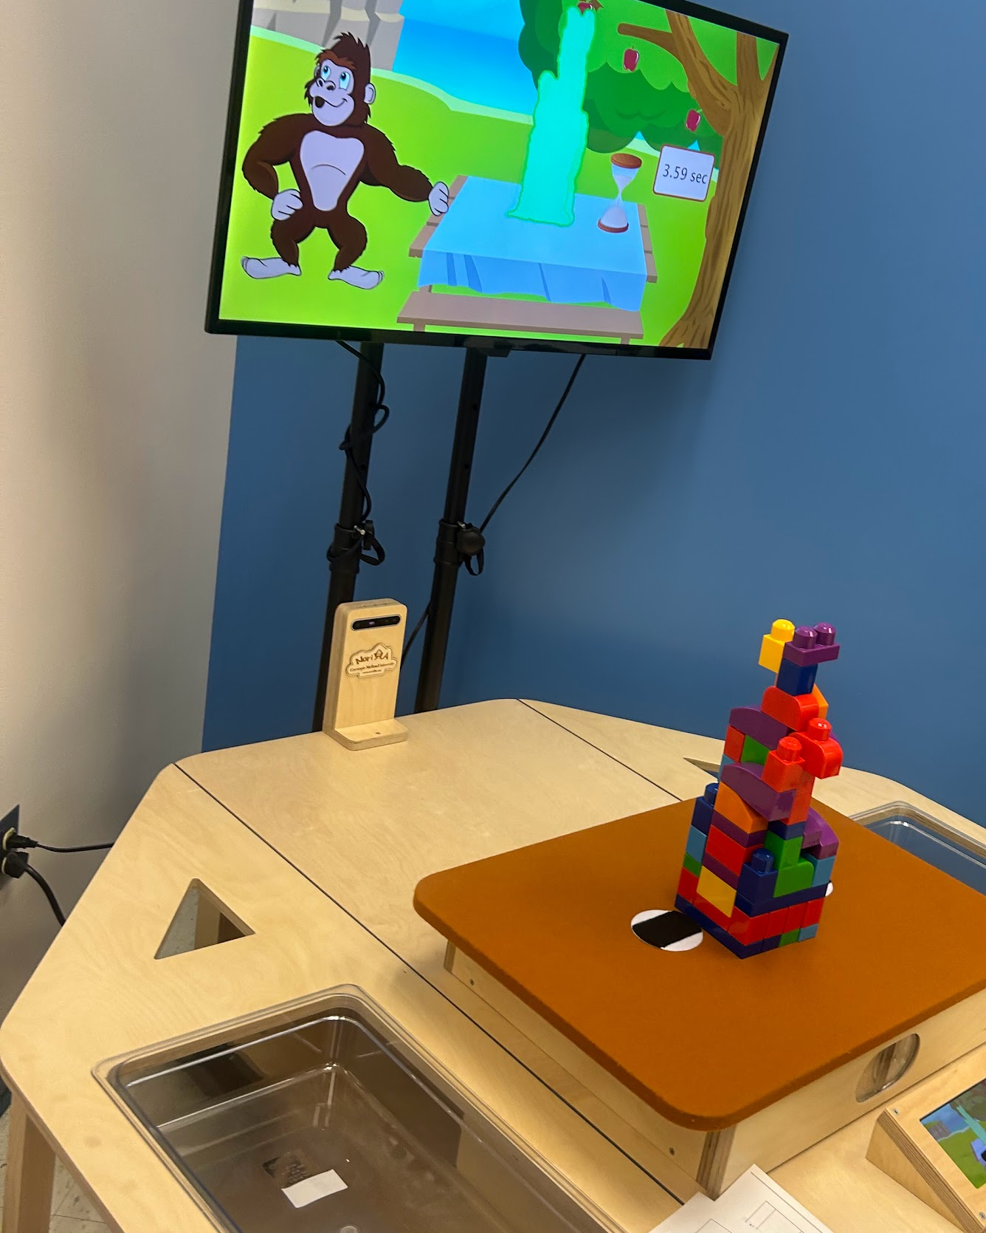
Let’s try out the
Norilla Table!
Lesson 3

Slide 20
At NoRILLA
Turn & Talk
Talk to your neighbor about your prediction. Listen to their prediction. Tell why you think the way you do.
Modeling for students
Charlotte: The orange tower will fall first because it is taller.
Wyatt: I don’t think so. I think the green one will fall first because it’s not symmetrical.
Charlotte: But they are both not symmetrical. So maybe we should look at the base?
Predict
Do you think the tower will stay up or fall down when the table shakes?
Lessons 3

Slide 21
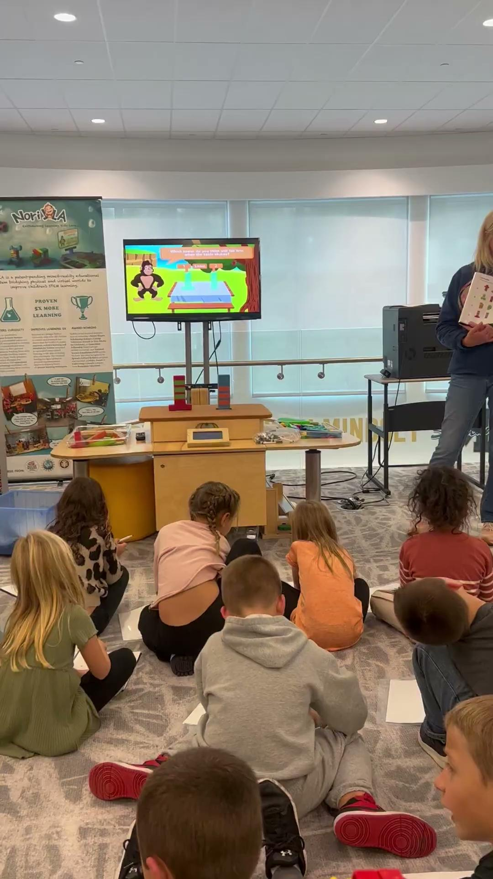
At NoRILLA
Turn & Talk
Talk to your neighbor about your prediction. Listen to their prediction. Tell why you think the way you do.
Predict
Do you think the tower will stay up or fall down when the table shakes?
Lessons 3
Notes:
SHOULD WE HAVE A PHOTO OF THE LAMINATED SHEETS AS OPTIONAL HERE?

Slide 22
Turn and Talk
Notes:
I’m adding this and the previous slide with the video. Only one of these slides should stay, but I wanted the chance to see both options.

Slide 23
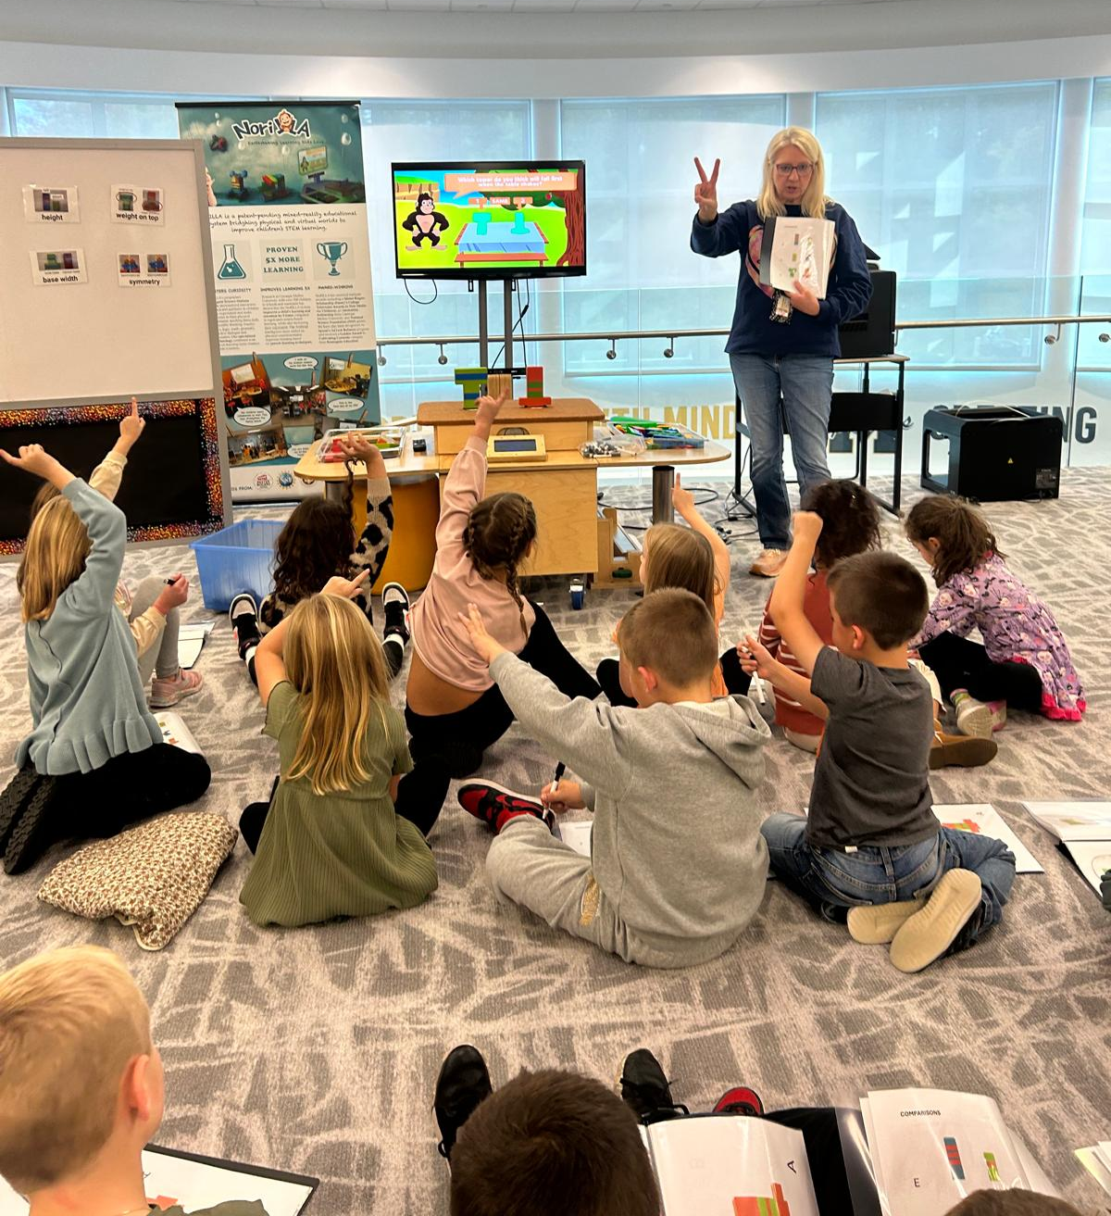
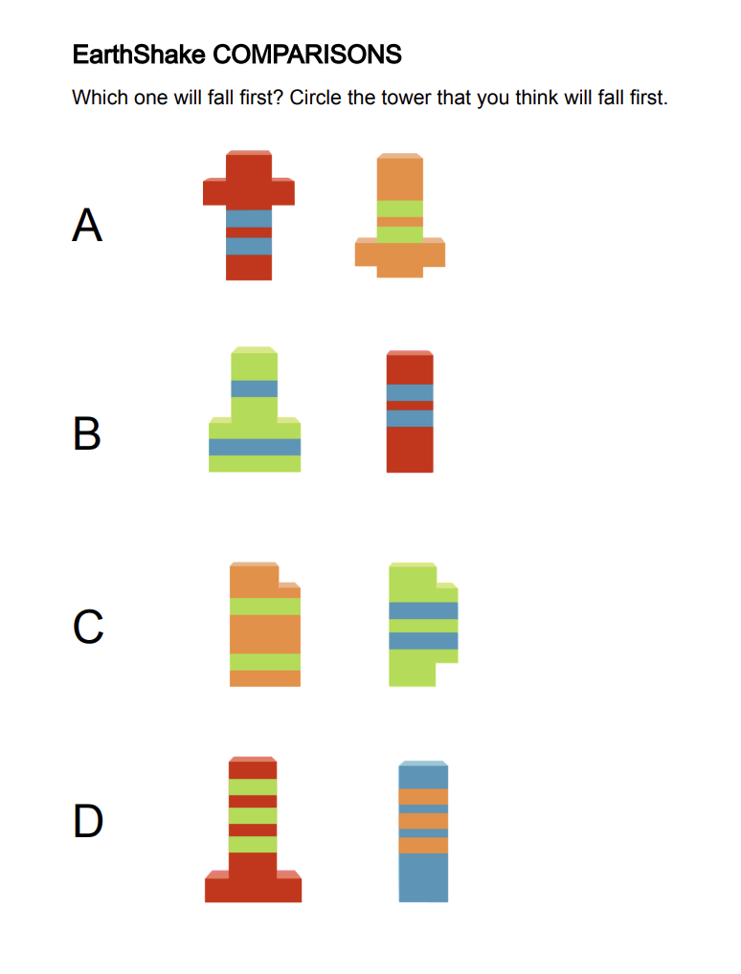
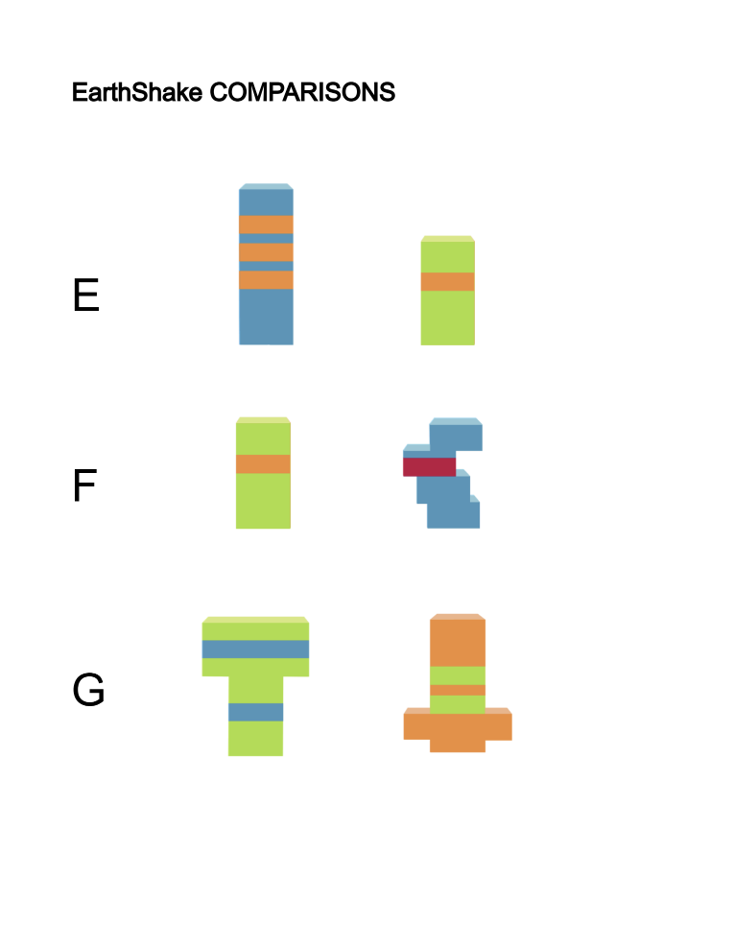
At NoRILLA
Optional Scaffold while doing Turn and Talk
Predict
Use laminated sheets to show and discuss your prediction with your partner
Lessons 3
Notes:
Hand out laminated EarthShake comparisons to students

Slide 24
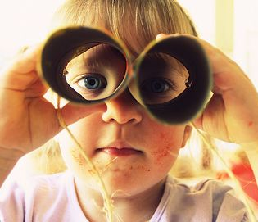
At NoRILLA
Did it stay up?
Observe
Watch the tower shake?
Did it fall?
Lessons 3

Slide 25
At NoRILLA
Turn & Talk
Talk about why you think that tower stayed up or fell.
Was your prediction correct?
Explain
Share your explanations with the class.
Use our
Science Words to discuss what we observed
Lessons 3
Notes:
ADD THE 4 EXPLANATIONS AND DO A FINGER COUNT - MAYBE PHOTO FROM ONE OF THE CLASSES DOING FINGERS

Slide 26
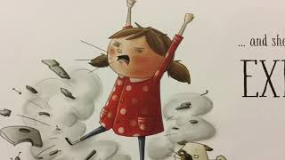
Think About How Engineers show
Perseverance
Listen to the Story:
Lesson 3

