Slide 1
Reference frames and dimensions

Slide 2
Knowledge:
information, understanding, or skill you get from experience or education
awareness of something
Notes:
Science is one of the ways to “know” something about our reality. When trying to understand the fundamentals of science, we first have to think a little bit about what it means to “know” something.
Here are just a couple definitions of “knowledge” I found on line. The first suggests it is a superset of learned information, understanding, and skill. The second is more concise, and implies that knowledge is about awareness.
Information is a key word for this class. When we measure something, we are collecting information.
Information is an element of knowledge, but most definitions use words like “understanding” or “awareness”. These words invoke the idea that knowledge is not just about data, but also knowing what those data mean. Or to put it another way, one level of knowledge is being able to describe a pattern in data. But another level of knowledge is to be able to predict that pattern from other data, based on knowledge of the causal relationship that defines the relationships between the data.
On the surface, measurement is about gaining information. But in reality, we actually rely on at least one, if not several, layers of the understanding of causality to gain a measurement.
Liquid thermometer example.

Slide 3
What is the philosophy of science?
How do we “know” something about the organization of objective reality?
Epistemology
How do we “know” something?
Philosophy of Science
Metaphysics
Ontology
How is reality organized?
What is reality?
The datum (singular of data) = an objective piece of information about the organization of reality
Notes:
What are the components of the philosophy of science?
It starts with metaphysics, or the philosophical attempt to describe the fundamental nature of being.
The goal of science is ultimately a quest for truth.
A consequence of accepting reality is that it must have some organization. The philosophical attempt to understand this organization is called ontology.
What are the fundamental units of reality and how do they relate to each other?
It’s easy to see how science falls into these philosophical fields, but there are many open questions about what we can actually “know” about ontological and metaphysical truths
There are other approaches to science, so what differentiates scientific approach?
I would argue that science is a field that depends on the assumption that at least some part of our existence is defined by an objective reality. In other words, there are a consistent set of rules that define reality and cannot be violated.
But this still doesn’t get us closer to a definition of “knowledge”
This leads us epistemology, or the philosophical attempt to understand the nature of knowledge.
If we accept that there is a reality, regardless of our ability to understand it, then the question is raised regarding what is “knowable” or “unknowable” about that reality.
How much, if at all, do the empirical relationships between data reflect truth?
How much, if at all, do empirical relationships allow us to “know” the truth?
The philosophy of science is a mixture of these philosophical approaches.
How do we organize our knowledge of an assumed objective reality?
Ontology allows analytical techniques to be applied to philosophy, specifically the use of numbers and mathematics
In this class, we are going to spend a lot of time talking about the datum.
It the context of philosophy, I would characterize the datum as a atomic organizational unit of what we know about reality.
Though what we actually “know” is still a epistemological argument, and we’ll talk later about how this manifests in our attempts to “measure” things.

Slide 4
Knowledge:
information, understanding, or skill you get from experience or education
awareness of something
Notes:
Science is one of the ways to “know” something about our reality. When trying to understand the fundamentals of science, we first have to think a little bit about what it means to “know” something.
Here are just a couple definitions of “knowledge” I found on line. The first suggests it is a superset of learned information, understanding, and skill. The second is more concise, and implies that knowledge is about awareness.
Information is a key word for this class. When we measure something, we are collecting information.
Information is an element of knowledge, but most definitions use words like “understanding” or “awareness”. These words invoke the idea that knowledge is not just about data, but also knowing what those data mean. Or to put it another way, one level of knowledge is being able to describe a pattern in data. But another level of knowledge is to be able to predict that pattern from other data, based on knowledge of the causal relationship that defines the relationships between the data.
On the surface, measurement is about gaining information. But in reality, we actually rely on at least one, if not several, layers of the understanding of causality to gain a measurement.
Liquid thermometer example.

Slide 5
How are data used in the scientific method?
Question
Hypothesis
Conclusion
Experiment

Slide 6
How are data used in the scientific method?
Why or how?
Question
Abduction
General law of nature
General law of nature
Hypothesis
Conclusion
Prediction
Induction
Deduction
Meta-analysis
Experiment
Specific pattern observed
Specific pattern observed
Analysis

Slide 7
How are data used in the scientific method?
Question
Introduction section
Abduction
General law of nature
General law of nature
Discussion
section
Hypothesis
Conclusion
Prediction
Induction
Deduction
Meta-analysis
Experiment
Specific pattern observed
Specific pattern observed
Analysis
Results
section
Methods section

Slide 8
How are data used in the scientific method?
Question
Abduction
General law of nature
General law of nature
Hypothesis
Conclusion
Prediction
Induction
Deduction
Meta-analysis
Experiment
Specific pattern observed
Specific pattern observed
Analysis
Fact
Fact

Slide 9


How do we put data into objective context?
Reference frame (or frame of reference)
Einstein’s special theory of relativity
Dimensions provide meaning
Variables have dimensions
A dimension describes a measurable component of a reference frame
Length is the fundamental dimension of space
$$x=2 m$$
Numbers have units
Units provide a scale
1
2
[L]
$$x$$
(meters, feet, furlongs)

Slide 10






Reference frames - spatial
Variables have dimensions,
Numbers have units
$$y$$
[L]
Equation for area of a rectangle is “dimensionally consistent” (dimensions on left are equal to dimensions on right)
$$A=xy$$
$$A$$
[L²]
$$\left[L^{2}\right]=$$
$$\left[L\right]\left[L\right]$$
Derived from fundamental geometric proofs and consistent application of any unit system will work
(e.g. lengths in cm will yield area in cm² or lengths in inches will yield area in in²)
$$x$$
[L]
Notes:
We’ve talked about the fundamental dimension of length and described it in the context of length in the “x” direction.
Let’s recognize the multidimensionality of space by recognizing there are lengths in other directions.
For example, we might pick an orthogonal direction and arbitrarily call it “y” as we might do in a cartesian coordinate system.
“Orthogonal” is just a fancy word that describes how values for y can change independently of values for x
Now that we can characterize space in two orthogonal dimensions, we can define the familiar spatial property of area.
Area might be thought of having dimensions of its own, but its dimensions are more commonly derived from the more fundamental dimension of length.
Your intuition may already be suggesting to you that those dimensions might by something like the square of length
And your intuition would be correct, but let’s derive those dimensions algebraically.
First, we recall from geometry that the area of a rectangle is calculated from the product of the length of its base times the length of its height.
We can convince ourselves that the dimensions of length squared is logical for area based on carrying dimensions through the algebra of the right side of this equation.
That derivation is fairly straightforward, demonstrating why the derived dimensions of length squared make sense for a rectangular area.
The fact that this derivation makes sense introduces the idea of dimensional consistency of equations.
When the mathematics are derived from logic that is independent of any given set of data collected, the dimensions of the mathematical terms will agree.
Here, the geometric logic is supported by the dimensions of the left-side term in the equation agreeing with the right-side term.
In this case, the independent logic supporting the dimensional consistency comes from geometric theory.
A consequence of dimensional consistency is that any consistent application of units will work for this equation.
For example, we can use either inches or centimeters for the lengths and get corresponding units of square inches or square centimeters for area.
This is the foundational theory underlying why we carry units through calculations with dimensional consistency to help us double check if we have plugged appropriate numbers into the equation

Slide 11
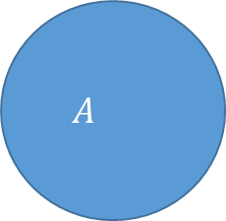




Reference frames - spatial
Variables have dimensions,
Numbers have units
$$y$$
[L]
$$A$$
[L²]
$$A=πr^{2}$$
$$\left[L^{2}\right]=$$
$$x$$
[L]
Notes:
As it turns out, you don’t have to use a rectangle to convince yourself that the dimensions of area will always be length squared
Let’s see if we can follow the same path of logic with a circle rather than a rectangle.
The intuition that area is length squared is not so obvious here, but let’s use theory to demonstrate that it still holds.
Theory from geometry and calculus provide us with the well known equation for the area of a circle, which is pi times the square of the radius
Again, our job here is to demonstrate dimensional consistency of this equation, which means we need to determine if pi times the square of the radius indeed works out to be length squared

Slide 12



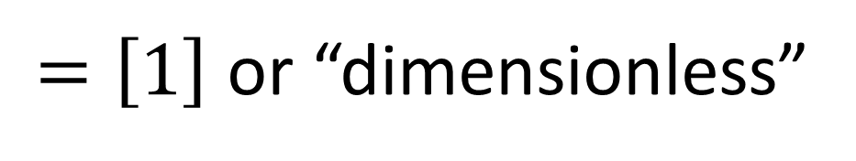


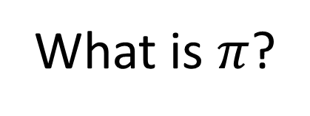
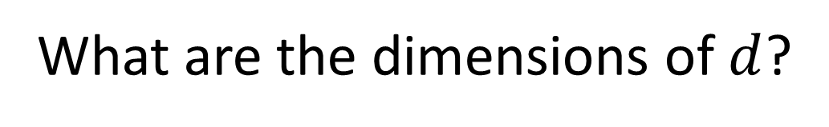

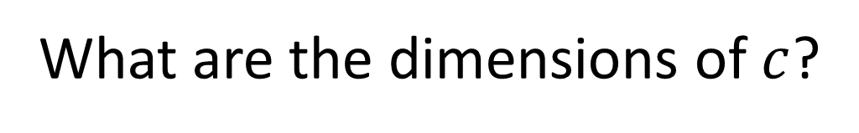
What are the dimensions of $π$?
What is $π$?
(Hint: it is a ratio that has something
to do with the geometry of a circle)
What are the dimensions of $c$?
$$c$$
What are the dimensions of $d$?
$$d$$
$$[L]$$
$$\frac{}{[L]}$$
$$π≡\frac{c}{d}$$
$=\left[1\right]$ or “dimensionless”
Notes:
The first challenge is to determine the dimensions of pi.
You may want to pause the video here and challenge yourself to see if you can work this out on your own.
I’ll give you a hint that you will need to know the definition of pi
And that definition has something to do with a ratio that describes the geometry of a circle
I’ll give you a chance here to pause the video, but I’m going to move on
The definition of pi is the ratio of the circumference of a circle to its diameter
This turns out to be the same number no matter how large or small the circle is.
I’m using the equals sign with three bars to emphasize that this is more than an equality, but a definition
You can read the three bars in English with the phrase “is defined by”
We can now carry the dimensions of circumference and diameter through this equation to determine the dimensions of pi
The diameter is the distance between the edges of the circle on a straight line through the center
This distance has dimensions of length, which we can plug into the equation
The circumference is a little trickier, in that we are talking about curved line around the outside of the circle rather than a straight line for our examples so far
But there is nothing about the dimensions of length that suggest it has to be along a straight line
The circumference still has a length along a single dimension, it’s just that the single dimension is now curved
After doing the algebra, we see that pi is what we call a dimensionless number.
The dimensions of the numerator and denominator cancel out to unity
This canceling of dimensions is a common property of generalized descriptors we use in nature.
A lack of dimensions tends to indicate a normalization of variables that allows the resulting ratio to be more transferable or comparable across different applications

Slide 13



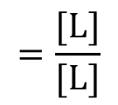
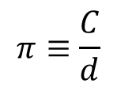
Reference frames - spatial
$$π≡\frac{C}{d}$$
Variables have dimensions,
Numbers have units
$$y$$
[L]
$$=\frac{[L]}{[L]}$$
$$[1]$$
$$A$$
[L²]
$$A=πr^{2}$$
Equation for area of a circle is “dimensionally consistent”
$$\left[L^{2}\right]=$$
$$[1]$$
$${\left[L\right]}^{2}$$
Consistent application of any unit system will work
(e.g. radius in cm will yield area in cm² or radius in inches will yield area in in²)
$$x$$
[L]
Notes:
Now that we know the dimensions of pi we can get back to our equation for the area of a circle.
The numeral one as a dimension represents the dimensionless character of pi
The radius is half the diameter, so it also has dimensions of length
Working through the algebra, we have again supported the dimensional consistency of this derivation from geometry and calculus
And again, we would expect that any system of units would work, in that we can chose any units of length for the radius and get the corresponding units squared as the units for the calculated area
Any equation for area derived from geometric theory should result in dimensions of length squared.
If not, there is a good chance you have either made a mistake in the algebra for the derivation or you are using an empirical equation that is based on arbitrary mathematical patterns in data rather than independent theory.

Slide 14

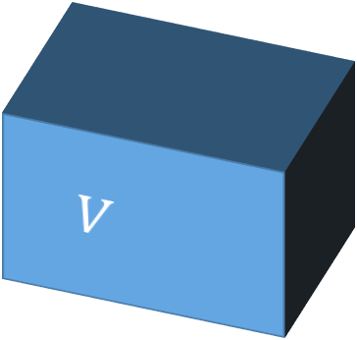





Reference frames - spatial
$$y$$
[L]
Variables have dimensions,
Numbers have units
$$z$$
[L]
$$V=xyz$$
$$V$$
$$\left[L^{3}\right]=$$
$$\left[L\right]\left[L\right]\left[L\right]$$
[L³]
$$x$$
[L]
Fundamentals of “dimensional analysis”: it is not just about unit conversion
Notes:
Your intuition is probably telling you we are not quite done with space
To uniquely identify a given location in space, we need a third orthogonal dimension
In a cartesian system, this is often referenced as a z axis
Three dimensions allows us to think about another derived spatial construct called a volume
Volumes are particularly important because they are fundamental to the physical definition of matter, where matter cannot be matter unless it occupies a volume in space
Your intuition is probably also telling you that the dimensionality of volume is likely length cubed, and you would be correct.
I will leave it to you to work through the geometric definition of the volume of a rectangular prism.
You should be able to convince yourself of the dimensional consistency that supports that the dimensions of volume from geometric theory will always be length cubed
You might try the equation for the volume of a sphere to reinforce that idea
Hopefully, this basic description of spatial dimensions starts to demonstrate the power of dimensional analysis.
It provides a consistent language for epistemologically mapping the variables we measure for objectivity science with the property those variables represent in nature
If you google “Dimensional analysis” you are likely to get a lot of hits to the unit factor technique for unit conversion.
However, dimensional analysis is a much more powerful epistemological tool than unit conversion alone and deserves attention much earlier and more often in the training of environmental scientists.

Slide 15
What is a datum?
Philosophically speaking:
  The datum = an objective piece of information about the organization of reality
In a quantitative measurement context:
  The datum = an evaluation (with units) of a property (with dimensions) describing a given entity within a given reference frame
Notes:
After an introduction to fundamental and derived dimensions of space, we can start seeing the basics of how dimensional analysis helps us describe the links between data and the real world.
Our abstract philosophical definition of datum was focused on how data lends objectivity to the practice of science,
but the dimensional perspective suggests that maybe we can find a more specific definition of datum when applied to quantitative science
The quantitative definition for a datum that I like is “an evaluation of a property that describes an entity within a given dimensional reference frame”.
The idea of dimensional analysis is to give us an unambiguous algebraic language to use when explaining to other scientists what can be interpreted from a given value we have measured.
We all know that units are important to knowing the meaning of a number evaluating a variable,
But while the scale for the number is important to using it in calculations, the dimensional context hinted by the units are even more important to fundamental agreement on how numbers should be interpreted
I suggest that relying on units alone to provide dimensional context is an ambiguous practice, and the formalizations of dimensional analysis are worth learning how to use

Slide 16
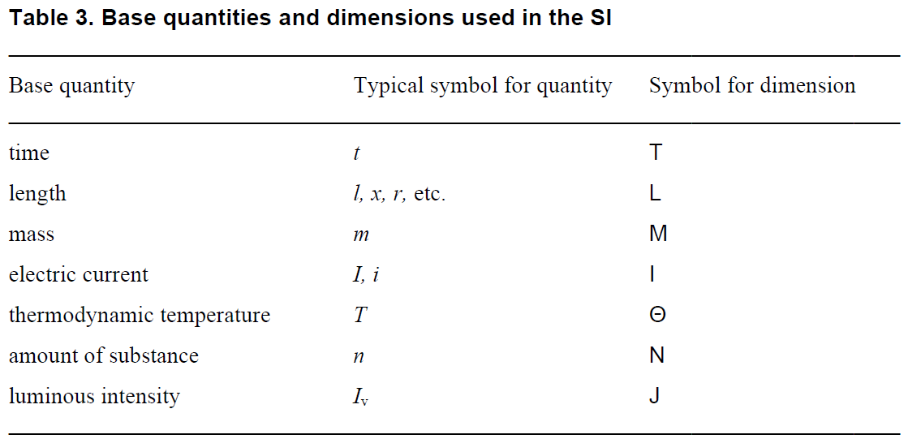
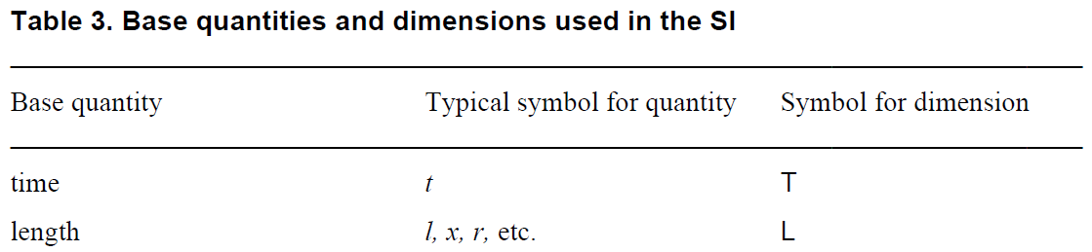
Fundamental dimensions
SI unit
[ ]
second
[ ]
meter
[ ]
kilogram
Derived from charge [Q]?
[ ]
ampere
[ ]
kelvin
or a count
[ ]
mole
Derived from energy?
[ ]
candela
Table from International System of Units Brochure 9th Edition 2019
Notes:
A more general application of dimensional analysis requires that we describe more properties of nature than just space.
Let’s work our way through the fundamental table of dimensions as suggested by the International System of Units, which we usually just abbreviate to SI units
A categorization and standardization of units across multiple cultures inherently requires dimensional thinking based on the most fundamental properties of nature we all understand
so it is logical that the basis for standardization of units is inherently built from a definition of fundamental dimensions
We’ve already talked about the fundamental dimension of length so I’ve already revealed that row from the table.
Many different variables may be used to represent length, as demonstrated by our use of x y and z to represent lengths in orthogonal cartesian directions
Ultimately, the goal of SI is to define a base unit for each fundamental dimension, so the base unit for length in the SI system is the meter.
As made famous by Einstein, characterizing movement in space inherently requires thinking about the dimension of time, which is symbolized with a capital T.
More often than not, time will be represented as a variable using a lower case t.
Time is one of those concepts that everybody understands abstractly, but the nature of time is very difficult to describe directly.
I like to think about time as the dimension of causality
One inarguable fact is that those of us operating in Earth’s gravitational field are all experiencing the same rate of cause and effect,
The concept of time allows us to agree on a common way to measure the pace of a resulting sequence of events.
Einstein famously showed that the fundamental rate of causality actually changes with your frame of reference,
but Earth-bound environmental scientists typically do not have to deal with meaningful variation in the pace of time in their calculations
The international community has agreed on the second as the base unit for the dimension of time
Speaking of gravity, another inarguable fact is that we all see the same effect of the stuff we call “matter” on spacetime
The degree of this effect is conceptualized as the dimension we call mass, which has a symbol of a capital M.
The magnitude of the effect of mass on spacetime is proportional to the magnitude of the apparent force we call gravity
though I think it is pretty well established at this point that gravity is actually a bending of spacetime that only has a similar effect as a force
The proportionality of mass with the effect of gravity gives us the ability to measure either based on the effect of the Earth’s mass on a given amount of matter
The international community has agreed that the base unit for mass should be the kilogram
While we often quantify an amount of matter relative to its gravitational effect, few scientists would argue against the idea that matter is made of bits of stuff we call molecules
So another way we talk about an amount of matter is by simply counting those bits, where the dimensions of this count are symbolized with a capital N
When we count in multiples of avogadros number, this count has units of moles, which is the international base unit for an amount of a substance
I would argue that counts are not limited to an “amount of a substance” and it is possible to have the dimension of count apply to conceptual entities as well
In terms of base dimensions, I am not sure “amount of substance” is a general enough descriptor for the concept of a count
But it provides a useful example
The need to predict the inarguable effects of matter on other nearby matter begins to highlight the need for dimensions related to energy.
As we will see later, Newton’s definition of energy does not require a fundamental dimension and can be derived only from the fundamental dimensions of Mass Length and Time
However, thinking about the thermodynamic energy content of matter starts to evoke notions of properties like temperature, based on the idea that we all fundamentally know the difference between stuff that is hot and stuff that is cold
The dimension of temperature is symbolized with a capital Greek letter theta, probably because a capital T was already taken by time.
Or perhaps because a capital Latin T used as a variable typically refers to temperature,
This potential confusion among symbols used for variables, dimensions, and units is why the best practice is to include square brackets around dimensions to differentiate them
The SI unit for temperature is a kelvin, where one Kelvin is conveniently the same difference in temperature as one Celsius degree
A couple more dimensions we will not focus on now include electrical current and light intensity.
The dimensions of current are symbolized with an I and the SI base unit is the ampere
We will talk later in the class about current being derived conceptually from a count of electrical charges per time
We will not be using light intensity in this class, but the dimensionality of J should not be confused with the unit of Joules of energy
Again, the square brackets help to differentiate a symbol that is used for different dimensions and units.
Luminous intensity is ultimately a type of angular energy flux with a base unit of candela that would be joules per steradian per second, where a steradian is kind of a 3-D version of an angle
There are nuances here regarding what constitutes a fundamental vs. a derived dimension
You might argue that current is actually a derived dimension and luminous intensity is almost certainly a derived dimension.
Ultimately the distinction between fundamental vs derived dimensions is not that critical as long as the element of nature being described is clear

Slide 17
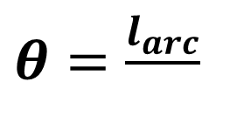
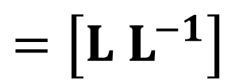

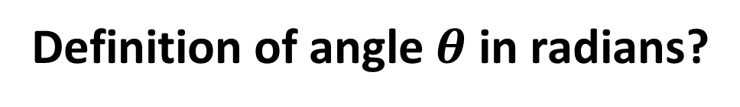

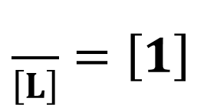



Fundamental derived dimensions
Space:
Units do not always algebraically reflect dimensions
(volume can be gallons, liters, teaspoons, cups, etc.)
Area, variable $A$, dimensions of [L²], value of 120 mi²
Volume, variable $V$, dimensions of [L³], value of 80 cm³
Dimensionless:
A dimensionless number can still have units!!
(percent, radians, etc.)
Ratios where dimensions cancel, dimensions of [1]
$$l_{arc}$$
Definition of angle $θ$ in radians?
$$θ$$
$$r$$
$\frac{}{\left[L\right]}=\left[1\right]$
$\frac{}{r}$
$\frac{\left[L\right]}{}$
$θ=\frac{l_{arc}}{}$
$=\left[L L^{−1}\right]$
Notes:
Let’s review a couple more dimensions that may be argued as being fundamental, though they have elements of derivation
We have already talked about the derived spatial dimensions of area and volume.
These are so commonly used in describing space that we seldom say “length squared” or “length cubed” when using these dimensions in a sentence, even when describing them in dimensional analysis.
While the symbol and derived dimension is length squared, we usually just say a corresponding variable has fundamental dimensions of area
This brings up another potential point of confusion in inferring dimensions from units.
Dimensions like area are commonly depicted in square units of length, like square inches or square meters.
However, area may also be specified in absolute units like hectares or acres, which do not directly evoke the squared length nature of the dimension
Volume might be specified in a large collection of absolute units, like gallons, liters, teaspoons, cups, etc., again not hinting at the cubed length nature of the inherent dimensions of the variable
Where absolute units are applied to a derived dimension, remembering the dimensions based on an applied unit requires a bit more memorization
Finally, many of the more transferable or comparable properties across many different types of systems are characterized with dimensionless variables
Dimensionless is a derived dimension in the sense that it arises from dimensionality of a ratio that divides out to unity
We have already reviewed a dimensionless property of circles we call pi
Fractions of a whole is another example of a common application of dimensionless ratios
Just because a variable is dimensionless does not mean that it does not have units.
For example, we very commonly refer to fractions of a whole in units of percent, which is a unit representing the ratio of a given count to a hundred count of the same thing.
We can use a similar principle as PI to think about the dimensionality of an angle represented by units of radians
A radian is characterized the distance along an arc of a circle cut off by two radii of the circle at a given angle
The distance along this arc has dimensions of length
To normalize this notion of an angle to any sized circle, we normalize the length of this arc to the radius,
yielding the derived dimensions of unity or a dimensionless number
You might also remember the dimensions of radians more specifically as a length per length to remind you of the nature of the property being measured
To solidify your understanding of the radian, you might start with the definition of pi and convince yourself why pi radians makes sense as the angle that divides the circle in half

Slide 18

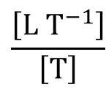











Derived dimensions
Energy:
Derived dimensions may have their own symbol if never decomposed into fundamentals
(kg m² s⁻²)
Variable $E$, dimensions of [?], value of 1 J
$$E=W=Fd$$
$$\left[M L T^{−2}\right]\left[L\right]$$
$$=\left[M L^{2} T^{−2}\right]$$
$$=\left[E\right]$$
Force:
(kg m s⁻²)
Variable $F$, dimensions of [?], value of 1 N
$$\left[M\right]\left[L T^{−2}\right]$$
$$=\left[M L T^{−2}\right]$$
$$F=ma$$
Acceleration:
Variable $a$, dimensions of [?], value of 1 m s⁻²
$$a=\frac{dv}{dt}$$
$$\frac{\left[L T^{−1}\right]}{\left[T\right]}$$
$$=\left[L T^{−2}\right]$$
Velocity:
Variable $v$, dimensions of [?], value of 1 m s
$$v=\frac{dx}{dt}$$
$$\frac{\left[L\right]}{\left[T\right]}$$
$$=\left[L T^{−1}\right]$$

Slide 19


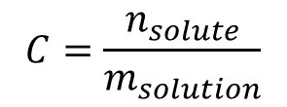
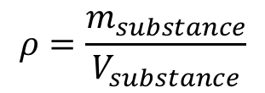

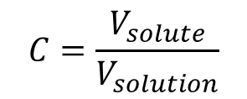


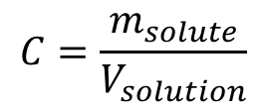


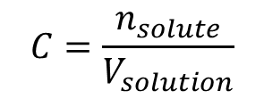



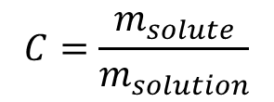

Derived dimensions
Density:
$$ρ=\frac{m_{substance}}{V_{substance}}$$
$m$ = mass [M] $V$ = volume [L³]
$ρ$ = density [M L⁻³]
Concentration:
$$C=\frac{m_{solute}}{V_{solution}}$$
$m$ = mass [M] $V$ = volume [L³]
$C$ = concentration [M L⁻³]
$$C=\frac{m_{solute}}{m_{solution}}$$
$m$ = mass [M]
$C$ = concentration [1]
[M M⁻¹]
$$C=\frac{V_{solute}}{V_{solution}}$$
$V$ = volume [L³]
$C$ = concentration [1]
[L³ L⁻³]
$$C=\frac{n_{solute}}{V_{solution}}$$
$n$ = count [N]
$C$ = concentration [N L⁻³]
(molarity)
$$C=\frac{n_{solute}}{m_{solution}}$$
$C$ = concentration [N M⁻¹]
(molality)
Notes:
Dimensions are essential to understanding the meaning of a variable, but they are also abstractions and may not be interpretable on their own without additional context.
Let’s look at an example of potential confusion where two variables with very different interpretations have the same dimensions.
Density is a property of matter that relates how its mass is distributed across the volume of space it occupies.
Typically we talk about density as the amount of mass per unit volume.
Hopefully the dimensionality of density is clear at this point, in that the mass of a given substance divided by the volume of that substance would yield dimensions of Mass per Volume or Mass per length cubed
The abstract character of dimensions is illustrated by other variables that also have dimensions of mass per volume
For example, the concentration of a solute in a solution is commonly reported as the mass of the solute normalized to the volume of the solution.
So without specific context, it appears we have two variables with comparable algebraic derivations…
leading to the same dimensions of mass per volume…
and perhaps creating the misconception that these two variables mean the same thing
Before attempting to interpret these dimensions, you should ask yourself contextual questions like “Which mass is being discussed?” and “Which volume is being discussed?” before you conclude what dimensions like mass per volume might mean.
The need for additional context is also emphasized in that the same concept might be represented by many different dimensions. Therefore a variable referenced with the same name might actually be a different variable depending on the dimensions used.
For example, the concentration of a solute in a solution might be characterized in many different ways.
We might talk about the mass of the solute relative to the mass of the solution rather than the volume of solution
In this case, the mass in both the numerator and denominator divide out to unity…
Meaning that concentration in this case is dimensionless
Volumetric ratios are a common way to report the alcohol content of beer or wine
The units are often in percent, but concentration is still fundamentally a dimensionless quantity, with volume in the numerator dividing out with volume in the denominator
Here we have two different conceptualizations of concentration that have the same dimensions but definitely do not produce the same number except in very specific situations
A common way to avoid this ambiguity is to report the non-simplified dimensional ratios
For example you might specifically designate a mass ratio as a mass per mass…
or you might specifically designate a volumetric ratio as a volume per volume to avoid any accidental confusion with a mass ratio
Chemists concerned with stoichiometric calculations will often report concentrations in molarity, which is defined as the count of solute molecules normalized to the volume of the solution
Molality is another common dimension of concentration where we consider the count of the solute per mass of the solution rather than the volume of the solution used in molarity
This isn’t even the end of the list of potential dimensions for concentration,
But hopefully I’ve made the point that context is everything when it comes to appropriate interpretation of how a given dimensional analysis reflects the real world

Slide 20
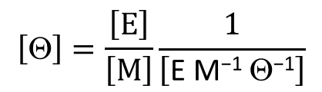
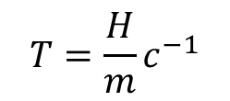
Temperature and heat
Definitions:
Heat:
total molecular-scale kinetic energy [E]
Temperature:
average kinetic energy of the molecules of a substance [Θ]
Dimensions:
$H=Tmc$ $m$ = mass [M] $c$ = specific heat [E M⁻¹ Θ⁻¹]
$$T=\frac{H}{m}c^{−1}$$
$$\left[\text{Q}\right]=\frac{\left[E\right]}{\left[M\right]}\frac{1}{\left[\text{E} \text{M}\text{−1} \text{Q}\text{−1}\right]}$$
If specific heat is a constant, temperature may be thought of as a concentration of heat energy per unit mass.

Slide 21
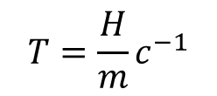
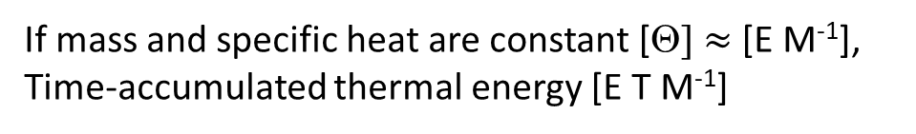
Tricky examples
Acre foot of water:
Acre = area [L²] Foot = depth [L] Acre foot = volume [L³]
Electricity:
What do we pay for?
Kilowatt hour
Power = energy per time [E T⁻¹] Hour = time [T]
Kilowatt hour = energy [E]
Degree day:
Degree = temperature [Θ] Day = time [T]
Degree day = time-accumulated temperature [Θ T]
$$T=\frac{H}{m}c^{−1}$$
If mass and specific heat are constant [Θ] $≈$ [E M⁻¹],
Time-accumulated thermal energy [E T M⁻¹]

Slide 22
Formatting
(Pay attention to this slide when doing your homework)
  Use capital letters with non-italicized fonts ([M] not [M] or [m])
  Always put in square brackets ([L] not L or (L))
  Use negative exponents rather than fractions
    Why? Less ambiguous order of operations
      [M/L²T] might be interpreted as [(M/L²)T] or [M/(L²T)]
      [M/(L²T)] is the correct dimension but technically the incorrect interpretation of [M/L²T]
      [M L⁻² T⁻¹] is unambiguous and the same as [M/(L²T)]
  When asked for dimensions, DO NOT GIVE UNITS!

Slide 23

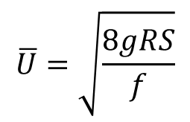
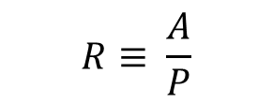



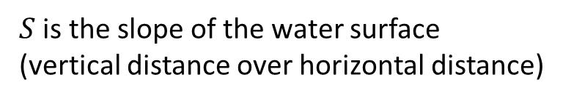


Dimensional consistency
Both sides of an equation have the same dimensions.
Is the Darcy Weisbach equation dimensionally consistent?
$$\overline{U}=\sqrt{\frac{8gRS}{f}}$$
$\overline{U}$ is the average velocity of stream water
$g$ is acceleration due to gravity
$R$ is the hydraulic radius
$$R≡ \frac{A}{P}$$
$A$ is the cross-sectional area of the channel
$P$ is the wetted perimeter of the channel
$S$ is the slope of the water surface
(vertical distance over horizontal distance)
$f$ is the dimensionless “friction factor”
Yes, this equation can be used with any consistent application of units.
Dimensionally consistent equations tend to be derived from fundamental theory.

Slide 24

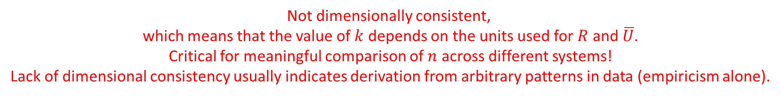
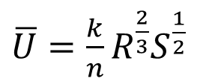

Dimensional consistency
Is Manning’s equation dimensionally consistent?
$\overline{U}=\frac{k}{n}R^{\frac{2}{3}}S^{\frac{1}{2}}$
$k$ is a dimensionless constant
$n$ is Manning’s roughness (dimensionless)
$R$ is the hydraulic radius
$$R≡ \frac{A}{P}$$
$A$ is the cross-sectional area of the channel
$P$ is the wetted perimeter of the channel
$S$ is the slope of the water surface
(vertical distance over horizontal distance)
Not dimensionally consistent,
which means that the value of $k$ depends on the units used for $R$ and $\overline{U}$.
Critical for meaningful comparison of $n$ across different systems!
Lack of dimensional consistency usually indicates derivation from arbitrary patterns in data (empiricism alone).

Slide 25





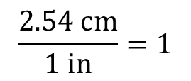

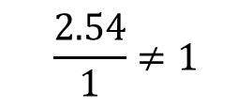


Unit conversion is a form of dimensional analysis
Unit-factor method:
Convert 5 inches to centimeters
$$2.54$$
$$cm$$
$$5 in$$
$$\frac{ }{ in }=$$
$$12.7$$
$$cm$$
$$1$$
$$\frac{2.54}{1}≠1$$
Numerically speaking: Numerator ≠ Denominator
Dimensionally speaking: Numerator = Denominator
$$\frac{2.54 cm}{1 in}=1$$
1. Numerator and denominator are measuring the same dimensions
2. Numerator and denominator have the same value in their respective scales
$$5 in=12.7 cm$$

