Slide 1


WINE FACTORY
Presentation Template
www.freepptbackgrounds.net

Slide 2
01：Briefing
02：Evaluation
03：Workshops
04：Design

Slide 3
01：BRIEFING

Slide 4
Skiing consists of wearing $3,000 worth
Skiing consists of wearing $3,000 worth
Assurance
Design
Quality
When you feel in your gut what you are

Slide 5
Layouts
Direction
Solution
04
03
When you feel in your gut what you are and then dynamically pursue it - don't back down and don't give up - then you're going to mystify a lot of folks.Bob Dylan
01
02
Content
Visual

Slide 6
Money
Impress
There is only one difference between a madman and me. I am not mad. Salvador Dali
I'm convinced that about half of what separates
Raise
Take calculated risks. That is quite different from being rash.
Invectors
Editable
I'm convinced that about half of what separates
There is only one difference between a madman and me. I am not mad. Salvador Dali

Slide 7
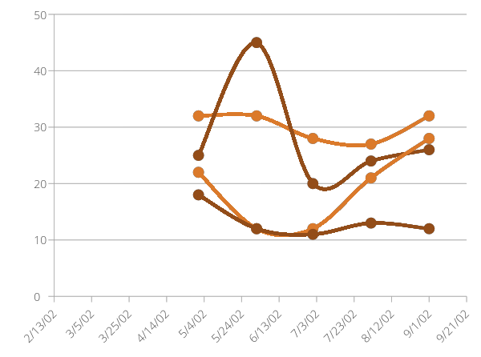
Take calculated risks. That is quite different from being rash. George S. Patton
There is only one difference between a madman and me. I am not mad. Salvador Dali
Company
Grow
Your

Slide 8

1 Base
Take calculated risks. That is quite different from being rash. George S. Patton
2 Models
To see what is in front of one's nose needs a constant struggle. George Orwell
3 Business
Take calculated risks. That is quite different from being rash. George S. Patton

Slide 9
02：EVALUATION

Slide 10
Customer
Acquisition
Enterprise
A
C
E
B
D
F
Enterprise
Acquisition
Customer
Business
A torn jacket is soon mended; but hard words bruise the heart of a child. Henry Wadsworth Longfellow

Slide 11
78%
80%
70%
62%
60%
50%
40%
40%
36%
You can’t change what’s going on around you until you start changing what’s going on with you.
30%
22%
20%
15%
10%
0%
01
02
03
04
05
06

Slide 12
63%
Be not afraid of going slowly, be afraid only of standing still Everybody has three chars ; the one is come out ,the one is owned ,the one is thought to have. You can’t change what’s going on around you until you start changing what’s going on with you.

Slide 13
Acquisition
Organic
Do you wonder what the difference between ignorance and genius is? .
01
02
Focused
Social Media
Defined
Everyone wants, happiness. No one wants pain. But you can’t have a rainbow without
04
03
Slideshare Campaign
Strategy
Do you wonder what the difference between ignorance and genius is? .

Slide 14
01
Our
Education is the
most powerful
04
02
Powerpoint
Events
God sometimes
removes
God sometimes
removes
03
Service
Education is the
most powerful

Slide 15
03：WORKSHOPS

Slide 16
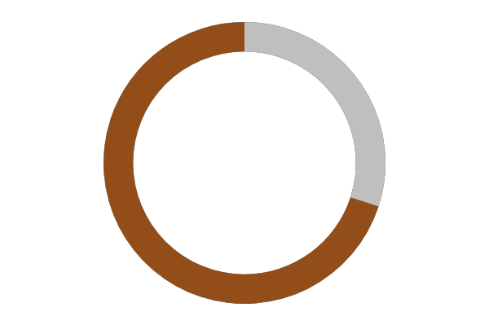
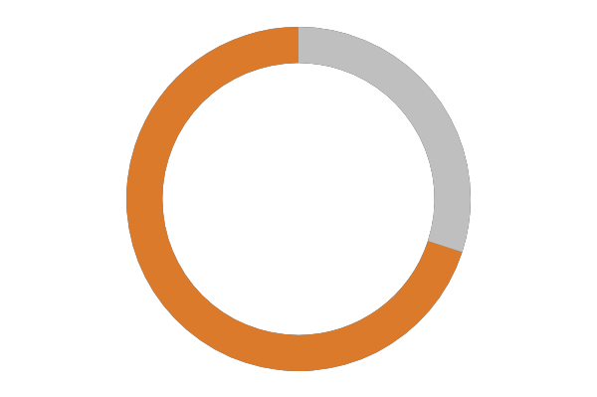


74%
43%
12%
88%
Development
Keynote
Web
Design

Slide 17
Idea
Think
Leaf
Make
Circle
Circle

Slide 18
Check
Meet
Education is the most powerful weapon which you can
Always give your best never worry for results.
Solutions
Team
God sometimes removes people from your life to protect you.
Education is the most powerful weapon which you can
Team
Check
Always give your best never worry for results.
God sometimes removes people from your life to protect you.

Slide 19
01
02
03
04
Web Design
Overview
Devices
Infographics
Everyone wants, happiness. No one wants pain. But you can’t have a rainbow without a little rain.
Enjoy the little things in life, because one day you will look back and realize they were the big things.

Slide 20

01
Everyone wants, happiness. No one wants pain. But you can’t have a
17%
38%
02
Always give your best never worry for results.
31%
Always give your best never worry for results.
03
19%
Everyone wants, happiness. No one wants pain. But you can’t have a
04
Education is the most powerful weapon which you can use to change the world. God sometimes removes people from your life to protect you. Do not run after them. Everyone wants, happiness. No one wants pain. But you can’t have a rainbow without a little rain. Enjoy the little things in life, because one day you will look back and realize they were the big things.

Slide 21
04：DESIGN

Slide 22
Speakers
Opening
Vision
Speakers
Enjoy the little things in life, because one day you will look back and realize they were the big things.
Break Time
Vision
Cerenomy
Values
Mission
Everyone wants, happiness. No one wants pain. But you can’t have a rainbow without a little rain.
Mission
Speakers
Opening
God sometimes removes people from your life to protect you. Do not run after them.
Break
Opening
Introduction

Slide 23
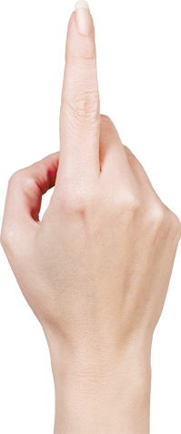


About us
Always give your best never worry for results.
Forum
Be an encourager, the world has enough critics already.
Services
Be an encourager, the world has enough critics already.
Timeline
Always give your best never worry for results.
Future
Everyone wants, happiness. No one wants pain. But you can’t have a rainbow without a little rain.
Enjoy the little things in life, because one day you will look back and realize they were the big things.

Slide 24
I feel very strongly that change is good because it stirs up the system. Ann Richards
80%
What we do?
A large income is the best recipe for happiness I ever heard of. Mansfield -
35%
Genius hath electric power which earth can never tame. Lydia M. Child
Pricing
I feel very strongly that change is good

Slide 25
Meeting
The time is now, the place is here. Stay in the present. You can do nothing to change the past, and the future will never come exactly as you plan or hope for. Dan Millman
Annual
Success
Suggest
Transport
Conferences
Annual
Meeting

Slide 26
Genius hath electric power which earth can never tame.
01
I feel very strongly that change is good because it stirs up the system.
A large income is the best recipe for happiness I ever heard of.
06
Accept
02
Lower
Split
05
03
Genius hath electric power which earth can never tame.
Send
Skills
I feel very strongly that change is good because it stirs up the system.
04
Share
A large income is the best recipe for happiness I ever heard of.

Slide 27
THANK YOU !
Wine Factory PTT Slides
www.freepptbackgrounds.net

