Slide 1




Mechanical Engineering
Free Presentation Template

Slide 2


Welcome
Welcome to the world of fantasy! Join us on a journey to explore the mystical creatures, enchanted lands, and magical wonders that exist beyond our reality. Discover the wonders and secrets of this exciting realm and unlock the power of imagination.

Slide 3






Table of Contents
01
Introduction
02
Encounters
The Extraordinary Realm
Unicorn Sightings
03
Wonders
04
Magic
Wishes Granted
Spellcasting
05
Adventure
06
Conclusion
Happily Ever After
Embrace the Fantasy

Slide 4


The Realm of the Extraordinary
Welcome to the Fantasy World, a realm of wonder and enchantment where anything is possible. Here, dragons breathe fire, unicorns prance through meadows, and rainbows shine brightly. This world is a place where wishes come true, where potions can be cursed and spells are cast. It's a place of treasure and adventure, where the impossible becomes possible. But the greatest treasure of all is the one that lies within.
The world of fantasy is a reflection of our deepest desires, our fondest dreams, and our wildest imaginations. It's a place where we can let go of the constraints of reality and explore the boundless possibilities of the human mind. In this introduction, we will delve into the mysteries of this realm, uncovering the magic and wonder that lies within. So come with us and let's embark on a journey through the Fantasy World.

Slide 5
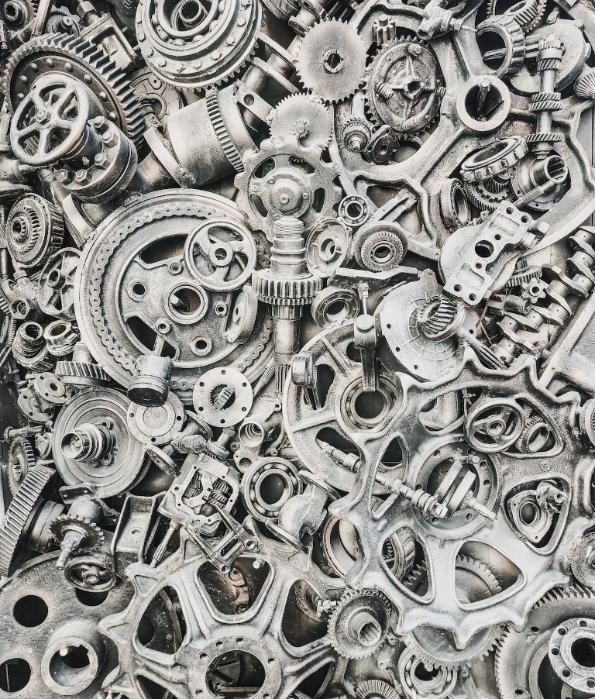


Unicorn Sightings
A record of the number of unicorns spotted in the fantasy realm and the beauty and mystery that surrounds these enchanting creatures.
Dragon Taming
A closer look at the art of taming dragons and the brave adventurers who dare to take on these fearsome creatures.

Slide 6




Dragon Taming
Unicorn Sightings
Dragon Taming
A closer look at the art of taming dragons and the brave adventurers who take on these creatures.
A record of the number of unicorns spotted in the fantasy realm and the beauty and mystery.
A closer look at the art of taming dragons and the brave adventurers who take on these creatures.

Slide 7






Fantasy is the gateway to the impossible, the land where the ordinary becomes extraordinary, and the impossible becomes possible. It is the realm of the imagination, where anything can happen and everything is possible.
The Dream Weaver

Slide 8


Dragon Taming Technique
A guide to taming and caring for dragons in the realm of magic.
The Art of Unicorn Sighting
Tips and tricks for spotting the elusive unicorns in their natural habitat.

Slide 9


The Magic of Dragons:
A Research
6.7M
4.4M
2.3M

Slide 10



The Elves: A Glimpse into Their World
Elegant inhabitants of enchanted forests, known for their mastery of magic and their close connection to nature. They possess an innate sense of harmony and balance, making them protectors of the natural world.
"The Music of the Elves": Immerse yourself in the enchanting music of the elves, whose songs have the power to heal.
"The Life of an Elf": Learn about the customs and daily life of the elves, from their familial structure to their religious beliefs.

Slide 11







Strengths
Weaknesses
Rare event causes unpredictable magic.
Rare event causes unpredictable magic.
S
W
O
T
Opportunities
Threats
Rare event causes unpredictable magic.
Rare event causes unpredictable magic.

Slide 12




Some Data
75%
Enchanted Creatures
possess the ability to cast spells.
60%
Magic-Wielding Individuals
practice the art of illusions.
90%
Spells Cast
are dark magic, foretelling danger.

Slide 13






234,567
Unicorn Sightings
A tally of the number of unicorns spotted in the fantasy realm.

Slide 14



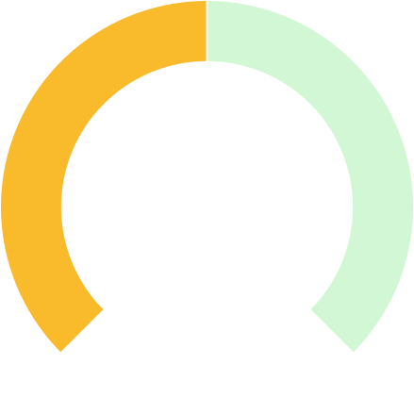


Some Graph
100
90
80
70
60
50
34.574
40
Total
30
20
10
0
1
2
3
4
5
6
7
8
Spellcasting Progress
Treasure Found
A record of the number of spells cast per year
A record of the amount of treasure found per month

Slide 15


Portal to Adventure
A web application
A web application designed for discovering the world of fantasy

Slide 16




The Future of Fantasy
An mobile app
An app designed for exploring and experiencing the enchanting realm of fantasy
  Explore a magical world
  Experience fantasy firsthand
  Immerse in a realm of magic
  Discover untold wonders
  Live your fantasy dreams

Slide 17


A Magic Picture

Slide 18

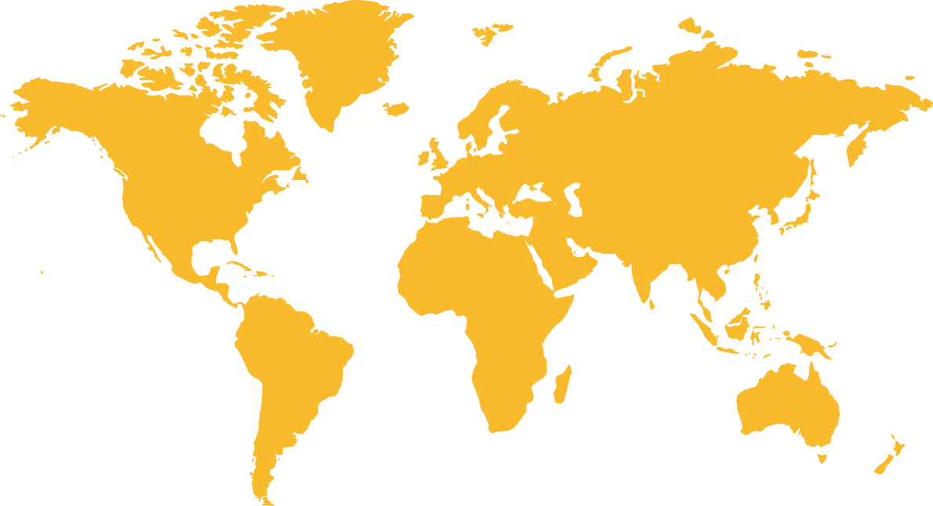
Fantasy Realm at a Glance
The Enchanted Forest
A magical forest filled with talking animals and enchanted creatures.
2.2M
4.7M
3.8M
The Crystal Caves
A network of underground caves filled with precious gems and crystals.
The Dragon's Lair
A dangerous and mysterious place where dragons reside.

Slide 19







The Timeline
First Month
Second Month
W1
W2
W3
W4
W1
W2
W3
W4
Rare event causes unpredictable magic.
Humans acquire Crystal
Shimmering City established
Peasant discovers magical powers.
Hero's honor.
Kingdoms clash in conflict.

Slide 20





Our Team
Eldruin
Elementalen
Lunaria
The Fire Mage
The Guardian
The Moon Priestess

Slide 21



Thank you for choosing EaTemp
We offer free and high-quality slides templates for your presentations. We appreciate you choosing us and hope our templates have been helpful.
As a new website, we rely on your support to grow, so please help us by sharing our site with your friends and colleagues.
Credit | Image: Unsplash

