Slide 1



TEMPLATES FOR PHOTOS
Free Presentation Template

Slide 2
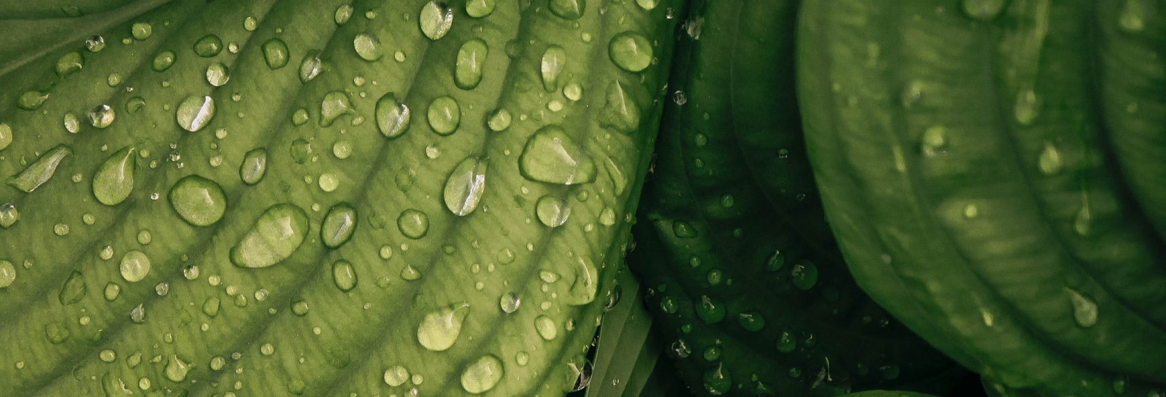
WELCOME
Welcome to the world of fantasy! Join us on a journey to explore the mystical creatures, enchanted lands, and magical wonders that exist beyond our reality. Discover the wonders and secrets of this exciting realm and unlock the power of imagination.

Slide 3

TABLE OF CONTENTS
01
Introduction
02
Encounters
The Extraordinary Realm
Unicorn Sightings
03
Wonders
04
Magic
Wishes Granted
Spellcasting
05
Adventure
06
Conclusion
Happily Ever After
Embrace the Fantasy

Slide 4




Unicorn Sightings
A record of the number of unicorns spotted in the fantasy realm and the beauty and mystery that surrounds these enchanting creatures.
Dragon Taming
A closer look at the art of taming dragons and the brave adventurers who dare to take on these fearsome creatures.

Slide 5

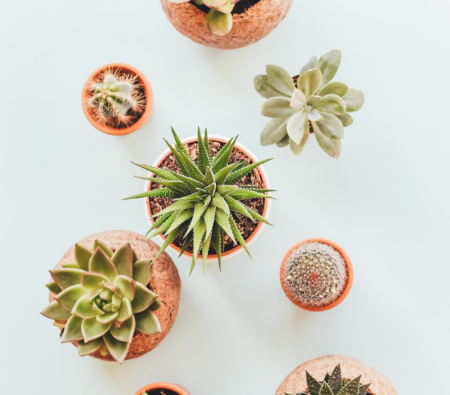
Unicorn Sightings
Dragon Taming
A record of the number of unicorns spotted in the fantasy realm and the beauty and mystery.
A closer look at the art of taming dragons and the adventurers who take on these creatures.

Slide 6
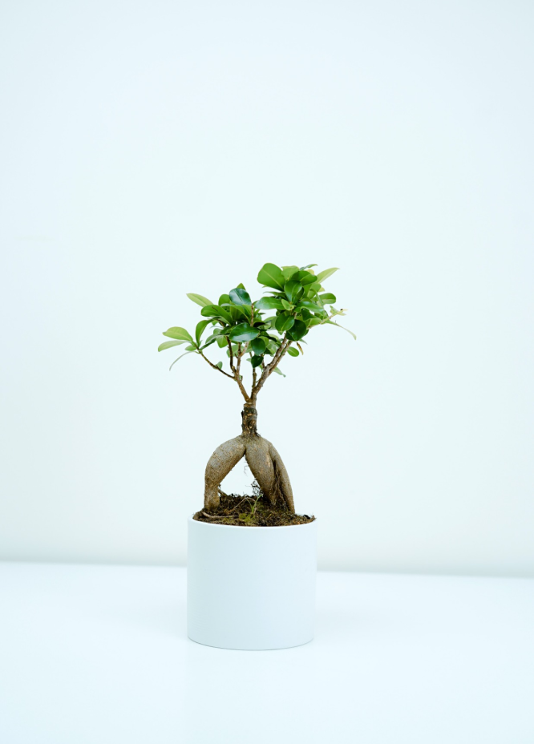

Fantasy is the gateway to the impossible, the land where the ordinary becomes extraordinary, and the impossible becomes possible. It is the realm of the imagination, where anything can happen and everything is possible.
The Dream Weaver

Slide 7


Dragon Taming
The Art of Unicorn
Dragon Taming
A guide to taming and caring for dragons in the realm of magic.
Tips and tricks for spotting the elusive unicorns in their habitat.
A guide to taming and caring for dragons in the realm of magic.

Slide 8

THE MAGIC OF DRAGONS: A RESEARCH
6.7M
4.4M
2.3M

Slide 9




PRICING PLAN
Basic
Elite
Legendary
  Access to the entry-level dungeons.
  Ability to form a small party with fellow adventurers.
  A greater number of quests and battles
  Ability to form larger parties with fellow adventurers.
  Access to the intermediate and advanced dungeons.
  Unlimited quests and battles per month.
$10/month
$50/month
$100/month

Slide 10



Slide 11


SOME DATA
Enchanted Creatures
75%
possess the ability to cast spells.
Magic-Wielding Individuals
60%
practice the art of illusions.
90%
Spells Cast
are dark magic, foretelling danger.

Slide 12




EXPLORATION OF THE INNER SELF:
A JOURNEY OF SELF-DISCOVERY

Slide 13






Slide 14

A MAGIC PICTURE

Slide 15


PORTAL TO ADVENTURE
A web application
A web application designed for discovering the world of fantasy

Slide 16


THE FUTURE OF FANTASY
An mobile app
An app designed for exploring and experiencing the enchanting realm of fantasy
  Explore a magical world
  Experience fantasy firsthand
  Immerse in a realm of magic
  Discover untold wonders
  Live your fantasy dreams

Slide 17

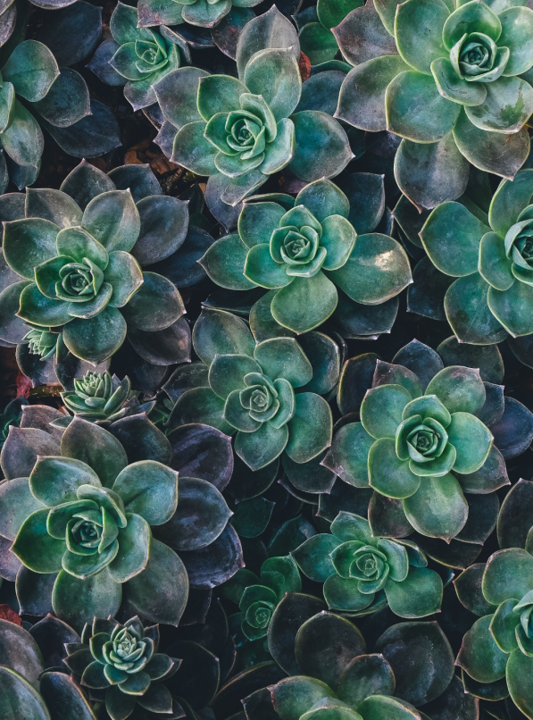
A GATEWAY TO
A WORLD OF
FANTASY AND
WONDER
  Immerse yourself in the world of magic and mystery
  Explore uncharted territories and fantastical lands
  Meet mythical creatures and legendary beings
  Uncover hidden treasures and secret treasures
A web application
A web application designed for discovering the world of fantasy

Slide 18

A MAGIC PICTURE

Slide 19

THE ENCHANTER: CAST SPELLS, CREATE ILLUSIONS, BRING MAGIC TO LIFE

Slide 20


AND TWO MAGIC PICTURES

Slide 21





Slide 22


Dragons: These mythical creatures are known for their fiery breath and massive size. They are often depicted as fearsome beasts, but some legends suggest that they can be tamed and even befriended.
Enchanters: Enchanters are magical beings who have the power to cast spells and create illusions. They are often sought after for their ability to bring wonder and magic into the lives of others.

Slide 23
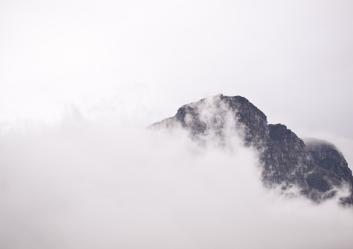

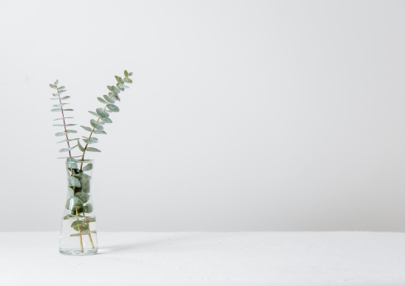
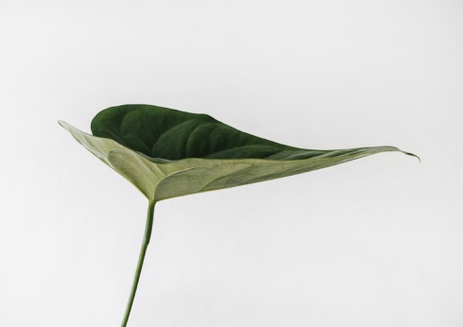


THE ENCHANTED OCEAN

Slide 24

AN UNFORGETTABLE JOURNEY
An Adventure Awaits
Enter the mysterious world of the sea serpents, where danger and beauty intertwine.

Slide 25
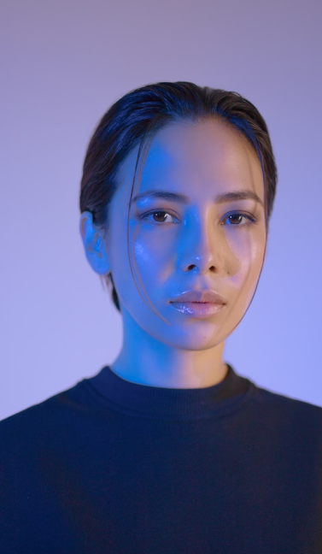


THE GRAPH
Eldruin
Elementalen
Lunaria
The Fire Mage
The Guardian
The Moon Priestess

Slide 26

CREATURES OF THE DEEP
Dangers Ahead
Discover the unique creatures that call the abyssal depths home, from fearsome sea dragons to enchanted mermaids.

Slide 27

We offer free and high-quality slides templates for your presentations. We appreciate you choosing us and hope our templates have been helpful.
As a new website, we rely on your support to grow, so please help us by sharing our site with your friends and colleagues.
Credit | Image: Unsplash
THANK YOU FOR
CHOOSING EATEMP

