Slide 1


Anchor Layer Teacher Guide
A curriculum companion for Anchor Layer users
Grade K
Plant Needs
Unit Web Link • Pacing Guide • Other Units

Slide 2
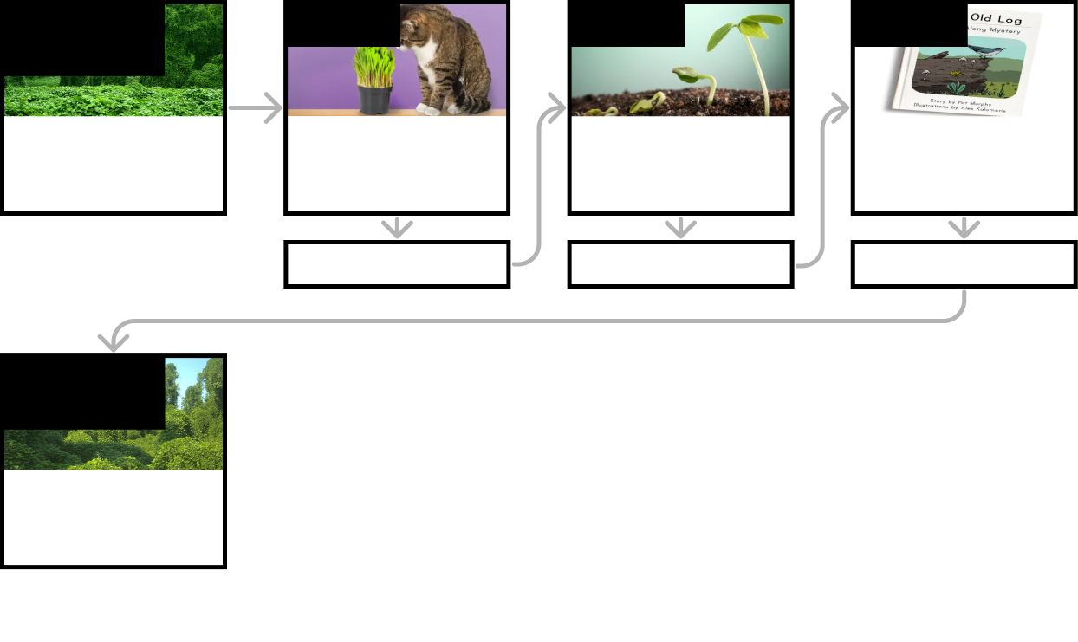
Plant Needs • Grade K
Anchor Layer Teacher Guide
Unit Summary
In this unit, students use observations to understand the basic needs of plants, such as water and sunlight. They also observe young plants and the changes they undergo as they grow from seed to seedling.
Performance Expectations | Science & Engineering Practices | Disciplinary Core Ideas | Crosscutting Concepts
• K-LS1-1. Use observations to describe patterns of what plants and animals (including humans) need to survive. • K-ESS3-3. Communicate solutions that will reduce the impact of humans on the land, water, air, and/or other living things in the local environment. | • Analyzing and Interpreting Data • Planning and Carrying Out Investigations • Obtaining, Evaluating, and Communicating Information | • LS1.C. Organization for Matter and Energy Flow in Organisms • ESS3.C: Human Impacts on Earth Systems | • Cause and Effect • Patterns
Anchor Phenomenon
Lesson 1
Lesson 2
Lesson 3
Living & Nonliving
Powerful Plants
Living & Nonliving
Are plants alive?
Plant Needs: Water & Light
How do plants and trees grow?
Human Impacts on the Environment
Why do you want an old log in your backyard?
Anchor Connection
Anchor Connection
Anchor Connection
Performance Task
Human Impacts on the Environment
How can we clear a bunch of kudzu?
‹#›

Slide 3
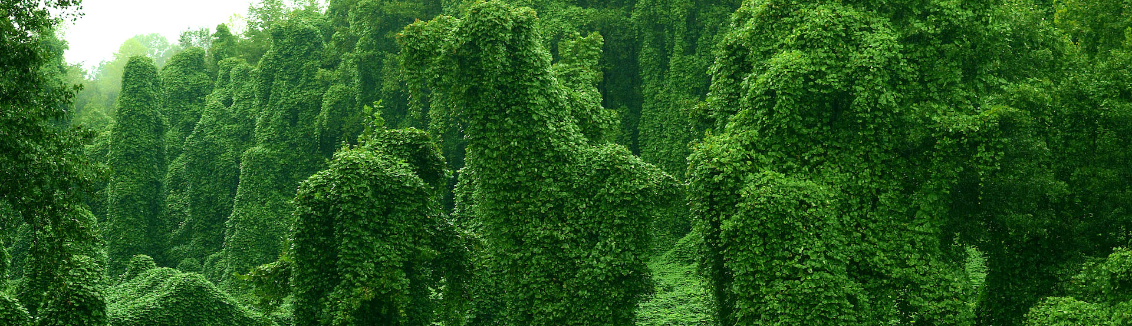
Plant Needs • Grade K
Anchor Layer Teacher Guide
Anchor Phenomenon Background
How do plants end up on so many different things?
For many young children, one of the defining characteristics of living things is the ability to move. Many children believe that all living things move; therefore, things that don’t move are not alive. This is one of the things that can lead to the misconception that plants are not alive. But plants are alive! And not only that, they move and grow–it just almost always happens to slowly to see.
Like all living things, plants have needs. Two of their most important needs are light and water. Different plants grow in different ways in order to meet those needs. Some plants grow low and wide to gather as much light as possible; while others grow as tall as possible. One side effect of this growth is that in some situations, plants can grow on top of other objects. Those objects have to stay still for a long time due to the slow growth of plants, but there are many examples visible in our daily lives of plants growing onto other objects. For children who have the misconception that plants do not grow or move, this can be a very surprising phenomenon.
While there are many situations in which people want plants to grow, such as gardening or farming, there are also many situations in which people want to prevent plants from growing or eliminate plants that have overgrown. Examples of this could include everything from a few unwanted weeds in a garden, to an invasive species completely overwhelming an ecosystem. Some methods of eliminating these kinds of plants can have very negative side effects. Many kinds of chemicals that kill plants, known as herbicides, can be toxic to people and other animals. So scientists continue to seek alternative ways to manage plant growth that minimize any negative effects.
‹#›

Slide 4
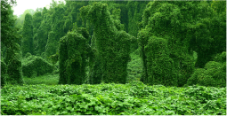
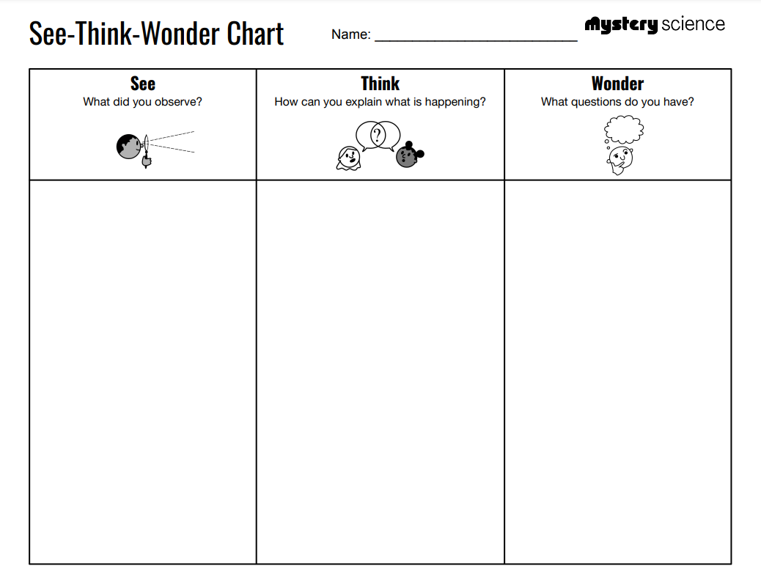
Plant Needs • Grade K
Anchor Layer Teacher Guide
Anchor Phenomenon: Powerful Plants
Living & Nonliving
Anchor Phenomenon Lesson Overview
Note: This lesson is part of this unit’s Anchor Layer. If you have the Anchor Layer turned on, we recommend teaching all of the lessons in this unit in order.
The anchor phenomenon for this unit is a collection of examples of plants that have grown onto other objects without anyone having put the plants there. How can this happen?
During the introduction, students generate observations and questions about the phenomenon and create a list of possible explanations for the phenomenon. Students will use these initial ideas to track how their understanding grows throughout the unit.
Anchor Phenomenon 10 mins
Guided Inquiry 15 mins
Student Work Samples & Notes
Students will gather clues during and after each lesson in this unit to help them improve their understanding and explanations. It is important to encourage students to recognize that even if they don't know the perfect answer yet, they are going to learn a lot throughout the unit and will have an opportunity to revisit the phenomenon over time.
A stop sign with a plant on it
An electricity pole with plants all the way up on the wires
A tractor covered in plants
I think maybe the plants were always there
I think maybe the plants grew onto those things
How did the plants get there?
Do plants climb onto things on their own?
Are plants alive?
‹#›

Slide 5
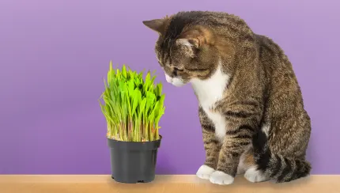
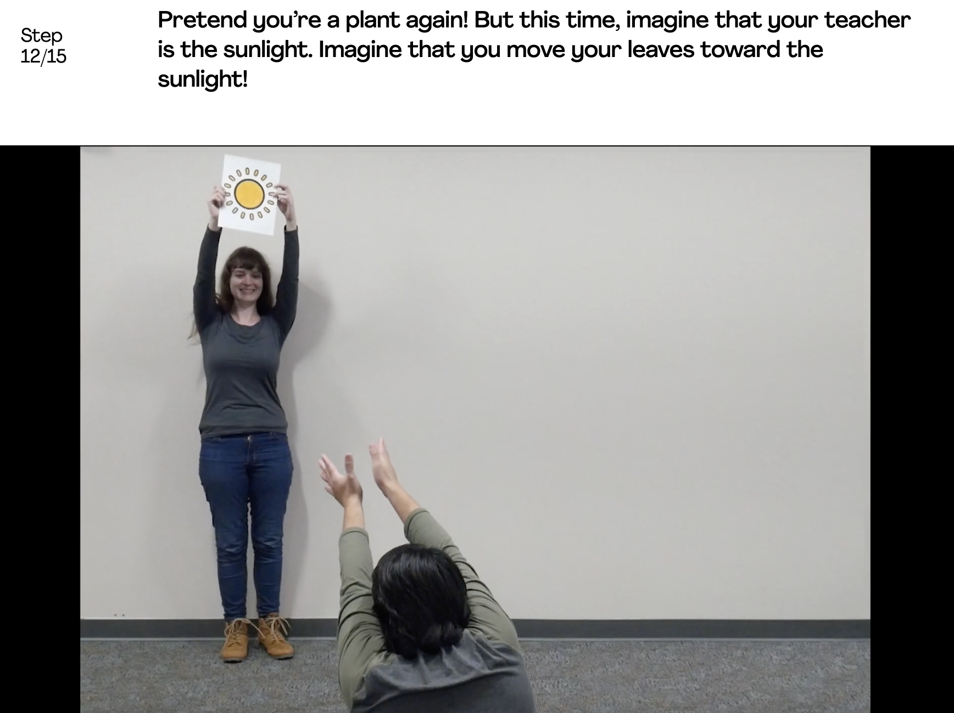
Plant Needs • Grade K
Anchor Layer Teacher Guide
Lesson 1: Are plants alive?
Living & Nonliving
Overview
In this lesson, students make observations of plants in order to identify their needs and that they are, in fact, living things.
In the activity, Plant Dance, students engage in a kinesthetic activity in which they observe and then model the appearance of plants when their needs are and aren’t met.
Anchor Connection
In this lesson, students learned that plants are alive. They grow over the course of their lives, which means that they can change over time. Just because a plant didn’t start on an object, that doesn’t mean it can’t grow over onto it!
Students revisit the See-Think-Wonder chart that they worked on during the Anchor Phenomenon. They should understand that plants may not seem like it, but they are living things with needs.
Connecting Storyline Question
How can we take care of plants?
Exploration 8 mins
Hands-On Activity 30 mins
Wrap-Up 4 mins
Anchor Connection 15 mins
Activity Notes
Students can either sit or stand for the movement activities. Make sure to plan space accordingly.
In one of the movement activities, we suggest that the teacher pretends to be the sunlight. You can use the Sun printout provided, a lamp, or anything else you'd like to use as a model for sunlight!
‹#›

Slide 6
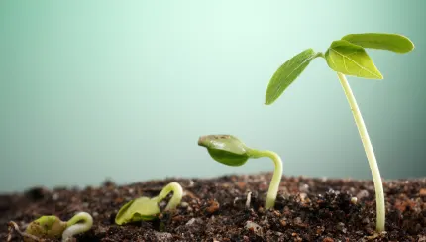
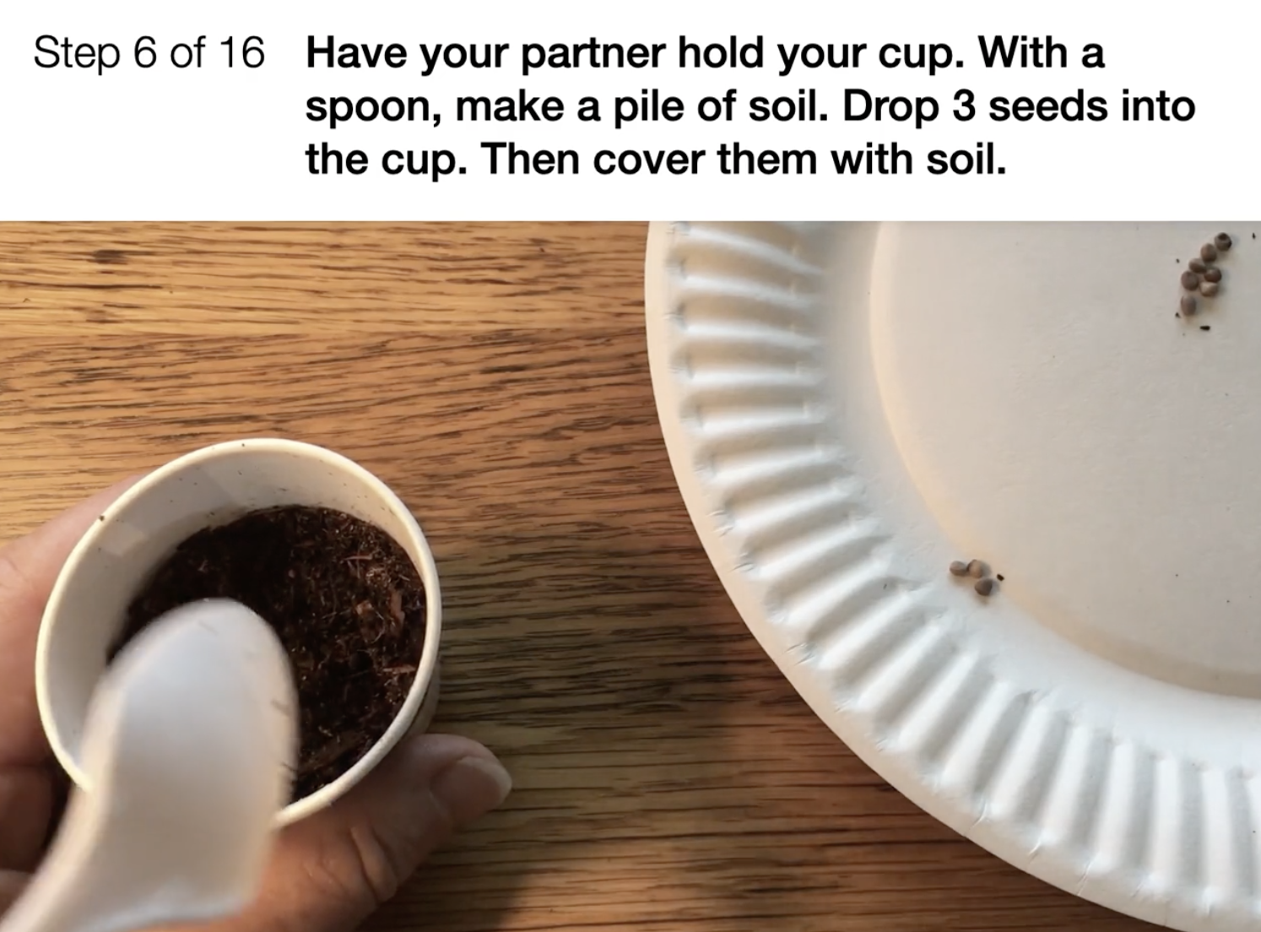
Plant Needs • Grade K
Anchor Layer Teacher Guide
Lesson 2: How do plants and trees grow?
Plant Needs: Water & Light
Overview
In this lesson, students investigate what plants need to grow.
In the two-part activity, Sprout a Seed, students plant radish seeds in paper cups. When the seeds sprout, students notice that the leaves of the young plants lean toward the light. A classroom root viewer made from a Ziploc bag and paper towels lets students observe root growth.
Anchor Connection
In this lesson, students learned that plants have needs. Two of their biggest needs are water and light. Plants grow in such a way that they get as much light as possible. That can mean that, for some plants, they can grow onto other nearby objects so that they are higher up and get more light.
Students will revisit the See-Think-Wonder chart that they initially worked on during the Anchor Phenomenon. They should understand that plants will grow in ways that help them meet their needs. Many plants will grow on top of other things in order to get more light.
Connecting Storyline Question
How can we help plants and animals meet their needs?
Exploration 20 mins
Hands-On Activity 30 mins
Wrap-Up 5 mins
Anchor Connection 15 mins
Assessment 20 mins
Activity Notes
This is a two-part activity. We recommend that you allow at least four days (up to one week) in between Part One and Part Two of the experiment to give the radish seeds time to germinate. (To speed germination, soak the seeds in water overnight.)
‹#›

Slide 7
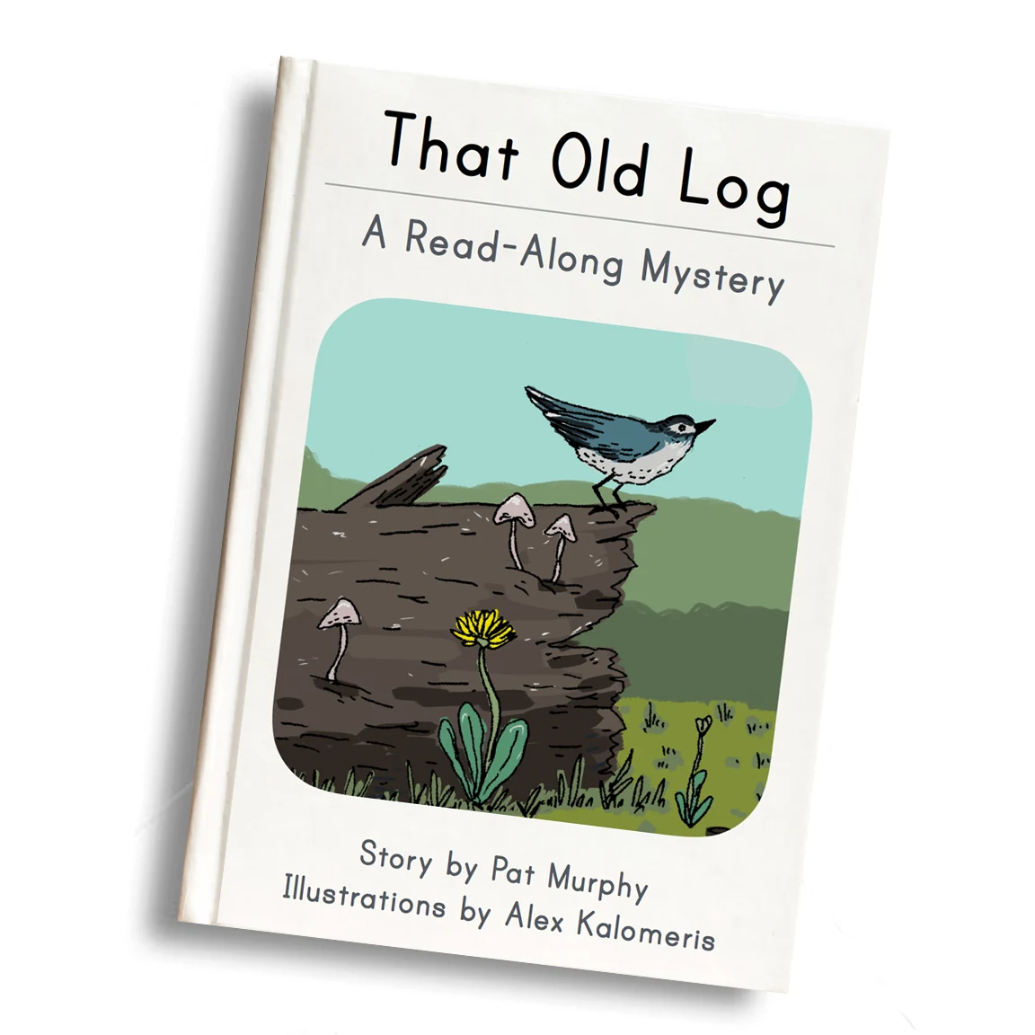
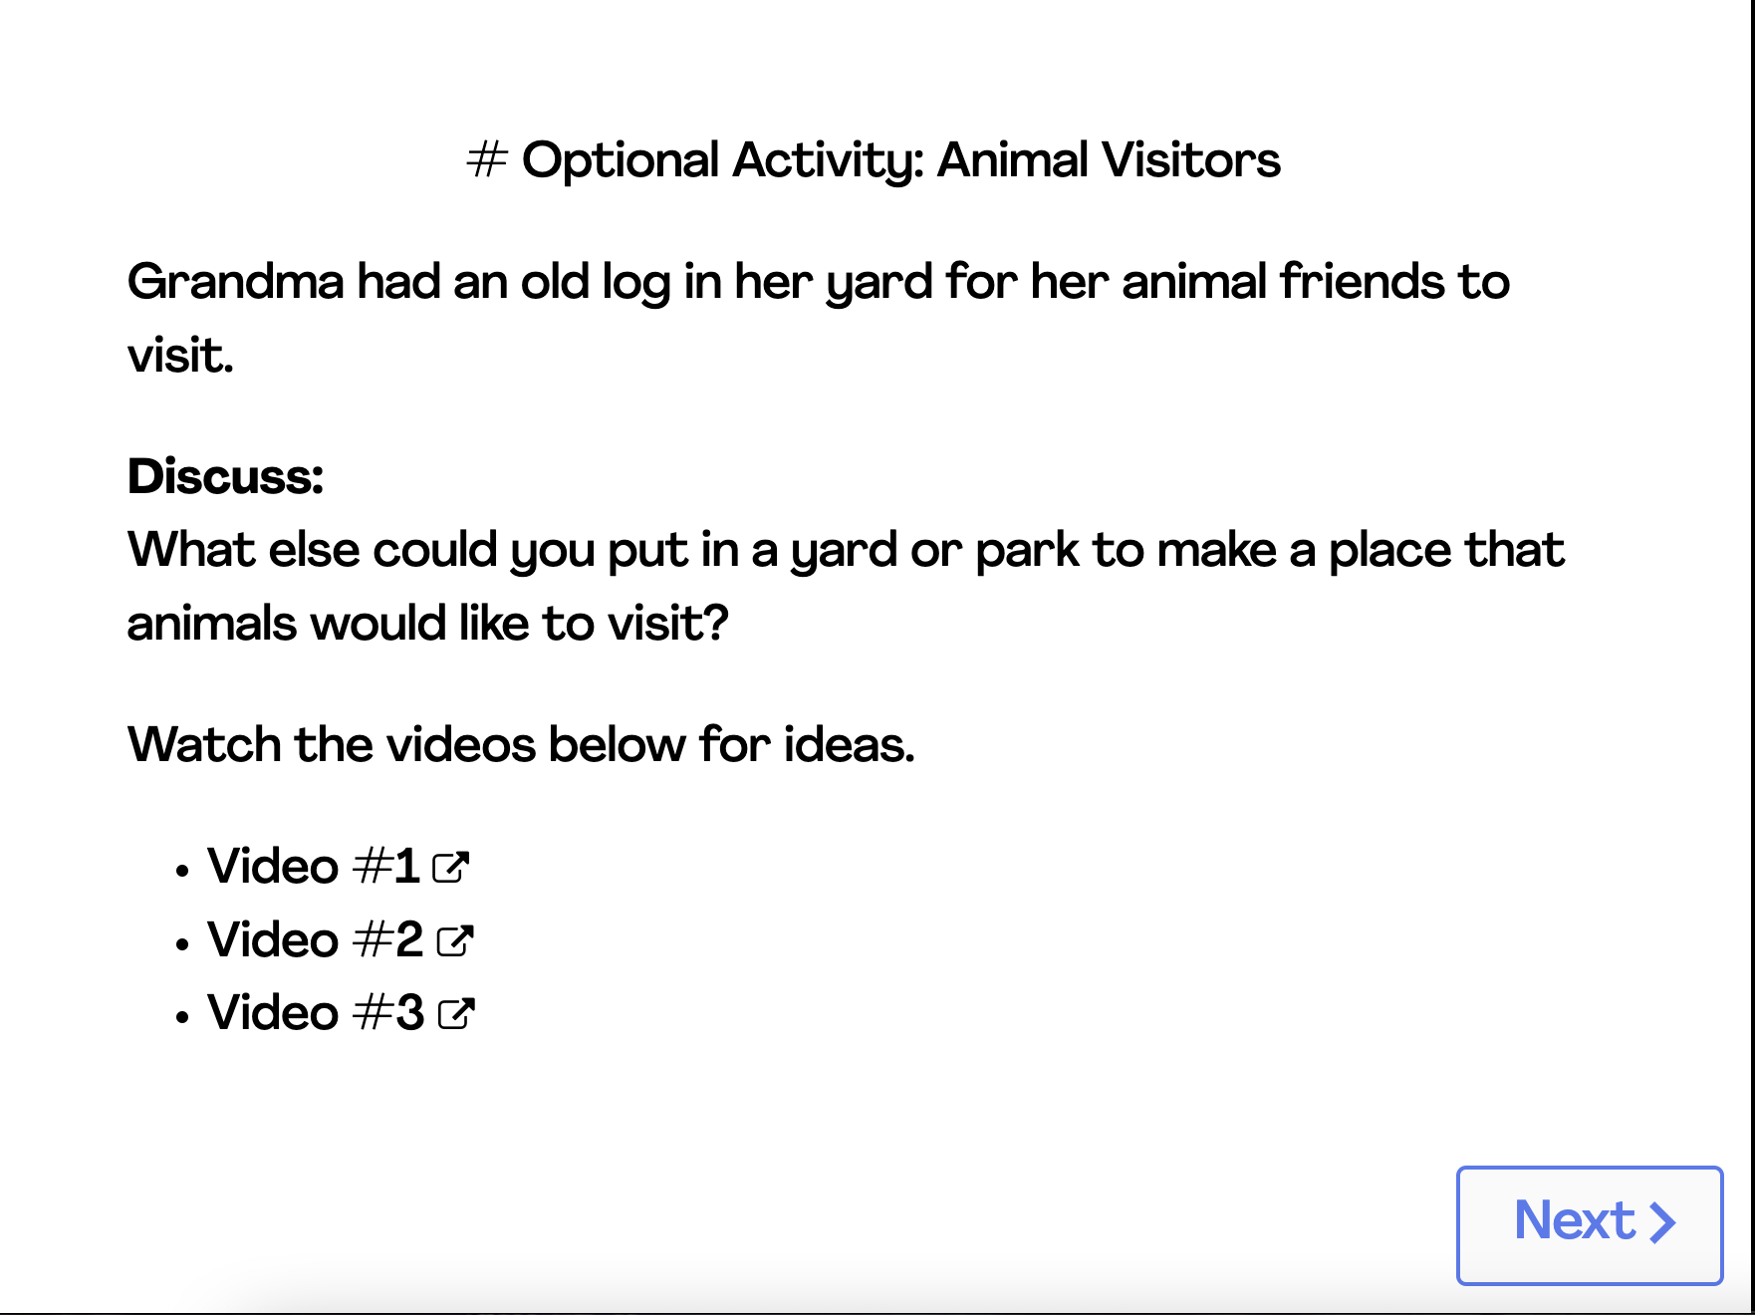
Plant Needs • Grade K
Anchor Layer Teacher Guide
Lesson 3: Why would you want an old log in your backyard?
Human impacts on the environment (pg 1 of 2)
Overview
In this Read-Along lesson, Sam wonders why his grandmother wants to keep an old log in her yard—until he begins to meet a few of her friends.
The lesson includes a short exercise where students pretend to be lizards eating ants, and discover why old logs are helpful to animals. You can extend the lesson with the optional activity, Animal Visitors, where students learn what they could put in a yard or park to attract animals.
Anchor Connection on Next Page
Digital Book (w/ Audio) 20 mins
Hands-On Activity 25 mins
Anchor Connection 15 mins
Assessment 20 mins
Activity Notes
This activity does not require supplies.
As an optional activity, we suggest having students discuss what they could put in a yard or park to attract animals. We include videos that show birds in a birdbath, at a bird feeder, and in a birdhouse, reinforcing the idea that animals are are attracted to spots that offer food, water, and shelter.
‹#›

Slide 8
Plant Needs • Grade K
Anchor Layer Teacher Guide
Lesson 3: Why would you want an old log in your backyard?
Human impacts on the environment (pg 2 of 2)
Anchor Connection
In this lesson, students learned that humans do many things that impact their surrounding environment. We can make choices that minimize the negative impacts of our actions. In particular, humans frequently go to great lengths to prevent the growth of some kinds of plants. Some options have more negative side effects than others. The discussion after this lesson is intended to set the stage for the performance task.
Students will revisit the See-Think-Wonder chart that they initially worked on during the Anchor Phenomenon. They should understand that people have an impact on the plants and animals around them. Sometimes we want to grow as many plants as possible, but sometimes plants grow too much.
Connecting Storyline Question
What can we do if a plant is growing too much?
Digital Book (w/ Audio) 20 mins
Hands-On Activity 25 mins
Anchor Connection 15 mins
Assessment 20 mins
‹#›

Slide 9
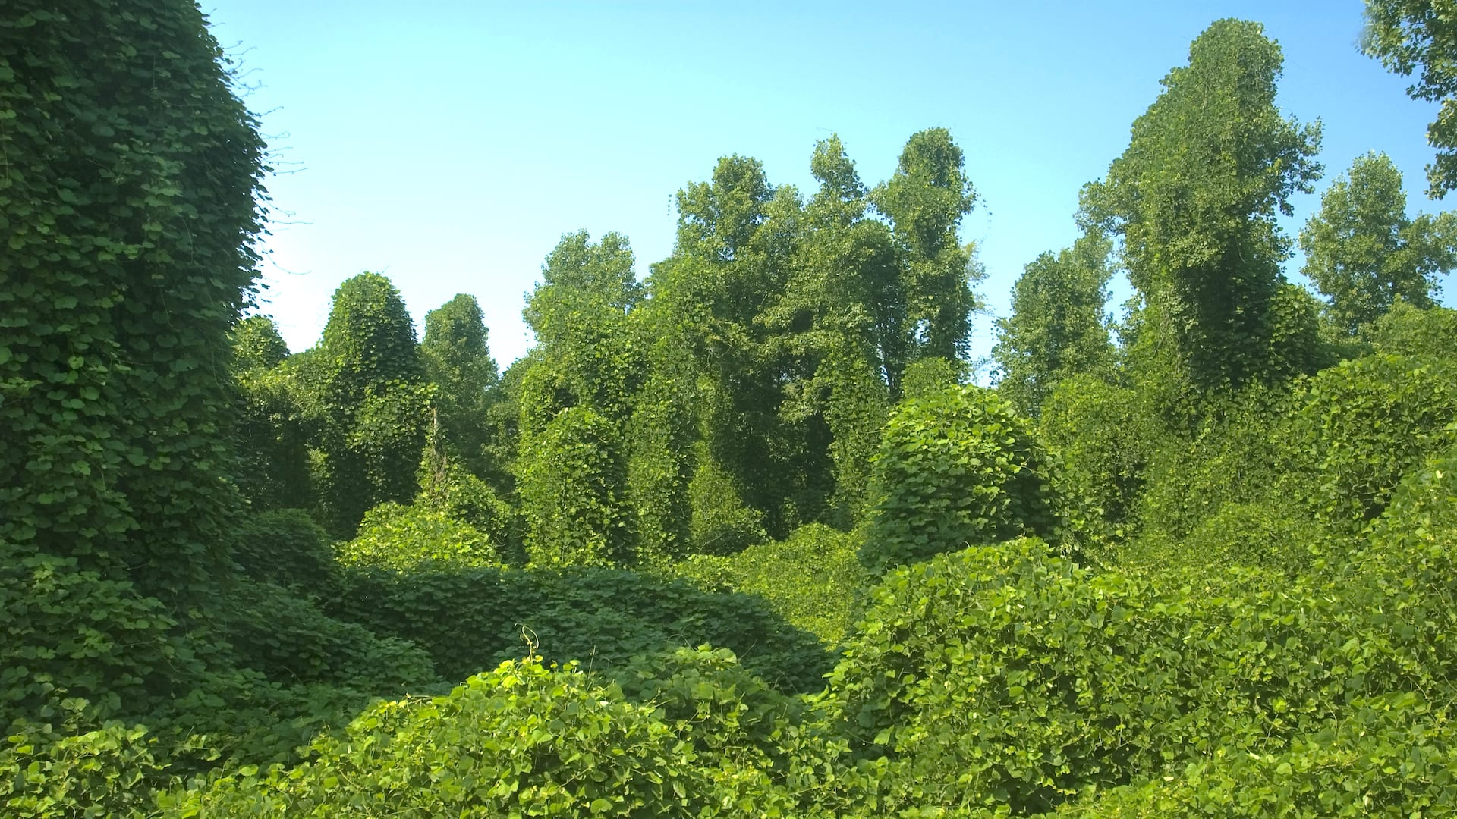
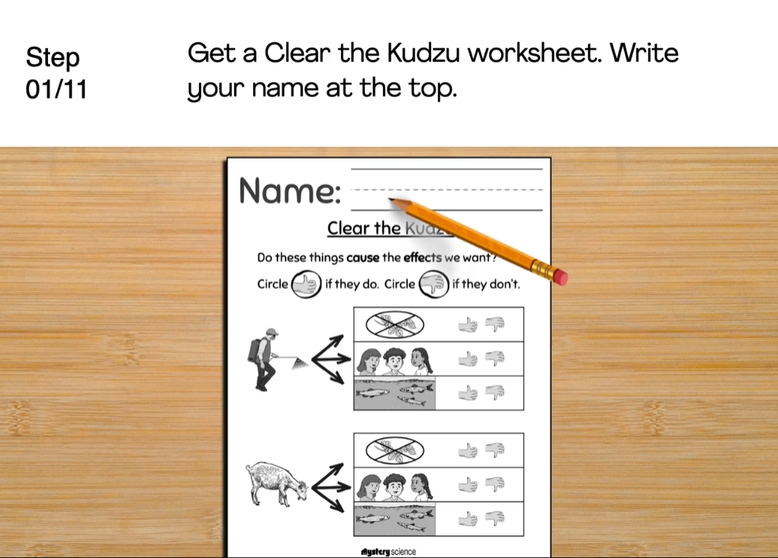
Plant Needs • Grade K
Anchor Layer Teacher Guide
Performance Task: How can we clear a bunch of kudzu?
Human Impacts on the Environment
Lesson Overview
In this performance task, students investigate the benefits and drawbacks of different options that communities have when removing an invasive plant.
After a brief review of the unit, students gather information about different ways that a community might remove kudzu, and then help recommend a solution that has the most benefits and fewest drawbacks.
Unit Review 10 mins
Hands-On Activity 35 mins
Performance Task Notes
Students can work as a class, in small groups, or individually. Each student will need one copy of the Clear the Kudzu worksheet.
With your students, begin the lesson. It begins with a brief unit review. Then, move through the activity. The activity includes a step-by-step guide and discussion questions throughout.
Crosscutting Concepts
Cause and Effect: By understanding cause and effect relationships, we can understand how the weather impacts our lives. Different weather conditions on any given day can lead us to wear different clothing or engage in different activities. And weather forecasts can help us to prepare in advance for a variety of situations, ranging from planning a day of kite-flying to preparing for a hurricane or tornado.
‹#›

