Slide 1
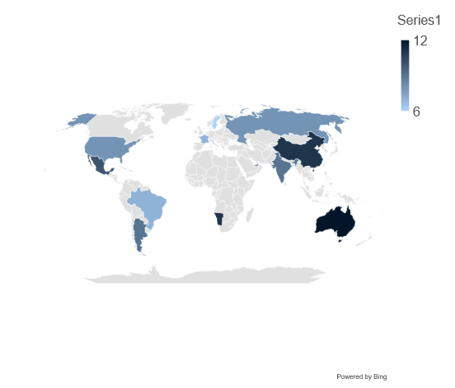
Map / Line Chart
Click to edit Header text styles
Click to edit Header text styles
Source: Complete if required

