Slide 1
Programmatic analysis
1
Using a programming language to analyze data

Slide 2




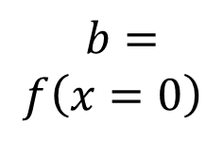

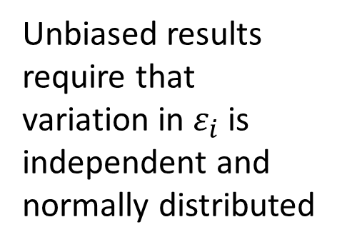

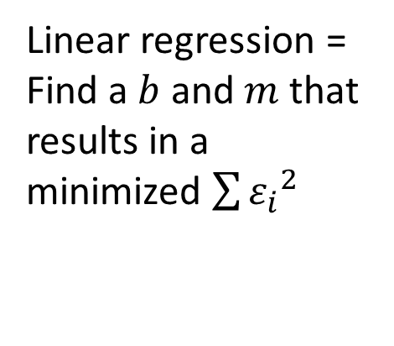
Simple example: linear regression
$$f\left(x\right)=b+mx$$
$$+ ε$$
Linear regression =
Find a $b$ and $m$ that results in a minimized $\sum{{ε_{i}}^{2}}$
$$ε=y−f\left(x\right)$$
$$y$$
$$m=\frac{∆f\left(x\right)}{∆x}$$
Unbiased results require that variation in $ε_{i}$ is independent and normally distributed
$$b= \\ f\left(x=0\right)$$
$$x$$

Slide 3

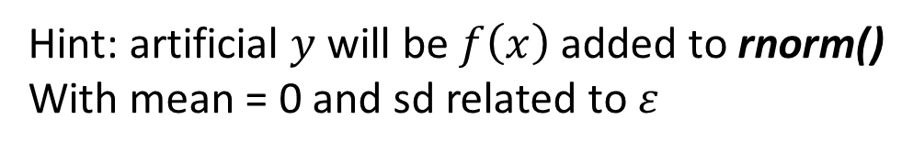
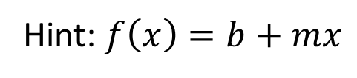
Linear regression Monte Carlo exercise: one realization
24
Hint: $f\left(x\right)=b+mx$
$$+ ε$$
$$y$$
Hint: artificial $y$ will be $f\left(x\right)$ added to rnorm()
With mean = 0 and sd related to $ε$
Hint: seq() function
$$x$$

Slide 4
Linear regression Monte Carlo exercise: one realization
24
$$y$$
Hint: lm(formula = y ~ x) and explore the
data structure that is returned
$$x$$

Slide 5
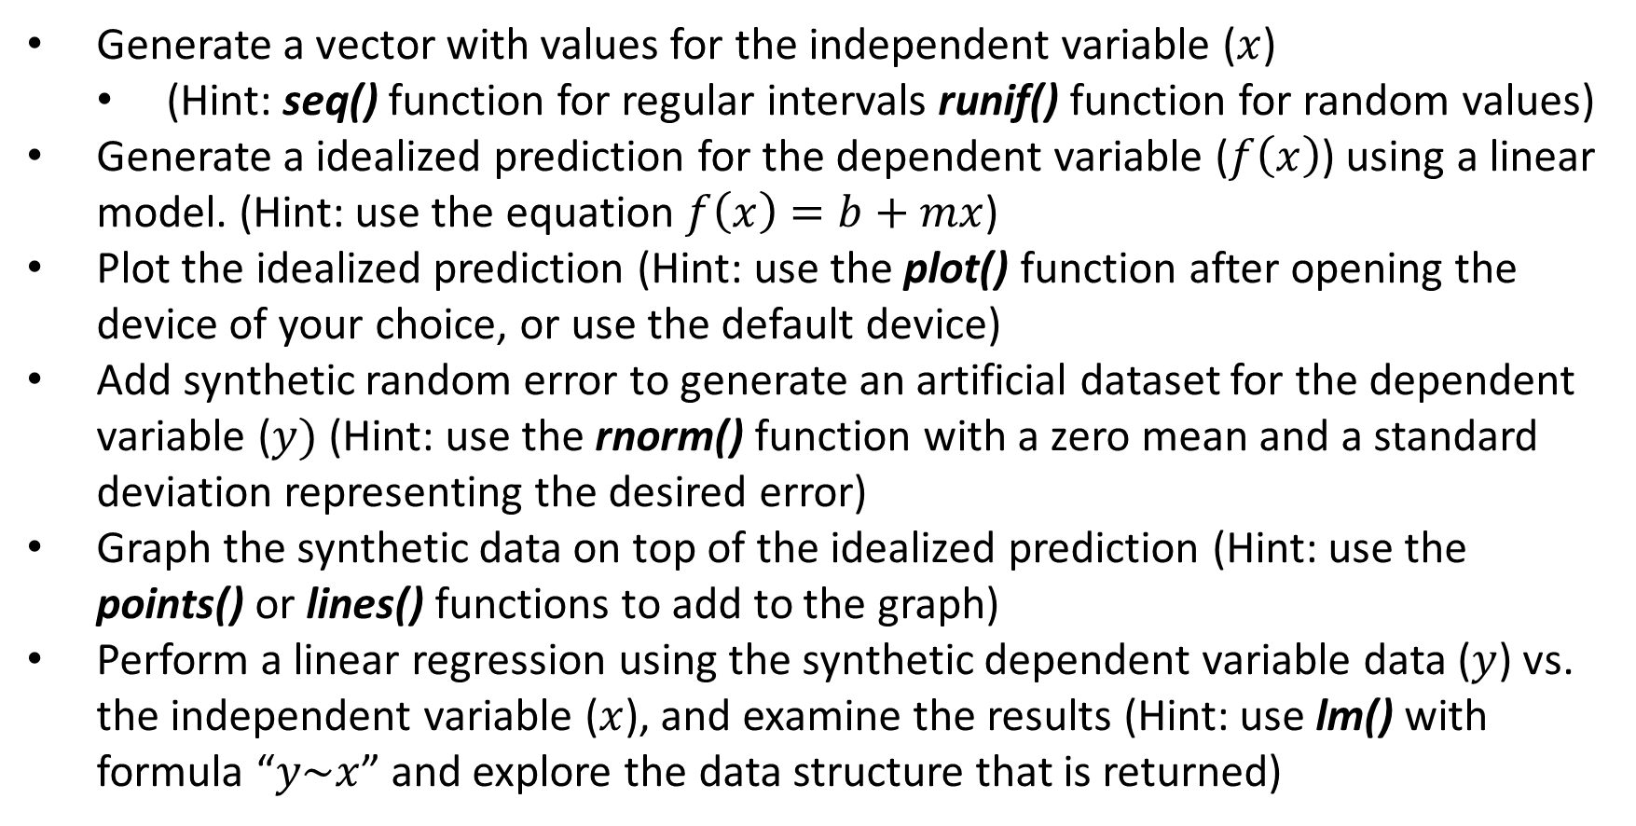
Linear regression Monte Carlo exercise: one realization
24
Generate a vector with values for the independent variable ($x$)
  (Hint: seq() function for regular intervals runif() function for random values)
Generate a idealized prediction for the dependent variable ($f\left(x\right)$) using a linear model. (Hint: use the equation $f\left(x\right)=b+mx$)
Plot the idealized prediction (Hint: use the plot() function after opening the device of your choice, or use the default device)
Add synthetic random error to generate an artificial dataset for the dependent variable ($y)$ (Hint: use the rnorm() function with a zero mean and a standard deviation representing the desired error)
Graph the synthetic data on top of the idealized prediction (Hint: use the points() or lines() functions to add to the graph)
Perform a linear regression using the synthetic dependent variable data ($y$) vs. the independent variable ($x$), and examine the results (Hint: use lm() with formula “$y\sim x$” and explore the data structure that is returned)

Slide 6
R Internal types: lists (or ‘list mode’ vectors)
14
The simplest generic (i.e. non-atomic) data type in R is a list, which is a vector of arbitrary objects
Lists can be created with the function list().
(or vector(mode=“list”,...) for a NULL list)
Lists can be indexed just like vectors
  Result will be a list of objects, i.e. a vector of references (even if only one)
  Note you cannot do math with lists (too abstract)
To get at the object referenced by a list elements, use double square brackets [[<index>]]
  Note that this only works with a single index value and indexing by vectors to obtain several elements does not make sense

Slide 7
Vector of mode “list” that references atomic vectors of mode “double”
Atomic vector of mode “double”
[1]
[1]
[1]
[2]
[3]
[n]
Real number
RAM address
[[1]] Contents
[1]
[2]
[3]
[n]
Real number
Real number
Real number
Real number
Real number
Real number
Real number
[[2]] Contents
[1]
[2]
[3]
[n]
[2]
[2]
[1]
[2]
[3]
[n]
Real number
Real number
Real number
Real number
Real number
Real number
RAM address
Real number
Real number
[[3]] Contents
[1]
[2]
[3]
[n]
[3]
[3]
[1]
[2]
[3]
[n]
Real number
Real number
Real number
Real number
Real number
Real number
RAM address
Real number
Real number
[1]
[2]
[3]
[n]
[1]
[2]
[3]
[n]
Real number
Real number
Real number
[[n]] Contents
Real number
Real number
[n]
[n]
Real number
Real number
Real number
RAM address

Slide 8
Vector of mode “list” that references arbitrary R objects
Atomic vector of mode “double”
[1]
[2]
[3]
[n]
[1]
[1]
[1]
[2]
[3]
[n]
Real number
Real number
Real number
Real number
Real number
Real number
RAM address
[[1]] Contents
Real number
Character string
[1]
[2]
[3]
[n]
[1]
[2]
[3]
[n]
Real number
Real number
Real number
[[2]] Contents
Real number
Real number
[2]
[2]
Real number
RAM address
Real number
RAM address
[3]
[3]
[[3]] Contents
Environment
Real number
RAM address
[n]
[n]
[[n]] Contents
Real number
RAM address
Function

Slide 9
Custom R objects: indexing by name
16
Indices can be named when using the list(<name>=<value>,...) function
Both vectors and lists store their names as an attribute of the base vector object (starting to get into Object Oriented concepts here)
attributes()$names or names() functions can be used to access a reference to the names attribute to change or add name indices directly
  Note that the attributes of an object are an object of type list, and the names attribute is an atomic vector of character strings
Names can be used in place of the index for both vectors or lists (including either the single or double brackets for lists)
For lists, the $ notation is more commonly used to access objects in the list

Slide 10
R classes: object-oriented concepts
17
An object has a higher level of type as defined by a class.
  The function class() can be used to determine the class of an R object.
  For atomic vectors typeof() and class() yield the same information
Classes are a higher level of structure built on top of the atomic R internal types, so typeof() and class() will give different results for objects that are not atomic vectors or lists
  The class of the object inherits all the properties of its underlying type
  The concept of inheritance is critical to understanding the object-oriented paradigm
  Classes can also be layered on top of each other in an inheritance hierarchy, such that the child class inherits the properties of the parent class.

Slide 11
R classes: matrices
18
A matrix is a two-dimensional data class based on a multidimensional perspective on an atomic vector type
  The function matrix() can be used to construct a matrix
  The attribute dim determines how the vector of values is organized into rows and columns
  Either the attributes()$dim or dim() functions can be used to change the dimensionality of a matrix without changing the underlying atomic vector
  Leaving an index blank for a matrix results in getting the whole row or column

Slide 12
R classes: functions
23
A function is a “closure” or “builtin” internal type of class “function”
  Constructor function is function() {}, where the arguments for the function are in the parentheses and the code for the function is in the curly brackets
  If the function is a “closure”, typing its name without parentheses will show you the raw code
  The args() function will summarize the possible arguments
  Arguments do not have to be in order if specified by name in the call to the function

Slide 13
25
R: accessing the file system
RStudio Integrated Development Environment (IDE)
Console
Environment
Files
Plots
R Console
Workspace
RStudio text editor
RStudio file manager
Rstudio graphics viewer
R Runtime Environment
Working directory – the default location in the file system where the R Runtime environment will look for file names without fully specified paths
functions setwd() and getwd()
...or... RStudio tools make it easy to change working directory
Operating system (Windows, OSX (BSD))
File system (NTFS, HFS+)

Slide 14
Saving and loading R objects to a file system
26
Review of the “working directory” concept
(getwd() and setwd() methods)
  Use of “relative paths” vs. “absolute paths”
Running other scripts using source()

